Slide 1

Holistic Student Support
Customizable Critical Juncture & Developmental Pathways Map
Notes:
Speaker: CommPartners
Slide Time: 1 minute
Animation: No
Speaker Notes:
My name is Jennifer l, and it is my pleasure to facilitate.
We muted all participant audio. If you need help, please send us a message.
This presentation will last up to 60 minutes and includes time for Q&A. We ask that you submit your questions through Q&A.
It is now my pleasure to welcome Dr. Mary Jo Wagner, Professor, Emergency Medicine Central Michigan University College of Medicine Chief Academic Officer/DIO
at CMU Medical Education Partners

Slide 2
Customizable Critical Juncture & Developmental Pathways Map
We are excited to introduce a customizable tool designed to help you tailor a map to your institution’s unique dates, milestones, and priorities. This map offers the flexibility to align critical junctures, detours, and off-ramps with your students’ timelines and institutional goals.
Key Features
Institution-Specific Milestones: Customize the map by adding your school’s milestones using the new Institutional Milestone icon.
Flexible Layout: Easily move icons and map components to reflect your institution's key considerations and events.
Editable Text: Update all text to align with your institution’s terminology, events, and dates.
Reference Example: The original map is included on the last slide for guidance or as a starting point.

Slide 3
How to Customize Your Map
Navigating the Map:
Open the slide deck and locate the slides with map elements (e.g., icons, detours, off-ramps).
Copying and Pasting Elements:
Select the element (e.g., detour, off-ramp, or icon) you want to move.
Press Ctrl + C (Windows) or Command + C (Mac) to copy it.
Navigate to the target slide.
Press Ctrl + V (Windows) or Command + V (Mac) to paste it.
Rearrange elements as needed to align with your school’s milestones.
Editing Text:
Click on any text box (e.g., milestone names or detours) to update the wording.
Using the Institutional Milestone Icon:
Use the Institutional Milestone icon to highlight school-specific events.
Copy and paste the icon as needed, then customize the associated text.
Referencing the Original Map:
The last slide contains the original map. Use it as a reference, to reset edits, or for inspiration.

Slide 4
Final Tips
Experiment with layouts and elements to best represent your school’s journey.
The map is designed for flexibility—there’s no one “right way” to use it. Adapt it to fit your institution’s unique needs.
We hope this tool helps you navigate critical junctures and support your students effectively.
For questions, assistance, or to share your customized map, email us at holisticreview@aamc.org

Slide 5
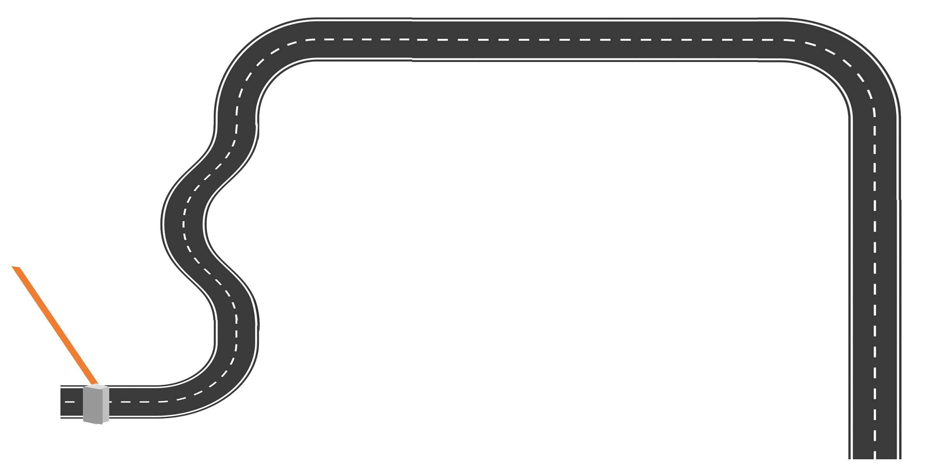

Critical Juncture and Developmental Pathway Map
Transition to Residency
Acceptance

Slide 6


Map Pieces
Detours
Off Ramp

Slide 7









Icons
Matriculation and Orientation
Professional Opportunities and Experiences
Detours
Academic Performance and Progression
Off Ramps
Transition to Clerkship
Institutional Critical Juncture
Residency Application and Interview Preparation
USMLE Exams

Slide 8
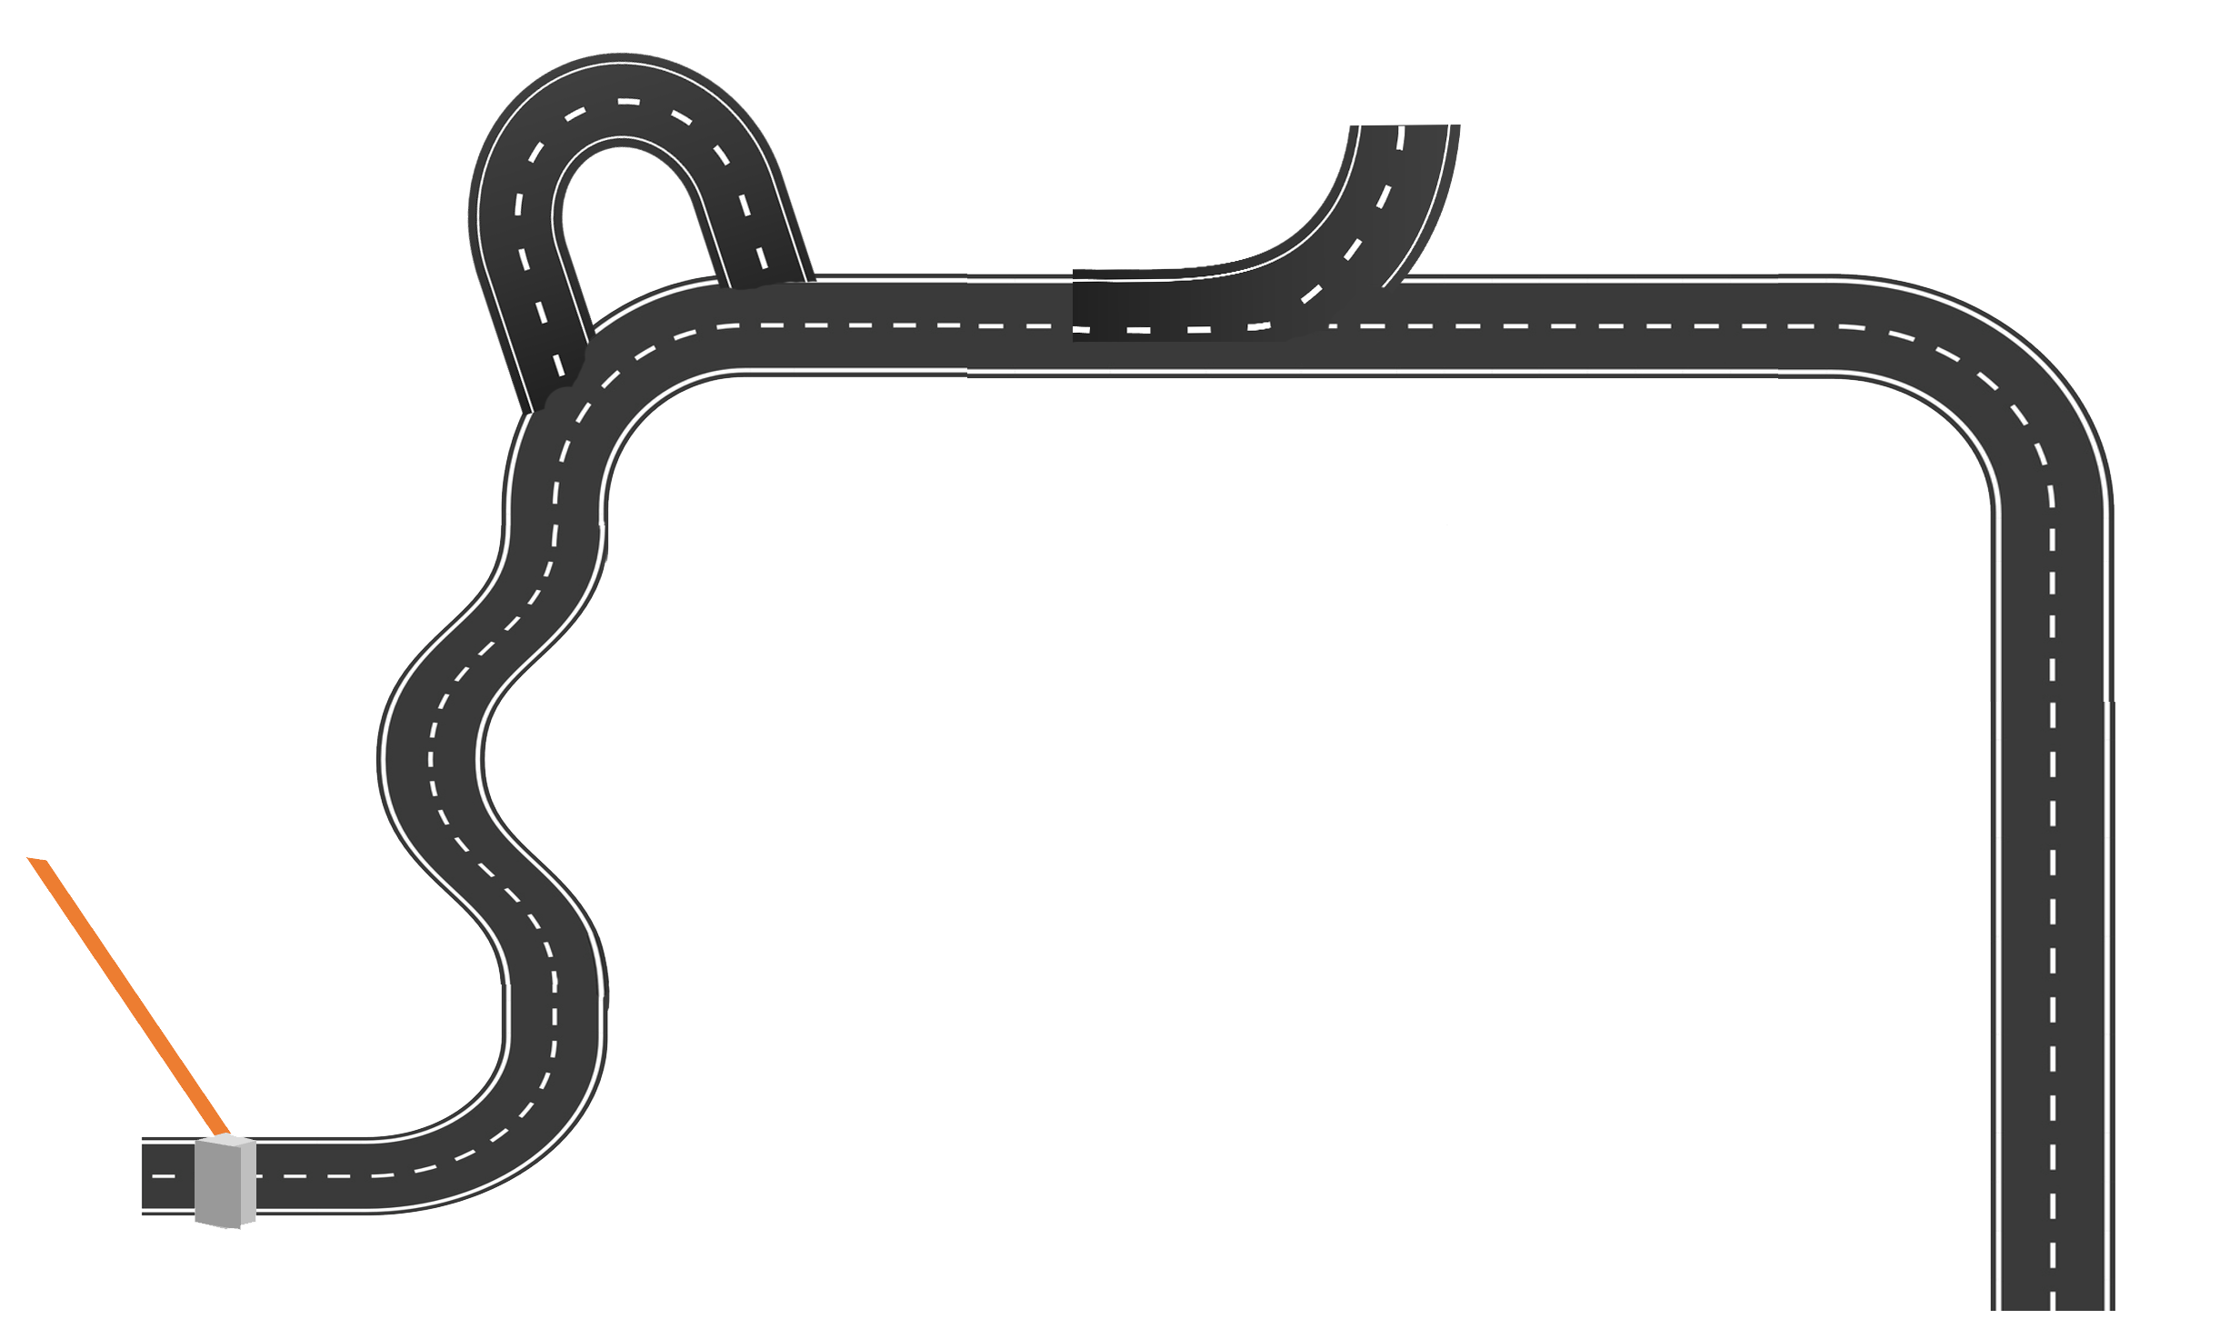
Medical School Critical Junctures and Developmental Pathways
Detours
Off Ramps
USMLE Exams
Transition to Clerkship
Professional Opportunities and Experiences
Residency Application and Interview Preparation
Academic Performance and Progression
Transition to Residency
Matriculation and Orientation
Acceptance

Slide 9
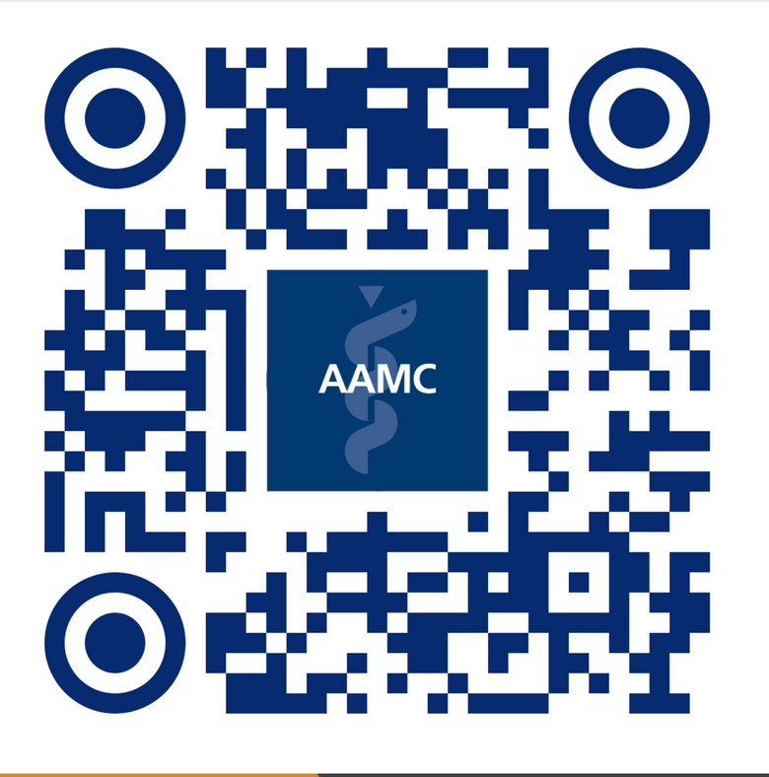




Holistic Student Support
Virtual Community
What can you do in the community?
Engage in Discussions
Share and Download Tools to Support Holistic Student Support
Pilot Test Tools and Resources
Thank you!
Email us at Holisticreview@aamc.org
Notes:
Speaker: Raechel
Slide Time: 3 minutes (Slide 17-20)
2:57-3:00
Animation: No
Speaker Notes:
Animations: No
Thank you again for your time and attention during this webinar. Please be on the lookout for follow-up communication from us about upcoming engagement opportunities with Holistic Student Support.
We are always looking for ways to improve our work and hope that you will take a couple of minutes to give us feedback on the survey that will follow this webinar.
I will now turn it over to Jennifer to close us out.

