Slide 1

AI-Powered Apps to
Turn Text to Visuals: Gamma.app
Teodora Hristov, MEd​
Debra Herrmann, DHSc, MPH ​
Kirsten Brown, PhD MA
Notes:
Welcome to our presentation on using Gamma. We are a group of instructional designers and health professions educators from George Washington School of Medicine & Health Sciences Center for Faculty Excellence.

Slide 2
GAMMA AI-Powered App to
Turn Text to Visuals
GUIDELINES
Learning Objective
Practice using Gamma.app to create visuals from text.
Instructions
Follow the directions step by step to gain understanding and skill.
Notes:
Gamma is an app that you can use to turn text into visuals, such as presentations or documents. After this short video, you should practice using the app. Follow the steps and try out Gamma yourself.

Slide 3
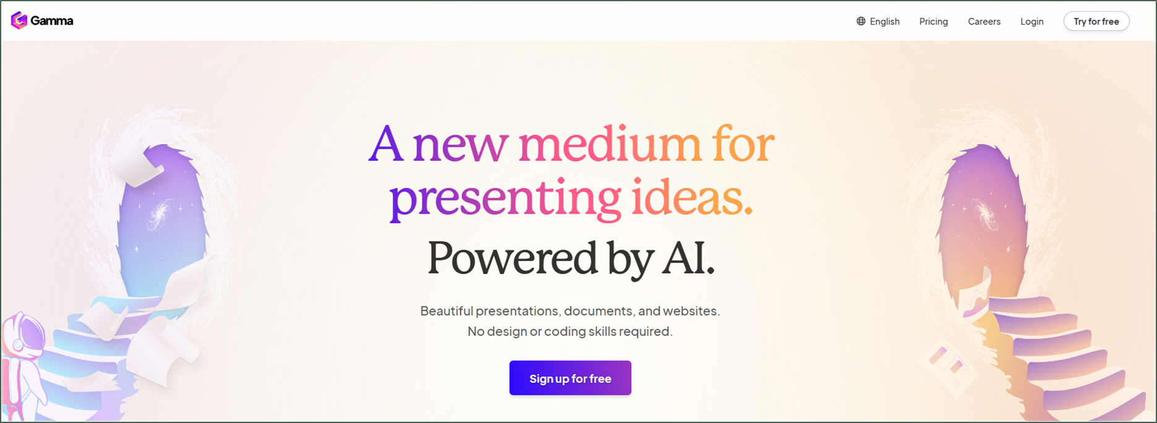
What is GAMMA AI?
A free (restricted) web-based AI-powered platform to generate and edit presentations, documents, and websites based on text prompts or other sources (documents, websites).
Notes:
Gamma is a web-based A I powered platform to generate and edit presentations, documents, and websites based on text prompts or other sources such as documents and websites. The free version of the app offers limited prompts, and every prompt generation costs credits. For the free version, you will receive 400 credits. We recommend trying out the free version first before deciding to go for the paid versions. You may find 400 credits meet your needs. Alternatively, as you gain proficiency and experience with the application, you may want to increase your credits.

Slide 4

How to Use gamma.app in 10 Easy Steps
10 Steps
Go to the gamma.app website
Sign up or log in
Paste the text prompt
Edit the text prompt, if needed
Pick a theme
Edit the visual output (slide)
Edit the layout, if needed
Export your slide(s)
Share your slide(s)
Import a branded theme, if needed
Steps 1 & 2
Go to https://gamma.app/
Sign up using Google SSO or email
Notes:
Let’s explore the app in ten easy steps. To begin using Gamma, we will sign in and add a text prompt for visualization. We will choose a style theme and edit the visual output slide. Then, we will export and show options for sharing the gamma workspace as well. An option to add a customized theme can be imported to brand the visualization. We like this ability because it allows us to create presentations that match our institution or organization’s brand.

Slide 5
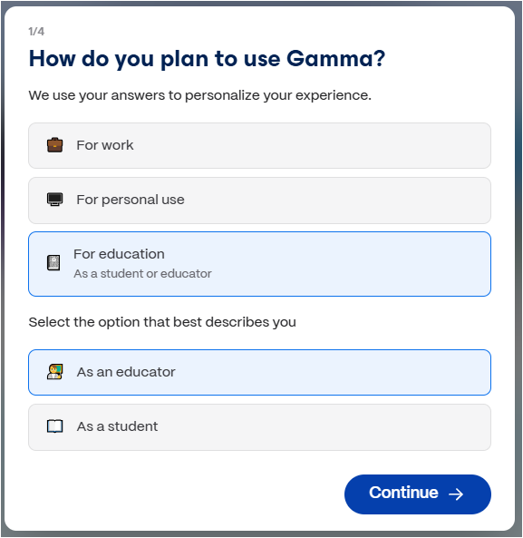
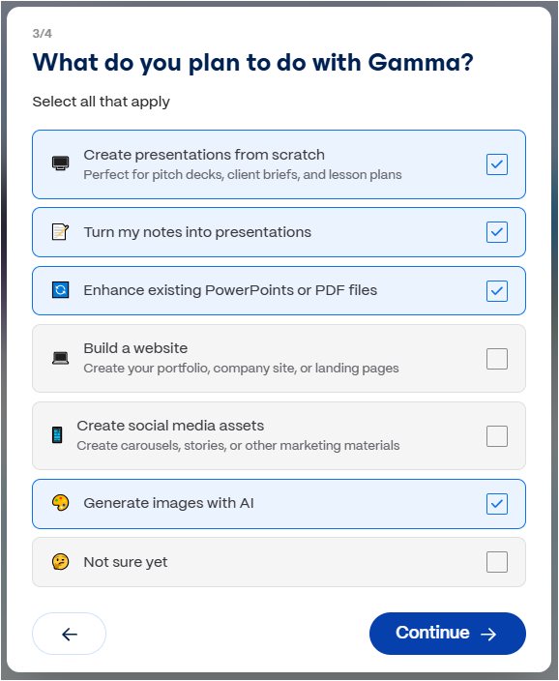
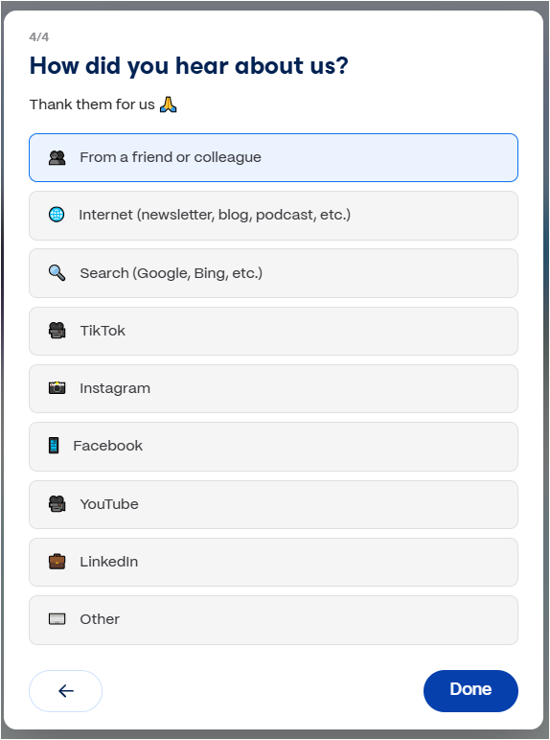
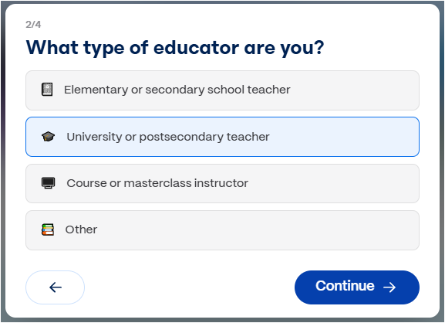
How to Use gamma.app in 10 Easy Steps
Answer the initial prompts to proceed. They will not appear after the first login.
Notes:
Upon initial sign up, answer the initial prompts to proceed. They will not appear after the first login. We have filled out options based on our needs.

Slide 6

How to Use gamma.app in 10 Easy Steps
Step 3
Copy the text prompt from the source
Source:
Supporting the District’s Primary Care Workforce.pdf
Click on the link to open the document and copy the text prompt shown below.
Text Prompt:
“Burnout and related factors impacting worker health and wellness (e.g., chronic work-related stress, anxiety, depression, exhaustion) have been widely reported among the healthcare workforce and are also often discussed among the primary drivers of healthcare workforce attrition.”
Notes:
As a reminder with any A I apps or tools, you should consider whether it is appropriate to share certain data before inputting it into the tool​. For the purpose of this demonstration, we selected a publicly available article, titled: Supporting the District's Primary Care Workforce. If you viewed our presentation on Napkin A I, it is the same article referenced in that content. You can access the article on the PDF link provided in the slides. Alternatively you can copy and paste a prompt of your choice.

Slide 7
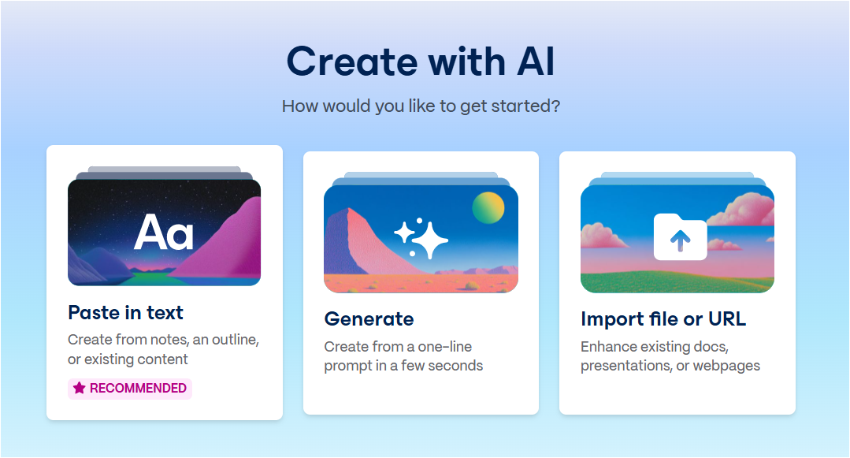
How to Use gamma.app in 10 Easy Steps
Step 3
Paste the text
In Gamma, select the first option, if you want to follow the steps in this demo.
Notes:
In Gamma, select the first option - Paste in text. Using the other two options will allow for AI-generated text and visuals to alter or expand upon the original text prompt. We will not demonstrate these options in this video but feel free to explore them on your own. For all options, please note that because Gamma generates text for presentations, you need to check the accuracy of the content.

Slide 8
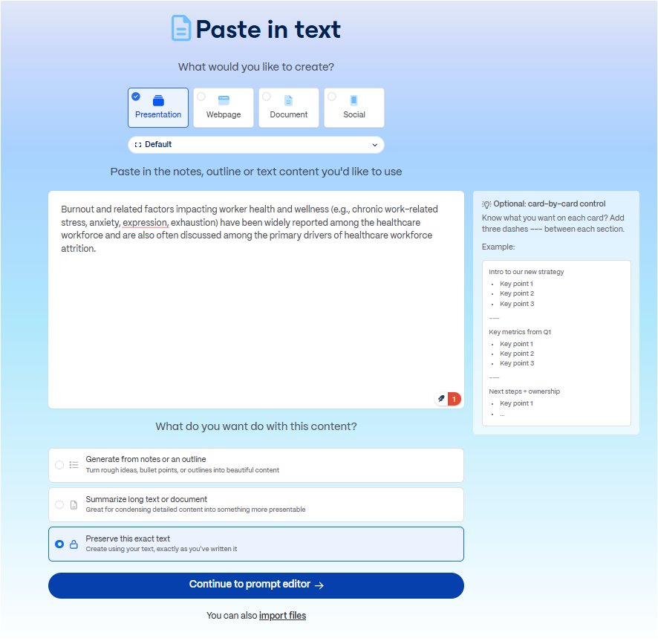
How to Use gamma.app in 10 Easy Steps
Step 3
Paste the text prompt
Paste the text prompt and the box.
Select the third option to preserve the exact text.
Click on the button to continue to the prompt editor for further customization.
Notes:
Let’s go back to the Paste in Text option. Paste the text prompt in the box. Select the third option to preserve the exact text. Then, continue to the prompt editor for further customization.

Slide 9
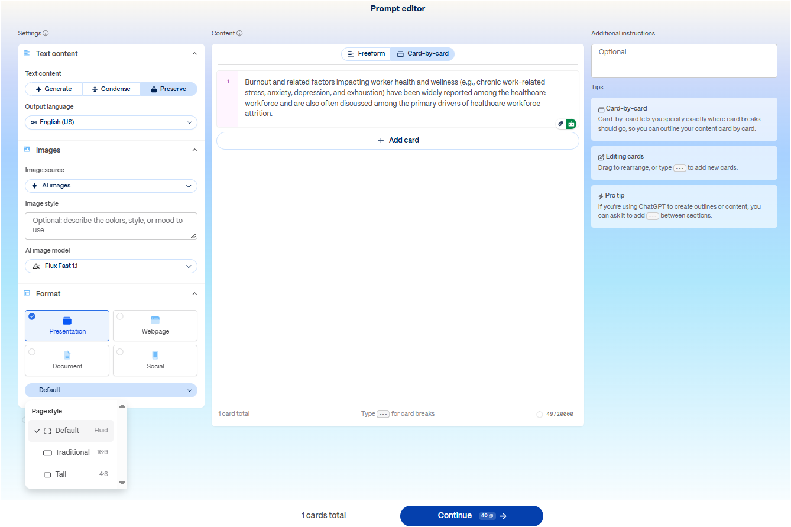
How to Use gamma.app in 10 Easy Steps
Step 4
Edit the text prompt, if needed
The Prompt Editor offers several options for customization:
Text content modifications
Choice of images: AI-generated, stock photos, web images, illustrations
Format of the output
The layout can be predetermined by selecting the number of cards (slides).
Notes:
The Prompt Editor offers several options for customization: The Text prompt can be edited, should you want to adjust verbiage. You may find this helpful after you create a presentation and your product is not exactly what you want. You can always go back and edit that prompt. Also, there are many choices for image generations from the text such as: A I images, stock photos, web images, or illustrations. You can also select whether you want the output to be formatted as a presentation, document, web page, or other format. Once you have made your selections, click on the Continue button at the bottom to proceed.

Slide 10
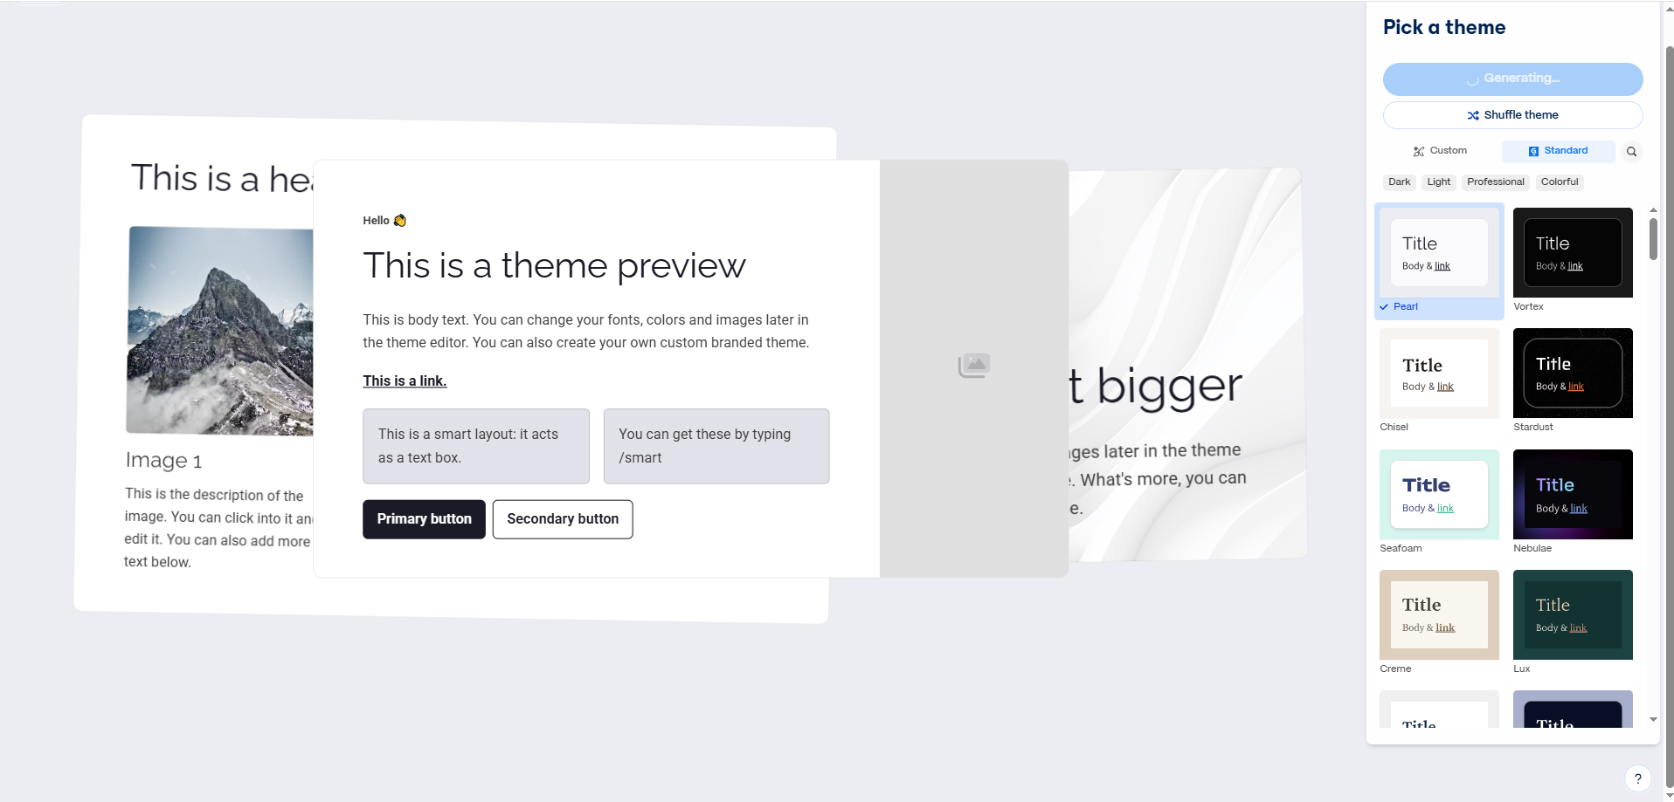
How to Use gamma.app in 10 Easy Steps
Select a theme from the available options on the right, and click the Generate button.
Step 5
Pick a theme
To customize a theme to add brand colors and fonts, a new custom theme can be imported and applied later (Step 10).
Notes:
Gamma allows many themes for its output. Themes let you customize colors, fonts, logo, and other visual styling. Select a theme from the available options on the right and click the Generate button. To customize a theme and add brand colors and fonts, a new custom theme can be applied or imported later.

Slide 11


How to Use gamma.app in 10 Easy Steps
Step 6
Edit the visual output (slide)
Every item on the slide - text, icons, images, layouts - can be modified by hovering over and clicking on each or a group of them to - the submenus reveal many editing options.
A slide is generated within seconds.
Upon completion, helpful guides show what has been created and how it can be modified.
Notes:
Once you select the Generate button, a new slide is created in seconds. If you selected multiple slides in your outline, then these will be generated until the outline is completed. Upon completion, helpful guides show what has been generated and how it can be modified. Note that every item on the card - text, icon, image, or layout can be edited by clicking on it to select it and to reveal the submenu with editing functionalities.

Slide 12


How to Use gamma.app in 10 Easy Steps
Step 6
Edit the visual output (slide)
Additional window within the platform opens up to allow for image prompt changes, and regeneration of the visual.
The pallete icon offers options for image edits.
Select the “Edit” next to Accent Image to update the AI image.
Notes:
Perhaps you don’t like the accent image that was used. If you hover over a part of the visual, such as the image, the palette icon offers options for image edits. Select the “Edit” next to Accent Image to update the AI image. An additional window within the platform opens up to allow for image prompt changes and regeneration of the visual. Every regeneration will cost credits, so keep that in mind when creating your presentation.

Slide 13

How to Use gamma.app in 10 Easy Steps
Step 6
Edit the visual output (slide)
The layout, the text, the icons, and the style can be all edited, if necessary. Additional elements can be created manually, generated by the app AI, or imported.
Notes:
Like the images, you can also edit the layout, the text, the icons, and the style, if necessary. Additional elements can be created manually, generated by the app AI, or imported.

Slide 14
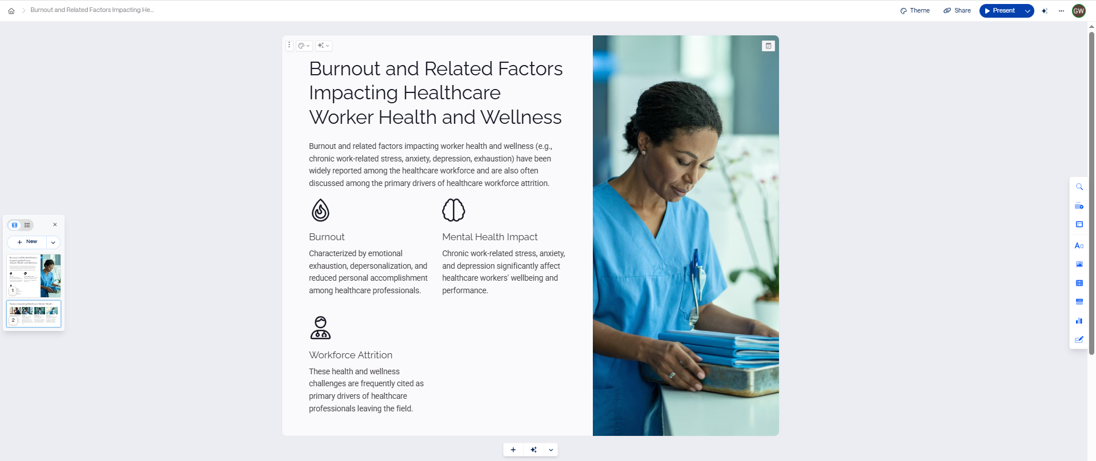
How to Use gamma.app in 10 Easy Steps
Step 7
Edit the layout, if needed
Editing options are always available as a menu on the right:
Type in search for/in text blocks, images, media, and embeds
Card templates
Smart layouts
Text blocks
Images
Videos & Media
Embed apps & webpages
Charts & diagrams
Forms & Buttons
Additional cards/slides can be added from the TOC on the left or below the card by selecting a layout.
Notes:
Here is a bird’s-eye view of the Gamma workspace. On the left and at the bottom, additional cards or slides can be added, allowing further customization. You may find this useful if you have created a presentation, but found that there is still content that needs to be incorporated. Rather than trying to edit the original prompt, you can add the content directly here. We find this option particularly useful when we like the overall presentation that Gamma created, but just need a few tweaks to better suit our needs. 0.5s
On the right, the edit menu is always available and offers many options such as: -Type-in search for and within text blocks, images, media, and embeds. -Card templates, -Smart layouts, -Text blocks, -Images, -Videos & Media, -Embeded apps & webpages, -Charts & diagrams, and -Forms & Buttons.
You should take some time to experiment with these options in your own presentation..

Slide 15
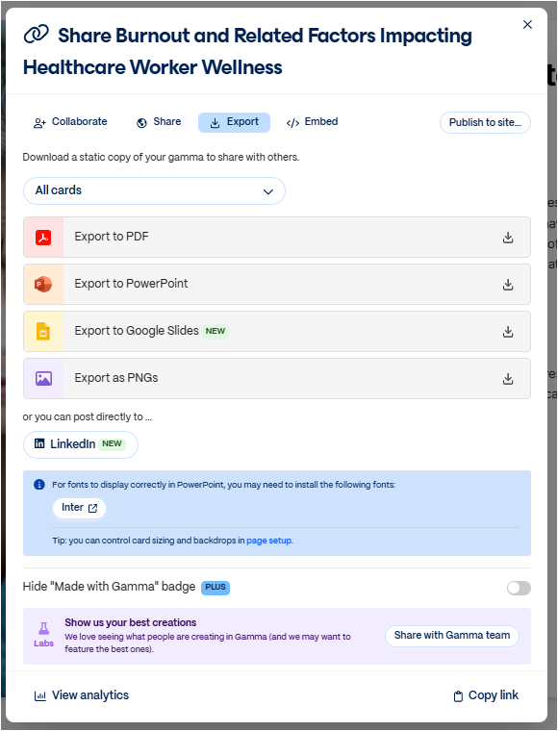
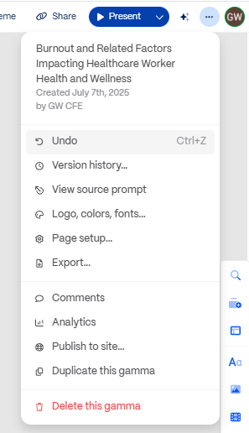
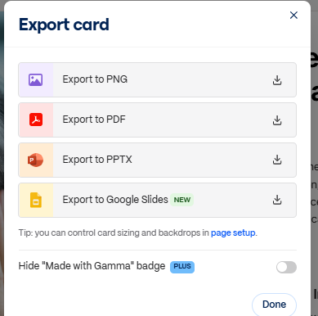
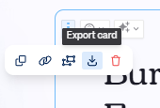
How to Use gamma.app in 10 Easy Steps
Step 8
Export your slide(s)
Additional functionality menu such as prompt edits, export, page setup, analytics, style, version history, and more are accessible via the account.
The Export options
allow for further editing opportunities on different applications.
A single card can be exported, too.
The Gamma logo is applied on every visual by default.
Notes:
Now that you’ve created a presentation, how do you export the content? Gamma allows you to export every slide individually or as a group. You can also post a presentation directly to LinkedIn. The Export options allow for further editing opportunities on different applications. Available formats include PDF, PowerPoint, Google Slides, or PNGs. Note that the free version of the app comes with an embedded Gamma logo in any exported output.

Slide 16

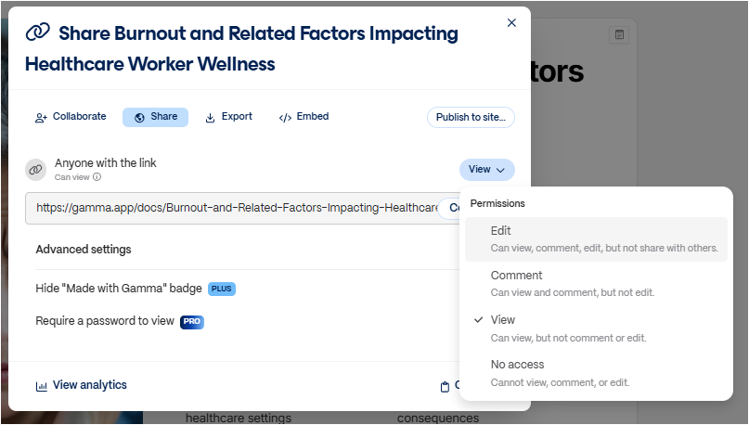

How to Use gamma.app in 10 Easy Steps
Step 9
Share your slide(s)
The Share options allow for teamwork collaboration, different levels of access, embedding to websites, and reviewing analytics.
Notes:
Gamma enables you to share presentations for teamwork collaboration with different levels of access, embed them on websites, and review analytics. You may want to use these options if you want to co-edit a presentation with a colleague or have a colleague review and provide comments on a presentation.

Slide 17
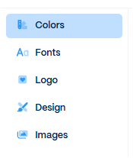
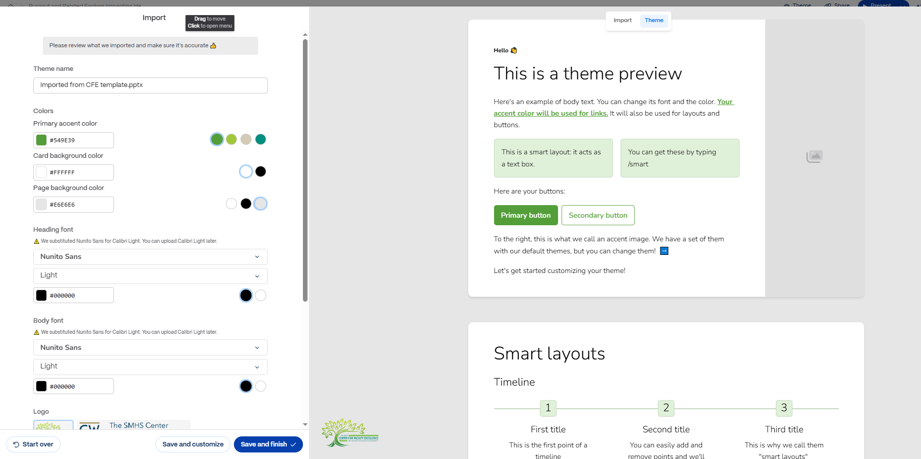

How to Use gamma.app in 10 Easy Steps
Step 10
Import a branded theme, if needed
A theme can be imported from a file: colors, and fonts, logo, design options, and images can be applied to cards/slides.
Notes:
As we mentioned earlier, you can create custom styles based on branding and color palettes. This is particularly useful for anyone who uses their institution's or organization's branding schemes in presentations, such as for professional conferences. Using the Theme button at the upper right corner, a custom style can be added by importing a file like PowerPoint or Google Slides. You can import the file to apply to any new or existing visual outputs. Note that your logo will appear on a slide only if there is a space for it.

Slide 18


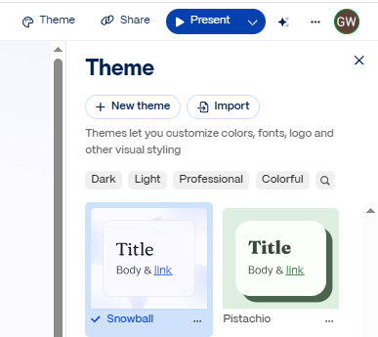
How to Use gamma.app in 10 Easy Steps
Step 10
Import a branded theme, and if needed, change it again!
Note that the colors are selected from within the selected theme color palette.
A new theme can be applied, or the current theme can be further edited.
Everything can be further edited and completely changed again.
Notes:
We imported our center PowerPoint template and applied it to the presentation. The branded theme incorporated the fonts, the logo, and the color palette. You can continue to edit the content, images, layout, and so on item by item, if necessary.

Slide 19
Gamma Benefits
Web-based app (no download & installation)
Free & (Cheap) Paid Accounts
Easy Login
Easy Use of editing tools
Mobile-friendly content on any screen
Track engagement with built-in, advanced analytics in web presentation mode
Password protect sensitive files
Connection and collaboration in real time
Ability to edit everything - text prompts, text, slides, images, image prompts
Easy import of other files and sync with other tools
Fully editable PowerPoint exports
Versatile design options - themes and examples
Fast and easy creation of aesthetically beautiful slides
Easy Use of interactive options - embeds, polls, quizzes, or videos
Time Efficiency:
• Instant content generation
• Instant formatting
• Rapid iterations
Professional Results:
• Consistent look and style
• Clean design
• Multiple format outputs
• Engagement tracking
Notes:
Why do we like Gamma? It offers time efficiency in the creation of professional looking presentations and visuals based on text. The app offers many editing and design options. You should take time to review the Gamma benefits on this slide for more information.

Slide 20
App Limitations
Free version limits the production and editing options
Limited credits for use in the free version
Overwhelming options for editing
Overload of text generation
Theme import does not include images
"Made with Gamma" logo stuck to slides in the free version
Custom logo not applied on every visual output/needs to be added manually
Templated design affects creative deviation
Extra time for customization needed
Notes:
We should also note that Gamma is a versatile app that has certain limitations. We have listed several here. While the app is relatively easy to use, it can be overwhelming for its numerous editing options. The limited credits may also present some challenges. Therefore, we encourage you to consider how you can best use Gamma for your line of work, and the extent to which you want to use all its capabilities. For example, you may find the ability to edit existing presentations more appealing than generating new ones. You can do both with Gamma, but one may be easier than the other. Above all, we hope you have fun experimenting with Gamma. Thank you for watching this brief demo of the application!

