Slide 1

AI-Powered Apps to
Turn Text to Visuals: Napkin.ai
Teodora Hristov, MEd​
Debra Herrmann, DHSc, MPH ​
Kirsten Brown, PhD MA
Notes:
Welcome to our presentation on using Napkin A I. We are a group of instructional designers and health professions educators from George Washington School of Medicine & Health Sciences Center for Faculty Excellence.

Slide 2
Napkin AI-Powered App to
Turn Text to Visuals
GUIDELINES
Learning Objective
Practice using Napkin.ai to create visuals from text.
Instructions
Follow the directions step by step to gain understanding and skill.
Notes:
After you complete this short video, you should practice using Napkin A I to create your own visuals from text. Follow the steps and try out Napkin A I for yourself.

Slide 3
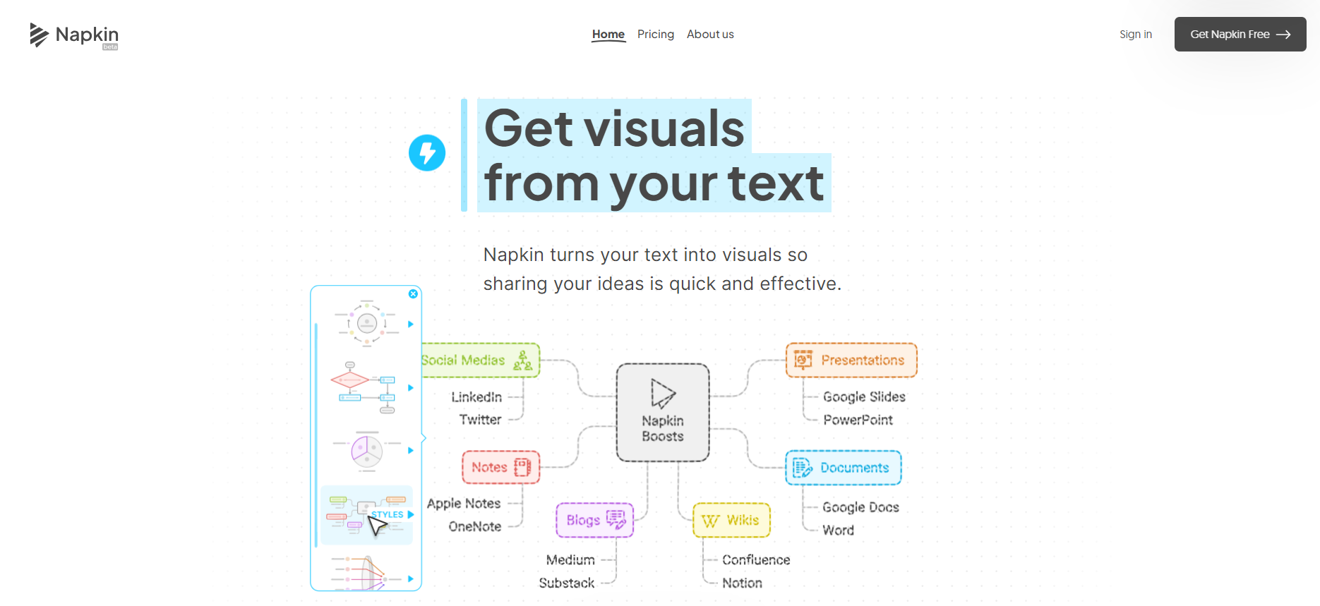
What is Napkin AI?
Napkin.ai is a free web-based AI app to generate and edit graphs, diagrams, and charts for visualization of text.
https://www.napkin.ai
Notes:
What can Napkin A I do for you? Napkin A I is a free web-based A I app that generates and edits graphs, diagrams, and charts for the visualization of text. You provide short text sections, and Napkin A I can turn your content into graphics for presentations.

Slide 4
How to Use Napkin.ai in 5 Easy Steps
Steps 1 & 2
Go to app.napkin.ai/signin
Sign up using Google SSO or email
Notes:
First, go to the napkin website to sign in. You will be prompted to answer a few questions upon login for the first time. Answer them to proceed.

Slide 5
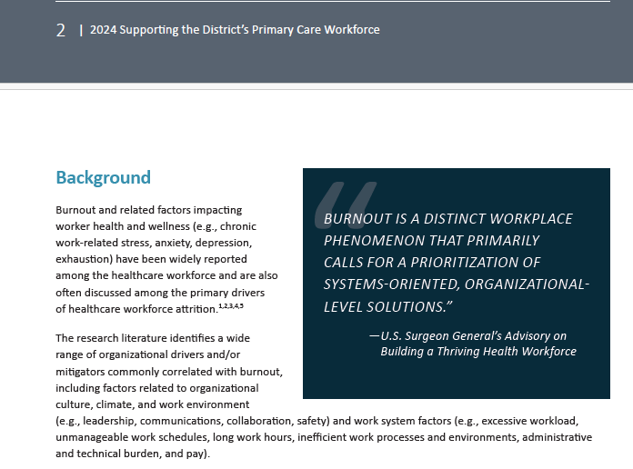
How to Use Napkin.ai in 5 Easy Steps
Step 3
Import or paste your text
Source:
Supporting the District’s Primary Care Workforce.pdf
Click on the link to open the document and copy the text prompt shown below.
The best use of Napkin AI is to generate visuals paragraph by paragraph.
Use a max of 60 to 300 words of content per visualization for optimal results.
Text Prompt:
“Burnout and related factors impacting worker health and wellness (e.g., chronic work-related stress, anxiety, depression, exhaustion) have been widely reported among the healthcare workforce and are also often discussed among the primary drivers of healthcare workforce attrition.”
Notes:
As a reminder with any A I apps or tools, you should consider whether it is appropriate to share certain data before inputting it into the tool​. For the purpose of this demonstration, we selected a publicly available article, titled: Supporting the DC Primary Care Workforce. You could either click on the PDF link provided in the slides or copy and paste a prompt of your choice.
Note- The best use of Napkin AI is to generate visuals paragraph by paragraph. Use a max of 60 to 300 words of content per visualization for optimal results.
https://dchealth.dc.gov/sites/default/files/dc/sites/doh/service_content/attachments/2024-DCHealth-Supporting-the-DC-Primary-Care-Workforce.pdf

Slide 6
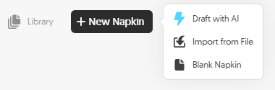
How to Use Napkin.ai in 5 Easy Steps
Step 3
Import or paste your text
Paste the text prompt into a new Blank Napkin.
Using the other two options will allow for AI-generated text to alter or expand upon the original text prompts.
Draft with AI created a 3-page text-based PDF from the original prompt.
Import from File - the Napkin app cannot create several visuals out of different paragraphs within a document. Visualizing of the text still needs to be done manually and incrementally on the platform.
Notes:
Click on the button, New Napkin, and pick the Blank Napkin option. Using the other two options will allow for AI-generated text to alter or expand upon the original text prompt. For example, using the same text, the Draft with AI option created a 3-page, text-based PDF on the topic of the original prompt. We have included the pdf in our materials so you can see what the Draft with AI option produces. The Import from File option does what it says. It allows you to upload a document. Please note that the app cannot create several visuals out of different paragraphs within a document. Visualizing the text still needs to be done manually and incrementally, paragraph by paragraph.

Slide 7
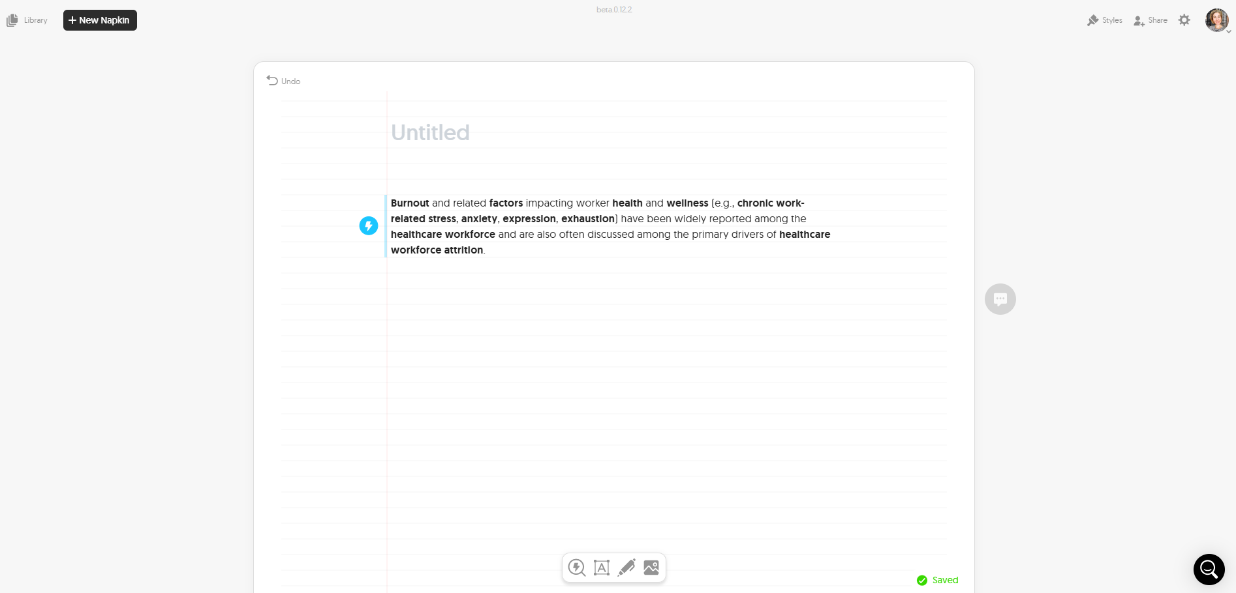
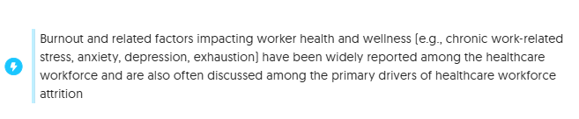
How to Use Napkin.ai in 5 Easy Steps
Step 3
Import or paste your text
Once pasted, hover over the text prompt and click on the blue circle with the thunderbolt to initiate the generation of different visuals.
The best way to create visuals is to generate them from short text prompts such as words, bullet lists, or short paragraphs.
Notes:
Once the prompt is pasted, hover over the text and click on the blue circle with the thunderbolt to initiate the generation of different visuals. The best way to create visuals is to generate them from short text prompts such as words, bullet lists, or short paragraphs.
https://dchealth.dc.gov/sites/default/files/dc/sites/doh/service_content/attachments/2024-DCHealth-Supporting-the-DC-Primary-Care-Workforce.pdf

Slide 8
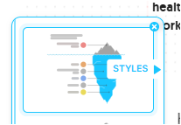
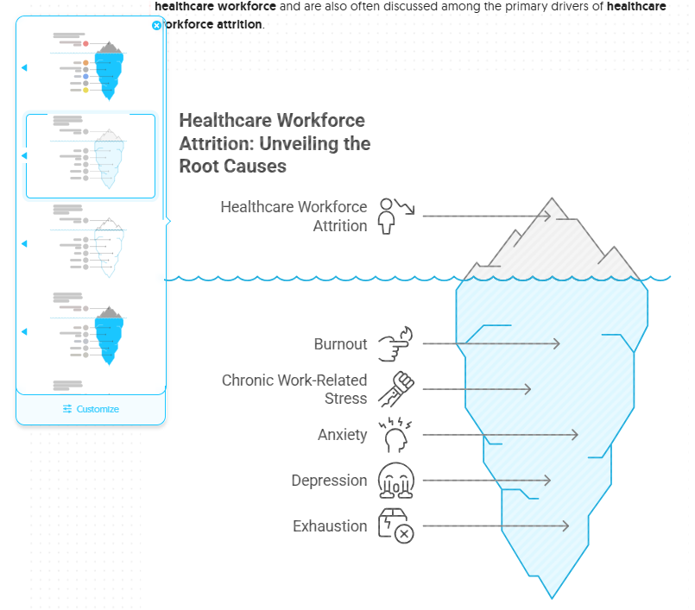
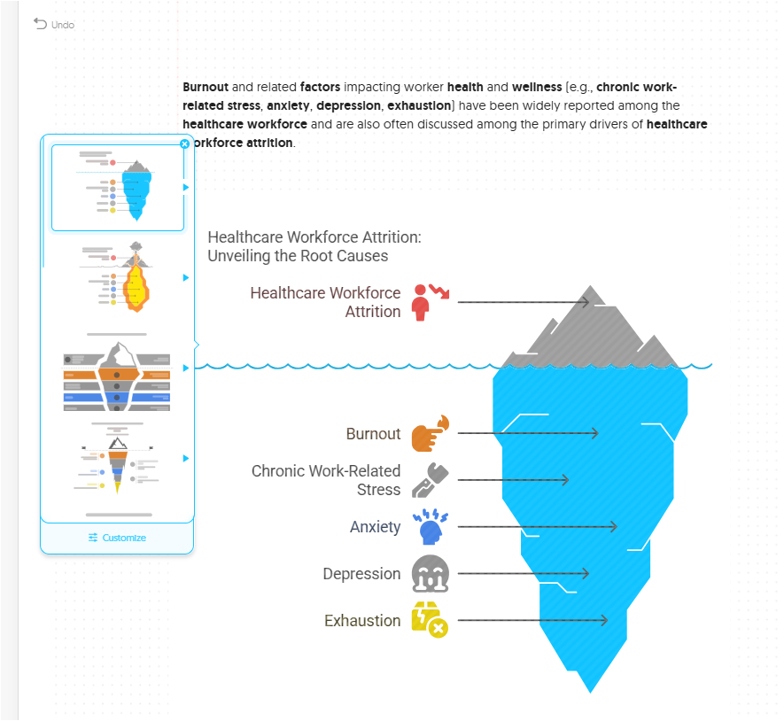
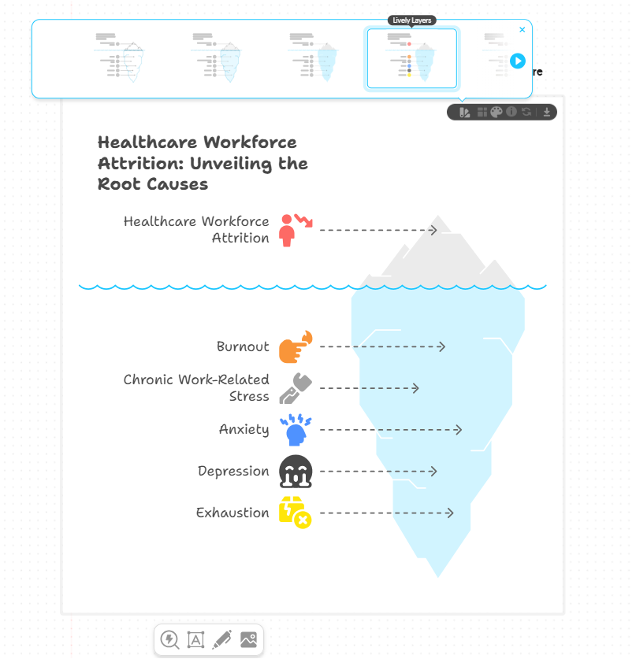
How to Use Napkin.ai in 5 Easy Steps
Step 4
Generate and customize visuals
As many times as needed!
OR, click on the Styles button to see predesigned options. Or,
Select a generated visual to place on the napkin, or,
OR, click on the Styles button to see other options after a visual was selected and placed.
Or…
Notes:
You can generate and customize as many visuals of your text prompt as you need. The generated options are pre-made. So, scroll the pop-up window to select a graphic of your liking. Notice that each generated visual has a Styles button available that offers more pre-generated edits. Click one to finalize the choice.

Slide 9
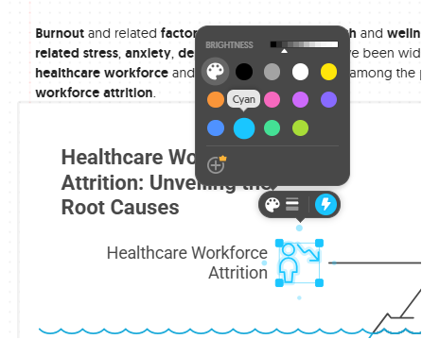
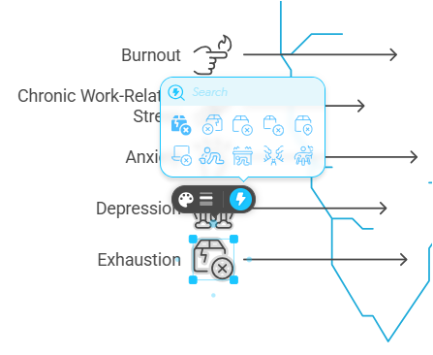
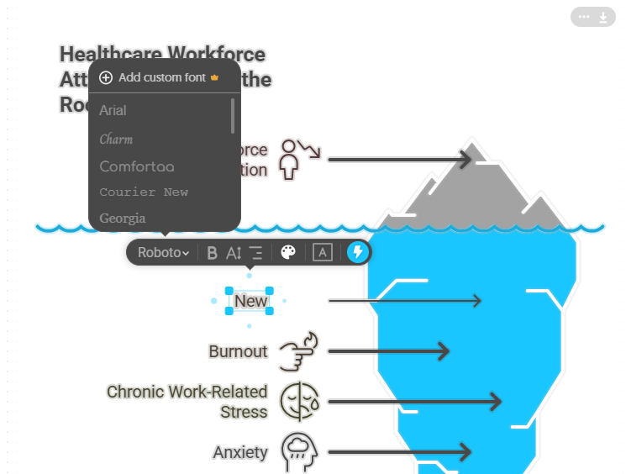
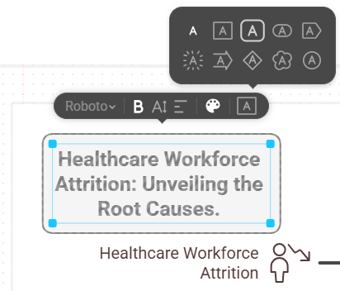
How to Use Napkin.ai in 5 Easy Steps
Step 4
Generate and customize visuals
As many times as needed!
OR, customize the graph more by editing each element:
the content - text and icons
the style - colors, fonts, connections, sizes
the connectors - adding new or removing ones
the decorations around labels
the thickness and brightness of shapes and lines
Notes:
The selected visual can be further modified. Every item can be edited as shown in the demo: - the content - either text or icons, - the style of text and icons, like the colors, fonts, icons, connections, and sizes, - the connectors between the items by adding new or removing old ones, - the decorations around labels, or, - the thickness and brightness of any shape or line. As shown here, we have made several changes to the original suggested visual to better suit our needs. You should experiment with these options after viewing the video.

Slide 10
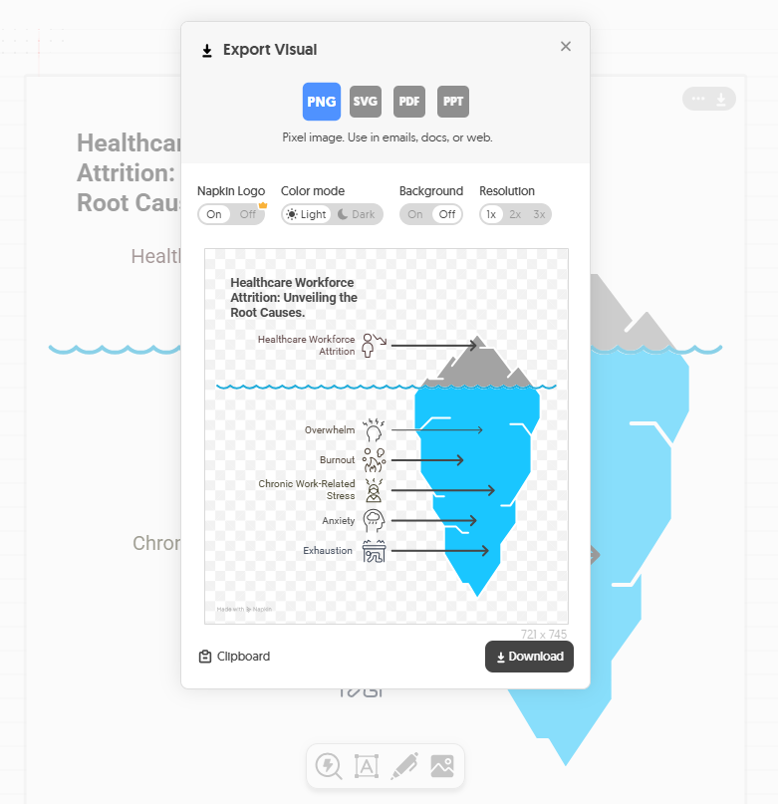
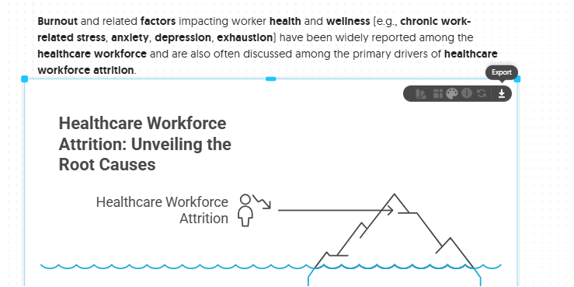
How to Use Napkin.ai in 5 Easy Steps
Hover over the visual to reveal the Export icon and click to see the window with the options for output.
Step 5
Export or share your visual
Export (.ppt, .png, .pdf, .svg) to share the visual embedded in documents and presentations.
PPT visuals are downloaded as slides and are editable and can be made animated.
SVG visuals can be downloaded as are editable and scalable vector images.
Or, click the visual to reveal the additional menu with the Export icon - click it to see the window with the options for output.
Notes:
Once you are satisfied with the visual, you can export it in different formats. To do so, hover over the image to reveal the export functionality in the upper-right corner. - Export options include downloads as ppt, png, pdf, or svg file formats. - PPT visuals are downloaded as editable slides. - SVG visuals can be downloaded as editable and scalable vector images. - Notice that the Napkin logo can be removed upon download if you want to attribute the visuals creation to a reference slide or at another place of your document. - The background of the visual can also be changed or removed.

Slide 11
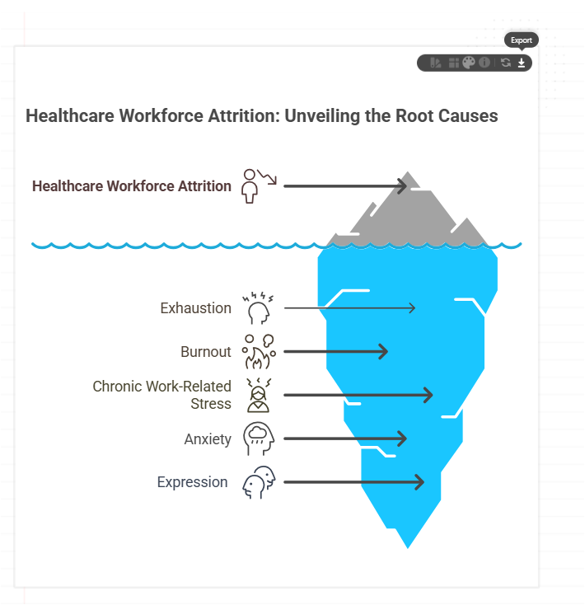
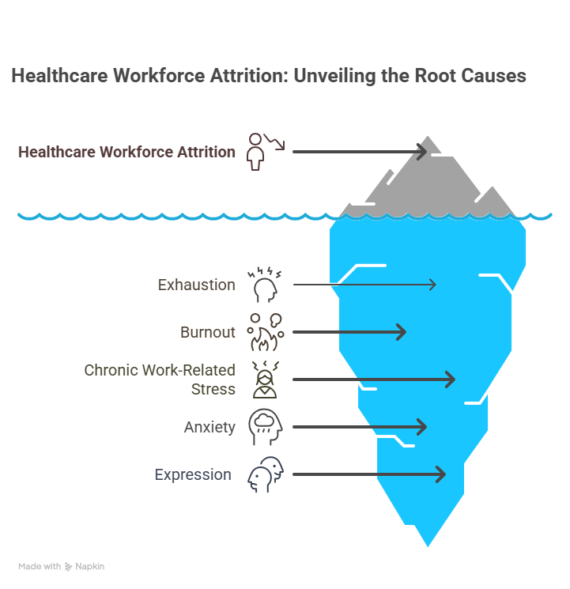
How to Use Napkin.ai in 5 Easy Steps
Step 5
Share your visual
Hover over the visual to share the output.
Notes:
Here is the final image.

Slide 12
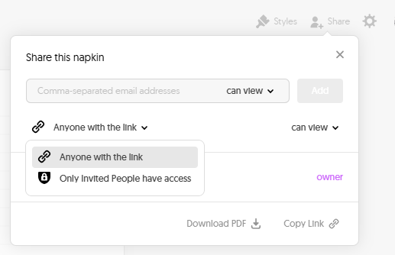
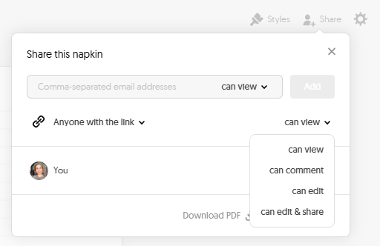
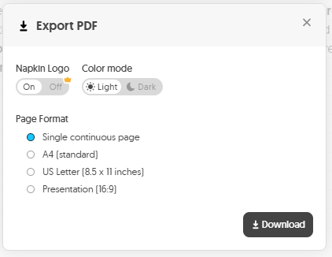
How to Use Napkin.ai in 5 Easy Steps
Step 5
Share your napkin
Share the napkin with a link with various editing privileges.
Download the napkin as an exported PDF: download it as a pdf file in 4 formats.
Notes:
You can also share the whole napkin either as a link with different levels of access or download it as a PDF file.

Slide 13
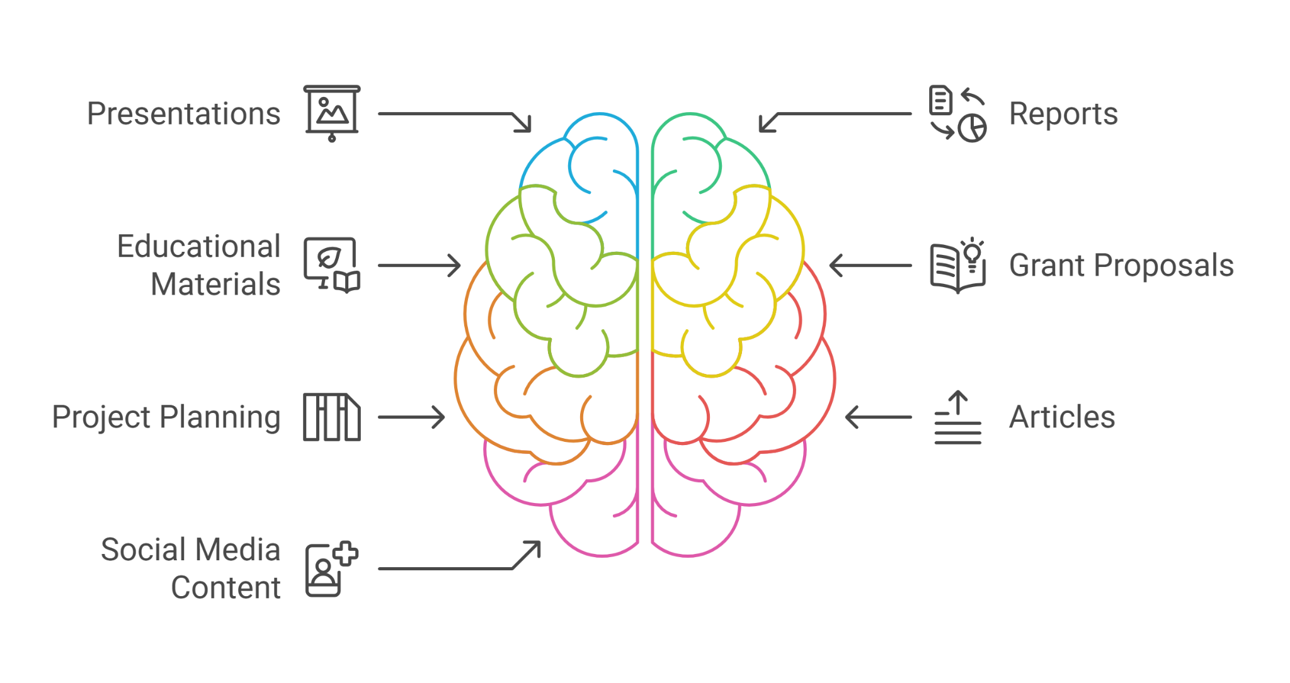
Practical Applications
Notes:
What is Napkin A I used for? We created a Napkin to show these practical applications. Napkin A I can be used for the creation of visuals to include in: - Presentations, - Reports, - Educational Materials, - Grant Proposals, - for Project Planning, - in Articles, and - Social Media Content.

Slide 14
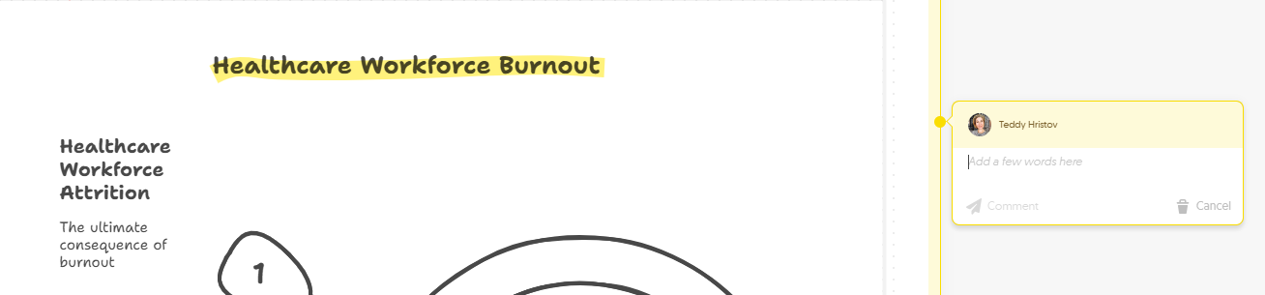
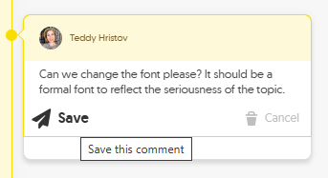
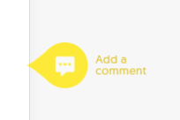
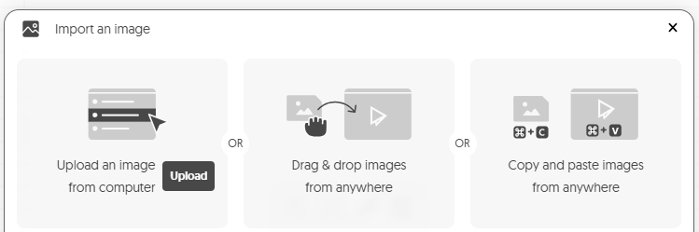
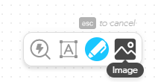
Napkin Benefits
No design expertise required
Real-time teamwork workspace
with collaboration tools:
Share links and feedback with comments
Multi-language support
Quality outputs- copy/paste or download editable graphs
Customizable visuals and styles
How-to guides & FAQs available on the website homepage
Search button for easy finds and more information
Type in text functionality
Free Sketch functionality
Photographic images import options
Notes:
Let's summarize the benefits of using Napkin a i: - First no design expertise is required. You can practice using the app immediately. - The app provides a Real-time teamwork workspace with collaboration tools, including shareable links and adding feedback with comments. This allows you to co-edit napkins with colleagues, such as when designing a figure for publication. - Multiple languages are available via the account settings. - The visuals are professionally done and of high quality. - The generated visuals and styles are fully customizable. Want to create a visual with your institution or organization’s color palette? You can modify the suggested colors as needed. - How To guides & FAQs are also available on the website homepage. - There is a Search button in the tool for more information. - Type-in text functionality is provided. - Free Sketching and Importing of photographic images to add on to a napkin functionalities are also available.

Slide 15
App Limitations
Predetermined options of generated visuals
Cannot generate photographic images
Finicky editing - requires some user practice
Glitches in Beta development version - lag in production or loading
Jumbled graphs and text during visual re-generation
Laptop version to edit only/not-mobile friendly
Additional outputs to textual prompts that deviate from the topic/point
Current version is free (2025) but there could be usage limits applied in the future:
maximum number of days that user content is retained
maximum amount and size of user content that can be stored
maximum storage space allotted to each user.
Notes:
The app is currently free, and a beta version is available for public use while in development. This may cause interruptions or limitations during use. We listed several potential obstacles for your consideration. Thank you for watching!

