Slide 1
Workshop: Mastering Challenging Feedback in Medical Education While Exploring the Role of AI Integration
Dr. Sarah Boutwell, MD MSPH
Dr. Kirsten Brown, PhD, MA
Dr. Shazia Samanani, MD MEd
Notes:
Welcome to our faculty development workshop on “Mastering Challenging Feedback in Medical Education While Exploring the Role of Artificial Intelligence Integration. An issue that many of us face is how to give challenging feedback effectively. Therefore, this workshop was designed for faculty to practice using AI tools, like ChatGPT or Yoodl, to plan feedback sessions, and understand how AI can enhance feedback delivery.
We have given this workshop in both in-person an online settings, at our home institution and a regional medical education conference. The timing is allocated for 1 hour, but we have found participants prefer having additional time for practicing the genAI tools. [ADVANCE SLIDE]

Slide 2
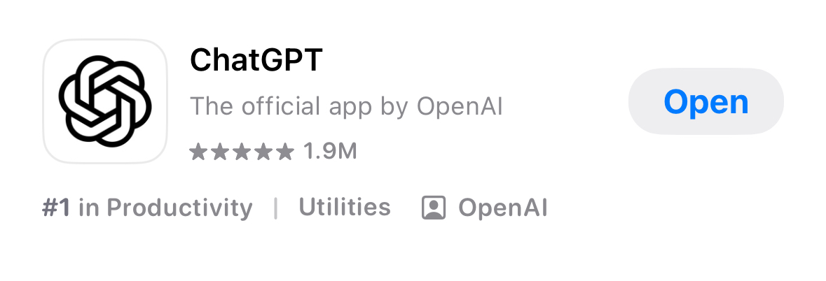

Select Your AI Tool
Please download and log into the ChatGPT app or online program
Alternatively. you may download or use whatever GenAI program that you choose
Notes:
While you wait for participants to join, we would suggest that you download ChatGPT or have access to the desktop application. If you prefer, you may use your own institutionally approved AI tool, such as Microsoft Copilot.
[ADVANCE SLIDE]

Slide 3
Disclosures
None of the presenters have a financial interest/arrangement or affiliation with one or more organizations that could be perceived as a real or apparent conflict of interest in the context of the subject of this presentation.
None of the presenters are “experts” in using artificial intelligence.
Notes:
We want to note that we having nothing to disclose regarding conflict of interest. More importantly, we want to disclose that none of us are “experts” in using artificial intelligence. We are faculty that have an interest in leveraging AI technology to improve our academic workflows and want to share our work!
[ADVANCE SLIDE]

Slide 4
What is feedback?
Specific information about the comparison between a trainee’s observed performance and a standard, given with the intent to improve the trainee’s performance (Van de Ridder et al., 2008; Aijawi & Regehr, 2019; Archer 2019).
Notes:
Before we get into practicing using AI tools for feedback, we want to provide a brief overview of the state of feedback in medical education. For many of us, when we initially discussed the concept of feedback in medical education, it was thought to be a very unidirectional process where teachers would tell the learners their feedback. This process was unidirectional, flowing from the feedback giver to the feedback receiver, with little to no interaction between the two. However, as our understanding of feedback evolves based on the work highlighted here, we recognize the need for a collaborative feedback approach, where it is no longer unidirectional but more of a “learning conversation.” In this model our learners play a critical role in the process.
[ADVANCE SLIDE]

Slide 5
Why is feedback important?
Essential component of experiential learning cycle/adult learning (Kolb, 1984)
Helps to reinforce good practice (Hattie, 1999).
Arguably the most important tool for enhancing achievement (Hattie, 1999).
Cornerstone of good and effective clinical teaching (Hesketh & Laidlaw, 2002).
Central to cognitive, technical and professional development (Burgess et al., 2020).
Notes:
Why is feedback in medical education important? Well we know from the literature that
Feedback is an essential component of the experiential learning cycle which forms the foundation of adult learning4
Feedback helps to reinforce good practice5.
Feedback is arguably the most important tool for enhancing achievement5.
Feedback is the cornerstone of good and effective clinical teaching6.
And finally feedback is central to cognitive, technical and professional development7.
The literature has ample examples outlining the importance of feedback in medical education, but are we providing enough feedback to our learners?
[ADVANCE SLIDE]

Slide 6
Learners Want Feedback!
Learners reported feedback is infrequent and inadequate. Additionally, learners report that those in medicine are rarely given feedback (Shultz, 2004).
Feedback is only given 3-6% on time in situations learners would expect it (Svinicki, 2015)
Only 8% of all learners are “very satisfied” with feedback.
  17% reported never or infrequently receiving reinforcing feedback
  80% reported never or infrequently received corrective feedback (Isacson et al, 1995).
Notes:
While we know from the literature that feedback is important, we also know that learners want feedback. Unfortunately, there are issues with that.
Research demonstrates that learners have identified that feedback is infrequent and inadequate and that learners in medicine are rarely given feedback.
Research also demonstrates hat feedback is only given 3-6% on time in situations learners would expect it to be given.
Another study indicates that only 8% of all learners are “very satisfied” with feedback. In the same study, 17% reported never or infrequently receiving reinforcing feedback, and 80% reported never or infrequently received corrective feedback.
This tells us that our learners want feedback, don’t receive it often when they would expect to, and when they do receive feedback they don’t receive reinforcing or corrective feedback.
[ADVANCE SLIDE]

Slide 7
Optional: Poll or question slide
What is a word or phrase that you think of when giving challenging feedback to learners?
Notes:
If you would like to have a break to ask your attendees a question or include a poll slide, feel free to do so. We revisited the responses at the end of the workshop. If you do not want to include a question or poll slide, feel free to remove.
[ADVANCE SLIDE]

Slide 8
Artificial Intelligence and GenAI
GenAI: type of AI that can create new content
Uses deep learning modules, which are like algorithms that mimic the human brain (some CPU generate, some human and some mixed)
These models are trained on large amounts of data of various modalities
The models learn patterns from the data and use that to predict sequences
Some of these models are then fine-tuned using human reviewers
Notes:
Now we will take a few moments to review artificial intelligence (AI) and generative AI (genAI). Simply put, GenAI is a type of AI that can create new content. It uses deep learning modules, which are like algorithms that mimic the human brain. These could be CPU generated, human generated, or a mixture of both. Critically, these models are trained on large amounts of data of various modalities that are pulled from the internet, open access resources, and information that is put in the models. Over time, the models learn patterns from the data and use that to predict sequences. Some of these models are then fine-tuned using human reviewers. Given there has been a rapid expansion of AI and genAI tools in academic medicine recently, we wanted to know what, if any use, these tools had on providing effective feedback.
[ADVANCE SLIDE]

Slide 9
Is artificial intelligence a transformative tool for delivering feedback?
Can be effectively used to provide both verbal and written feedback for medical learners (Cook et al., 2025).
Can be used to simulate patient-doctor interactions and give feedback on these (Venter et al. 2025).
Can allow for more timely feedback.
Can help with personalization of feedback.
Can help free up time for instructors (PPD, research, lesson plans) (Sreedhar et al., 2025).
LLMs can assist with grading formative assessments (Sreedhar et al., 2025).
Custom GPTs can be designed to help with faculty development allowing educators to deliver constructive feedback through simulated scenarios (Mehta et al. 2025).
Notes:
We are not the first people to look at this use of AI. A search of the literature identified the following uses for genAI in feedback within medical education. Some of this is novel because it is so new.
One study demonstrated that genAI can be effectively used to provide both verbal and written feedback for medical learners
Can be used to simulate patient-doctor interactions and give feedback on these
Can allow for more timely feedback
Can help with personalization of feedback
Can help free up time for instructors which in turn can be used towards PPD, research, lesson plans
LLMs can assist with grading formative assessments
Custom GPTs can be designed to help with faculty development allowing educators to deliver constructive feedback through simulated scenarios
[ADVANCE SLIDE]

Slide 10
How are others using AI for feedback delivery?
Grade assignments (Sreedher et al., 2024)
GPT grades agreed with faculty grades 67% of the time (p<0.001)
Learning Plans
(Booth et al. 2020)
Customized natural language program took narrative evaluations created learning plans
Practice Feedback
(Mehta et al, 2020)
Created custom GPTs to provide feedback to struggling students
Internal consistency and reliability 0.64 (ChatGPT) 0.69 (faculty)
Overall similar outcomes but reduced faculty work-load by 5x
Specific to learner strengths and weaknesses
Used faculty created evaluations from multiple GME sites to organize subcompetencies to help guide self evaluation too
Custom GPT simulated struggling students and coaches to provide on demand training
Notes:
Here’s some more details of how others are using AI for feedback delivery with respect to grading, creating learning plans and practicing feedback.
Sreedhar and authors (2024) used ChatGPT to grade preclinical student assignments.
They found that GPT grades agreed with faculty grades 67% of the time (p<0.001)
They also found similarities in internal consistency and reliability between ChatGPT (0.64) and faculty (0.69)
Overall, the authors found similar grading outcomes when comparing faculty and ChatGPT, but AI-used helped to reduce faculty workload by 5x.
Booth and authors (2023) used a customized natural language program that took narrative evaluations and helped create learning plans.
The program used faculty created evaluations from multiple GME sites to organize subcompetencies to help guide self evaluation tool
The learning plans were specific to learner strengths and weaknesses.
Finally, Mehta and authors (2025) used AI to help faculty practice feedback.
The authors created custom GPTs to provide feedback to struggling students.
The custom GPT simulated struggling students and coaches to provide on demand training.
So we can see how others in academic medicine are using AI for feedback purposes. Let’s look at some other options and practice! [ADVANCE SLIDE]

Slide 11


Let’s Practice with ChatGPT to Give In-Person Feedback!
The Case of Confident Carl
Carl is a late 3rd year medical student, planning to match into psychiatry. He is gregarious and well-liked by patients for his jokes and big personality. He is working with you on an outpatient medicine rotation. His presentations are disorganized, and he rarely offers a plan that is not related to psychiatric conditions. His medical knowledge is behind on diabetes, hypertension, and age-based screening guidelines.
Notes:
One of the cool things about using the ChatGPT app is that you can use ChatGPT voice. So, you can directly record what you want to say and then ChatGPT can provide you some tips. To do this, instead of typing within ChatGPT, toggle to the microphone button and instead speak to ChatGPT by holding this down.
Our scenario is around the student here, who we call “Confident Carl.” [READ description on slide]
What we’re going to do is show you how we took this scenario and recorded a prompt. The prompt is available in your supplemental document so you can see what we recorded. We asked ChatGPT for advise on this verbal feedback scenario.
[HIT PLAY BUTTON]
*facilitator note – it takes several seconds to generate a response from the app.**
What did you all think? We like it because it works to improve what we said. For example de-emphasizing bad (which we did intentionally) to focus on areas for growth. It also suggested specific areas of improvement. What the app wasn’t able to comment on was any physical mannerisms, so keep that in mind. Now that you’ve seen us try the program, take some time to practice!
[ADVANCE SLIDE]

Slide 12

Let’s Practice with Yoodli to Give In-Person Feedback!
https://yoodli.ai/
Notes:
One of our favorite tools to practice with is a program called Yoodli. Yoodli is an AI-powered speech coaching platform providing real-time feedback on speech, clarity, filler words, pacing, tone using its video interface.
There are several pricing options, including a free one that grants you 5 Yoodlis. They also have a pro-option for $11 a month that provides you with 10 Yoodlis per week. One negative of Yoodli is that it does not provide the best feedback on body language and non-verbal communication as you’ll see.
Although the 5 Yoodlis seems minimal, we have found that it works well for our needs.
[ADVANCE SLIDE]

Slide 13
Let’s Practice with Yoodli to Give In-Person Feedback!
Melissa is a 3rd year student on her OBGYN rotation in the labor ward. The residents on the team gave you feedback that Melissa is constantly negative, and it is starting to affect the team dynamic. The rest of the team feels very uncomfortable working with her, and she is making it very difficult for them to work in good spirits. She frequently makes negative comments towards other physicians, consultants and even about the patients she has seen. She recently made a comment saying one of her patients was “lazy and clearly had a low IQ”. Your residents also reported a comment she made about another patient who she said was “better off not passing her genetics to her offspring.”
Notes:
So here is a fictional case about a 3rd year student on her OB/GYN rotation. [READ SCENARIO]
We will be using this in Yoodli to get feedback.

Slide 14
Prompt:
Hi Melissa. Thank you for meeting with me today. So, I'm just going to get right to the point a lot of your colleagues have been making. You know, they've brought some concerns to me about some of the comments that you're making on the word they you know, they're concerned that your attitude has been very negative, and that you're kind of bringing down the team dynamic because you're creating an environment that's uncomfortable for them to work with. You know, they're actually really concerned about their ability to work with you going forward. You know, to pass this rotation, you have to kind of check the professionalism boxes as well. And with what I'm being told, I'm a little bit worried that, that you're maybe not checking the professionalism boxes. You know, they also mentioned that you're making some very derogatory comments towards patients. And you know, it doesn't matter if these things are said outside of a patient room. They're very inappropriate. And you know, we need to medicine. Part of medicine is being respectful. And some of these comments that you're saying are just, they're just not demonstrating that to me. You know, I was told you said a patient looked lazy and had had a low IQ, or that another patient was better off not passing her genetics to her offspring. These are just not things that you can be saying they're incredibly inappropriate. And I just want to make sure that I'm being clear about that, that you need to change these behaviors going forward, or you're not going to do well on this rotation. Okay. Is that clear?
Notes:
Here is how we turned that scenario into a prompt for recording. We have included it on the slides here but also in the supplementary document. Please note that we have included vague phrases (um, you know, etc.) purposefully.

Slide 15
Insert Yoodli Video
Notes:
[Facilitator note: Because these are large file sizes, we are recommending users create their own Yoodli video clips. You can use the prompt from Slide 14, or create your own. Record yourself reading the prompt. Once you have finished recording, save the video clip. Insert it into the slide deck.]
We’re going to play a video demonstrating both the prompt and the output that we provided with respect to this case.
[PLAY VIDEO CLIP]
*facilitator note – you may need to turn computer audio up to hear**

Slide 16
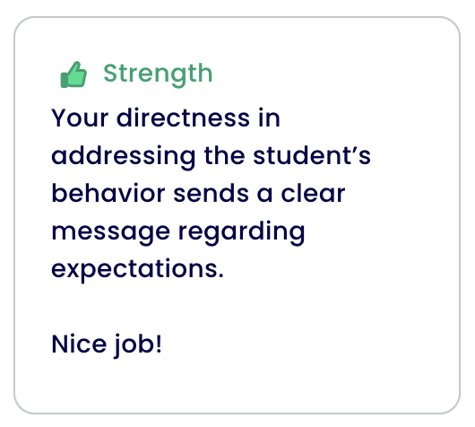
Let’s Practice with Yoodli to Give In-Person Feedback!
Notes:
[*facilitator note- We have added the output from our own recording using the prompt from slide 14. Please add your own strengths and growth areas based on the video you recorded]
Yoodli will give you output displayed like this. It is divided into strengths and areas of growth. Here we have a strength. Our faculty member got high praise for their directness.
[ADVANCE SLIDE]

Slide 17
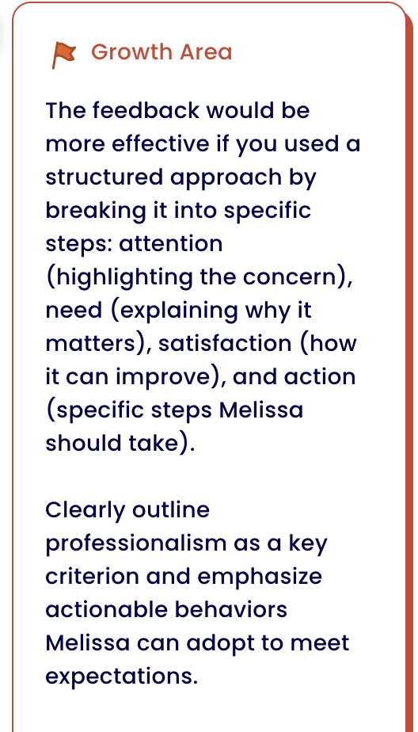
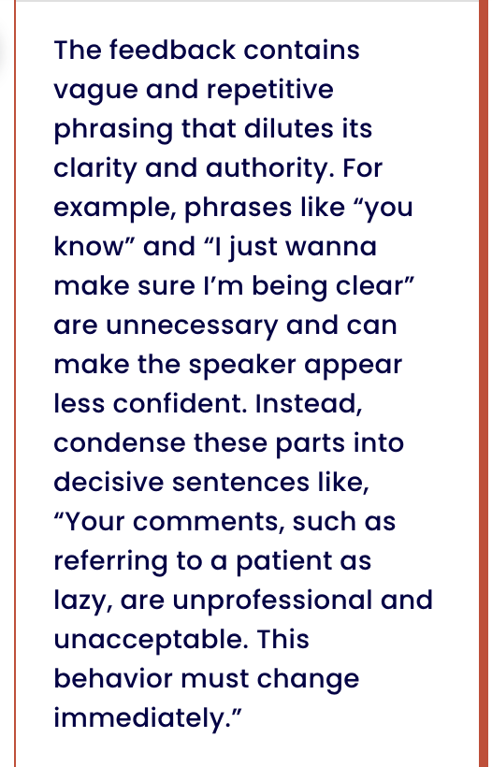
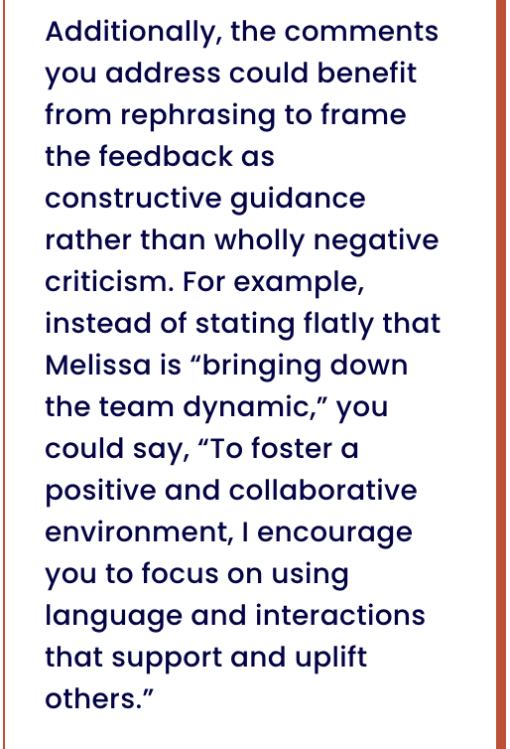
Let’s Practice with Yoodli to Give In-Person Feedback!
Notes:
And now we have some areas for improvement or growth. They recommended a structured approach, emphasizing professionalism, incorporating decisive language. They also recommended reframing the feedback from negative criticism to constructive guidance.
There’s lots of advice that we can use. Does anything resonate with you?
[ADVANCE SLIDE]

Slide 18
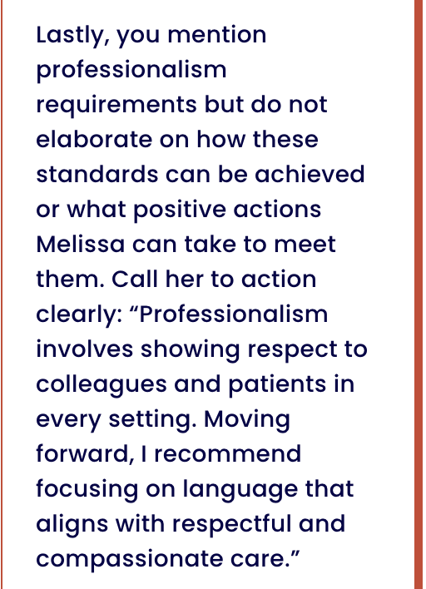
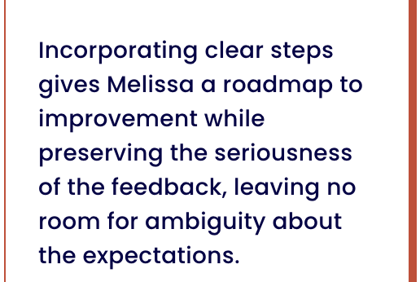
Let’s Practice with Yoodli to Give In-Person Feedback!
Notes:
And we still MORE areas for improvement! Yoodli has recommended aligning our professionalism expectation with standards that Melissa can use to achieve them. Yoodli also recommended providing specific steps to meet her goals.
[ADVANCE SLIDE]

Slide 19
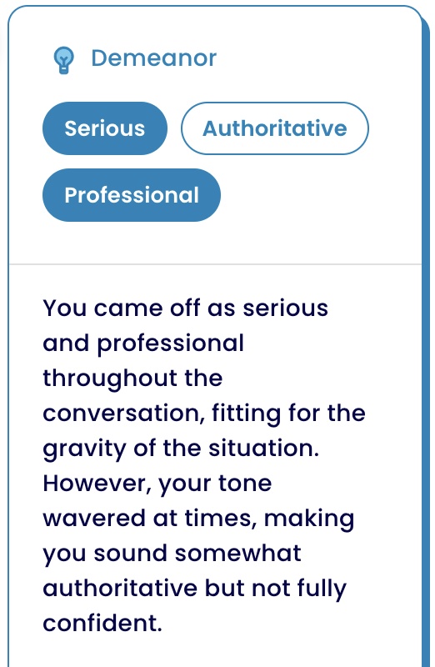
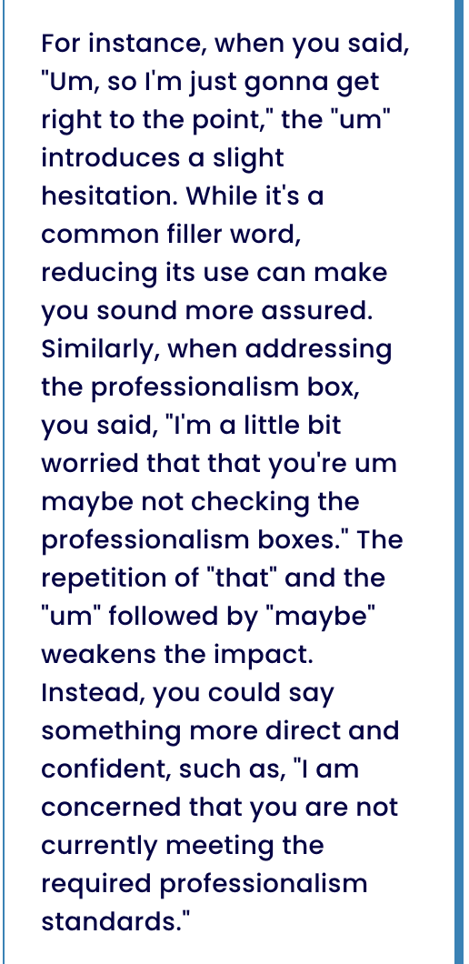
Let’s Practice with Yoodli to Give In-Person Feedback!
Notes:
Finally, Yoodli does provide limited feedback regarding body language since you are sharing a video. Keep that in mind when you practice. If you’re not focusing on your demeanor, then this feedback (on your feedback) might not be helpful. As you can see it is focused more on what you say, including removing filler language and did not comment as much on specific non-verbal communication (e.g., facial expressions).
[ADVANCE SLIDE]

Slide 20




Platform | Overview | Comments
 | AI driven tools to provide coaching and insights | Allows for practicing and refining communication skills including delivering feedback. Users given a prompt/scenario and then they record their response with audio or video.
 | AI communication coach giving real time feedback (designed to improve public speaking and communication skills). | Will give feedback on tone, clarity, and use of filler words and will give you a confidence score at the end.
 | Offers an immersive experience via learning simulations to help folks improve their interpersonal communication skills | Has an extensive back of scenarios where you can practice facilitating challenging conversations, providing feedback and de-escalating scenarios Has a large range of DEI content. Needs institutional subscription.
 | AI-powered transcription and note taking tool that converts speech to text in real time | Can use it to generate rehearsal transcript or in conjunction with other AI tool like ChatGPT to then generate feedback on the transcript.
Notes:
We want to note that there are other AI-powered platforms for practicing communication skills. We have included several here – Rehearsal, Poised, Mursion, and Otter.ai. Review these on your own.
[ADVANCE]

Slide 21

Let’s Practice with ChatGPT to Provide Written Feedback!
Each group will get a scenario, have someone in your scenario role play giving feedback to your learner.
Preclinical
Clinical
Intern
Notes:
So now that we’ve practiced with verbal feedback, we’re going to switch gears and focus on written feedback. For this portion of the workshop, we have provided prompts for you to practice as word document.
[SHARE WORD DOCUMENT WITH ATTENDEES].
We are going to break you up into groups. Each group will get a specific scenario – preclinical student, clinical student, resident. You will review the scenario and then role play in your groups, practicing giving feedback. The document has prompts that you will use in ChatGPT, but first we want you to try it without AI.
You may practice giving feedback!
After you have practiced without AI, we now want you to copy and paste the prompt into ChatGPT (or whichever GenAI you have institutional access to) and ask it to help you develop written feedback for this learner.

Slide 22
Let’s Practice with ChatGPT to Provide Written Feedback!
Preclinical Prompt:
I need to provide written feedback for my medical student, Jane. She is a 2nd year medical student in my small group based clinical skills course. Even though there are only 8 students in the group, she consistently sits towards the back of the room and appears to nod off during discussions. However, when called on Jane consistently knows the material well. She is engaging with standardized patients and gets good feedback. She is well liked by her peers and provides very insightful feedback during clinical practice sessions. I would like her to participate more in class.
Notes:
So now that we’ve practiced with verbal feedback, we’re going to switch gears and focus on written feedback. For this portion of the workshop we have provided prompts for you to practice as word document.
Please input the prompt into your ChatGPT or program of your choice. How did the program do? Any suggestions for improvements?
[ADVANCE SLIDE]

Slide 23
Let’s Practice with ChatGPT to Provide Written Feedback!
Now ask ChatGPT to amend its feedback and play around with asking it to include some of these. This can be done simply by typing “do it again but this time____”
Make the feedback timely
Make the feedback more specific
Make the feedback more actionable
Use a model to draft the feedback (Ex Pendelton’s Model for feedback)
Describe your role more and ask it to re-draft from someone in your position
Change the language to be more neutral, non-bias or inclusive
Notes:
If you want to make some changes to get more tailored feedback, you may consider the following prompts. After you output from ChatGPT, simply tell the program to “do it again but this time_____” and select one of the options here.
We have these at the end of the document so you can easily cut and paste it into ChatGPT. You may want to consider whether you want you to adapt this to be more conversational to prepare you for a discussion.
We find that the more specific prompts you put in, the better feedback it helps you develop.
[ADVANCE SLIDE]

Slide 24
Seven Fundamental Principles of Effective Feedback
Effective feedback helps clarify what good performance is – e.g. goals, criteria, expected standards
Effective feedback facilitates the development of self-assessment and reflection in learning
Effective feedback delivers high quality information to students about their learning
Effective feedback encourages teacher and peer dialogue around learning
Effective feedback encourages positive motivational beliefs and self-esteem
Effective feedback provides opportunities to close the gap between current and desired performance
Effective feedback provides information to teachers that can be used to help shape teaching
Nicol and Macfarlane-Dick, 2006
Notes:
As we wrap up here’s just a reminder about the benefits of effective feedback. Regardless of you whether you use AI or not in your feedback processes, the feedback should be effective. Nicol and Macfarlane-Dick outlined 7 fundamental principles.
They are
[READ PRINCIPLES]
[ADVANCE SLIDE]

Slide 25

Ethical Considerations
“Algorithmic fairness”
AI tries to have a large input data set but if there is bias within that data it cannot differentiate it.
Art of Medicine
Empathy
True meaning or context of outputs
Biases in AI Algorithms
Limitations
of AI
Who owns data inputted ?
The more info you put in the more personalized output you get.
Privacy
Concerns
Finding the
Balance
What is the ideal balance?
Masters, 2023
Notes:
We can’t finish a discussion on AI without discussing some of the ethical considerations. We have lumped them into the following four categories here for your thoughts:
1. Algorithmic fairness – Like other AI programs or tools, ChatGPT tries to have a large dataset of diverse content it searches, but it cannot differentiate when the literature already has biases within it. The models try and filter biased info before releasing their final module and aim for a balanced representation of gender, ethnicity, culture, perspective. After training the model is fine tuned using human reviewers who are trained to avoid harmful biases. When prompted some genAI can analyse for unintended bias. You can also include additional language to your prompts such as, “ensure neutral or inclusive language”, “check for bias and minimize” , and “provide feedback that is free of gender or cultural bias.”
2. Privacy Concerns – There is a wealth of information regarding privacy concerns with data, including who owns the data inputted, where data is being pulled from, and transparency of processes for models. AI models are trained to get more personalized with the more data you put in. However, there needs to a balance between sharing data and personalized outputs. While many organizations and institutions are instituting processes, we would also advocate for education of users as the AI landscape evolves.
3. Limitations of AI- AI models generate outputs by predicting the likelihood of words and phrases based on the large amounts of data. This allows them produce intelligible-sounding outputs; however, their outputs determined by statistical patterns rather than true meaning or context of the outputs. This may mean that outputs “sound” correct, but lack depth, coherence, or factual confirmation. Moreover, for those of us in academic medicine, it does not account for the empathy in our field, and what we collectively think of as the “Art of Medicine.” These are areas where combining AI with human input become very important.
4. Finding the balance - Finally, we all should continue to have conversations regarding what is the ideal balance, both for our own uses but also on a larger scale within the profession.
[ADVANCE SLIDE]

Slide 26




Summary
AI as a tool to help
In-Person Feedback
Written Feedback
Ethics & Limitations
AI can be a great tool to help practice delivering or structuring feedback when used in conjunction with human input.
For in person feedback, GPTs can provide feedback to us on structure, tone, bias and help ensure the feedback we give is actionable.
For written feedback, AI can be used to not only help us frame the feedback effectively but also help us write it out in a way that is actionable.
Must always consider the ethical implications and limitations of what AI cannot do.
Notes:
In summary, we believe that AI is a tool that can help with delivering and structuring feedback. BUT you must have human review and oversight to make it most effective.
For in-person feedback, both ChatGPT and programs like Yoodli can provide feedback on your delivery and approach. They also can help you structure your feedback to make the recommendations actionable.
For written feedback, programs like ChatGPT can help us create clear, actionable feedback framed effectively for learner growth.
Finally, you must always be aware of ethical issues and limitations of AI programs, including what AI can do and cannot do.
Thank you for coming to our workshop!
[ADVANCE SLIDE]

Slide 27
Optional Evaluation Form
Notes:
*Facilitator note*
This is a placeholder for an QR code for an evaluation form or a link to provide one to your group. Feel free to remove if you do not want plan to evaluate the workshop.

Slide 28
References
OpenAI. ChatGPT. ChatGPT. Published 2025. https://chatgpt.com/
van de Ridder JM, Stokking KM, McGaghie WC, ten Cate OT. What is feedback in clinical education?. Med Educ. 2008;42(2):189-197. doi:10.1111/j.1365-2923.2007.02973.x
Ajjawi R, Regehr G. When I say … feedback. Med Educ. 2019;53(7):652-654. doi:10.1111/medu.13746
Archer JC. State of the science in health professional education: effective feedback. Med Educ. 2010;44(1):101-108. doi:10.1111/j.1365-2923.2009.03546.x
Kolb, D. A. (1984). Experiential Learning: Experience as the Source of Learning and Development. Englewood Cliffs, NJ: Prentice Hall
Hattie, J. (1999). Influences on student learning. Inaugural professorial address, University of Auckland, New Zealand
Hesketh EA, Laidlaw JM. Developing the teaching instinct, 1: feedback. Med Teach. 2002;24(3):245-248. doi:10.1080/014215902201409911
Burgess A, van Diggele C, Roberts C, Mellis C. Feedback in the clinical setting. BMC Med Educ. 2020;20(Suppl 2):460. Published 2020 Dec 3. doi:10.1186/s12909-020-02280-5
Schultz KW, Kirby J, Delva D, et al. Medical Students' and Residents' preferred site characteristics and preceptor behaviours for learning in the ambulatory setting: a cross-sectional survey. BMC Med Educ. 2004;4:12. Published 2004 Aug 6. doi:10.1186/1472-6920-4-12
Notes:
Here are our references

Slide 29
References
Svinicki, M. Marking, grading, and giving feedback: The importance of feedback to students. Epigeum, Ltd. http://www.epigeum.com/downloads/uct_accessible/us/06_mark/html/course_files/3_10.html 2011.
Isaacson JH, Posk LK, Litaker DG, Halperin AK. Resident perceptions of the evaluation process. Society of General Internal Medicine. J Gen Intern Med. 1995;10(suppl):89.
Cook DA, Overgaard J, Pankratz VS, Del Fiol G, Aakre CA. Virtual patients using large language models: Scalable, contextualized simulation of clinician-patient dialog with feedback. J Med Internet Res. Published online January 13, 2025. doi:10.2196/68486
Venter J, Coetzee SA, Schmulian A. Exploring the use of artificial intelligence (AI) in the delivery of effective feedback. Assessment & Evaluation in Higher Education. Published online October 20, 2024:1-21. doi:https://doi.org/10.1080/02602938.2024.2415649
Sreedhar R, Chang L, Gangopadhyaya A, et al. Comparing Scoring Consistency of Large Language Models with Faculty for Formative Assessments in Medical Education. J Gen Intern Med. 2025;40(1):127-134. doi:10.1007/s11606-024-09050-9
Mehta N, Nielsen C, Zack A, Christensen T, Isaacson JH. Creating custom GPTs for faculty development: An example using the Johari Window and Crucial Conversation frameworks for providing feedback to struggling students. Medical Teacher. Published online January 9, 2025:1-3. doi:https://doi.org/10.1080/0142159x.2024.2445043
Yoodli | Free Communication Coach. Yoodli.ai. Published 2024. https://yoodli.ai/
Booth GJ, Ross B, Cronin WA, et al. Competency-Based Assessments: Leveraging Artificial Intelligence to Predict Subcompetency Content. Acad Med. 2023;98(4):497-504. doi:10.1097/ACM.0000000000005115
Nicol DJ, Macfarlane‐Dick D. Formative Assessment and Self‐regulated learning: a Model and Seven Principles of Good Feedback Practice. Studies in Higher Education. 2006;31(2):199-218. doi:https://doi.org/10.1080/03075070600572090
‌Masters K. Ethical use of artificial intelligence in health professions education: AMEE Guide No.158. Medical Teacher. 2023;45(6):1-11. doi:https://doi.org/10.1080/0142159x.2023.2186203

