Slide 1

Applying the Principles for Artificial Intelligence to Enhance Medical Education
Image generated using Microsoft Copilot

Slide 2

Agenda
Introduction to the Principles for the Responsible Use of AI in and for Medical Education
Discuss case studies of AI application
Debrief as a large group
Closing and call to action

Slide 3




Principles for the Responsible Use of Artificial Intelligence in and for Medical Education
Overview
Principle to Practice
References
Available at aamc.org/AI
Notes:
We will provide a quick overview of the principles and discuss each. The QR code links to the full document

Slide 4
Principles for the Responsible Use of Artificial Intelligence in and for Medical Education
Maintain Human-Centered Focus
Ensure Ethical and Transparent Use
Provide Equitable Access to AI
Foster Education, Training, and Continuing Professional Development
Develop Curricula Through Interdisciplinary Collaboration
Protect Data Privacy
Monitor and Evaluate
Notes:
A summary of the 7 principles

Slide 5
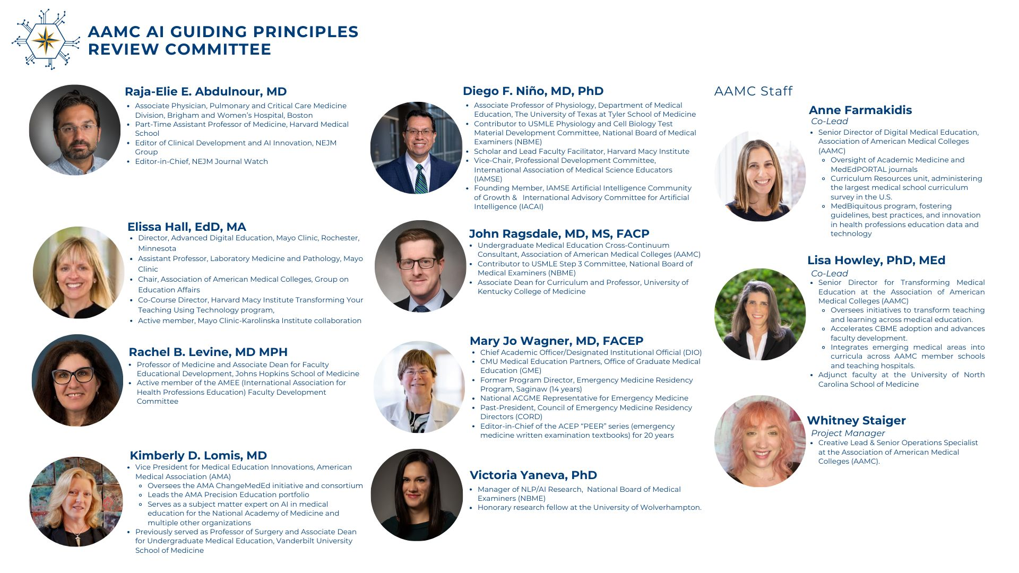
© AAMC
Notes:
The committee that developed the principles

Slide 6

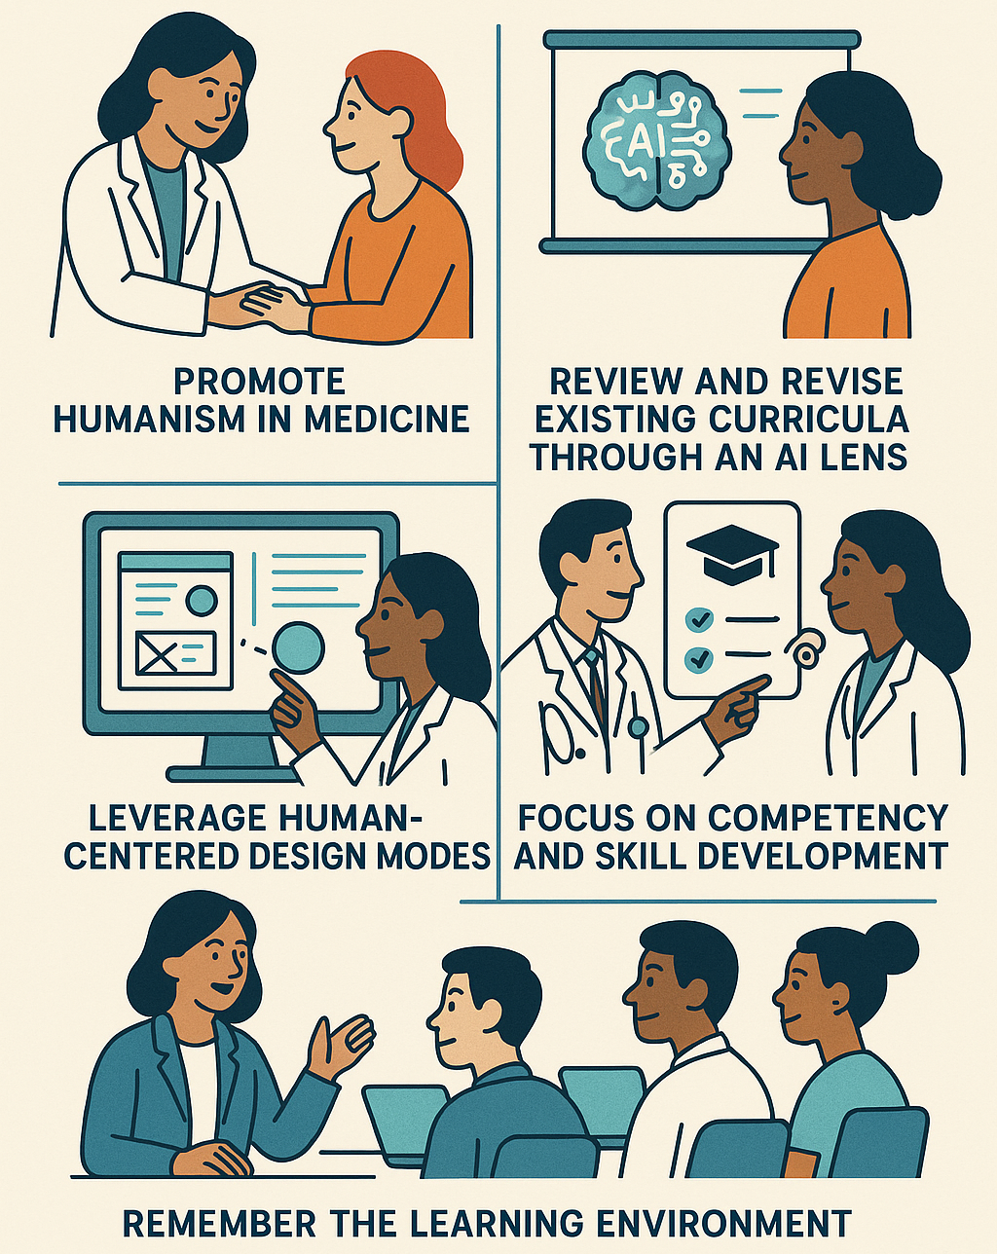
1. Maintain Human-Centered Focus
Promote humanism in medicine
Review and revise existing curricula through an AI lens
Leverage human-centered design models
Focus on competency and skill development
Remember the learning environment
Images generated using Microsoft Copilot and ChatGPT4o
Notes:
On this slide and subsequent, we discuss each principle in turn

Slide 7
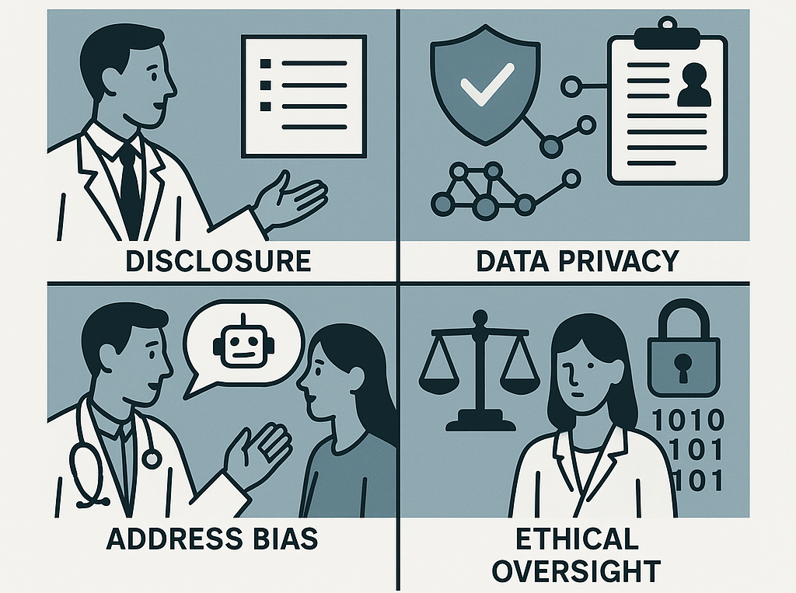
2. Ensure Ethical and Transparent Use
Promote transparency
Establish ethical guardrails and oversight
Educate on ethical and responsible use
Images generated using Microsoft Copilot and ChatGPT4o

Slide 8

3. Provide Equitable Access to AI
Ensure universal access to education and training
Engage learners in the process
Ensure equal access for all learners and educators
Adapt to learner needs
Monitor the process and outcomes
Images generated using Microsoft Copilot and Gemini 2.5 Pro

Slide 9

4. Foster Education, Training, and Continuing Professional Development
Provide access to learning resources
Adopt a competency framework
Review and revise existing programs
Promote diversity in expertise
Create shared resources for national collaboration
Images generated using Microsoft Copilot and ChatGPT4o

Slide 10
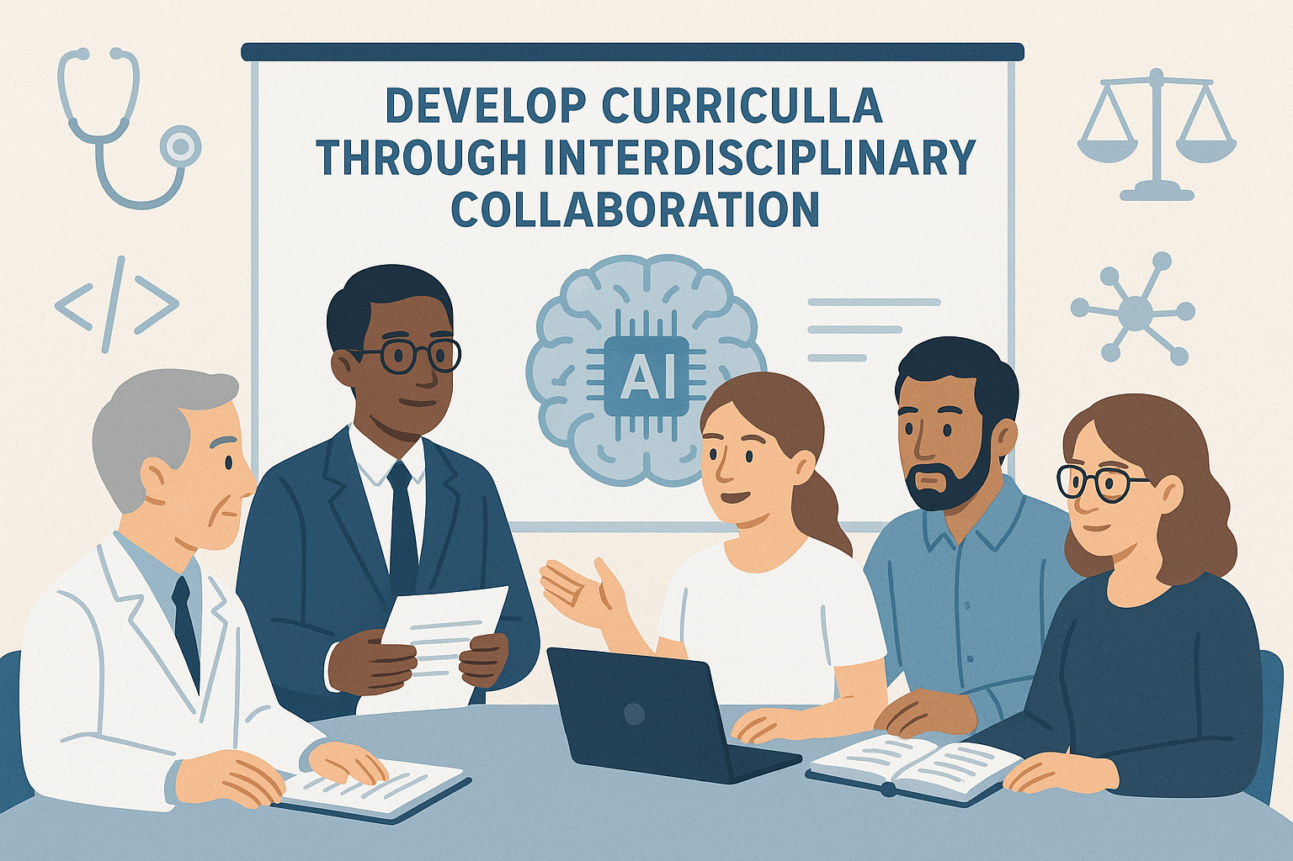
5. Develop Curricula Through Interdisciplinary Collaboration
Include foundational AI literacy in medical education curricula
Develop advanced AI curricula tailored to specialties
Cultivate interdisciplinary collaboration in curriculum design
Identify AI learning needs for team-based care
Develop outcome metrics
Images generated using Microsoft Copilot and ChatGPT4o

Slide 11
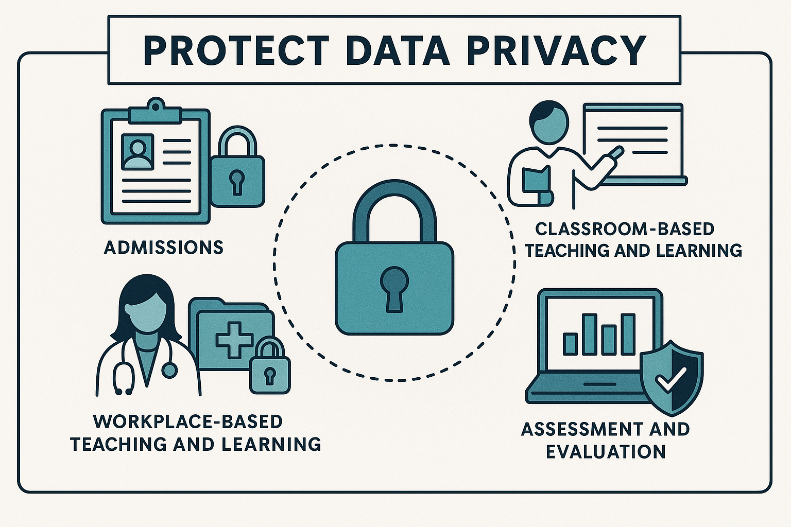
6. Protect Data Privacy
Provide learners access to their data
Teach educators, staff, and learners about data privacy
Ensure compliance with data privacy regulations
Conduct regular audits
Balance data privacy with collaboration
Images generated using Microsoft Copilot and ChatGPT4o

Slide 12

7. Monitor and Evaluate
Implement programmatic assessment for AI tools
Support research in AI evaluation
Gather and appraise diverse sources of evidence
Images generated using Microsoft Copilot and ChatGPT4o

Slide 13
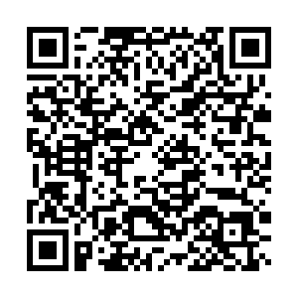
Example of AI Application
Writing Letters of Recommendation for students, residents, and faculty can be time consuming and tedious
How could AI assist with the process?
An approach proposed by this article:
Fried JC, Johnson NR, Pelletier A, Landman A, Bartz D. Using Generative Artificial Intelligence When Writing Letters of Recommendation. Academic Medicine, March 24, 2025.
Notes:
An example to demonstrate how to apply the principles. The example was pulled from the article, which is available at the QR code.

Slide 14
Using AI to Assist with Writing Letters of Recommendation
Two different approaches proposed by the authors:
AI-as-editor
You write the letter, then ask AI to revise it based on goals you provide
AI-as-author
You ask AI to write a draft based on guidelines and information you provide, then you refine it
Notes:
How the article framed approaches for using AI to help with letters of recommendation

Slide 15
Applying the Principles for Responsible Use
Maintain Human-Centered Focus
The letter is ultimately about a person and needs to come from a person (you)
AI is a tool, but you’re actively engaged in the process and have final oversight
Ensure Ethical and Transparent Use
The authors recommend adding a disclosure to the letter about the use of AI
Protect Data Privacy
Only share personal information if it’s a secure AI tool
Can de-identify and then re-identify information if needed
Notes:
One way to apply the principles to this use of AI for medical education (writing letters of recommendation). Ask the audience if they see other examples of how the principles might apply to this situation

Slide 16
Now It’s Your Turn!
In a small group, select 1 of the 3 case studies
Discuss the questions as a group
Focus on the human interactions, rather than on the technology tools
You have 20 minutes
Notes:
Divide the audience into small groups (ideally 3-5 people) and provide these instructions. Distribute the case studies (which can be assigned to groups or you can allow them to choose). Put up the next slide as they begin their discussions.

Slide 17
Principles for the Responsible Use of Artificial Intelligence in and for Medical Education
Maintain Human-Centered Focus
Ensure Ethical and Transparent Use
Provide Equitable Access to AI
Foster Education, Training, and Continuing Professional Development
Develop Curricula Through Interdisciplinary Collaboration
Protect Data Privacy
Monitor and Evaluate
Notes:
Display this slide as the small groups work so that they can be reminded of the 7 principles and have access to the full document.

Slide 18
Now It’s Your Turn!
If you have finished discussing, now consider using an AI tool to analyze the case
Are there any new insights or considerations?
Notes:
At 15 minutes into the small group time (when there is 5 minutes remaining), display this slide and ask the small group to now consider whether an AI tool could help them analyze their case

Slide 19
Let’s Discuss!
“The Case of the MSPE Adventure”
“The Case of the Course Director Feedback Frenzy”
“The Case of the Missing Diagnoses”
Notes:
Ask a representative from each small group to summarize their group’s discussion of their case. If there are multiple groups working on the same case, then you can ask 1 group to present and ask other groups for any additional ideas not covered by the first group.

Slide 20
Applying the Principles for Responsible Use
As we conclude, reflect on:
How can you apply these principles in your own work?
How can you educate faculty, staff, and learners about them?

Slide 21

Workshop Developers
John Ragsdale, MD, MS
Christy K. Boscardin, PhD
Diego F. Niño, MD, PhD
Alexis Rossi, PhD
Lisa Howley, PhD, MEd
Applying the Principles for Artificial Intelligence to Enhance Medical Education ©2025 is licensed under CC BY-NC-SA 4.0. To view a copy of this license, visit https://creativecommons.org/licenses/by-nc-sa/4.0/
Image generated using Microsoft Copilot

