Slide 1
AI Tools for Residents as Teachers
Patrick Buckley, MD, MBA Casey McQuade, MD, MSEd
We have no relevant financial relationships to disclose.

Slide 2
Agenda
DIDACTIC
Role of AI in Medical Education
DEMO
Creating Educational Products with AI
SMALL GROUP
Prototype an Educational Product
LARGE GROUP
Show Off Your Product & Discuss

Slide 3
By Show of Hands…
Notes:
Who is already using generative artificial intelligence tools for teaching? In what capacity?

Slide 4
What is Artificial Intelligence (AI)?
Learning
Reasoning
Perception
Planning
Problem-Solving
Decision-Making
Notes:
Artificial intelligence enables machines to perform tasks typically associated with human intelligence, such as reasoning, planning, and making decisions.

Slide 5
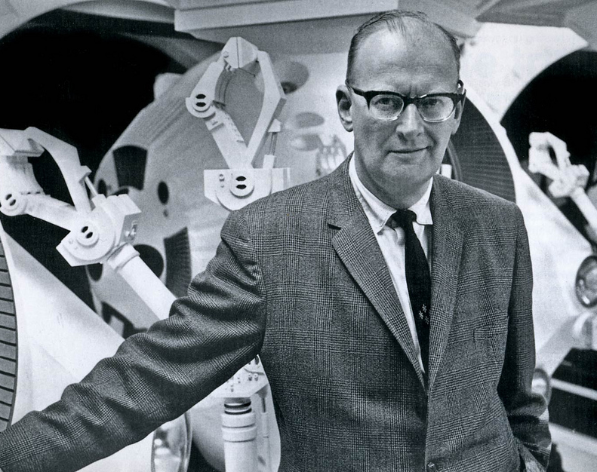
“Any sufficiently advanced technology is indistinguishable from magic.”
Arthur C. Clarke
Notes:
We will not be focusing today on the mechanics of how generative artificial intelligence works. Instead, we will be focusing on how to use these tools to help the learners you work with.
In order to understand the strengths and weaknesses of these tools, though, it is important to know a little bit about how they work. Generative AI tools are built on machine learning models trained on vast amounts of data, enabling them to recognize patterns and generate human-like text, images, or other content. These models predict the most likely next word, sentence, or image detail based on their training, but they do not truly "understand" concepts in the way humans do. As a result, while they can produce highly coherent and creative outputs, they may also generate incorrect or biased information, making critical evaluation essential when using them in education.

Slide 6
RISKS
Hallucinations
Security
Bias
Notes:
Hallucinations: AI tools can generate false or misleading information that appears credible. Users must critically verify outputs before relying on them.
Security: Using AI tools with sensitive data, such as protected health information or student data, can pose privacy risks. AI tools may store or inadvertently expose confidential information.
Bias: AI models can reflect and amplify biases present in their training data, potentially leading to unfair or inaccurate outputs that must be carefully assessed.

Slide 7
Where does AI fit into medical student education?
Notes:
What educational needs are we potentially addressing with AI tools?

Slide 8
Gen Z Learners…
Rely on technology as “digital natives”
Prefer individualized and self-paced teaching
Expect prompt feedback
Appreciate multimodal & blended approaches

Slide 9
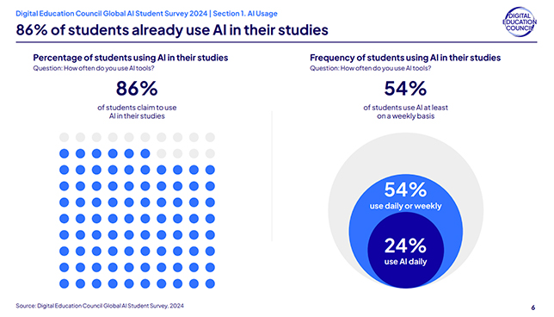
Gen Z Learners Are Already Using AI
Notes:
Survey of 3,839 undergraduate and graduate students across multiple fields of study in 16 countries.

Slide 10
Your Med Students Are Already Using AI
Summarizing lecture notes
Creating Anki flash cards
Generating board-style review questions
Deepening knowledge with interactive explanations
MS1 Students at Pitt Estimate That
80%
Of Their Classmates Regularly Use AI to Study
Notes:
Per unpublished survey data of MS-1 students participating in AI-enabled flipped journal club led by Pat Buckley.

Slide 11
DEMONSTRATION
Using AI Tools to Create Educational Products

Slide 12
SMALL GROUP
Prototype Your Own Educational Tool Using AI
Notes:
Participants will work in small groups to use AI tools to generate new educational tools from their existing materials. Examples could include:
-- Generating lecture handouts or summaries from existing slides
-- Creating a short podcast based on a journal article they regularly give to students. Using this as the foundation for a “flipped” approach where student listens to podcast after clinic and then discusses with preceptor next week
-- Making shelf-style questions to intersperse within a lecture to improve interactivity

Slide 13
LARGE GROUP
Show Off Your Work & Group Discussion

Slide 14
References
Digital Education Council. Global AI Student Survey 2024. Published August 2, 2024. Accessed January 15, 2025. https://www.digitaleducationcouncil.com/post/digital-education-council-global-ai-student-survey-2024
Eckleberry-Hunt J, Lick D, Hunt R. Is Medical Education Ready for Generation Z? J Grad Med Educ. 2018 Aug;10(4):378-381
Patel P. “Meeting the Needs of Generation Z in Medical Education”. ACLGIM Leadership Forum. 2022 May. https://connect.sgim.org/viewdocument/meeting-the-needs-of-generation-z-i
Shorey S, Chan V, Rajendran P, Ang E. Learning styles, preferences and needs of generation Z healthcare students: Scoping review. Nurse Educ Pract. 2021 Nov;57:103247
Walinski CJ, Ontiveros JC, Liu F, Crain G, Vardar-Sengul S. Optimizing teaching effectiveness in dental education for a new generation of learners. J Dent Educ. 2023 Feb;87(2):182-188.

