Slide 1
Harnessing ChatGPT to create Multiple Choice Questions (MCQs)
Kirsten M. Brown
Associate Director, Teaching & Learning Career Development,
GW SMHS Center for Faculty Excellence
Ioannis Koutroulis MD, PhD, MBA
Associate Dean of Admissions
Associate Professor of Pediatrics and Emergency Medicine
GW SMHS
Notes:
Welcome to our faculty development workshop on using ChatGPT to generate multiple choice questions (MCQs). One issue that we have faced our medical curriculum is generating MCQs for teaching and assessment purposes. Therefore, this workshop was designed for our faculty to have practice using AI tools, like ChatGPT, to generate MCQs for their own use

Slide 2
Learning Objectives
Use ChatGPT to create multiple choice questions (MCQs)
Recognize issues bias and accuracy in reviewing ChatGPT-generated MCQs.
Discuss ways that AI-generated MCQs can be used in teaching and assessments.
Notes:
The learning objectives for this workshop are:
Recognize issues bias and accuracy in reviewing ChatGPT-generated MCQs.
Use ChatGPT to create multiple choice questions.
Discuss ways that AI-generated MCQs can be used in teaching and assessments.

Slide 3
Outline
Overview of Topics (30 min)
Practice with ChatGPT and Generating MCQs (10 min)
Discussion of Outputs (10 min)
Next steps to evaluate prompts and outputs with discussion (20 min)
Next steps for using in teaching or assessment with discussion (10 min)
Summary and Final Thoughts (10 min)
Notes:
Here’s an outline with estimated timing for the presentation today. This is a 90 min workshop, with a mix of didactic information, practice, and discussion. Please feel free to ask questions at any time.

Slide 4
What is Artificial Intelligence
Artificial intelligence (AI) refers to a broad range of advanced computational techniques and processes that perform complex tasks.
Key AI technologies include large-language models (LLMs), machine learning (ML), and natural language processing (NLP).
AI can build upon the existing body of literature and traditional techniques by using more advanced mathematical algorithms or models.
This evolution has transformed healthcare and can make AI a powerful tool for educational, research, and academic administrative purposes.
Notes:
First, we want to provide a very brief overview of what artificial intelligence is. AI refers to advanced computational techniques that enable machines to perform complex tasks efficiently. It includes technologies such as Large Language Models that generate context-aware responses, Machine Learning which allows computers to learn from sets of data and Natural Language Processing, which allows computers to understand and respond to human language. AI has revolutionized healthcare and can be a powerful and innovative tool in medical education, research and academic administration.

Slide 5
AI in Medical Education
AI has already been integrated into medical education in several ways¹⁻³:
Curriculum Development: AI allows for personalized learning by adapting to students’ needs and knowledge gaps.
Assessment and Evaluation: AI can assist in generating multiple-choice questions (MCQs), evaluate assays and analyze performance data. It can also be a valuable tool in accreditation with functions such as curriculum mapping and evaluation analysis.
Simulation and Clinical scenarios: AI enables realistic patient simulations and clinical scenarios for training purposes.
Admission and Selection: Many AI-powered tools offer mission-aligned reviews of applications for medical school and residency training, making those processes more efficient.
Administrative Support: AI has the ability to assist with scheduling, grading, and academic planning.
Notes:
AI has already been integrated into medical education in several impactful ways. [ADVANCE SLIDE]
First, in curriculum development, AI enables personalized learning by adapting to students' individual needs and knowledge gaps. [ADVANCE SLIDE]
Second, in assessment and evaluation, AI assists in generating multiple-choice questions, evaluating essays, and analyzing performance data. It also plays a key role in accreditation through curriculum mapping and evaluation analysis. [ADVANCE SLIDE]
Third, AI enhances simulation and clinical scenarios, providing realistic training experiences for medical students. [ADVANCE SLIDE]
Fourth, in admissions and selection, AI-powered tools streamline application reviews for medical school and residency, ensuring mission-aligned and efficient decision-making. [ADVANCE SLIDE]
Lastly, AI supports administrative functions by assisting with scheduling, grading, and academic planning. These applications illustrate the growing role of AI in transforming medical education.

Slide 6
There are ethical issues with Artificial Intelligence (AI)
AI tools, like ChatGPT, have several ethical and equity issues including:
Equity and Bias: They can exacerbate stereotypes for diseases/disorders due to over or underrepresentation in data sets⁴⁻⁶. You need to review all outputs to reduce biases where possible.
Privacy: There are concerns with how data is stored, collected, and used in AI systems and the potential risk to PII (Personally Identifiable Information), PHI (Patient Health Information), and student data (i.e., FERPA)⁶. Be careful about what you decide to put into the algorithms. If you are unsure, ask and/or do not include data.
Accuracy: They cannot guarantee accuracy of information⁶⁻⁷. Therefore, you will need to review all outputs to ensure they are accurate.
Human input and review is still critical for using these systems⁷
You should be informed so you can use ChatGPT and other tools similarly!
Notes:
While there is potential with using AI for academic needs, we also need to address some of the issues with artificial intelligence. These are incredibly broad and we in no way expect to delve into each issue fully before we start working with the tools; however, we want to make sure everyone has a general understanding so they can evaluate the tools, prompts, and outputs critically.
[ADVANCE SLIDE}
Equity and bias: As several authors have demonstrated, these systems can exacerbate biases and stereotypes. This is also a concern for MCQ as we try to generate realistic scenarios that are free of these stereotypes. As we will discuss, you should revie all outputs before using them.
[ADVANCE SLIDE]
Privacy: There are also concerns with how data is stored, collected in used in AI systems. How is risk mitigated? While there are legal guidelines for how PII, PHI, and student data is used, other types of data may not be clear. Say you want to use ChatGPT to write a letter for promotion? Does your institution have guidelines for what to include in AI tools for this? Our general guidelines are to be cautious and ask before you put anything into the tools or algorithms. If you are unsure, do not share the data. This would include things like exam questions, where you are worried about their security.
[ADVANCE SLIDE]
Accuracy: You will absolutely get an output for anything generated with AI. However, there is no guarantee it is accurate. Therefore, like for the biases, you need to review all outputs before use.
[ADVANCE SLIDE}
Above all, human input and review is critical for these systems. You are the most critical part of the process.

Slide 7
There are other issues to consider with AI tools, like ChatGPT
Practice: Using AI to create MCQs will take practice⁸. You will likely not get it right the first try.
Cost: ChatGPT has different pricing model⁹. The free version has a limit for how many prompts you can run during a given period of time. You may want to consider the monthly version if you find yourself using it more frequently.
Notes:
There are additional issues to consider with using AI tools like ChatGPT
Practice: Engineering the right prompt will take practice. You will likely not get it correct the first time. We continually practice with prompts to get them “just right” for their use.
There are costs associated with AI systems. Your institution may or may not have licensing with specific tools. ChatGPT has different pricing models. While there is a free version, you have a limit for how many prompts you can run in a given period of time. If you find yourself using a particular system frequently, you may want to investigate licensing options.

Slide 8
Using ChatGPT to Create Multiple Choice Questions
Notes:
Now that we’ve provided an introduction to AI and some of the ethical issues, let’s consider its role in creating multiple choice questions.

Slide 9
Why use ChatGPT to create MCQs?
MCQs are a cornerstone of assessment in medical education.
Because tests have such a powerful influence on student learning, tests should be properly aligned with educational goals and objectives¹⁰.
However, creating effective MCQs is a time-intensive process.
Previous work has demonstrated ChatGPT performed at near the passing threshold of 60% for USMLE-style questions, identifying the potential in using AI tools for reducing some of that time and cognitive load for creating questions¹¹.
Notes:
Why would we want to use ChatGPT to create MCQs, particularly USMLE-style ones? First, we know that MCQs are a cornerstone of assessment in medical education. [ADVANCE SLIDE]
We also know that test have a powerful influence on student learning. Therefore, best practice indicates that we need to align items with objectives to hopefully maximize student learning. [ADVANCE SLIDE]
However, creating effective MCQs is a time intensive process. There’s a reason there are workshop for item writers for USMLE exams – it takes time to develop the questions! [ADVANCE SLIDE]
Previous work has demonstrated that ChatGPT performed at a near passing threshold in correctly answering USMLE-style questions. If they can answer the questions, they should be able to write them, right? That is what the authors suggested - that AI tools have the potential to assist in MCQ generation, thereby reducing the human time and cognitive load/

Slide 10
Anatomy of an USMLE-style MCQ
Stem:
The introduction
Sets the scenario and includes patient vignette
Could also include images or figures
Lead-In: The actual question being asked
Responses:
Answer choices
Distractors: Incorrect answer choices
Notes:
Before we jump into ChatGPT examples, I want to make sure everyone knows the general anatomy of a USMLE-style MCQ. USMLE-style MCQs have a very particular format. It includes the stem, which is most commonly the patient vignette. It introduces the scenario and provides relevant foundational and clinical science information. It may also include images, like a radiograph, our figures and charts. [ADVANCE SLIDE]
The lead-in the is question being asked. We will see how we can change these in the ChatGPT prompt to get different MCQs. [ADVANCE SLIDE]
Finally, the responses are the answer choices, including the correct answer and realistic distractors.
Each of our examples from literature has included these sections in their prompt.

Slide 11
Using ChatGPT to Write MCQs: General Tips
Find an existing peer-reviewed (if possible) format to practice. This can eliminate a lot of the trial and error associated with developing the perfect prompt
Example #1: Stadler and authors “Crafting medical MCQs with generative AI: A how-to guide on leveraging ChatGPT”¹²
Example #2: Kıyak’s “ChatGPT Prompt for Writing Case-Based Multiple-Choice Questions.”¹³
Follow existing best-practices for item creation. Consider using the guidance from the NBME Item-Writing Guide: Constructing Written Test for the Health Sciences¹⁻
In addition to general tips, this resource has examples of lead-ins for your prompt to narrow down what you want the MCQ to focus on
Also contains “Guidelines for Item Writers on the Use of Patient Characteristics (PC)” (page 45), which will be helpful in recognizing biases in outputs
Notes:
If you’re here, then you likely to want to see how we can connect the dots from USMLE-style MCQ and ChatGPT. Here are some general tips:
First, find an existing peer-reviewed description. The most challenging part of this exercise is likely to be the prompt, or what you put into ChatGPT. Thankfully, we have found two similar examples that follow the USMLE-formats.
The first is from Stadler and Authors and is titled, “Crafting medical MCQs with generative AI: A how-to guide on leveraging ChatGPT.”
The second is from Kıyak, and is titled, “ChatGPT Prompt for Writing Case-Based Multiple-Choice Questions.”
[ADVANCE SLIDE]
Second, regardless of your prompt, remember to follow existing best-practices for item writing. The NBME has an extensive document that we use at our institution to help guide faculty.
Not only does it have general tips, but it has many lead-ins to choose from. For example, do you want to your prompt to focus on identification of a location for lesion? Or how about selecting the next step in management? We will see some of these examples shortly.
Additionally, the guide has specific guidance on use of patient characteristics in MCQs. One of the decisions you can make is whether to include these or not in the vignette, particularly as they can in results in stereotypes or biases. Both of the examples have that information, but you can remove it. We will talk more about this.

Slide 12
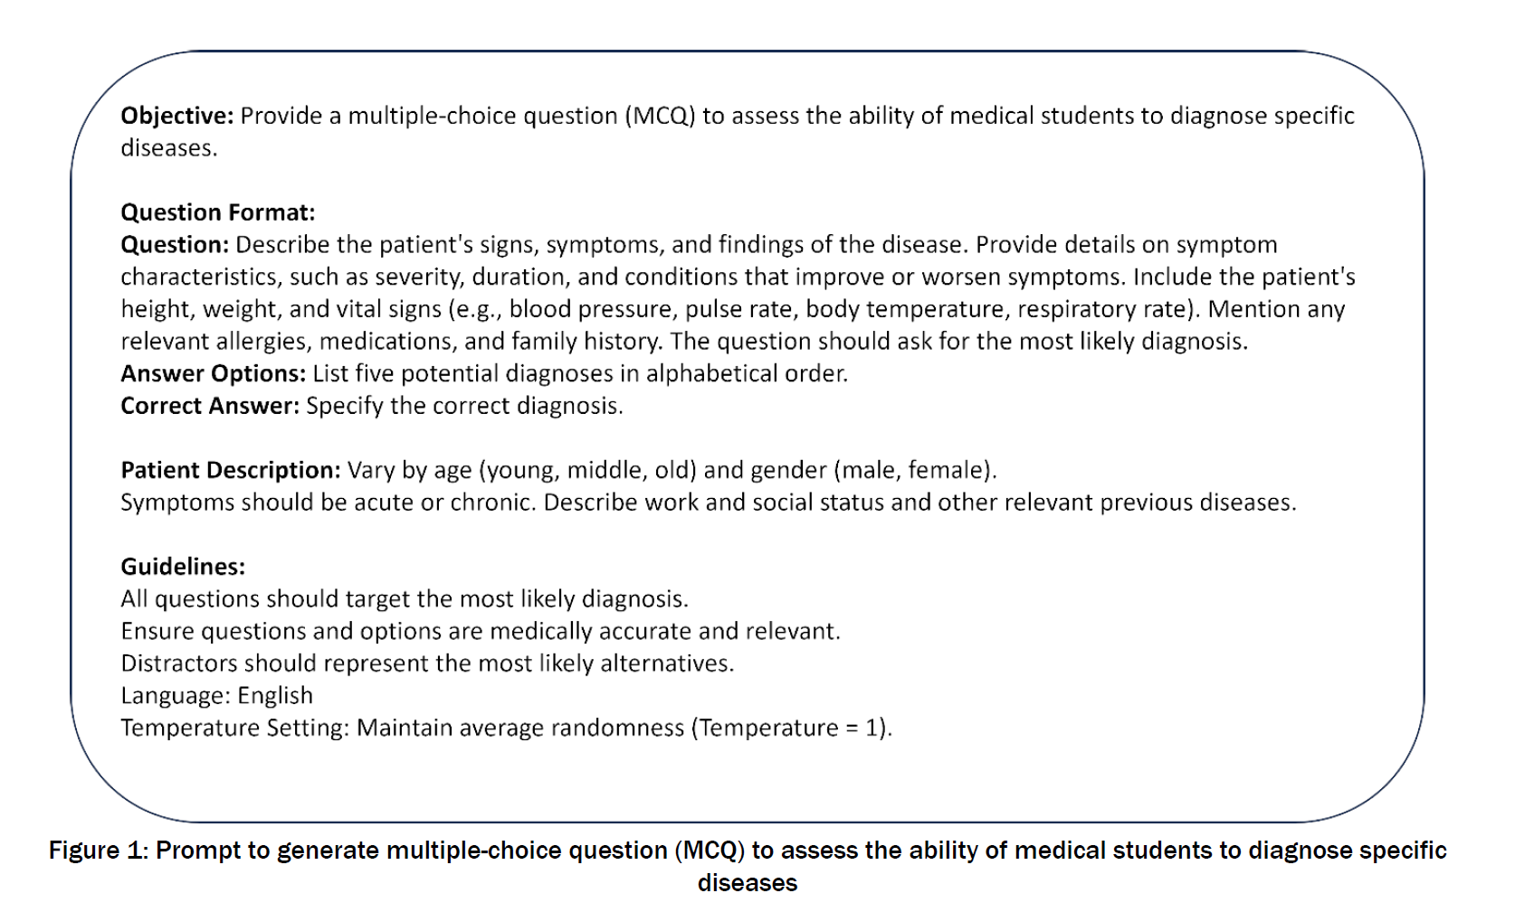
Using ChatGPT to Write MCQs: Stadler and authors¹²
Notes:
Let’s see how we can use ChatGPT to help us create “anatomically” correct MCQs! This is a screenshot of Stadler and authors 2024 paper outlining a prompt for generated USMLE-style MCQs using ChatGPT. The original prompt contains several sections: Objective: Creates the primary goal of the prompt.
Question Format: Provides the blueprint for how your question will appear. Included in here are patient signs, symptoms, vital signs, and other relevant medical history. You may choose to include all of this information or not. The section also includes how you want the answer options to display and if the correct answer is indicated.
Patient Description: Creates the backdrop for varying patient characteristics that you may want to include or not.
Guidelines: Think of this as the quality control portion of the prompt, including accuracy, realistic distractors, and targeted answers. Temperature is balance between predictability and randomness. Increased temperature means increased randomness and may lead for very unrealistic outputs. Lower temperatures are more likely to have similar outputs based on predictive models.
Any and all of these sections are editable depending upon your needs.

Slide 13
Additional Modifications from a USMLE Question Writer
and social
(infant/child, young adult, elderly)
when applicable
For rationale, provide reasons for incorrect and correct options.
Notes:
Dr. Koutroulis previously served as a USMLE question writer, and based on his experiences we have tailored the prompt to be more reflective of that format. Additional edits we suggested include:
[ADVANCE SLIDE}
Removing allergies and medications
[ADVANCE SLIDE}
Clarifying family AND social history
[ADVANCE SLIDE}
Clarifying age ranges to be infant/child, young adult elderly)
[ADVANCE SLIDE}
Removing categories for gender
[ADVANCE SLIDE}
Adding “when applicable” to work
[ADVANCE SLIDE}
Removing “any other relevant previous diseases”
[ADVANCE SLIDE}
Specifying rationales for incorrect and correct options.

Slide 14
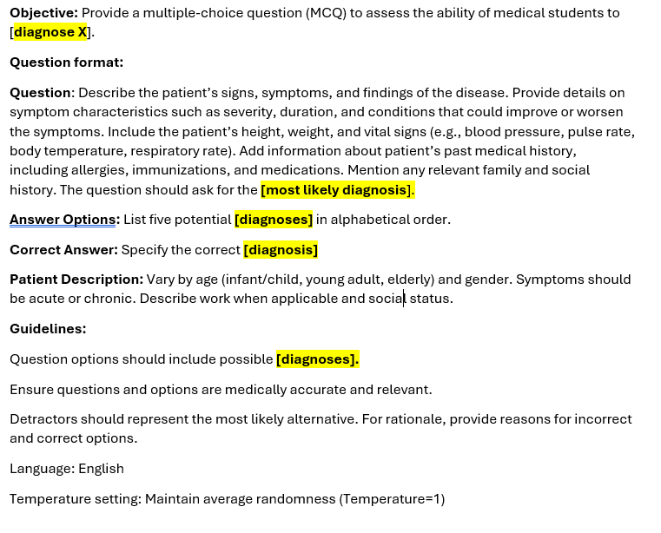
Updated Stadler and authors¹² MCQ Prompt
Notes:
Here is the updated version of the prompt with the changes made. This is the format we will be using moving forward.

Slide 15
What if I want an stem besides most likely diagnosis?
Several areas to edit:
Objective
Format
Guidelines
Notes:
Stadler and authors’ original example was focused on most likely diagnosis. Note that this is reinforced in the objective, format, and guidelines. We have bolded and highlighted those areas you need to be changed if you want a different lead-in.

Slide 16
What are some good lead-ins for the Foundational Sciences¹⁰?
Which of the following is the most likely infectious agent?
Which of the following is the most likely explanation for these findings?
Which of the following is the most likely location of this patient’s lesion?
A biopsy specimen is most likely to show which of the following?
This patient most likely has a defect in which of the following?
Which of the following structures is at greatest risk for damage during this procedure?
Which of the following is the most likely pathogen?
Notes:
If you want to change the lead-in, what are some other lead-ins that might be useful for you? Here are a few from the NBME Writing Guide for the Foudational Sciences. This is only a preview of several commonly used lead-ins, so be sure to refer to the document for more information

Slide 17
What are some good lead-ins for Clinical Application¹⁰?
Obtaining and Predicting History and Physical Examination
Which of the following factors in this patient’s history most increased her risk for developing this condition?
Which of the following additional information regarding this patient’s history is most appropriate to obtain at this time?
Selecting and Interpreting Diagnostic Studies
Which of the following is the most appropriate diagnostic study to obtain at this time?
Which of the following laboratory studies is most likely to confirm the diagnosis?
Which of the following is the most likely explanation for these laboratory findings?
Notes:
Here are a few from the NBME Writing Guide for Clinical Application. Note that this section is subdivided into several sections, including questions related to History and Physical Examination and Selecting and Intepreting Diagnostic Studies. This is only a preview of several commonly used lead-ins, so be sure to refer to the document for more information.

Slide 18
What are some good lead-ins for Clinical Application¹⁰?
Management
Which of the following is the most appropriate screening test?
Which of the following tests would have predicted these findings?
Which of the following is the most appropriate intervention?
For which of the following conditions is this patient at greatest risk?
Pharmacotherapy/Clinical Interventions and Treatments
Which of the following is the most appropriate initial or next step in patient care?
Which of the following is the most appropriate management?
Notes:
Finally, here are additional lead-ins for Clinical Application related to Management and Pharmacotherapy and Treatment.
You have so many options to generate MCQs! But you need to be thoughtful about what to include.

Slide 19
Changing the Prompt: Modifying the Lead-In
Overall Focus | Objective | Format | Guidelines
Diagnosis | “to diagnose X” | The question should ask for the most likely diagnosis. Answer options: List five potential diagnoses Correct Answer: Specify the correct diagnosis | Question options should include possible diagnoses.
Pathological findings | “to identify pathological findings in a patient with X” | The question should ask for the most likely to be found in this patient upon biopsy. Answer options: List five potential pathological findings Correct Answer: Specify the correct finding. | Question options should include possible pathological findings.
Selecting a diagnostic study | “ to select a diagnostic study confirming X” | The question should ask which of the following is the most appropriate diagnostic study to obtain at this time? Answer options: List five potential diagnostic studies Correct Answer: Specify the correct study. | Question options should include possible diagnostic studies.
Mechanism of action | “to identify mechanism of action for drugs used to treat X” | The question should ask which of the following is the most appropriate medication for this patient will have which of the following mechanisms of action? Answer options: List five potential mechanisms of actions Correct Answer: Specify the correct mechanism of action: | Question options should include possible mechanisms of action for treatment.
Notes:
As we alluded to earlier, if you choose to use a different lead-in (which we encourage!), you’ll need to edit the prompt. This is a table illustrating how we have edited the prompt to focus on a different lead in for each row in the table. Bolded terms indicate where changes need to be made in each section.
Diagnosis: The original lead-in from Stadler and authors.
Pathological findings: An updated prompt focus on description of pathological findings, such as in a biopsy. Note that format is specific to “findings upon biopsy” and answer choices are adjusted. Guidelines have been updated.
Diagnostic study: An updated prompt focus on selecting diagnostic study, such as MRI or other imaging modality.. Note that format is specific to “most appropriate diagnostic study to obtain.” Answer choices are adjusted to reflect new focus and guidelines have been updated.
Mechanism of action: An updated on the correct mechanism of action for a treatment option. Again, the format is focused around “the following mechanism of action.” Answer choices are adjusted to reflect new focus and guidelines have been updated.

Slide 20
Practice on your own!
Notes:
Now that we’ve gone over the format, you should practice on your own. Because the prompt is rather long and there are multiple changes needed, we’ve provided some standard prompts for you to copy and paste into ChatGPT in the attached handout. The first example, is the original prompt focusing on a diagnosis. Notice the bolded and highlighted text reinforces sections that may need to be changed.
Please take a few minutes to practice with the prompt.

Slide 21
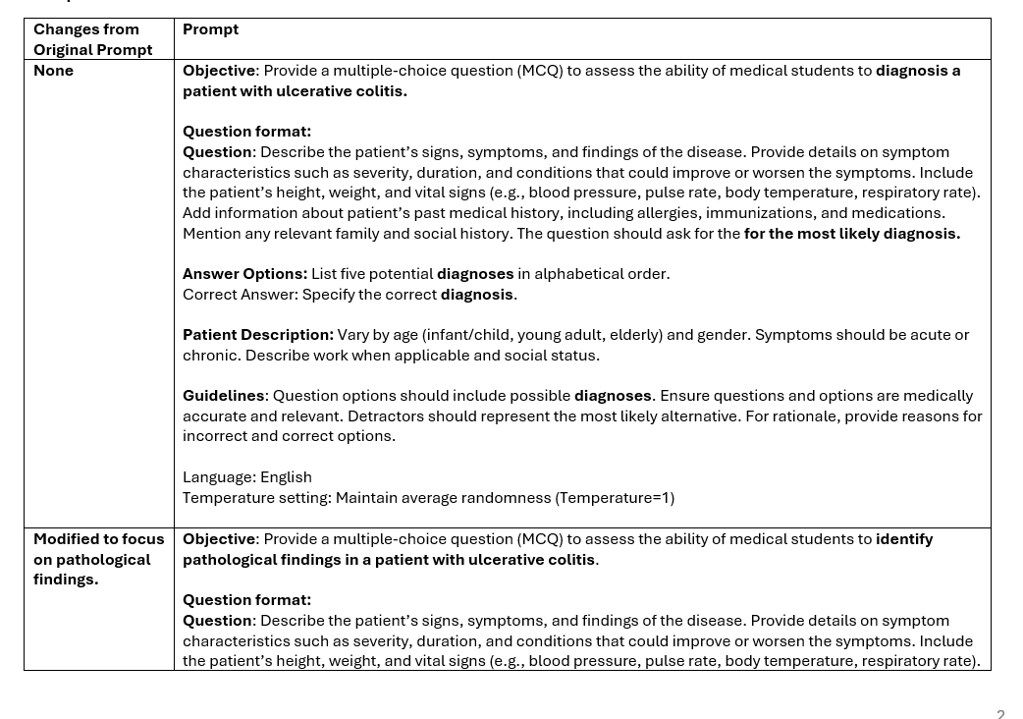
Practice on your own!
Notes:
To facilitate your ability to edit the prompt and refocus the MCQ around a new lead-in, we have also created several examples so you can see the changes in total. For these, the prompt is rather long and there are multiple changes needed, we’ve provided some standard prompts for you to copy and past into ChatGPT in the handout. Please note that these were created around a patient with ulcerative colitis. You are free to select any disease or disorder you like.
For each row in the table., we have provided the modification (i.e., changes to lead-in) and bolded text where changes had to be made from the original prompt. There are prompts for:
Pathological findings
Selecting a diagnostic study
Focusing on a mechanism of action of a drug
Selecting management
As discussed in the beginning of this workshop, ChatGPT does not guarantee the accuracy of the output. Therefore, for each prompt you run, you’ll need to critically assess the output. We will talk more about that shortly.
Please take a few minutes to practice with the new prompt modifications.

Slide 22
Let’s Generate an MCQ- Gross Anatomy Prompt
Objective: Provide a multiple-choice question (MCQ) to assess the ability of medical students to identify upper limb nerve injuries.
Question format:
Question: Describe the patient’s signs, symptoms, and findings of the disease. Provide details on symptom characteristics such as severity, duration, and conditions that could improve or worsen the symptoms. Include the patient’s height, weight, and vital signs (e.g., blood pressure, pulse rate, body temperature, respiratory rate). Add information about patient’s past medical history, including allergies, immunizations, and medications. Mention any relevant family and social history. The question should ask which of the following structures is most likely damaged?
Answer Options: List five potential anatomical structures in alphabetical order.
Correct Answer: Specify the correct structure
Patient Description: Vary by age (infant/child, young adult, elderly) and gender. Symptoms should be acute or chronic. Describe work when applicable and social status.
Guidelines: Question options should include possible anatomical structures. Ensure questions and options are medically accurate and relevant. Detractors should represent the most likely alternative. For rationale, provide reasons for incorrect and correct options.
Language: English
Temperature setting: Maintain average randomness (Temperature=1)
Notes:
Here’s an example of how we used the format to create a MCQ focused on gross anatomy, specifically upper limb nerve injuries. In the example, we decided to not to include height, weight, and vital signs to simplify the question. We also did not want to include patient description to narrow the focus of the question to form and dysfunction. The updated the lead-in focuses on most likely damaged structure. Answer options and guidelines were similarly updated.
We will quickly review this output in the next section.

Slide 23
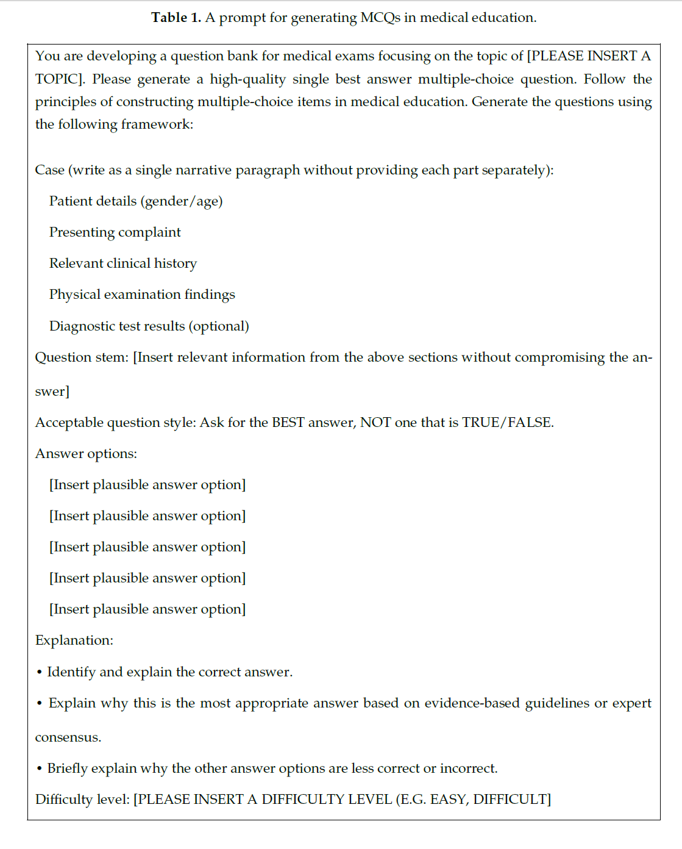
Using ChatGPT to Write MCQs: Kıyak¹³ Format
Two things to edit:
1. [PLEASE INSERT A TOPIC]
2. [PLEASE INSERT A DIFFICULTY LEVEL (E.G. EASY, DIFFICULT)
Notes:
Kıyak has also provided an additional format of developing USMLE-style MCQs. The above is a screenshot of the original prompt. Kıyak’s format has many of the same sections as Stadler and authors, including the objective, where you provide the goal for the prompt. It also has sections for patient history, tests, and answer choice selections.
Compared to Stadler and authors, Kıyak’s format only has you edit two sections as underlined in teal:
Objective: This is where you specific the topic of interest for the MCQ.
Difficulty: Allows you to create easier or harder MCQs.

Slide 24
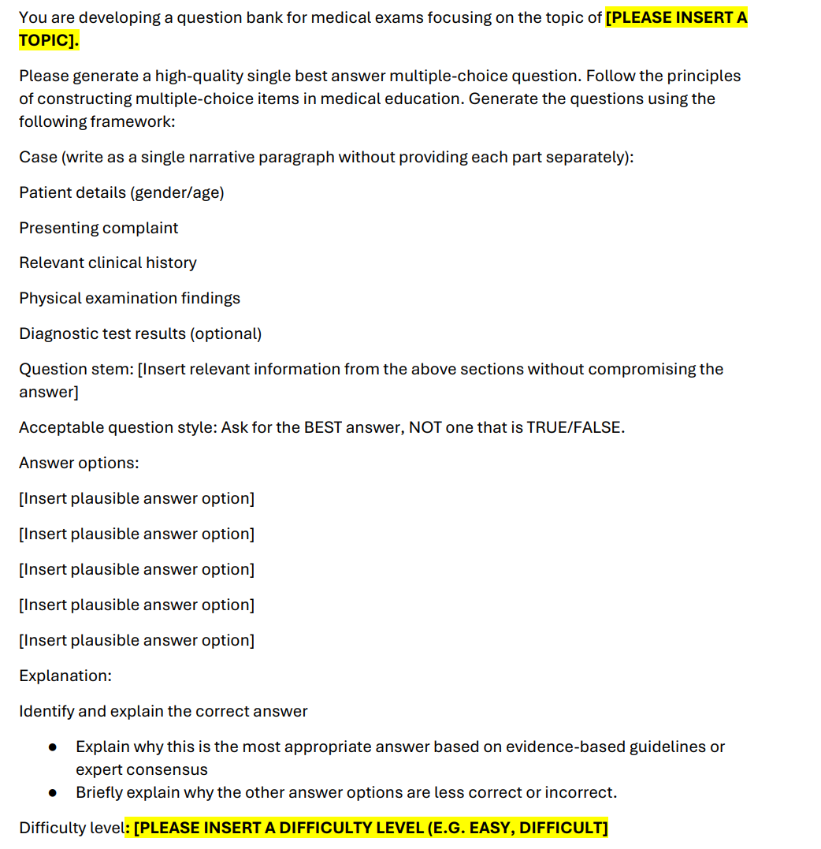
Practice on your own!
Notes:
Now that we’ve gone over the format, you should practice on your own. Because the prompt is rather long, we’ve provided the standard prompt for you to copy and paste into ChatGPT in the attached handout. The first example, is the original prompt focusing on a diagnosis. Notice the bolded and highlighted text reinforces sections that may need to be changed.
Please take a few minutes to practice with the prompt.

Slide 25
Let’s Generate an MCQ- Neuroanatomy
topic of spinal cord anatomy
EASY
Notes:
We generated a prompt based on the same format provided. We chose neuroanatomy at an easy level because Dr. Brown teaches the content to first- and second-year medical students. Everything else we kept the same.
We will go over next steps shortly.

Slide 26
Comparison of MCQ Formats
 | Stadler et al. Format | Kıyak Format
General | Specifics for objective, question format, patient description, and guidelines | Specifics for topic, case, question stem, acceptable question style, answer options, explanation, and difficulty
Modifiable sections | Objective, question format, and guidelines (adapted to lean-in) | Topic and difficulty only
Potential challenges to implement | Numerous requirements to change modifiable sections Need to evaluate outputs for accuracy and biases | Getting the topic correct to generate an output for usage Need to evaluate outputs for accuracy and biases
Notes:
This is just a table comparing the two formats, emphasizing the general format of the prompt, the modifiable sections, and our experienced challenges to implement.

Slide 27
Next Steps in Using your MCQs
Notes:
So you have a ChatGPT-created MCQ. Now what do you do?

Slide 28
What should I do next with my prompt or output?
Step 1: Review the Output
Is output accurate?⁶⁻⁷
Have other content experts review your output
Does output include harmful biases or stereotypes?⁴⁻⁶
Have other content experts review your output to assess.
Is output reflective of your content, course, program?
There is a possibility that the MCQ, its vignette, or answer choices may contain information that has not been covered in your session, course, or program, as the final output is likely cumulative over a total body of knowledge
Make sure the MCQ is aligned with the content taught
Is output reflective of the educational goals?
Make sure the MCQ meets the objectives you have you determined for your session, course, or program.
If it is assessed, it should be linked to an objective
If your MCQ fails to meet these, move to Step 2
Notes:
As we discussed in the introduction, there are ethical issues with AI outputs. You want to review all output before you consider using them. If at any point your MCQ fails to meet these questions, you should consider moving to Step 2 (Editing Prompt) and Step 3 (Editing Output).
Is it accurate? While you can assess some accuracy you should get other content experts to review for anything you may have missed. [ADVANCE SLIDE]
Does it include harmful biases or stereotypes? Having multiple reviewers can help identify these issues, if they are present. [ADVANCE SLIDE]
Is it reflective of your content, course, or program? AI algorithms are collating multiple resources together to generate output. You can think of it as a cumulative body of knowledge, much like the USMLE assessments. As an educator, it is important to know that the MCQ may not be aligned directly with the content. That means the patient vignette or answer options may include content that is not reflective of you needs. As an example, you could develop a prompt for the most likely diagnosis for a disorder. The answer options presents distractors that you know your learners have not covered yet. Therefore, you need to determine whether, even if the MCQ is accurate and does not contain biases, is it appropriate for your use? [ADVANCE SLIDE]
Similarly, is it reflective of the educational goals? The objectives, assessments, and content should all be aligned. If it’s important enough to test it, then it should be reflected in objectives and content taught. . [ADVANCE SLIDE]
If there are concerns with any of these when you review your output, you should move to Step 2.

Slide 29
Let’s Generate an MCQ- Gross Anatomy Output
A 35-year-old male presents to the emergency department after a fall from a ladder onto his outstretched hand. He reports immediate pain and weakness in his right hand. On examination, he has difficulty extending his wrist and fingers, resulting in a wrist drop. Sensory testing reveals diminished sensation over the dorsum of the hand and the first dorsal web space. Reflex testing shows a normal biceps reflex but a weakened triceps reflex. His past medical history is unremarkable, with no known drug allergies. He works as an electrician and denies smoking or alcohol use.
Which of the following structures is most likely damaged?
A) Axillary nerve B) Median nerve **C) Radial nerve*** D) Ulnar nerve E) Upper trunk of the brachial plexus
Rationales:
Axillary nerve (A): Injury to the axillary nerve would primarily cause deltoid and teres minor weakness, leading to impaired shoulder abduction and a loss of sensation over the lateral shoulder.
Median nerve (B): Median nerve damage would result in thenar muscle weakness, loss of thumb opposition, and sensory deficits in the
Radial nerve (C): The patient's presentation of wrist drop, weakness in wrist and finger extension, and sensory loss over the dorsum of the hand strongly suggests radial nerve injury. The weakened triceps reflex suggests involvement of the nerve proximal to the elbow, likely in the midshaft humerus region. This is consistent with a humeral shaft fracture leading to radial nerve palsy.
Ulnar nerve (D): Ulnar nerve injury leads to weakness in intrinsic hand muscles, claw hand deformity, and sensory loss in the medial hand and digits 4-5.
Upper trunk of the brachial plexus (E): Damage here would cause Erb-Duchenne palsy, leading to a "waiter’s tip" posture due to weakness in the deltoid, biceps, and brachialis.
Notes:
Here’s our output from her prompt on upper limb injuries. Recall that we removed most patient characteristics, including vital signs and patient description. The vignette is focused on anatomy and sensory and motor deficits, which is appropriate Dr. Brown’s needs teaching 1st and 2nd year medical students anatomy. The answer options are realistic and the rationales are appropriate. Upon quick review it is okay. However, Dr. Brown would still have peers, both foundational and clinical science, review the output to ensure accuracy and minimize any biases.

Slide 30
Discussion Break
Based on a quick review,
What, if any, issues do you see in your initial MCQ output?
Notes:
After practicing with prompts, what if any issues do you see in your initial outputs?

Slide 31
What should I do next with my prompt or output?
Step 2: Edit the Prompt
Edit the lead-in
Instead of focusing on most likely diagnosis, consider next step in management or a different lead-in
Edit the difficulty or guidelines
Edit the background specifics
Disease severity (mild to moderate vs. severe)
Patient Characteristics¹⁰: Age, sex, gender, etc. if necessary and pertinent.
“Health professionals and educators creating assessments should follow guidelines that encourage thoughtful consideration of including patient characteristics, while at the same time strive to promote diversity and present patients who reflect the population served by your examinees.” (page 43)
See the Guidelines for Item Writers on the Use of Patient Characteristics (PC) on page 45.
If your MCQ fails to fully meet your needs after editing and
running the prompt again, move to step 3.
Notes:
If you identified issues in your output, you can consider editing the prompt as an option and Step 2 in the evaluation process. Remember that it will take practice to get the right output, so you can rerun the prompt with edits if necessary. Things you may want to consider:
Edit the lead-in: Perhaps your output wasn’t exactly what you were looking for. Maybe you want a different lead-in to better direct ChatGPT for your output. [ADVANCE SLIDE]
Edit the difficulty guidelines: Perhaps the output was too easy or too hard. Alternatively, maybe you need more guidance for the question format or answer choices. [ADVANCE SLIDE]
Edit the background specifics:
When we tested out the formats, we found the MCQs defaulted to mild to moderate disease state. Perhaps you want to focus on more severe disease state. You can specify that in the prompt.
This is also a perfect opportunity to determine what specific patient characteristics you should include. The original prompts we provided included standard language for that. However, we have discussed AI algorithms have the potential to introduce biases and stereotypes into their output, including for diseases and disorders.
In editing the prompt, consider the guidance provided by the NBME, “Health professionals and educators creating assessments should follow guidelines that encourage thoughtful consideration of including patient characteristics, while at the same time strive to promote diversity and present patients who reflect the population served by your examinees.”
If the characteristics aren’t necessary and pertinent to the MCQ, then you may want to remove them.
The NBME has an excellent flowchart to help you navigate this issue on page 45.
[ADVANCE SLIDE]
Once you make you edits, run the prompt again. Review the output as before. If you still are not getting the output you’re looking for, move to step 3.

Slide 32
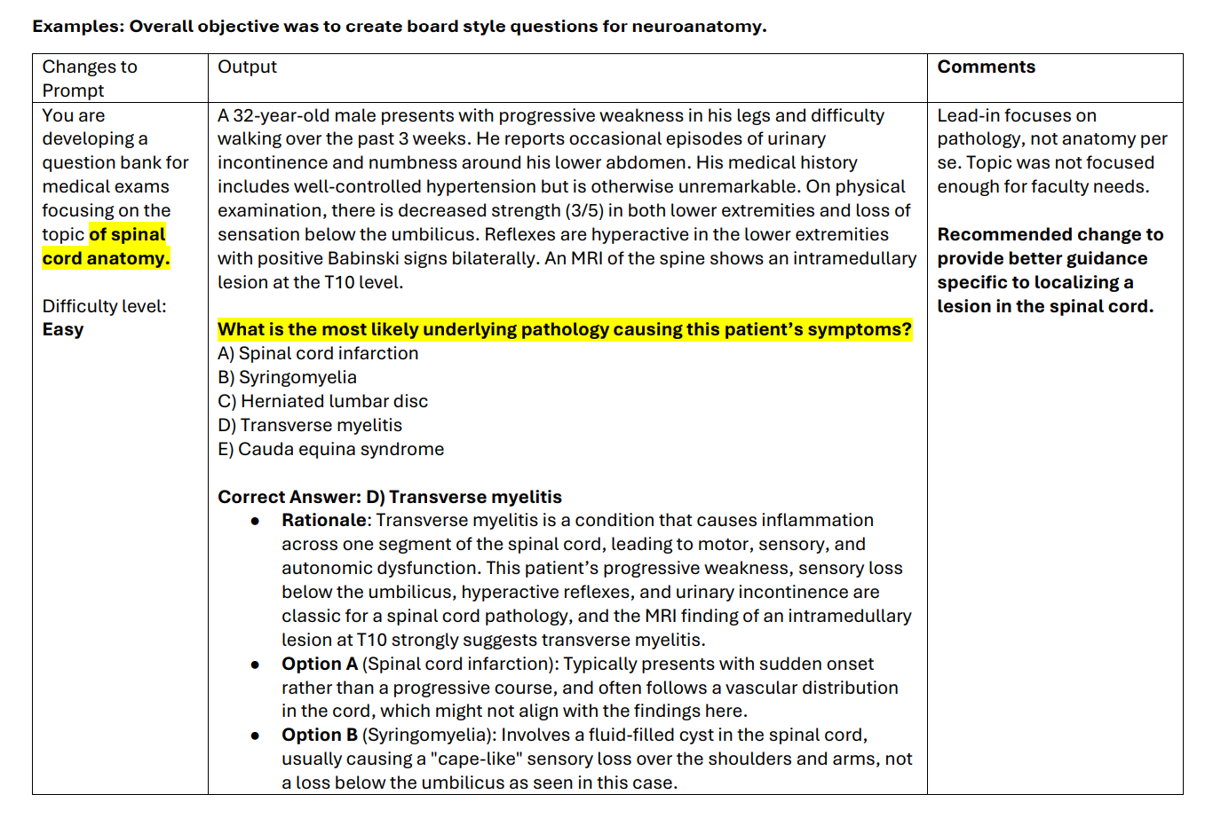
Let’s Generate an MCQ- Neuroanatomy Output
Notes:
Here’s an example of editing the prompt after an output review. This example uses the Kıyak format described earlier. Based on our experience, while the format was easy to use, generating the topic for the MCQ was slightly more difficult compared to Stadler and colleagues’ format. In the example provided in the handout, Dr. Brown attempted to create a MCQ around spinal cord anatomy. While the output was related, the initial topic she requested was not specific enough for her needs of neuroanatomy. The current output included neuroanatomy content, but was more clinically-focused than she was looking for. When editing the prompt to focus on “localizing a lesion within the spinal cord,” the output was more appropriate (see handout). Similar to the previous example, Dr. Brown would still have peers review the question for accuracy and biases.
We presented this to illustrate the point we made earlier: getting the right prompt is perhaps the most challenging part of working with AI tools like ChatGPT. You will likely have to practice with them, even if you have formats.

Slide 33
Discussion Break
Based on a quick review,
what, if any, changes do you want to make in your prompt?
Notes:
After reviewing outputs, what changes, if any, do you want to make to your prompt?

Slide 34
What should I do next with my prompt or output?
Step 3: Edit the Output
Change lead-in and answers if not relevant or not appropriate
Since you already have a vignette, you can adapt the lead-in and corresponding answer choices
This may be appropriate if you are concerned about the answers choices not being reflective of content taught
Edit background (history, testing, etc.) if not relevant
Be careful that you’re not removing critical information to answer the MCQ
Continue with peer review by content experts
Add on to the MCQ
USMLE-style questions also include figures, charts, and images
If these are appropriate for your content, considering adding these to the output
You are not required to use the original output. Be creative!
Notes:
Sometimes the easiest step is to simply edit the output! ChatGPT already did a lot of work for you in creating a template. But as content expert, you can take creative license to make the MCQ more appropriate for your needs, content, course, etc. You may want to consider the following changes:
If you already have a well-written vignette, consider changing the lead-in and answer to create a whole new question. This allows to you make sure the MCQ adequately addresses your content and objectives. You can also consider getting more bang for your buck so to speak. With one prompt you can edit the output and generate many different MCQs that can be used formatively and summatively. [ADVANCE SLIDE]
If the background information including patient characteristics are not necessary, you can remove them. Be sure that you’re not removing critical information to answer the question. Continue with peer review by content experts [ADVANCE SLIDE]
One thing the prompt formats we provided did not include was additional information, like images, figures, charts, etc. USMLE-style question include a variety of these in their vignettes or answer choices so considering adding them to the output.
[ADVANCE SLIDE}
Above all be creative! You are not required to use the original prompt.

Slide 35
Discussion Break
Based on a quick review,
what changes, if any, do you want to make in your output?
Notes:
What, if any, changes do you want to make in your output?

Slide 36
Next Steps in Using MCQs in Teaching and Assessments
Notes:
Now that you’ve generated some MCQs, what can you do with them? We will briefly discuss tips for integrating them in teaching or assessments.

Slide 37
How can I use the MCQs in my teaching?
Educator Developed MCQs
Have learners…
Answer questions in groups in class
Create their own rationales if you provide them with answer choices
Reanalyze the MCQ by changing the lead-in or vignette during a class
Original MCQ asks for likely diagnosis. You follow up with management, or treatment.
Original MCQ asks for mild to moderate management. You follow up with severe management.
Learner-Developed MCQs
Have learners…
Write their own prompts to create MCQs
Follow Steps 2-3 for evaluating prompt and outputs
Is this accurate? Does this have any include harmful biases or stereotypes?
Is it reflective of our current content coverage?
Do we need to edit anything or add images, figures, graphs, etc.?
Notes:
You can consider MCQs in two related areas for teaching: Ones that you generated and have learners use OR ones that maybe learners generate. The former are likely techniques you are already using!
For Educator-Developed MCQs like we’ve been working on:
You can use these MCQs formatively in a group or class setting. In this case you could provide the MCQ and answer options, and they could answer. You would then review the correct and incorrect answers.
Alternatively, you could do the exercise can have them provide the rationales.
Finally, you can be flexible in class and change the lead-in for the vignette. As an example, learners could answer an original question on diagnosis, and you follow up with management or treatment. can you could ask about mild to moderate disease management and then query learners how that differs for severe disease management.
[ADVANCE SLIDE}
Perhaps something you are less familiar with is asking learners to walk through the same steps that you did today to generate prompts and evaluate outputs. They can be used to quiz peers or generate test banks.
Have them test out the two formats we tried to develop their own MCQs.
Emphasize the need to evaluate the outputs for accuracy and biases and stereotypes.
Have learners think about making the outputs more reflective of the session or course they are in currently.
Encourage them to suggest additions, such as figures, graphs, etc.
Learners can flex their creative muscles like educators!

Slide 38
How can I use the MCQs in my teaching?
If you can create it, a learner can create it!
Formative Assessments
Use for learner practice or low-stakes graded assessments
Conduct peer review
Because content is not secure, you might consider editing output before using
Summative Assessments
Use for high-stakes graded assessments
Because content is not secure, you should edit the output before using
Notes:
Finally, we’ll close with a few comments on using the MCQs for formative and summative purposes.
For formative purposes, you can use them for learner practice like in the teaching slide previously, or even on low-stakes graded assessments. You should have conducted a peer review of the MCQs during the steps we described before you deploy them to the leaners. Keep in mind that if you can generate these questions in ChatGPT, so can leaners. Therefore, the MCQs are not secure from an assessment perspective. For formative purposes that may not matter as much.
[ADVANCE SLIDE]
However, for summative assessments, such as those high-stakes graded assessments, we would strongly recommend you edit all output before deploying for use.

Slide 39
Discussion Break
How likely are you to use your ChatGPT MCQs in your teaching or assessments?
Notes:
After thinking about teaching and assessments, how likely are you to use your ChatGPT MCQs for these purposes? Are there any other examples of ways to use them that we have not considered?

Slide 40
Summary
Artificial intelligence tools, like ChatGPT, have potential for medical education, but there are ethical and practical issues with their use.
These tools in conjunction with question writing guidance, can help educators save time in creating MCQs,
When designing MCQs with ChatGPT, identify and an existing format to help you engineer prompts.
Review all outputs for accuracy, biases, and to make sure they meet educational goals
If outputs are not ideal, considering editing the prompt or even editing the output to meet your teaching or assessment needs.
If you’re using ChatGPT MCQs for assessment purposes, strongly considering editing outputs prior to deployment for security concerns.
Notes:
Here is a short summary of what we have covered today.

Slide 41
Questions? Email Us! Kirsten Brown, PhD, MA: kmbrown@gwu.edu Ioannis Koutroulis, MD, PhD, MBA: ikoutroulis@gwu.edu
Notes:
Thank you for joining our workshop today. If you have questions, please feel free to reach out to us!

Slide 42
References
Mir MM, Mir GM, Raina NT, Mir SM, Mir SM, Miskeen E, Alharthi MH, Alamri MMS. Application of Artificial Intelligence in Medical Education: Current Scenario and Future Perspectives. J Adv Med Educ Prof. 2023 Jul;11(3):133-140. doi: 10.30476/JAMP.2023.98655.1803.
Narayanan S, Ramakrishnan R, Durairaj E, Das A. Artificial Intelligence Revolutionizing the Field of Medical Education. Cureus. 2023 Nov 28;15(11):e49604. doi: 10.7759/cureus.49604.
Keir G, Hu W, Filippi CG, Ellenbogen L, Woldenberg R. Using artificial intelligence in medical school admissions screening to decrease inter- and intra-observer variability. JAMIA Open. 2023 Feb 17;6(1):ooad011. doi: 10.1093/jamiaopen/ooad011. \
Gurevich E, El Hassan B, El Morr C. Equity within AI systems: What can health leaders expect?. Health Manage Forum. 2023;36(2):119-124. doi:10.1177/08404704221125368
Zack T, Lehman E, Suzgun M, et al. Assessing the potential of GPT-4 to perpetuate racial and gender biases in health care: a model evaluation study [published correction appears in Lancet Digit Health. 2024 Jul;6(7):e445. doi: 10.1016/S2589-7500(24)00120-1]. Lancet Digit Health. 2024;6(1):e12-e22. doi:10.1016/S2589-7500(23)00225-X
Franco D'Souza R, Mathew M, Mishra V, Surapaneni KM. Twelve tips for addressing ethical concerns in the implementation of artificial intelligence in medical education. Med Educ Online. 2024;29(1):2330250. doi:10.1080/10872981.2024.233025
Masters K. Medical Teacher's first ChatGPT's referencing hallucinations: Lessons for editors, reviewers, and teachers. Med Teach. 2023;45(7):673-675. doi:10.1080/0142159X.2023.2208731
Kıyak YS. Beginner-Level Tips for Medical Educators: Guidance on Selection, Prompt Engineering, and the Use of Artificial Intelligence Chatbots. Med Sci Educ. Published online August 17, 2024. doi:https://doi.org/10.1007/s40670-024-02146-1
OpenAI. ChatGPT Pricing. Openai.com. Published 2015. https://openai.com/chatgpt/pricing/
Billings et al. 2021. NBME Item-Writing Guide: Constructing Written Test Questions for the Health Sciences. National Board of Medical Examiners (NBME). V. 6.0.
Kung TH, Cheatham M, Medenilla A, et al. Performance of ChatGPT on USMLE: Potential for AI-assisted medical education using large language models. PLOS Digit Health. 2023;2(2):e0000198. Published 2023 Feb 9. doi:10.1371/journal.pdig.0000198
Stadler M, Horrer A, Fischer MR. Crafting medical MCQs with generative AI: A how-to guide on leveraging ChatGPT. GMS J Med Educ. 2024;41(2):Doc20. Published 2024 Apr 15. doi:10.3205/zma001675.
Yavuz Selim Kıyak. A ChatGPT Prompt for Writing Case-Based Multiple-Choice Questions. Revista española de educación médica. 2023;4(3). doi:https://doi.org/10.6018/edumed.587451

