Slide 2
Summary of 2024 Learn Serve Lead Annual Meeting for CFAS Reps

Slide 3
CFAS Overview: Mission
The Council of Faculty and Academic Societies (CFAS) identifies critical issues facing medical school faculty and academic societies and serves as a voice for both constituencies within AAMC’s leadership and governance structures.

Slide 4
CFAS Overview: Charge
Preserving the mission of academic medicine
Advancing the work of faculty and our impact
Caring for our patients, learners, communities, and each other

Slide 5
What Does CFAS Do?
Identify critical issues facing medical school faculty members, including clinicians, scientists, and educators
Represent the perspectives and concerns of the 70+ Academic Society members of the AAMC
Create programming, resources, discussion opportunities to address issues and challenges, and to find solutions
Explore, elevate, and express important topics and issues critical to faculty that require focused exploration and discussion

Slide 6
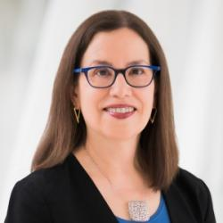
New Chief Scientific Officer
Elena Fuentes-Afflick, MD, MPH, joined the AAMC (and CFAS) on July 16, 2024, after serving as faculty and vice dean for the UCSF School of Medicine; as Chief Scientific Officer, she oversees CFAS
Dr. Fuentes-Afflick has held national leadership roles as a council member and president for both the American Pediatric Society and the Society for Pediatric Research.
She is an elected member of the American Academy of Arts and Sciences and the National Academy of Medicine (NAM), and serves as NAM Home Secretary
Scholarly work has focused on equity, including Latino health, immigrant health, health disparities, and diversity in academic medicine
Elena Fuentes-Afflick, MD

Slide 7
CFAS Representative Demographics
293 CFAS reps totals (181 women – 62%)
211 School reps (appointed by AAMC-member schools)
82 society reps (appointed by 71 AAMC-member academic societies)
160 Senior reps (including 65 dept. chairs and vice chairs)
133 Junior reps (faculty within their first 10 years of an initial faculty appointment)
45 CFAS Affiliates (past “official” reps who remain engaged)

Slide 8
Highlights of Recent and Ongoing CFAS Work
CFAS Administrative Board Retreat, 2024: Setting a Path Forward
Joint 2024 Spring Meeting with GFA and ORR
Monthly CFASConnects community building Zoom calls to connect faculty
Completion of CFAS Diversity & Inclusion Survey
Upcoming CFAS Wellbeing Committee report: “Empowering Wellness: Generalizable Approaches for Designing and Implementing Well-Being Initiatives within Health Systems” – publication in early 2025
Faculty as Medical Educators focus groups and analysis on faculty roles
Diversity and P&T paper drafted for journal publication
Aligning CFAS work with AAMC priorities and strategic plans

Slide 9
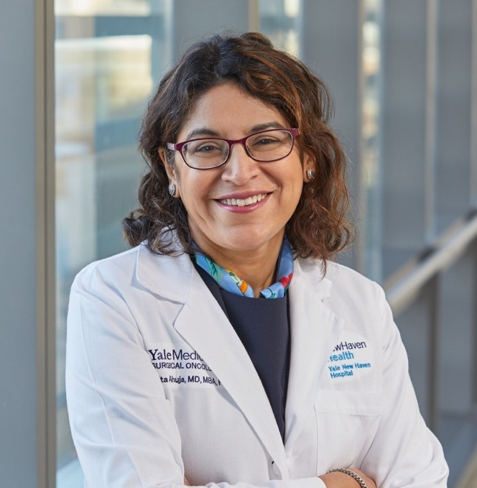
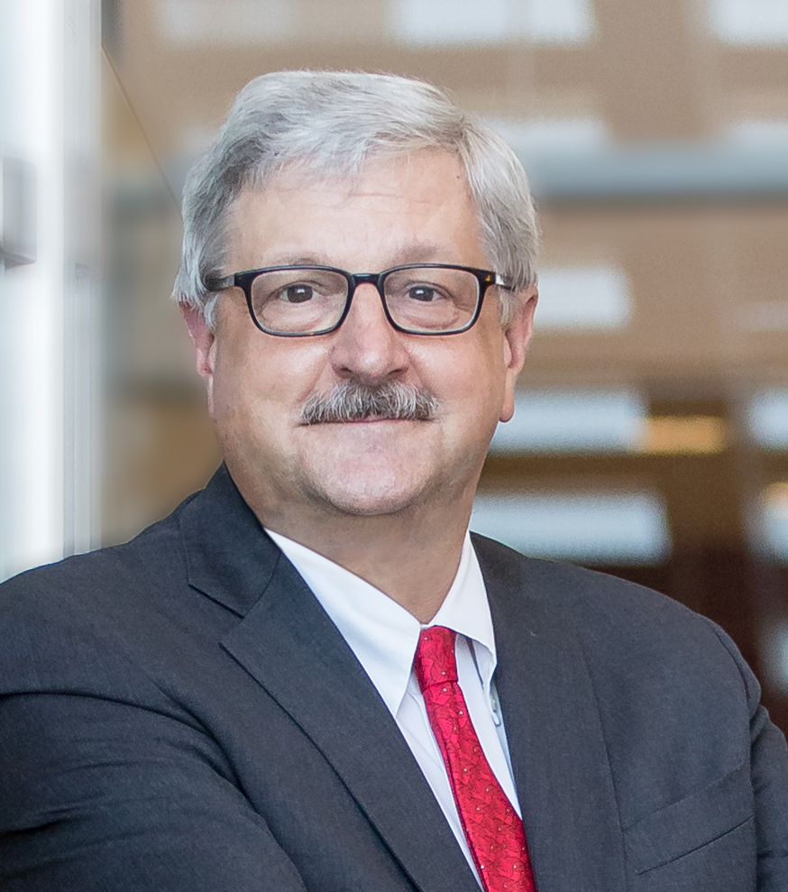
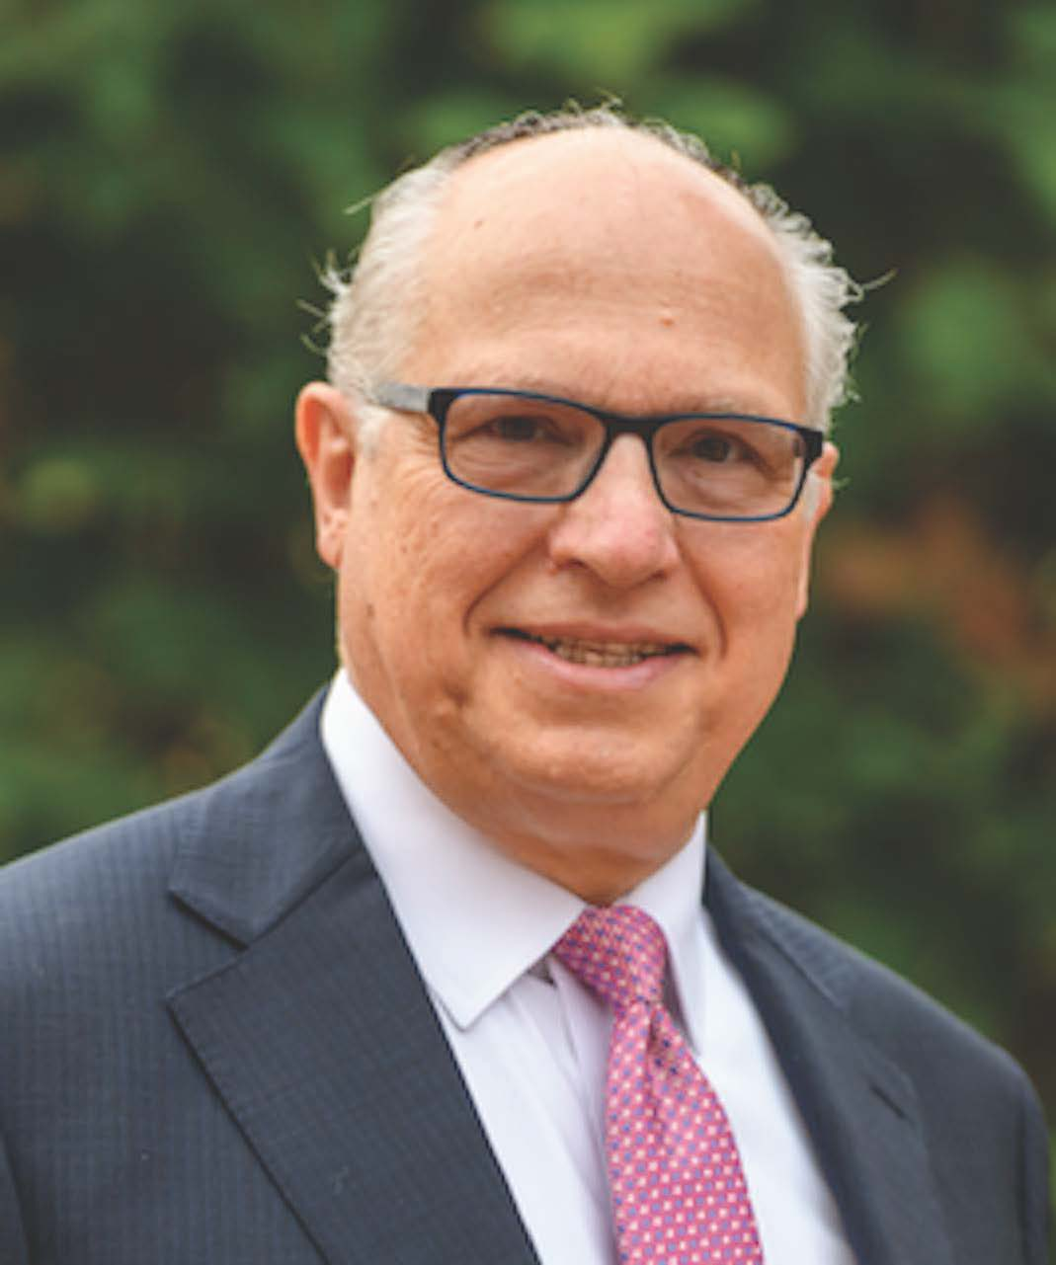
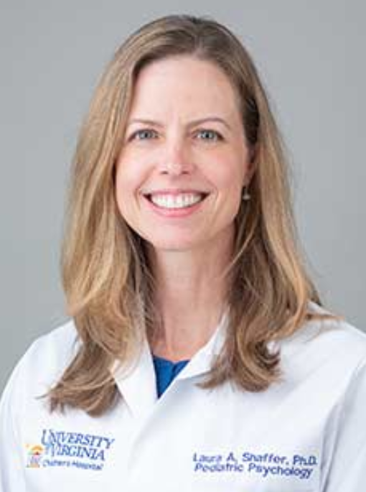
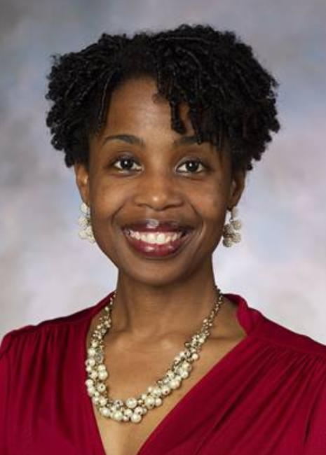
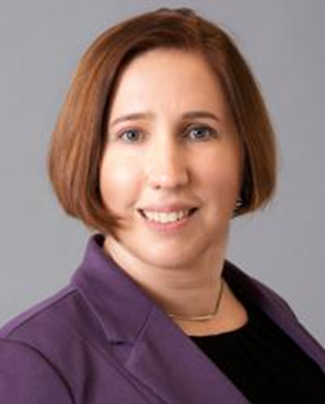
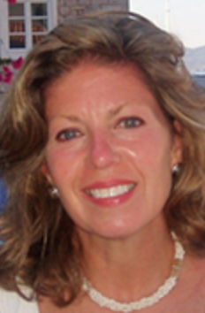
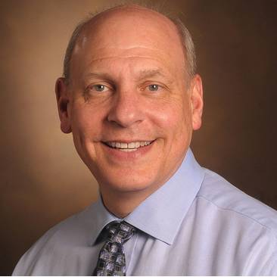
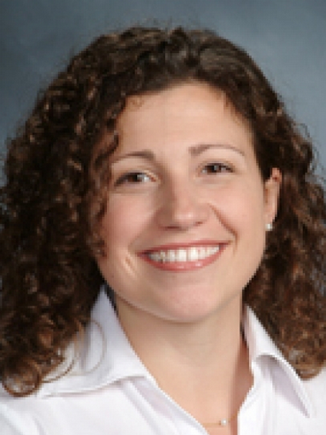
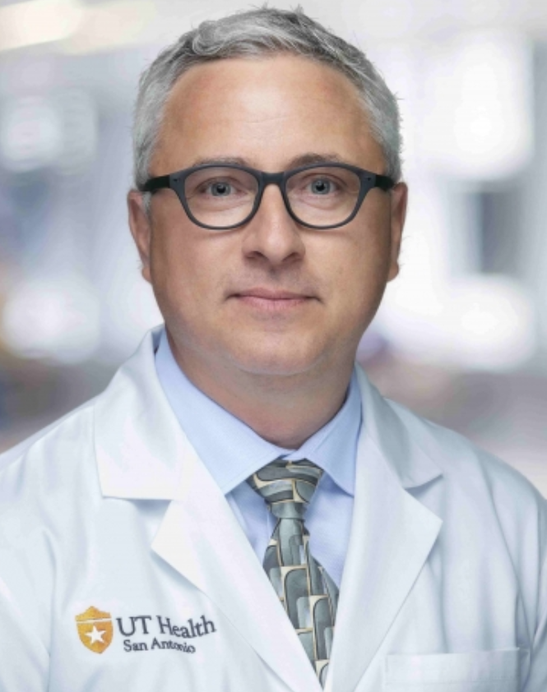
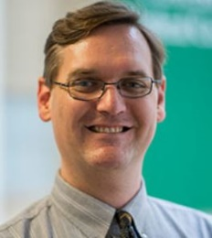
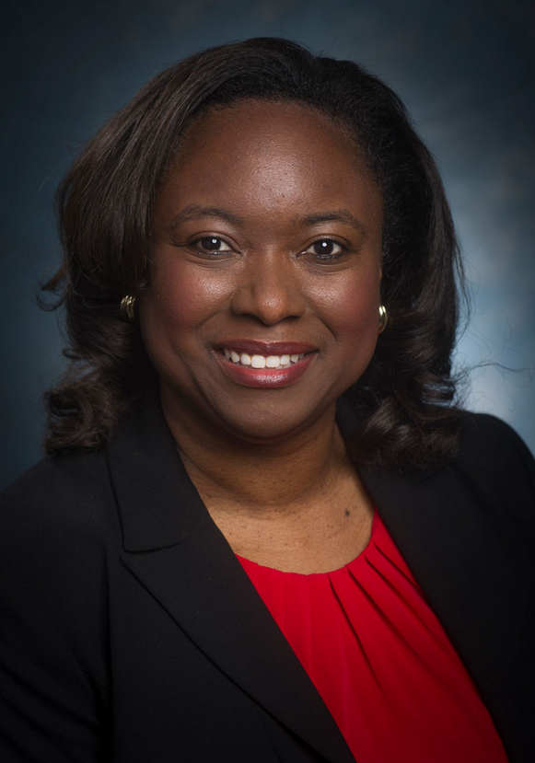
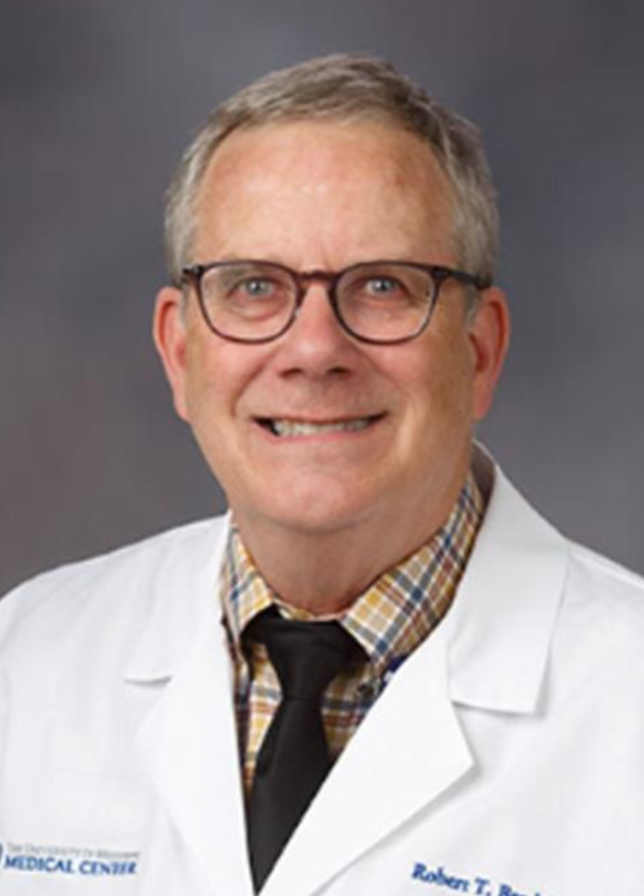
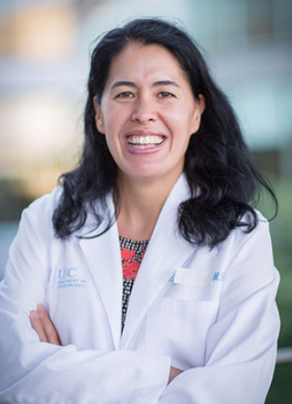
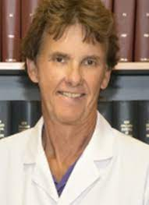
CFAS Administrative Board, 2024-25
Nita Ahuja, MD, Chair
Arthur Derse, MD, JD Chair-elect
Aviad “Adi” Haramati, PhD, Immediate Past Chair
Valencia Walker, MD
Shirley “Lee” Eisner, PhD
Neil Osheroff, PhD
Laura Shaffer, PhD
Kimberly Lumpkins, MD
Lily Belfi, MD
Jon Courand, MD
Adam Franks, MD
Monica Baskin, PhD
Robert T. Brodell, MD
Deanna Sasaki-Adams, MD
Nicholas Delamere, PhD
Johnson George, MBA – Ex Officio – GFA Chair

Slide 10
CFAS Topical Committees (and Chairs)
Advocacy Committee (Deanna Sasaki Adams, Laura Shaffer)
Diversity & Inclusion Committee (Monica Baskin, Valencia Walker)
Mission Alignment Committee (Stewart Babbott), transitioning to Faculty Leaders, Advancement & Governance Comm. (Adam Franks)
Biomedical Research & Training Committee (Neil Osheroff)
Engagement Committee (Kimberly Lumpkins)
Faculty and Organization Wellbeing Committee (Jon Courand)
Faculty as Medical Educators Committee (Lily Belfi)

Slide 11
Key Issues at LSL
Opening Plenary: “It’s About ‘Us’” – Journalist Scott Pelley on Seeking Solutions Amid Disorder
The “60 Minutes” correspondent and former anchor of the “CBS Evening News,” highlighted stories of bravery and resilience he has documented over his 50-year journalism career during the opening plenary session
Reflecting on the political discourse in the United States, Mr. Pelley noted, “I think we make a mistake when we try to win an argument or win a conversation… In my view, winning is losing because both sides have stopped listening to one another. I would recommend, if you’re going to have a potentially contentious conversation, start with, ‘I’m really interested in hearing what you have to say.’”
Mr. Pelley acknowledged the current tension and divisions in the country while also pointing out that division has always been a part of U.S. history.

Slide 12
Key Issues at LSL
Plenary: “Moments Matter. Generative Artificial Intelligence: An ‘Ecosystem Transformation for Medicine” – James N. Weinstein, Senior Vice President, Microsoft Health
In assessing the benefits or risks of AI, academic medicine leaders and faculty should consider whether people and the institutions they run can keep up with the technology to fully understand and govern how it works.
“Can we ensure no harm?” Dr. Weinstein asked. “I'm not sure.” Can AI be trusted and be equitable and fair in the eyes of those impacted? That really depends on us.”
AI success depends upon ensuring transparency about how the systems collect and share patient data; eliminating bias in the collection and use of data; and fully informing patients about how the systems work so that they can make informed choices about participating in processes driven by AI.
Governance of AI use is important, and transparency is key.

Slide 13
Key Issues at LSL
Plenary: “Thinking outside the box: A new approach to scientific discovery” – Kizzmekia S. Corbett-Helaire, PhD, and David Fajgenbaum, MD, MBA, MSc; moderated by Elena Fuentes-Afflick, MD, MPH
Groundbreaking scientific discovery goes beyond “What small discovery can I make that will advance the science?” but instead explores “What big ideas do I have that can make a meaningful difference?”
Effective science and scientists see value in the importance of sharing not just positive research results – but negative ones as well – to advance scientific knowledge.
The career of a successful scientist goes beyond just a contribution to research, but involves the advancement of a community – being a mentor, building teams of colleagues, navigating complicated funding environments, and helping to inform the public how the science works and why it’s valuable.
“Who wants to save the world alone?” Dr. Corbett-Helaire asked

Slide 14
Key Issues at LSL
Leadership Plenary with AAMC President & CEO David Skorton, MD, and AAMC Board Chair Lee Jones, MD
Academic medicine still provides caregivers, researchers, and educators the privilege of offering people care, treatment, and knowledge to get through some of the greatest challenges many will face
Faculty in academic medicine are facing difficult circumstances today, including pervasive burnout, divisive politics, and devastating world events – but they are not singular to our time, and instead have been faced through history.
In academic medicine, faculty need to cultivate “an environment of empathy and compassion, acknowledging our shared humanity.”
Dr. Skorton urged those in attendance to “Always do your best” — for patients, colleagues, and community. “That is what we all strive to do. Even when it’s the hardest of all things to do.”

Slide 15
CFAS-Oriented Main Program Sessions
Breakout sessions featuring CFAS rep speakers and CFAS-related work
Why Consider Sex as a Variable in Medical Research?
Reducing the Stigma of Accessing Mental Healthcare Along the Continuum
Private Equity Investors and Their Potential Impact on Academic Medicine
A Data Driven Approach to Identify Successful Strategies for Addressing Faculty Burnout
Precision Medical Education in Action: Challenges and Solutions
Applying the Clinician-Educator Milestones to Professional Transitions Across the Continuum
Let's Hang on to What We've Got: Retaining Basic Science Educators and Researchers
Building Your Best Mosquito Net: Strategic Plan for Addressing Microagressions in Your Learning Environment
Every Physician is a Leader: Implementing Leadership Competencies for a Successful GME Transition

