Slide 1
Veterans Health Administration Health Professions Trainees Background Check and Information Technology Issues
September 23, 2024
American Association of Medical Colleges (AAMC) Webinar

Slide 2
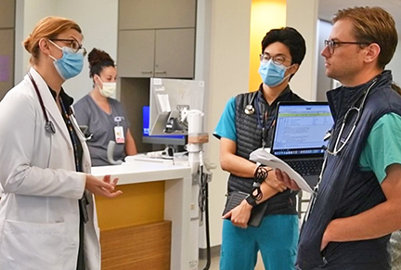
VA Goal for Health Professions Trainee (HPT) Onboarding
Day One Readiness
Every Health Professions Trainee
Fully onboarded
Trained, provisioned
Ready to care for Veterans on Day One of their VA experience

Slide 3
Previous Requirements for Screening HPTs
Special Agreement Check (SAC) | National Agency Check with Inquiries (NACI) or Tier 1 Background Check
Majority of Health Professions Trainees were exempt from a Tier 1 and therefore in this category | Very limited number of HPTs (>180 aggregate days or >1 year of continuous service), i.e. medical students on longitudinal integrated clerkships of over 6 months duration, VA-based chief residents
Fingerprint check, FBI database check, no special form needed | SAC plus FBI investigation (interviews, etc.), requires trainees to fill out a form to list their relatives, residences, etc. (estimated time 2 h)
Approximately 48 hours turnaround time | Highly variable, weeks to months, must be completed within the first year of service
Trainees were issued a PIV-I card for three years | Trainees were issued a PIV card for three years

Slide 4
VA Leadership Decision
New Requirements for Screening HPTs
US Citizens & lawful permanent residents in the country for > 3 years
Tier 1 Background Check
3-year PIV card
Non-US Citizens
Counterintelligence Check
PIV-I card with six-month certificates

Slide 5
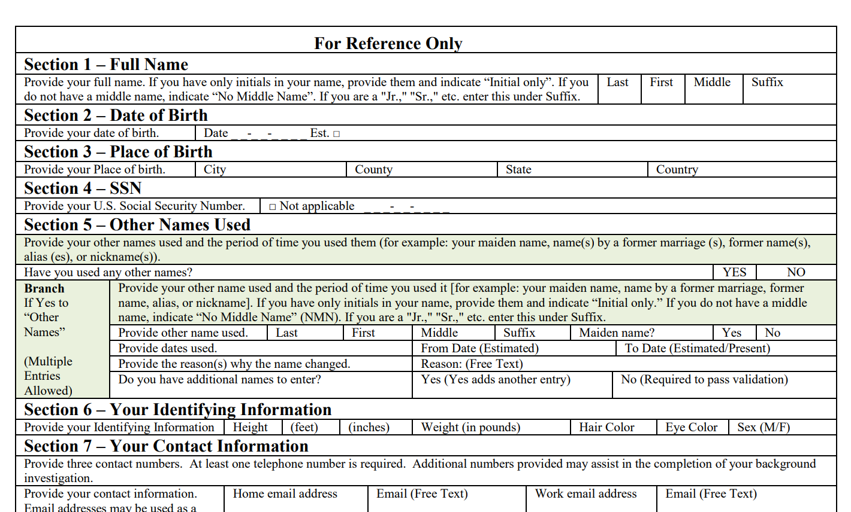
Tier-1 and Non-US Citizen Checks
Tier-1 Background Check
Still requires fingerprints and Special Agreement Check
Online SF-85 Questionnaire for Non-Sensitive Positions
Sent by electronic invitation
Counterintelligence Check
Managed by VA Counterintelligence
Visa, passport, and date of entry to U.S.
Completion required before SAC check and fingerprints can be scheduled

Slide 6
Implementation and Timeline
Integrated Project Team
Workplace Management and Consulting
Evaluating integration with Account Provisioning and Deprovisioning Onboarding Solution
Developing communications to stakeholders
Pilot Testing
October 2024
Implementation January 1, 2025
Goals
Day 1 readiness
HPTs working during background check
Implement new security procedures

Slide 7
Pilot Sites
VISN | VA Facility | VISN | VA Facility
1 | VA Boston Healthcare System, Boston, MA | 12 | Clement J. Zablocki VAMC, Milwaukee, WI
2 | VA Hudson Valley HCS, Montrose, NY | 15 | Kansas City VAMC, Kansas City, MO
4 | Michael J. Crescenz VAMC, Philadelphia, PA | 16 | Central Arkansas VA HCS, Little Rock, AR
5 | Baltimore VAMC, Baltimore, MD | 17 | South Texas HCS, San Antonio, TX
6 | Central Virginia VA HCS, Richmond, VA | 19 | Oklahoma City VA Medical Center, Oklahoma City, OK
7 | Columbia VA HCS, Columbia, SC | 20 | VA Puget Sound Healthcare System, Seattle, WA
8 | James A. Haley VAMC, Tampa, FL | 21 | San Francisco VA Health Care System, San Francisco, CA
9 | Luke Weathers Jr. VAMC, Memphis, TN | 22 | VA New Mexico HCS, Albuquerque, NM
10 | John D. Dingell VAMC, Detroit, MI | 23 | Minneapolis VAMC, Minneapolis, MN
VISN = Veterans Integrated Service Network

Slide 8
VA Challenges
Workflow still under development
Integration into the Account Provisioning and Deprovisioning System
Additional personnel
Information Technology upgrades
May be delays in the ability of HPTs to be on-site on Day One

Slide 9
Concerns
Academic Affiliate Challenges
Recruitment season starting
Coordination with VA onboarding processes
Retrospective evaluation of suitability
Do not have required data to complete background checks on existing non-US citizen HPTs
A separate time and resource-intensive process from the prospective pilot process
Academic affiliates and non-US citizen HPTs
Provide data for background checks
Concerning findings would preclude HPTs from accessing VA sites

Slide 10
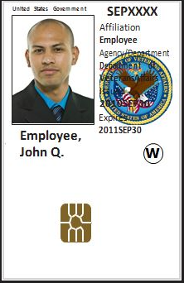
Personal Identify Verification (PIV) Cards
Previously, most HPTs received PIV-I cards with 3-year expiration dates
PIV-I cards now limited to 182-day expiration
Mandate from General Services Administration – USAccess Federal Credentialling Services
Onboarding majority of new HPTs with PIV-I
PIV-I expiration date of previously onboarded HPTs will not be revised
Communication critical as HPTs approach PIV-I expiration date

Slide 11
Account Inactivity Disablement
Vulnerability of unused accounts to cyber attack
Currently 60 days, moving to 30 days
Pilot Testing in VISN 17
VA Enterprise Service Desk improving services
Account disabled for inactivity
< 20 minutes to reenable
Account disabled for a prolonged activity or incomplete training
5 days to re-enable
Key – Sign in every 30 days

Slide 12
Questions

Slide 13
Staying Connected – Best Practices to Maintain Accounts
Use remote access to sign in at least every 30 days
Remote access requested through VA (Health Professions Education team and IT)
At individual level / PIV card reader may be provided by VA facility*
Programs may set up card reader at didactic sites
Notifications for Mandatory Training for Trainees status
Can set supervisor to VA Site Director for alerts of pending expiration
Work with VA Site Director, HPE team, and Training (TMS) managers
VA Site Directors / Affiliate Program Coordinates use a “two-week checklist”
Account deactivation issues can be solved within two weeks even in worst-case scenario
Checking in 2-4 weeks ahead of a VA rotation will maintain day one readiness

Slide 14
