Slide 1
Exploring the Relationship Between Geographic Preference & Interview Invitations Across Specialties
2024 ERAS® Analysis
Data as of 2/28/2024

Slide 2
Geographic Preferences: Overview
Goals for Geographic Preferences Section:
Provide a process for sharing geographic preferences that enhances accuracy and fairness.
Communicate the importance of geography for an applicant.
Provide an opportunity to share preferences for divisions and location setting.
Geographic Preferences
Notes:
As a reminder, the aim of the geographic and setting preferences questions in the MyERAS® application is to provide applicants with a structured method to express their desired geographic divisions or their willingness to train anywhere in the country. Our goal in implementing this structured approach was to enhance accuracy and fairness in interpreting and utilizing geographic preference information within the application.
Before, the MyERAS application captured and reported applicant's geographic information through various methods, often relying on open-ended responses or informal communication channels such as advisor recommendations or post-submission emails to program directors. This approach presented inherent risks of bias and disadvantage, especially for students who may not have equal access to such channels.
To address these concerns, our objective with the geographic and setting preferences section was to level the playing field and provide a more structured and equitable way for students to indicate their geographic preferences. We recognize that geographic preference plays a significant role in the selection process, and we wanted to ensure that all applicants have an equal opportunity to express their preferences transparently.

Slide 3
How are geographic preferences shared with programs?
Applicant indicates preference for your division.
Applicant indicates preference for another division.
Applicant indicates no division preference.
Applicant skipped question or left unanswered.
Your
program
sees:
Yes + Explanation
No information is displayed.
No Preference + Explanation
No information is displayed.
Notes:
We specifically designed the process for collecting and sharing division preferences to provide accurate information to programs while minimizing risk to applicants.
Only programs located in a selected division see the applicant’s division preference.
**If an applicant selects the division in which your program is located, you will receive a geography signal (so to speak) and a short explanation for their preference if provided.
**If an applicant selected a division in which your program is NOT located, you will not receive any information about this preference.
**If an applicant selects “I do not have a division preference.”, you will be notified that they have “no preference” and so would all other programs.

Slide 4
Sample of 2024 ERAS Applicants
The sample for analysis includes the following specialties who had at least 10 programs and made geographic preferences viewable at their program as of September 29, 2023.
Adult Neurology.
Anesthesiology.
Child Neurology.
Dermatology.
Diagnostic Radiology.
Emergency Medicine.
Family Medicine.
General Surgery.
Internal Medicine.
Internal Medicine-Pediatrics.
Internal Medicine/Psychiatry.
Interventional Radiology.
Neurological Surgery.
Obstetrics & Gynecology.
Orthopedic Surgery.
Otolaryngology.
Pathology.
Pediatrics.
Physical Medicine & Rehabilitation.
Psychiatry.
Radiation Oncology.
Transitional Year.
Urology.
Vascular Surgery-Integrated.
Notes:
All specialties had the opportunity to access geographic preferences.
The sample for analysis includes the following specialties who had at least 10 programs that chose to make geographic preferences viewable at their program as of September 29, 2023.
Results for some specialties are not included due to small sample size.
The sample for this study is all applicants who applied to participating programs in any of the 24 participating specialties with at least 10 programs that viewed geographic preference in the 2024 ERAS® cycle. Among the 50,823 unique MyERAS applicants to the 24 participating specialties with at least 10 programs in the sample onscreen, 49,724 (or 98%) had at least 1 geographic preference.

Slide 5
Analysis
Predictors:
Geographic Preference.
Outcome:
Scheduled to interview PDWS or Thalamus Interview Scheduler as of February 28, 2024, (Main Residency Match® only).
Analysis:
Results analyzed separately by program.
Computed geographic preference to interview conversion rates by program.
Summarized the distribution of conversion rates programs using boxplots.
Notes:
We examined the relationship between geographic preference and whether an applicant was invited to interview.
To conduct the analysis, we computed interview rates separately by program because selection processes vary by program. Then, we summarized results within a specialty by plotting the distribution of interview offer rates for programs.

Slide 6
What information is provided by a boxplot?
Boxplots show the distribution of signal to interview conversion rates for all programs in a specialty.
The colored box shows the signal to interview conversion rates for the bulk of the programs. The bottom of the box is the 25th percentile, the horizontal line is the median or the 50th percentile, and the top of the box is the 75th percentile.
The whiskers represent the 10th and 90th percentile of programs’ interview invitation rates.

Slide 7
Adult Neurology: Program Sample & Inclusion Criteria
 | N of Programs for Geographic Preference
Total programs | 176
Total programs who made geographic preference viewable at their program | 87
Met inclusion rule equal to or larger than 7:1; Provided PGY1 info in GME track; Provided interview offer data by February 28, 2024 | 66
Total analytic sample | 66
Total % of programs who made geographic preference viewable at their program | 76%
Total % of all Adult Neurology programs in 2024 ERAS® cycle | 38%
Notes:
There were a total of 176 Adult Neurology programs in the 2024 ERAS cycle. Out of those, 87 made geographic preference viewable at their program as of 9/29/23.
We included 66 of them from this analysis because they reported PGY1 information in GME track; provided interview invitation data by February 28, 2024, (which is when we pulled the data); and met the inclusion rule for quality data that was created by Adult Neurology specialty leadership. That rule specified that any interview data provided by a program could only be included if the ratio of interview invites to positions available in that program was equal to or larger than 7:1.
The final analytic sample for the geographic preference analysis was 66 Adult Neurology programs, representing approximately 76% of all eligible Adult Neurology programs and 38% of the total Adult Neurology program population for the 2024 ERAS cycle.

Slide 8
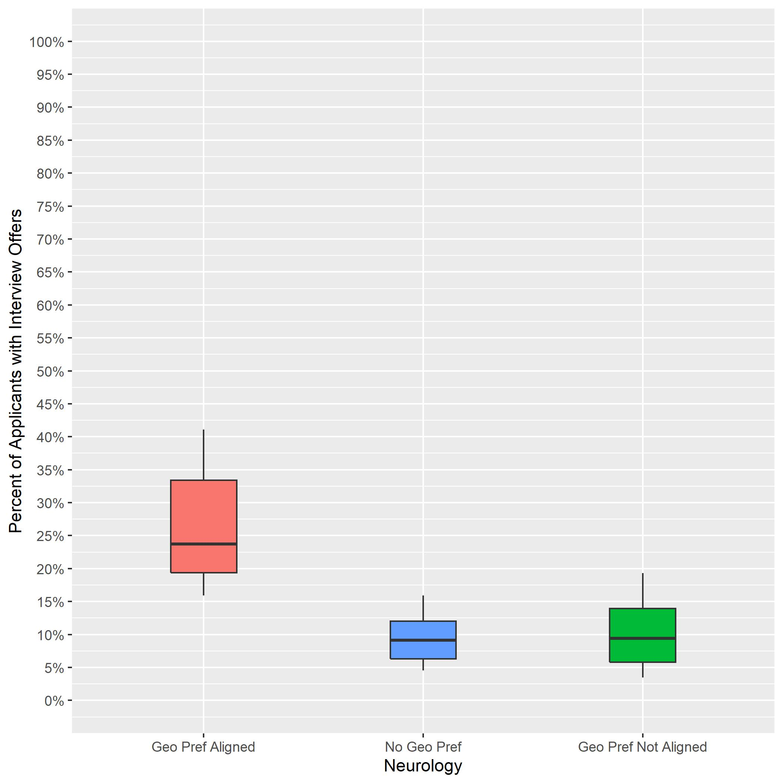
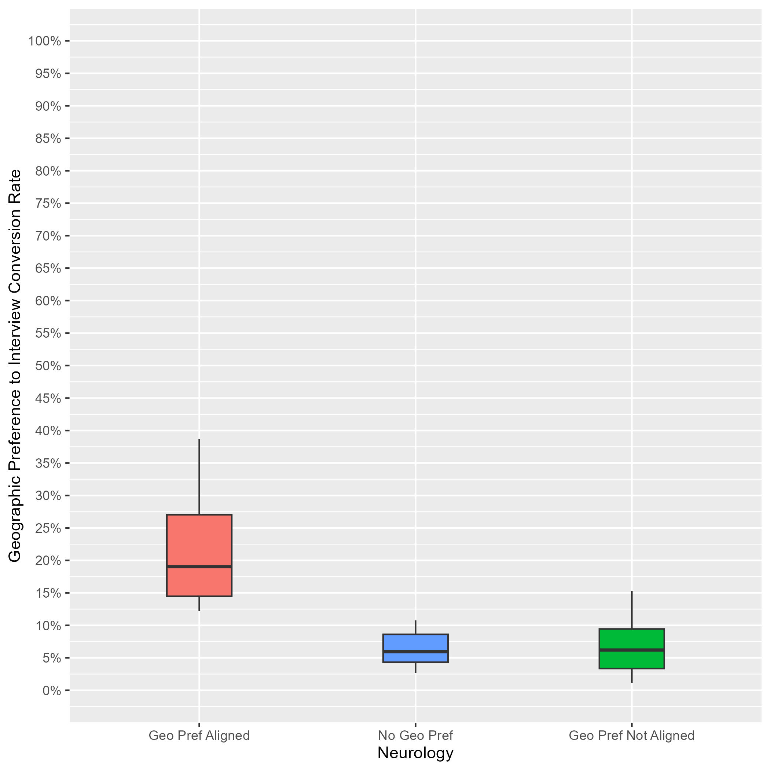
Adult Neurology: Interview Rates by Geographic Preference Alignment Year-Over-Year Comparison
2023 ERAS Data as of 3/15/23
# Programs: 132
2024 ERAS Data as of 2/28/24
# Programs: 66
Geographic Preference to interview Conversion Rate
Notes:
Year 2 findings suggest that:
In general, applicants whose geographic preferences aligned with the program’s location were invited to interview at a higher rate than those who reported no preference and those whose preferences were misaligned (19% vs 6% vs 6%). Further, there was not much overlap between the aligned geographic preference distribution and the other distributions, suggesting that programs put more weight on aligned preferences than no or misaligned preferences.
There was a lot of overlap between the distributions for applicants with no geographic preference and those with misaligned geographic preferences, suggesting that many PDs may not have differentiated between these two responses, and there is a need for additional training.
Average interview invitation rates for aligned geographic preference in 2023 (24%) are similar to 2024 aligned geographic preference invitation rates (19%).
The number of programs in the sample for 2024 is lower than 2023 because we implemented a new inclusion rule based on whether a program made geographic preference viewable at their program.

Slide 9
Anesthesiology: Program Sample & Inclusion Criteria
 | N of Programs for Geographic Preference
Total programs | 166
Total programs who made geographic preference viewable at their program | 89
Met inclusion rule equal to or larger than 7:1; Provided PGY1 info in GME track; Provided interview offer data by February 28, 2024 | 77
Total analytic sample | 77
Total % of programs who made geographic preference viewable at their program | 87%
Total % of all Anesthesiology programs in 2024 ERAS cycle | 46%
Notes:
There were a total of 166 Anesthesiology programs in the 2024 ERAS cycle. Out of those, 89 made geographic preference viewable at their program as of 9/29/23.
We included 77 of them from this analysis because they reported PGY1 information in GME track; provided interview invitation data by February 28, 2024, (which is when we pulled the data); and they met the inclusion rule for quality data that was created by Anesthesiology specialty leadership. That rule specified that any interview data provided by a program could only be included if the ratio of interview invites to positions available in that program was equal to or larger than 5:1.
The final analytic sample for the geographic preference analysis was 77 Anesthesiology programs, representing 87% of all eligible anesthesiology programs and 46% of the total anesthesiology program population for the 2024 ERAS cycle.

Slide 10
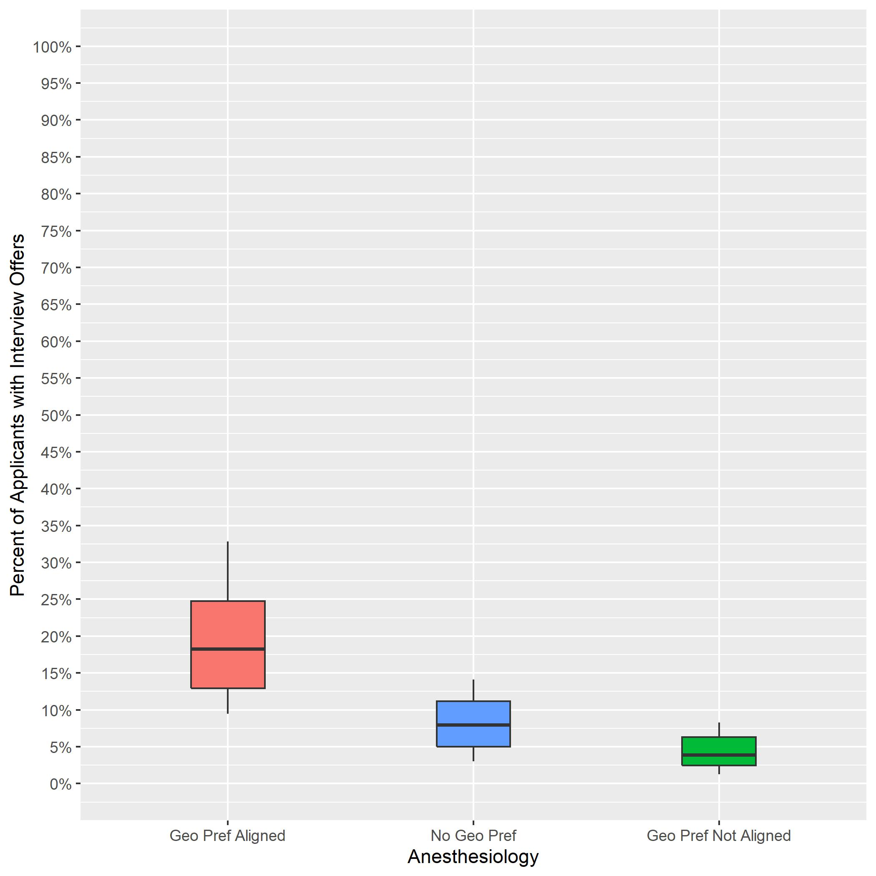
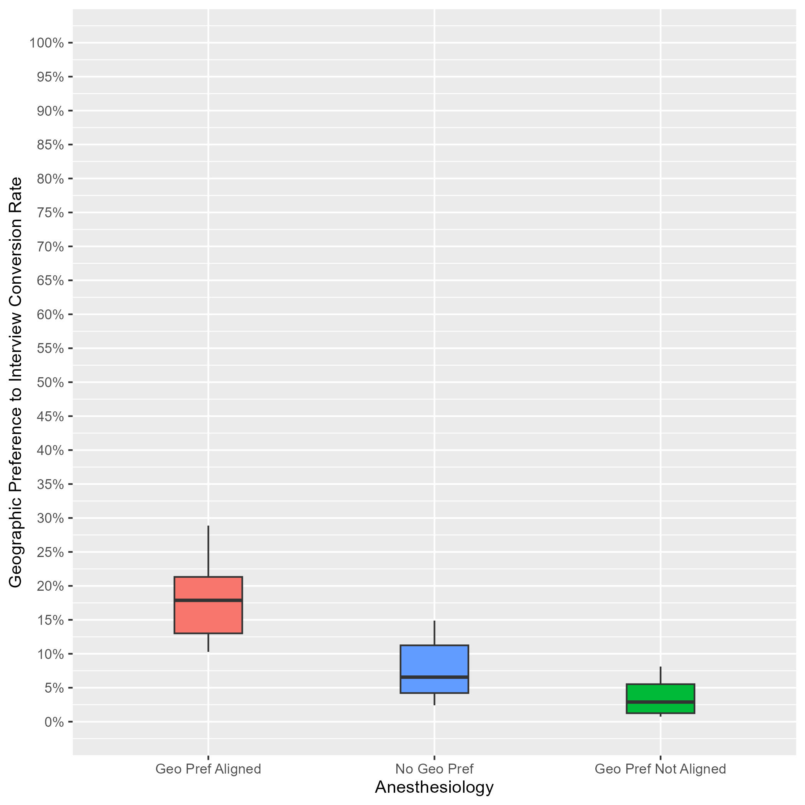
Anesthesiology: Interview Rates by Geographic Preference Alignment Year-Over-Year Comparison
2023 ERAS Data as of 3/15/23
# Programs: 110
2024 ERAS Data as of 2/28/24
# Programs: 77
Geographic Preference to interview Conversion Rate
Notes:
Year 2 findings suggest that:
In general, applicants whose geographic preferences aligned with the program’s location were invited to interview at a higher rate than those who reported no preference and those whose preferences were misaligned. (18% vs 7% vs 3%). There was not much overlap between the aligned geographic preference distribution and the other distributions, suggesting that programs put more weight on aligned preferences than no or misaligned preferences.
There was a little overlap between the distributions for applicants with no geographic preference and those with misaligned geographic preferences, which suggests some programs did not differentiate these two responses and suggests a need for additional training.
Average interview invitation rates for aligned geographic preference in 2023 (18%) are similar to 2024 aligned geographic preference invitation rates (18%).
The number of programs in the sample for 2024 is lower than 2023 because we implemented a new inclusion rule based on whether a program made geographic preference viewable at their program.

Slide 11
Child Neurology: Program Sample & Inclusion Criteria
 | N of Programs for Geographic Preference
Total programs | 77
Total programs who made geographic preference viewable at their program | 32
Met inclusion rule equal to or larger than 7:1; Provided PGY1 info in GME track; Provided interview offer data by February 28, 2024 | 26
Total analytic sample | 26
Total % of programs who made geographic preference viewable at their program | 81%
Total % of all Child Neurology programs in 2024 ERAS cycle | 34%
Notes:
There were a total of 77 Child Neurology programs in the 2024 ERAS cycle. Out of those 32 made geographic preference viewable at their program as of 9/29/23.
We included 26 of them from this analysis because they reported PGY1 information in GME track; provided interview invitation data by February 28, 2024, (which is when we pulled the data); and met the inclusion rule for quality data that was created by Child Neurology specialty leadership. That rule specified that any interview data provided by a program could only be included if the ratio of interview invites to positions available in that program was equal to or larger than 7:1.
The final analytic sample for the geographic preference analysis was 26 Child Neurology programs, representing approximately 81% of all eligible child Neurology programs, and 34% of the total Child Neurology program population for the 2024 ERAS cycle.

Slide 12
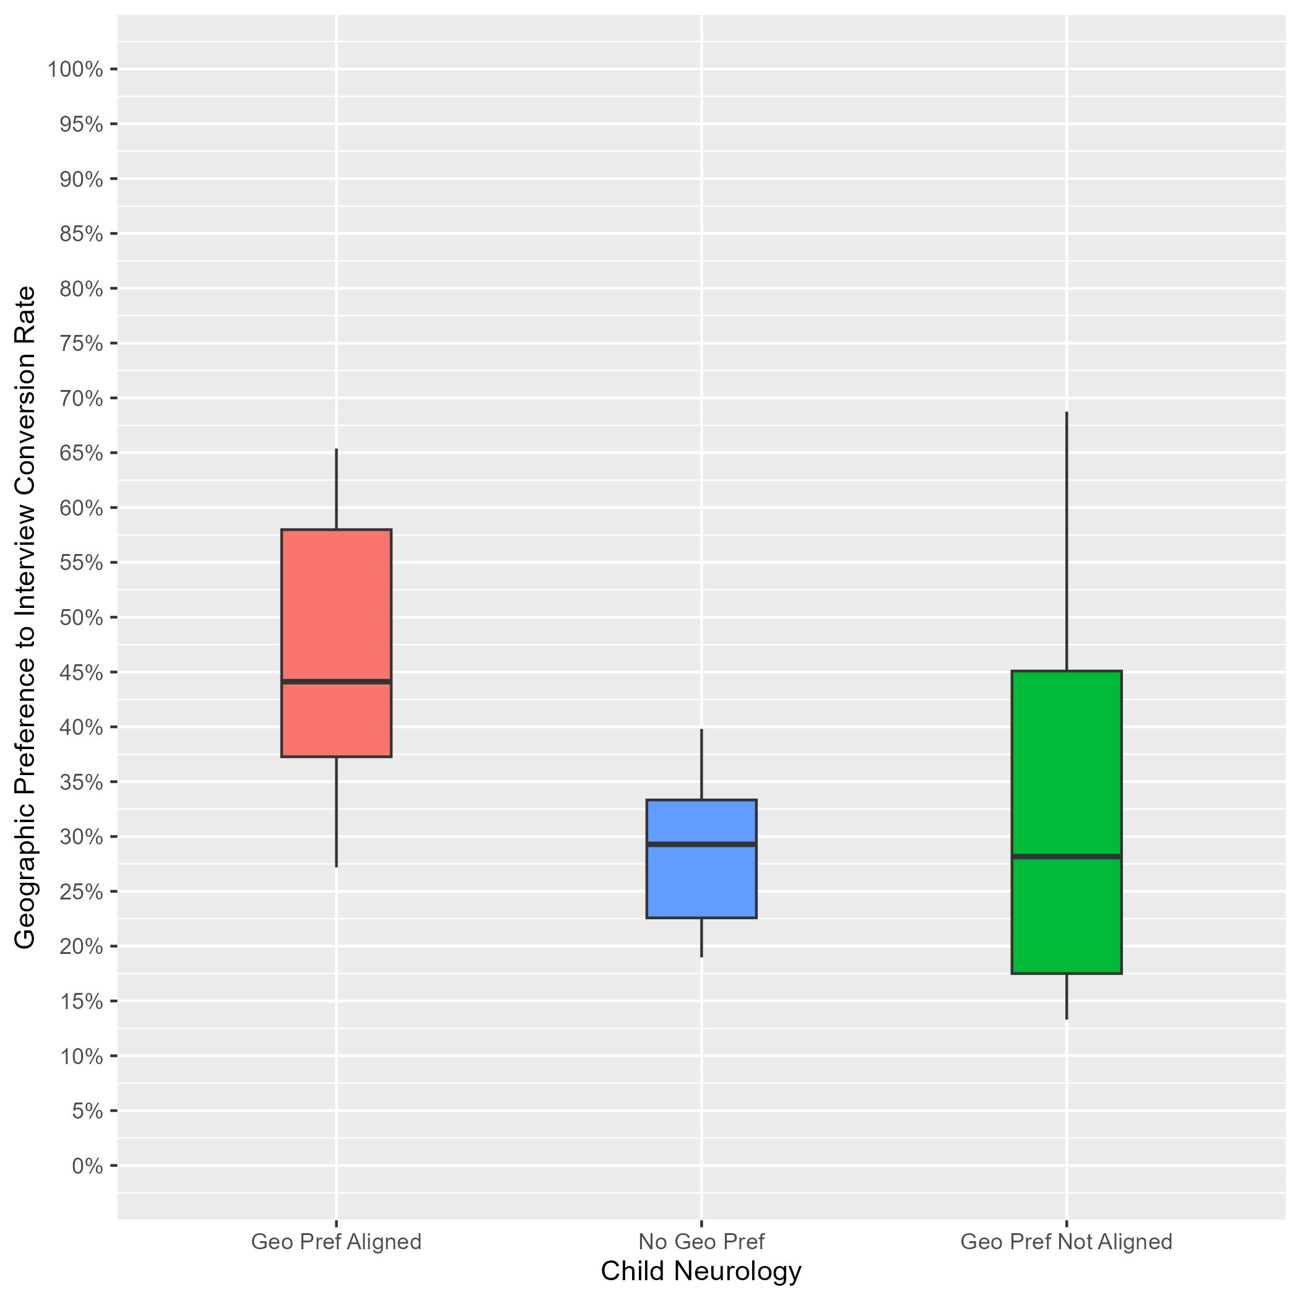
Child Neurology: Interview Rates by Geographic Preference Alignment
Data as of 2/28/24
# of Programs: 26
Applicants whose geographic preference aligned with the program:
Median of interview offers: 44%.
10th percentile: 27%.
90th percentile: 65%.
Applicants with no geographic preference:
Median of interview offers: 29%.
10th percentile: 19%.
90th percentile: 40%.
Applicants whose geographic preference(s) did not align with the program:
Median of interview offers: 28%.
10th percentile: 13%.
90th percentile: 69%.
Notes:
Year 1 findings suggest that:
In general, applicants whose geographic preferences aligned with the program’s location were invited to interview at a higher rate than those who reported no preference and those whose preferences were misaligned (44% vs 29% vs 28%). There was not much overlap between the aligned geographic preference distribution and the no geographic preference distribution, suggesting that programs put more weight on aligned preferences than no preferences. However, there was noticeable overlap between the aligned geographic preference distribution and the misaligned distribution, indicating that some programs did not differentiate these two responses.
There was a lot of overlap between the distributions for applicants with no geographic preference and those with misaligned geographic preferences, suggesting that many PDs may not have differentiated between these two responses, and there is a need for additional training.

Slide 13
Dermatology: Program Sample & Inclusion Criteria
 | N of Programs for Geographic Preference
Total programs | 138
Total programs who made geographic preference viewable at their program | 43
Met inclusion rule equal to or larger than 7:1; Provided PGY1 info in GME track; Provided interview offer data by February 28, 2024 | 25
Total analytic sample | 25
Total % of programs who made geographic preference viewable at their program | 58%
Total % of all Dermatology programs in 2024 ERAS cycle | 18%
Notes:
There were a total of 138 Dermatology programs in the 2024 ERAS cycle. Out of those, 43 made geographic preference viewable at their program as of 9/29/23.
We included 25 of them from this analysis because they reported PGY1 information in GME track; provided interview invitation data by February 28, 2024, (which is when we pulled the data); and they met the inclusion rule for quality data that was created by Dermatology specialty leadership. That rule specified that any interview data provided by a program could only be included if the ratio of interview invites to positions available in that program was equal to or larger than 7:1.
The final analytic sample for the geographic preference analysis was 25 Dermatology programs, representing approximately 58% of all eligible dermatology programs and 18% of the total Dermatology program population for the 2024 ERAS cycle.

Slide 14
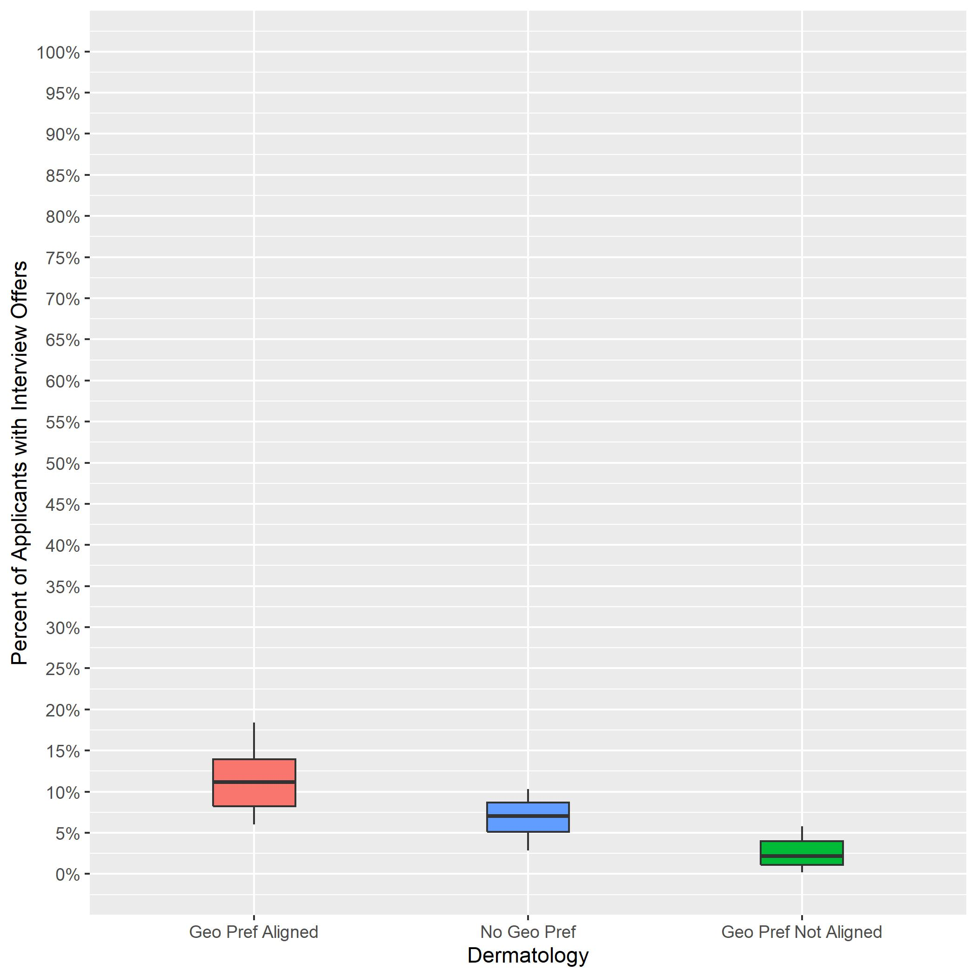
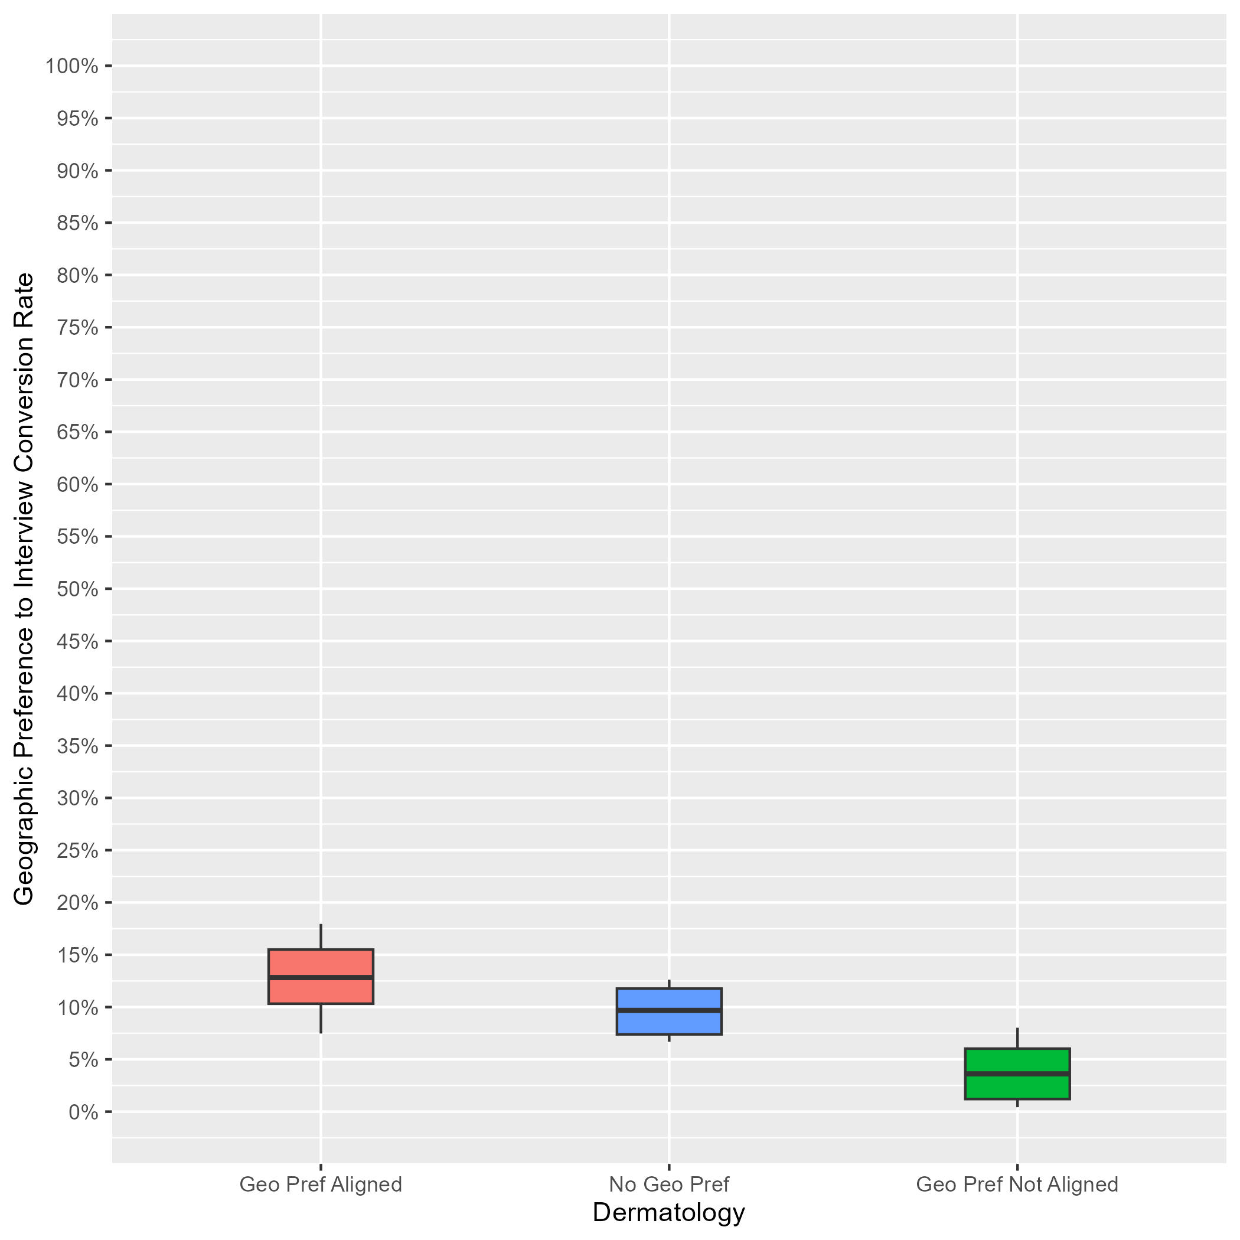
Dermatology: Interview Rates by Geographic Preference Alignment Year-Over-Year Comparison
2023 ERAS Data as of 3/15/23
# of Programs: 86
2024 ERAS Data as of 2/28/24
# of Programs: 25
Geographic Preference to interview Conversion Rate
Notes:
Year 2 findings suggest that:
In general, applicants whose geographic preferences aligned with the program’s location were invited to interview at a higher rate than those who reported no preference and those whose preferences were misaligned (13% vs 10% vs 4%). There was not much overlap between the aligned geographic preference distribution and the other distributions, suggesting that programs put more weight on aligned preferences than no or misaligned preferences.
There was a little overlap between the distributions for applicants with no geographic preference and those with misaligned geographic preferences, suggesting that many PDs may not have differentiated between these two responses, and there is a need for additional training.
Average interview invitation rates for aligned geographic preference in 2023 (11%) are similar to 2024 aligned geographic preference invitation rates (13%).
The number of programs in the sample for 2024 is lower than 2023 because we implemented a new inclusion rule based on whether a program made geographic preference viewable at their program.

Slide 15
Diagnostic Radiology: Program Sample & Inclusion Criteria
 | N of Programs for Geographic Preference
Total programs | 187
Total programs who made geographic preference viewable at their program | 99
Met inclusion rule equal to or larger than 7:1; Provided PGY1 info in GME track; Provided interview offer data by February 28, 2024 | 83
Total analytic sample | 83
Total % of programs who made geographic preference viewable at their program | 84%
Total % of all Diagnostic Radiology programs in 2024 ERAS cycle | 44%
Notes:
There were a total of 187 Diagnostic Radiology programs in the 2024 ERAS cycle. Out of those, 99 made geographic preference viewable at their program as of 9/29/23.
We included 83 of them from this analysis because they reported PGY1 information in GME track; provided interview invitation data by February 28, 2024, (which is when we pulled the data); and met the inclusion rule for quality data that was created by Diagnostic Radiology specialty leadership. That rule specified that any interview data provided by a program could only be included if the ratio of interview invites to positions available in that program was equal to or larger than 10:1.
The final analytic sample for the geographic preference analysis was 83 Diagnostic Radiology programs, representing approximately 84% of all eligible diagnostic radiology programs and 44% of the total Diagnostic Radiology program population for the 2024 ERAS cycle.

Slide 16
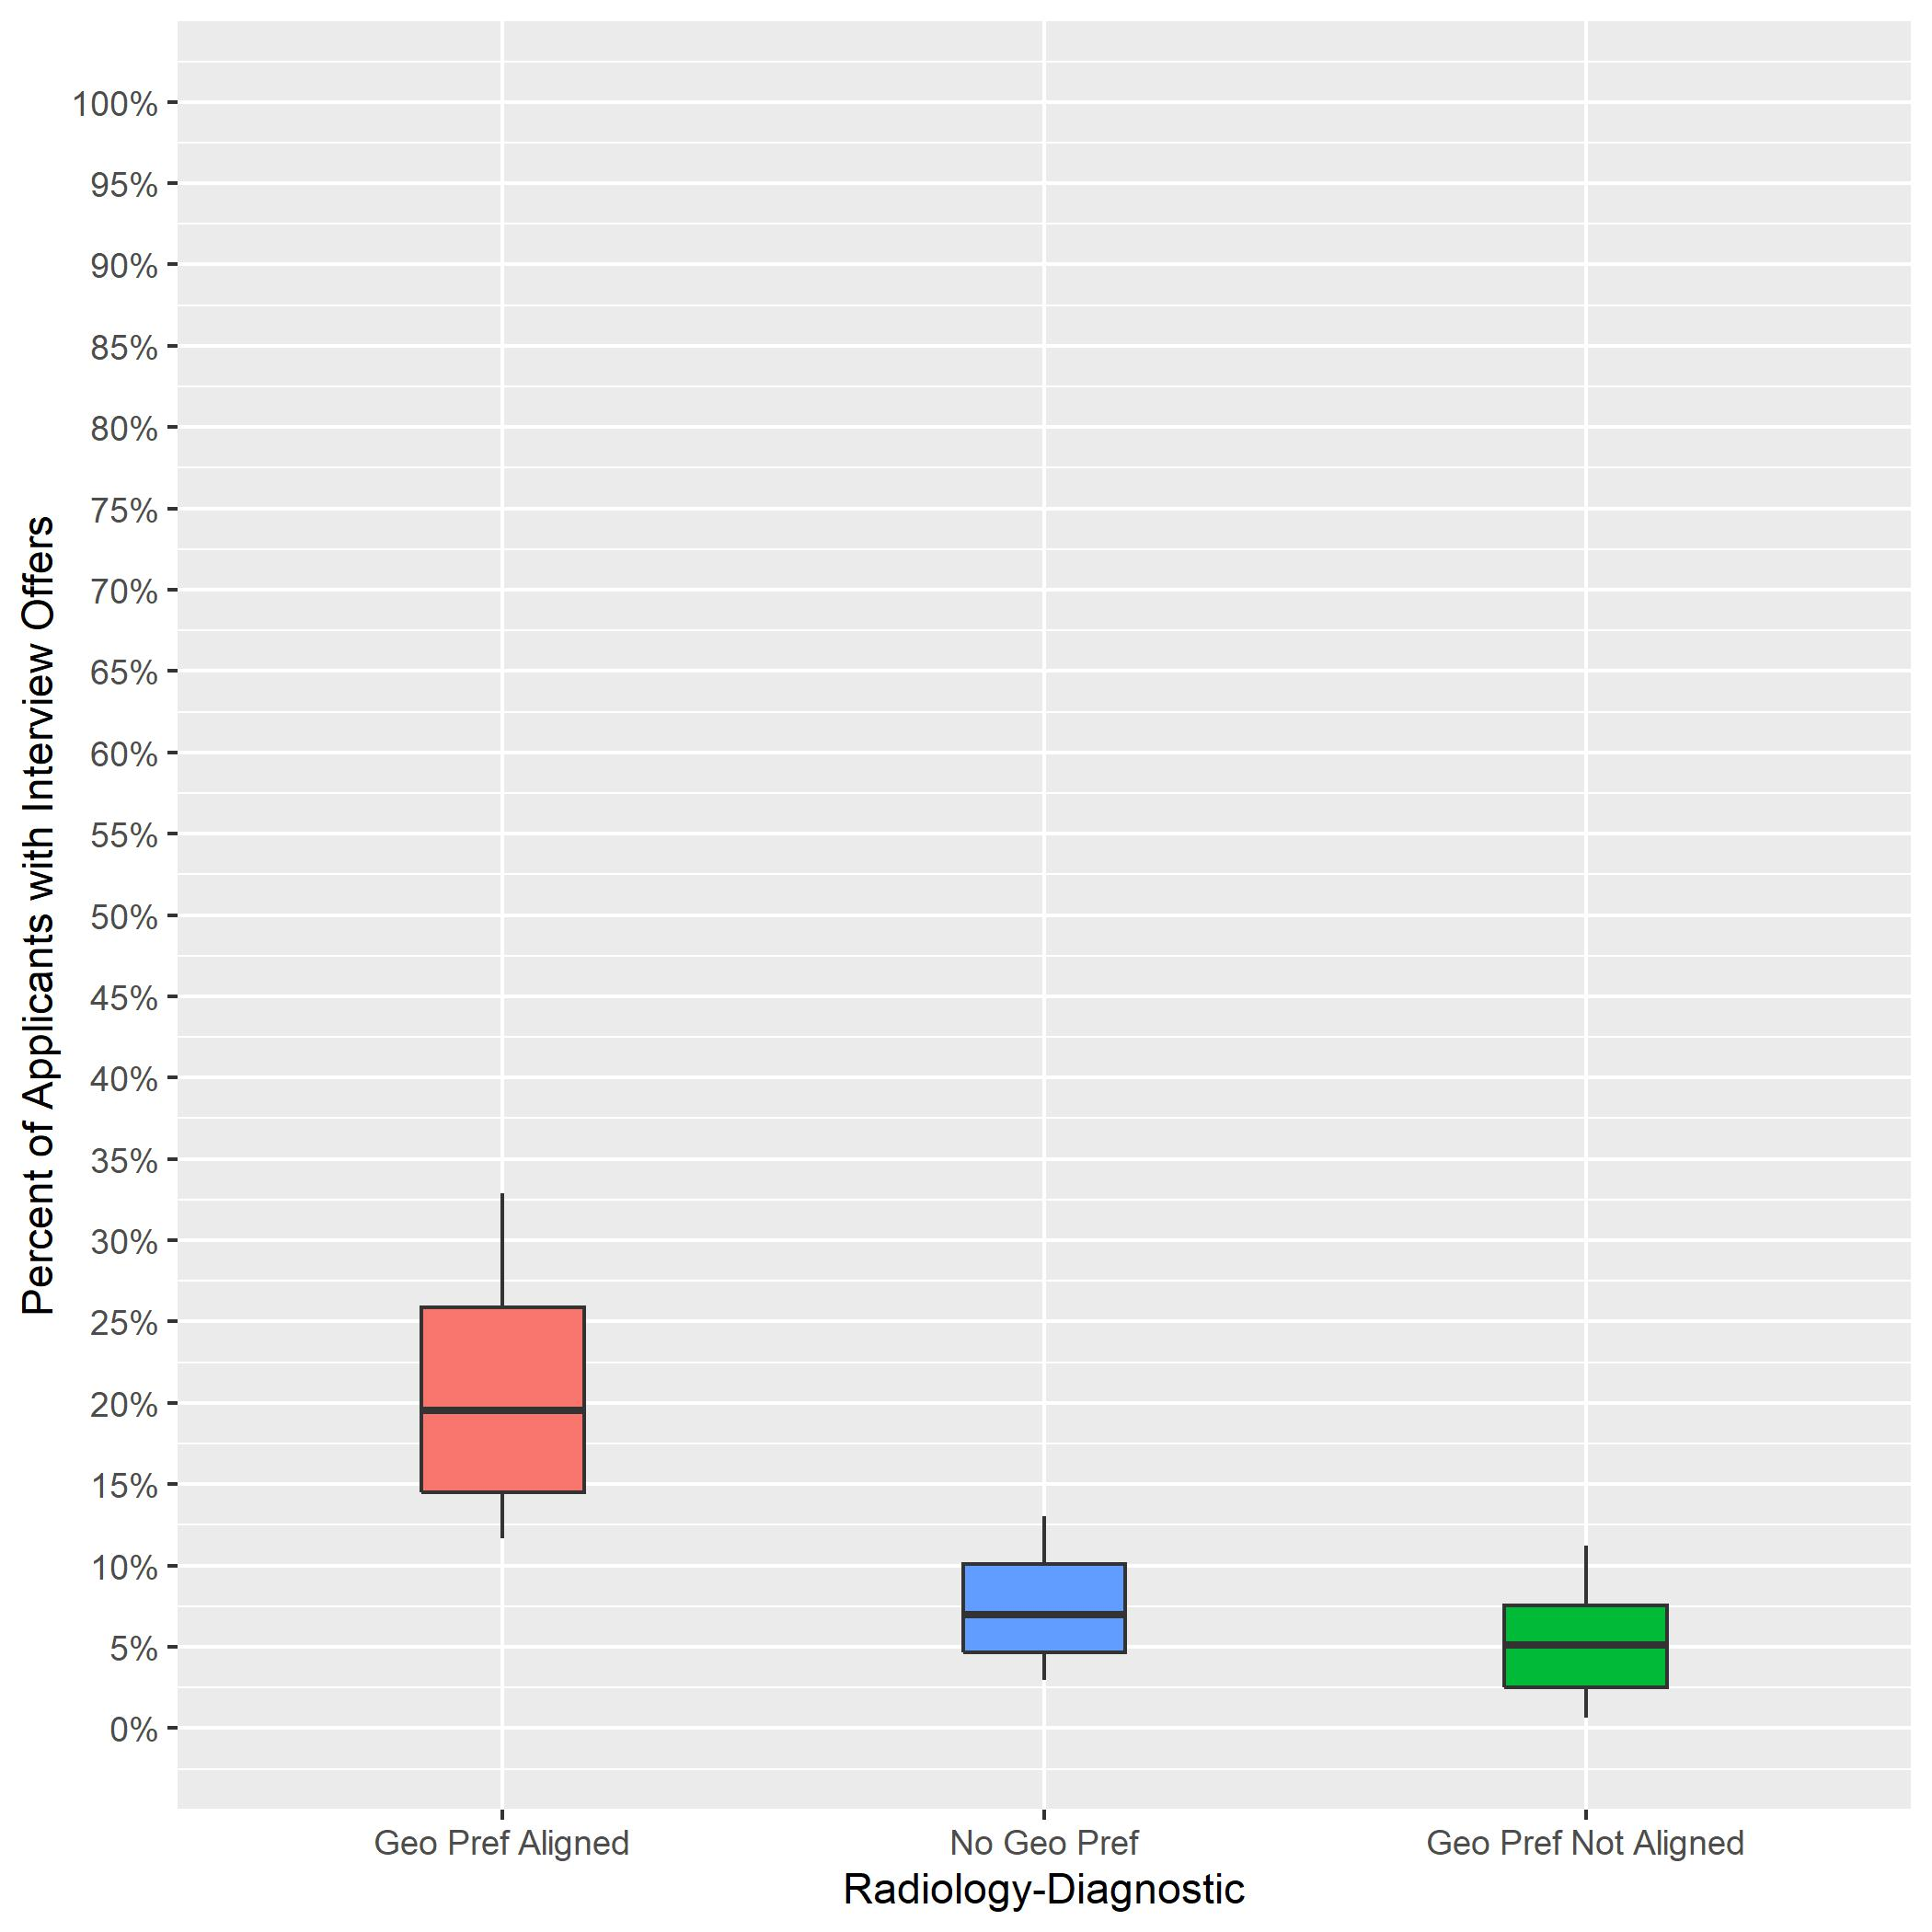
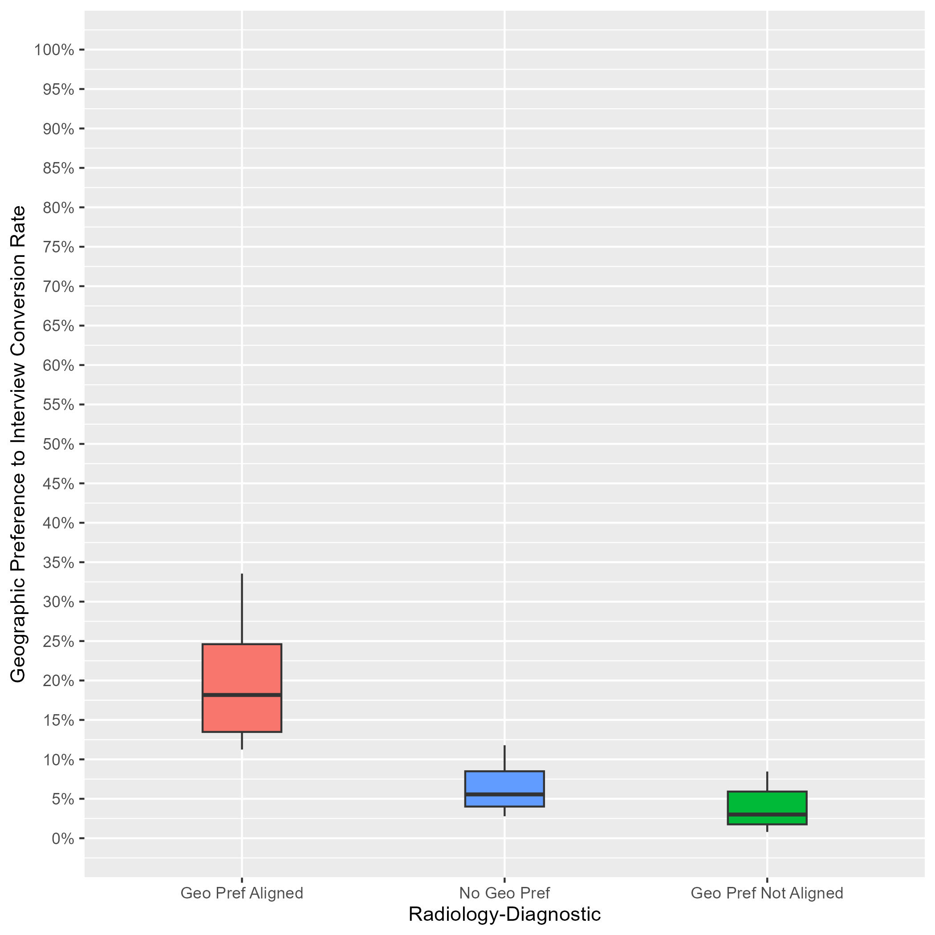
Diagnostic Radiology: Interview Rates by Geographic Preference Alignment Year-Over-Year Comparison
2023 ERAS Data as of 3/15/23
# of Programs: 146
2024 ERAS Data as of 2/28/24
# of Programs: 83
Geographic Preference to interview Conversion Rate
Notes:
Year 2 findings suggest that:
In general, applicants whose geographic preferences aligned with the program’s location were invited to interview at a higher rate than those who reported no preference and those whose preferences were misaligned (18% vs 6% vs 3%). There was not much overlap between the aligned geographic preference distribution and the other distributions, suggesting that programs put more weight on aligned preferences than no or misaligned preferences.
There was a little overlap between the distributions for applicants with no geographic preference and those with misaligned geographic preferences, suggesting that many PDs may not have differentiated between these two responses, and there is a need for additional training.
Average interview invitation rates for aligned geographic preference in 2023 (20%) are similar to 2024 aligned geographic preference invitation rates (18%).
The number of programs in the sample for 2024 is lower than 2023 because we implemented a new inclusion rule based on whether a program made geographic preference viewable at their program.

Slide 17
Emergency Medicine: Program Sample & Inclusion Criteria
 | N of Programs for Geographic Preference
Total programs | 280
Total programs who made geographic preference viewable at their program | 147
Met inclusion rule equal to or larger than 7:1; Provided PGY1 info in GME track; Provided interview offer data by February 28, 2024 | 130
Total analytic sample | 130
Total % of programs who made geographic preference viewable at their program | 88%
Total % of all Emergency Medicine programs in 2024 ERAS cycle | 46%
Notes:
There were a total of 280 Emergency Medicine programs in the ERAS 2024 cycle. Out of those, 147 made geographic preference viewable at their program as of 9/29/23.
We included 130 of them from this analysis because they reported PGY1 information in GME track; provided interview invitation data by February 28, 2024, (which is when we pulled the data); and met the inclusion rule for quality data that was created by Emergency Medicine specialty leadership. That rule specified that any interview data provided by a program could only be included if the ratio of interview invites to positions available in that program was equal to or larger than 7:1.
The final analytic sample for the geographic preference analysis was 130 Emergency Medicine programs, representing approximately 88% of all eligible emergency medicine programs and 46% of the total Emergency Medicine program population for the 2024 ERAS cycle.

Slide 18
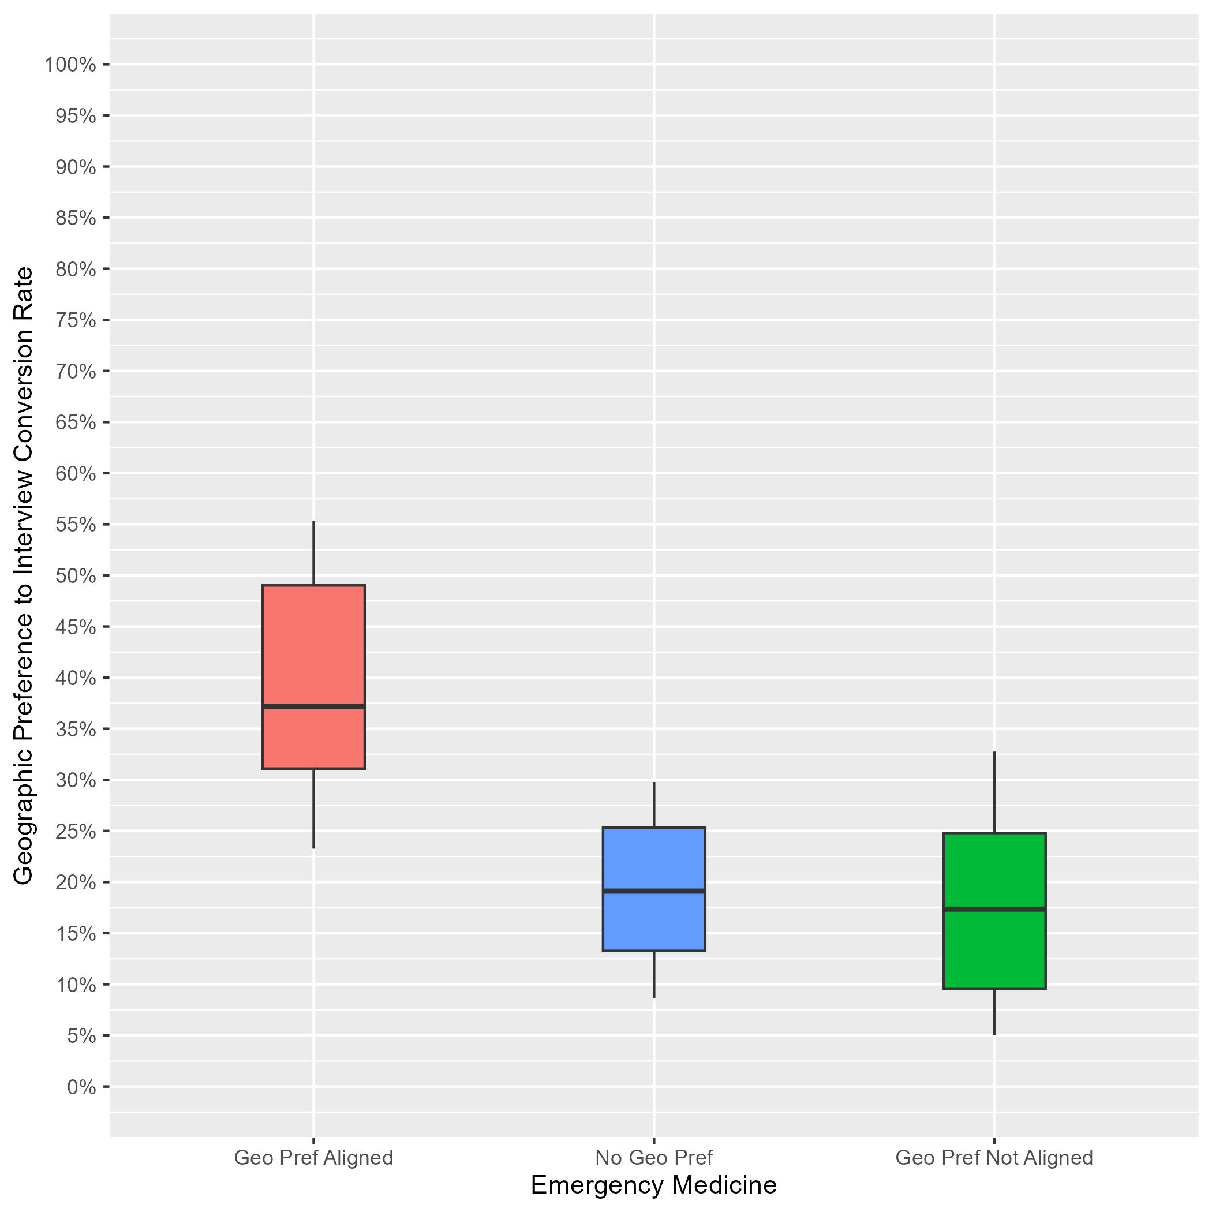
Emergency Medicine: Interview Rates by Geographic Preference Alignment
Data as of 2/28/24
# of Programs: 130
Applicants whose geographic preference aligned with the program:
Median of interview offers: 37%.
10th percentile: 23%.
90th percentile: 55%.
Applicants with no geographic preference:
Median of interview offers: 19%.
10th percentile: 9%.
90th percentile: 30%.
Applicants whose geographic preference(s) did not align with the program:
Median of interview offers: 17%.
10th percentile: 5%.
90th percentile: 33%.
Notes:
Year 1 findings suggest that:
In general, applicants whose geographic preferences aligned with the program’s location were invited to interview at a higher rate than those who reported no preference and those whose preferences were misaligned (37% vs 19% vs 17%). There was not much overlap between the aligned geographic preference distribution and the other distributions, suggesting that programs put more weight on aligned preferences than no or misaligned preferences.
There was a lot of overlap between the distributions for applicants with no geographic preference and those with misaligned geographic preferences, suggesting that many PDs may not have differentiated between these two responses, and there is a need for additional training.

Slide 19
Family Medicine: Program Sample & Inclusion Criteria
 | N of Programs for Geographic Preference
Total programs | 730
Total programs who made geographic preference viewable at their program | 392
Met inclusion rule equal to or larger than 7:1; Provided PGY1 info in GME track; Provided interview offer data by February 28, 2024 | 347
Total analytic sample | 347
Total % of programs who made geographic preference viewable at their program | 89%
Total % of all Family Medicine programs in 2024 ERAS cycle | 48%
Notes:
There were a total of 730 Family Medicine programs in the 2024 ERAS cycle. Out of those, 392 made geographic preference viewable at their program as of 9/29/23.
We included 347 of them from this analysis because they reported PGY1 information in GME track; provided interview invitation data by February 28, 2024, (which is when we pulled the data); and met the inclusion rule for quality data that was created by Family Medicine specialty leadership. That rule specified that any interview data provided by a program could only be included if the ratio of interview invites to positions available in that program was equal to or larger than 7:1.
The final analytic sample for the geographic preference analysis was 347 Family Medicine programs, representing approximately 89% of all eligible family medicine programs and 48% of the total Family Medicine program population for the 2024 ERAS cycle.

Slide 20
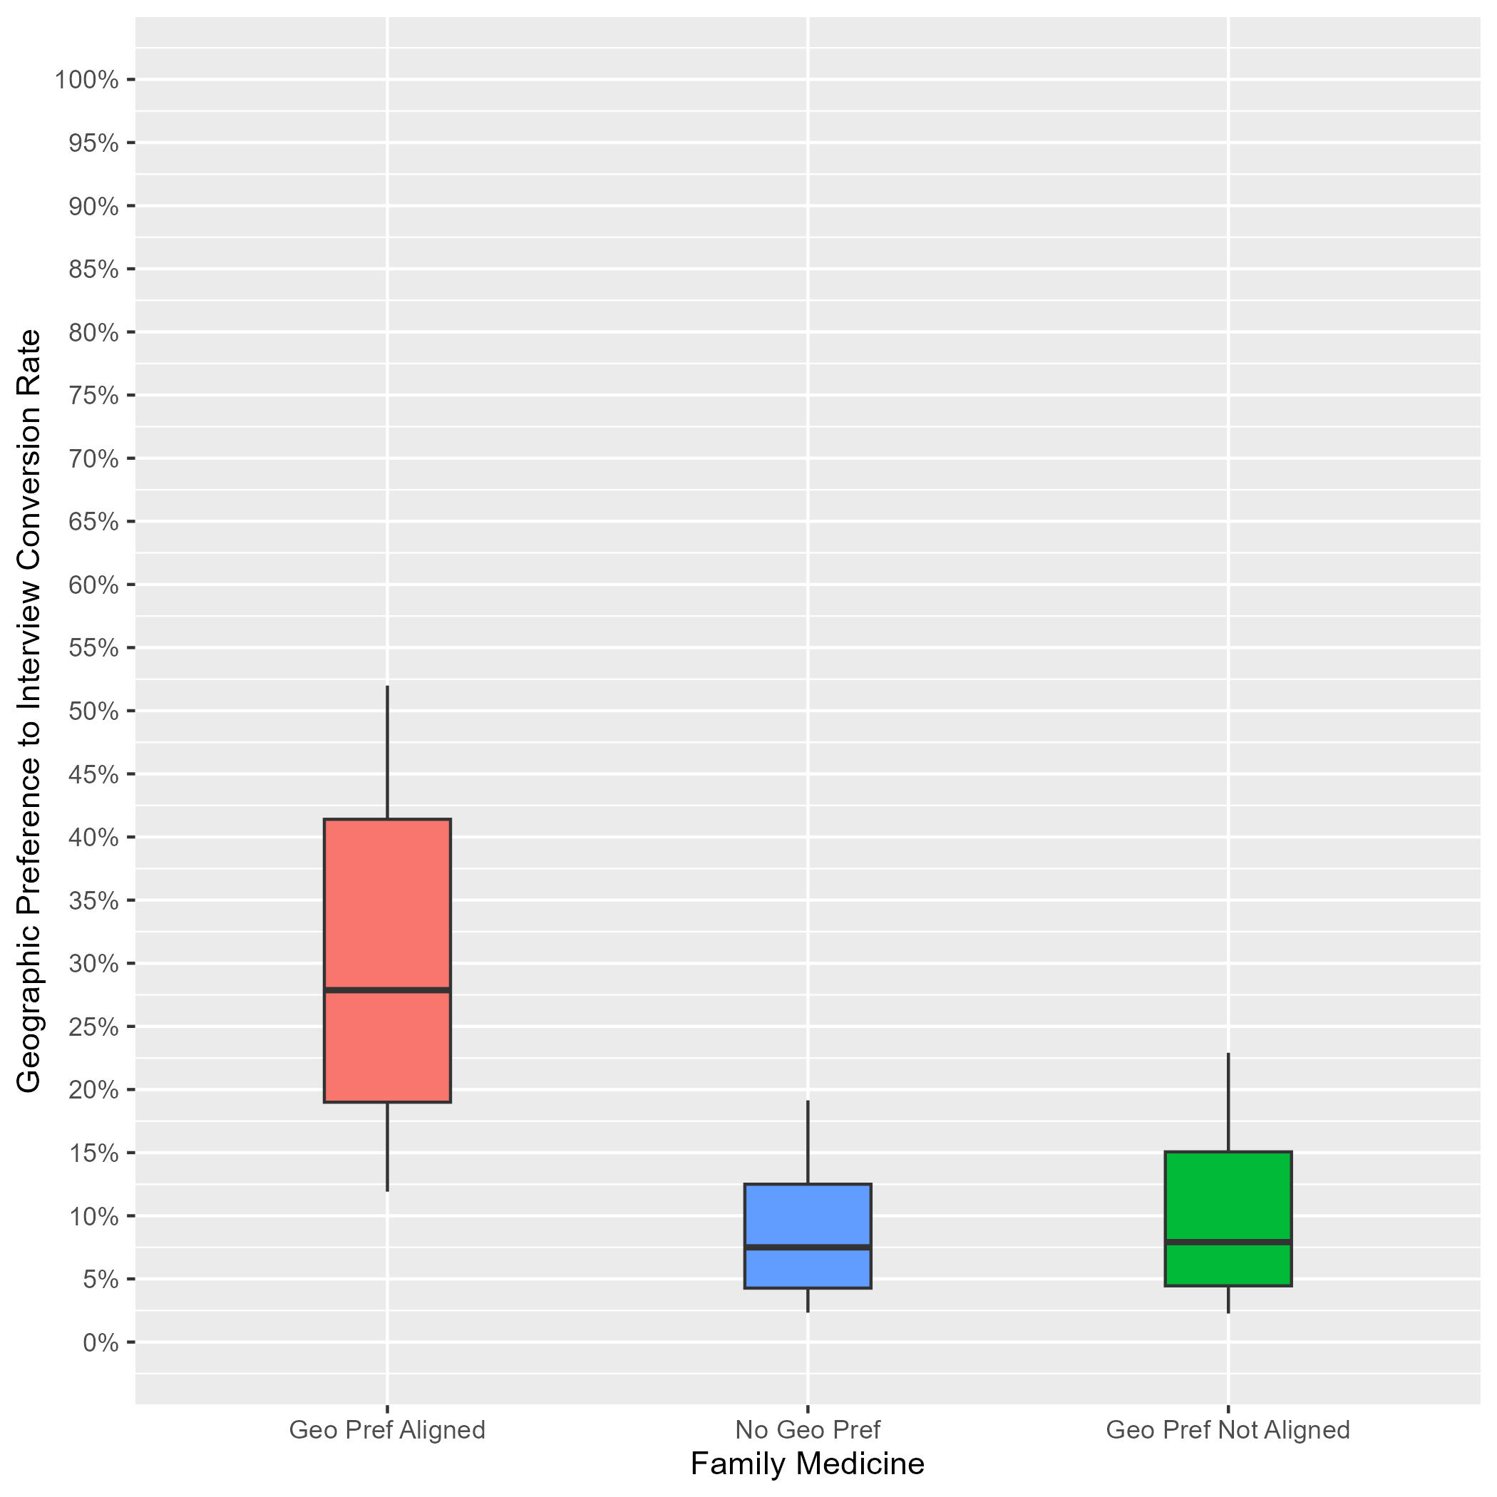
Family Medicine: Interview Rates by Geographic Preference Alignment
Data as of 2/28/24
# of Programs: 347
Applicants whose geographic preference aligned with the program:
Median of interview offers: 28%.
10th percentile: 12%.
90th percentile: 52%.
Applicants with no geographic preference:
Median of interview offers: 8%.
10th percentile: 2%.
90th percentile: 19%.
Applicants whose geographic preference(s) did not align with the program:
Median of interview offers: 8%.
10th percentile: 2%.
90th percentile: 23%.
Notes:
Year 1 findings suggest that:
In general, applicants whose geographic preferences aligned with the program’s location were invited to interview at a higher rate than those who reported no preference and those whose preferences were misaligned (28% vs 8% vs 8%). There was not much overlap between the aligned geographic preference distribution and the other distributions, suggesting that programs put more weight on aligned preferences than no or misaligned preferences.
There was a lot of overlap between the distributions for applicants with no geographic preference and those with misaligned geographic preferences, suggesting that many PDs may not have differentiated between these two responses, and there is a need for additional training.

Slide 21
General Surgery: Program Sample & Inclusion Criteria
 | N of Programs for Geographic Preference
Total programs | 344
Total programs who made geographic preference viewable at their program | 158
Met inclusion rule equal to or larger than 7:1; Provided PGY1 info in GME track; Provided interview offer data by February 28, 2024 | 114
Total analytic sample | 114
Total % of programs who made geographic preference viewable at their program | 72%
Total % of all General Surgery programs in 2024 ERAS cycle | 33%
Notes:
There were a total of 344 General Surgery programs in the 2024 ERAS cycle. Out of those, 158 made geographic preference viewable at their program as of 9/29/23.
We included 114 of them from this analysis because they reported PGY1 information in GME track; provided interview invitation data by February 28, 2024, (which is when we pulled the data); and met the inclusion rule for quality data that was created by General Surgery specialty leadership. That rule specified that any interview data provided by a program could only be included if the ratio of interview invites to positions available in that program was equal to or larger than 8:1.
The final analytic sample for the geographic preference analysis was 114 General Surgery programs, representing approximately 72% of all eligible general surgery programs and 33% of the total General Surgery program population for the 2024 ERAS cycle.

Slide 22
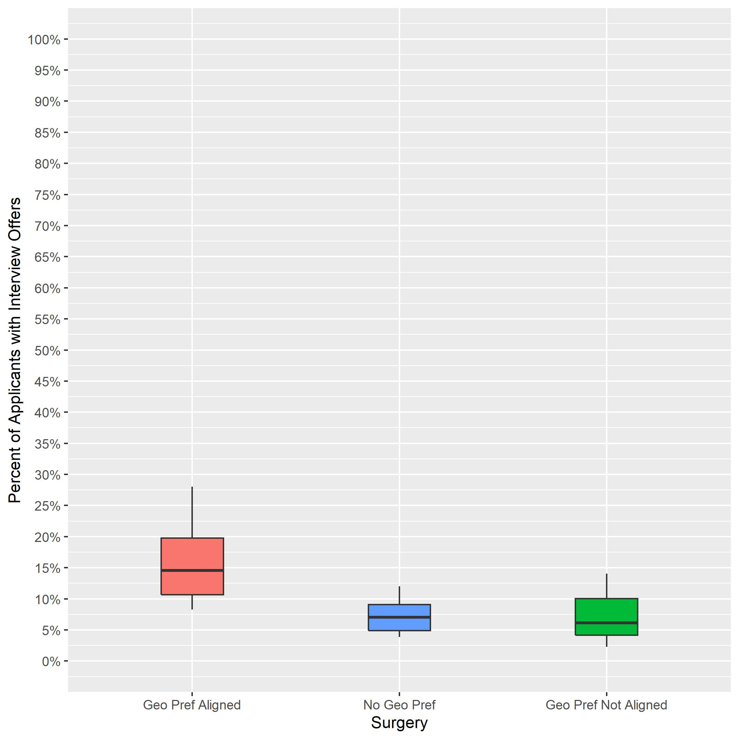
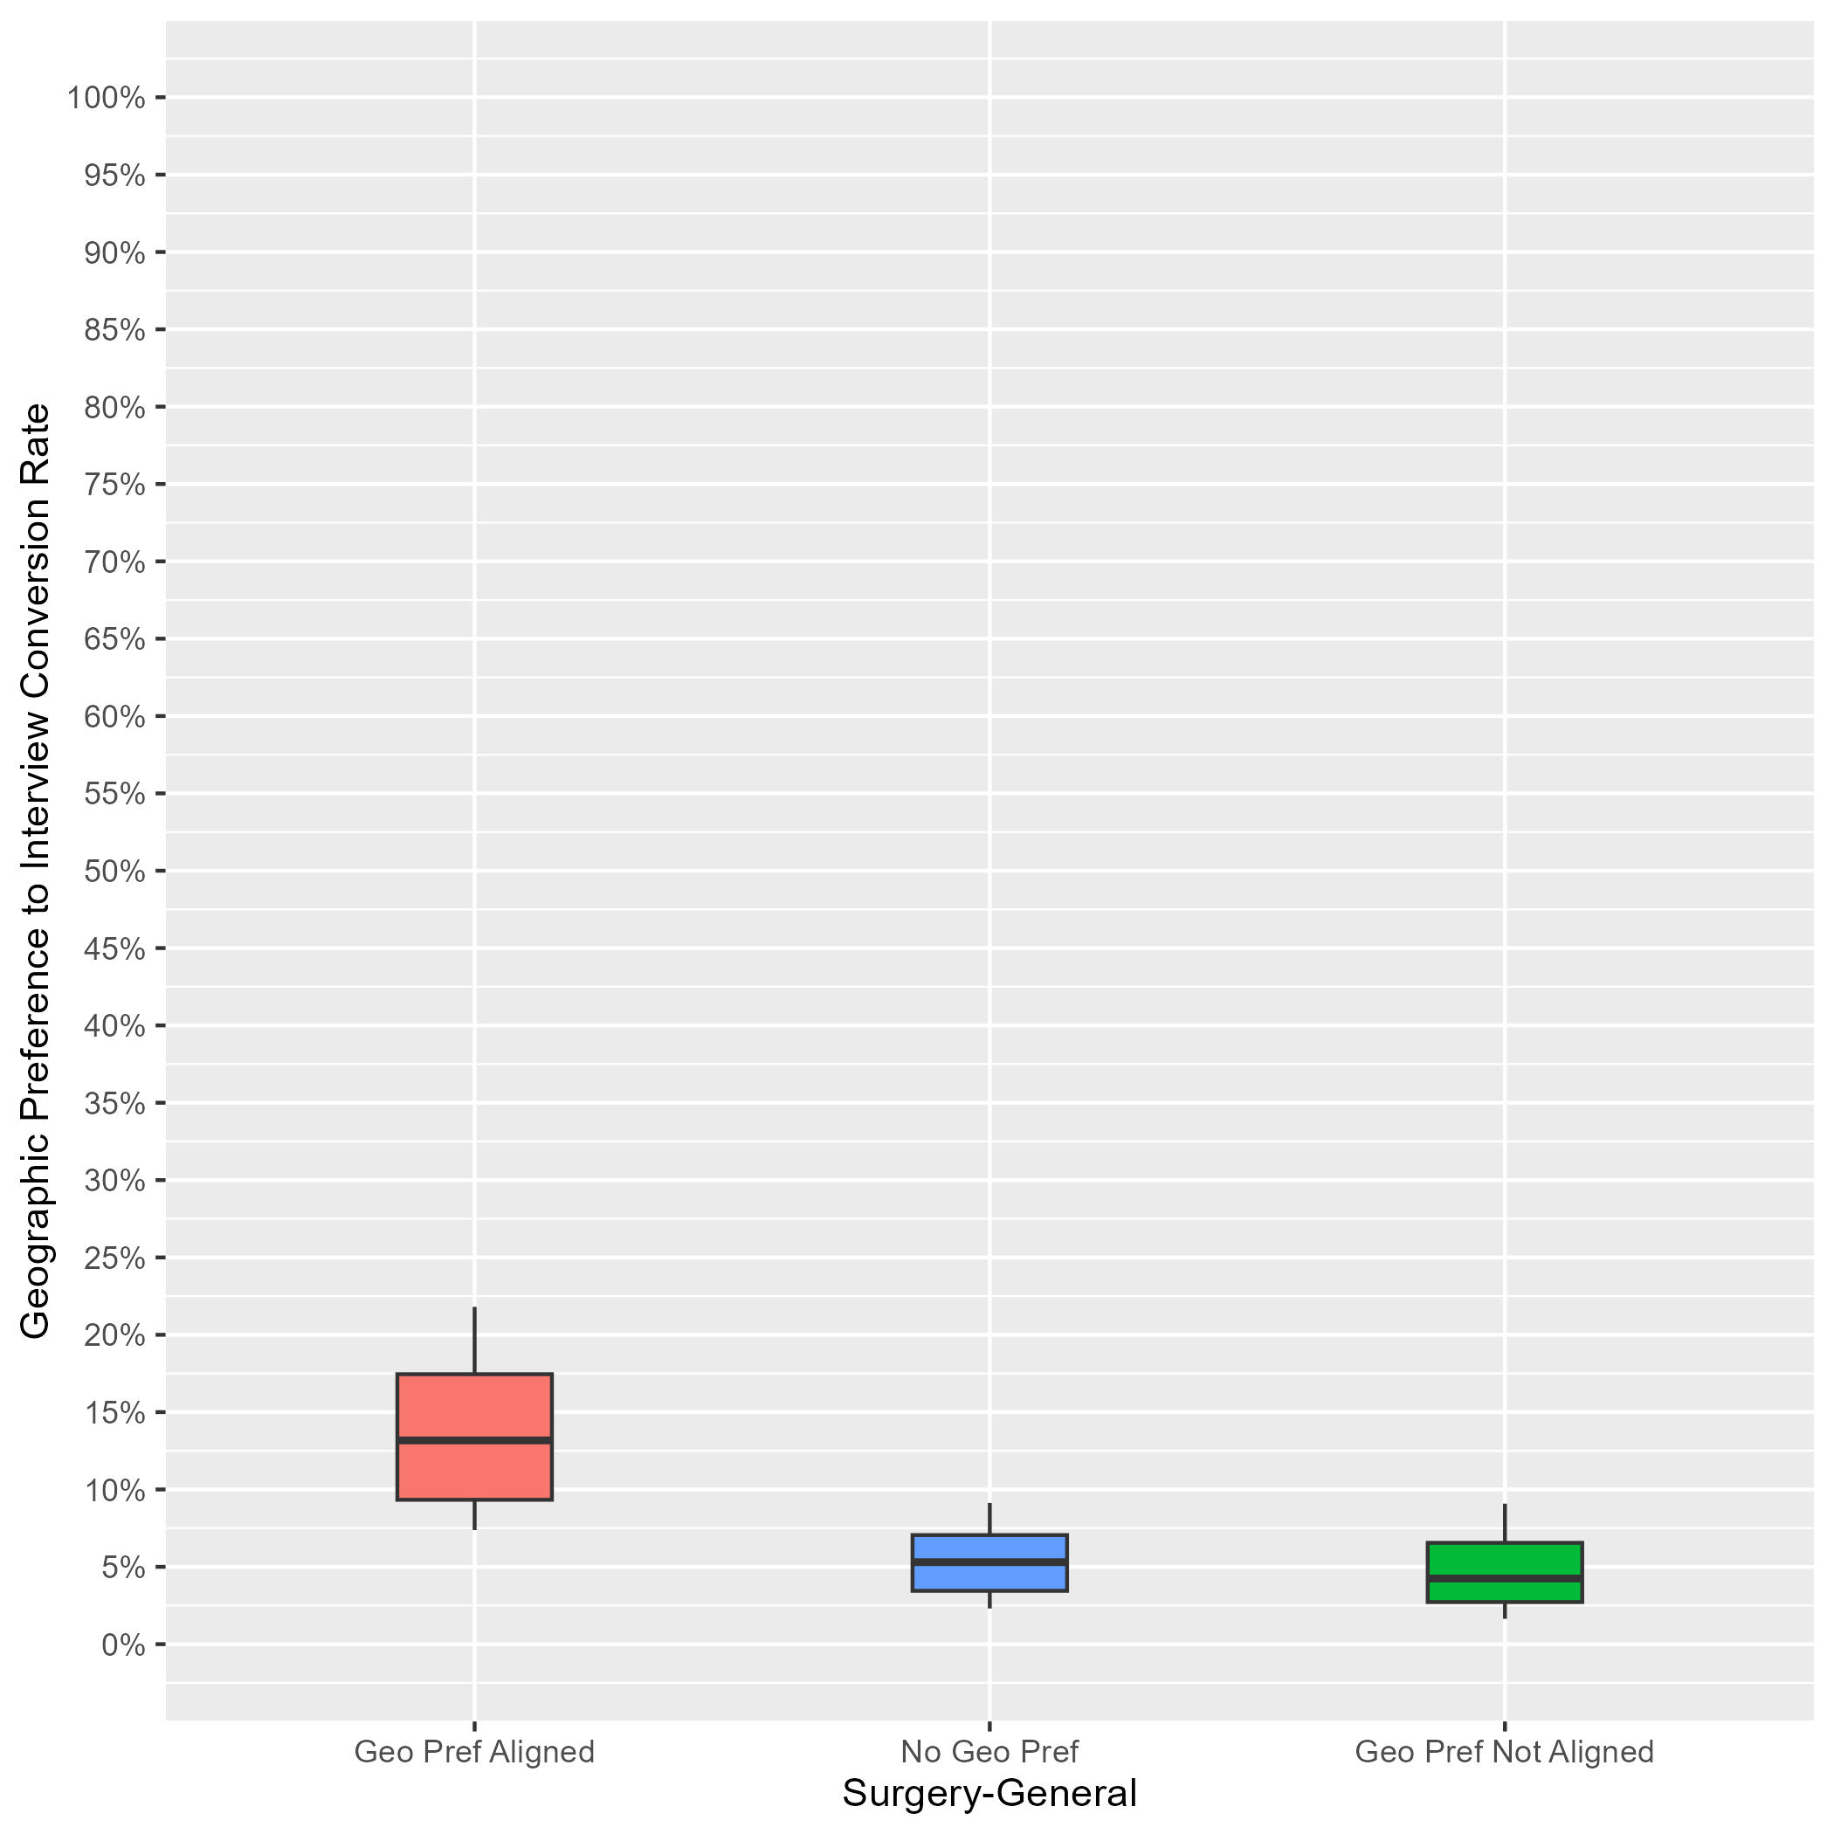
General Surgery: Interview Rates by Geographic Preference Alignment Year-Over-Year Comparison
2023 ERAS Data as of 3/15/23
# of Programs: 166
2024 ERAS Data as of 2/28/24
# of Programs: 114
Geographic Preference to interview Conversion Rate
Notes:
Year 2 findings suggest that:
In general, applicants whose geographic preferences aligned with the program’s location were invited to interview at a higher rate than those who reported no preference and those whose preferences were misaligned (13% vs 5% vs 4%). Further, there was not much overlap between the aligned geographic preference distribution and the other distributions, suggesting that programs put more weight on aligned preferences than no or misaligned preferences.
There was a lot of overlap between the distributions for applicants with no geographic preference and those with misaligned geographic preferences, suggesting both that many PDs may not have differentiated between these two responses, and there is a need for additional training.
Average interview invitation rates for aligned geographic preference in 2023 (15%) are similar to 2024 aligned geographic preference invitation rates (13%).
The number of programs in the sample for 2024 is lower than 2023 because we implemented a new inclusion rule based on whether a program made geographic preference viewable at their program.

Slide 23
Internal Medicine: Program Sample & Inclusion Criteria
 | N of Programs for Geographic Preference
Total programs | 626
Total programs who made geographic preference viewable at their program | 308
Met inclusion rule equal to or larger than 7:1; Provided PGY1 info in GME track; Provided interview offer data by February 28, 2024 | 270
Total analytic sample | 270
Total % of programs who made geographic preference viewable at their program | 88%
Total % of all Internal Medicine programs in 2024 ERAS cycle | 43%
Notes:
There were a total of 626 Internal Medicine programs in the 2024 ERAS cycle. Out of those, 308 made geographic preference viewable at their program as of 9/29/23.
We included 270 of them from this analysis because they reported PGY1 information in GME track; provided interview invitation data by February 28, 2024, (which is when we pulled the data); and met the inclusion rule for quality data that was created by Internal Medicine specialty leadership. That rule specified that any interview data provided by a program could only be included if the ratio of interview invites to positions available in that program was equal to or larger than 5:1.
The final analytic sample for the geographic preference analysis was 270 Internal Medicine programs, representing approximately 88% of all eligible internal medicine programs and 43% of the total internal medicine program population for the 2024 ERAS cycle.

Slide 24
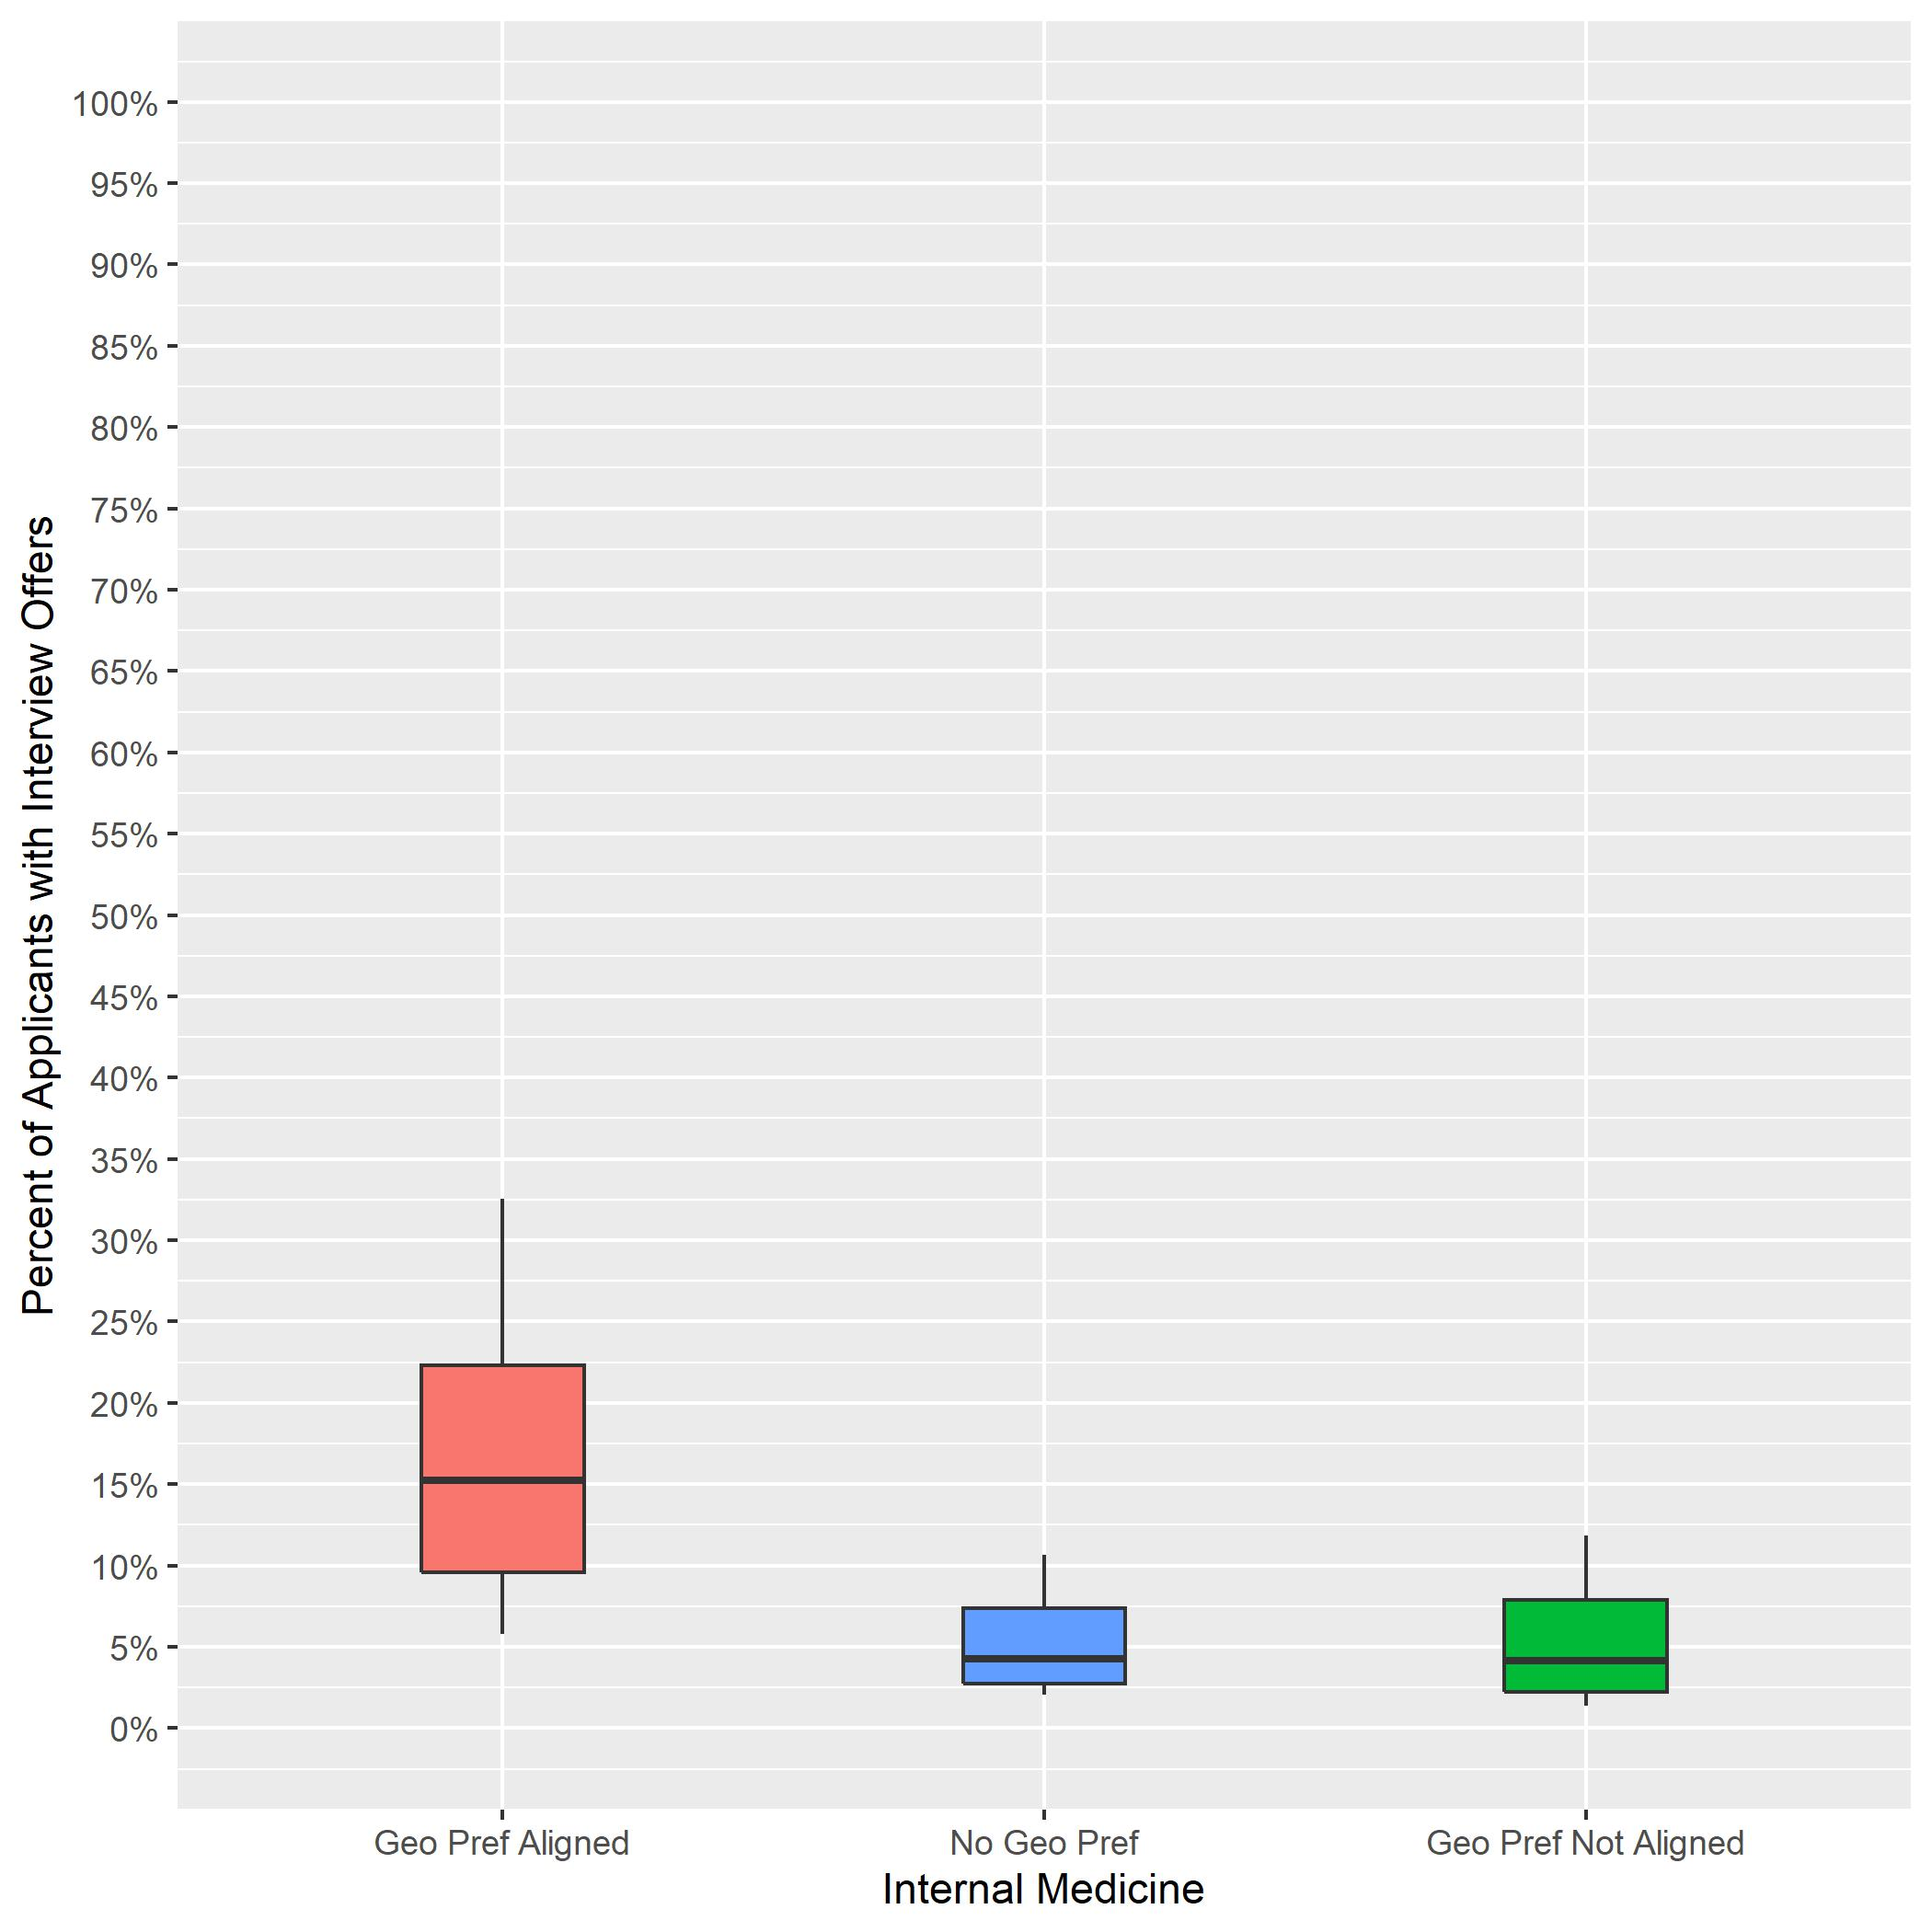
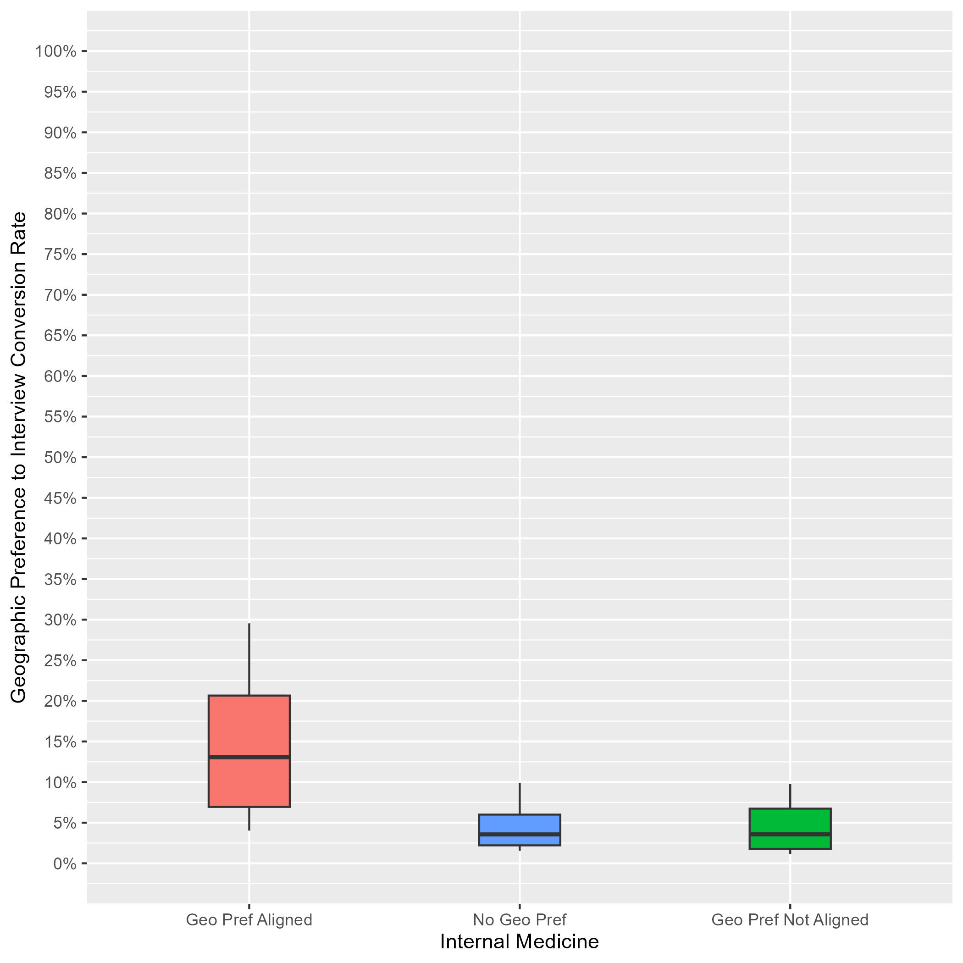
Internal Medicine: Interview Rates by Geographic Preference Alignment Year-Over-Year Comparison
2023 ERAS Data as of 3/15/23
# of Programs: 334
2024 ERAS Data as of 2/28/24
# of Programs: 270
Geographic Preference to interview Conversion Rate
Notes:
Year 2 findings suggest that:
In general, applicants whose geographic preferences aligned with the program’s location were invited to interview at a higher rate than those who reported no preference and those whose preferences were misaligned (13% vs 4% vs 4%). Further, there was not much overlap between the aligned geographic preference distribution and the other distributions, suggesting that programs put more weight on aligned preferences than no or misaligned preferences.
There was a lot of overlap between the distributions for applicants with no geographic preference and those with misaligned geographic preferences, suggesting that many PDs may not have differentiated between these two responses, and there is a need for additional training.
Average interview invitation rates for aligned geographic preference in 2023 (15%) are similar to 2024 aligned geographic preference invitation rates (13%).
The number of programs in the sample for 2024 is lower than 2023 because we implemented a new inclusion rule based on whether a program made geographic preference viewable at their program.

Slide 25
Internal Medicine/Pediatrics: Program Sample & Inclusion Criteria
 | N of Programs for Geographic Preference
Total programs | 77
Total programs who made geographic preference viewable at their program | 39
Met inclusion rule equal to or larger than 7:1; Provided PGY1 info in GME track; Provided interview offer data by February 28, 2024 | 35
Total analytic sample | 35
Total % of programs who made geographic preference viewable at their program | 90%
Total % of all Internal Medicine/Pediatrics programs in 2024 ERAS cycle | 45%
Notes:
There were a total of 77 Internal Medicine/Pediatrics programs in the 2024 ERAS cycle. Out of those, 39 made geographic preference viewable at their program as of 9/29/23.
We included 35 of them from this analysis because they reported PGY1 information in GME track; provided interview invitation data by February 28, 2024, (which is when we pulled the data); and met the inclusion rule for quality data that was created by Internal Medicine/Pediatrics specialty leadership. That rule specified that any interview data provided by a program could only be included if the ratio of interview invites to positions available in that program was equal to or larger than 7:1.
The final analytic sample for the geographic preference analysis was 35 Internal Medicine/Pediatrics programs, representing approximately 90% of all eligible Internal Medicine/Pediatrics programs and 45% of the total Internal Medicine/Pediatrics program population for the 2024 ERAS cycle.

Slide 26
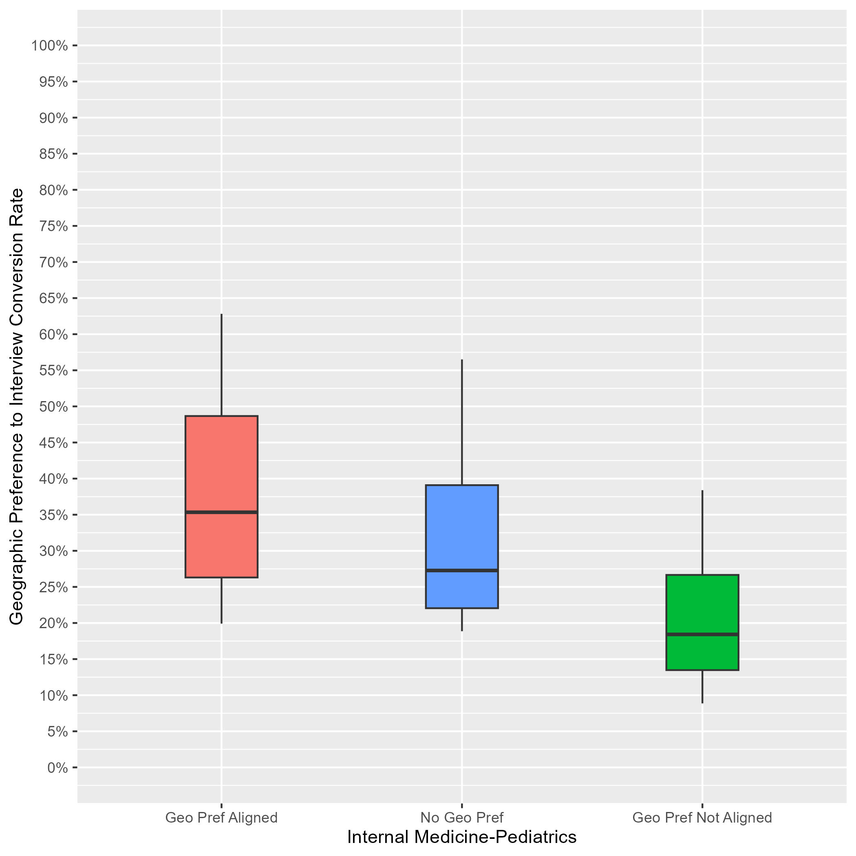
Internal Medicine/Pediatrics: Interview Rates by Geographic Preference Alignment
Data as of 2/28/24
# of Programs: 35
Applicants whose geographic preference aligned with the program:
Median of interview offers: 35%.
10th percentile: 20%.
90th percentile: 63%.
Applicants with no geographic preference:
Median of interview offers: 27%.
10th percentile: 19%.
90th percentile: 57%.
Applicants whose geographic preference(s) did not align with the program:
Median of interview offers: 18%.
10th percentile: 9%.
90th percentile: 38%.
Notes:
Year 1 findings suggest that:
In general, applicants whose geographic preferences aligned with the program’s location were invited to interview at a higher rate than those who reported no preference and those whose preferences were misaligned. (35% vs 27% vs 18%). However, there was noticeable overlap between the aligned geographic preference distribution and the no geographic preference distribution, indicating that some programs did not differentiate these responses.
There was a little overlap between the distributions for applicants with misaligned geographic preference and the other distributions, suggesting that many PDs may not have differentiated among these three responses, and there is a need for additional training.

Slide 27
Internal Medicine/Psychiatry: Program Sample & Inclusion Criteria
 | N of Programs for Geographic Preference
Total programs | 13
Total programs who made geographic preference viewable at their program | 10
Met inclusion rule equal to or larger than 7:1; Provided PGY1 info in GME track; Provided interview offer data by February 28, 2024 | 10
Total analytic sample | 10
Total % of programs who made geographic preference viewable at their program | 100%
Total % of all Internal Medicine/Psychiatry programs in 2024 ERAS cycle | 77%
Notes:
There were a total of 13 Internal Medicine/Psychiatry programs in the 2024 ERAS cycle. Out of those 10 made geographic preference viewable at their program as of 9/29/23.
We included 10 of them from this analysis because they reported PGY1 information in GME track; provided interview invitation data by February 28, 2024, (which is when we pulled the data); and met the inclusion rule for quality data that was created by Internal Medicine/Psychiatry specialty leadership. And that rule was that any interview data provided by a program could only be included if the ratio of interview invites to positions available in that program was equal to or larger than 7:1.
The final analytic sample for the geographic preference analysis was 10 Internal Medicine/Psychiatry programs, representing approximately 100% of all eligible Internal Medicine/Psychiatry programs and 77% of the total Internal Medicine/Psychiatry program population for the 2024 ERAS cycle.

Slide 28
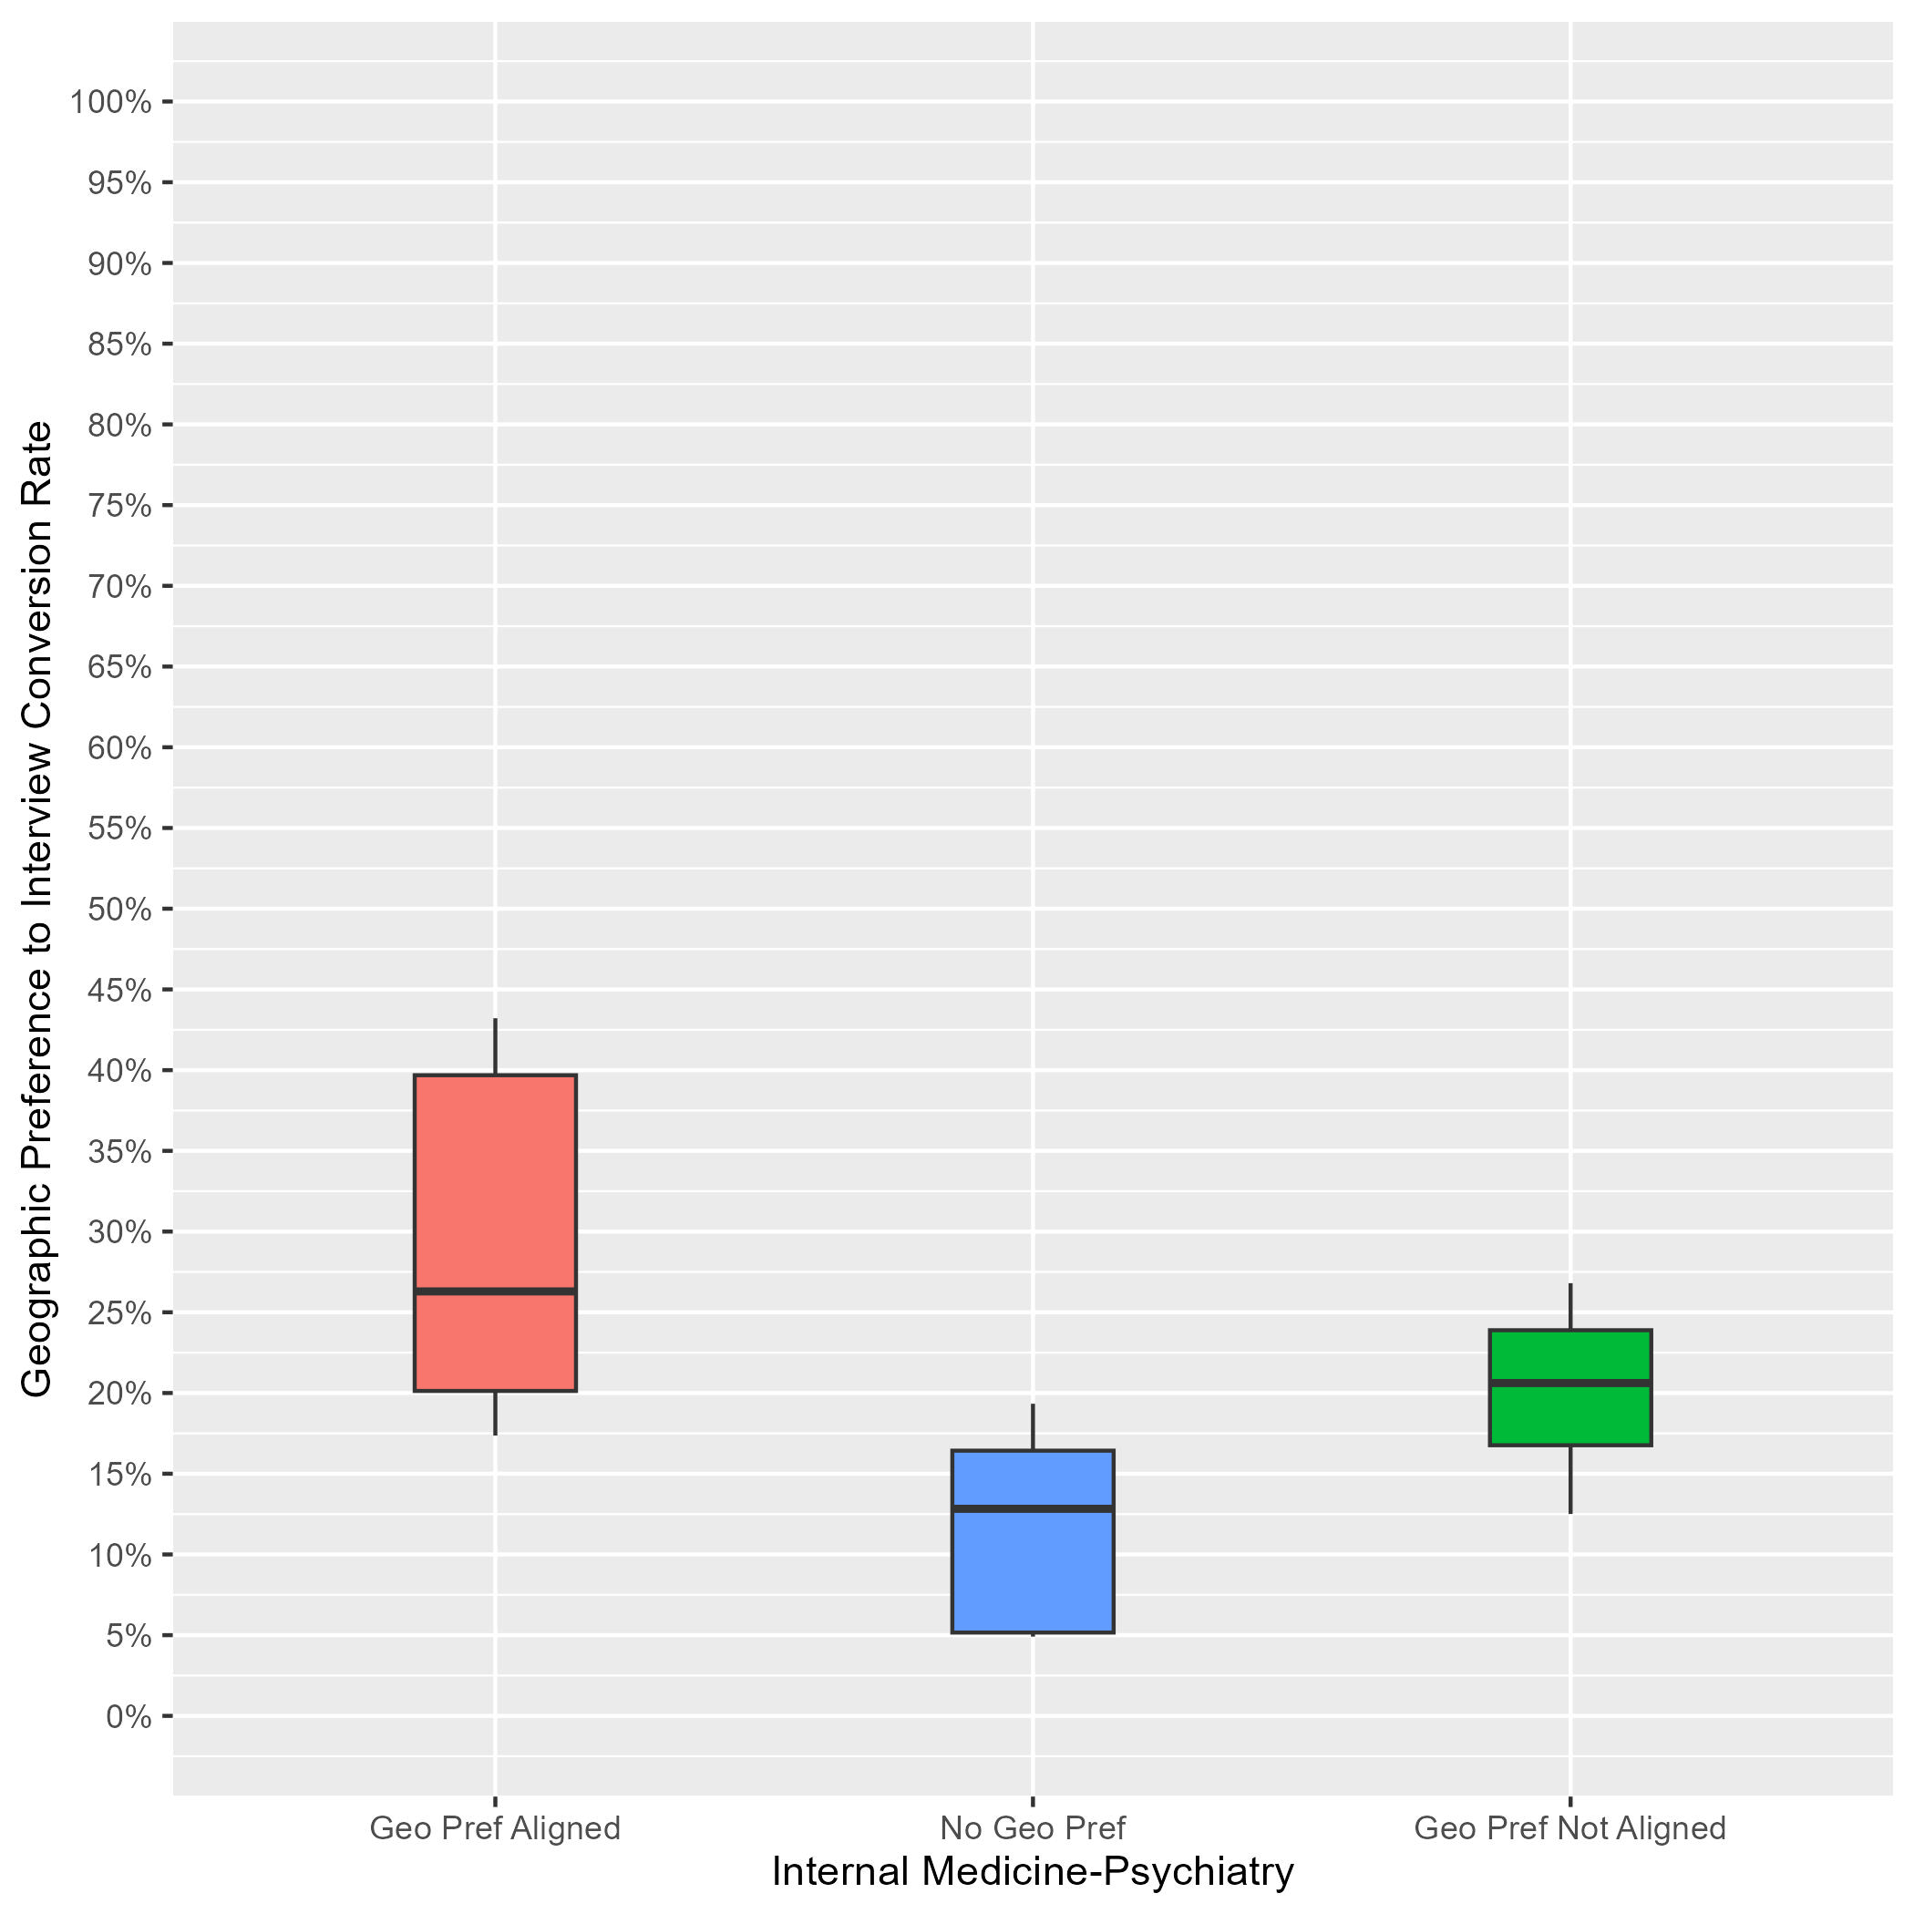
Internal Medicine/Psychiatry: Interview Rates by Geographic Preference Alignment
Data as of 2/28/24
# of Programs: 10
Applicants whose geographic preference aligned with the program:
Median of interview offers: 26%.
10th percentile: 17%.
90th percentile: 43%.
Applicants with no geographic preference:
Median of interview offers: 13%.
10th percentile: 5%.
90th percentile: 19%.
Applicants whose geographic preference(s) did not align with the program:
Median of interview offers: 21%.
10th percentile: 13%.
90th percentile: 27%.
Notes:
Year 1 findings suggest that:
In general, applicants whose geographic preferences aligned with the program’s location were invited to interview at a higher rate than those who reported no preference and those whose preferences were misaligned. (26% vs 13% vs 21%).
There was a little overlap between the distributions for applicants with aligned geographic preference and those applicants with misaligned geographic preferences, suggesting that many PDs may not have differentiated these two response, and suggesting a need for additional training. Furthermore, applicants with misaligned geographic preference had higher invited to interview rates than applicants with no geographic preference.

Slide 29
Interventional Radiology: Program Sample & Inclusion Criteria
 | N of Programs for Geographic Preference
Total programs | 96
Total programs who made geographic preference viewable at their program | 50
Met inclusion rule equal to or larger than 7:1; Provided PGY1 info in GME track; Provided interview offer data by February 28, 2024 | 29
Total analytic sample | 29
Total % of programs who made geographic preference viewable at their program | 58%
Total % of all Interventional Radiology programs in 2024 ERAS cycle | 30%
Notes:
There were a total of 96 Interventional Radiology programs in the 2024 ERAS cycle. Out of those, 50 made geographic preference viewable at their program as of 9/29/23.
We included 29 of them from this analysis because they reported PGY1 information in GME track; provided interview invitation data by February 28, 2024, (which is when we pulled the data); and met the inclusion rule for quality data that was created by Interventional Radiology specialty leadership. That rule specified that any interview data provided by a program could only be included if the ratio of interview invites to positions available in that program was between 10:1 and 40:1.
The final analytic sample for the geographic preference analysis was 29 Interventional Radiology programs representing approximately 58% of all eligible internal medicine programs and 30% of the total Interventional Radiology program population for the 2024 ERAS cycle.

Slide 30
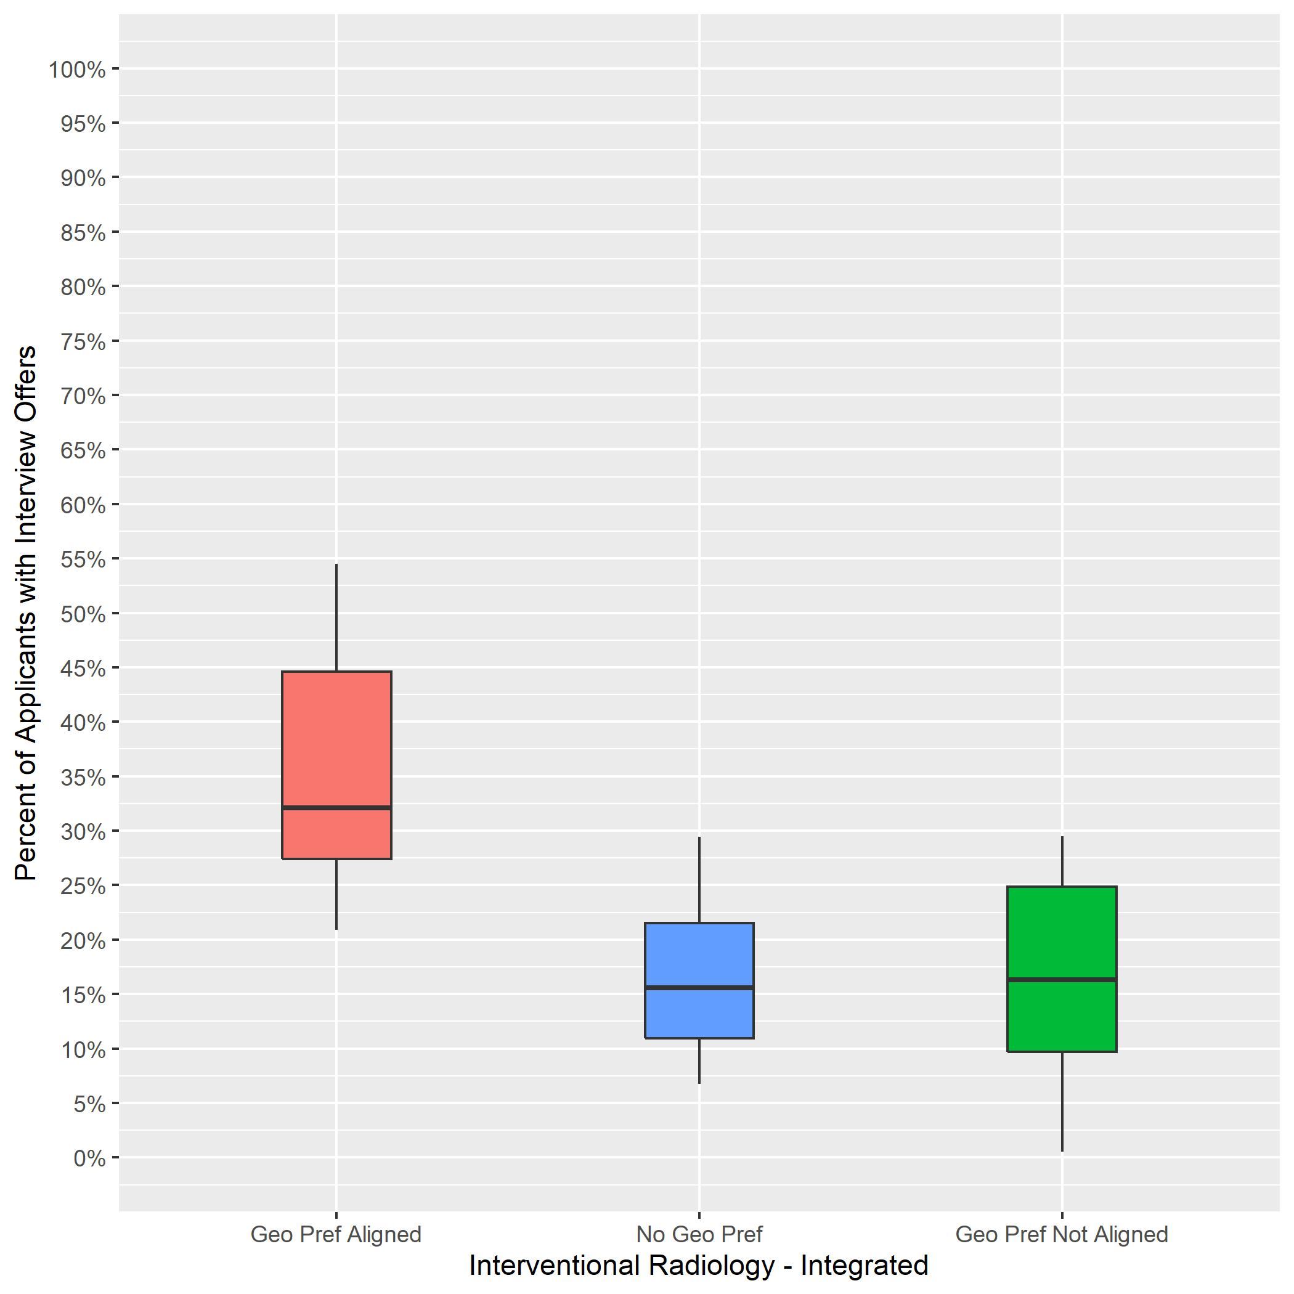
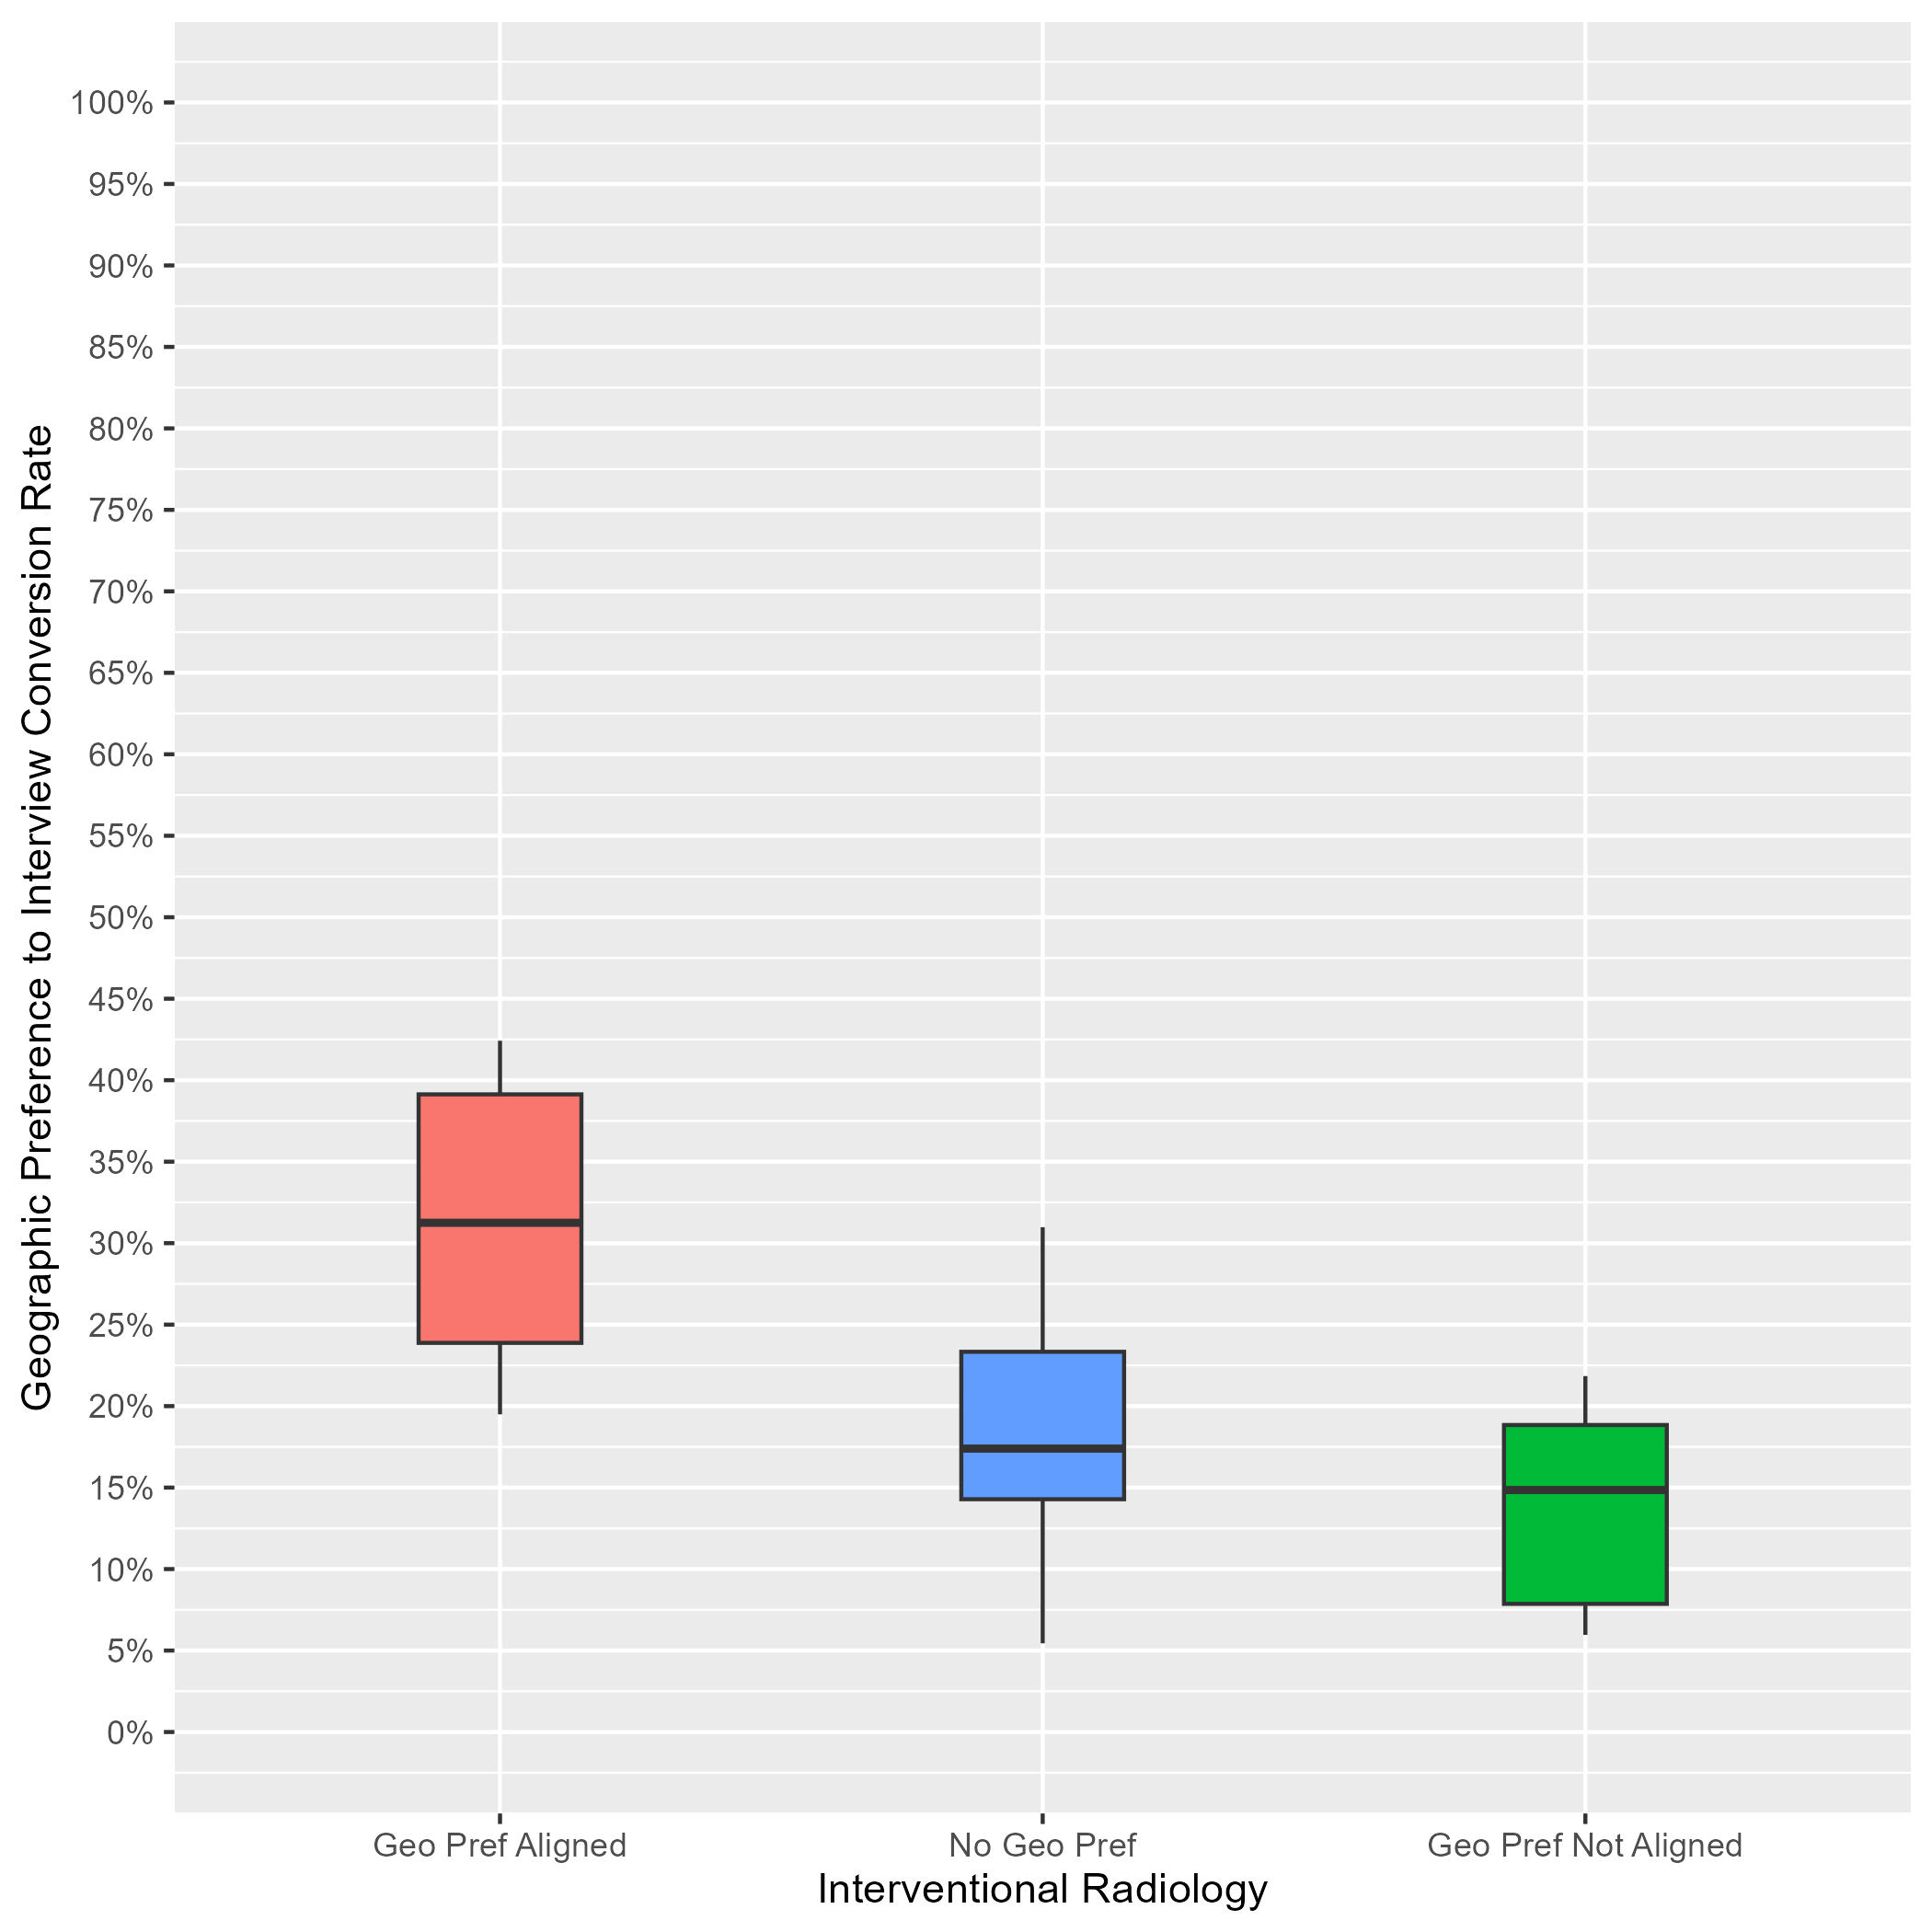
Interventional Radiology: Interview Rates by Geographic Preference Alignment Year-Over-Year Comparison
2023 ERAS Data as of 3/15/23
# of Programs: 63
2024 ERAS Data as of 2/28/24
# of Programs: 29
Geographic Preference to interview Conversion Rate
Notes:
Year 2 findings suggest that:
In general, applicants whose geographic preferences aligned with the program’s location were invited to interview at a higher rate than those who reported no preference and those whose preferences were misaligned. (31% vs 17% vs 15%). Further, there was not much overlap between the aligned geographic preference distribution and the other distributions, suggesting that programs put more weight on aligned preferences than no or misaligned preferences.
There was a lot of overlap between the distributions for applicants with no geographic preference and those with misaligned geographic preferences, suggesting that many PDs may not have differentiated between these two responses, and there is a need for additional training.
Average interview invitation rates for aligned geographic preference in 2023 (32%) are similar to 2024 aligned geographic preference invitation rates (31%).
The number of programs in the sample for 2024 is lower than 2023 because we implemented a new inclusion rule based on whether a program made geographic preference viewable at their program.

Slide 31
Neurological Surgery: Program Sample & Inclusion Criteria
 | N of Programs for Geographic Preference
Total programs | 116
Total programs who made geographic preference viewable at their program | 54
Met inclusion rule equal to or larger than 7:1; Provided PGY1 info in GME track; Provided interview offer data by February 28, 2024 | 43
Total analytic sample | 43
Total % of programs who made geographic preference viewable at their program | 80%
Total % of all Neurological Surgery programs in 2024 ERAS cycle | 37%
Notes:
There were a total of 116 Neurological Surgery programs in the 2024 ERAS cycle. Out of those 54 made geographic preference viewable at their program as of 9/29/23.
We included 43 of them from this analysis because they reported PGY1 information in GME track; provided interview invitation data by February 28, 2024, (which is when we pulled the data); and met the inclusion rule for quality data that was created by Neurological Surgery specialty leadership. That rule specified that any interview data provided by a program could only be included if the ratio of interview invites to positions available in that program was equal to or larger than 7:1.
The final analytic sample for the geographic preference analysis was 43 Neurological Surgery programs, representing approximately 80% of all eligible neurological surgery programs and 37% of the total Neurological Surgery program population for the 2024 ERAS cycle.

Slide 32
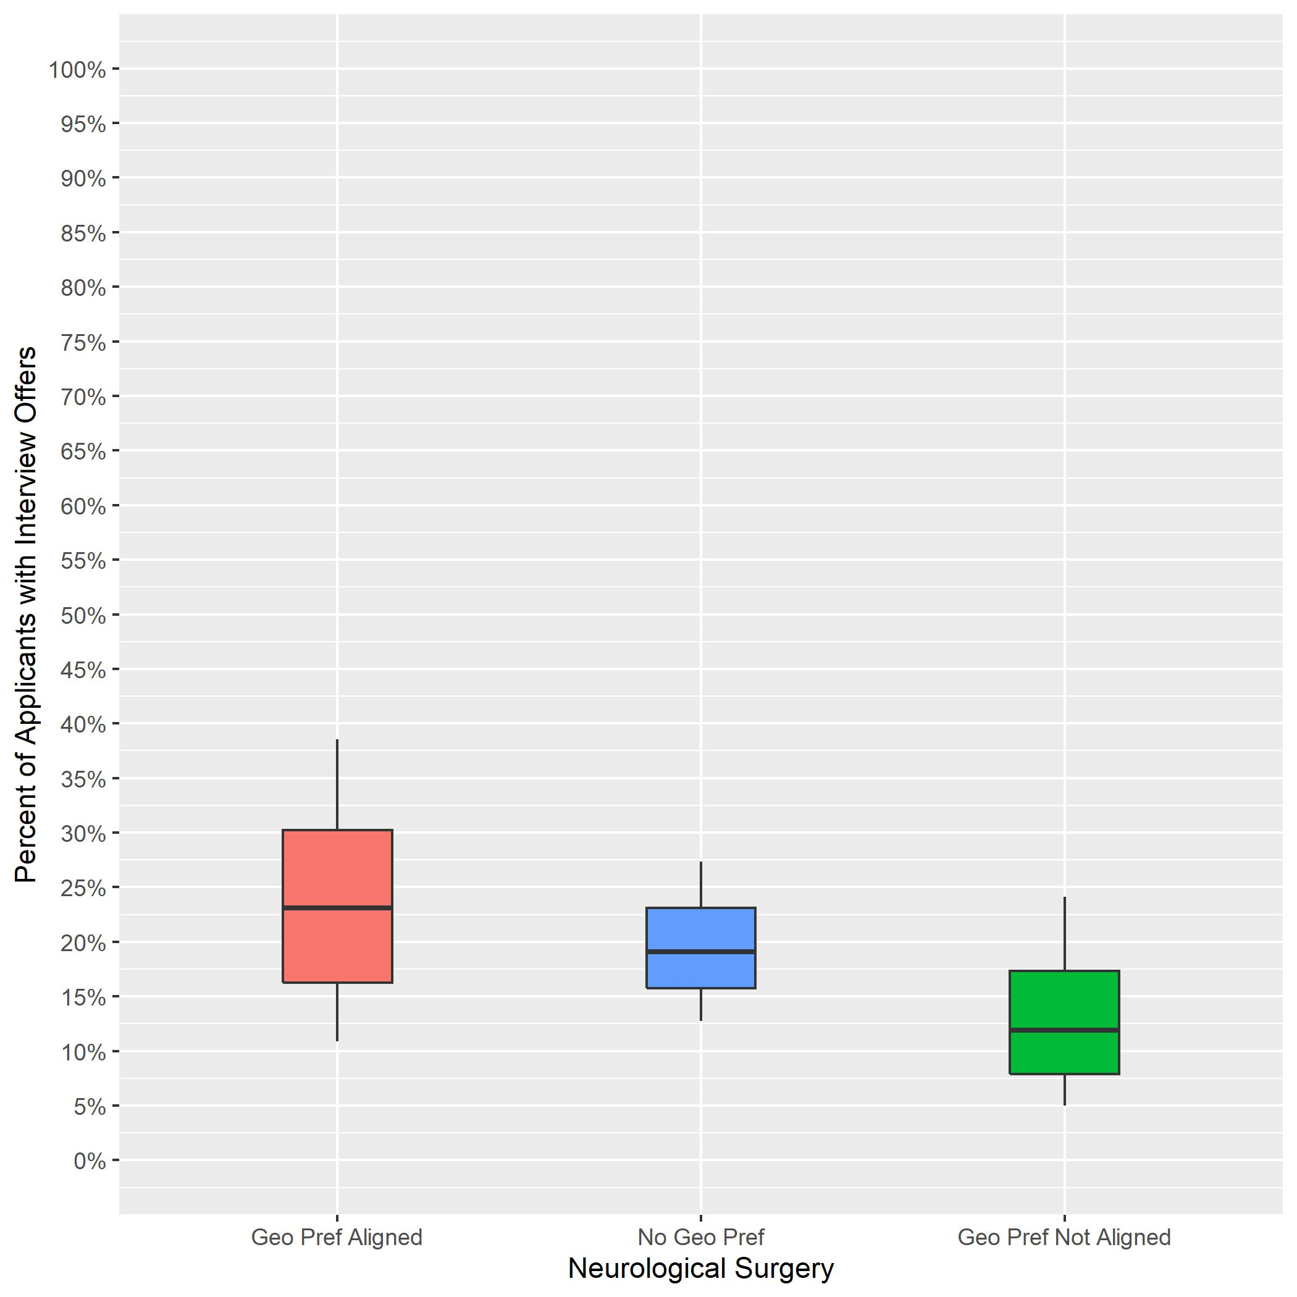
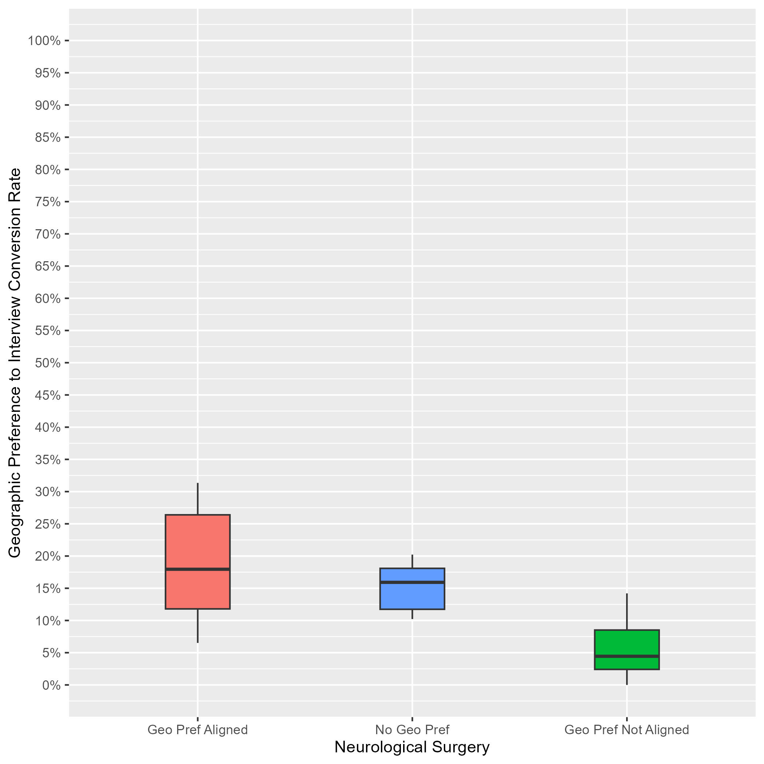
Neurological Surgery: Interview Rates by Geographic Preference Alignment Year-Over-Year Comparison
2023 ERAS Data as of 3/15/23
# of Programs: 85
2024 ERAS Data as of 2/28/24
# of Programs: 43
Geographic Preference to interview Conversion Rate
Notes:
Year 2 findings suggest that:
In general, applicants whose geographic preferences aligned with the program’s location were invited to interview at a higher rate than those who reported no preference and those whose preferences were misaligned. (18% vs 16% vs 4%). However, there was noticeable overlap between the aligned geographic preference distribution and the no geographic preference distribution, indicating that some programs did not differentiate these responses.
There was little overlap between the distributions for applicants with misaligned geographic preference and the other geographic preferences, which suggests most programs differentiated misaligned from the other two responses.
Average interview invitation rates for aligned geographic preference in 2023 (23%) are similar to 2024 aligned geographic preference invitation rates (18%).
The number of programs in the sample for 2024 is lower than 2023 because we implemented a new inclusion rule based on whether a program made geographic preference viewable at their program.

Slide 33
OBGYN: Program Sample & Inclusion Criteria
 | N of Programs for Geographic Preference
Total programs | 287
Total programs who made geographic preference viewable at their program | 140
Met inclusion rule equal to or larger than 7:1; Provided PGY1 info in GME track; Provided interview offer data by February 28, 2024 | 115
Total analytic sample | 115
Total % of programs who made geographic preference viewable at their program | 82%
Total % of all OBGYN programs in 2024 ERAS cycle | 40%
Notes:
There were a total of 287 OBGYN programs in the 2024 ERAS cycle. Out of those, 140 made geographic preference viewable at their program as of 9/29/23.
We included 115 of them from this analysis because they reported PGY1 information in GME track; provided interview invitation data by February 28, 2024, (which is when we pulled the data); and met the inclusion rule for quality data that was created by OBGYN specialty leadership. That rule specified that any interview data provided by a program could only be included if the ratio of interview invites to positions available in that program was between 8:1 and 25:1.
The final analytic sample for the geographic preference analysis was 115 OBGYN programs, representing approximately 82% of all eligible OBGYN programs and 40% of the total OBGYN program population for the 2024 ERAS cycle.

Slide 34
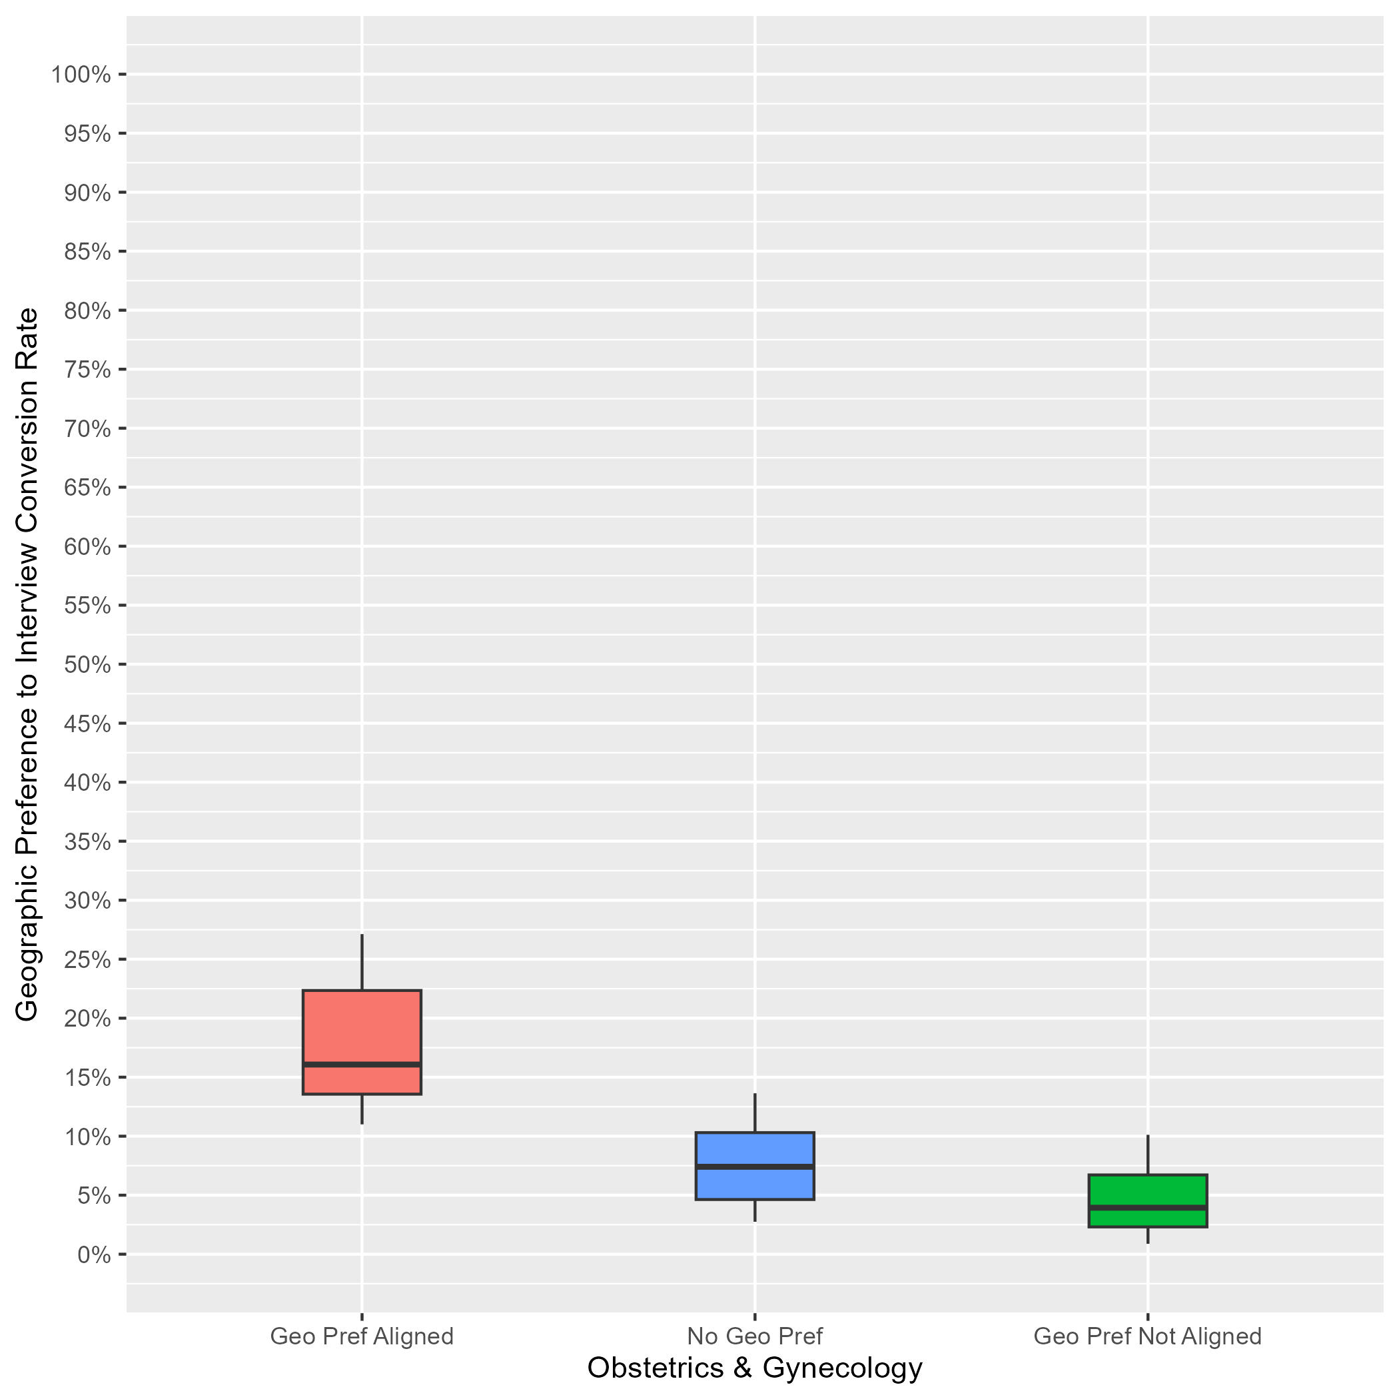
OBGYN: Interview Rates by Geographic Preference Alignment
Data as of 2/28/24
# of Programs: 115
Applicants whose geographic preference aligned with the program:
Median of interview offers: 16%.
10th percentile: 11%.
90th percentile: 27%.
Applicants with no geographic preference:
Median of interview offers: 7%.
10th percentile: 3%.
90th percentile: 14%.
Applicants whose geographic preference(s) did not align with the program:
Median of interview offers: 4%.
10th percentile: 1%.
90th percentile: 10%.
Notes:
Year 1 findings suggest that:
In general, applicants whose geographic preferences aligned with the program’s location were invited to interview at a higher rate than those who reported no preference and those whose preferences were misaligned. (16% vs 7% vs 4%). Further, there was not much overlap between the aligned geographic preference distribution and the other distributions, suggesting that programs put more weight on aligned preferences than no or misaligned preferences.
There was a lot of overlap between the distributions for applicants with no geographic preference and those with misaligned geographic preferences, suggesting that many PDs may not have differentiated between these two responses, and there is a need for additional training.

Slide 35
Orthopedic Surgery: Program Sample & Inclusion Criteria
 | N of Programs for Geographic Preference
Total programs | 201
Total programs who made geographic preference viewable at their program | 94
Met inclusion rule equal to or larger than 7:1; Provided PGY1 info in GME track; Provided interview offer data by February 28, 2024 | 69
Total analytic sample | 69
Total % of programs who made geographic preference viewable at their program | 73%
Total % of all Orthopedic Surgery programs in 2024 ERAS cycle | 34%
Notes:
There were a total of 201 Orthopedic Surgery programs in the 2024 ERAS cycle. Out of those, 94 made geographic preference viewable at their program as of 9/29/23.
We included 69 of them from this analysis because they reported PGY1 information in GME track; provided interview invitation data by February 28, 2024, (which is when we pulled the data); and met the inclusion rule for quality data that was created by Orthopedic Surgery specialty leadership. That rule specified that any interview data provided by a program could only be included if the ratio of interview invites to positions available in that program was equal to or larger than 5:1.
The final analytic sample for the geographic preference analysis was 69 Orthopedic Surgery programs, representing approximately 73% of all eligible orthopedic surgery programs and 34% of the total Orthopedic Surgery program population for the 2024 ERAS cycle.

Slide 36
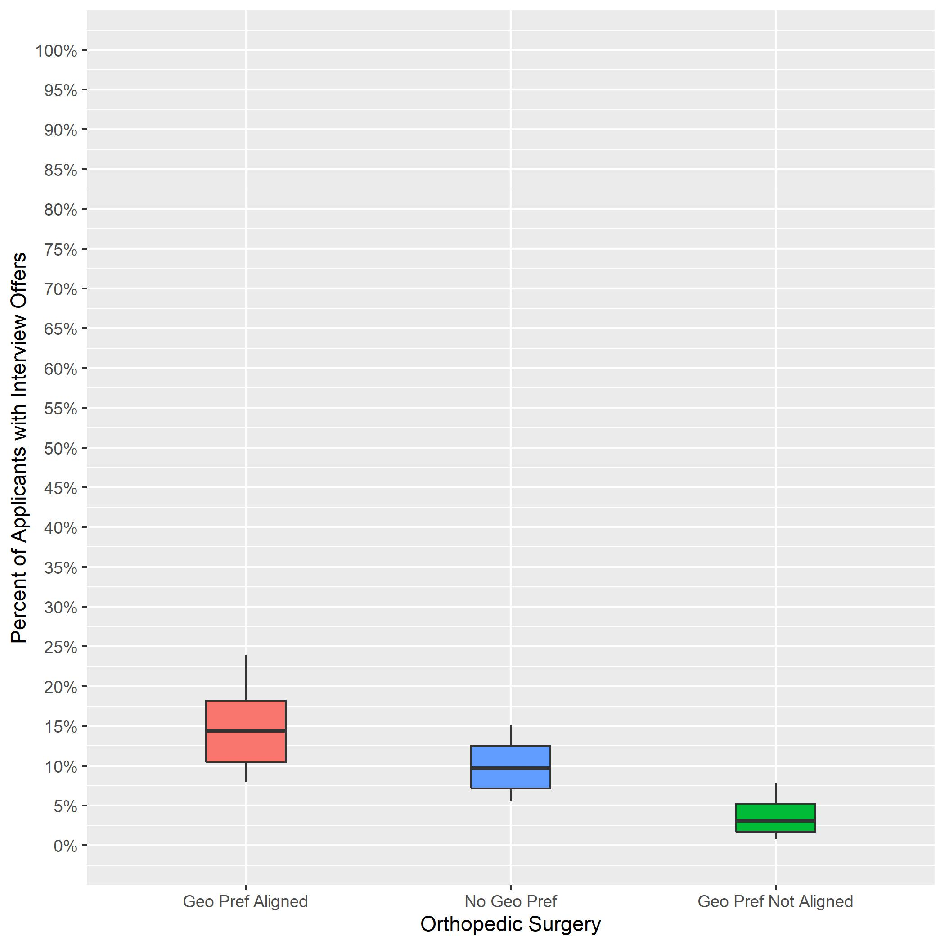
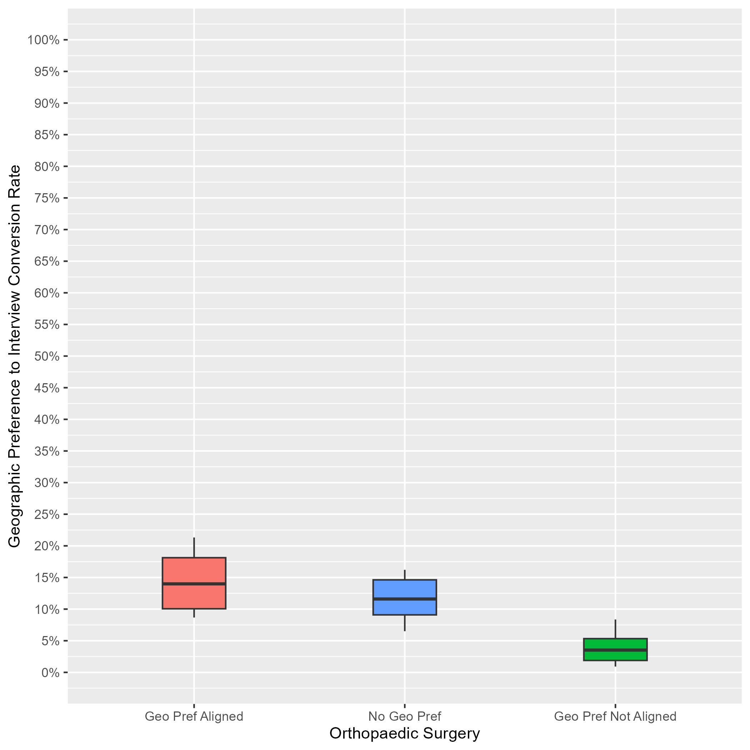
Orthopedic Surgery: Interview Rates by Geographic Preference Alignment Year-Over-Year Comparison
2023 ERAS Data as of 3/15/23
# of Programs: 158
2024 ERAS Data as of 2/28/24
# of Programs: 69
Geographic Preference to interview Conversion Rate
Orthopedic Surgery
Orthopedic Surgery
Notes:
Year 2 findings suggest that:
In general, applicants whose geographic preferences aligned with the program’s location were invited to interview at a higher rate than those who reported no preference and those whose preferences were misaligned. (14% vs 12% vs 4%). However, there was noticeable overlap between the aligned geographic preference distribution and the no geographic preference distribution, indicating that some programs did not differentiate these responses.
There was little overlap between the distributions for applicants with misaligned geographic preference and the other geographic preferences, which suggests most programs differentiated misaligned distribution from the two other responses.
Average interview invitation rates for aligned geographic preference in 2023 (14%) are similar to 2024 aligned geographic preference invitation rates (14%).
The number of programs in the sample for 2024 is lower than 2023 because we implemented a new inclusion rule based on whether a program made geographic preference viewable at their program.

Slide 37
Otolaryngology: Program Sample & Inclusion Criteria
 | N of Programs for Geographic Preference
Total programs | 125
Total programs who made geographic preference viewable at their program | 55
Met inclusion rule equal to or larger than 7:1; Provided PGY1 info in GME track; Provided interview offer data by February 28, 2024 | 38
Total analytic sample | 38
Total % of programs who made geographic preference viewable at their program | 69%
Total % of all Otolaryngology programs in 2024 ERAS cycle | 30%
Notes:
There were a total of 125 Otolaryngology programs in the 2024 ERAS cycle. Out of those, 55 made geographic preference viewable at their program as of 9/29/23.
We included 38 of them from this analysis because they reported PGY1 information in GME track; provided interview invitation data by February 28, 2024, (which is when we pulled the data); and met the inclusion rule for quality data that was created by Otolaryngology specialty leadership. That rule specified that any interview data provided by a program could only be included if the ratio of interview invites to positions available in that program was equal to or larger than 7:1.
The final analytic sample for the geographic preference analysis was 38 Otolaryngology programs, representing approximately 69% of all eligible Otolaryngology programs and 30% of the total Otolaryngology program population for the 2024 ERAS cycle.

Slide 38
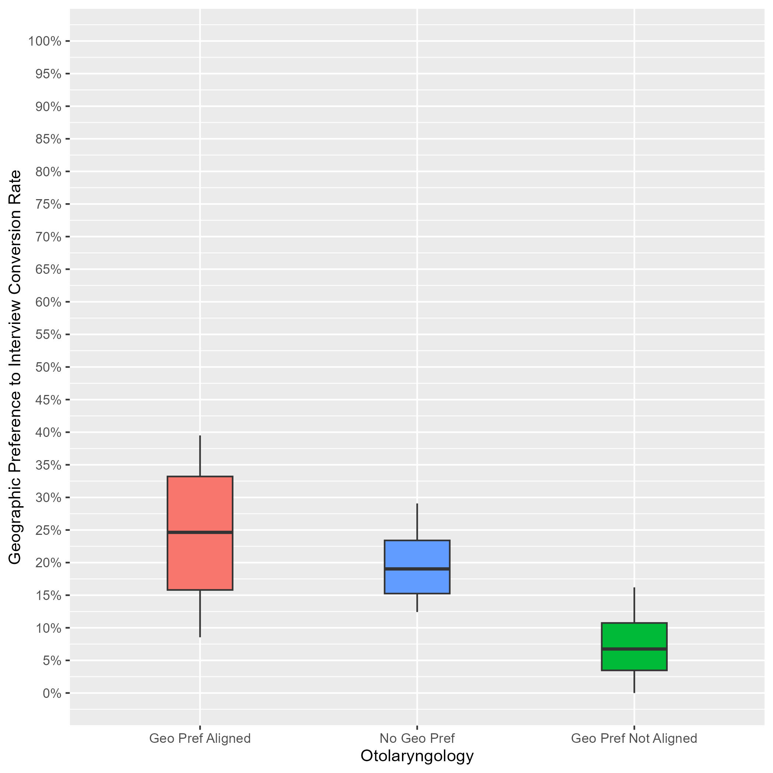
Otolaryngology: Interview Rates by Geographic Preference Alignment
Data as of 2/28/24
# of Programs: 38
Applicants whose geographic preference aligned with the program:
Median of interview offers: 25%.
10th percentile: 9%.
90th percentile: 40%.
Applicants with no geographic preference:
Median of interview offers: 19%.
10th percentile: 12%.
90th percentile: 29%.
Applicants whose geographic preference(s) did not align with the program:
Median of interview offers: 7%.
10th percentile: 0%.
90th percentile: 16%.
Notes:
Year 1 findings suggest that:
In general, applicants whose geographic preferences aligned with the program’s location were invited to interview at a higher rate than those who reported no preference and those whose preferences were misaligned. (25% vs 19% vs 7%). However, there was noticeable overlap between the aligned geographic preference distribution and the no geographic preference distribution, indicating that some programs did not differentiate these responses.
There was little overlap between the distributions for applicants with misaligned geographic preference and the other geographic preferences, which suggests most programs differentiated misaligned distribution from the two other responses.

Slide 39
Pathology: Program Sample & Inclusion Criteria
 | N of Programs for Geographic Preference
Total programs | 139
Total programs who made geographic preference viewable at their program | 66
Met inclusion rule equal to or larger than 7:1; Provided PGY1 info in GME track; Provided interview offer data by February 28, 2024 | 48
Total analytic sample | 48
Total % of programs who made geographic preference viewable at their program | 72%
Total % of all Pathology programs in 2024 ERAS cycle | 35%
Notes:
There were a total of 139 Pathology programs in the 2024 ERAS cycle. Out of those, 66 made geographic preference viewable at their program as of 9/29/23.
We included 48 of them from this analysis because they reported PGY1 information in GME track; provided interview invitation data by February 28, 2024, (which is when we pulled the data); and met the inclusion rule for quality data that was created by Pathology specialty leadership. That rule specified that any interview data provided by a program could only be included if the ratio of interview invites to positions available in that program was equal to or larger than 7:1.
The final analytic sample for the geographic preference analysis was 48 Pathology programs, representing approximately 72% of all eligible Pathology programs and 35% of the total Pathology program population for the 2024 ERAS cycle.

Slide 40
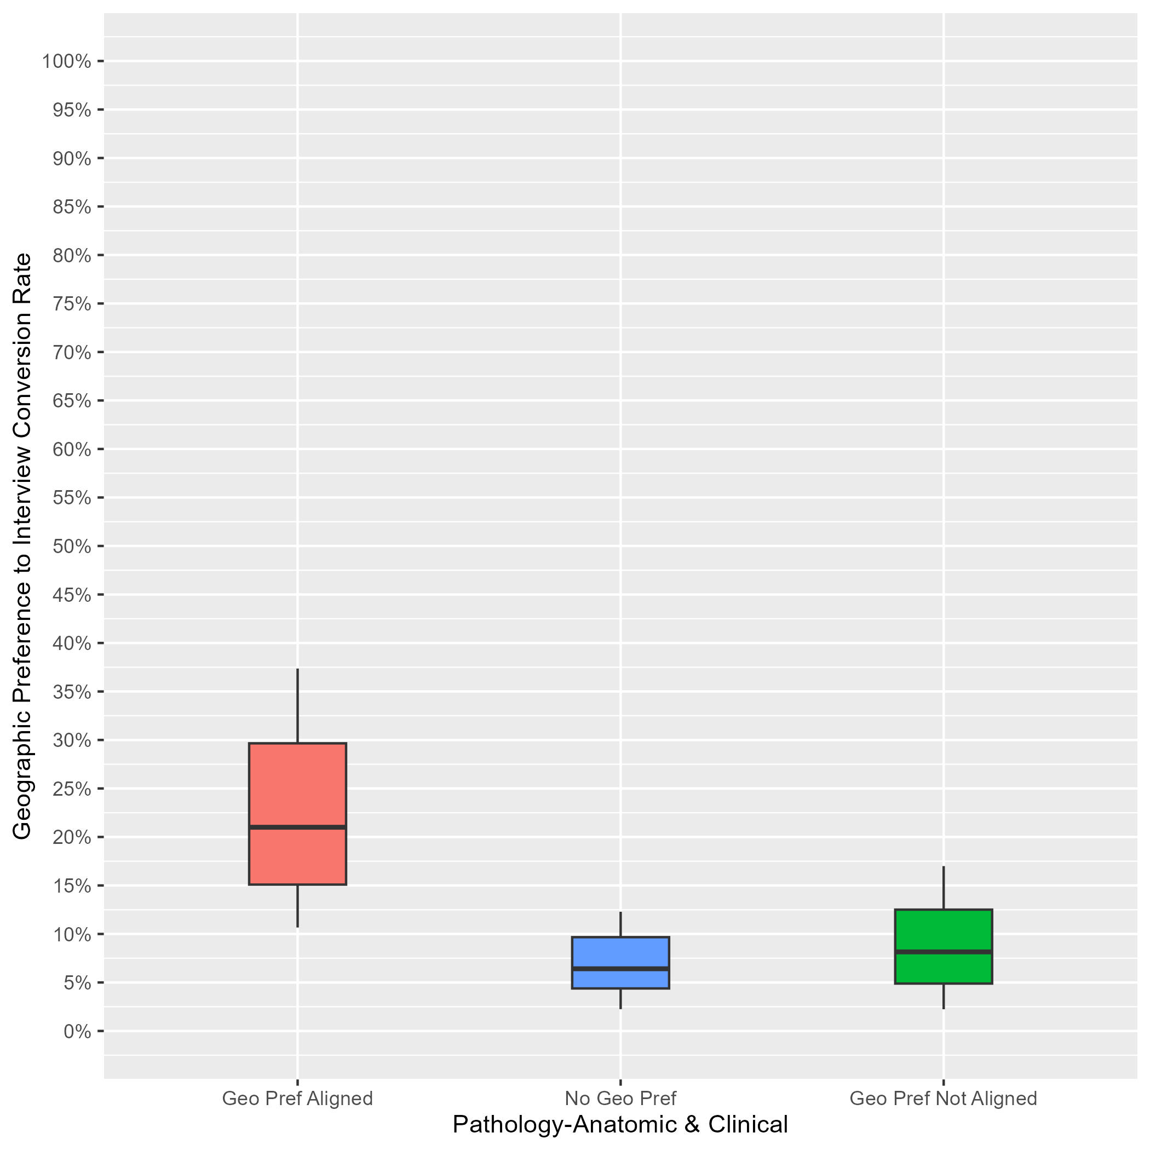
Pathology: Interview Rates by Geographic Preference Alignment
Data as of 2/28/24
# of Programs: 48
Applicants whose geographic preference aligned with the program:
Median of interview offers: 21%.
10th percentile: 11%.
90th percentile: 37%.
Applicants with no geographic preference:
Median of interview offers: 6%.
10th percentile: 2%.
90th percentile: 12%.
Applicants whose geographic preference(s) did not align with the program:
Median of interview offers: 8%.
10th percentile: 2%.
90th percentile: 17%.
Notes:
Year 1 findings suggest that:
In general, applicants whose geographic preferences aligned with the program’s location were invited to interview at a higher rate than those who reported no preference and those whose preferences were misaligned. (21% vs 6% vs 8%). Further, there was not much overlap between the aligned geographic preference distribution and the other distributions, suggesting that programs put more weight on aligned preferences than no or misaligned preferences.
There was a lot of overlap between the distributions for applicants with no geographic preference and those with misaligned geographic preferences, suggesting that many PDs may not have differentiated between these two responses, and there is a need for additional training.

Slide 41
Pediatrics: Program Sample & Inclusion Criteria
 | N of Programs for Geographic Preference
Total programs | 211
Total programs who made geographic preference viewable at their program | 101
Met inclusion rule equal to or larger than 7:1; Provided PGY1 info in GME track; Provided interview offer data by February 28, 2024 | 88
Total analytic sample | 88
Total % of programs who made geographic preference viewable at their program | 87%
Total % of all Pediatrics programs in 2024 ERAS cycle | 42%
Notes:
There were a total of 211 Pediatrics programs in the 2024 ERAS cycle. Out of those, 101 made geographic preference viewable at their program as of 9/29/23.
We included 88 of them from this analysis because they reported PGY1 information in GME track; provided interview invitation data by February 28, 2024, (which is when we pulled the data); and met the inclusion rule for quality data that was created by Pediatrics specialty leadership. That rule specified that any interview data provided by a program could only be included if the ratio of interview invites to positions available in that program was equal to or larger than 7:1.
The final analytic sample for the geographic preference analysis was 88 Pediatrics programs, representing approximately 87% of all eligible Pediatrics programs and 42% of the total Pediatrics program population for the 2024 ERAS cycle.

Slide 42
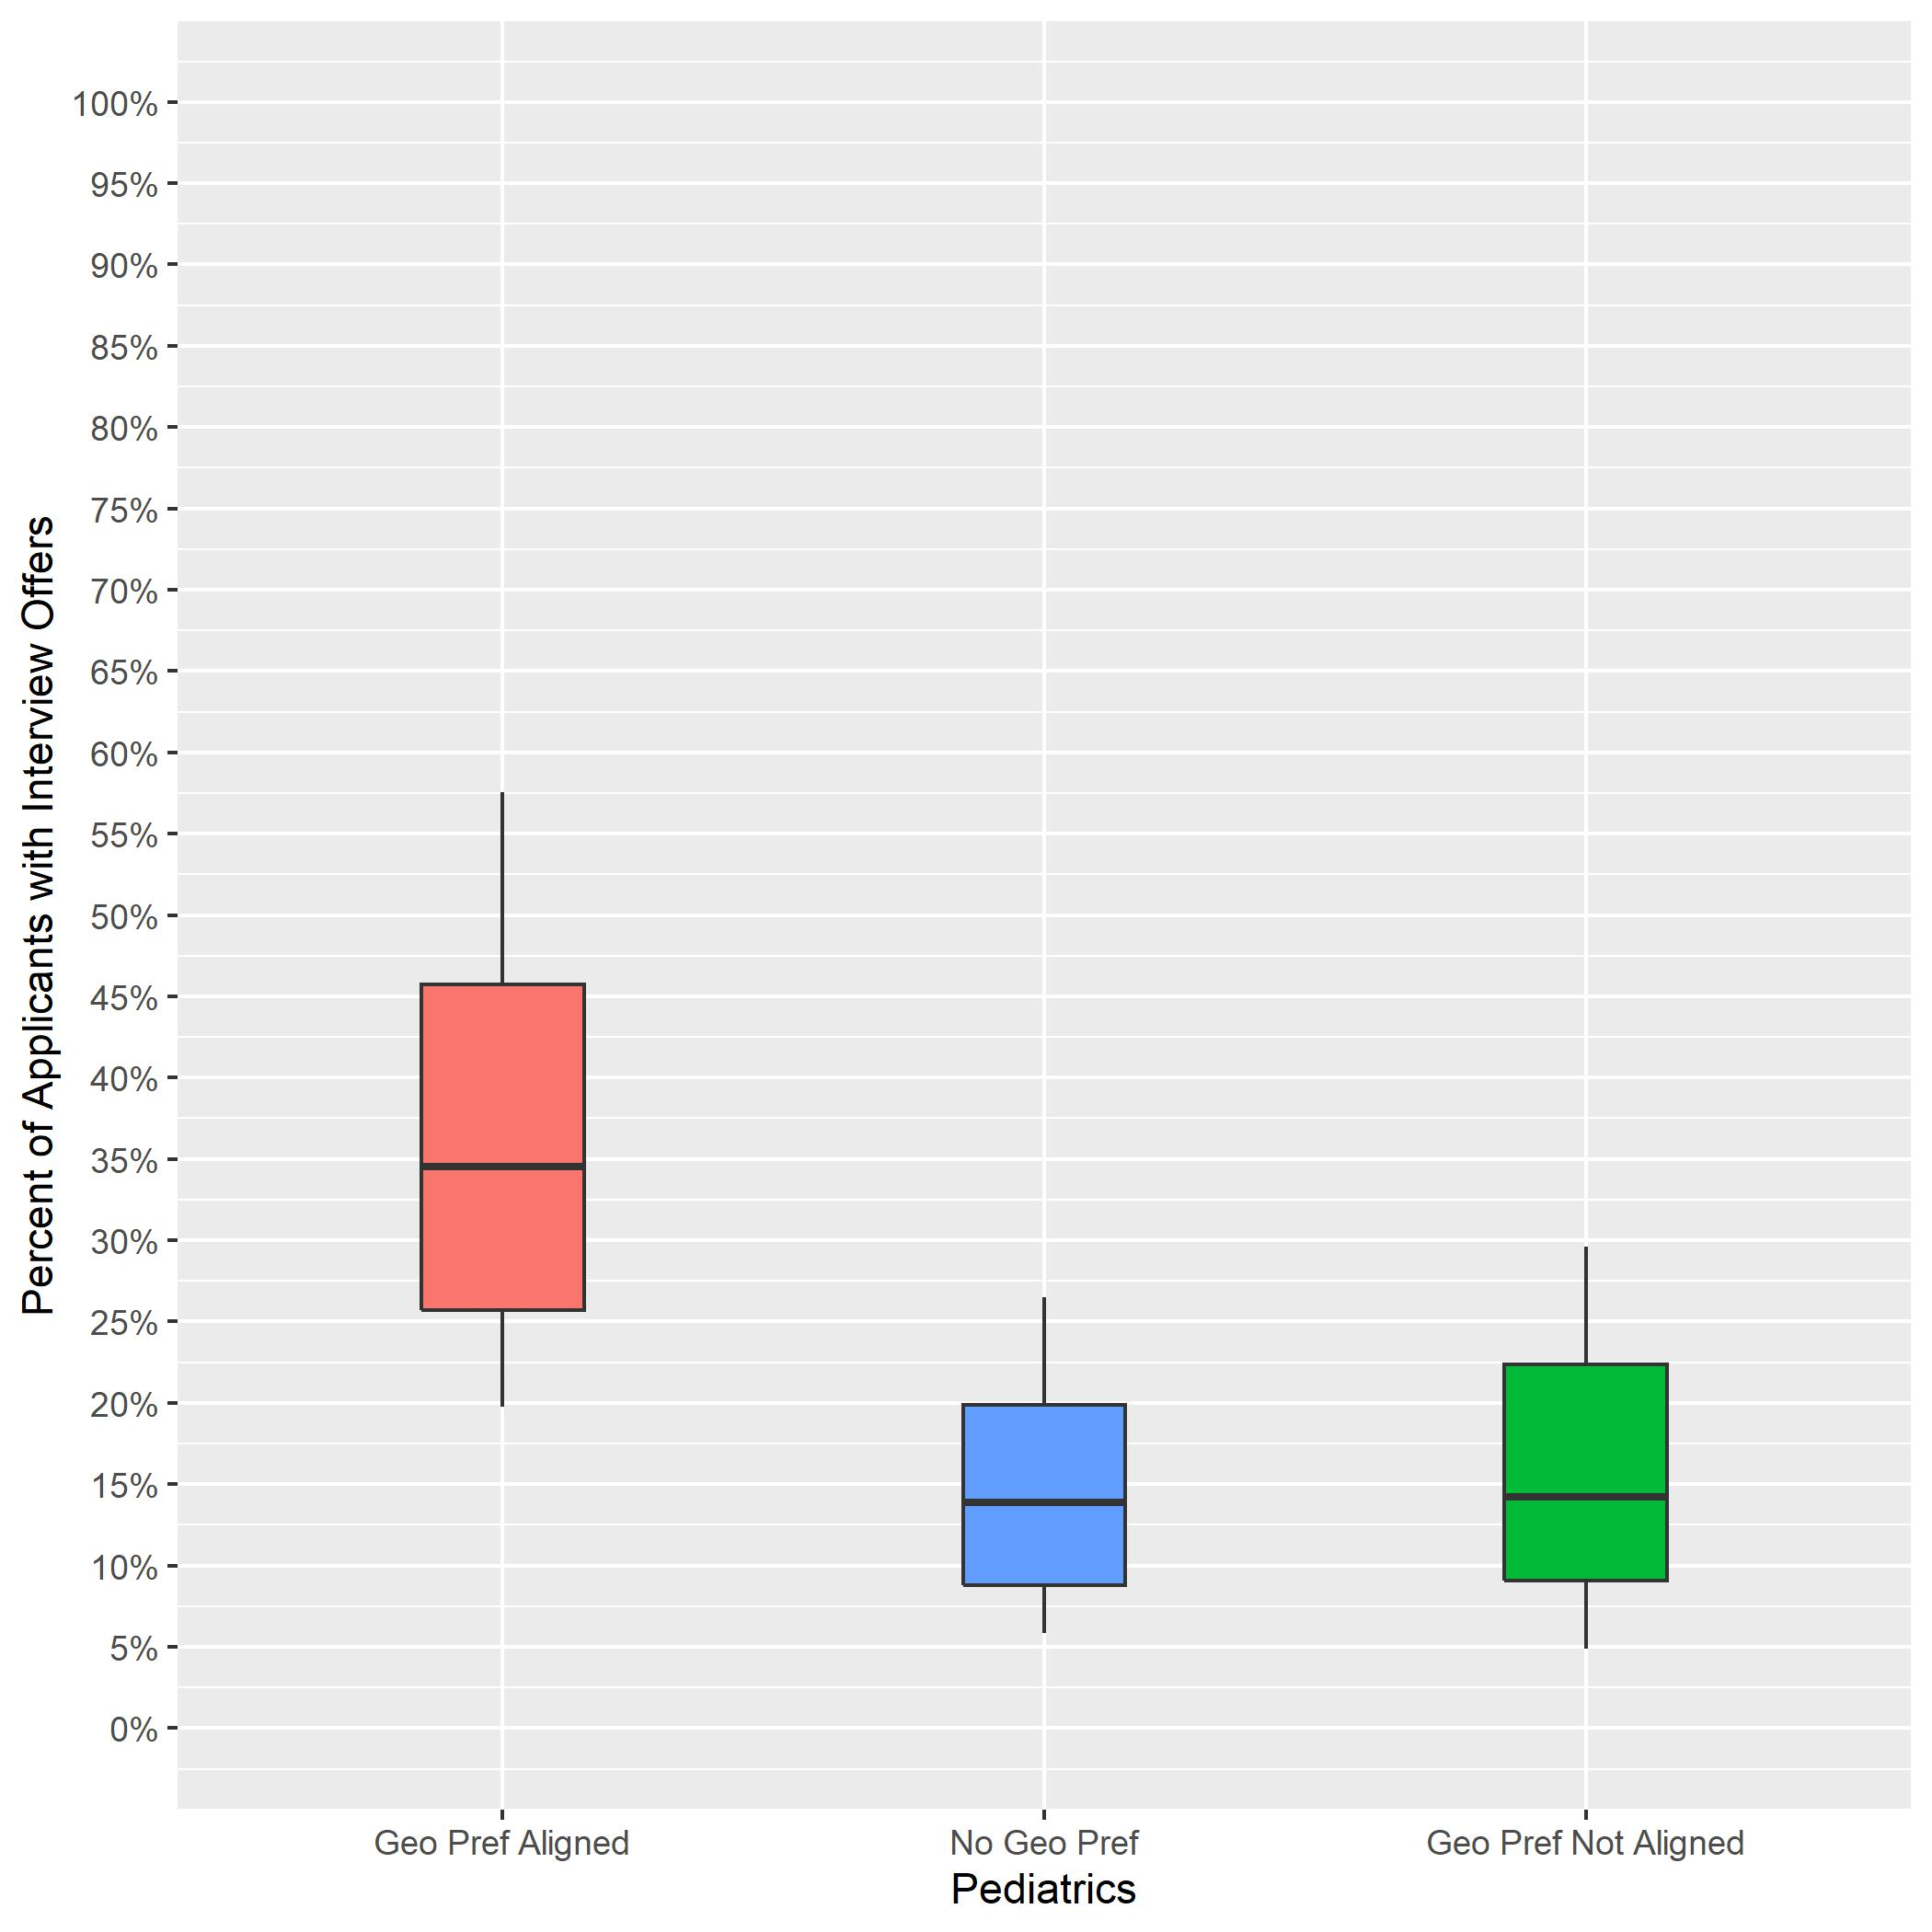
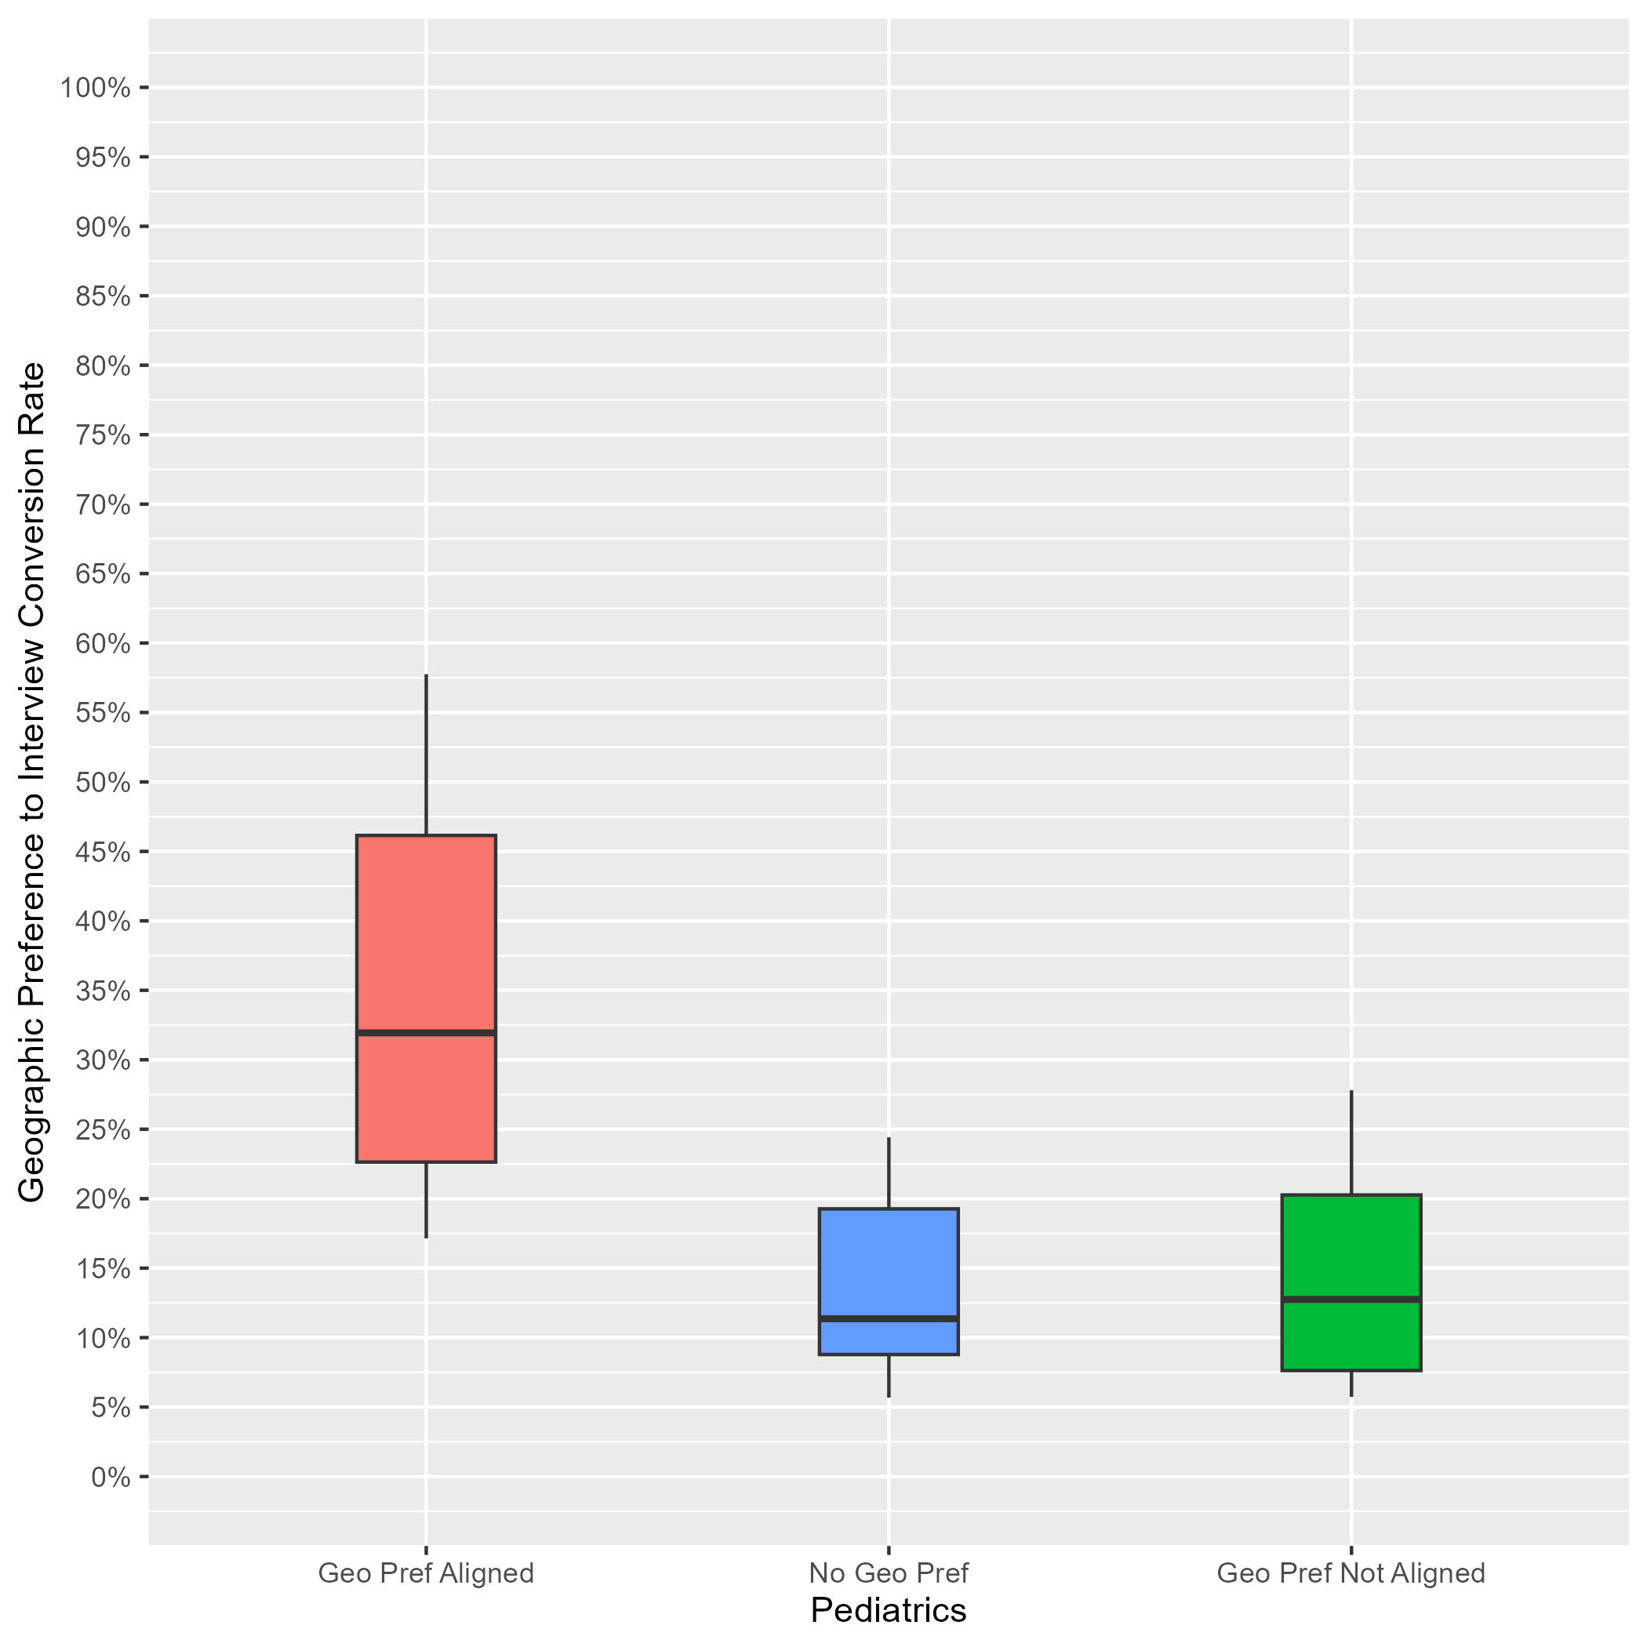
Pediatrics: Interview Rates by Geographic Preference Alignment Year-Over-Year Comparison
2023 ERAS Data as of 3/15/23
# of Programs: 186
2024 ERAS Data as of 2/28/24
# Programs: 88
Geographic Preference to interview Conversion Rate
Notes:
Year 2 findings suggest that:
In general, applicants whose geographic preferences aligned with the program’s location were invited to interview at a higher rate than those who reported no preference and those whose preferences were misaligned. (32% vs 11% vs 13%). Further, there was not much overlap between the aligned geographic preference distribution and the other distributions, suggesting that programs put more weight on aligned preferences than no or misaligned preferences.
There was a lot of overlap between the distributions for applicants with no geographic preference and those with misaligned geographic preferences, suggesting that many PDs may not have differentiated between these two responses, and there is a need for additional training.
Average interview invitation rates for aligned geographic preference in 2023 (35%) are similar to 2024 aligned geographic preference invitation rates (32%).
The number of programs in the sample for 2024 is lower than 2023 because we implemented a new inclusion rule based on whether a program made geographic preference viewable at their program.

Slide 43
PM&R: Program Sample & Inclusion Criteria
 | N of Programs for Geographic Preference
Total programs | 107
Total programs who made geographic preference viewable at their program | 47
Met inclusion rule equal to or larger than 7:1; Provided PGY1 info in GME track; Provided interview offer data by February 28, 2024 | 39
Total analytic sample | 39
Total % of programs who made geographic preference viewable at their program | 83%
Total % of all PM&R programs in 2024 ERAS cycle | 36%
Notes:
There were a total of 107 physical medicine and rehabilitation programs in the 2024 ERAS cycle. Out of those, 47 made geographic preference viewable at their program as of 9/29/23.
We included 39 of them from this analysis because they reported PGY1 information in GME track; provided interview invitation data by February 28, 2024, (which is when we pulled the data); and met the inclusion rule for quality data that was created by PM&R specialty leadership. That rule specified that any interview data provided by a program could only be included if the ratio of interview invites to positions available in that program was equal to or larger than 7:1.
The final analytic sample for the geographic preference analysis was 39 PM&R programs, representing approximately 83% of all eligible PM&R programs and 36% of the total PM&R program population for the 2024 ERAS cycle.

Slide 44
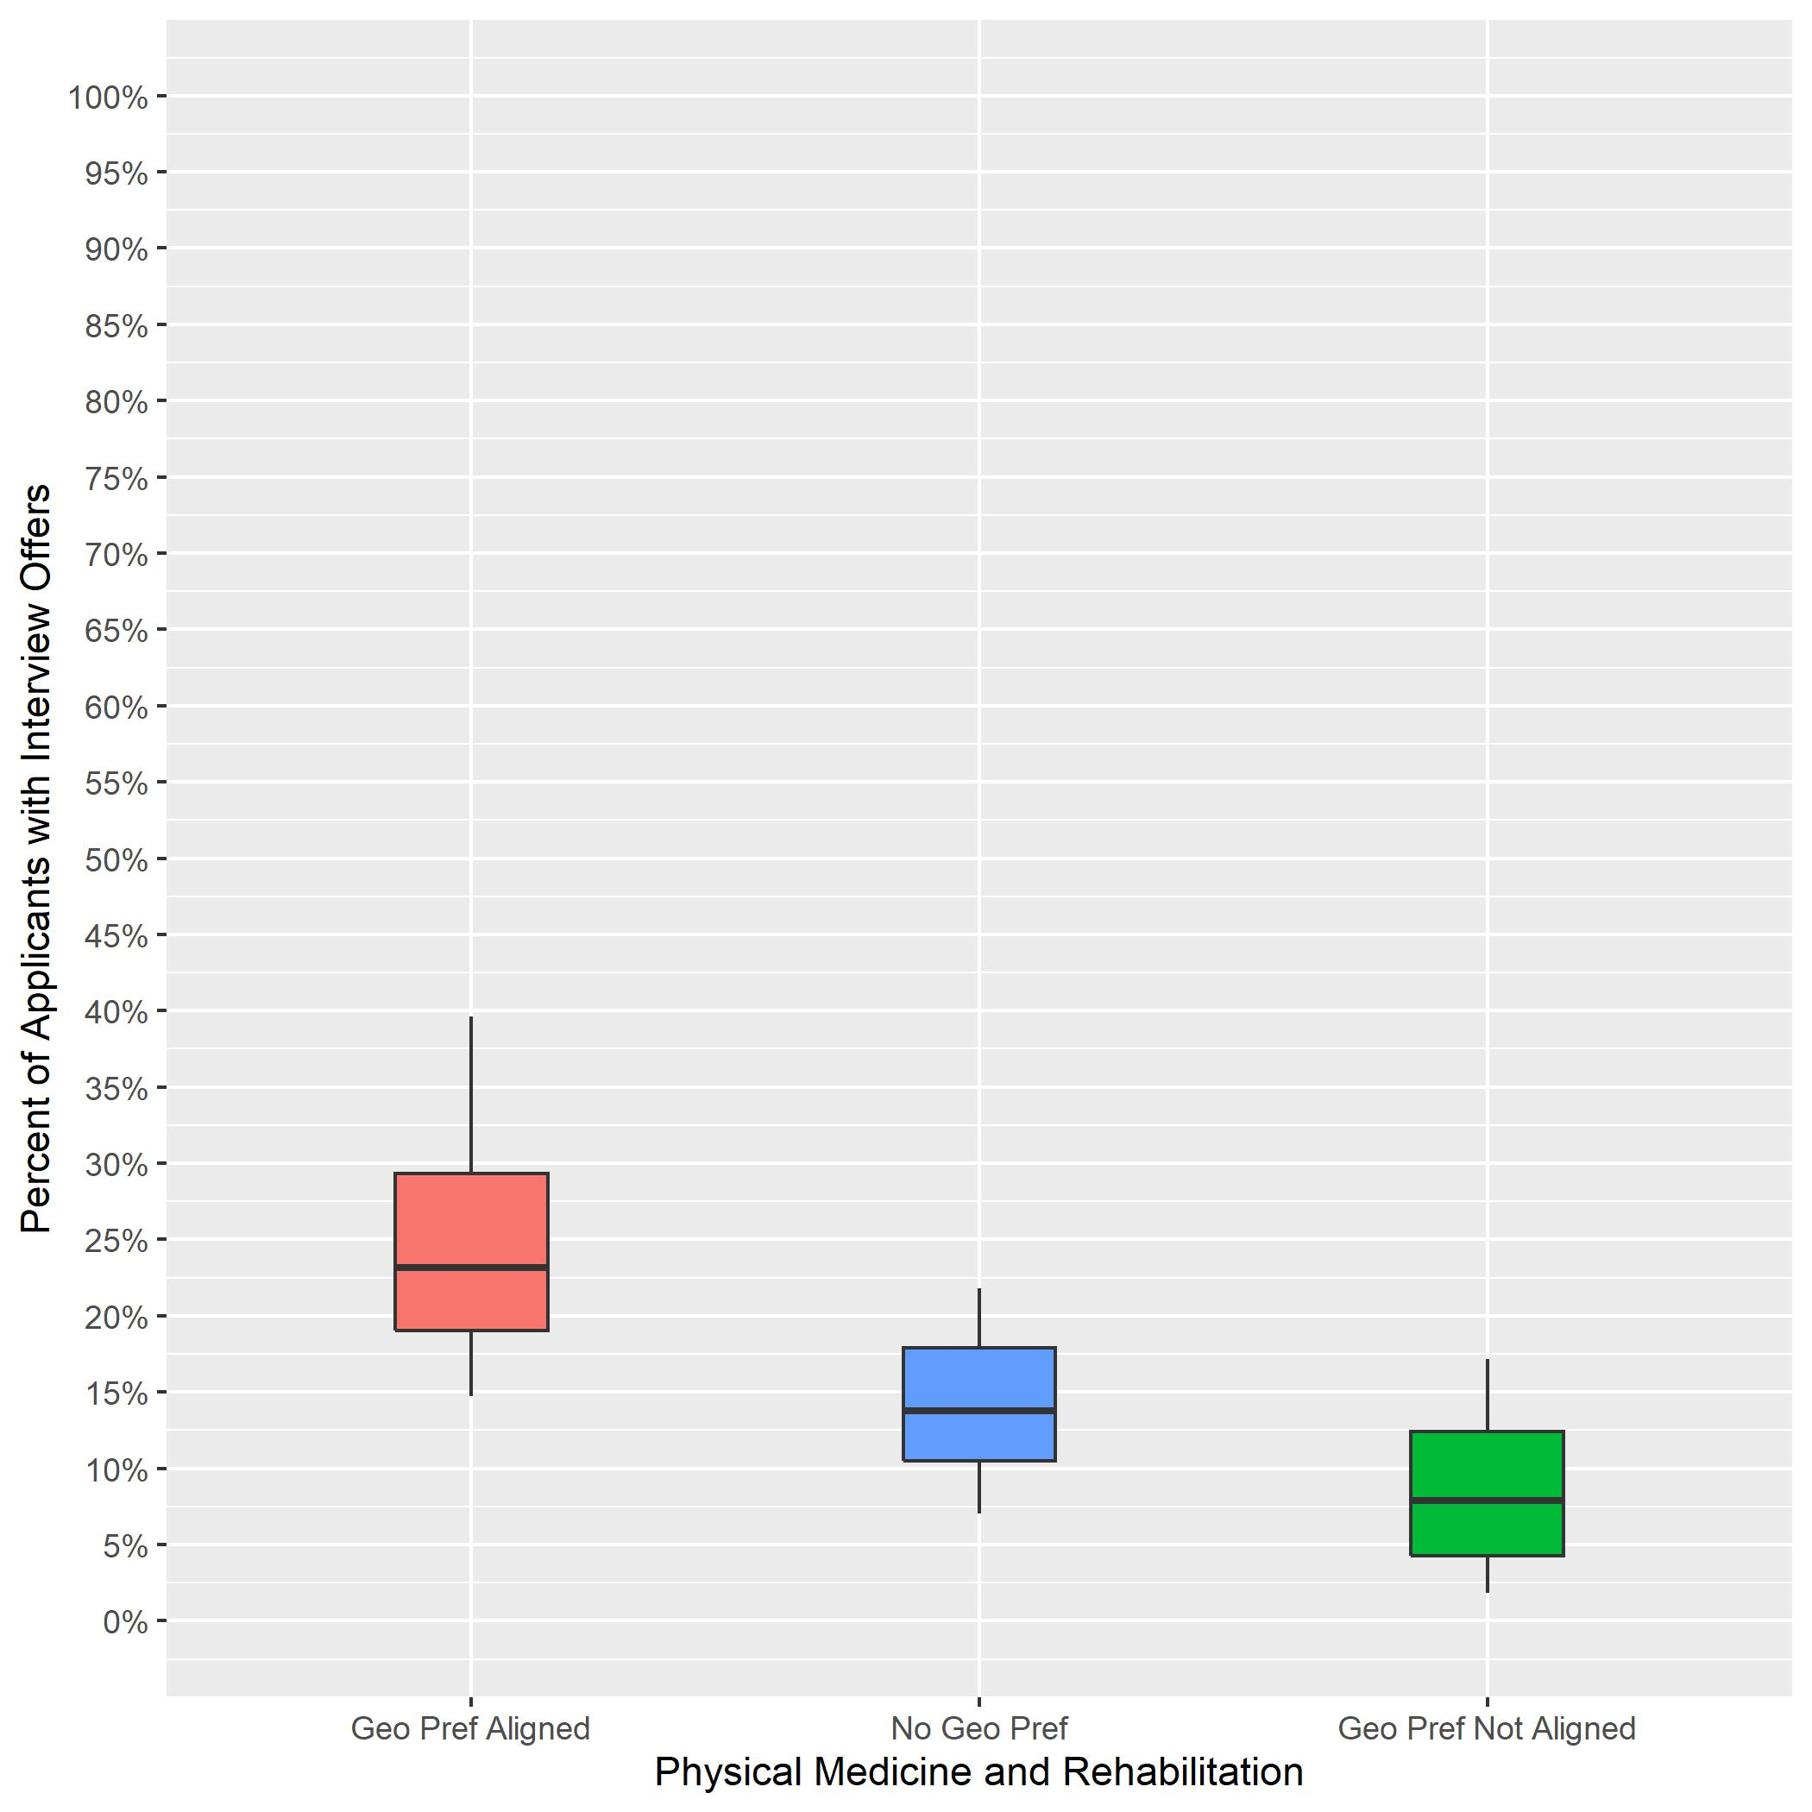
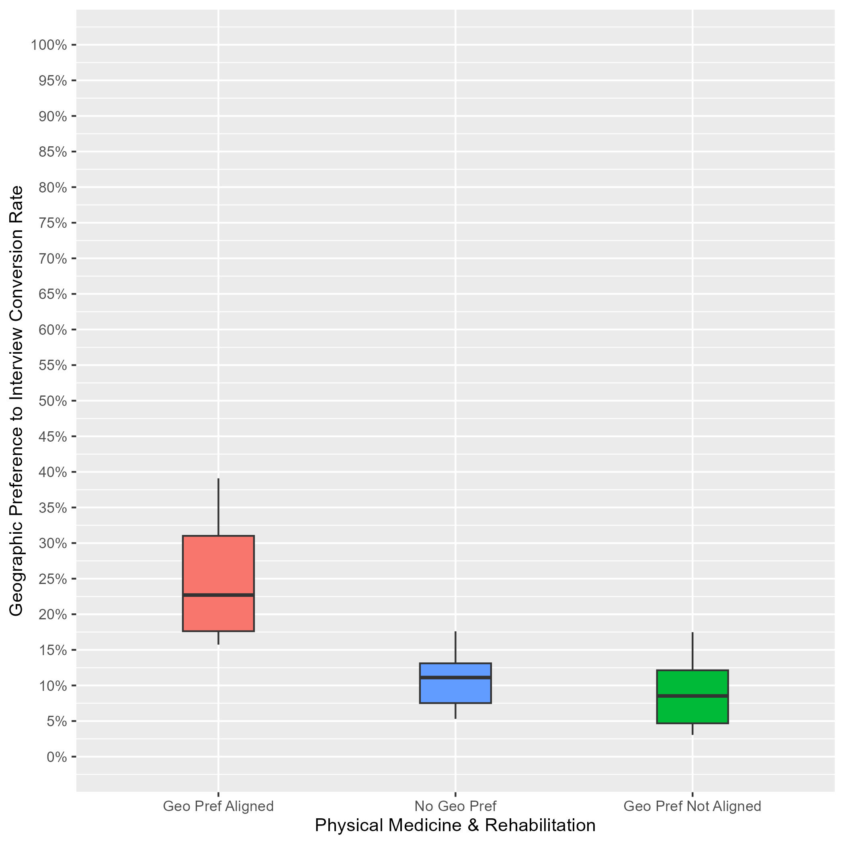
PM&R: Interview Rates by Geographic Preference Alignment Year-Over-Year Comparison
2023 ERAS Data as of 3/15/23
# of Programs: 85
2024 ERAS Data as of 2/28/24
# of Programs: 39
Geographic Preference to interview Conversion Rate
Notes:
Year 2 findings suggest that:
In general, applicants whose geographic preferences aligned with the program’s location were invited to interview at a higher rate than those who reported no preference and those whose preferences were misaligned. (23% vs 11% vs 9%). Further, there was not much overlap between the aligned geographic preference distribution and the other distributions, suggesting that programs put more weight on aligned preferences than no or misaligned preferences.
There was a lot of overlap between the distributions for applicants with no geographic preference and those with misaligned geographic preferences, suggesting that many PDs may not have differentiated between these two responses, and there is a need for additional training.
Average interview invitation rates for aligned geographic preference in 2023 (23%) are similar to 2024 aligned geographic preference invitation rates (23%).
The number of programs in the sample for 2024 is lower than 2023 because we implemented a new inclusion rule based on whether a program made geographic preference viewable at their program.

Slide 45
Psychiatry: Program Sample & Inclusion Criteria
 | N of Programs for Geographic Preference
Total programs | 304
Total programs who made geographic preference viewable at their program | 161
Met inclusion rule equal to or larger than 7:1; Provided PGY1 info in GME track; Provided interview offer data by February 28, 2024 | 132
Total analytic sample | 132
Total % of programs who made geographic preference viewable at their program | 82%
Total % of all Psychiatry programs in 2024 ERAS cycle | 43%
Notes:
There were a total of 304 Psychiatry programs in the 2024 ERAS cycle. Out of those 161 made geographic preference viewable at their program as of 9/29/23.
We included 132 of them from this analysis because they reported PGY1 information in GME track; provided interview invitation data by February 28, 2024, (which is when we pulled the data); and met the inclusion rule for quality data that was created by Psychiatry specialty leadership. That rule specified that any interview data provided by a program could only be included if the ratio of interview invites to positions available in that program was equal to or larger than 7:1.
The final analytic sample for the geographic preference analysis was 132 Psychiatry programs, representing approximately 82% of all eligible Psychiatry programs and 43% of the total Psychiatry program population for the 2024 ERAS cycle.

Slide 46
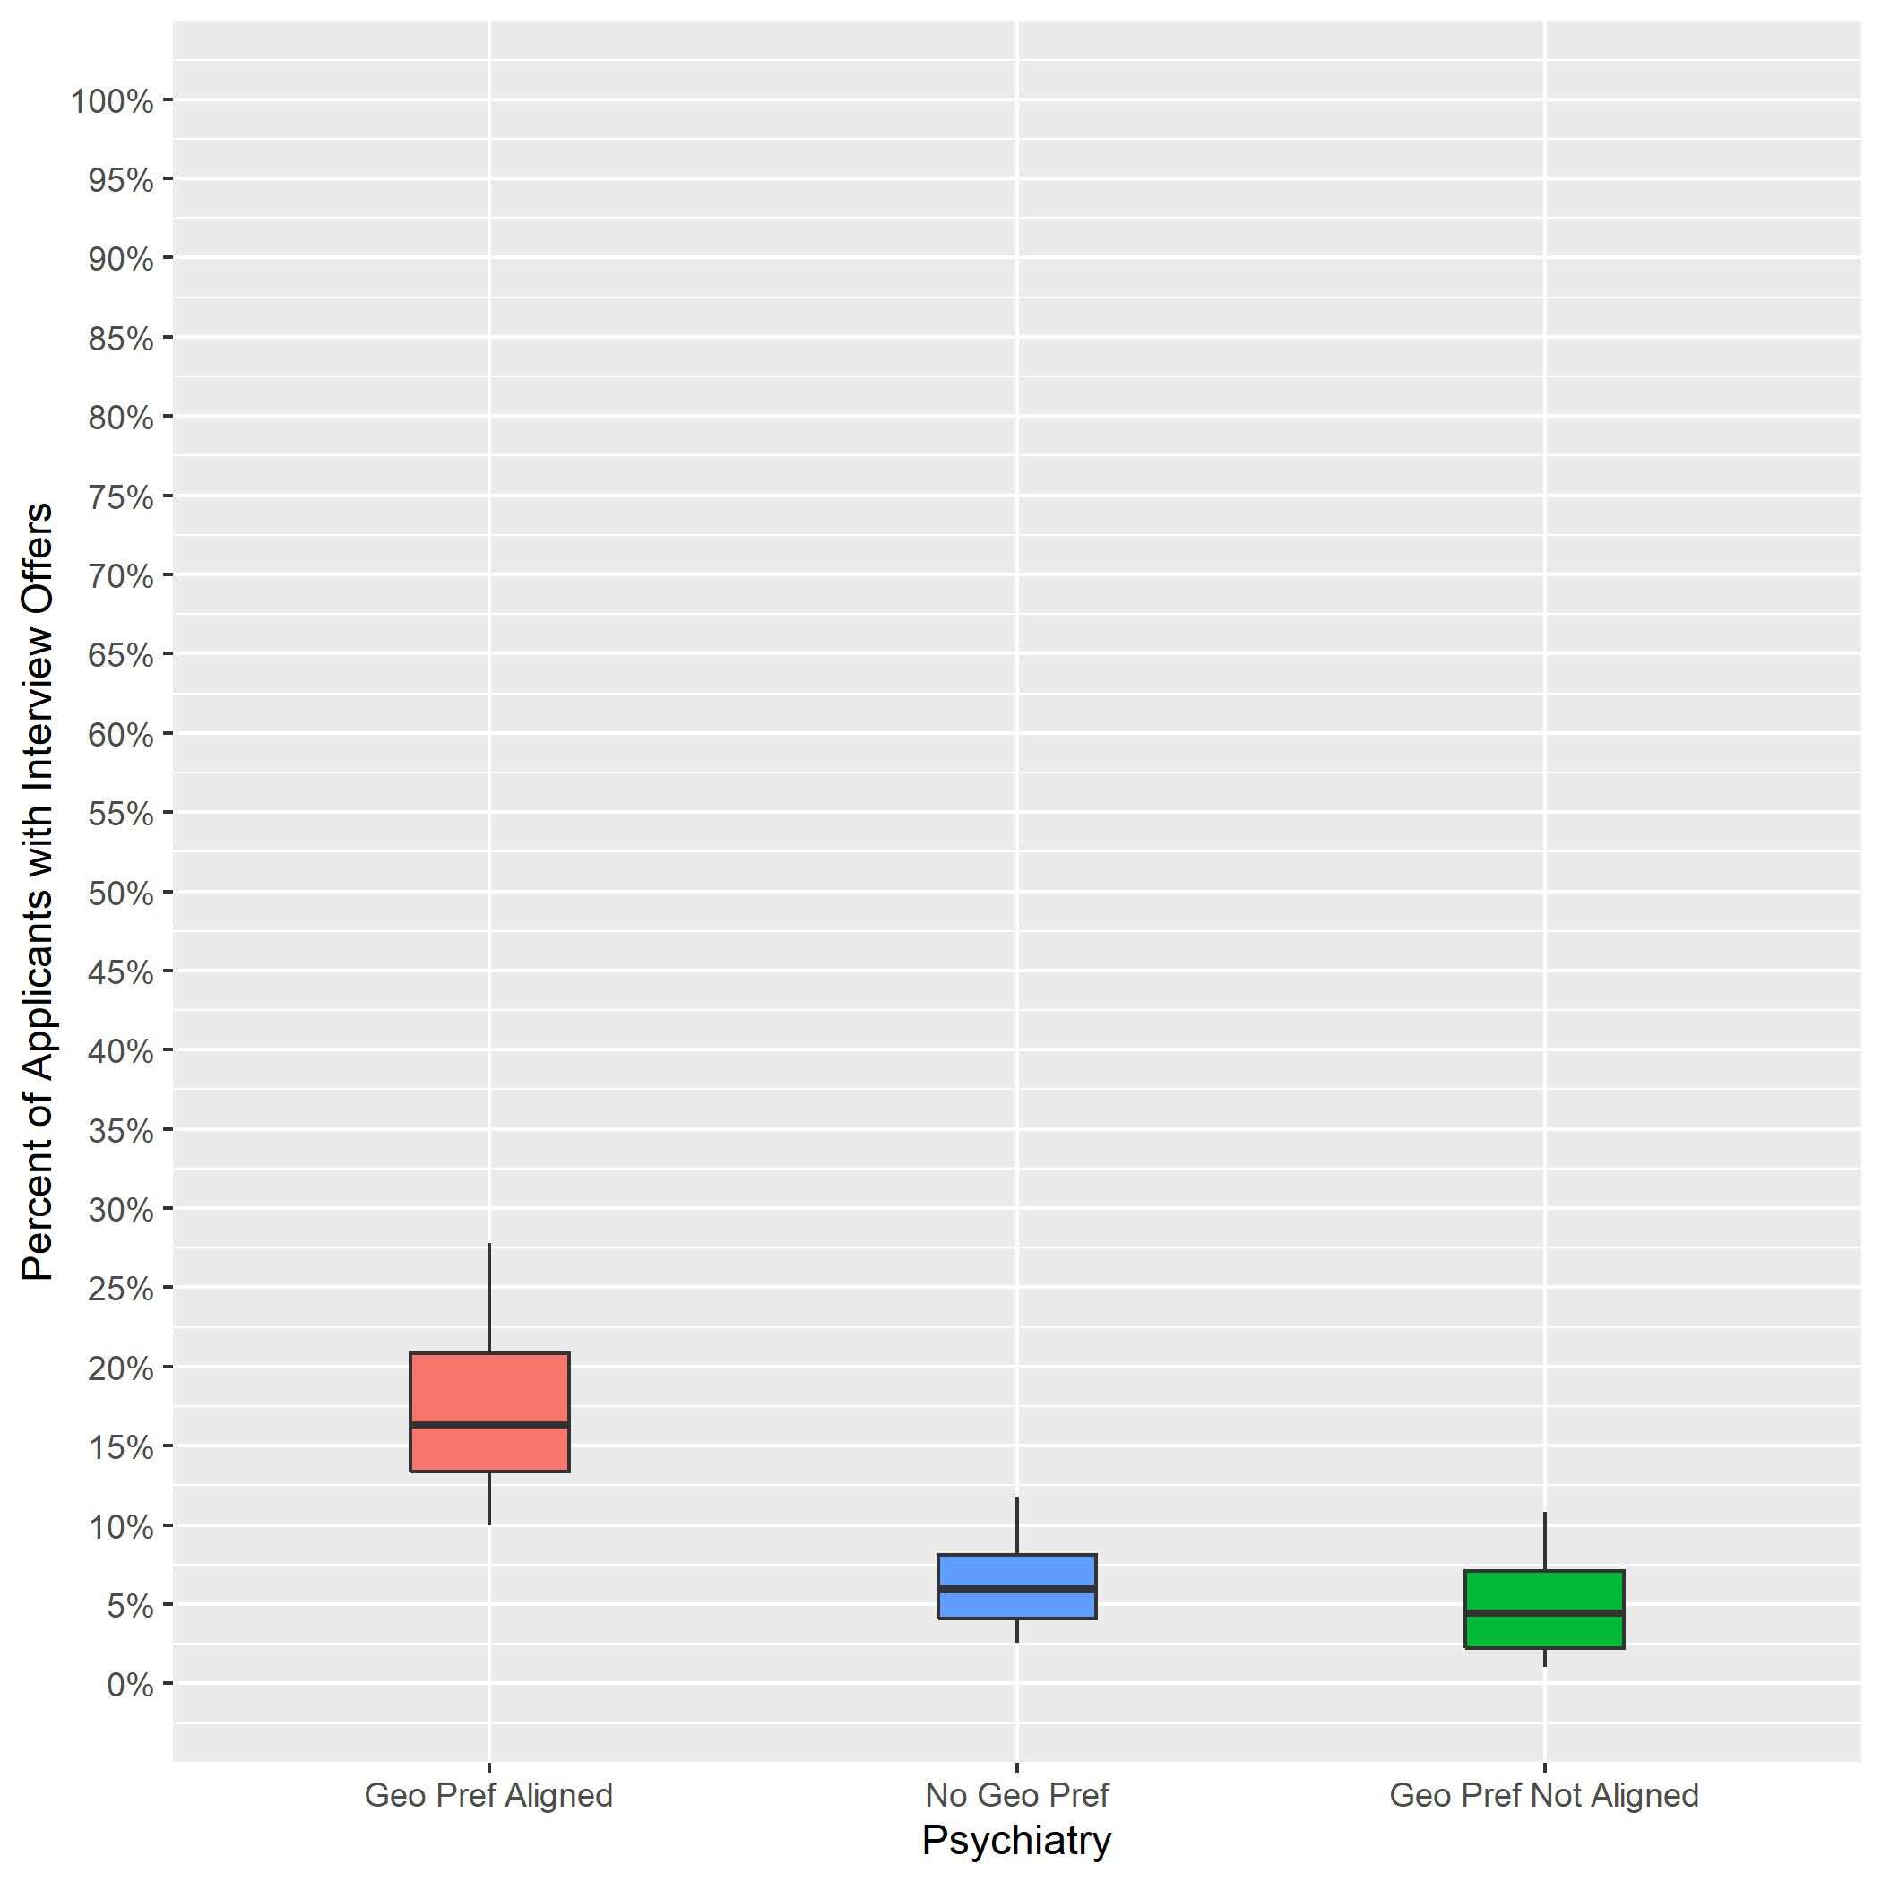
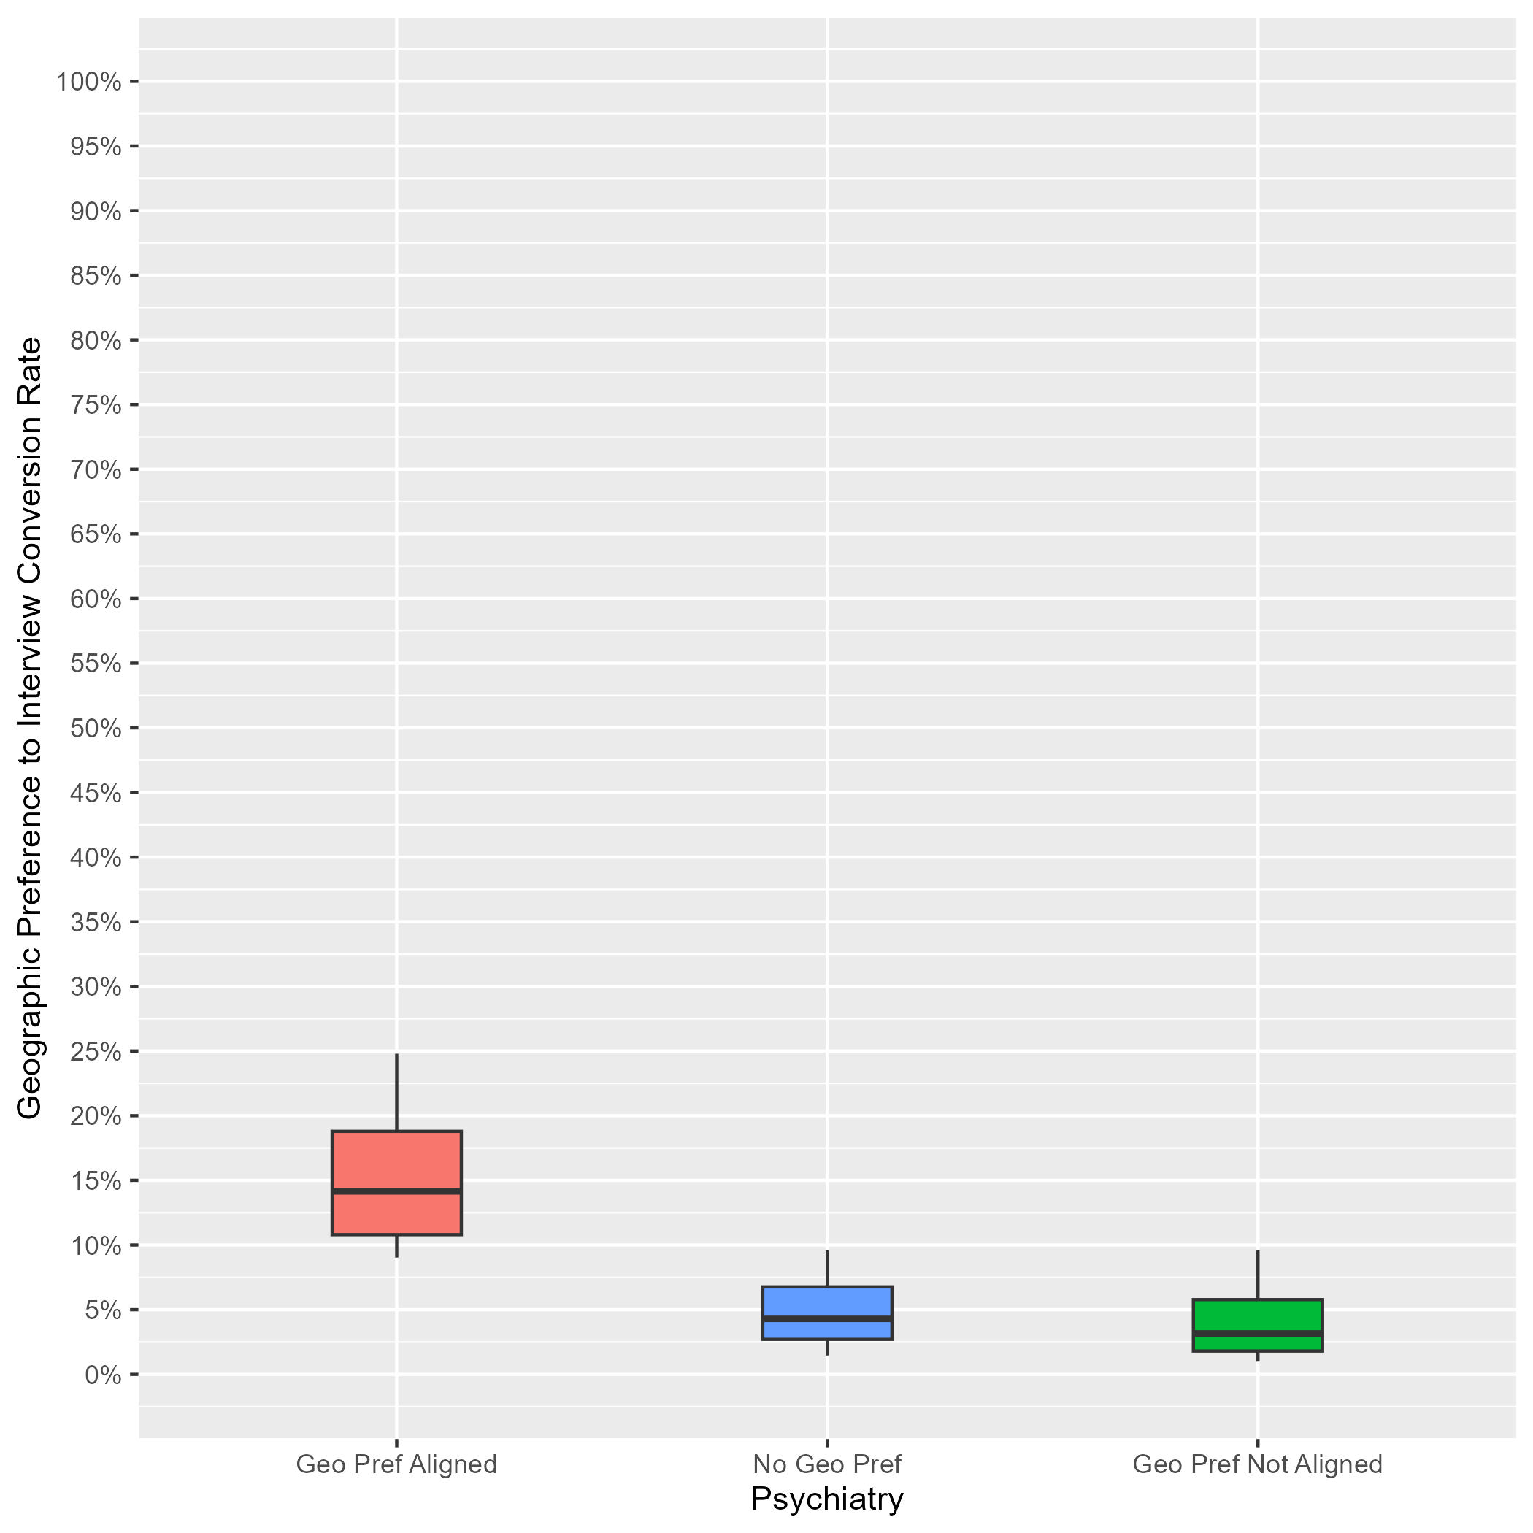
Psychiatry: Interview Rates by Geographic Preference Alignment Year-Over-Year Comparison
2023 ERAS Data as of 3/15/23
# of Programs: 221
2024 ERAS Data as of 2/28/24
# of Programs: 132
Geographic Preference to interview Conversion Rate
Notes:
Year 2 findings suggest that:
In general, applicants whose geographic preferences aligned with the program’s location were invited to interview at a higher rate than those who reported no preference and those whose preferences were misaligned. (14% vs 4% vs 3%). Further, there was not much overlap between the aligned geographic preference distribution and the other distributions, suggesting that programs put more weight on aligned preferences than no or misaligned preferences.
There was a lot of overlap between the distributions for applicants with no geographic preference and those with misaligned geographic preferences, suggesting that many PDs may not have differentiated between these two responses, and there is a need for additional training.
Average interview invitation rates for aligned geographic preference in 2023 (16%) are similar to 2024 aligned geographic preference invitation rates (14%).
The number of programs in the sample for 2024 is lower than 2023 because we implemented a new inclusion rule based on whether a program made geographic preference viewable at their program.

Slide 47
Radiation Oncology: Program Sample & Inclusion Criteria
 | N of Programs for Geographic Preference
Total programs | 85
Total programs who made geographic preference viewable at their program | 29
Met inclusion rule equal to or larger than 7:1; Provided PGY1 info in GME track; Provided interview offer data by February 28, 2024 | 19
Total analytic sample | 19
Total % of programs who made geographic preference viewable at their program | 66%
Total % of all Radiation Oncology programs in 2024 ERAS cycle | 22%
Notes:
There were a total of 85 Radiation Oncology programs in the 2024 ERAS cycle. Out of those, 29 made geographic preference viewable at their program as of 9/29/23.
We included 19 of them from this analysis because they reported PGY1 information in GME track; provided interview invitation data by February 28, 2024, (which is when we pulled the data); and met the inclusion rule for quality data that was created by Radiation Oncology specialty leadership. That rule specified that any interview data provided by a program could only be included if the ratio of interview invites to positions available in that program was equal to or larger than 7:1.
The final analytic sample for the geographic preference analysis was 19 Radiation Oncology programs, representing approximately 66% of all eligible Radiation Oncology programs and 22% of the total Radiation Oncology program population for the 2024 ERAS cycle.

Slide 48
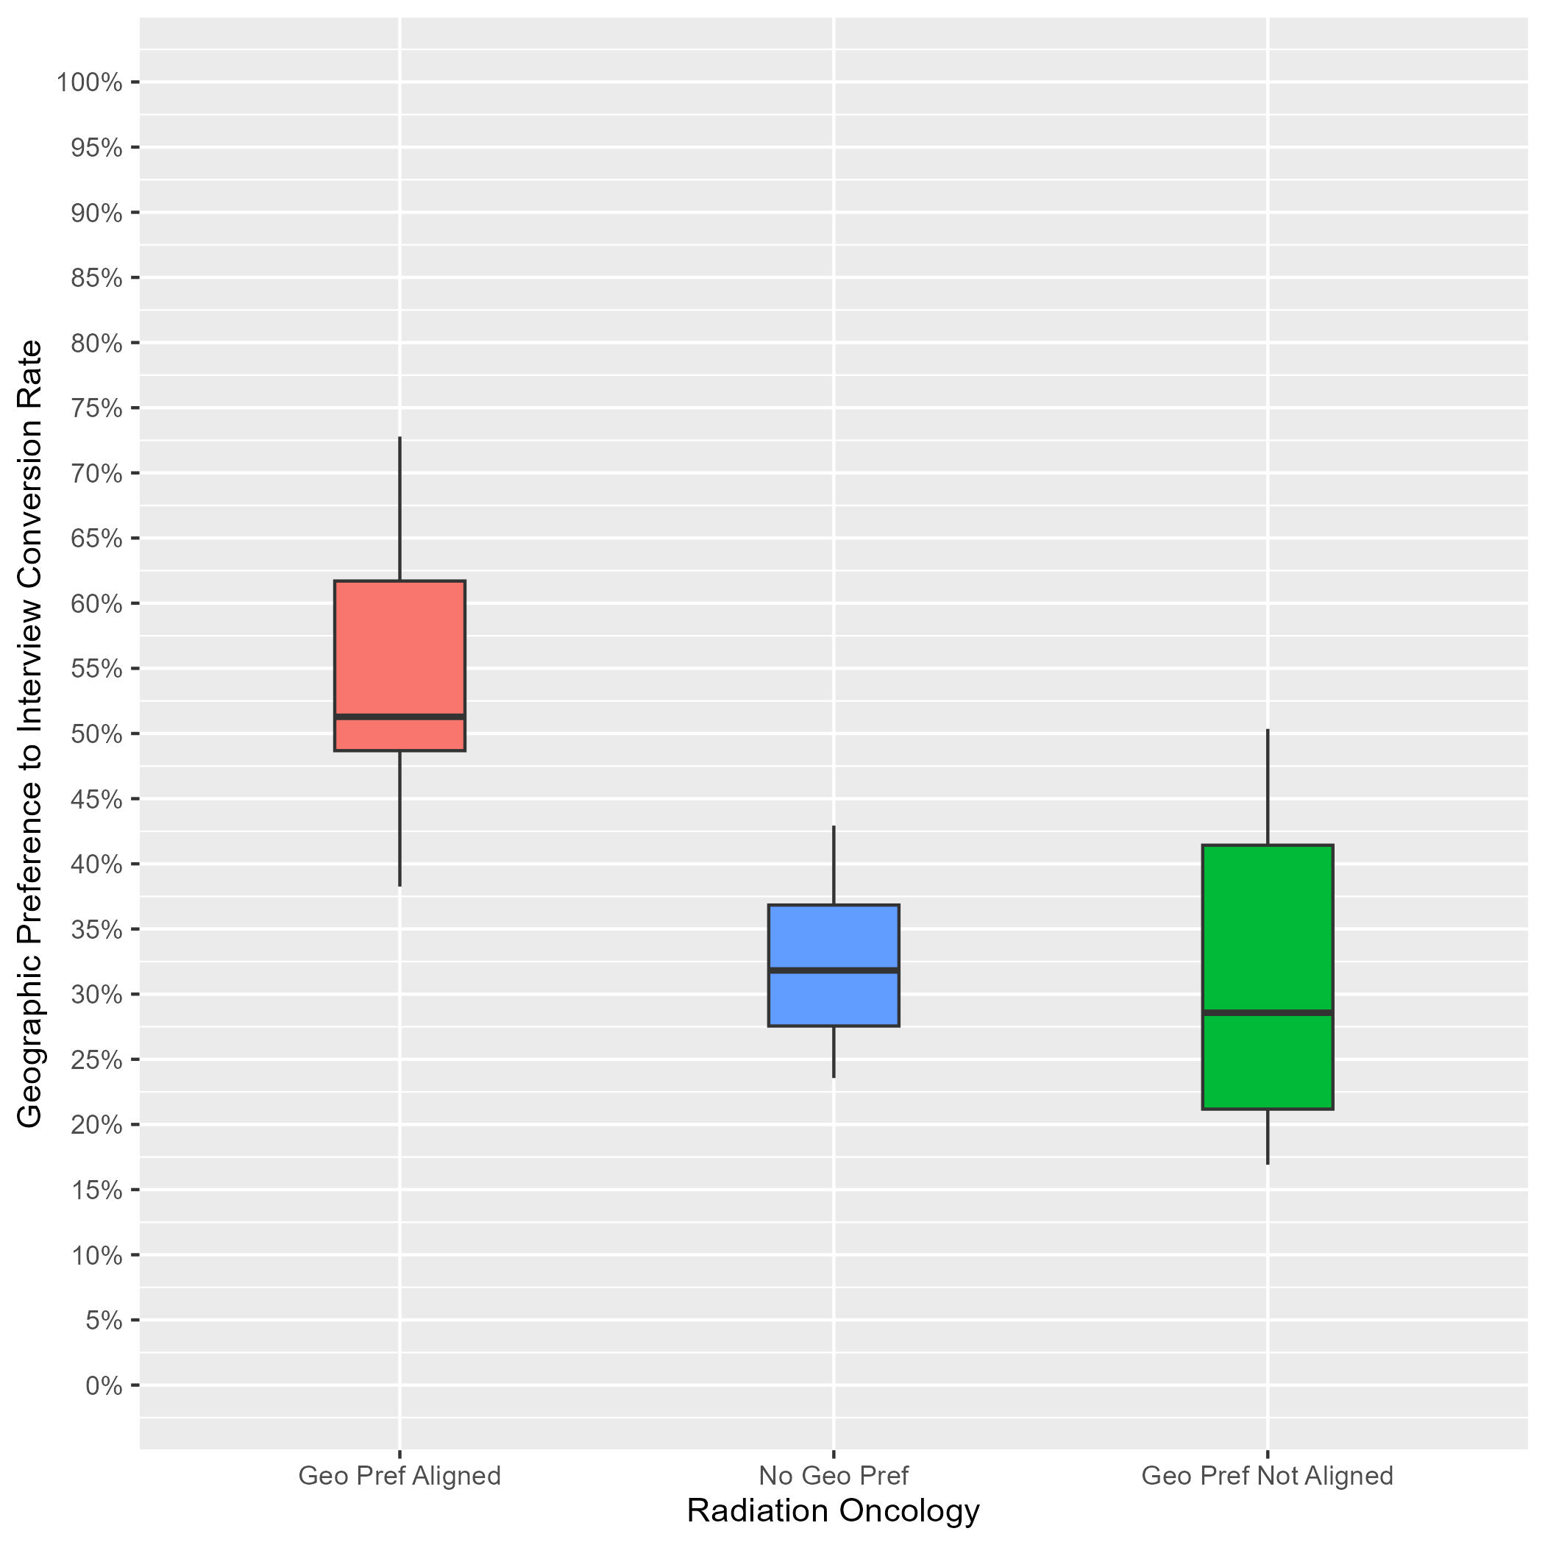
Radiation Oncology: Interview Rates by Geographic Preference Alignment
Data as of 2/28/24
# of Programs: 19
Applicants whose geographic preference aligned with the program:
Median of interview offers: 51%.
10th percentile: 38%.
90th percentile: 73%.
Applicants with no geographic preference:
Median of interview offers: 32%.
10th percentile: 24%.
90th percentile: 43%.
Applicants whose geographic preference(s) did not align with the program:
Median of interview offers: 29%.
10th percentile: 17%.
90th percentile: 50%.
Notes:
Year 1 findings suggest that:
In general, applicants whose geographic preferences aligned with the program’s location were invited to interview at a higher rate than those who reported no preference and those whose preferences were misaligned. (51% vs 32% vs 29%). Further, there was not much overlap between the aligned geographic preference distribution and the other distributions, suggesting that programs put more weight on aligned preferences than no or misaligned preferences.
There was a lot of overlap between the distributions for applicants with no geographic preference and those with misaligned geographic preferences, suggesting that many PDs may not have differentiated between these two responses, and there is a need for additional training.

Slide 49
Transitional Year: Program Sample & Inclusion Criteria
 | N of Programs for Geographic Preference
Total programs | 168
Total programs who made geographic preference viewable at their program | 67
Met inclusion rule equal to or larger than 7:1; Provided PGY1 info in GME track; Provided interview offer data by February 28, 2024 | 45
Total analytic sample | 45
Total % of programs who made geographic preference viewable at their program | 67%
Total % of all Transitional Year programs in 2024 ERAS cycle | 27%
Notes:
There were a total of 168 Transitional Year programs in the 2024 ERAS cycle. Out of those, 67 made geographic preference viewable at their program as of 9/29/23.
We included 45 of them from this analysis because they reported PGY1 information in GME track; provided interview invitation data by February 28, 2024, (which is when we pulled the data); and met the inclusion rule for quality data that was created by Transitional Year specialty leadership. That rule specified that any interview data provided by a program could only be included if the ratio of interview invites to positions available in that program was equal to or larger than 7:1.
The final analytic sample for the geographic preference analysis was 45 Transitional Year programs, representing approximately 67% of all eligible Transitional Year programs and 27% of the total Transitional Year program population for the 2024 ERAS cycle.

Slide 50
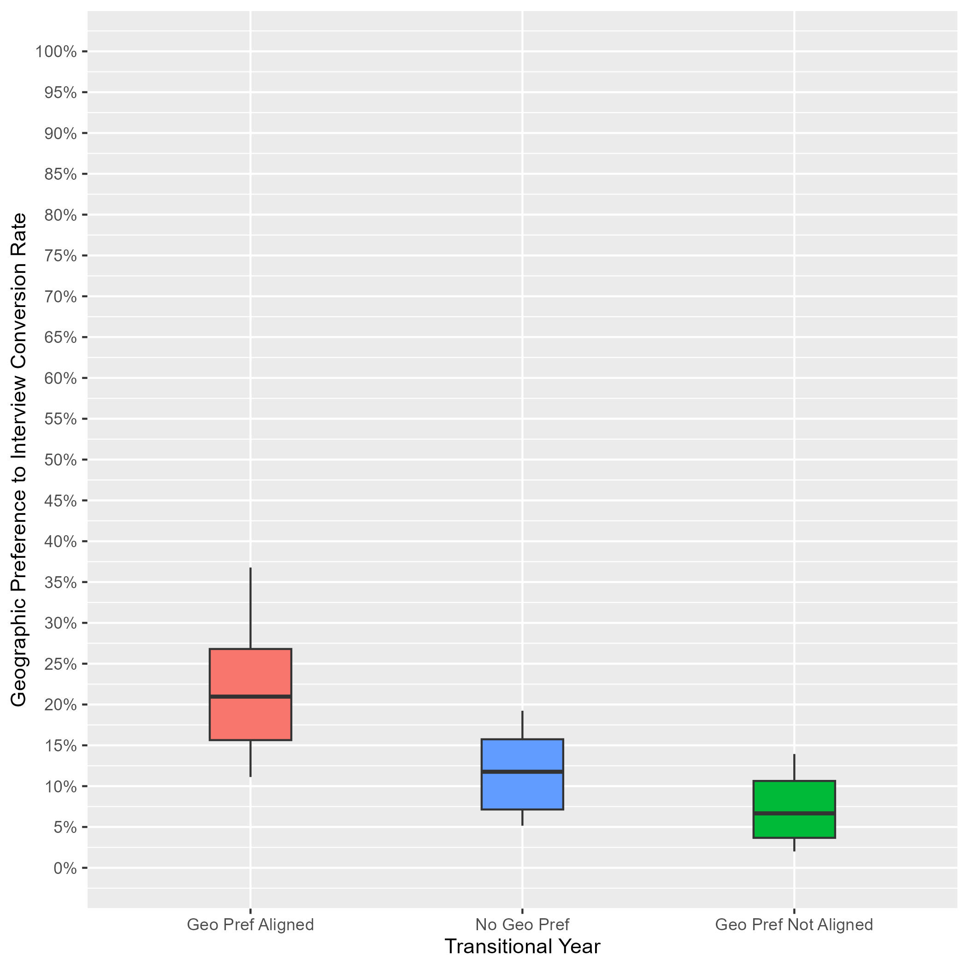
Transitional Year: Interview Rates by Geographic Preference Alignment
Data as of 2/28/24
# of Programs: 45
Applicants whose geographic preference aligned with the program:
Median of interview offers: 21%.
10th percentile: 11%.
90th percentile: 37%.
Applicants with no geographic preference:
Median of interview offers: 12%.
10th percentile: 5%.
90th percentile: 19%.
Applicants whose geographic preference(s) did not align with the program:
Median of interview offers: 7%.
10th percentile: 2%.
90th percentile: 14%.
Notes:
Year 1 findings suggest that:
In general, applicants whose geographic preferences aligned with the program’s location were invited to interview at a higher rate than those who reported no preference and those whose preferences were misaligned. (21% vs 12% vs 7%). Further, there was not much overlap between the aligned geographic preference distribution and the other distributions, suggesting that programs put more weight on aligned preferences than no or misaligned preferences.
There was a lot of overlap between the distributions for applicants with no geographic preference and those with misaligned geographic preferences, suggesting that many PDs may not have differentiated between these two responses, and there is a need for additional training.

Slide 51
Urology: Program Sample & Inclusion Criteria
 | N of Programs for Geographic Preference
Total programs | 145
Total programs who made geographic preference viewable at their program | 120
Met inclusion rule equal to or larger than 7:1; Provided PGY1 info in GME track; Provided interview offer data by February 28, 2024 | 53
Total analytic sample | 53
Total % of programs who made geographic preference viewable at their program | 44%
Total % of all Urology programs in 2024 ERAS cycle | 37%
Notes:
There were a total of 145 Urology programs in the 2024 ERAS cycle. Out of those, 120 made geographic preference viewable at their program as of 9/29/23.
We included 53 of them from this analysis because they reported PGY1 information in GME track; provided interview invitation data by February 28, 2024, (which is when we pulled the data); and met the inclusion rule for quality data that was created by Urology specialty leadership. That rule specified any interview data provided by a program could only be included if the ratio of interview invites to positions available in that program was equal to or larger than 7:1.
The final analytic sample for the geographic preference analysis was 53 Urology programs, representing approximately 44% of all eligible Urology programs and 37% of the total Urology program population for the 2024 ERAS cycle.

Slide 52
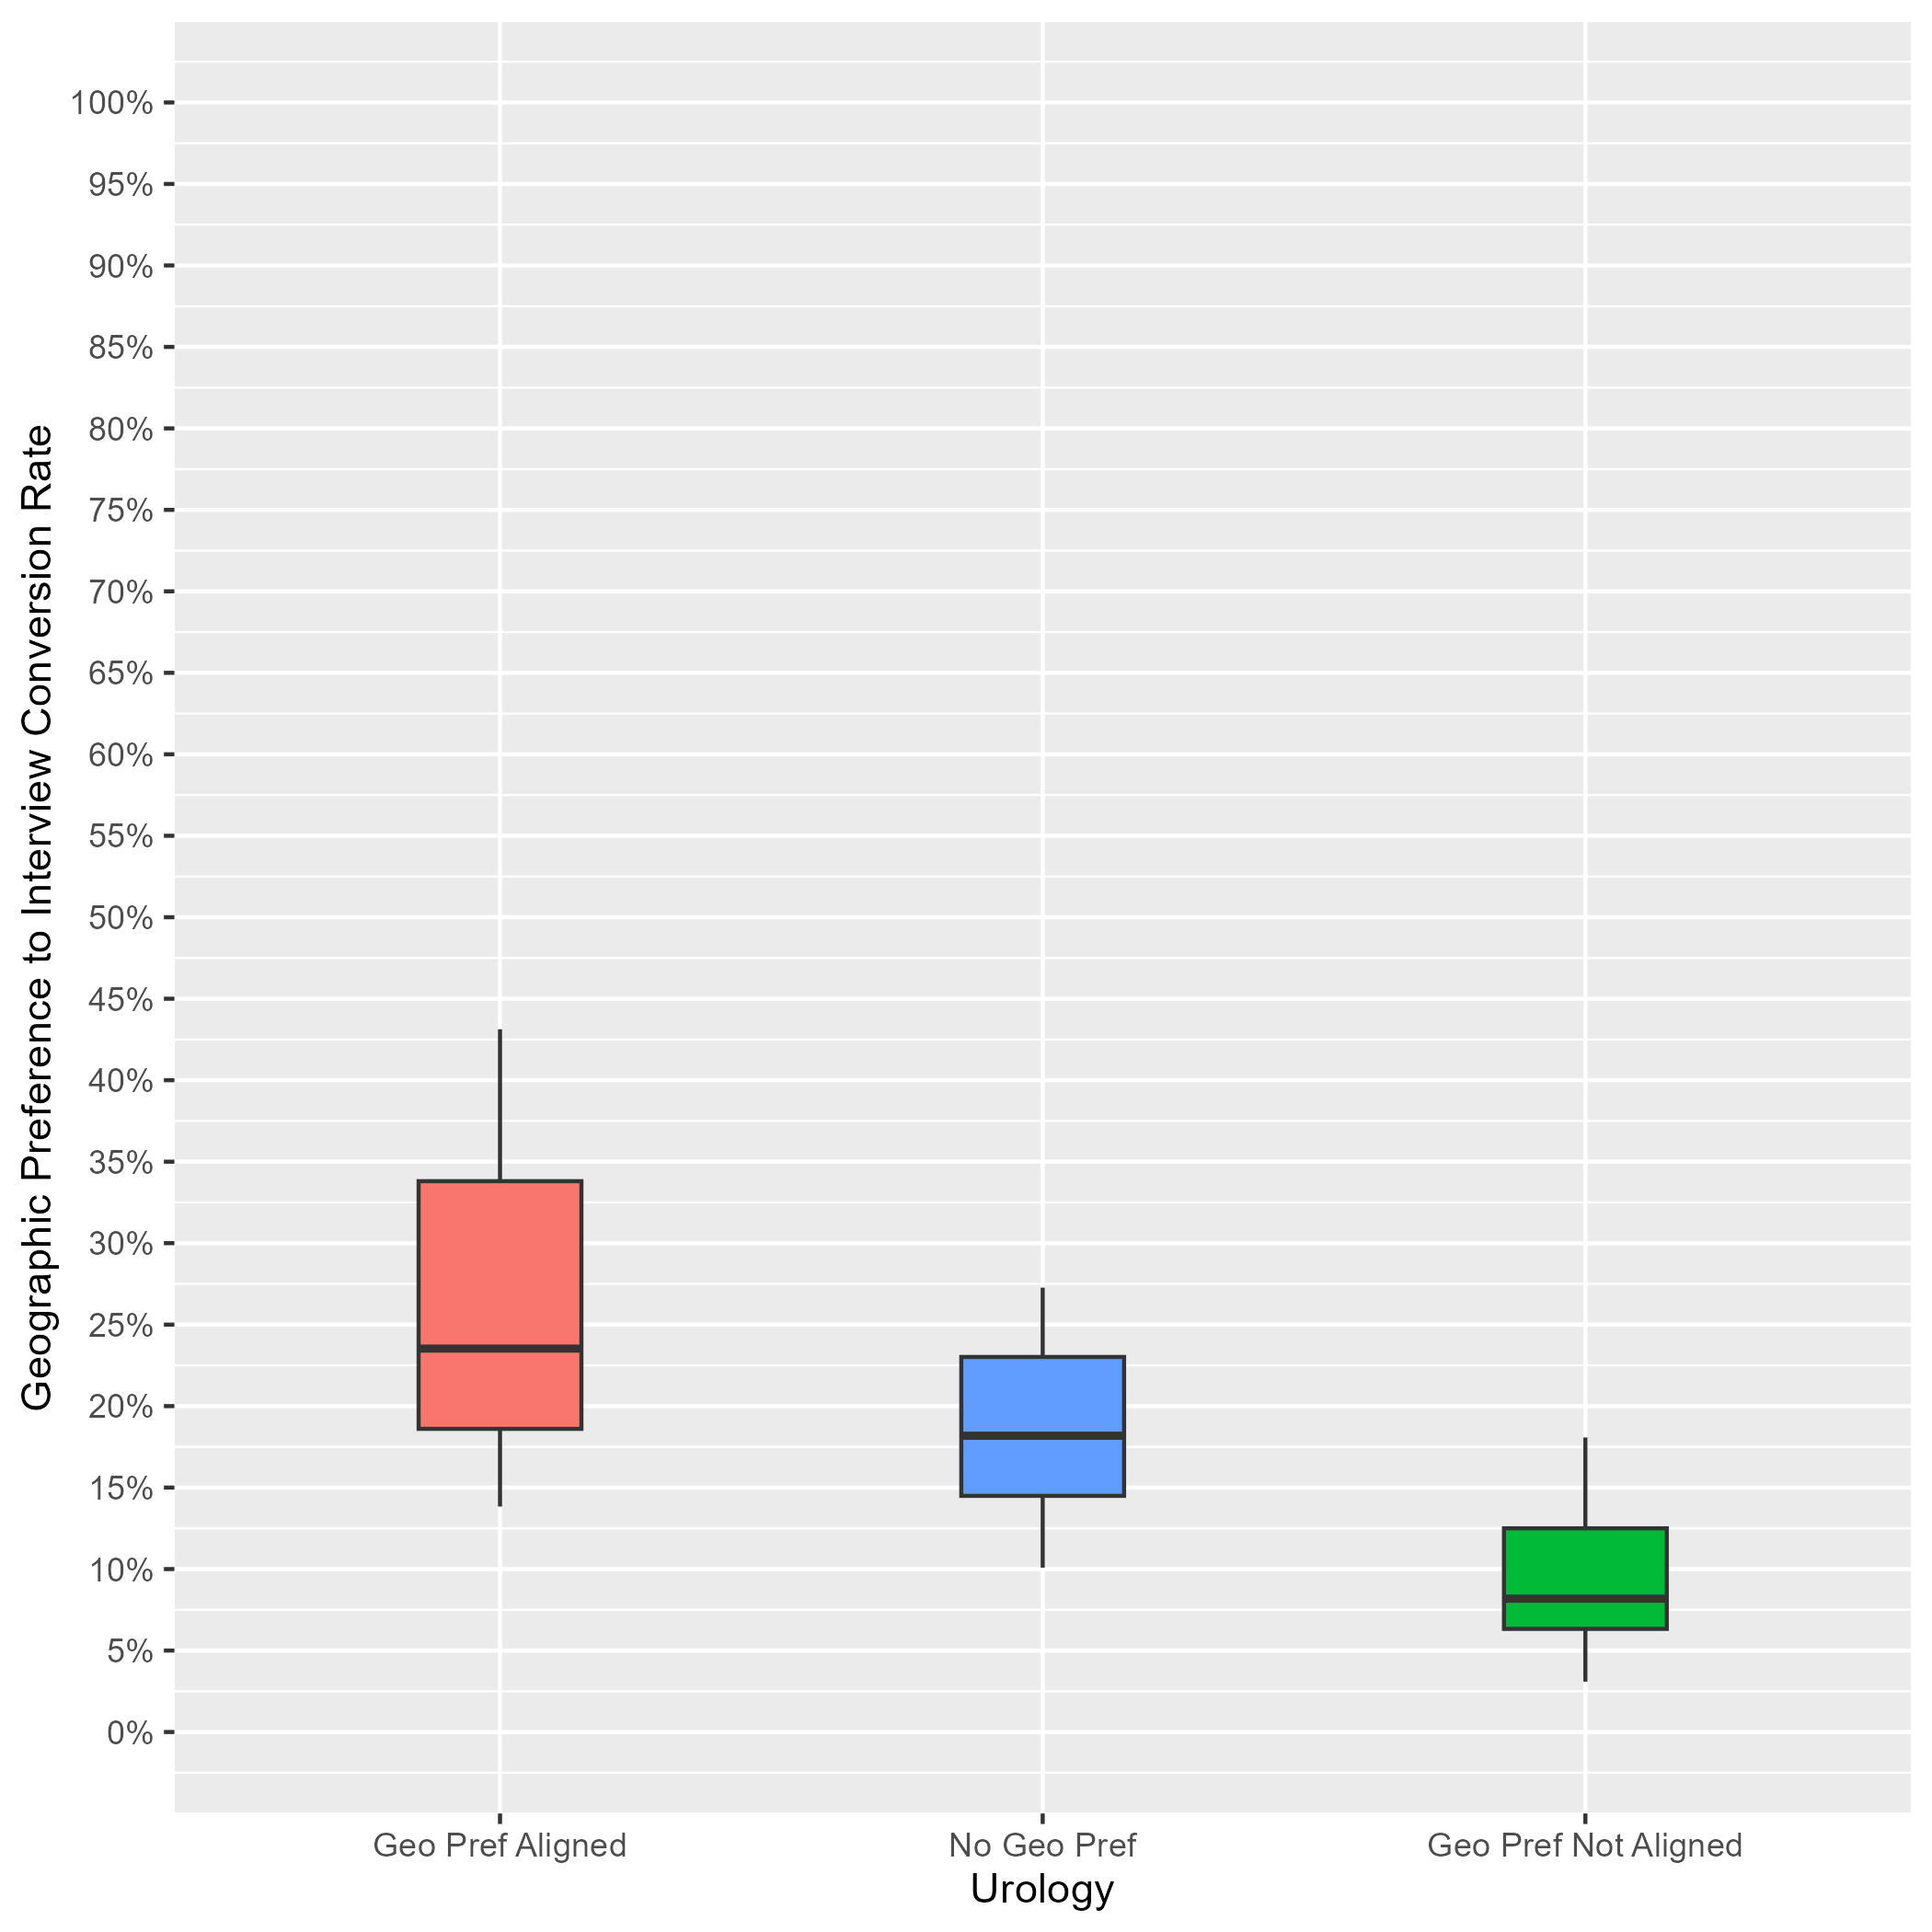
Urology: Interview Rates by Geographic Preference Alignment
Data as of 2/28/24
# of Programs: 53
Applicants whose geographic preference aligned with the program:
Median of interview offers: 24%.
10th percentile: 14%.
90th percentile: 43%.
Applicants with no geographic preference:
Median of interview offers: 18%.
10th percentile: 10%.
90th percentile: 27%.
Applicants whose geographic preference(s) did not align with the program:
Median of interview offers: 8%.
10th percentile: 3%.
90th percentile: 18%.
Notes:
Year 1 findings suggest that:
In general, applicants whose geographic preferences aligned with the program’s location were invited to interview at a higher rate than those who reported no preference and those whose preferences were misaligned. (24% vs 18% vs 8%). However, there was noticeable overlap between the aligned geographic preference distribution and the no geographic preference distribution, indicating that some programs did not differentiate these responses.
There was little overlap between the distributions for applicants with misaligned geographic preference and the other geographic preferences, which suggests most programs differentiated misaligned distribution from the two other responses.

Slide 53
Vascular Surgery: Program Sample & Inclusion Criteria
 | N of Programs for Geographic Preference
Total programs | 76
Total programs who made geographic preference viewable at their program | 29
Met inclusion rule equal to or larger than 7:1; Provided PGY1 info in GME track; Provided interview offer data by February 28, 2024 | 22
Total analytic sample | 22
Total % of programs who made geographic preference viewable at their program | 76%
Total % of all Vascular Surgery programs in 2024 ERAS cycle | 29%
Notes:
There were a total of 76 Vascular Surgery programs in the 2024 ERAS cycle. Out of those, 29 made geographic preference viewable at their program as of 9/29/23.
We included 22 of them from this analysis because they reported PGY1 information in GME track; provided interview invitation data by February 28, 2024, (which is when we pulled the data); and they met the inclusion rule for quality data that was created by Vascular Surgery specialty leadership. That rule specified that any interview data provided by a program could only be included if the ratio of interview invites to positions available in that program was equal to or larger than 7:1.
The final analytic sample for the geographic preference analysis was 22 Vascular Surgery programs, representing approximately 76% of all eligible Vascular Surgery programs and 29% of the total Vascular Surgery program population for the 2024 ERAS cycle.

Slide 54
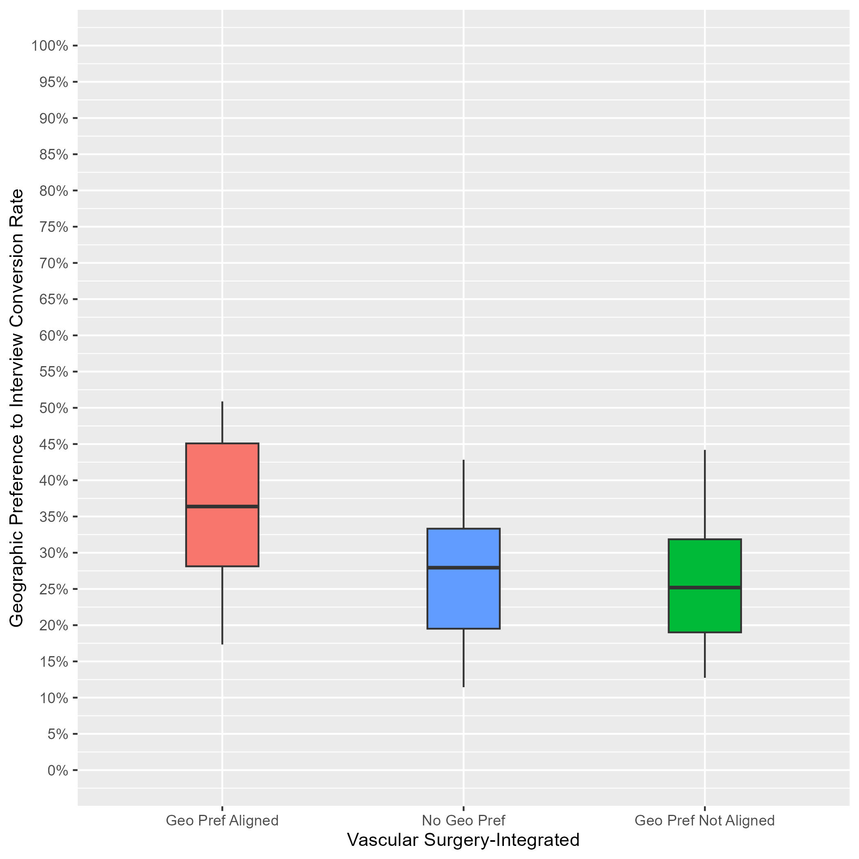
Vascular Surgery: Interview Rates by Geographic Preference Alignment
Data as of 2/28/24
# of Programs: 22
Applicants whose geographic preference aligned with the program:
Median of interview offers: 36%.
10th percentile: 17%.
90th percentile: 51%.
Applicants with no geographic preference:
Median of interview offers: 28%.
10th percentile: 11%.
90th percentile: 43%.
Applicants whose geographic preference(s) did not align with the program:
Median of interview offers: 25%.
10th percentile: 13%.
90th percentile: 44%.
Notes:
Year 1 findings suggest that:
In general, applicants whose geographic preferences aligned with the program’s location were invited to interview at a higher rate than those who reported no preference and those whose preferences were misaligned. (36% vs 28% vs 25%). However, there was noticeable overlap between the aligned geographic preference distribution and the other distributions, indicating that some programs did not differentiate these responses.
There was a lot of overlap between the distributions for applicants with no geographic preference and those with misaligned geographic preferences, suggesting that many PDs may not have differentiated between these two responses, and there is a need for additional training.

Slide 55
Executive Summary
Having an aligned geographic preference has a greater impact on interview invitation rates compared to having no preference or a misaligned preference in all specialties, although this impact is lower than sending a program signal.
In half of the specialties we examined (12 of 24), median interview rates were higher for those who selected no geographic preference compared to those who were unaligned.
For 11 other specialties, median interview rates between those with no preference and those who were unaligned were nearly the same.
There is great variability in use of geographic preferences by programs, and opportunity for program director training on the meaning of no preference.
Notes:
Across all participating specialties examined in our sample, we observed that median interview rates were highest for those who were aligned in terms of geographic preference.
In half of the specialties we examined (12 of 24), median interview rates were higher for those who selected no geographic preference compared to those who were unaligned.
For 11 other specialties, we did not observe this pattern. Instead, median interview rates between those with no preference and those who were unaligned were nearly the same (within 2%), and this pattern was present in most of the largest specialties such as Family Medicine, Internal Medicine, General Surgery, and Emergency Medicine. These results suggest there is an opportunity to train program directors on the meaning of “No Preference.”
Throughout our analysis, we observed considerable variability in the utilization of geographic preferences by programs. This variability indicates that programs have different approaches and strategies when considering this factor in their selection process.

Slide 56
Limitations and Considerations
Because a relatively low percentage of programs made geographic preferences viewable by 9/29/23 in each specialty, results should be interpreted with caution and may not apply to all programs.
These results do not account for out of state or in-state status. Geographic preferences can be interpreted or contextualized differently for in-state vs. out-of-state applicants.
Geographic preferences are only one part of the application, and are considered alongside program signals, academic qualifications, and other aspects of the application by program directors when making interview invitation decisions.
The impact of geographic preferences across applicant types and demographic subgroups will continue to be studied in future cycles as applicants, advisors and program directors learn more about their meaning and utility at different programs.
Notes:
Because a relatively low percentage of programs made geographic preference viewable at their program in each specialty, results should be interpreted with caution and may not apply to all programs. However, in the specialties we examined with multiple years of data, interview rates were similar to those in the previous year with larger program sample sizes when all programs were retained in the analytic sample.
These results do not account for out-of-state or in-state status. Geographic preferences can be interpreted or contextualized differently for in-state vs. out-of-state applicants.
Geographic preferences are only one part of the application, and are considered alongside signals, academic qualifications, and other aspects of the application by program directors when making interview invitation decisions.
The impact of geographic preferences across applicant types and demographic subgroups will continue to be studied in future cycles as applicants, advisors, and program directors learn more about their meaning and utility at different programs.

Slide 57
For more information:
ERAS Statistics. This page contains current and historical data related to ERAS applicants and applications. It includes Final End of Season Data, Specialty Specific Data, and Cross Specialty Applicant Data.
Notes:
Links to other information and reports available on our website.

