Slide 1
VSLO Advisory Committee
July 15, 2024 (10:00a to 11:15a)
July 16, 2024 (8:30a to 11:00a)
Robin Carle, VSLO Senior Director
Ken Self, VSLO Technical Director

Slide 2
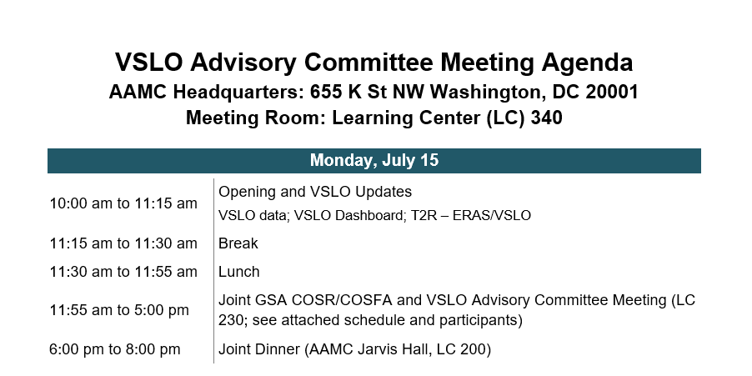

Slide 3
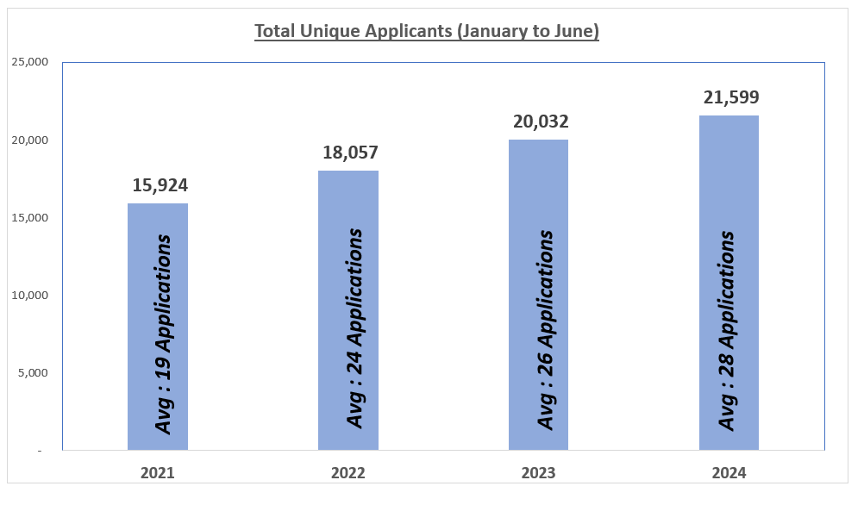
7.8% Increase in Applicants
(2023 vs. 2024)
Students apply to an average of
10 Unique electives
(2024CY YTD)

Slide 4
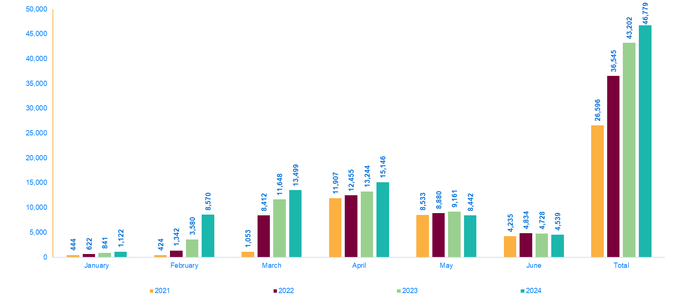
Number of Students Submitting Applications by Month (January - June)
Students continue to start submitting applications earlier every year.

Slide 5
VSLO Stats (2023 vs. 2024)
Students are applying to 11.5% More Unique Electives.
MD students are applying on average for 3 more date options per Elective.
MD Students are applying on average to 1 additional
Unique Elective.

Slide 6
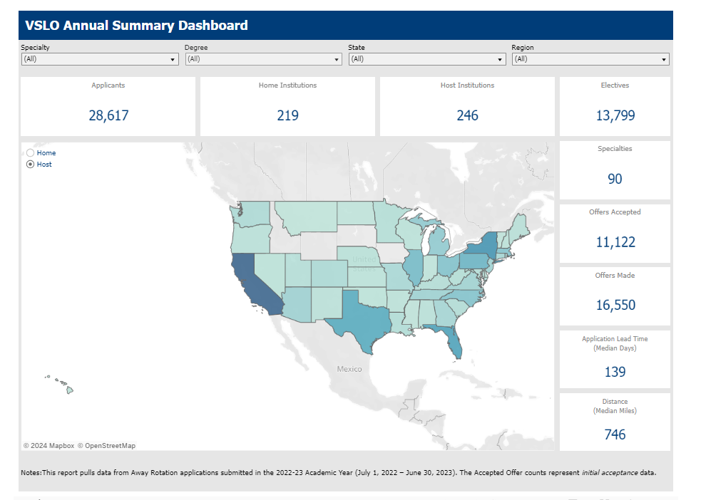
VSLO DASHBOARD
In the process of updating this with the 2023-2024 Academic Year data.
Discussions are still occurring if this will be a full replace or if we will be able to add the 2023-2024 Academic Year data to this report to have 2 years available.

Slide 7
VSLO and Transition to Residency
How can VSLO Data be used in the T2R process to support a more transparent student journey?
Comparison Data
    VSLO Student Accepted Offers
    ERAS Interview Data
    Residency Data
    Signaling Data
Additional Points of Access to VSLO Data:
    Working with ERAS to determine what VSLO Data can be integrated to enhance/expand the Dean’s Workstation (DWS).

Slide 8
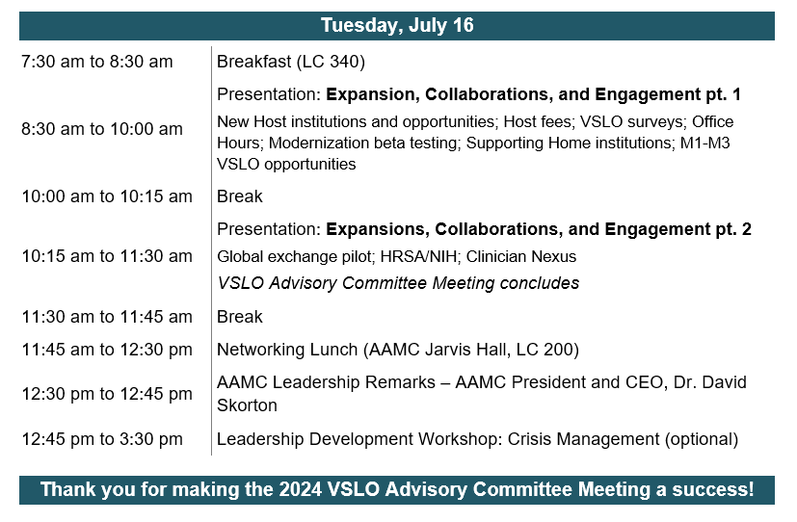

Slide 9
VSLO Advisory Committee
Expansion, Collaborations, and Engagement

Slide 10
VSLO Surveys
Adding a short VSLO on-boarding survey
Annual VSLO Institutional Survey -- August 2024
  Are there any topics/questions you would like to see included?
COSR surveys in the field
  Affiliation Agreements
  Impact of Step scoring changes on rotations

Slide 11
VSLO Modernization Beta Testing
Have a VSLO Modernization Testing Environment created to allow users the opportunity to use the Modernized Software prior to the launch.
The goal is to make sure what was developed matches the needs and requests of our users.
Also, this may identify any potential bugs from the User perspective that need to be addressed.
Planning an April/May 2025 timeline to have it ready.

Slide 12
Global Exchange Pilot
Only accepting Global Institutions with a pre-established partnership with a VSLO U.S. Institution.
Global Institution students can only apply to electives at the U.S. Location they have a partnership with.
Currently have 11 U.S. Institutions in the pilot.
  11 new Global Institutions are either already using VSLO or in the process of being onboarded.
  Allows approximately 625 Global Students from these new sites to access VSLO.

Slide 13
VSLO Program Expansion (AY 23-24)
  29 New Host Locations across all Regions
    21 of these Hosts are now Active in VSLO
    8 of these Hosts have signed their agreement and have been scheduled for new Host Training/Onboarding
Region | Number of New Hosts
Mid West | 6
Northeast | 5
South | 8
West | 10
TOTAL | 29

Slide 14
VSLO Program Expansion (AY 23-24)
Top Expanded Elective Specialties:
  Family Medicine
  Internal Medicine
  Emergency Medicine
  Surgery
  Urology

Slide 15
VSLO Program Expansion (AY 24-25)
16 additional New Host sites are in the process of signing their agreements and will be scheduled for Training/Onboarding in the coming weeks.
Region | Number of Prospective New Hosts
Mid West | 4
Northeast | 6
South | 4
West | 2
TOTAL | 16

Slide 16
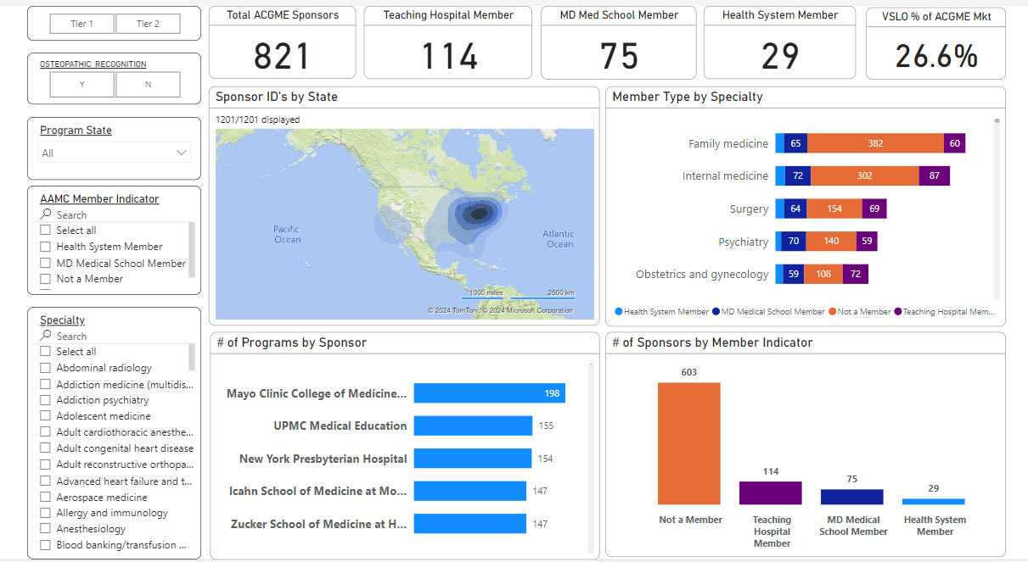
ACGME Strategic Dashboard

Slide 17
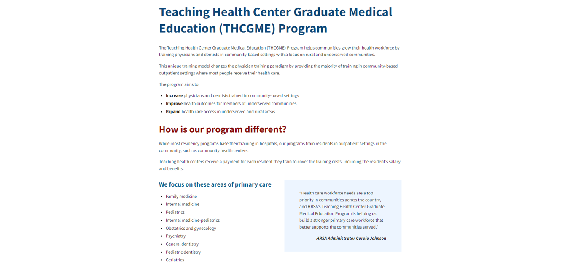
Health Resources and Services Administration (HRSA)

Slide 18
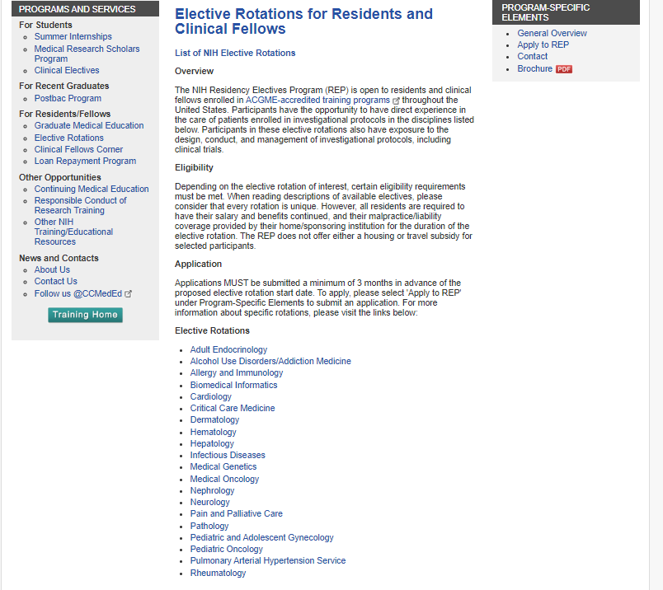
National Institutes of Health (NIH)

Slide 19
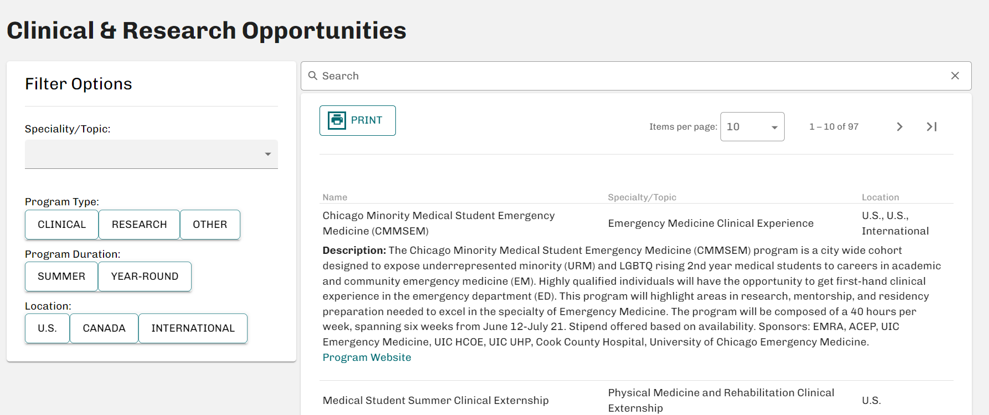
VSLO Users
Tiered Host Fees
Home Use of VSLO
    Comprehensive management of their students' clinical and research experiences
    M1-M3 opportunities internal to your institution
    M1-M3 opportunities outside your institution

Slide 20
Clinician Nexus Collaboration Status
Developing a LOI to support the creation of a proposal that would address many/all of the following areas of medical education to workforce.
Sourcing future physicians:
During high school and college: Connect students as early as high school to experiences and content that expose them to the health professions, while collecting data along their journey.
As they transition to medical school: Connect aspiring medical student’s data from as early as high school to their applications to medical school.
Supporting medical students:
During medical school: Connect enrolled medical students with direct access to shadow, core, and elective clinical experiences to gain confidence in their specialty of choice prior to interview season.
  As they transition to residency: Connect the experiential data from high-school-medical school to their residency applications, empowering program directors to see more data on the quality of students before interview season while affording school/specialty advisors a comprehensive view of their students' journey.
Supporting early-career physicians:
  During residency & fellowship: Consider an integration or development of products that help residency programs manage and monitor the quality of the residents and fellows as they progress through their programs and medical schools further refine their curriculum and clinical training.

Slide 21
Thank You for Another Great Meeting!

