Slide 1
2024 CFAS-GRA-ORR Spring Meeting Summary
April 2-4, Arlington, VA

Slide 2
CFAS Mission
CFAS aspires to be the voice of academic faculty within the AAMC’s governance and leadership structures. The Council is charged with:
Identify critical issues facing faculty members of medical schools and within academic societies;
Articulate a common faculty voice on these issues to the AAMC as they relate to creation and implementation of the AAMC programs, services, and policies;
Serve as a bidirectional communications conduit regarding matters related to the core missions of academic medicine
Our activity over the past year has embodied these roles. CFAS is a stronger, more representative, and more effective voice

Slide 3
New Committee Focus
CFAS Committees are being refocused so that their work is more aligned with and directed by the CFAS Ad Board.
The CFAS Ad Board will now govern and approve the projects and activities undertaken by committees.

Slide 4
CFAS Leadership Impact
CFAS Chair and Chair-elect serve on the AAMC Board of Directors
Faculty representation, including a junior faculty voice, is critical on the AAMC Board of Directors
Faculty impact on AAMC Leadership is mad in part by the CFAS Chair and Chair-elect, who serve as AAMC Board of Directors members

Slide 5
CFAS Papers and Surveys in the Works
Faculty who are underrepresented in medicine (URM) (collaboration between Mission Alignment group and Diversity & Inclusion Committee)
Skills for faculty leaders or “champions” in well-being to increase reach and effectiveness among faculty peers (Well-being Committee)
Best practices in wellness programming from five AAMC member institutions (Well-being Committee)
Diversity & Inclusion survey; survey on the role of chairs; survey on faculty as medical educators and related survey on biomedical researchers

Slide 6
CFAS Connects
CFAS Connects, our monthly community building Zoom forum, launched in 2020 to fill the gap with no in-person meetings
Reports on CFAS work but also other topics, including conversations with AAMC leadership, collaboration, wellbeing, DEI issues, and more
About 8 sessions per year; 60 or more CFAS reps join each session

Slide 7
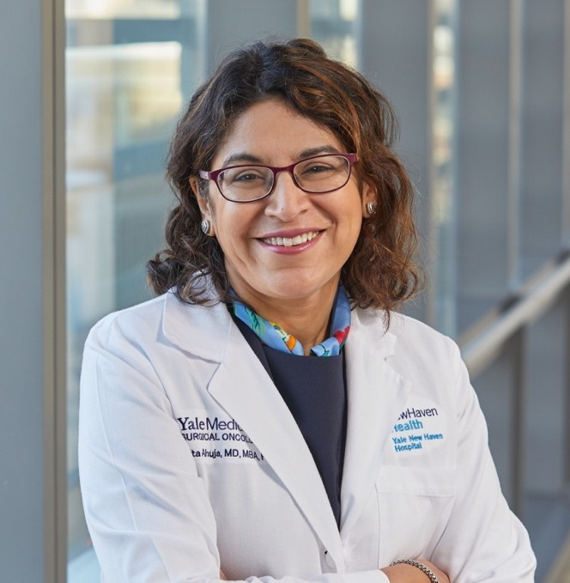
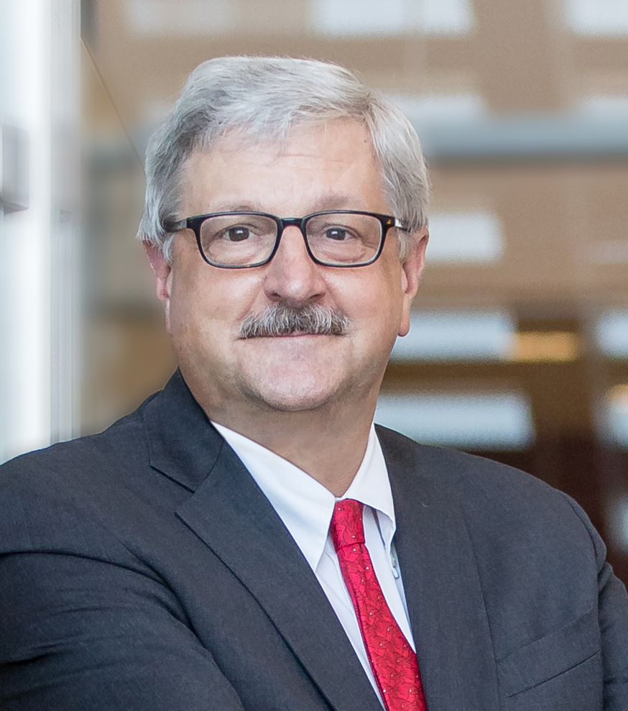
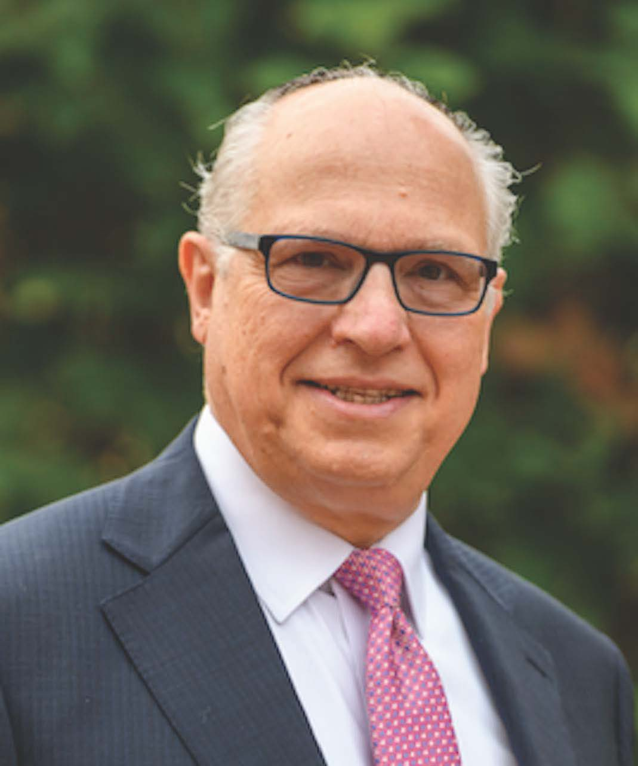
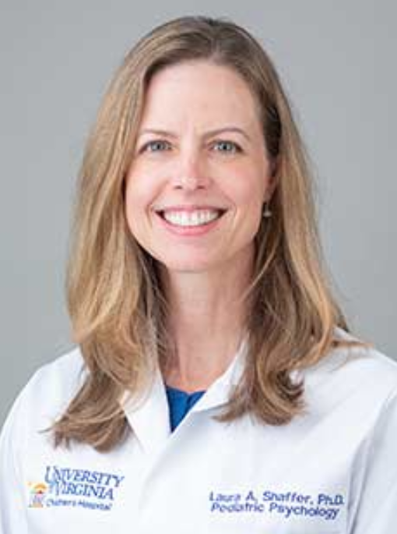
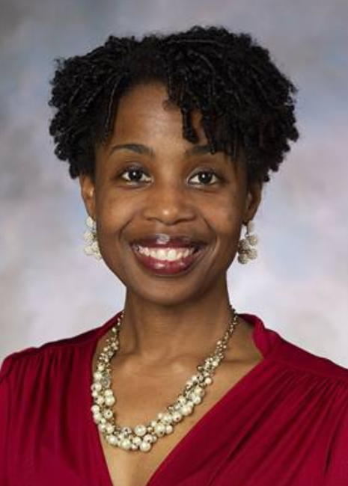
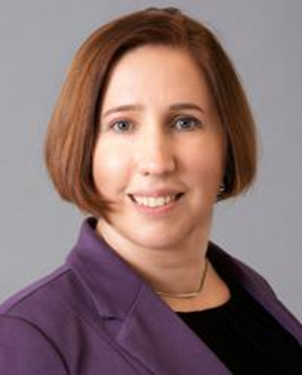
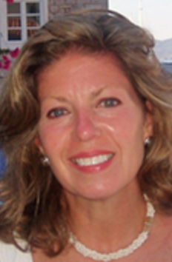
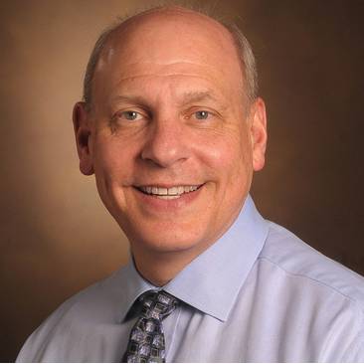
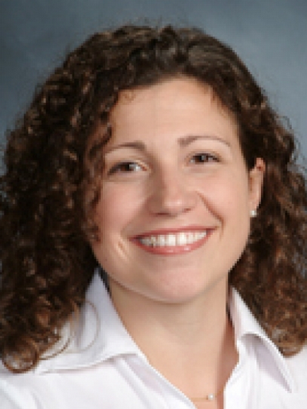
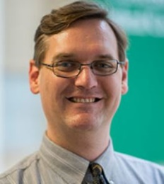
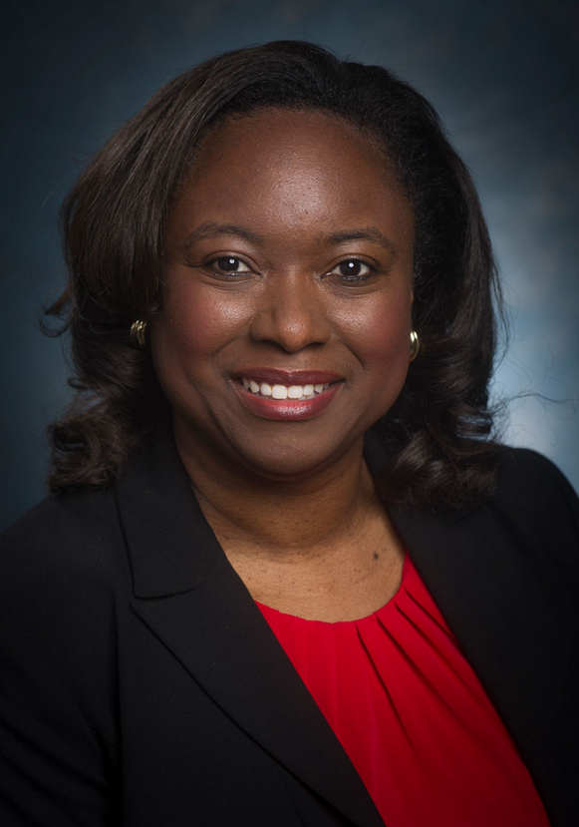
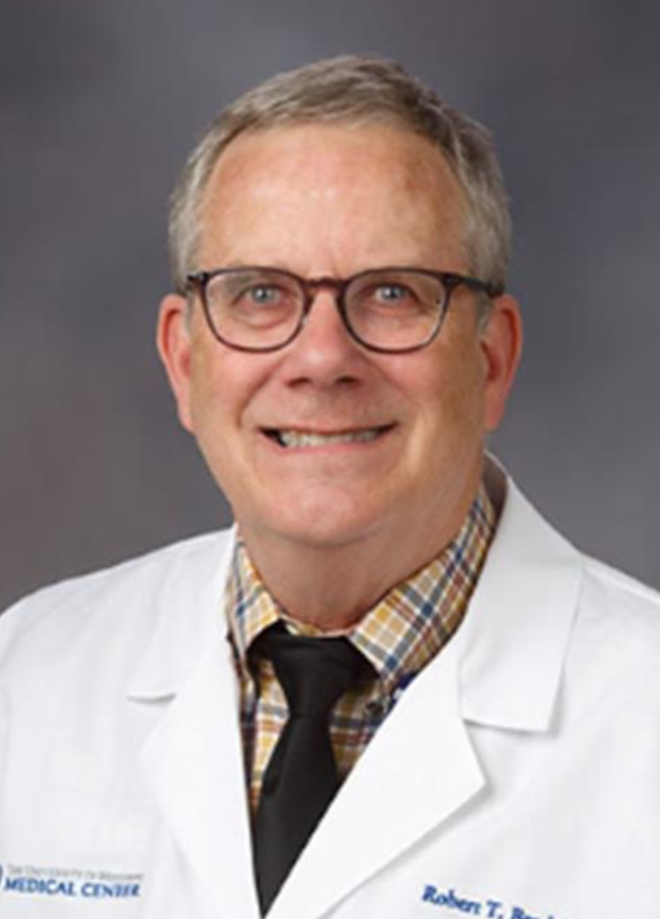
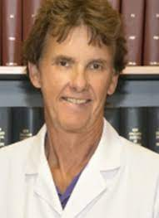
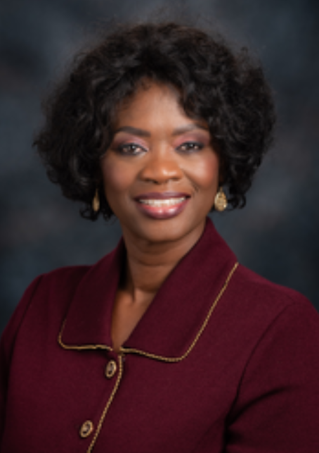
CFAS Administrative Board, 2024-2025
Nita Ahuja, MD, Chair
Arthur Derse, MD, JD Chair-elect
Aviad “Adi” Haramati, PhD, Immediate Past Chair
Valencia Walker, MD
Shirley “Lee” Eisner, PhD
Neil Osheroff, PhD
Laura Shaffer, PhD
Kimberly Lumpkins, MD
Lily Belfi, MD
Jon Courand, MD
Adam Franks, MD
Monica Baskin, PhD
Robert T. Brodell, MD
Deanna Sasaki-Adams, MD
Nicholas Delamere, PhD
Lisa D. Cain (Ex-Officio GFA Chair)

Slide 8
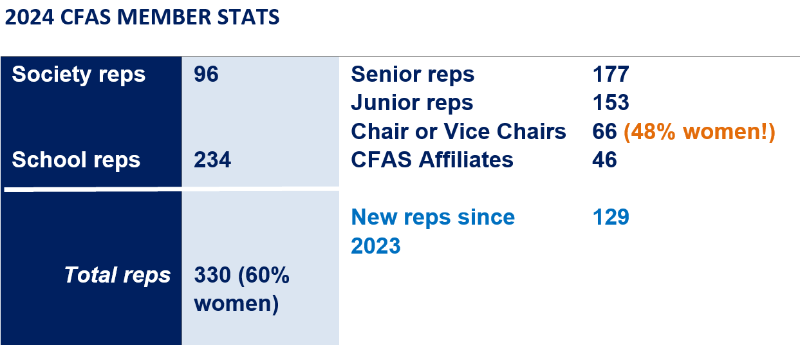
CFAS Rep Stats

Slide 9
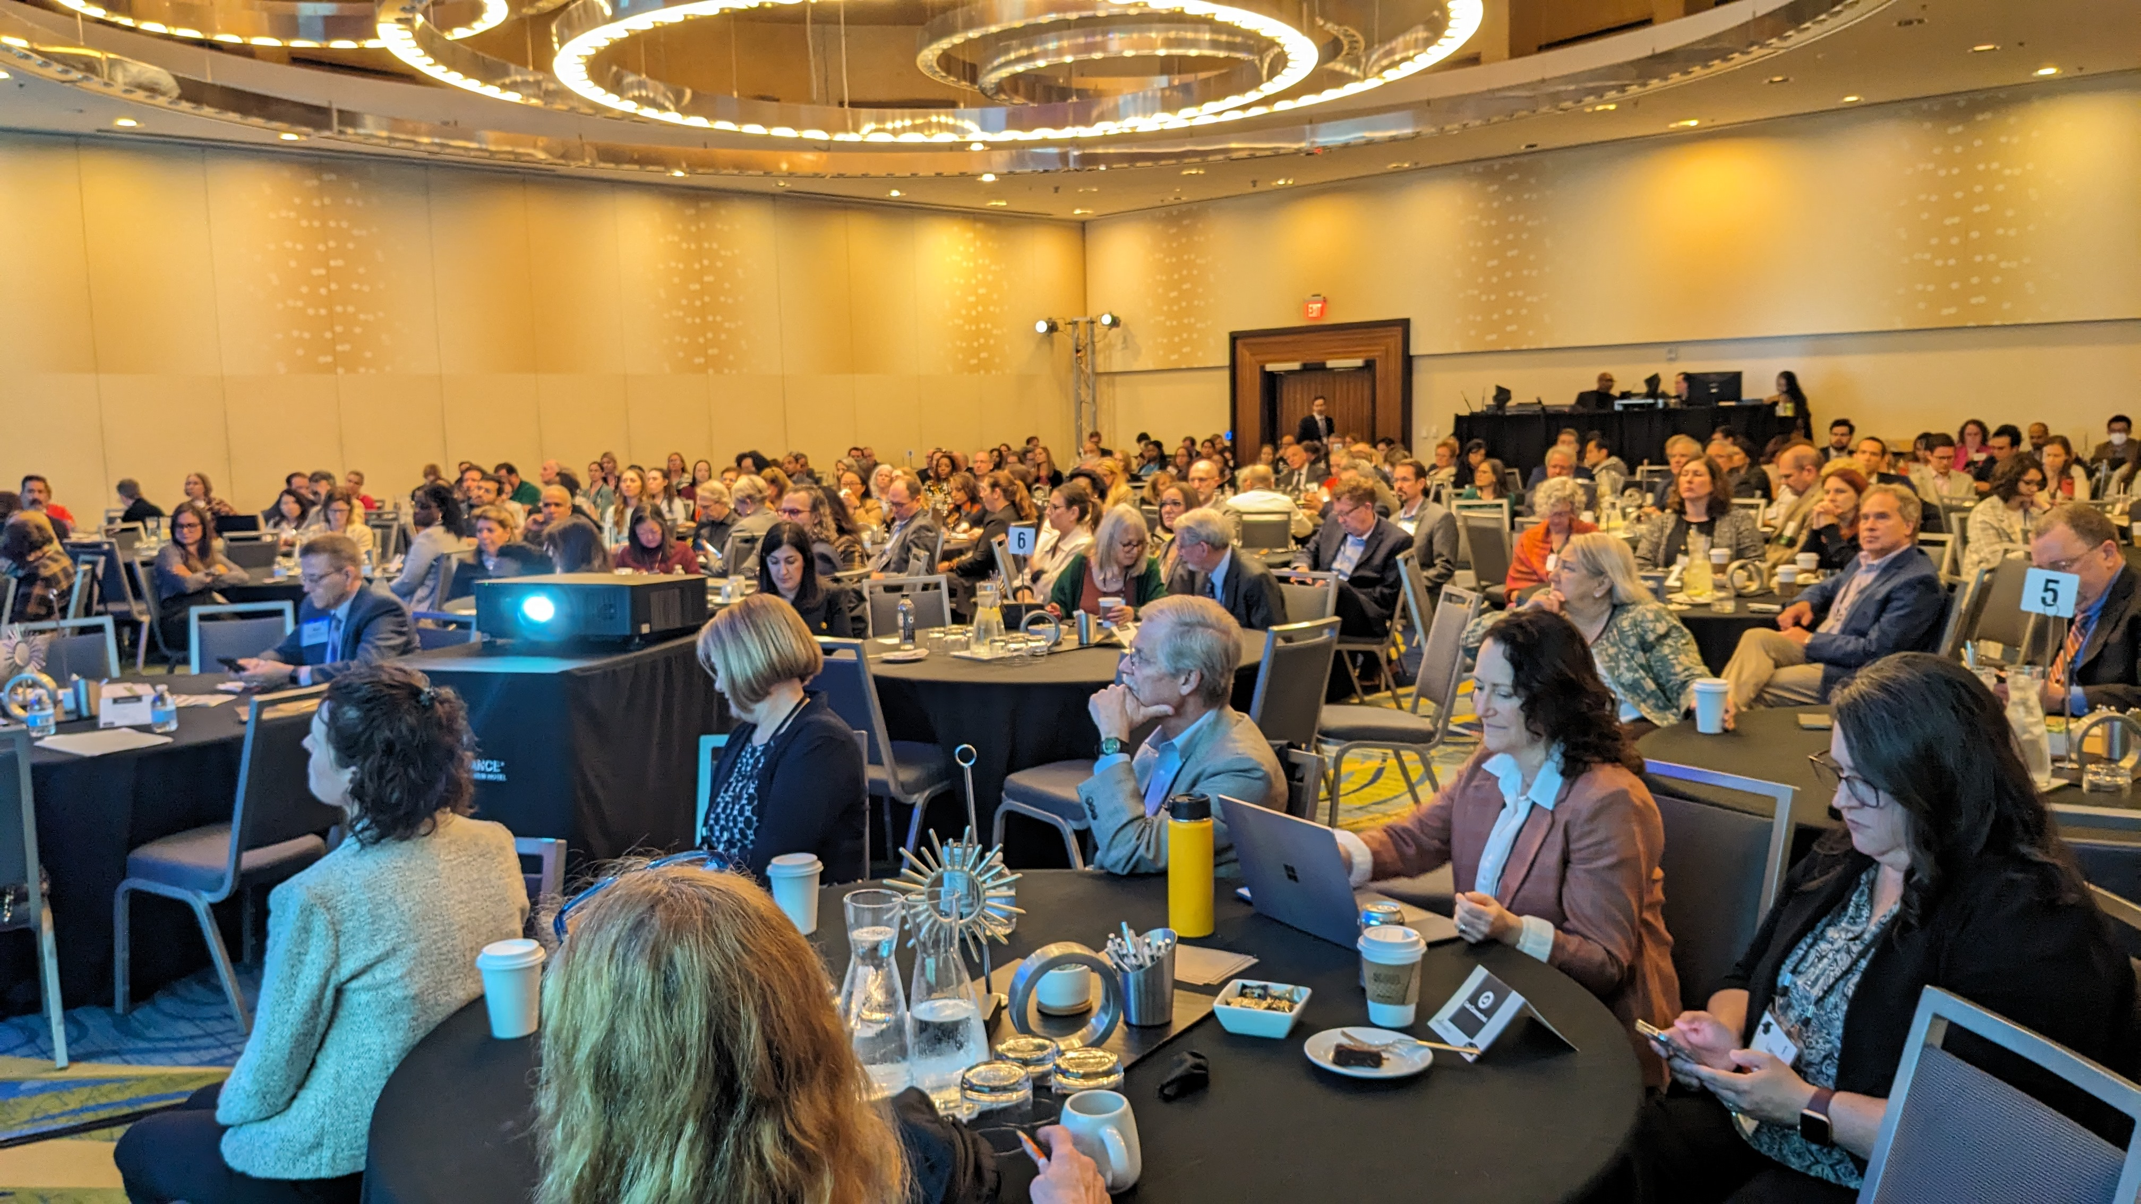
Plenary Session Summaries and Highlights

Slide 10
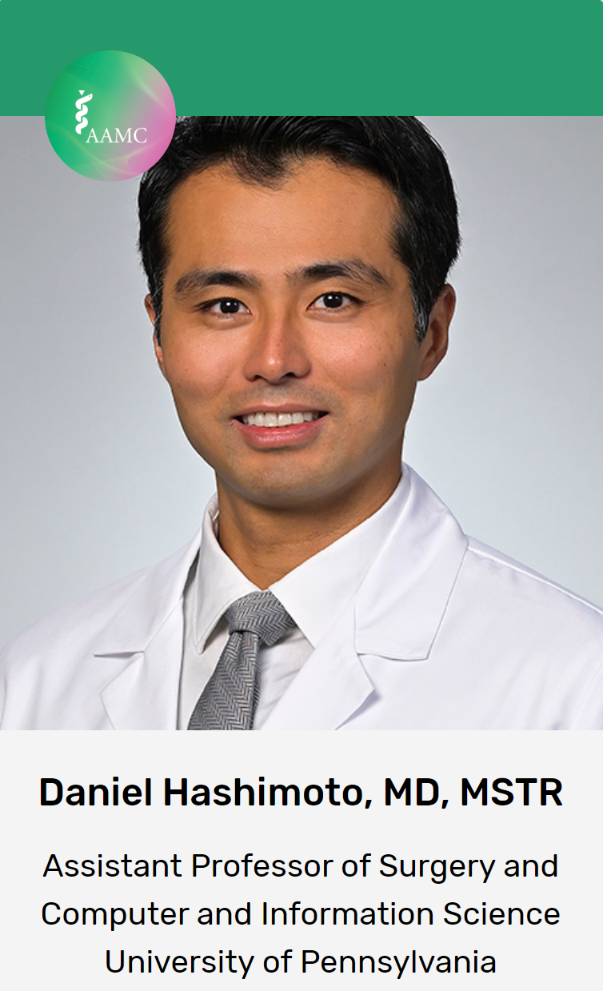
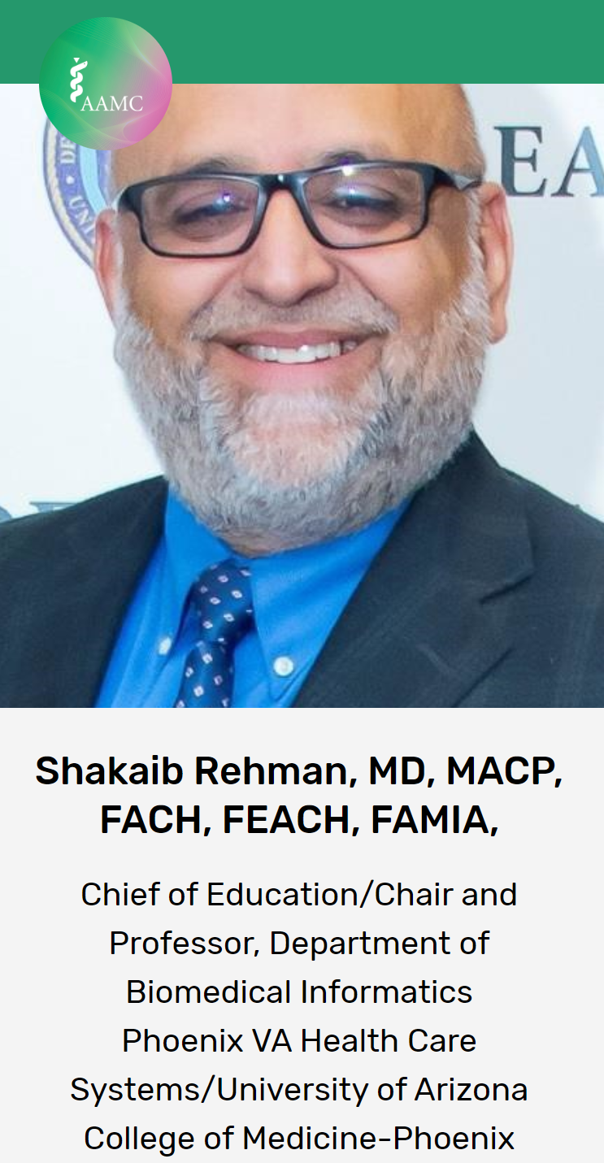
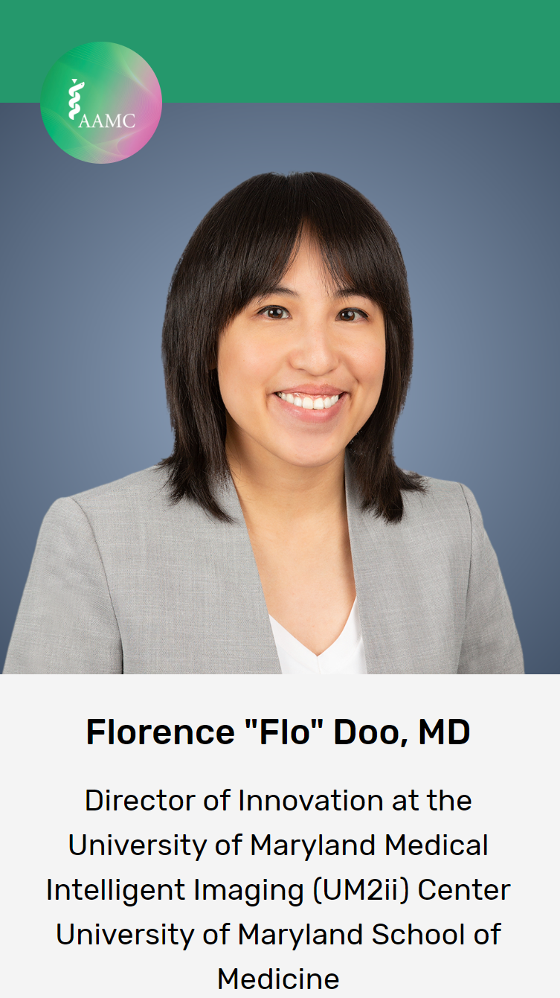
Opening Plenary: AI Literacy: The Competency You Didn’t Know You Need

Slide 11
Opening Plenary: AI Literacy: The Competency You Didn’t Know You Need
More is being done by AI – how do we stay in the driver seat? There are no formal policies on educating with AI
Presentation from Dr. Doo:
AI 101: Image data – teaching algorithms what something is based on labelling a large amount of images.
This has enormous implications in medicine for classifying and sifting through a large amount of information faster than humans can.
As AI goes multimodal, medical applications are increasing.
“Artificial intelligence will not replace physicians, physicians who use AI will replace the ones who don’t.”

Slide 12
Opening Plenary: AI Literacy: The Competency You Didn’t Know You Need
Presentation from Dr. Doo:
Some specialties (radiology) have had to grapple with AI more because of the number of applications.
Biases to watch out for when applying AI: autopilot (trusting AI more than yourself) and the IKEA effect (“we love it more if we made it”)
We have to understand in our own disciplines where AI is limited and where it can go wrong
Studies have shown ChatGPT was preferred over some clinicians for quality and empathy
How do we make sure we all use AI safely and effectively? How do we build AI literacy and competence into medical education, patient care, and research?

Slide 13
Opening Plenary: AI Literacy: The Competency You Didn’t Know You Need
Presentation from Daniel Hashimoto, MD:
AI can be used for procedural education through automated detection of safe/unsafe zones of dissection. Video tutorials of specific surgical procedures show where experienced surgeons would have made a cut, etc. This can be an interactive format that uses algorithms to analyze videos of duct surgeries and show how injuries could have been prevented. A lot of errors are result of visual perception errors that the system could have avoided.
AI for assessment: AI can help with analyzing complex, unstructured data. Can AI models help determine which residents can go on to next year and which can’t based on competency assessments?
Analyzing outcomes on something like prostate surgery can identify at what point and which movements/techniques cause side effects like erectile dysfunction. Then this can be taught to surgical residents

Slide 14
Opening Plenary: AI Literacy: The Competency You Didn’t Know You Need
Presentation from Daniel Hashimoto, MD:
There’s inequity in guidance and accessibility of assistance in applying to medical school
Students from wealthier backgrounds are paying $20k for a consultant to write their material, so maybe AI could help make this more equitable and should not be banned in applying to med school
One obstacles to AI implementation is understanding the metrics of AI performance

Slide 15
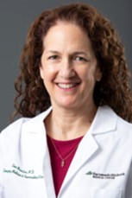
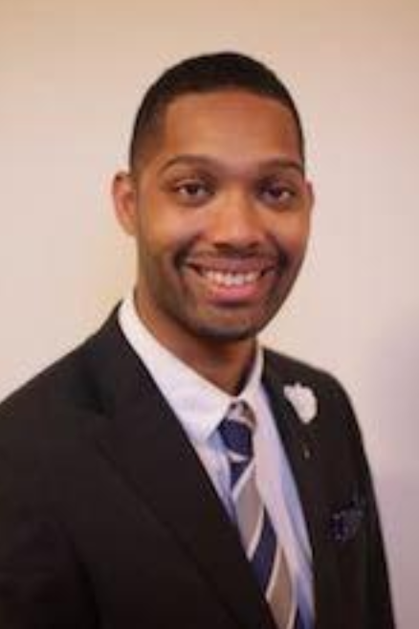
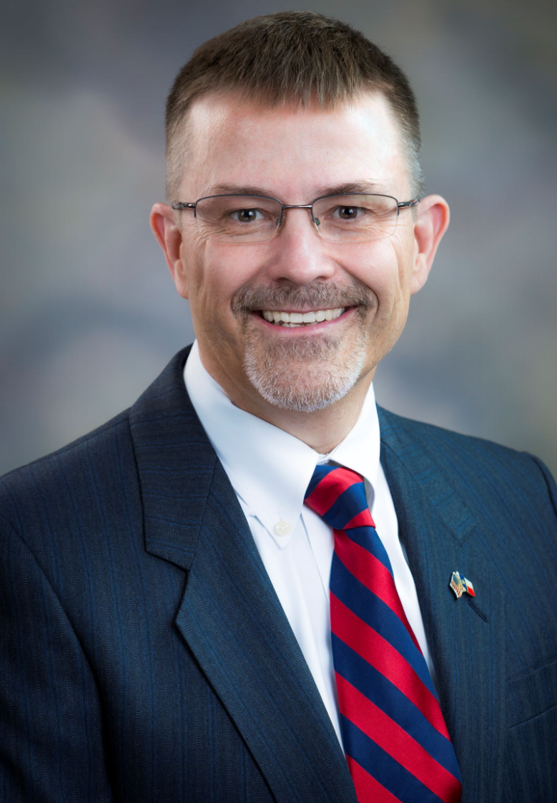
Plenary II: Addressing Workplace Violence Prevention to Protect Healthcare Professionals
Evie Marcolini, MD
Geisel School of Medicine at Dartmouth
Mallory Abney, MD
1st Year Critical Care Fellow, Internal Medicine
University of Michigan Medical School
Woodson "Scott" Jones, MD
Vice Dean of GME/DIO, Lois L. Bready, M.D. Endowed Professor
Long School of Medicine, UT Health, San Antonio

Slide 16
Plenary II: Addressing Workplace Violence Prevention to Protect Healthcare Professionals
Opening discussion:
There is almost always an underlying reason for a patient’s combativeness and usually there is something a provider can do to deescalate by trying to address that underlying driver. But if a provider has already experienced violence, it may not be advisable to expect them to be ready to work through issues with a threatening patient
Only some institutions have required training on what to do if a workplace violence incident happens
Some institutions have special codes and cameras that can detect weapons
There was discussion on how to handle different types of confrontations from a blatant threat of violence to a patient berating someone at the front desk, etc.

Slide 17
Plenary II: Addressing Workplace Violence Prevention to Protect Healthcare Professionals
Presentation from Dr. Marcolini:
Threats, violence, and combative behavior have gotten worse over the years. How do we balance the duty of providing health care while protecting health care workers?
Psychiatric institutions, emergency departments, and hospitals with substance abuse disorder programs experience higher rates of violence
Registered nurses are most likely to experience violence among health care workers
Sources of violence include individual factors such as fear and suffering from illness, disinhibition and other effects of substance use disorder, and institutional stressors such as ambient political strife, inadequate access to mental health care, and pandemic change and stress

Slide 18
Plenary II: Addressing Workplace Violence Prevention to Protect Healthcare Professionals
Ethical considerations of health care-related violence:
Professionalism is about compassion and doing all that is needed for the patients. Sometimes this can create tension between self-protection and promoting respectful and equitable institutional culture
Clinicians should bring a trauma-informed lens to the workplace, which helps shift focus to the possible untold stories of difficult patients that explain their behavior. Clinicians should have awareness of our unconscious bias and defensive postures we may have when caring for difficult patients
It’s helpful to start with curiosity and think about what got the person to the place they are in when they act out of anger. Challenging behaviors are often a maladaptive response to a perceived or real grievance
There are ethical questions about labelling patients as violent and considering how that will affect their ability to get care in other places and at other times. What kind of bias would be introduced if we’re assessing patients as violent based on their records, social media, etc.?

Slide 19
Plenary II: Addressing Workplace Violence Prevention to Protect Healthcare Professionals
Steps that can improve safety:
There are cell phone apps for safety that give the ability to call for security anywhere. Having communication ability like this can be helpful
Some people think “I must take care of this patient,” but the institutions should also emphasize the importance of health care workers caring about their own safety too
Institutions could offer trainings, debriefings, create behavioral response teams, and create leadership accountability for prevention of violence

Slide 20
Plenary II: Addressing Workplace Violence Prevention to Protect Healthcare Professionals
Institutions can take steps to become “harder targets” by creating fewer entrances, and systems of layered security and permission to enter certain areas
The cost to creating heightened security can be a barrier, so institutions need to make the most of what they have and be creative, like using panic buttons, having metal detectors at entrances, having plain clothes officers close by, having wellness officers on call, etc.
Sometimes the things that cost the most are not as effective, such as not letting people who have proven to be violent enter the facility. Institutions should stick up for the safety and respect of the health care teams when there’s a known risk

Slide 21
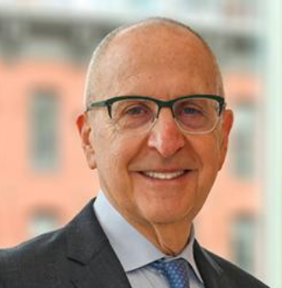
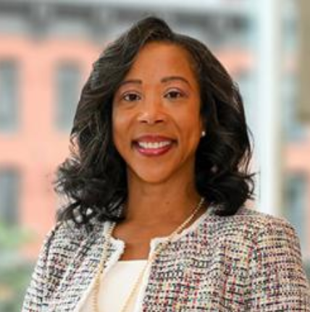
AAMC Leadership Lunch
David J. Skorton, MD
President and CEO
AAMC
Daniel Turnipseed, JD, MSHA, MPP
Chief Public Policy Officer
AAMC

Slide 22
AAMC Leadership Lunch
Policy Update from Danielle Turnipseed:
Most recent congressional spending package allocated:
$943 million for VA prosthetics
$8 billion in Medicaid DSH cuts eliminated through 2024
Medicare physician fee service cut mitigated through 2024
Site neutral payments/HOPD cuts are still being worked on
$48.3 billion for NIH base budget
AAMC is advocating for at least $51.3 billion for NIH base budget. This would be an increase of $4.2 billion (9%) over the comparable FY 2024 funding level
AAMC has an NIH advocacy toolkit which includes a new infographic on value of NIH-funded research, key messages, sample social media posts and graphics, template op-ed

Slide 23
AAMC Leadership Lunch
EDUCATE Act is important to combat, please reach out to your congressional reps if you have any who have signed on
Presentation from David Skorton, MD:
AAMC will not waver in its commitment to DEI
AAMC meetings are increasingly trying to integrate the work of affinity groups to represent the complex realities of academic medicine
AAMC has developed a monthly webinar series on AI in academic medicine
There are concerns about the health of the research workforce. The NIH’s Maximizing Opportunities for Scientific and Academic Independent Careers (MOSAIC) program is an important program to advance diversity in the research workforce. K99 and R00 award recipients eligible and the AAMC is participating in the program
New competencies have been released by GRA and there is a new assessment tool

Slide 24
AAMC Leadership Lunch
Dr. Skorton and AAMC Chief Services Officer Gabrielle Campbell are hosting sessions called “AAMC Listens” to learn about issues facing ERAS program and to field questions about the program
ERAS is evolving because of feedback given to ERAS team. 130 specialties will be part of next ERAS system. System improvements that have been made have been from feedback
AAMC is collaborating with Thalamus, a start up company. AAMC data, history, and input are being matched with technological prowess of Thalamus. The partnership is contributing to successes on ERAS. Schools will have access to more data, transparency, and more tech innovation than before
Discussion:
Evidence on diverse teams making better decisions goes back decades
Anti-DEI activities at state level: member institutions inform AAMC what’s going on and AAMC is starting to track it more. AAMC is able to connect states that are similarly situated. AAMC resources aimed at federal level can be adapted by constituents to advocate at state level

Slide 25
AAMC Leadership Lunch
DEI lifts the tide for all. It would be helpful for more people who are in the majority to use messaging such as, “I may not use DEI office, but these resources are helpful.”
Organizations can decide how to support their people in voting such as giving time off for voting, providing transportation, etc.

Slide 26
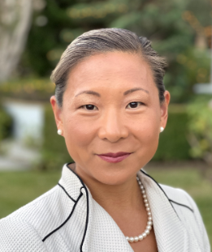
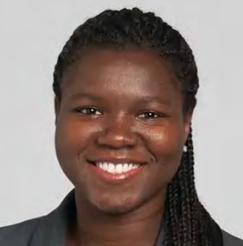
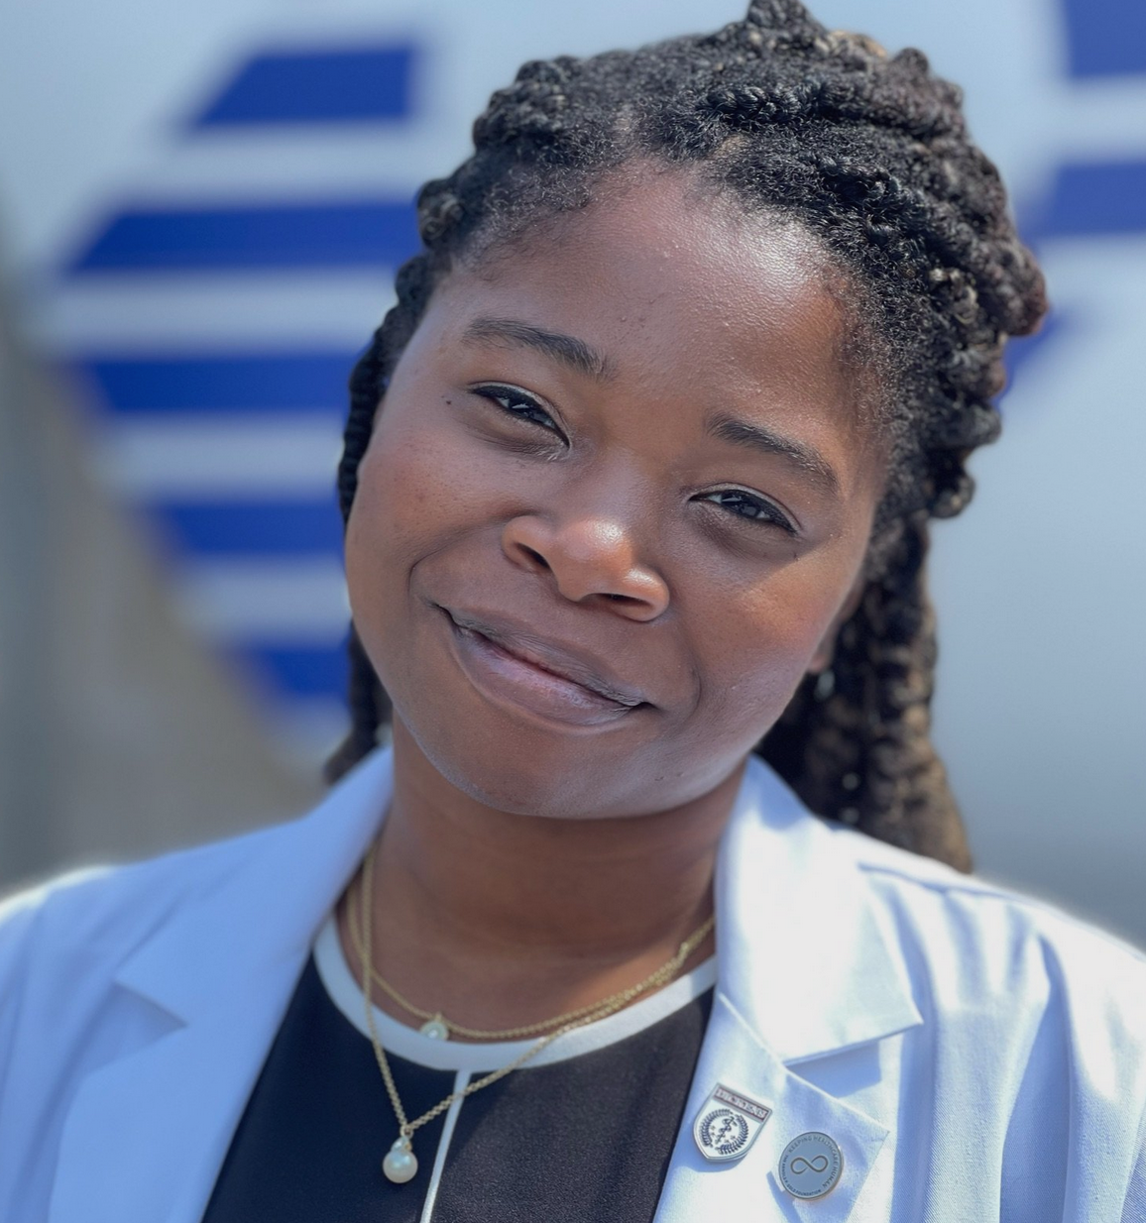
Experiences and Expectations: Taking the Pulse of Justice for Women Physicians of Color
Janet Adegboye, MD
Resident Physician, Anesthesiology
Johns Hopkins University School of Medicine
Valencia Walker, MD, MPH
Vice Dean for Health Equity and Inclusion
Geisinger Commonwealth School of Medicine
Jasmine Brown, M.Phil., MD Candidate
4th Year Medical Student, Author
Perelman School of Medicine at the University of Pennsylvania
Deena Shin McRae, MD
Associate Vice President, Academic Health Sciences
University of California Office of the President

Slide 27
Experiences and Expectations: Taking the Pulse of Justice for Women Physicians of Color
Women have been majority applicants, matriculants and enrollees in medical school recently but active physicians are only 37.6% female
Only slightly more than 20% of deans are women
Attrition rates are significantly higher for women than men doctors at every career stage
The numbers of women of color in academic medicine have remained stagnant

Slide 28
Experiences and Expectations: Taking the Pulse of Justice for Women Physicians of Color
2020 was a major year of change and there was broad support for fighting racism, now in 2024 there is an anti-DEI movement
American Academy of Dermatology recently introduced a measure to sunset all diversity initiatives
This is burning out DEI leaders and organizations need to step up to support them through this time

Slide 29
Experiences and Expectations: Taking the Pulse of Justice for Women Physicians of Color
Black women with MDs and PhDs have higher rates of mortality than White woman with high school degrees. Chronic stress and discrimination are having real physical effects
Privilege is often invisible to those who have it and people who have certain privileges believe that they have earned them
When institutions don’t support their DEI leaders, it is very demoralizing for women of color at those institutions
Book titled Twice as Hard: The Stories of Black Women who Fought to Become Physicians, from the Civil War to the 21st Century by Jasmine Brown. The book is an exploration of the trials and triumphs of Black women physicians throughout history

Slide 30
Experiences and Expectations: Taking the Pulse of Justice for Women Physicians of Color
Pervasive moral injury has especially impacted physician women of color. 50% of women in academic medicine experience sexual harassment. 62% of Black women physicians report discrimination from patients. Women physicians of color frequently have their competency questioned by peers, which leads to increased burnout and increased risk of attrition
Moral injury is an important driver of physicians’ decisions to leave the workforce. Factors include institutional racism, individual acts of discrimination committed by patients and colleagues, increased focus on revenue generation rather than missions, decreased boundaries between work and personal life due to tech, and the “minority tax” (faculty members of color being disproportionately assigned to do uncompensated DEI work on top of all their other work)
A recent study showed that 24% of women physicians were considering a different profession altogether. Top reason was overwhelmingly decreased satisfaction with medical specialty

Slide 31
Experiences and Expectations: Taking the Pulse of Justice for Women Physicians of Color
Recommendations:
Implementation of evidence-based strategies for recruiting and retaining diverse physician workforce is essential
Factors that improve career satisfaction and should be part of these strategies include workplace flexibility, control and autonomy, a sense of community and belonging and sense of being valued, equitable pay and benefits, and access to opportunities for research and leadership
Just understanding and acknowledging the problem can help. There are disproportionate expectations on women physicians to respond to messages sent through patient portals, be extra compassionate, do more administrative work, etc.
Promote accountability: identify and share high-yield metrics to help determine success with DEI programs and retention efforts

Slide 32
Experiences and Expectations: Taking the Pulse of Justice for Women Physicians of Color
More recommendations:
Establish transparency in DEI measures and employee feedback, and develop an accountability framework that tracks plans to address inequalities and outcomes
Compensate for the diversity tax
Revitalize employees’ sense of meaning and community at work
DEI initiatives and activities need adequate staffing and resources to be successful
It’s important to work together across schools to spread DEI messages across country and demand data and evidence to work from so we can address anti-DEI efforts. Building coalitions is important

Slide 33
Experiences and Expectations: Taking the Pulse of Justice for Women Physicians of Color
Discussion:
Panelists shared experiences of microaggressions, unwarranted targeting, being disproportionately criticized and scrutinized and overcoming those things to become successful students and physicians
Treating everyone with respect is baseline and then listening is an important skill. It’s difficult when you are trying to rush through patients, but it’s important to ask people about their backgrounds and values when they are from different backgrounds. Being genuinely curious and compassionate goes a long way. The noble call of our profession is a great way to start
Finding role models and supporters is important for women physicians of color to succeed because Black people in academia are often isolated. Having community is essential – connecting with people who genuinely believe in you and are invested in your success is crucial. Don’t always assume things are supposed to hurt, but instead embrace the ability to thrive and the possibility that we don’t have to suffer

Slide 34
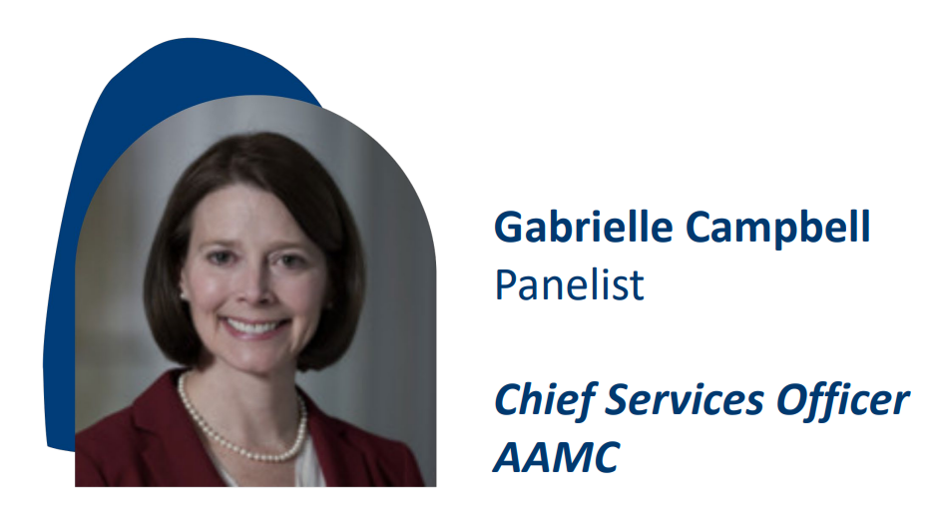
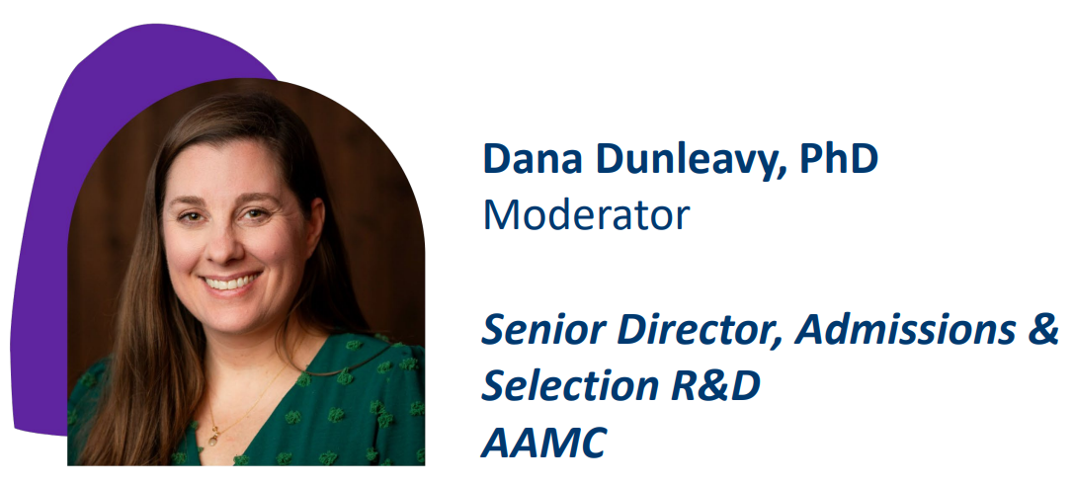
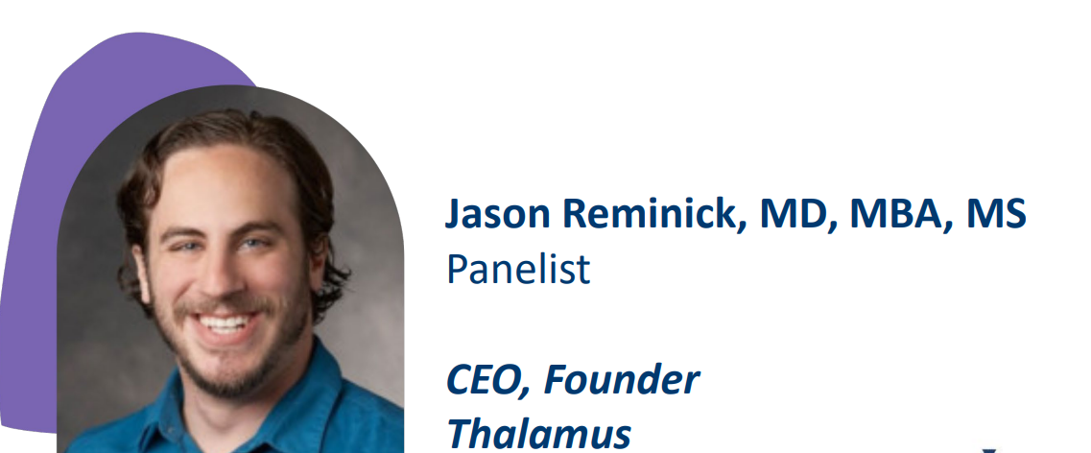
It’s More than the Applications – Improving the Transition to Residency

Slide 35
It’s More than the Applications – Improving the Transition to Residency
The ERAS program has made progress to increase transparency, improve the experience, and reduce fragmentation through selection tools, data analytics, and thought leadership and research
Data analytics:
Cerebellum for institutions
School/advisor analytics
Residency Explorer tool
Thought leadership and research:
Evaluation of new content
Multi-organization research collaboration
Increased engagement with specialties and programs
Selection tools:
New ERAS application to support holistic review
Improved PDWS
New interview management platform
Lower costs

Slide 36
It’s More than the Applications – Improving the Transition to Residency
Through its partnership with Thalamus, the AAMC has been able to improve the ERAS program
The academic medicine community has also been involved in making improvements by gathering diverse input from program staff, medical school reps, med students, and residents at both university and community-focused affiliated hospitals, in a variety of specialties, and across a wide geographic location
An evaluation working group has reviewed evaluation work and provided feedback and recommendations
And applicant input and data has been retrieved through application reaction surveys and prior ERAS applicant data

Slide 37
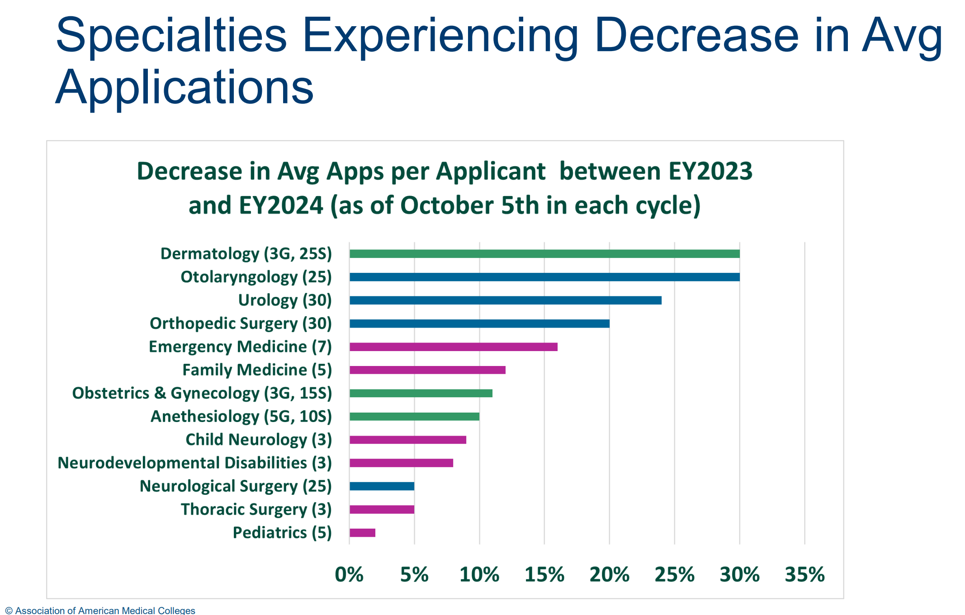
It’s More than the Applications – Improving the Transition to Residency

Slide 38
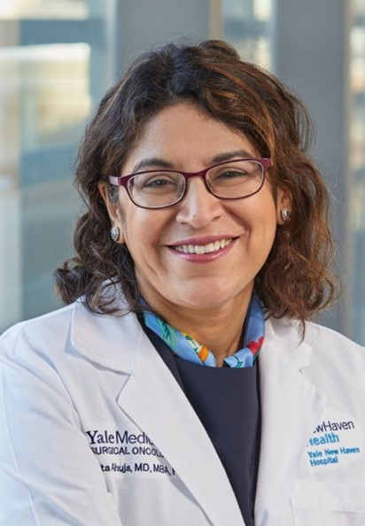
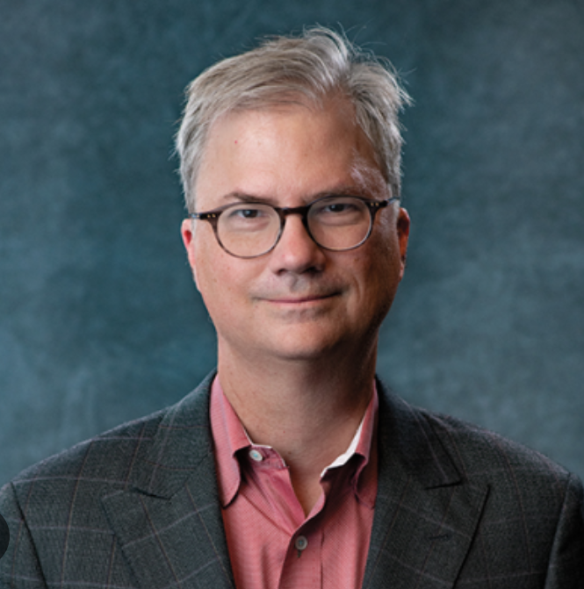
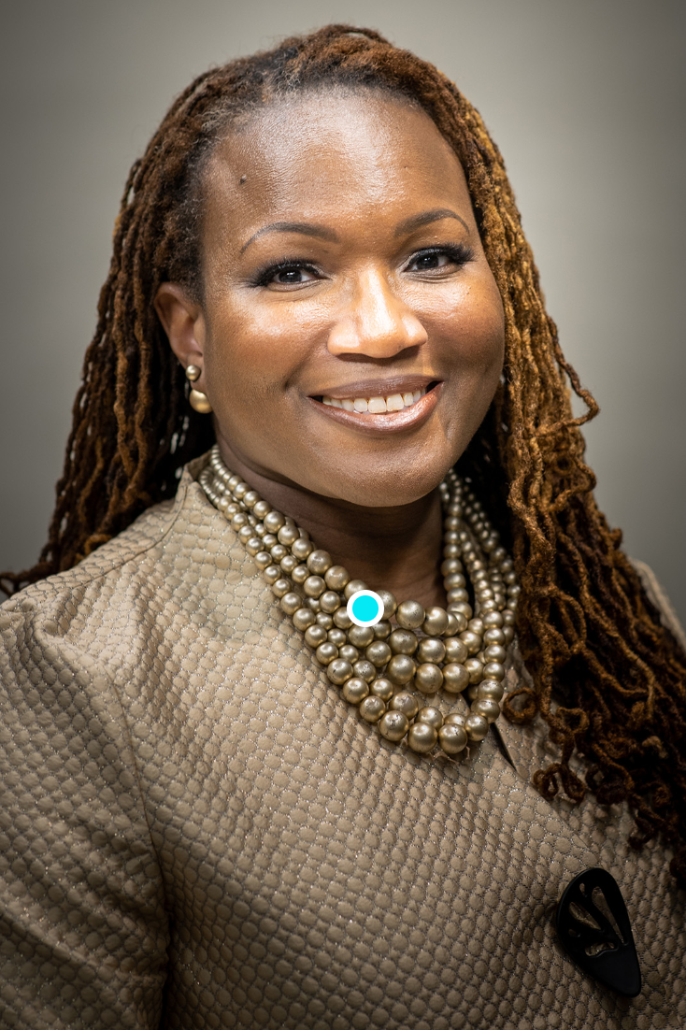
Closing Plenary: Counteracting the Corrosive Effect of Disinformation in Medicine and Science
Nita Ahuja, MD
Chair, Department of Surgery
Yale School of Medicine
Holden Thorpe, PhD
Editor in Chief
American Association for the Advancement of Science
Andrea Anderson, MD, MEd, FAAFP
Associate Chief of the Division of Family Medicine and Associate Professor
The George Washington School of Medicine and Health Sciences

Slide 39
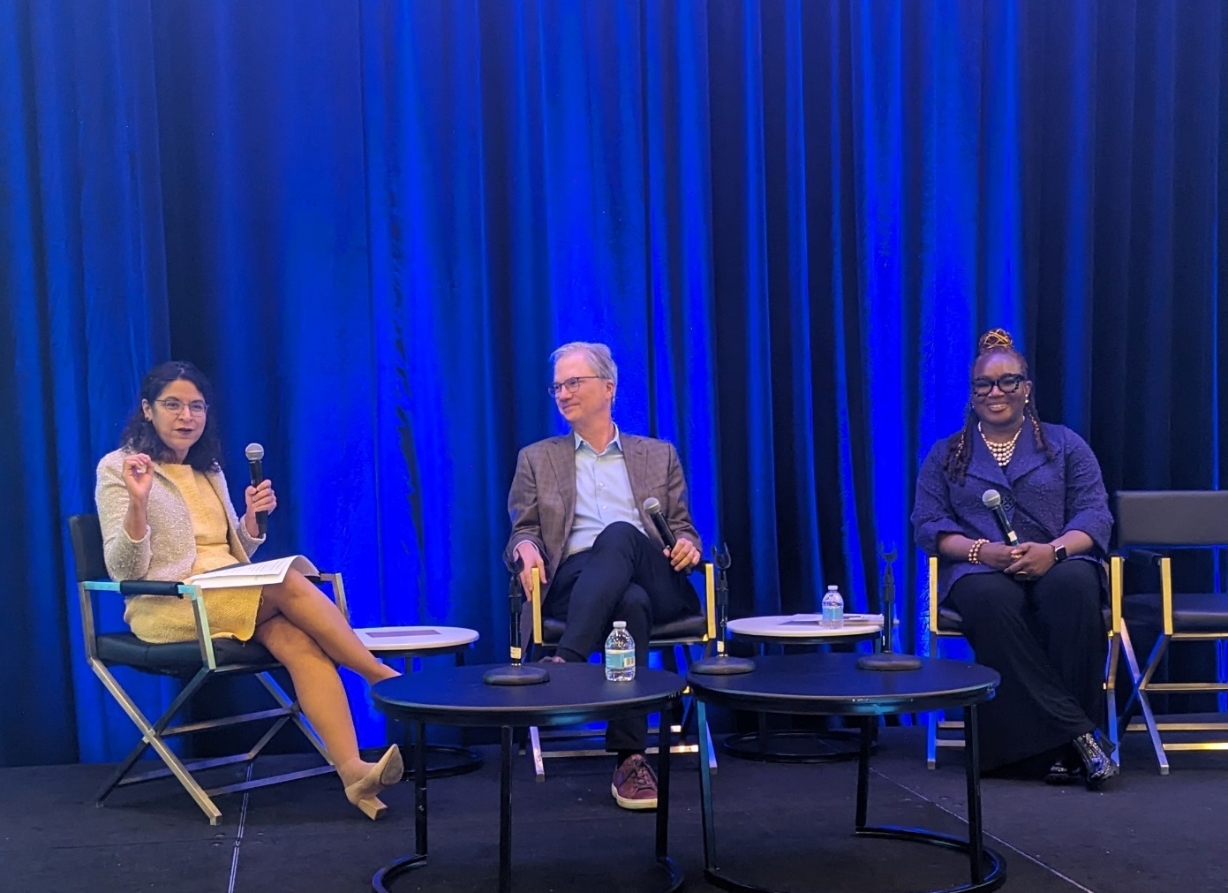
Closing Plenary: Counteracting the Corrosive Effect of Disinformation in Medicine and Science
The scientific and medical community can’t control what patients and members of the public hear, or what gets out on social media, but they can control their response to misinformation
Science changes and data gets revised – that’s the nature of science, but it’s important for scientists and those working on behalf of science to communicate this, because some members of the general public take changing guidelines to mean that the scientists don’t really know what they are doing
Scientists don’t always do a great job communicating and can fall into the scholastic fallacy – when academics think that everyone else thinks like they do

Slide 40
Closing Plenary: Counteracting the Corrosive Effect of Disinformation in Medicine and Science
Scientific and medical workforce would be stronger if they were taught the history of science and how it works
It’s not enough to understand science communication – how do we talk about and disseminate science?
When explaining how science works and countering misinformation/disinformation, the scientific community should also think about who the key messengers are, depending on the audience. Not all scientists are the best communicators to certain members of the public
Communicating science, advocating for science, teaching the history and philosophy of science, and the social sciences are all just as important as bench science, and there shouldn’t be a prejudice within the scientific community for bench science being preeminent

Slide 41
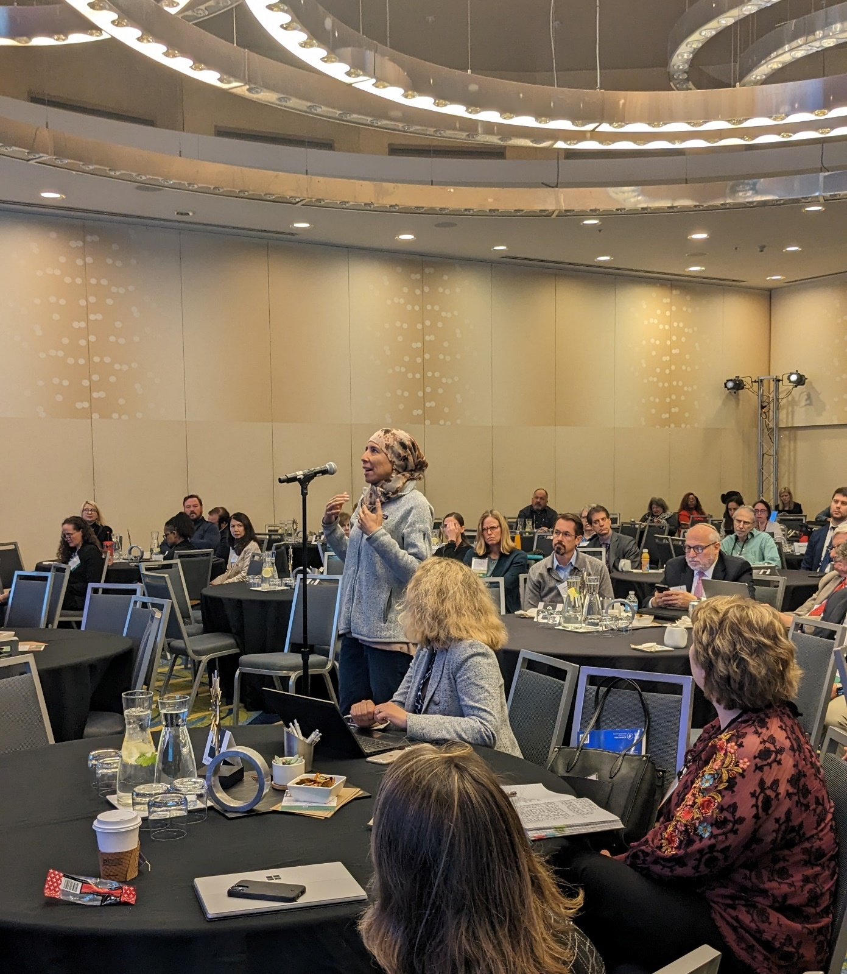
Closing Plenary: Counteracting the Corrosive Effect of Disinformation in Medicine and Science
The scientific community should acknowledge when it gets something wrong, because getting defensive and not acknowledging mistakes engenders further mistrust
The scientific community needs to figure out how to become trusted messengers again, because the mistrust is having real health effects on populations
Institutions should carefully balance the need to communicate the kinds of research being done by its staff and over-hyping the potential impact of that research

Slide 42
CFAS Business Meeting

Slide 43
CFAS Leadership Impact
CFAS Chair and Chair-elect serve on the AAMC Board of Directors
Faculty representation on the Board of Directors is important
Junior faculty voice
Faculty impact on AAMC Leadership

Slide 44
CFAS Rep Stats

Slide 45
New Committee Focus
CFAS Committees are being refocused so that their work is more aligned with priorities agreed to by the CFAS Administrative Board
All CFAS Committee Chairs sit on the Administrative Board, so alignment will be efficient
The CFAS Ad Board will oversee projects and activities undertaken by committees to ensure good workflow, use of resources, and shared goals
Committees are where so much of our work in CFAS really happens – we want to leverage these effective and creative groups to best effect

Slide 46
CFAS Committee Lightning Round Reports
Thematic Committees open to all CFAS reps and affiliates.
Advocacy Committee – Deanna Sasaki-Adams, Chair
Biomedical Research and Training Committee – Neil Osheroff, Chair
Diversity, Equity, and Inclusion Committee - Monica Baskin, Chair
Engagement Committee – Kimberly Lumpkins, Chair
Mission Alignment Committee - Stewart Babbott, Chair
Faculty as Medical Educators Committee – Lily Belfi, Chair
Faculty and Organizational Well-being Committee - Cathy Pipas, Chair
Structural Committees open to appointed members.
Program Committee – Arthur Derse, Chair
Nominating Committee – Adi Haramati, Chair

Slide 47
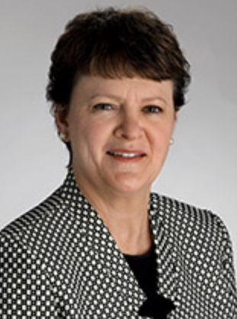
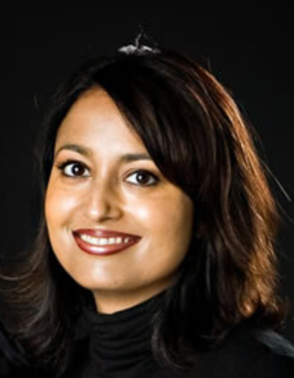
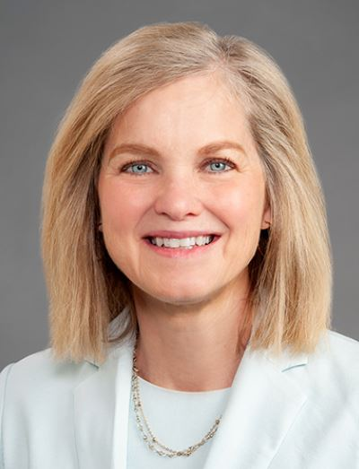
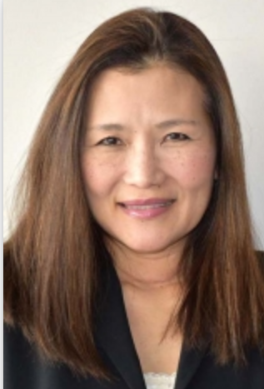
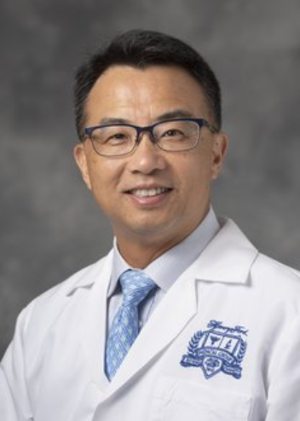
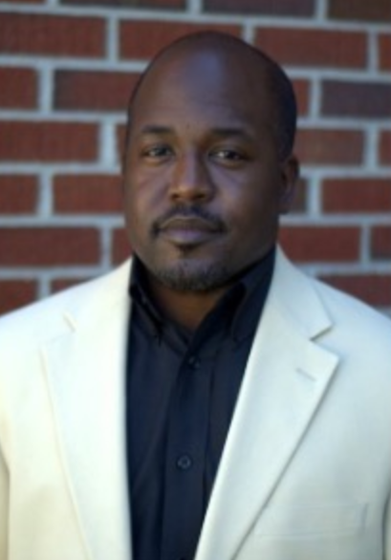
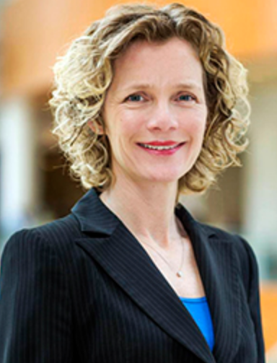
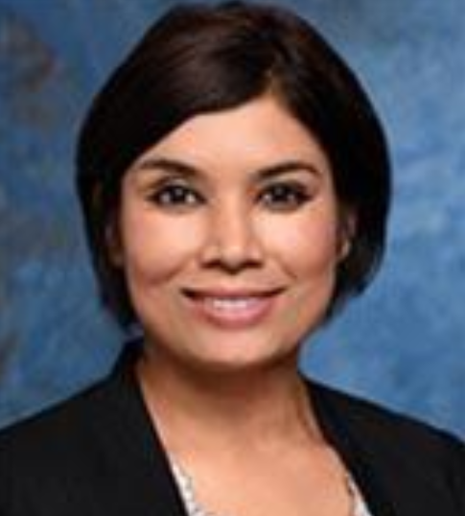
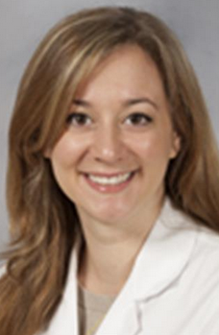
CFAS Program Committee
Arthur Derse, MD, JD
CFAS Chair-Elect, 2023 – 2025
Adi Haramati, PhD
CFAS Immediate Past Chair, 2023 – 2025
(ex officio through November 2025)
Nita Ahuja, MD CFAS Chair, 2023 – 2025
Tanna Boyer, DO
2023 – 2026
Robert T. Brodell, MD
2023 – 2026
Giulia Bonaminio, PhD
2023 – 2026
Mithu Sen, MD
2022 – 2024
Martha Alexander-Miller, PhD
2022 – 2024
Yoshimi Anzai, MD, MPH
2022 – 2024
Charles S. Day, MD, MBA
2022 – 2024
Poonam Sharma, MD
2023 – 2026
Sarah A. Sterling, MD
2021 – 2024
Jon Courand, MD
2022 – 2024
Eric Brown, PhD
2023 – 2026
Lotte Dyrbye, MD
2023 – 2026

Slide 48
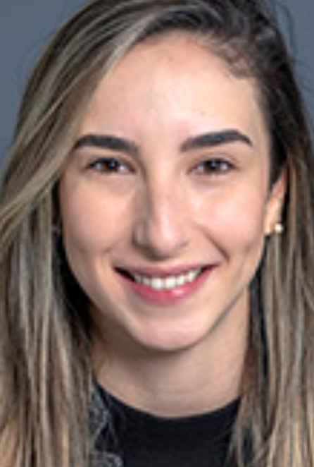
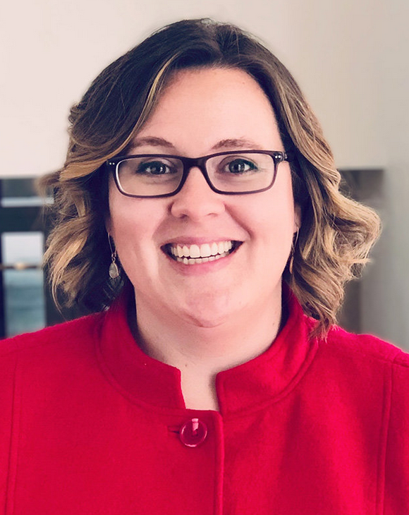
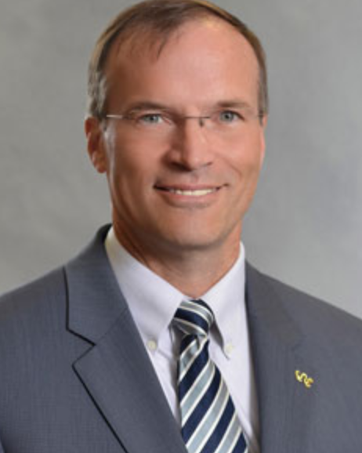
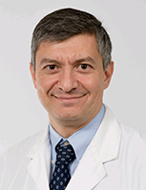
Nominating Committee
Chair: Aviad “Adi” Haramati, PhD (2025)
Patricia Balthazar, MD (1st term, 2025)
Kimberly Lumpkins, MD (1st term, 2024)
Kelly M. Quesnelle, PhD (1st term, 2026)
Richard Hamilton, MD (2nd term, 2025)
Steven Angus, MD (1st term, 2024)
Neil Osheroff, PhD (1st term, 2024)

Slide 49
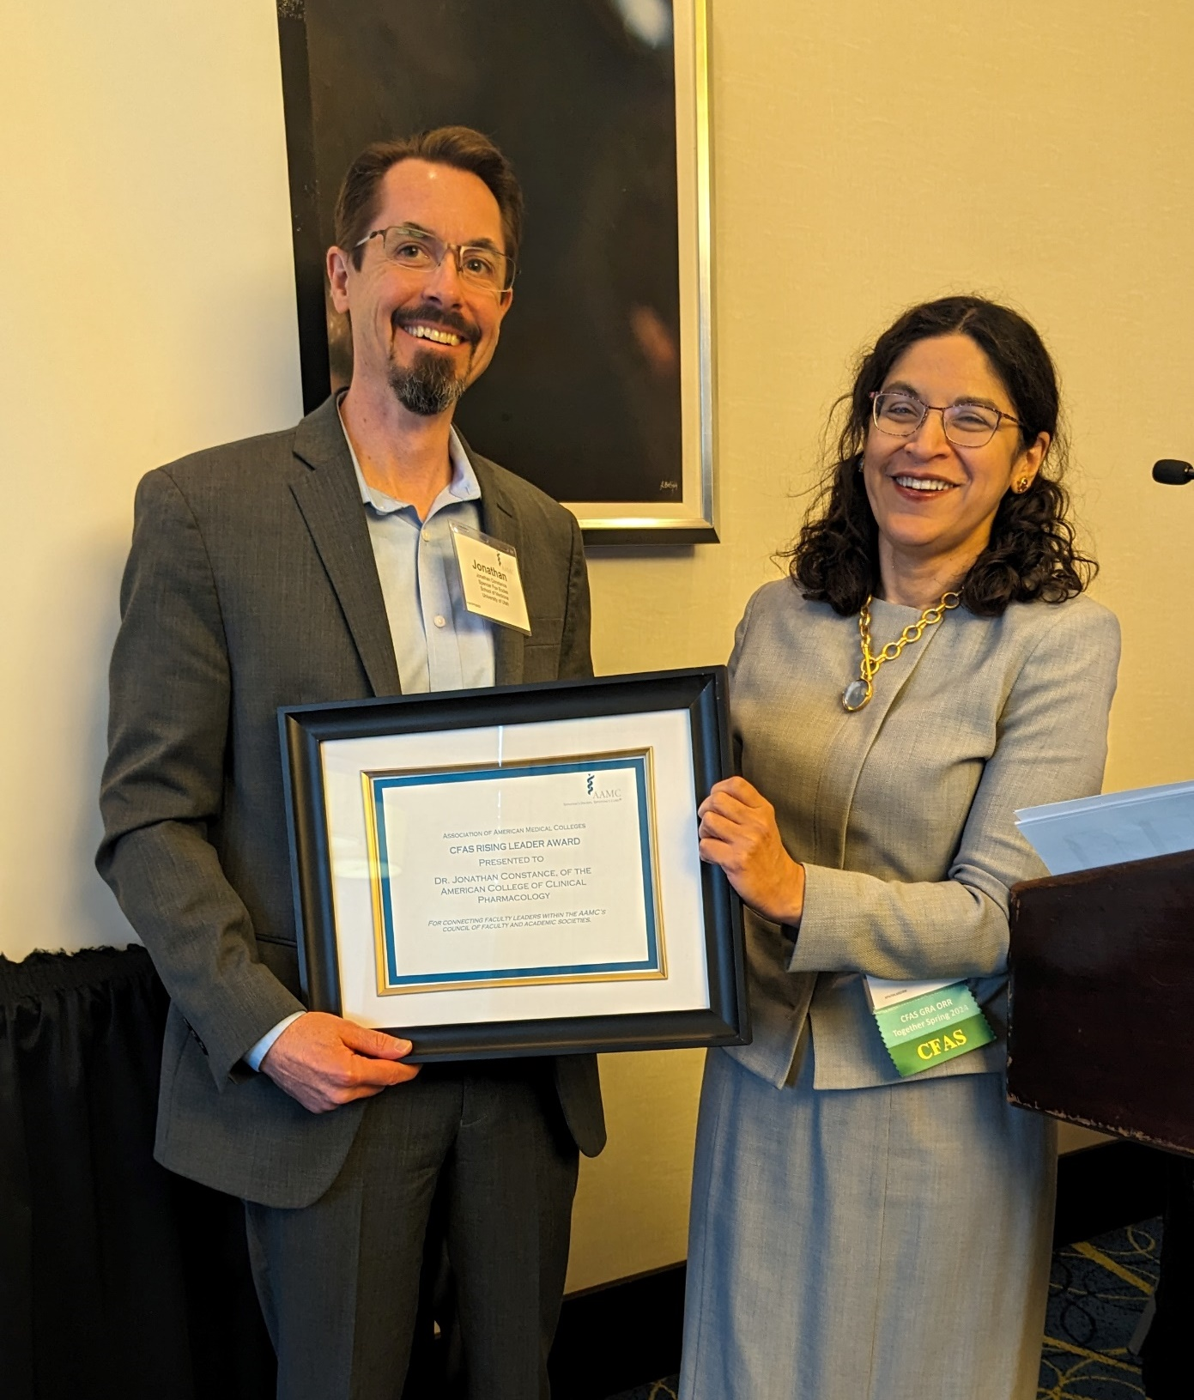
CFAS Awards
Jonathan Constance, MD, is the 2024 recipient of the CFAS Rising Star Award for connecting faculty and leaders within the AAMC Council of Faculty and Academic Societies. Dr. Constance represents the American College of Clinical Pharmacology
Tracey Weiler, PhD, is the 2024 recipient of the CFAS Bright Light Award for creative contributions to the AAMC Council of Faculty and Academic Societies. Dr. Weiler represents the Association of Professors of Human and Medical Genetics

Slide 50
New AAMC Chief Scientific Officer
Elena Fuentes-Afflick, MD, MPH Professor of Pediatrics Vice Dean for the UCSF School of Medicine at Zuckerberg San Francisco General Hospital
(Starts in the CSO role July 16, 2024)

Slide 51
The AAMC CFAS Team
Eric Weissman, Senior Director, Society and Faculty Engagement eweissman@aamc.org
Stephen Barry, CFAS Engagement Specialist sbarry@aamc.org
Anne Berry, Director, CFAS Programming and Engagement aberry@aamc.org
Alex Bolt, Senior Communications Specialist, CFAS abolt@aamc.org
Sabrina Gentzler, Administrative Support Specialist
sgentzler@aamc.org

