Slide 1
2024 CFAS-GRA-ORR Spring Meeting Abbreviated Summary
April 2-4, Arlington, VA

Slide 2
CFAS Mission
CFAS aspires to be the voice of academic faculty within the AAMC’s governance and leadership structures. The Council is charged with:
Identify critical issues facing faculty members of medical schools and within academic societies;
Articulate a common faculty voice on these issues to the AAMC as they relate to creation and implementation of the AAMC programs, services, and policies;
Serve as a bidirectional communications conduit regarding matters related to the core missions of academic medicine
Our activity over the past year has embodied these roles. CFAS is a stronger, more representative, and more effective voice

Slide 3
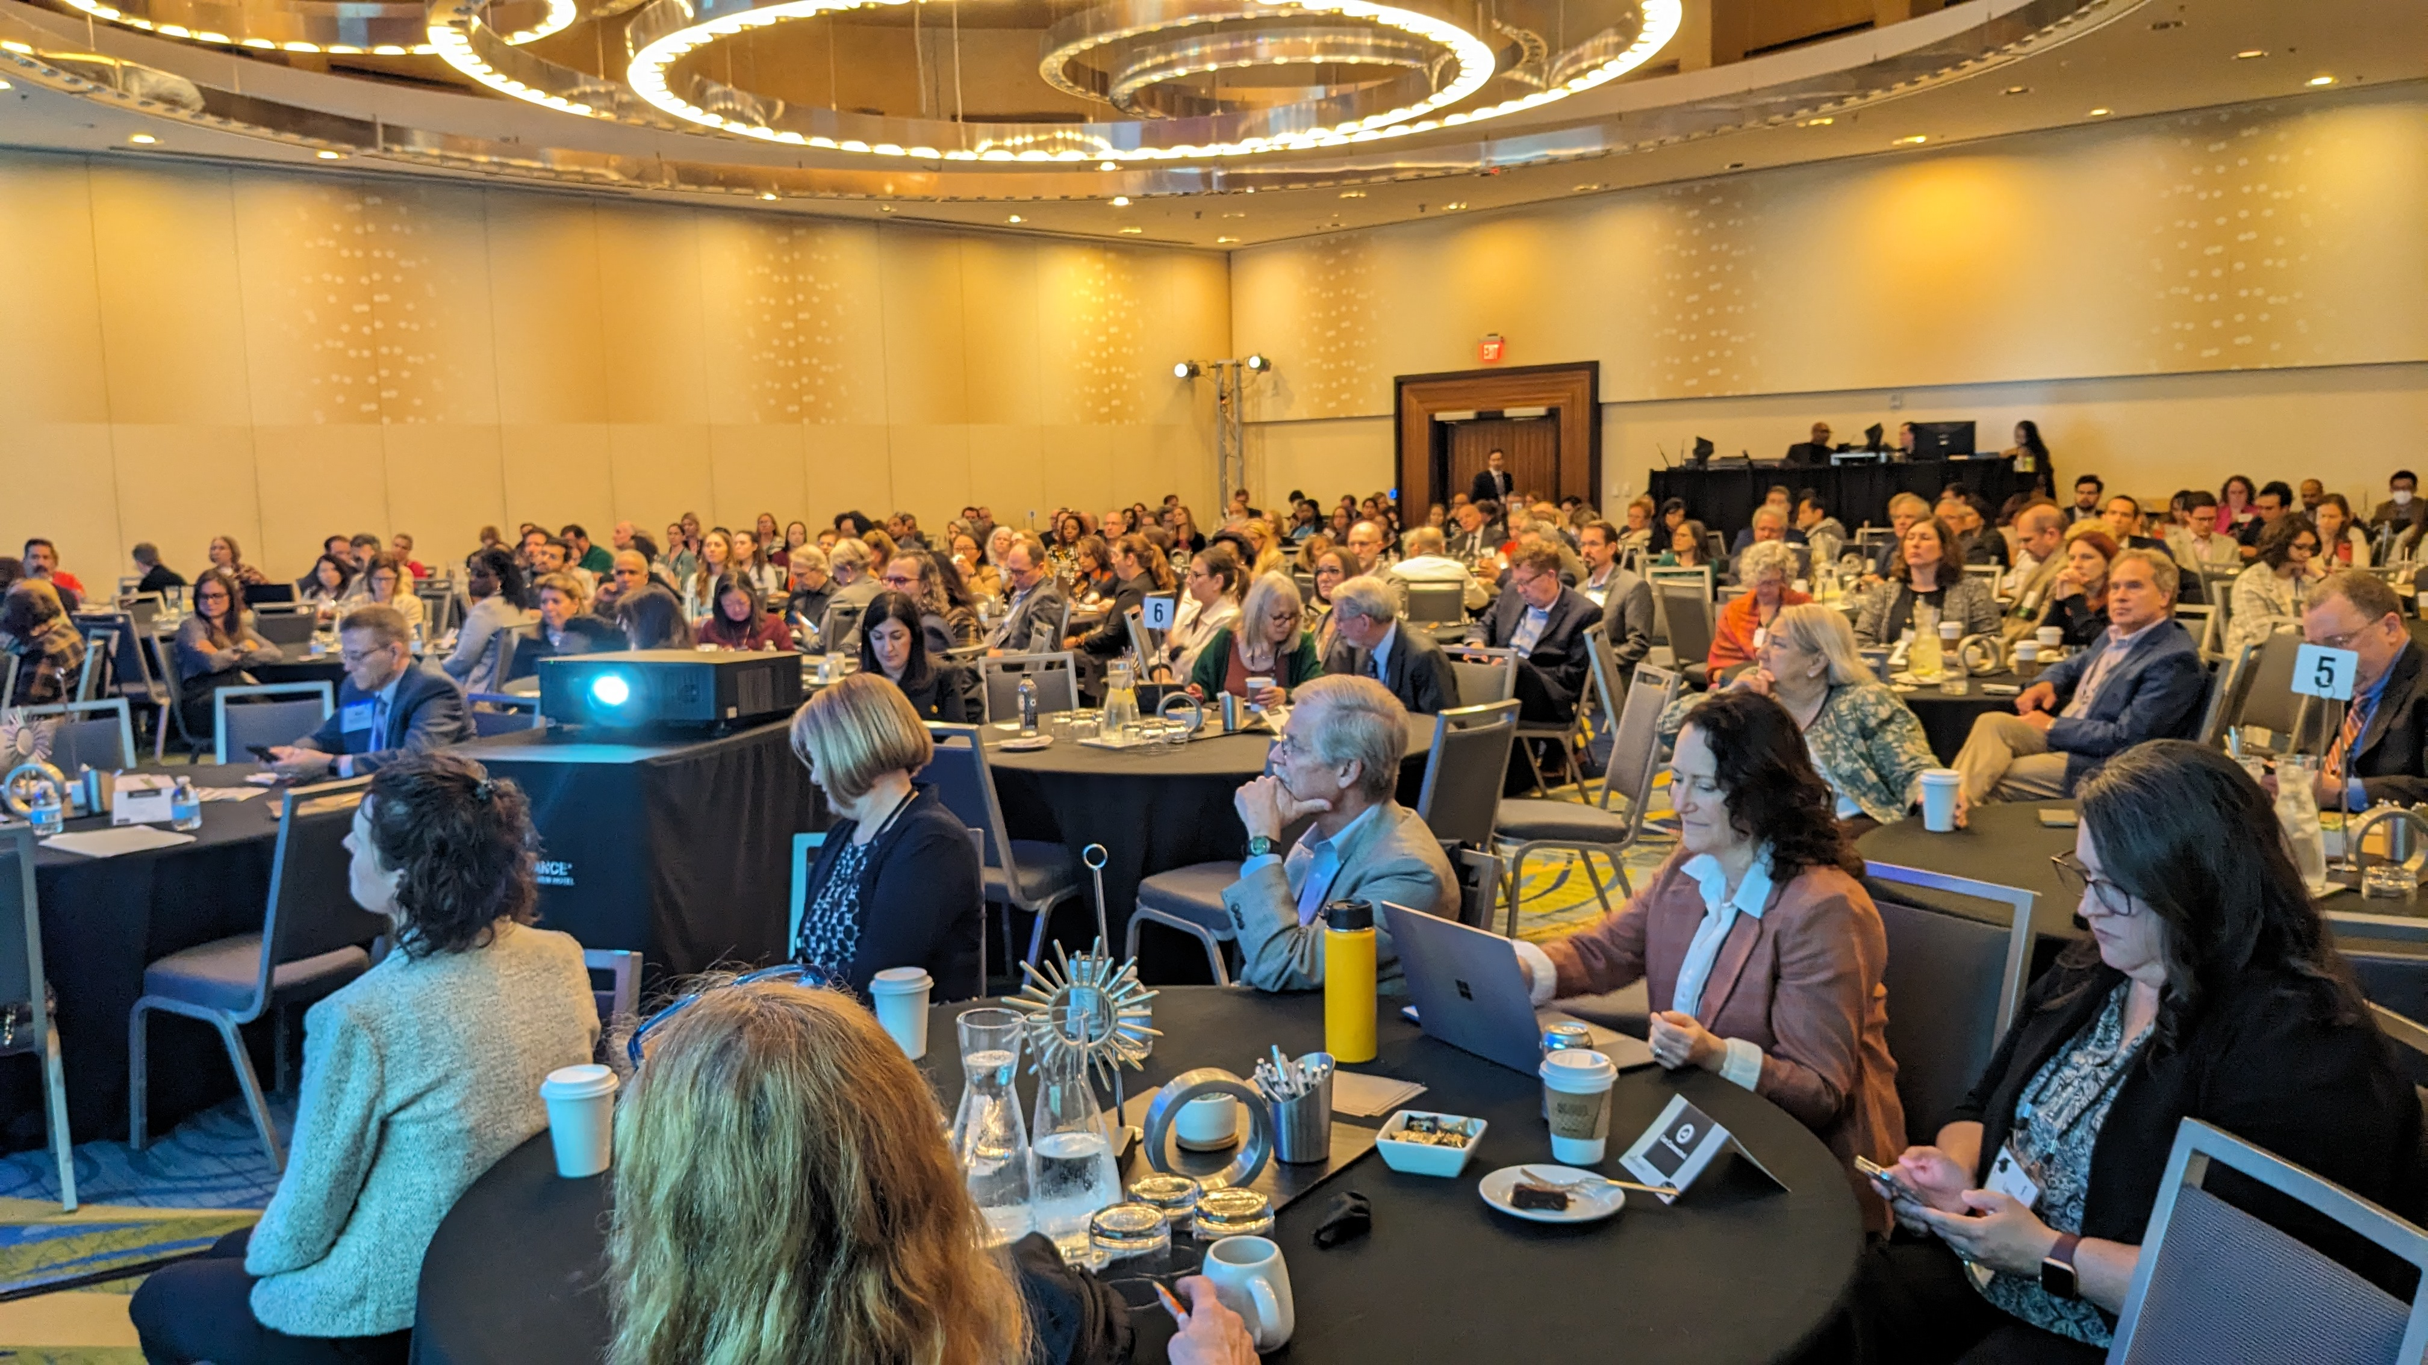
Plenary Session Summaries and Highlights

Slide 4
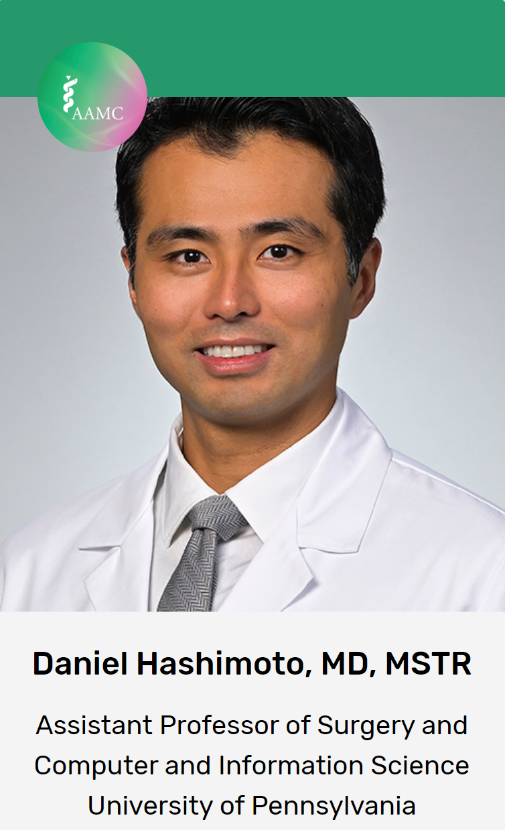
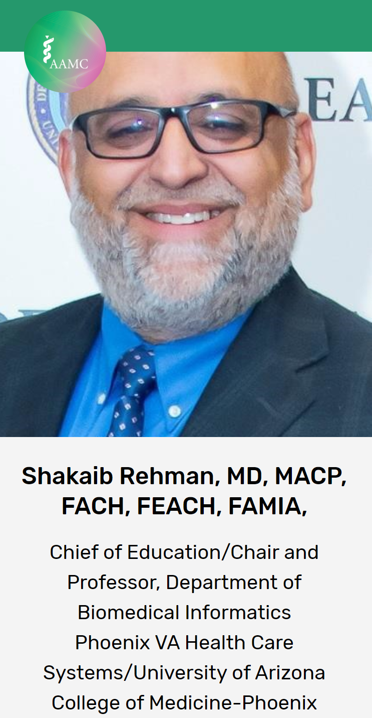
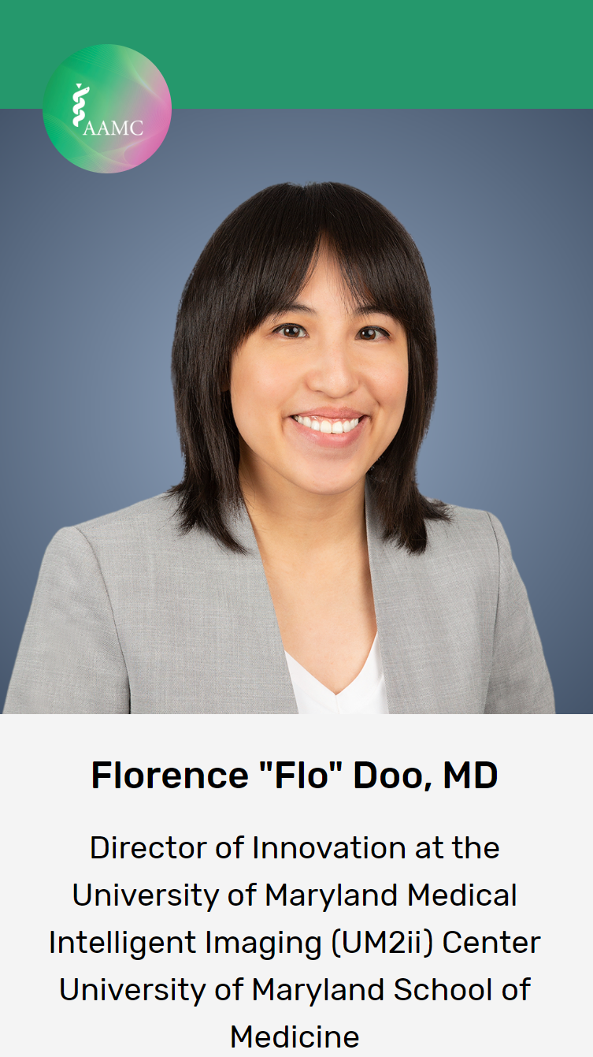
Opening Plenary: AI Literacy: The Competency You Didn’t Know You Need

Slide 5
Opening Plenary: AI Literacy: The Competency You Didn’t Know You Need
Presentation from Dr. Doo:
Some specialties (radiology) have had to grapple with AI more because of the number of applications.
Biases to watch out for when applying AI: autopilot (trusting AI more than yourself) and the IKEA effect (“we love it more if we made it”)
We have to understand in our own disciplines where AI is limited and where it can go wrong
Studies have shown ChatGPT was preferred over some clinicians for quality and empathy
How do we make sure we all use AI safely and effectively? How do we build AI literacy and competence into medical education, patient care, and research?

Slide 6
Opening Plenary: AI Literacy: The Competency You Didn’t Know You Need
Presentation from Daniel Hashimoto, MD:
AI can be used for procedural education through automated detection of safe/unsafe zones of dissection. Video tutorials of specific surgical procedures show where experienced surgeons would have made a cut, etc. This can be an interactive format that uses algorithms to analyze videos of duct surgeries and show how injuries could have been prevented. A lot of errors are result of visual perception errors that the system could have avoided.
AI for assessment: AI can help with analyzing complex, unstructured data. Can AI models help determine which residents can go on to next year and which can’t based on competency assessments?
Analyzing outcomes on something like prostate surgery can identify at what point and which movements/techniques cause side effects like erectile dysfunction. Then this can be taught to surgical residents

Slide 7
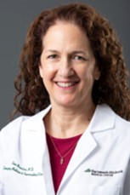
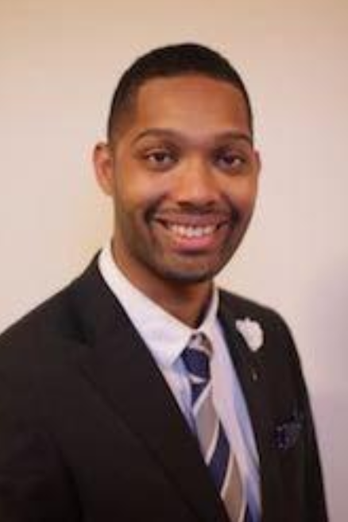
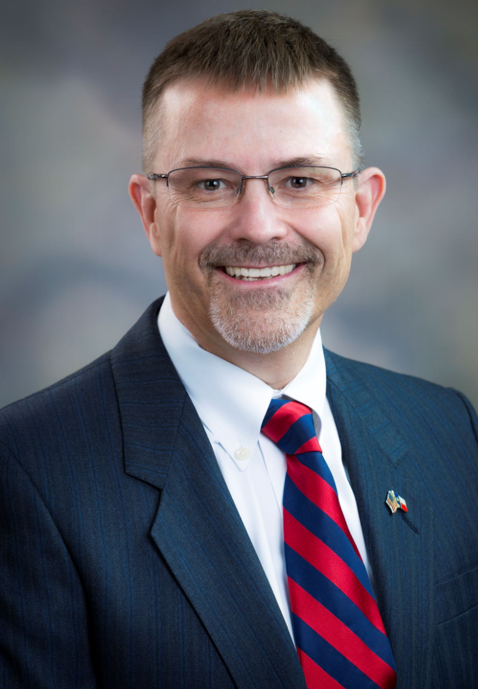
Plenary II: Addressing Workplace Violence Prevention to Protect Healthcare Professionals
Evie Marcolini, MD
Geisel School of Medicine at Dartmouth
Mallory Abney, MD
1st Year Critical Care Fellow, Internal Medicine
University of Michigan Medical School
Woodson "Scott" Jones, MD
Vice Dean of GME/DIO, Lois L. Bready, M.D. Endowed Professor
Long School of Medicine, UT Health, San Antonio

Slide 8
Plenary II: Addressing Workplace Violence Prevention to Protect Healthcare Professionals
Steps that can improve safety:
There are cell phone apps for safety that give the ability to call for security anywhere. Having communication ability like this can be helpful
Some people think “I must take care of this patient,” but the institutions should also emphasize the importance of health care workers caring about their own safety too
Institutions could offer trainings, debriefings, create behavioral response teams, and create leadership accountability for prevention of violence

Slide 9
Plenary II: Addressing Workplace Violence Prevention to Protect Healthcare Professionals
Institutions can take steps to become “harder targets” by creating fewer entrances, and systems of layered security and permission to enter certain areas
The cost to creating heightened security can be a barrier, so institutions need to make the most of what they have and be creative, like using panic buttons, having metal detectors at entrances, having plain clothes officers close by, having wellness officers on call, etc.
Sometimes the things that cost the most are not as effective, such as not letting people who have proven to be violent enter the facility. Institutions should stick up for the safety and respect of the health care teams when there’s a known risk

Slide 10
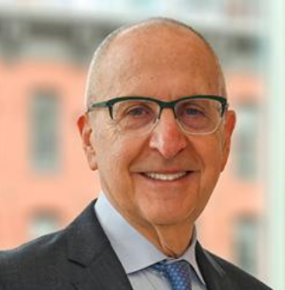
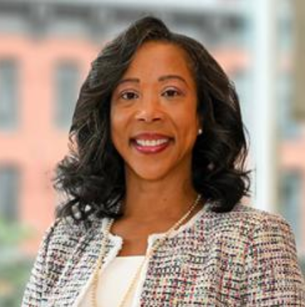
AAMC Leadership Lunch
David J. Skorton, MD
President and CEO
AAMC
Daniel Turnipseed, JD, MSHA, MPP
Chief Public Policy Officer
AAMC

Slide 11
AAMC Leadership Lunch
Policy Update from Danielle Turnipseed:
Most recent congressional spending package allocated:
$943 million for VA prosthetics
$8 billion in Medicaid DSH cuts eliminated through 2024
Medicare physician fee service cut mitigated through 2024
Site neutral payments/HOPD cuts are still being worked on
$48.3 billion for NIH base budget
AAMC is advocating for at least $51.3 billion for NIH base budget. This would be an increase of $4.2 billion (9%) over the comparable FY 2024 funding level
AAMC has an NIH advocacy toolkit which includes a new infographic on value of NIH-funded research, key messages, sample social media posts and graphics, template op-ed

Slide 12
AAMC Leadership Lunch
EDUCATE Act is important to combat, please reach out to your congressional reps if you have any who have signed on
Presentation from David Skorton, MD:
AAMC will not waver in its commitment to DEI
AAMC meetings are increasingly trying to integrate the work of affinity groups to represent the complex realities of academic medicine
AAMC has developed a monthly webinar series on AI in academic medicine
There are concerns about the health of the research workforce. The NIH’s Maximizing Opportunities for Scientific and Academic Independent Careers (MOSAIC) program is an important program to advance diversity in the research workforce. K99 and R00 award recipients eligible and the AAMC is participating in the program
New competencies have been released by GRA and there is a new assessment tool

Slide 13
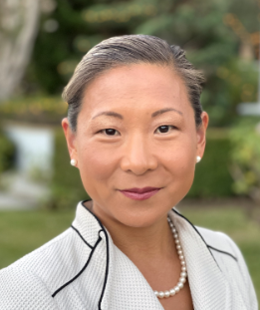
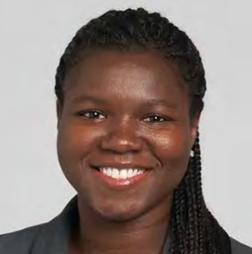
Experiences and Expectations: Taking the Pulse of Justice for Women Physicians of Color
Janet Adegboye, MD
Resident Physician, Anesthesiology
Johns Hopkins University School of Medicine
Valencia Walker, MD, MPH
Vice Dean for Health Equity and Inclusion
Geisinger Commonwealth School of Medicine
Jasmine Brown, M.Phil., MD Candidate
4th Year Medical Student, Author
Perelman School of Medicine at the University of Pennsylvania
Deena Shin McRae, MD
Associate Vice President, Academic Health Sciences
University of California Office of the President

Slide 14
Experiences and Expectations: Taking the Pulse of Justice for Women Physicians of Color
Recommendations:
Implementation of evidence-based strategies for recruiting and retaining diverse physician workforce is essential
Factors that improve career satisfaction and should be part of these strategies include workplace flexibility, control and autonomy, a sense of community and belonging and sense of being valued, equitable pay and benefits, and access to opportunities for research and leadership
Just understanding and acknowledging the problem can help. There are disproportionate expectations on women physicians to respond to messages sent through patient portals, be extra compassionate, do more administrative work, etc.
Promote accountability: identify and share high-yield metrics to help determine success with DEI programs and retention efforts

Slide 15
Experiences and Expectations: Taking the Pulse of Justice for Women Physicians of Color
More recommendations:
Establish transparency in DEI measures and employee feedback, and develop an accountability framework that tracks plans to address inequalities and outcomes
Compensate for the diversity tax
Revitalize employees’ sense of meaning and community at work
DEI initiatives and activities need adequate staffing and resources to be successful
It’s important to work together across schools to spread DEI messages across country and demand data and evidence to work from so we can address anti-DEI efforts. Building coalitions is important

Slide 16
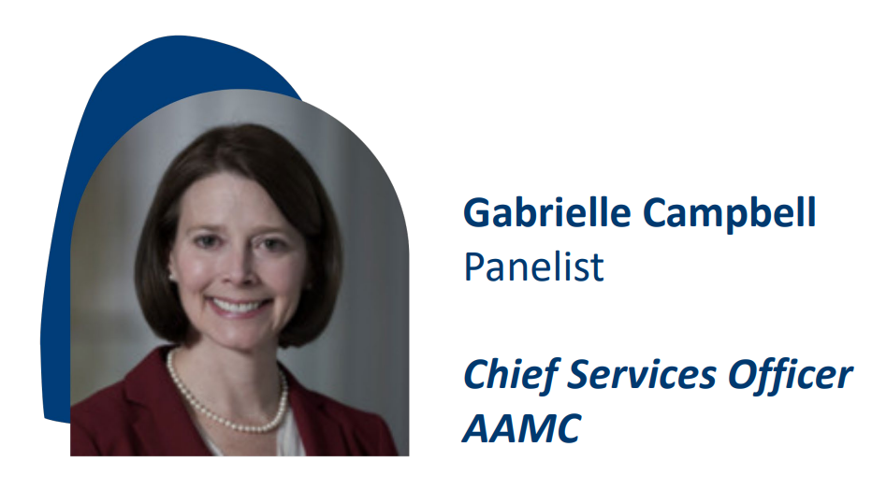
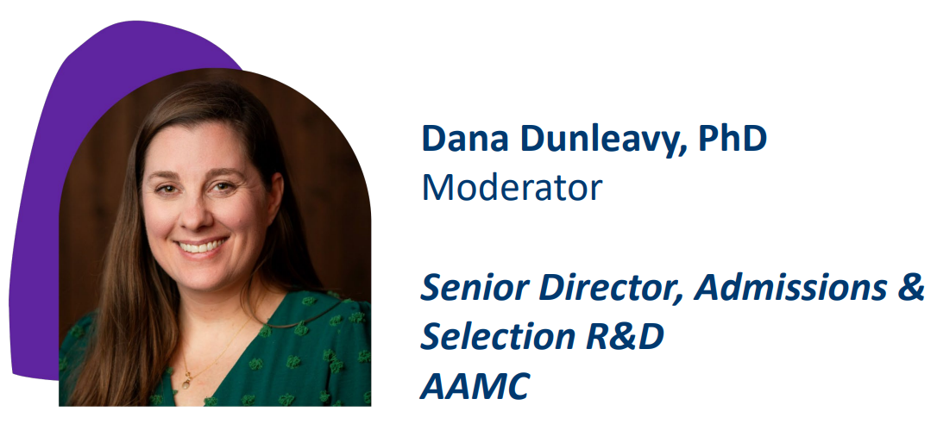
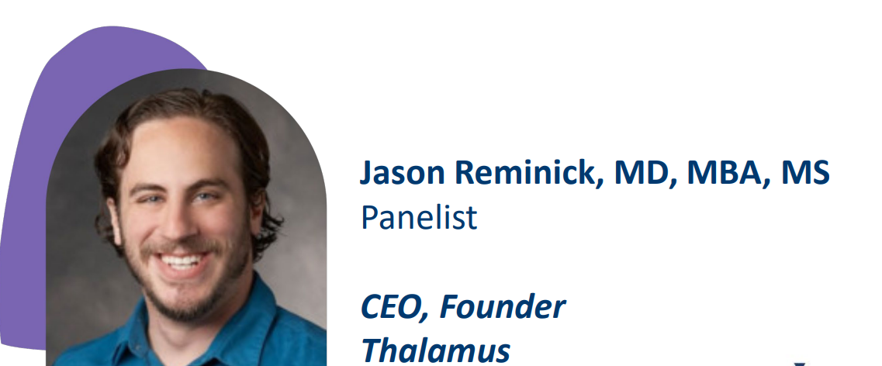
It’s More than the Applications – Improving the Transition to Residency

Slide 17
It’s More than the Applications – Improving the Transition to Residency
The ERAS program has made progress to increase transparency, improve the experience, and reduce fragmentation through selection tools, data analytics, and thought leadership and research
Data analytics:
Cerebellum for institutions
School/advisor analytics
Residency Explorer tool
Thought leadership and research:
Evaluation of new content
Multi-organization research collaboration
Increased engagement with specialties and programs
Selection tools:
New ERAS application to support holistic review
Improved PDWS
New interview management platform
Lower costs

Slide 18
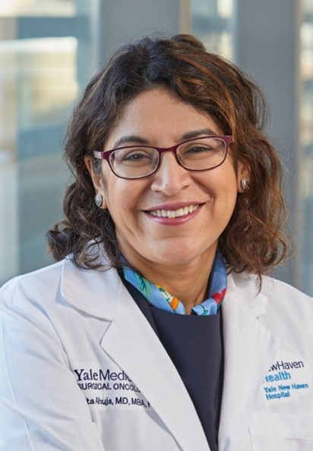
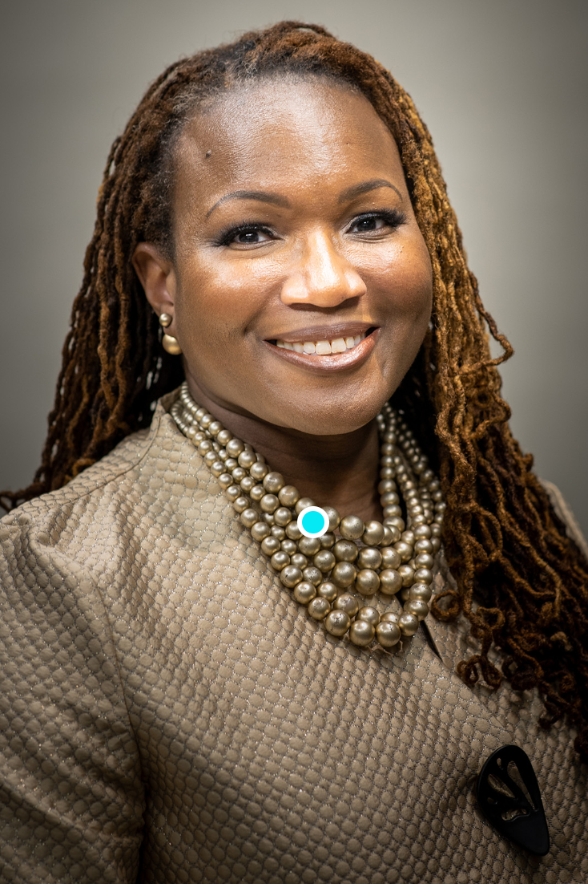
Closing Plenary: Counteracting the Corrosive Effect of Disinformation in Medicine and Science
Nita Ahuja, MD
Chair, Department of Surgery
Yale School of Medicine
Holden Thorpe, PhD
Editor in Chief
American Association for the Advancement of Science
Andrea Anderson, MD, MEd, FAAFP
Associate Chief of the Division of Family Medicine and Associate Professor
The George Washington School of Medicine and Health Sciences

Slide 19
Closing Plenary: Counteracting the Corrosive Effect of Disinformation in Medicine and Science
The scientific and medical community can’t control what patients and members of the public hear, or what gets out on social media, but they can control their response to misinformation
Science changes and data gets revised – that’s the nature of science, but it’s important for scientists and those working on behalf of science to communicate this, because some members of the general public take changing guidelines to mean that the scientists don’t really know what they are doing
Scientists don’t always do a great job communicating and can fall into the scholastic fallacy – when academics think that everyone else thinks like they do

Slide 20
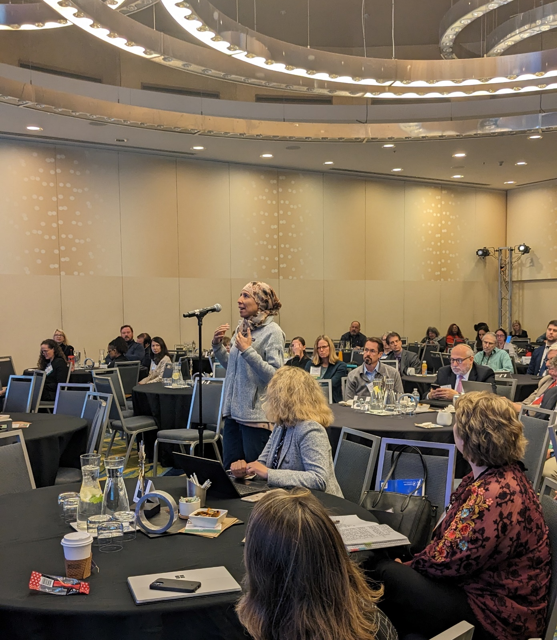
Closing Plenary: Counteracting the Corrosive Effect of Disinformation in Medicine and Science
The scientific community should acknowledge when it gets something wrong, because getting defensive and not acknowledging mistakes engenders further mistrust
The scientific community needs to figure out how to become trusted messengers again, because the mistrust is having real health effects on populations
Institutions should carefully balance the need to communicate the kinds of research being done by its staff and over-hyping the potential impact of that research

