Slide 1
A Post-Pandemic Update on the AAMC’s Visiting Student Learning Opportunities (VSLO) Program
Presentation title goes here Subtitle of Presentation
Robin Carle
Senior Director - VSLO
April 28, 2023

Slide 2
Visiting Students Learning Opportunities (VSLO) Program
The VSLO program provides the platform for participating medical schools, qualifying clinical sites, and non-profit organizations located in the United States and around the globe to offer medical students short term learning opportunities that can enhance their medical education.

Slide 3
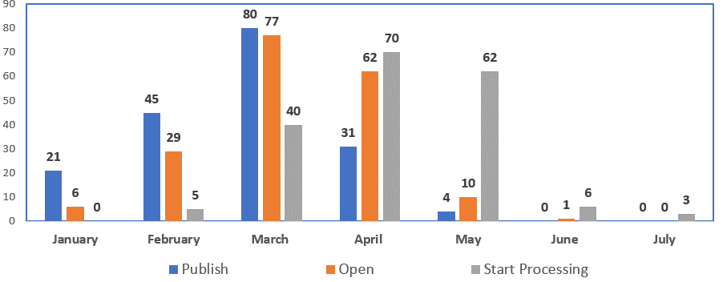
VSLO Catalog Statuses (2023 CY)
Notes:
Additionally, there are 13 institutions who have not entered in dates, and 74 who have dates that need updating.

Slide 4
Applications Submitted By Month 2022-2023 Academic Year
Total Applications
452,580
Applications are counted as an Elective and Unique Date Combination

Slide 5
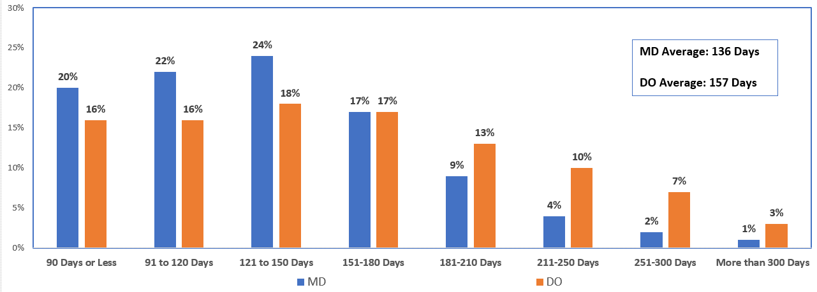
Time Between Application Date and Elective Start Date Academic Year 2022-2023

Slide 6
Total Applicants
19,042
18,387
10,848

Slide 7
Unique Electives and Applications
Average Electives | DO | MD
2021-2022 | 11 | 6.5
2022-2023 | 13 | 7.5
2023-2024* | 6 | 4.6
153,119
55,828
452,580
Average Application | DO | MD
2021-2022 | 29 | 12
2022-2023 | 37 | 15.5
2023-2024* | 19.5 | 10.7
338,434
155,040
* Data as of March 29, 2023
Notes:
By academic year

Slide 8
Total Applications Submitted
452,580
338,434
155,040
* Data as of March 29, 2023
Notes:
By academic year

Slide 9
Total Offers
2.7 Average Offers
1.7 Average Offers
2.9 Average Offers
1.9 Average Offers
* Data as of March 29, 2023
Notes:
By academic year

Slide 10
Total Acceptances
61% Acceptance
52% Acceptance
67% Acceptance
59% Acceptance
* Data as of March 29, 2023
Notes:
By academic year

Slide 11
VSLO Student
Post Rotation Survey

Slide 12
VSLO Student Post Rotation Survey - Goals
To gather data to help better assess the decisions students make regarding their away rotation opportunities and how those decisions and experiences inform residency decisions. Focused on the following areas:
Students' decision process when applying for an away rotation.
The benefits they hope to derive from their rotation experience.
The costs they incurred associated with the away rotation.
The scope/availability of away rotation opportunities they found in the VSLO application service.

Slide 13
Student Survey 2022
Total Invited
29,494
Student Survey Responses
Total Responses
6,390
21.67%
MD Completed
3,836
13.01%
DO Completed
2,554
8.66%

Slide 14
Top 10 Specialties for DO Students
Intended Specialties
Internal Medicine
Emergency Medicine
Pediatrics
Family Medicine
Anesthesiology
Obstetrics and Gynecology
Surgery – General
Psychiatry
Physical Medicine and Rehabilitation
Orthopaedic Surgery
Applied To
Internal Medicine
Pediatrics
Anesthesiology
Obstetrics and Gynecology
Psychiatry
Surgery – General
Emergency Medicine
Family Medicine
Radiology – Diagnostic
Physical Medicine and Rehabilitation
Notes:
Intended Specialties is based on survey responses
Applied to is for the 2022-23 academic year

Slide 15
How Did You Decide to Apply For This Away Rotation? (All Responses)

Slide 16
How Did You Decide to Apply For This Away Rotation? (DO Responses)

Slide 17
The Goal of my Rotation Was….
Overall
DO Students
1
Explore Residency
2
LOR/LOE
3
4
5
Meet specialty and degree requirements
Explore a specialty not at my institution
Explore a specialty other than my
intended specialty
1
Explore Residency
2
LOR/LOE
3
4
5
Explore a specialty not at my institution
Explore a specialty other than my
Meet specialty and degree requirements
intended specialty
Ranked
Most Important
To
Least Important

Slide 18
Did your away rotation help affirm your intended specialty choice?

Slide 19
Do you intend to apply for the residency program where you completed your rotation?

Slide 20
Would you rank this away rotation as one of your top three choices when applying for residency?

Slide 21
Did you connect with anyone who you believe may be a professional mentor for you in the future?

Slide 22
What was the biggest financial decision in committing to the away rotation?
1
Housing
2
Flight/Transportation
3
4
Application Costs
Tuition for away rotation
Ranked
Biggest
To
Smallest
Financial Challenges
Notes:
Same ranking for overall, and for DO students

Slide 23
What range best represents the total cost for your away rotation?

Slide 24
Were all or some of your rotation expenses included in your Home Institution fee?

Slide 25
Were there enough opportunities available in your specialty area of interest?

Slide 26
Were there enough sites/locations offering the specialty to which you were applying?

Slide 27
Were there enough dates available to fit your rotation schedule?

Slide 28
VSLO Priorities
2023-2024

Slide 29
Expansion of Rotation Opportunities
Adding New Host Sites
Expanded Offerings by Current Hosts
Data is being used to prioritize by specialty/location
New VSLO Team Members
Expanded Definition of a Host

Slide 30
Expanded VSLO Host Definition
To qualify for VSLO access as a Host institution, a site must be an:
​
AAMC member ​
ACGME accredited Sponsoring Organization
ACGME Sponsoring Organization’s Participating Site
Sponsoring Organizations create formal relationships with Participating Sites to ensure the education and supervision of the residents/fellows rotating at a Participating Site.

Slide 31
VSLO Modernization
Modernization is . . .
Rebuilding the entire VSLO Software from the ground up.
A multi-year project to implement new technology.
The project development phase completed, the project phase launched in January 2023, and it is expected to be in development through the end of 2024 (subject to change).
Modernization will . . .
Address pain points and user requested features.
Allow for a faster time to market for future enhancement and software changes.
Create a more stable technical foundation to support VSLO’s current and future needs.
Involve end user testing throughout the process, utilizing the support of the VSLO Community.

Slide 32
Improving Utilization of VSLO Data
Utilizing existing data, provide information that allows Institutions and Students and their Advisors to make more informed decisions about Away Rotations
Focus will be on data at following levels:
National
Institution
Specialty
Iterative Process Maturing in 2024

Slide 33
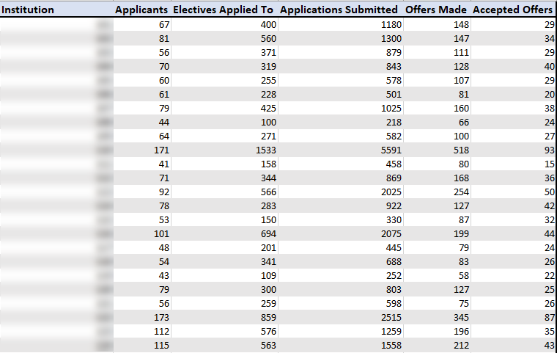
Analyzing Data at the Institution Levels

Slide 34
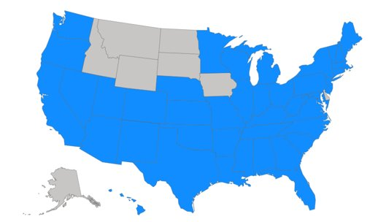
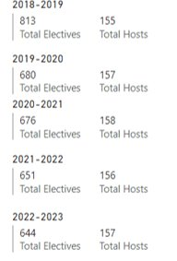
Deeper Dives into Specialty Data OBGYN VSLO Data

Slide 35
Global Network
The limited number of available opportunities for students in the VSLO Global Network is a historical issue. COVID continues to impact the network.
VSLO is identifying ways to restructure the current VSLO Global Program model to better support institutions and students in our global network space. ​
Currently, students at schools in the Global Network can apply for available opportunities.
New institutions from outside the U.S. are not being accepted into the VSLO Global Network currently. ​
Exception: If a U.S. institution is a Host/Home in the VSLO Global Network and has a formal, existing relationship with an accredited institution outside the U.S. not currently in the VSLO program, we will add that institution to our Global Network for purposes of allowing each site’s students to complete their away rotations at the partner institution.
​

Slide 36
VSLO Advisory Committee
Charged with ensuring the VSLO program is responsive to the needs of the institutions that send and receive medical and public health students for short-term learning opportunities. ​
Petra Bricker, Manager of the Office of Career Services, University of Missouri-Kansas City School of Medicine ​
Gary Chien, MD, Assistant Area Medical Director, Kaiser Permanente Los Angeles Medical Center​
Robert Hyde, MD, Director of Undergraduate Medical Education for Emergency Medicine, Mayo Clinic ​
Wendy Finch, Clinical Career Advisor, Rocky Vista University ​
Sandy Saintonge, MD, Clinical Professor and Medical Student Advisor, CUNY School of Medicine ​
Carolina Quezada, MD, Assistant Dean of Clinical Education, A.T. Still University School of Osteopathic Medicine. ​
​Each of the committee members brings a wealth of knowledge and experience from their work in undergraduate and graduate medical education. We are grateful for their commitment to helping us shape the future of the VSLO program.

Slide 37
Useful Links
AAMC Standardized Immunization Form
AAMC Uniform Clinical Training Affiliation Agreement
URiM Opportunities for Visiting Students
VSLO Updates and Resources

Slide 38
Contact Information
Email: visitingstudents@aamc.org
Website: aamc.org/vslo
Phone: (202) 478-9878
Client Support team hours:
Monday - Friday 8:00am-6:00pm ET

Slide 39
A Post-Pandemic Update on the AAMC’s Visiting Student Learning Opportunities (VSLO) Program
Presentation title goes here Subtitle of Presentation
Robin Carle
Senior Director - VSLO
April 28, 2023

