Slide 1
2023 CFAS Spring Meeting Summary
Salt Lake City, Utah
March 27–29

Slide 2
CFAS Mission
CFAS aspires to be the voice of academic faculty within the AAMC’s governance and leadership structures. The Council is charged with:
Identify critical issues facing faculty members of medical schools and within academic societies;
Articulate a common faculty voice on these issues to the AAMC as they relate to creation and implementation of the AAMC programs, services, and policies;
Serve as a bidirectional communications conduit regarding matters related to the core missions of academic medicine
Notes:
Adi to cover an overview of CFAS – align these mission areas to the program of the spring meeting
-Inform people that there will be resources after the meeting to present back to home institutions and societies.

Slide 3
Leadership Sessions and Breakouts

Slide 4
Leadership Session: Strategic and Alternative Pathways to Academic Leadership
How to Be an Effective CFAS Rep: New Reps and Seasoned Reps Alike
Charles S. Day, MD, MBA
Moderator
Interim Chair, Medical Director & Professor, Department of Orthopaedic Surgery and Service Line Henry Ford Health/ Wayne State University School of Medicine Junior Representative to CFAS from the American Orthopaedic Association
Denise Jamieson, MD, MPH
Speaker
Chair, Department of Gynecology & Obstetrics
Emory University School of Medicine
Alex Bolt
Moderator
Senior Communications Specialist, Faculty and Academic Societies
AAMC
Adam Franks, MD
Speaker
Professor, Family Medicine
Marshall University Joan C. Edwards School of Medicine
Optimizing the Faculty Experience: Aligning Mission to Action (Developing Your “Personal Brand”)
Scott Gitlin, MD
Moderator
Former CFAS chair
Assistant Dean for GME; Professor, Internal Medicine
University of Michigan Medical School/American Society of Hematology
Kimberly Lumpkins, MD, MBA
Speaker
Chief, Pediatric Surgery and Urology
University of Maryland School of Medicine
Laura Shaffer, PhD, ABPP
Speaker
Professor; Chief, Section of Pediatric Psychology
University of Virginia School of Medicine

Slide 5
Concurrent Sessions

Slide 6
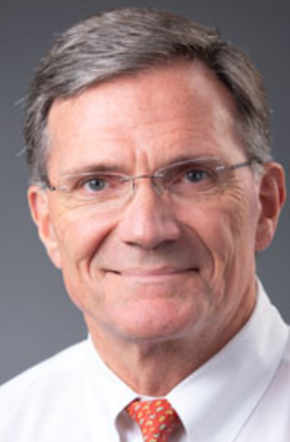
Focus on Our Medical Students: How are They, and We, Doing?
Vincent Pellegrini, MD
Moderator
Professor, Orthopaedics; Vice Chair, Education & Research Affairs
Geisel School of Medicine at Dartmouth
Sara Lamb, MD
Speaker
Vice Dean of Education
Spencer Fox Eccles School of Medicine at the University of Utah
Rana Ali
Speaker
Student
Spencer Fox Eccles School of Medicine at the University of Utah
Ivy Christofferson
Speaker
Student
Spencer Fox Eccles School of Medicine at the University of Utah

Slide 7
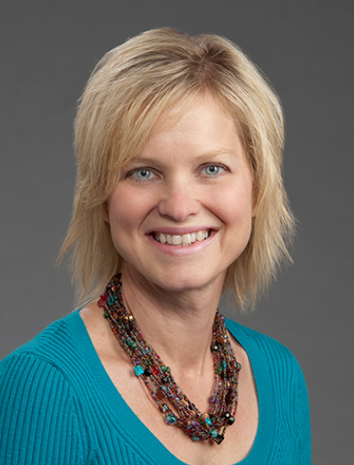
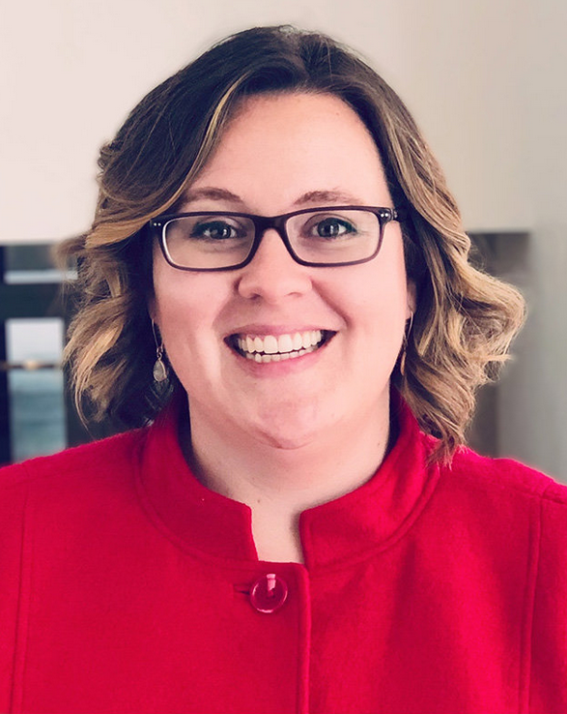
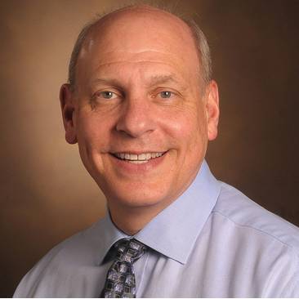
“I Couldn’t Sleep at All Last Night”: Challenges to Biomedical Researchers and Educators
Neil Osheroff, PhD
Moderator
Professor, Biochemistry; Professor, Medicine (Hem/Onc); John G Coniglio Chair, Biochemistry
Vanderbilt University School of Medicine
Kelly Quesnelle, PhD
Speaker
Clinical Professor & Chair of Biomedical Sciences
University of South Carolina School of Medicine Greenville/International Association of Medical Science Educators (IAMSE)
Martha Alexander-Miller, PhD
Speaker
Professor and Chair, Dept. of Microbiology and Immunology
Wake Forest University School of Medicine

Slide 8
CFAS Business Meeting

Slide 9
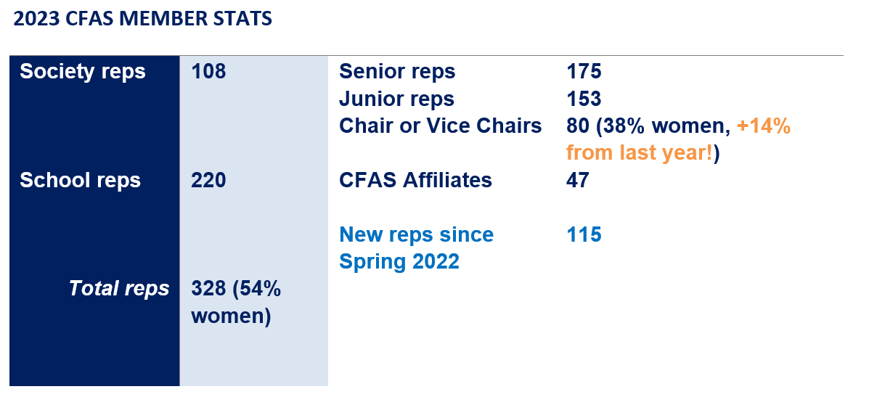
CFAS Reps by the Numbers
Notes:
Return to Adi – provide an overview of CFAS reps – note a larger number of women chairs joining the organization.

Slide 10
Major Activities in 2022-23
Formed new CFAS Committees and revamped existing committees
Refined a new committee structure and written committee rules
Launched effort to increase representative numbers and new society members
Focused on supporting ongoing connectivity with:
Monthly electronic CFAS Rep Bulletin
Monthly online CFAS Connects live sessions
Annual CFAS Spring Meeting, transitioning back to in-person meeting in 2023
Launched planning for biennial CFAS Society Summit
Notes:
Highlight the focus on committee structure
Highlight that when we met less in person that our committees generally met more.
Details will be coming soon on the society summit – date is July 17, 2023.

Slide 11
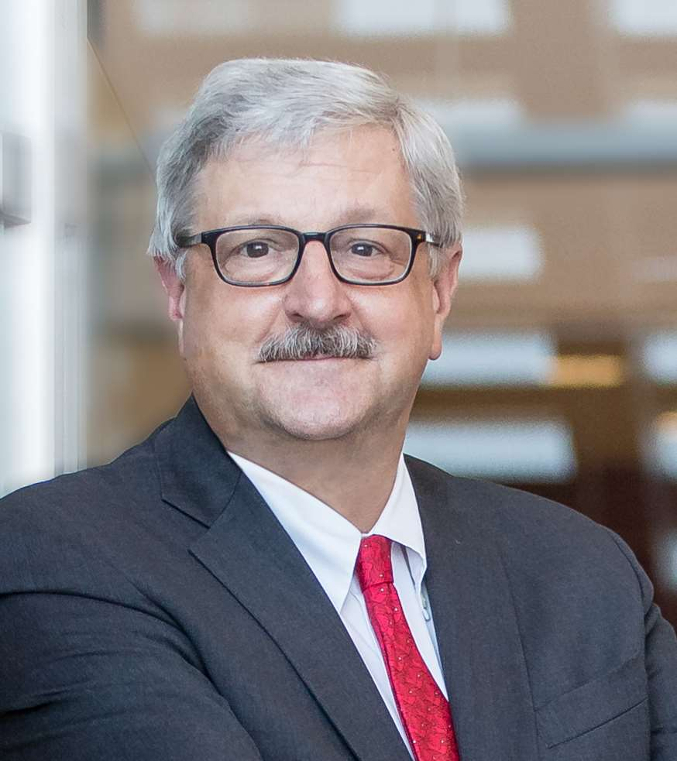
Incoming CFAS Chair-elect (effective 11/2023)
Arthur Derse, MD, JD
Director, Center for Bioethics and Medical Humanities; Julia and David Uihlein Chair in Medical Humanities, and Professor of Bioethics and Emergency Medicine, Medical College of Wisconsin
Association of Bioethics Program Directors
Notes:
And the Committee selected Art Derse to become CFAS Chair-elect – a seat that will become official at the conclusion of the Learn Serve Lead Annual Meeting in November.
As such, Dr. Derse will become a member of the AAMC Board of Directors, as Dr. Ahuja moves from being chair-elect to CFAS Chair.

Slide 12
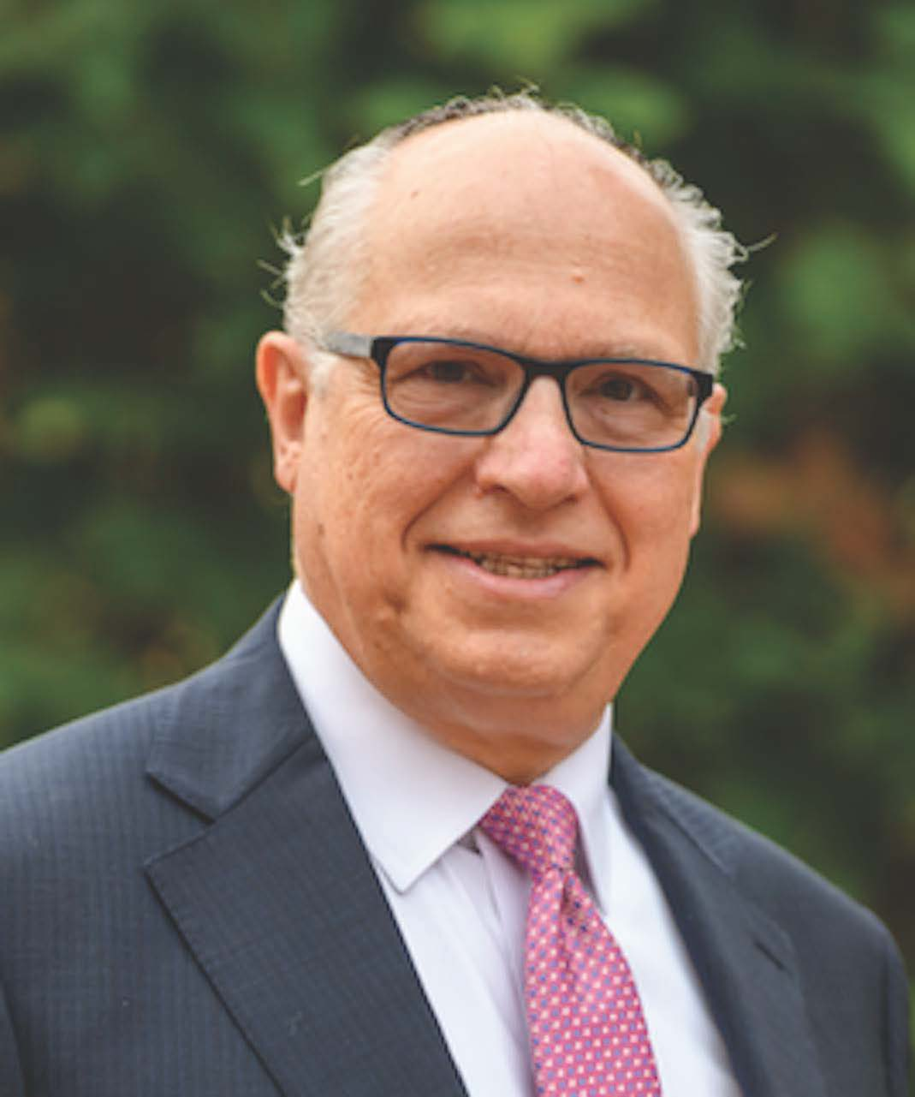
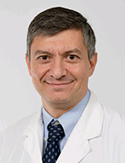
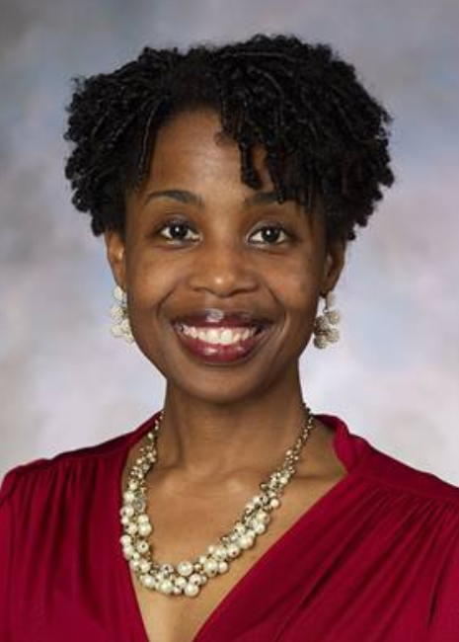
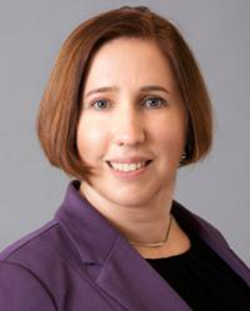
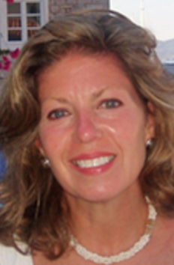
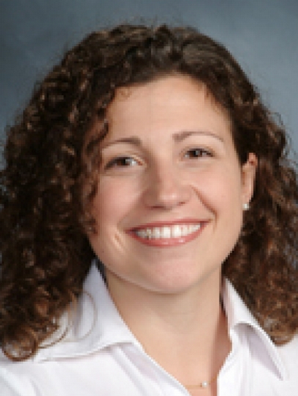
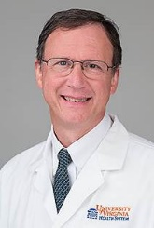
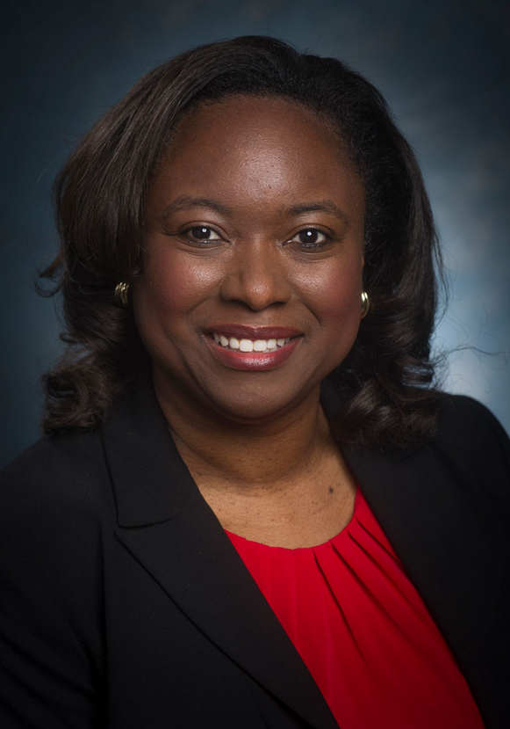
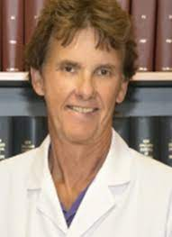
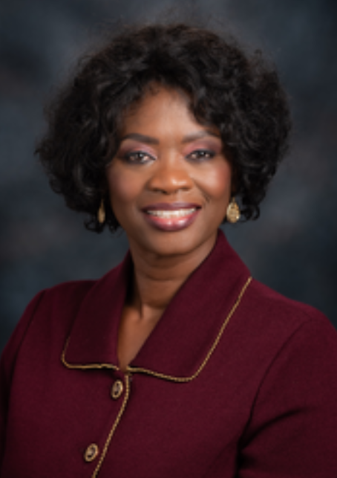
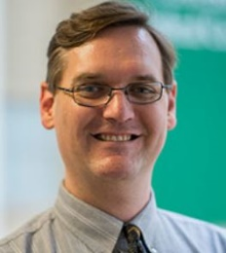
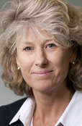
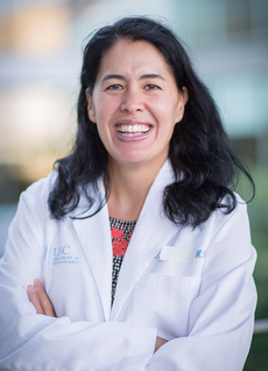
New CFAS Administrative Board, 2023-24
Nita Ahuja, MD, Chair
Arthur Derse, MD, JD Chair-elect
Aviad “Adi” Haramati, PhD, Immediate Past Chair
Steven Angus, MD
Valencia Walker, MD
Kimberly Lumpkins, MD
Shirley “Lee” Eisner, PhD
Neil Osheroff, PhD
Lily Belfi, MD
Stewart Babbott, MD
Adam Franks, MD
Monica Baskin, PhD
Catherine Pipas, MD
Deanna Sasaki-Adams, MD
Nicholas Delamere, PhD
Lisa D. Cain (Ex-Officio GFA Chair)
Notes:
And this slide shows the slate after LSL 2023 in Seattle, with Dr. Popescu rotating off the ad board.
The system allows for refreshing members and adding new faces.
All CFAS reps are encouraged to nominate themselves for roles in the next call.
We want to be sure to represent junior/early career faculty in the future

Slide 13
CFAS Committee Activities
The CFAS Faculty Resilience Committee has been renamed the CFAS Faculty and Organizational Well-being Committee
The Biomedical Research and Education Committee has refocused into the Biomedical Research and Training Committee
The Communication Committee has been renamed the Engagement Committee
Notes:
Adi takes the podium.
Shift in committee names; adding a new committee; changing focus of committees.

Slide 14
Other CFAS Committee Changes
A new committee has been established:
Faculty as Medical Educators
Chair: Lily Belfi, MD
Associate Professor of Clinical Radiology at Weill Cornell Medical College; Associate Attending Radiologist at New York-Presbyterian Hospital-Weill Cornell Campus
Notes:
Introduce Lily Belfi in her role as chair of a new committee and discuss the relevance of the committee – why this committee and why now?

Slide 15
CFAS Committee Roster
Thematic Committees open to all CFAS reps and affiliates.
Advocacy Committee - Art Derse, Chair
Biomedical Research and Training Committee – Neil Osheroff, Chair (Newly named committee)
Diversity, Equity, and Inclusion Committee - Monica Baskin, Chair
Engagement Committee – Kimberly Lumpkins, Chair (New committee)
Mission Alignment Committee - Stewart Babbott, Chair
Faculty as Medical Educators Committee – Lily Belfi, Chair (New Committee)
Faculty and Organizational Well-being Committee - Cathy Pipas, Chair (Newly named committee)
Structural Committees open to appointed members.
Program Committee - Nita Ahuja, Chair
Nominating Committee - Gabriela Popescu, Chair
Notes:
Review the overall committee roster
As time allows, invite very brief updates from committee chairs on the floor.

Slide 16
AAMC Strategic Plan: Society Outreach
A work project within the AAMC’s Strategic Planning Action Plan to Adapt to Change and Serve AAMC Members, has launched to increase academic society membership to the AAMC
An AAMC working group convened by Eric Weissman has been established to identify prospective society members, create an outreach plan, develop materials, and enhance marketing efforts to encourage new specialty societies to join the AAMC and CFAS
CFAS reps are encouraged to send prospective member society candidates to Eric Weissman: eweissman@aamc.org
A full list of current society members is available online
Notes:
Adi: You can turn it over to me if you want – but if you wish to continue:
Simple message: Three are scores of academic and specialty societies that could easily be members of the AAMC and engage in CFAS.
An AAMC-staff-driven working group has been identified, led by Eric Weissman, and will develop a plan to reach out to societies to get them to become regular, ongoing members of the AAMC, and thereby become active CFAS societies who will join us at the table.

Slide 17
Publications Connected to CFAS Work
Rank and Tenure Amongst Faculty at Academic Medical Centers: A Study of More Than 50 Years of Gender Disparities (2022) Adam M Franks, Nandini Calamur, Anca Dobrian, Mark Danielsen, Serina A Neumann, Eileen Cowan, Tracey Weiler
When Off-Label Prescribing Becomes Politicized: Do No Harm (2022) Vera S Donnenberg, Arthur R Derse, David P Sklar, Ross E McKinney
Grit, Gratitude, Grace, and Guidance: Moving Academic Medicine From Crisis to Transformation (2022) Lily M Belfi, Eric Weissman, Aviad Haramati
The Rise of Wellness Initiatives in Health Care: Using National Survey Data to Support Effective Well-Being Champions and Wellness Programs (2021) CFAS Faculty and Organizational Well-Being Committee
Finding Greater Value in the Fourth Year of Medical School: Accelerating the Transition to Residency (2020) Vincent D Pellegrini Jr, Adam M Franks, Robert Englander
The Definition of Faculty Must Evolve: A Call to Action (2020) Bellini, Lisa M. MD; Kaplan, Brian MD; Fischel, Janet E. PhD; Meltzer, Carolyn MD; Peterson, Pamela MD; Sonnino, Roberta E. MD
Governance of Academic Health Centers and Systems: A Conceptual Framework for Analysis (2019)
Vincent D Pellegrini Jr, David S Guzick, Donald E Wilson, C McCollister Evarts
The Evolution of Faculty in U.S. Medical Schools and the Transformation of the Council of Academic Societies Into the Council of Faculty and Academic Societies (2015) Nelson, Kathleen G. MD; Crawford, James M. MD, PhD; Fisher, Rosemarie L.L. MD
Academic Health Center Psychology Representation to the Council of Faculty and Academic Societies (CFAS) of the Association of American Medical Colleges (AAMC) (2017)
Barbara A. Cubic & Laura A. Shaffer
Notes:
A variety of CFAS committee projects, sessions, and other activity have made it into the literature, as either peer reviewed research papers or as reports or reviews of programming.
It has been an ongoing goal of CFAS to leverage our work into a durable and lasting form.
While some of the work is not always the direct outcome of CFAS, the connections and relationships may have brought it to light.
Please work with your committee or presentation colleagues on potential papers or concepts for research

Slide 18
CFAS Connects
CFAS has continued to organize monthly CFAS Connects sessions, including:
Caring for Older Adults: Clinical, Research, and Training Challenges
A Conversation with David Skorton, MD
Keeping Women in Medicine: A Conversation about Retaining Talented Women Physicians
Opportunities and Challenges in Building COVID-19 Vaccine Confidence: Seeking CFAS Feedback on an AAMC Strategic Planning Initiative
Gender Parity – An Example of Aligning with the Mission of CFAS
A presentation on the work of the CFAS Faculty and Organizational Well-being Committee
The program attracts between 50 – 75 reps per session and provides a connection between member societies and medical schools between in-person meetings. All sessions are recorded and notes and summaries of sessions are available to reps on our website
Notes:
CFAS Connects arose out of necessity: Our need to stay connected as an AAMC council when the early days of the COVID-19 pandemic made it impossible for us to gather in person.
The program has become useful and varied in a way we did not anticipated upon starting it – and now that we are able to meet again in person, the online / virtual meetings started by CFAS Connects aren’t going anywhere.
In the next session, you’ll hear from AAMC President and CEO David Skorton, but he is also our featured guest in an open town hall meeting of CFAS Connects in about a month from now.

Slide 19
Plenary Summaries and Highlights

Slide 20
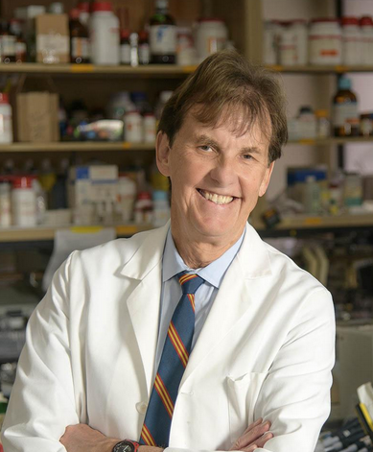
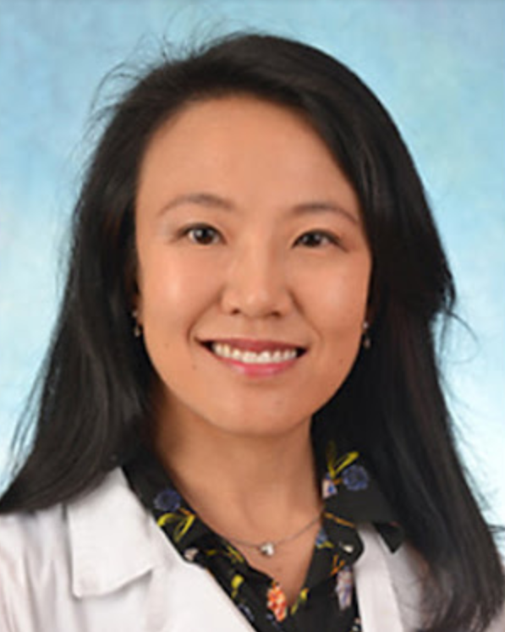
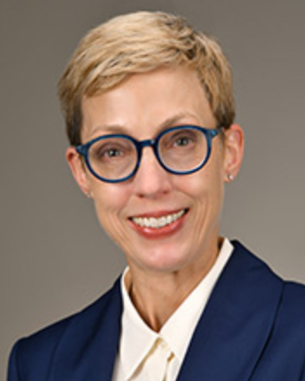
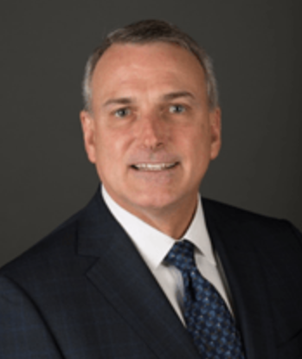
Opening Plenary: Faculty Thriving in Academic Medicine: From Mission Impossible to Mission Accomplished
Nicholas Delamere, PhD
Moderator
Department Head, Physiology; Professor
University of Arizona College of Medicine/Association of Chairs of Departments of Physiology
Nicholas “Nick” Delamere is the senior CFAS representative from the Association of Chairs of Physiology Departments (ACDP)
Winnie Lau, MD
Speaker
Clinical Assistant Professor, Neurology
University of North Carolina at Chapel Hill School of Medicine
Allison Ownby, PhD, Med
Speaker
Associate Dean and Professor, Educational Programs
McGovern Medical School at the University of Texas Health Science Center at Houston/Society of Directors of Research in Medical Education
Kent Vrana, PhD
Speaker
Elliot S. Vesell Professor & Chair of Pharmacology
Penn State College of Medicine

Slide 21
Opening Plenary: Faculty Thriving in Academic Medicine: From Mission Impossible to Mission Accomplished
Tripartite Mission - Clinical
The strength of academic med center is to have the mix of all 3 missions (patient care, research, education) with faculty participating in all 3
In our institutions, it can often seem like the missions are in conflict from an individual standpoint
Shortages of all kinds of health care workers of are adding up (technicians, nursing assistants, etc). Those of us who survived pandemic are still being stretched. We’re also in a financial crisis because of fallout of pandemic.
Medicare fee schedule is always reimbursing less, but our hospital systems ask us to produce more.

Slide 22
Opening Plenary: Faculty Thriving in Academic Medicine: From Mission Impossible to Mission Accomplished
Clinical mission
Consolidating community health centers pulls clinical faculty away from the tripartite mission because of added responsibilities.
Institutions should realign for translational science and their clinicians should partner with data and quality scientists to get better patient care.
Pandemic forced educators to be innovative and we should apply lessons learned by educators to improve our clinical education. For example, how can we improve things through simulation?

Slide 23
Opening Plenary: Faculty Thriving in Academic Medicine: From Mission Impossible to Mission Accomplished
Education mission
The educational mission in our institutions is vulnerable, costly, and relies on research and patient care revenues.
One of the biggest challenges for educators in 2023 is isolation/lack of sense of community. We’ve become too used to participating in facets of mission virtually.
When missions are aligned, there is give and take and the understanding that missions support each other.
Institutions should ensure promotion tracks reflect the educational activities faculty do, including mentoring
One institution intentional supports faculty in the following ways:
Faculty development for teaching and educational research skills
Teaching academies and local educational conferences
Peer coaching and educational consults
Teams of basic science and clinical faculty experts
Teaching awards

Slide 24
Opening Plenary: Faculty Thriving in Academic Medicine: From Mission Impossible to Mission Accomplished
Research mission
Challenges for the Tripartite Mission:
Changing priorities – creation of new med schools with minimized research emphases
Widespread recognition that research is expensive
Emphasis on clinical revenue generation
Creation of the Office of Medical Education
Recruitment of non-educator basic scientists
Competition for resources

Slide 25
Opening Plenary: Faculty Thriving in Academic Medicine: From Mission Impossible to Mission Accomplished
Research mission
Research sets AMCs apart – it’s an investment that makes us better, but it’s costly
Research crosses all missions and we need to find ways to tie the missions together through research
Potential solutions:
Clinical and translational science institutes (CTSAs)
Centers for Medical Education Research
Health system science initiatives
Engage researchers in education
Team science to support clinician involvement (beyond simply being a source of samples)

Slide 26
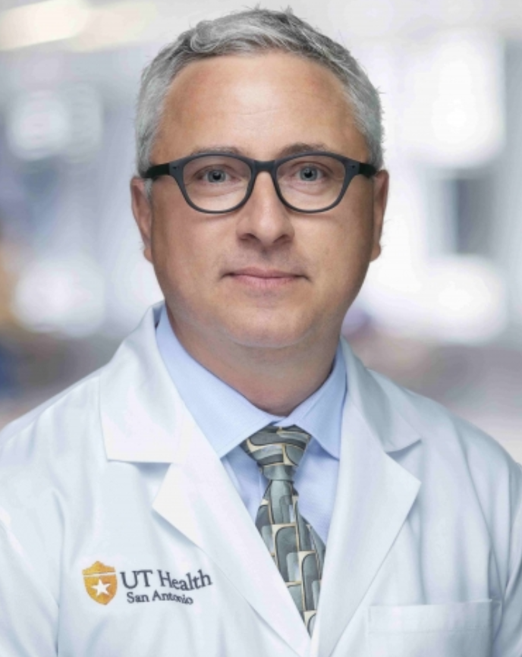
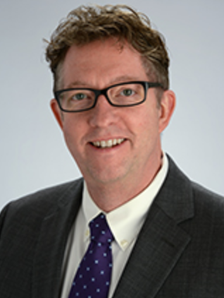
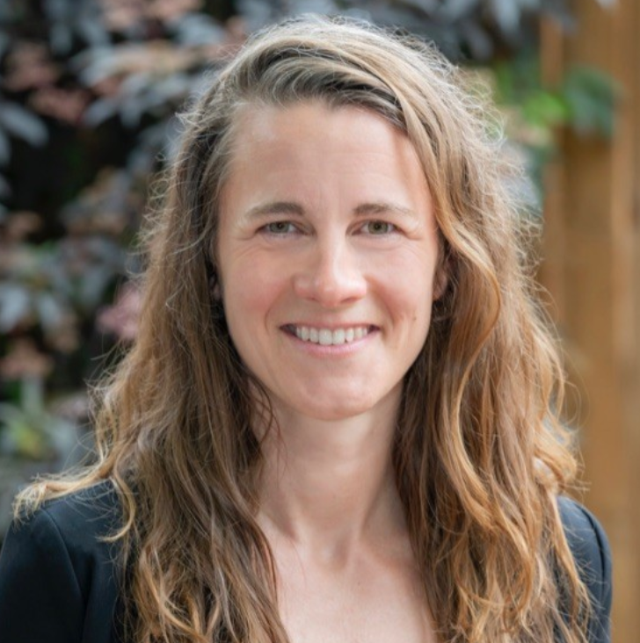
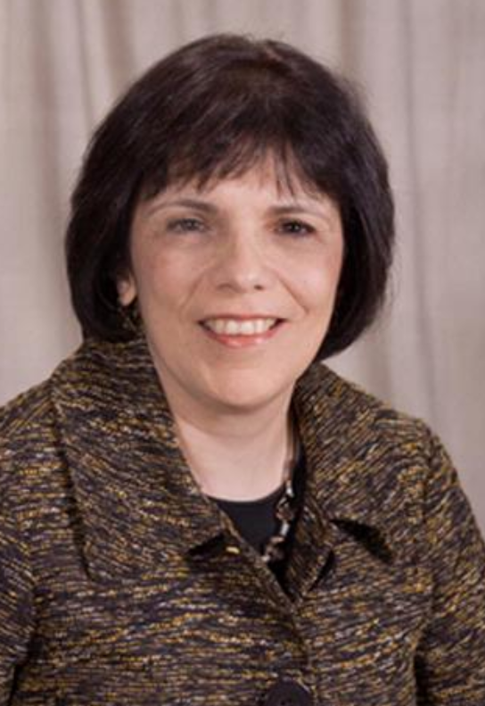
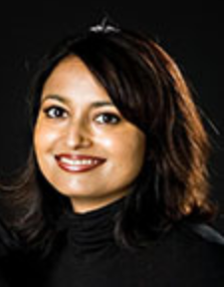
Intention to Action: Leveraging Well-being to Support Researchers, Educators, and Clinicians
Jon Courand, MD
Moderator
Assistant Dean for Well-being, Office of GME, and Vice Chair for Pediatrics
The University of Texas Health Science Center at San Antonio Joe R. and Teresa Lozano Long School of Medicine
Brad Barth, MD
Speaker
Vice-Chair, Leadership & Professional Development; Assoc. Dean, Faculty Dev; Prof, Emerg. Med.
University of Kansas Medical Center
Megan Furnari, MD
Speaker
Assistant Professor of Pediatrics, Nursery Hospitalist, OHSU Well-Being Leadership Team Chair
Oregon Health & Science University School of Medicine
Aviad "Adi" Haramati, PhD
Speaker
CFAS Chair
Professor and Director, Center for Innovation & Leadership in Education
Georgetown University School of Medicine/Academic Consortium for Integrative Medicine and Health
Mithu Sen, MD
Speaker
Assistant Dean, Faculty Equity & Wellness; Professor, Medicine
The University of Western Ontario - Schulich School of Medicine & Dentistry
Janine Shapiro, MD
Associate Dean for Faculty Development
Professor of Anesthesiology
University of Rochester School of Medicine and Dentistry

Slide 27
Intention to Action: Leveraging Well-being to Support Researchers, Educators, and Clinicians
Session overview:
The session explored what can individuals do within their own institutions to advance well-being
It’s crucial for faculty members to take care of themselves
Stress and morale of academic biomedical scientists: fear of not maintaining funding; frustration with time spent doing paperwork and administrative duties

Slide 28
Intention to Action: Leveraging Well-being to Support Researchers, Educators, and Clinicians
Mind-Body Medicine Program at Georgetown University School of Medicine:
Results showed impact of facilitators’ scores: significantly lower on perceived stress and higher on mindfulness. Also showed improvements in communication between colleagues, increased sense of connection between students and colleagues, increased empathy, and heightened self-confidence.
When faculty and senior staff serve as facilitators of the mind-body medicine program, they help learners and also help their own well-being. Reviewed steps toward developing a competency framework for well-being as it relates to competency based medical education.
Well-being was one of the four universal pillars identified as part of the Clinician Educator Milestones Project, a joint initiative between the AAMC, ACGME, ACCME, AACOM. The other three pillars were professionalism, reflective practice, and the recognition and mitigation of bias.

Slide 29
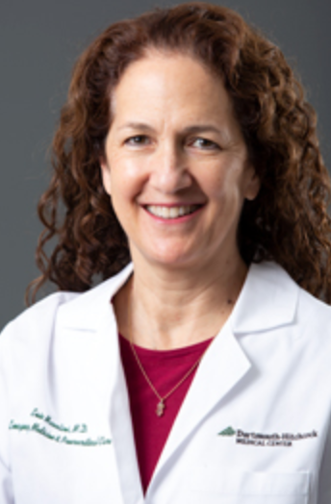
Unintended Bias – How to Reduce the Risk, but When it Happens, How to Respond: The ROI of Inclusion
Valencia Walker, MD, MPH
Moderator
Vice Dean, Health Equity & Inclusion
Geisinger Commonwealth School of Medicine
Monica Baskin, PhD Speaker
Assistant Vice Chancellor for Community Health Equity, Health Sciences
University of Pittsburgh School of Medicine/Society of Behavioral Medicine
Evie Marcolini, MD
Speaker
Associate Professor, Department of Emergency Medicine Associate Professor, Division of Neurocritical
Geisel School of Medicine at Dartmouth

Slide 30
Unintended Bias – How to Reduce the Risk, but When it Happens, How to Respond: The ROI of Inclusion
Words matter. Bias is prejudice in favor of or against one thing, person, or group compared with another, often leading to stereotyping.
Unconscious/implicit biases are unintentional prejudices.
Racism is a system of structuring opportunity and assigning value based on the social interpretation of how one looks (often called “race”), that unfairly disadvantages some individuals and communities

Slide 31
Unintended Bias – How to Reduce the Risk, but When it Happens, How to Respond: The ROI of Inclusion
Microaggressions are “brief and commonplace daily verbal, behavioral and environmental indignities whether unintentional or intentional that impact victims.”
Microaggressions can be subtle and stunning. There’s a cumulative effect to the victim of unimaginable magnitude over the course of their life.
There’s documented literature on microaggressions, such as when a male doctor introduces a female doctor on a panel and calls her by her first name instead of her title.

Slide 32
Unintended Bias – How to Reduce the Risk, but When it Happens, How to Respond: The ROI of Inclusion
This session included interactivity through PollEverwhere responses to how institutional officials should handle scenarios involving microaggressions/exclusion. Then there was time for small group discussions at tables and reporting out what each table focused.
One proposed solution to handling instances of microaggressions and/or exclusion was to identify follow-on questions to further clarify the situation.
There was a question on how to decide when a microaggression has occurred. The way a faculty member may experience the world can be very different than how a student experiences the world, even though they can be in the same building, doing the same activities, etc. It’s important to separate the intent from the impact of a microaggression and focus on the impact.

Slide 33
Unintended Bias – How to Reduce the Risk, but When it Happens, How to Respond: The ROI of Inclusion
Try to look at microaggressions from the perspective of person who made the comment. Looking at everyone’s perspective who was involved is important.
AAMC’s creation of institutional competencies for DEI is very important because so much of what affects a patient’s outcome is influenced by the system’s structure and there is bias in the systems.
Helpful articles include: “Ouch! That Stereotype hurts” and “Promoting Inclusion in Academic Medicine” from Elena Fuentes-Afflick.
“The ultimate tragedy is not the oppression and cruelty by the bad people but the silence over that by the good people” – MLK

Slide 34
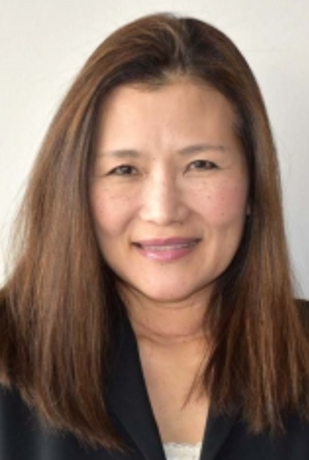
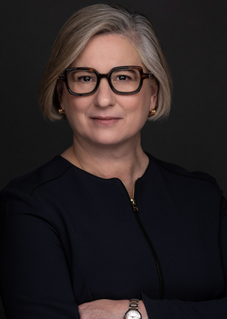
Trends and New Directions for Salary Equity in Academic Medicine
Yoshimi Anzai, MD, MPH Moderator
Associate Chief Medical Quality Officer, Professor of Radiology, Adjunct Professor of Population Health
Spencer Fox Eccles School of Medicine at the University of Utah/American College of Radiology
Amy Gottlieb, MD Speaker
Associate Dean for Faculty Affairs/Chief Faculty Development Officer,
UMass Chan Medical School – Baystate/Baystate Health
Arthur Derse, MD, JD Speaker
Julia and David Uihlein Chair in Medical Humanities
Medical College of Wisconsin/Association of Bioethics Program Directors
Diana Lautenberger, MA Speaker
Director, Gender Equity Initiatives
AAMC
Valerie Dandar, MA
Speaker
Director of Medical School Operations, Academic Affairs
AAMC

Slide 35
Trends and New Directions for Salary Equity in Academic Medicine
Intro
Salary equity refers to whether or not individuals have: access to opportunities that allow them to earn and be paid similar compensation for comparable work given shared qualifications regardless of individual identities. Salary equity is important for recruiting and retaining talented faculty members
Salary equity is a component of a comprehensive gender equity strategy: mentoring and sponsorship, family friendly policies/work-life balance, and equal access to opportunities
AAMC started work on salary equity work in 2019 with Promising Practices for Understanding and Addressing Salary Equity at U.S. Medical Schools and has produced two follow-on reports since then.

Slide 36
Trends and New Directions for Salary Equity in Academic Medicine
White men are paid more than men of other races and women of all races. Sometimes white women make more than women of color. Just because we have diversity, doesn’t mean we have equity.
To gain traction on salary equity:
Establish mandatory unconscious bias training
Examine trends in faculty recruitment selection and hiring
Ensure equitable distribution of duties and resources across faculty
Promote flexible workplace policies
Assess trends

Slide 37
Trends and New Directions for Salary Equity in Academic Medicine
Amy S. Gottlieb, MD
Implicit biases and traditional compensation methodologies work together to contribute to gender pay gap.
Women physicians experience one of largest pay gaps in America and the pay gap is increasing
Women are often penalized for negotiating on their salary and also face “occupational gender segregation,” where they are directed toward certain specialties.
As women physicians have become over-represented in pediatrics and obstetrics and gynecology, their relative earnings have been observed to decline.
Women also carry a greater share of organizational service activities, have more domestic duties and part-time work, spend more time with patients, and have to navigate pregnancy, maternity leave, etc.
“Second generation gender bias”: No overt intention to exclude but exclusion still happens because of embedded unconscious bias/stereotypes.
In academic medicine, women who advance to dean roles often do so in faculty affairs, not research, etc.

Slide 38
Trends and New Directions for Salary Equity in Academic Medicine
To close gender pay gap, institutions need to identify and explore factors that are driving compensation calculations, develop frameworks that account for gender inequities, and recognize and reward mission aligned pockets of productivity that may be currently ignored.
Culture change is also important in changing salary inequity. We need to sponsor high potential women for leadership opportunities.
Talent is universal, opportunity is not, and sponsorship provides that opportunity. Women have a visibility gap.
The Society of General internal Medicine’s (SGIM) Career Advising Program is a longitudinal sponsorship initiative to advance women in academic promotion process. It was launched in 2013 and now serves 400 participants nationwide.

Slide 39
Trends and New Directions for Salary Equity in Academic Medicine
Arthur Derse, MD, JD:
Salary equity at medical college of Wisconsin:
Culture is the foundation of DEI
Every year, one institution’s salary equity team identifies fair market value using Vizient®, AAMC data, and other sources, and puts data into quartiles. Institutional leaders have to resolve any pay gaps or provide written justification for differences.
The institution has gender equity adjustments and adjustments for underrepresented in medicine (URM) faculty.
The institution ensures transparency by establishing a planned timeline for leadership to share salary equity reports with individual faculty members.

Slide 40
Trends and New Directions for Salary Equity in Academic Medicine
Diana Lautenberger:
Salary disparities for graduating trainees is not rationalizable and starting salaries should be equalized right out of training. Closing these pay gaps before they start will have considerable financial impact on faculty members’ compensation trajectories.
Promising practices and actions:
Studies on salary equity: Commit to initial study taking at least a year to design and refine the study
Financial strategies: account for salary adjustments as a regular part of compensation philosophy and identify foundational competency approach at institutional level.
Communication strategies: Connect salary equity to other equity initiatives. Have departmental leaders regularly communicate on these issues.

Slide 41
Trends and New Directions for Salary Equity in Academic Medicine
Promising practices and actions:
Steps institutions can take: Make specialty-specific salary data widely available to members of your specialty society
Host salary equity sessions during your annual conferences
Consider programming that might build opportunities for increased equity among members at local institutions
Steps individuals can take: Educate yourself about components of pay in academic medicine, research salary benchmarks for your rank, department, and geographical location using AAMC and other society-related benchmarks
During the discussion portion for this session, it was suggested that AAMC should be pushing harder on reducing disparities in salaries across specialties, or having compensation based on experience, etc.

Slide 42
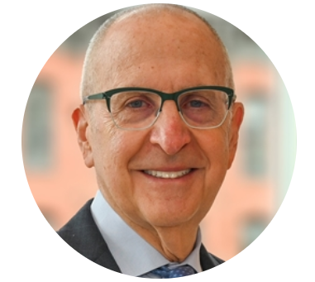
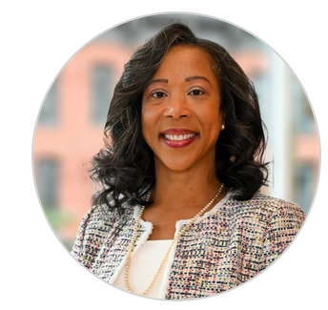
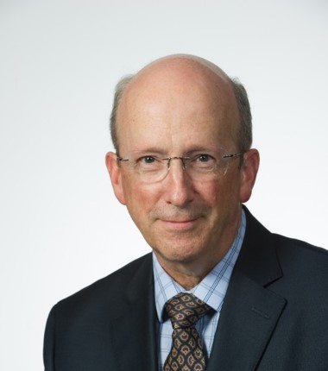
Leadership Plenary and Community Forum
Aviad "Adi" Haramati, PhD Moderator
Professor and Director, Center for Innovation & Leadership in Education
Georgetown University School of Medicine/Academic Consortium for Integrative Medicine and Health
Nita Ahuja, MD Moderator
Chair, Department of Surgery Yale School of Medicine
David Skorton, MD Speaker
President and CEO
AAMC
Danielle Turnipseed, JD Speaker
Chief Public Policy Officer
AAMC
Ross McKinney, MD Speaker
Chief Scientific Officer
AAMC

Slide 43
Leadership Plenary and Community Forum
Policy Update from AAMC Chief Public Policy Officer Danielle Turnipseed, JD
Recent academic medicine wins:
NIH funding is up to $47.5 billion (+5.6%)
ARPA-H is up to $1.5 billion
HRS Title VII and VIII health workforce programs up to $879.8 million (+12%)
VALID Act (would have let FDA regulate lab-designed tests) was excluded

Slide 44
Leadership Plenary and Community Forum
Policy Priorities:
VIPER Act
Prevent Pandemics Act provisions
200 new Medicare GME slots
Two-year delay of the 4% Medicaid PAYGO sequester cut
Upcoming Supreme Court decisions around race conscious admissions
Senate HELP Committee hearing held Feb. 16 on health care workforce shortages
340B drug pricing program is under new attack and AAMC is campaigning to protect 340B
Top AAMC policy priorities and advocacy efforts remain:
GME and HRSA programs, health equity, NIH, financial stability of academic medicine (coverage, Medicare, 340B, Medicaid, physician payment),
“If you don’t tell your story, someone else will.”

Slide 45
Leadership Plenary and Community Forum
AAMC Organizing:
AAMC has working relationships with AHA, AMA, National Medical Association, ACGME, etc.
AAMC also involved in Coalition to Protect America’s Health Care, Friends of VA Medical Care and Health Research, Ad Hoc Group for Medical Research, GME Advocacy Coalition, Health Professions and Nursing Education Coalition.
AAMC campaign on value of academic medicine: “Academic Medicine: What starts here saves lives” whatstartshere.aamc.org

Slide 46
Leadership Plenary and Community Forum
Update from AAMC Chief Scientific Officer Ross McKinney:
The power keeps moving away from the dean to the CEO suite in hospitals and health systems. With this increasing focus on margin, academic medicine must keep the focus on our missions
Health system CEOs are facing challenges from DSH payments ($8 billion cut – will impact lower income people). Possibly 25% cut to NIH budget – we need faculty engaged in these policy conversations. NIH may not have a permanent director for another 2 years
The good news is that the funding rate for NIH is still 30%. But a challenge is that NIH funding is set as a criteria for promotion

Slide 47
Leadership Plenary and Community Forum
Update from AAMC Chief Scientific Officer Ross McKinney:
The larger the average grant size, the fewer the grants. There will be increased costs from unionization of grad students and the number of grants may drop. NIH funding is almost back to where 2003 levels in inflation-adjusted dollars
The COVID pandemic would have been worse without the research – often from academic health settings – that brought us vaccines and treatments in record time

Slide 48
Leadership Plenary and Community Forum
Discussion:
There was discussion about whether the AAMC can identify which governance models are more beneficial considering the marginalization of the academic mission in many AMCs
There was discussion on how to address mistrust of science. People have more trust at local health levels than on national level, so it’s important to reach out to local communities
Community collaborations requires listening to our communities because the people suffering the injustice are in the best position to understand and resolve those injustices

Slide 49
Leadership Plenary and Community Forum
Discussion:
We have to make it plain when communicating the value of what we do. Understand where the community is coming from
The increase in GME slots is not being picked up by increases in Medicare payments, which is a problem
There’s a concerning conversation about cutting GME support from Medicare

Slide 50
Ignite Sessions on Mission Alignment
Mithu Sen, MD Moderator
Assistant Dean, Faculty Equity & Wellness; Professor, Medicine
The University of Western Ontario - Schulich School of Medicine & Dentistry
Stewart Babbott, MD Moderator
Professor, General Medicine, Geriatrics and Palliative Care
University of Virginia School of Medicine/Society of General Internal Medicine
Presentations:
Brad Barth: Communities of Practice as Sources of Flourishing
Robert Brodell: Learning While Doing: Developing Symbiotic Relationships with Medical Students to Advance Rural Access to Care Initiatives
Brian Clark-Smith: Gaming the System: Successfully Navigating the Corporatization of Academic Medicine
Adam Franks: Integrating Research into the Other Parts of the Tripartite Mission
Katherine Gold: Balancing Time Between Department, Clinic, and Myself: Finding Joy and Fulfilment in My Work
Kimberly Lumpkins: Your Brain Is Finite, but You Don’t Have to Be: Creating Strategies that Relieve Mental Load
Edgar Meyer: The Potential of Postbaccalaureate Programs to Improve Diversity, Equity, and Inclusion in Medicine and the Other Health Professional Sciences: A Mississippi Story
Deanna Sasaki-Adams: How My Life Became an Illustration of the Kenny Roger’s Song, “The Joker”

Slide 51
Ignite Style Presentations
Themes for ignite sessions:
Communities of practice are sources of joy – it’s important to find or create your own
Honor yourself, stay true to your values, break down silos and have other people help you achieve your missions – leverage your community
“If you want to help yourself, practice compassion, if you want to help others, practice compassion.”
Never let a crisis (or a big change) go to waste: advance and improve the current state
Recognize core values and alignment of those values and reflect on current and future career path

Slide 52
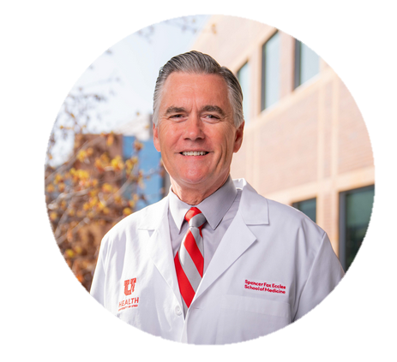
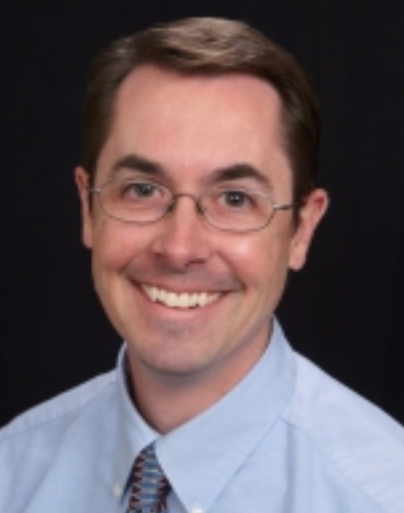
The Big Picture of Mission Alignment: A Conversation with Michael Good
Michael Good, MD Speaker
Senior VP for Health Sciences, CEO of University of Utah Health, and Executive Dean
University of Utah Health/Spencer Fox Eccles School of Medicine
Jonathan Constance, PhD Moderator
Assistant Professor, Clinical Pharmacology
Spencer Fox Eccles School of Medicine at the U of Utah/American College of Clinical Pharmacology
Nita Ahuja, MD Moderator
Chair, Department of Surgery Yale School of Medicine

Slide 53
The Big Picture of Mission Alignment
Takeaways:
Perhaps it’s best to have physician leaders for both the school and hospital side
In leadership, we have to learn to lead ourselves. Leadership is a learned skill and we need to know our strengths and weaknesses
We live in tense times and leaders need to learn how not to avoid difficult situations, but instead to put themselves in the center of the hardships their employees face. Becoming a “conflict-competent leader”: Conflict can be good if it’s kept in a constructive setting and focused on ideas, in contrast to destructive conflict that involves personal attacks
“Progressive incrementalism” vs. disruption. Any system can be improved. The best approach is “aggressive incrementalism” because progressive incrementalism is too slow, and disruption creates other problems

Slide 54
The Big Picture of Mission Alignment
Takeaways:
Our jobs have infinite work. If work is infinite, we have to ask ourselves how we are going to approach work. One idea is to write yourself “vacation prescriptions”
Human performance drops off dramatically after 16 hours. We need to get better at accepting our limits. We should ask ourselves how long we need to work today and what we’re going to do first. Then prioritize the most important thing.
Q&A:
Chairs should understand the finances of the hospital and where the margin comes from. And the hospital CEO needs to understand the NIH and what a research-focused faculty member goes through. Health systems need at least a 5% margin to keep up. When you get 10%, then you have resources to reinvest back into education and research. Both department chairs and hospital officials need to be at the table to determine how resources are allocated.

Slide 55
The Big Picture of Mission Alignment
Q&A:
The tenure of deans needs to increase so they can have the time to understand all the issues. Average tenure of deans right now is ~5 year
Listening is the most important skill in communication and leaders need to know how to listen. It’s vital to evaluate how potential leaders communicate when considering them for leadership roles
A leader’s job is to make chairs and deans successful, and then the chairs and deans make the faculty successful, and then the faculty makes the students successful
Leaders need to be more concerned for others than themselves, especially at the higher levels

Slide 56
The Big Picture of Mission Alignment
Q&A:
The concept of servant leadership is very valuable
Trust takes a long period of time to gain, and it can be lost in a short amount of time. Leaders have to build trust as well as relationships
“Play cards with the cards up” to encourage institutions to be collaborative and open with each other, i.e., a department sharing their books with the hospital side and vice versa
Our missions are indispensable to the public, so that should always be a source of optimism and motivation for us to figure out how to work together to improve peoples’ health

Slide 57
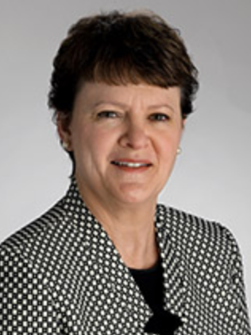
Mission Accepted: Sustaining Faculty for Success as Medical Educators
Giulia Bonaminio, MS, PhD Speaker
Senior Associate Dean for Medical Education; Research Professor, Department of Family Medicine
University of Kansas School of Medicine/International Association of Medical Science Educators
Steven Angus, MD Speaker
Professor, Department of Medicine
University of Connecticut School of Medicine
Lily Belfi, MD Moderator
Associate Professor of Clinical Radiology
Weill Cornell Medicine/Association of University Radiologists
Lee Eisner, PhD Speaker
Associate Professor of Cell Biology
SUNY Downstate Health Sciences University College of Medicine

Slide 58
Mission Accepted: Sustaining Faculty for Success as Medical Educators
A PollEverywhere activity asked what the audience to identify the greatest challenge faced by a medical educator or leader of medical education. Answers included a lack of value of medical education, isolation, integration problems, faculty have no “spare time”, and struggles with lack of engagement
Educator’s perspective:
Moral injury is huge driver of burnout
Faculty should bring students to the table to help develop curriculum and policy. There are currently 3 troubling trends: 1) the devolving relationship between students and faculty, 2) students mostly communicating with administrators, and 3) how medical educators are valued. These impact us as well as the growth and professional maturity of our learners
Oftentimes, there’s no administrative consequences for students who don’t attend mandatory sessions

Slide 59
Mission Accepted: Sustaining Faculty for Success as Medical Educators
Chair’s perspective:
Early career faculty have traditionally had to “pay their dues,” but its unclear if the new generation will want to get into positions where that’s the dynamic. How do we reset expectations so everyone is on the same page from educational standpoint?
Most chairs are on the side of the faculty but it’s hard for chairs to get resources faculty need because they’ve been taken out of planning decisions. Often times, when chairs ask why the school wants them to teach things that won’t make students practice-ready, the response is, “well, the LCME says we have to.”

Slide 60
Mission Accepted: Sustaining Faculty for Success as Medical Educators
Dean’s perspective:
Deans are accountable to the public
Faculty need to have dedicated time and to maintain a safe learning environment. Deans are aware that faculty have competing demands for their time
There must be institutional transparency in how departments and individuals get funded

Slide 61
Mission Accepted: Sustaining Faculty for Success as Medical Educators
Success stories:
Another PollEverywhere question asked, “what’s your greatest achievement as a med educator or leader of med ed at this moment?”
Responses: Creating teams of faculty, development of nationally recognized successful pre clerkship curriculum, sustained success of learning, integrating pharmacology into a systems-based curriculum, getting 95% attendant for opt in sessions, working as a chair on mission alignment to prioritize education, foster engagement through teams across disciplines, increasing dialogue with stakeholders on UME
Discussion:
One idea was to have dedicated educators (basic science, clinical, etc.) who are supported to do the work of education for half of an FTE

Slide 62
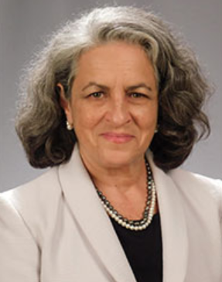
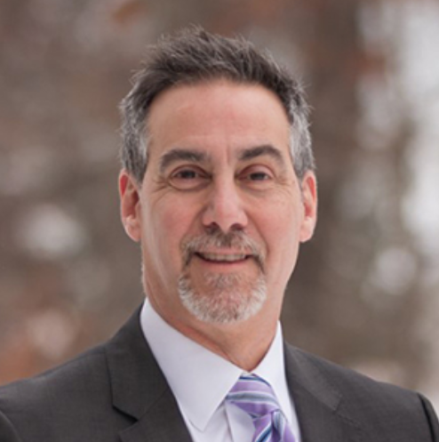
Closing Plenary and Final Thoughts: Recognizing and Embracing the Tension
Anne Mosenthal, MD Speaker
Chief Academic Officer
Lahey Health
Aviad "Adi" Haramati, PhD Moderator
Professor and Director, Center for Innovation & Leadership in Education
Georgetown University School of Medicine/Academic Consortium for Integrative Medicine and Health
Jonathan Jaffery, MD, MS, MMM, FACP,
Chief Health Care Officer AAMC

Slide 63
Closing Plenary and Final Thoughts: Recognizing and Embracing the Tension
Food for thought:
How can academics help academic medical centers increase their market share?
Academic medicine should help society rethink the business model of health care in the U.S.
Moral injury is a huge challenge and becoming engaged in the benefits our missions bring to society can help us find our way out
Institutional leadership needs to embrace the conflict and tension between missions, but so do the faculty
It’s important to keep in mind that health systems are only getting bigger as we try to align and complete our missions
Hospital finances are under financial pressures that are new and don’t seem like they’re going away i.e. commercial payors are lowering their reimbursements now as well as public payors (who have not historically reimbursed much anyway)

Slide 64
Closing Plenary and Final Thoughts: Recognizing and Embracing the Tension
The way forward:
Those of us working in academic medicine need to be realistic and figure out how to do more with less. But on the other hand, many physicians are older and are leaving the profession, so there are major concerns over workforce. If we try to do too much more with less, we’ll be in a very bad situation
We have to get to a culture where everyone can contribute and speak up to improve the system, similar to the Toyota assembly line
Realizing population health and value-based care is the way to move forward. Fee for service alone can’t help us anymore, but we can have synergistic models that use fee for service in some places and value-based care in others

Slide 65
Closing Plenary and Final Thoughts: Recognizing and Embracing the Tension
Perhaps it’s time to change the whole structure, because it’s too focused on the costs to government, corporate America, employers, etc. and not on the costs to patient. Maybe we should question some of the basic assumptions of our system if we really believe that health care is a public good
Giving physicians a set salary that doesn’t depend on the number of patients they see could be a very helpful reform
Closing remarks:
Academic medicine needs to address salary inequities between specialties in order to incentivize more students to enter primary care

Slide 66
Closing Plenary and Final Thoughts: Recognizing and Embracing the Tension
Closing remarks:
There was discussion about the need to have a joint meeting between CFAS, the AAMC’s Council of Deans (COD), and the AAMC’s Council of Teaching Hospitals and Health Systems (COTH)
Academic medical centers need to create models that value education and research, and the transition may be difficult and may face pushback from payors, but it’s necessary to move to these models and highlighting models that already do this well is important in those efforts
Next CFAS Spring meeting is combined with the AAMC’s Group on Resident Affairs (GRA) and the AAMC’s Organization of Resident Representatives (ORR)

Slide 67
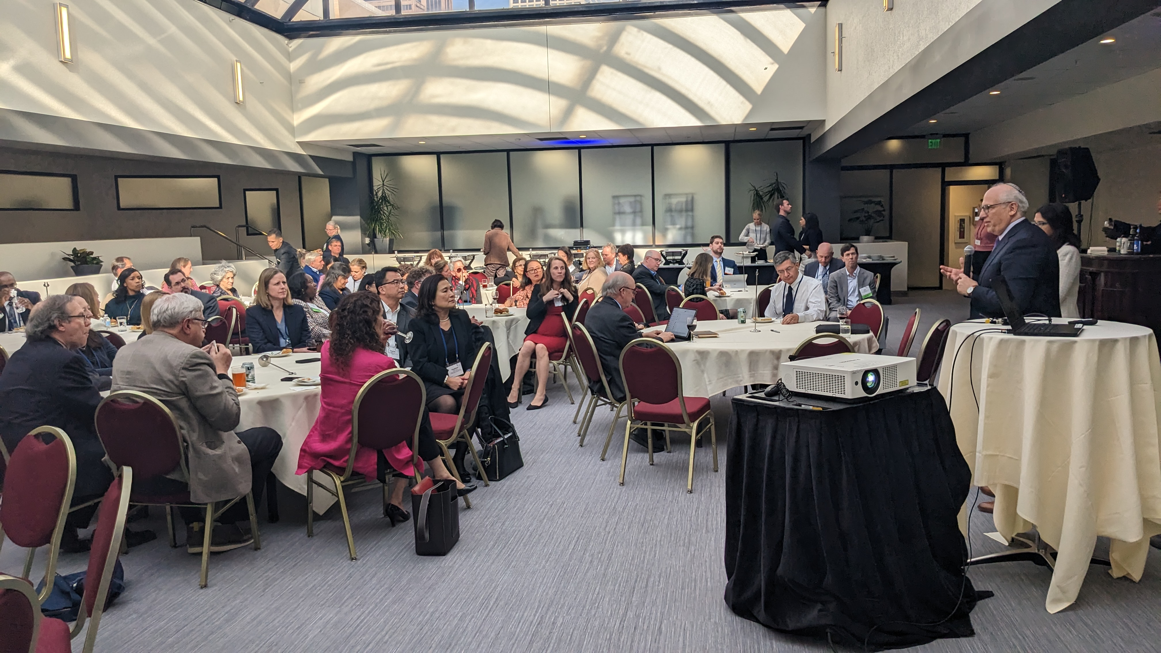
Knowledge Sharing Session

Slide 68
Knowledge Sharing Session
Key takeaways:
“No margin no mission; no mission no margin.” It feels like faculty are being squeezed.
Younger generations have more defined sense of work-life balance and we can’t expect 55-60 hours per week from future physicians. We need to ask ourselves if our expectations are realistic
There’s a lot of tensions – between wellness and work, between margin and mission. Hopefully we’ll get the boards of CFAS and COTH and COD together because neither group can solve the problems on their own without creating unintended consequences
Talking about all the problems can be deflating but focusing on what we do in our science, care, and community service is what makes it all worth it. This meeting has been a validation of how important our environment is, despite its’ challenges
Faculty should help design new systems and models. Maybe every dollar of revenue should be taxed for research and education.

Slide 69
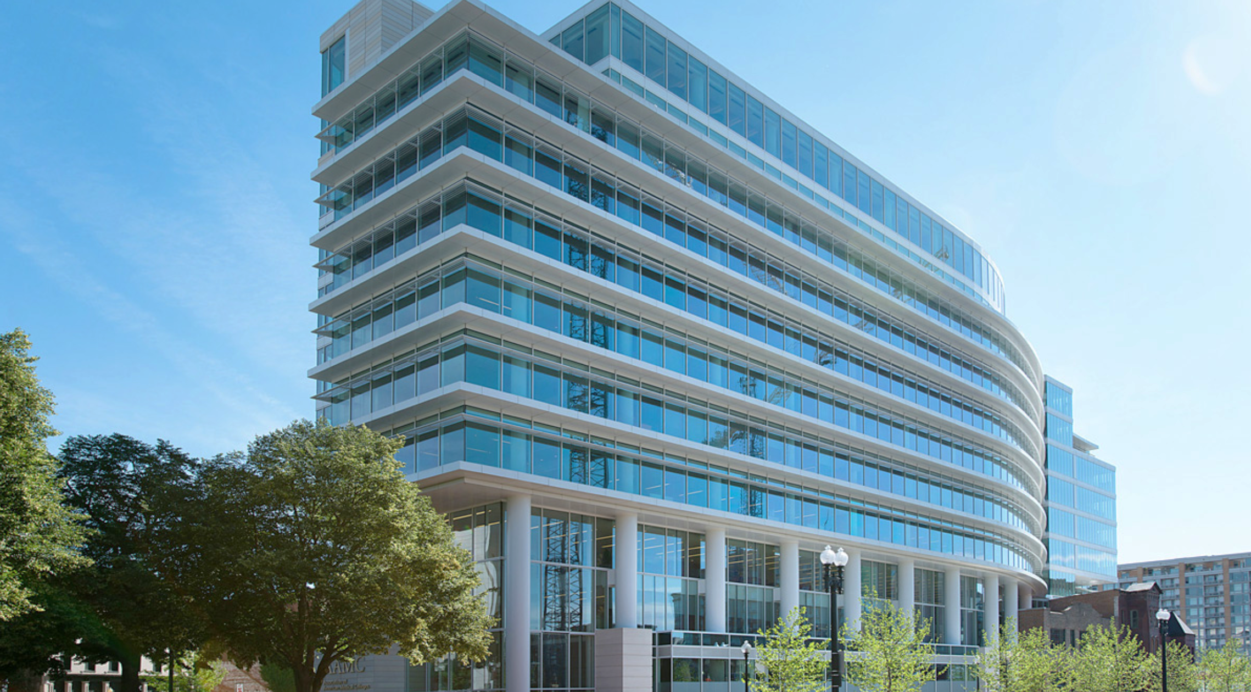
Save the Date!
Third Biennial CFAS Society Summit
AAMC’s Washington, D.C. Headquarters
July 17, 2023
Notes:
The first CFAS Society Summit was held in the Summer of 2019. A subsequent summit was held virtually in 2021. We are excited to return to an in-person format in July at the AAMC this summer.
This is a program focused on the executive directors and leaders of the AAMC-member societies.

Slide 70
CFAS Society Summit
Held every other year to create engagement and highlight benefits to AAMC- CFAS-member societies
Programming is geared toward society executives, but society reps are welcome to participate if interested
Society executives receive updates on AAMC initiatives, strategy, and priorities, and share their own priorities with AAMC leaders and society peers
The 2021 summit was held as a virtual event. The July 17 summit marks our return to an in-person event at the AAMC
Notes:
In addition to updates on AAMC activity, initiatives, and strategies, societies are invited to share their own priorities in order to create and identify areas of collaboration.
Society representatives are invited to attend if they wish. While there is no registration fee to attend, society reps will be responsible for travel and housing if they choose to come.

