Slide 1
2023 CFAS Spring Meeting Summary
Salt Lake City, Utah
March 27–29

Slide 2
CFAS Mission
CFAS aspires to be the voice of academic faculty within the AAMC’s governance and leadership structures. The Council is charged with:
Identify critical issues facing faculty members of medical schools and within academic societies;
Articulate a common faculty voice on these issues to the AAMC as they relate to creation and implementation of the AAMC programs, services, and policies;
Serve as a bidirectional communications conduit regarding matters related to the core missions of academic medicine
Notes:
Adi to cover an overview of CFAS – align these mission areas to the program of the spring meeting
-Inform people that there will be resources after the meeting to present back to home institutions and societies.

Slide 3
Major Activities in 2022-23
Formed new CFAS Committees and revamped existing committees
Refined a new committee structure and written committee rules
Launched effort to increase representative numbers and new society members
Focused on supporting ongoing connectivity with:
Monthly electronic CFAS Rep Bulletin
Monthly online CFAS Connects live sessions
Annual CFAS Spring Meeting, transitioning back to in-person meeting in 2023
Launched planning for biennial CFAS Society Summit
Notes:
Highlight the focus on committee structure
Highlight that when we met less in person that our committees generally met more.
Details will be coming soon on the society summit – date is July 17, 2023.

Slide 4
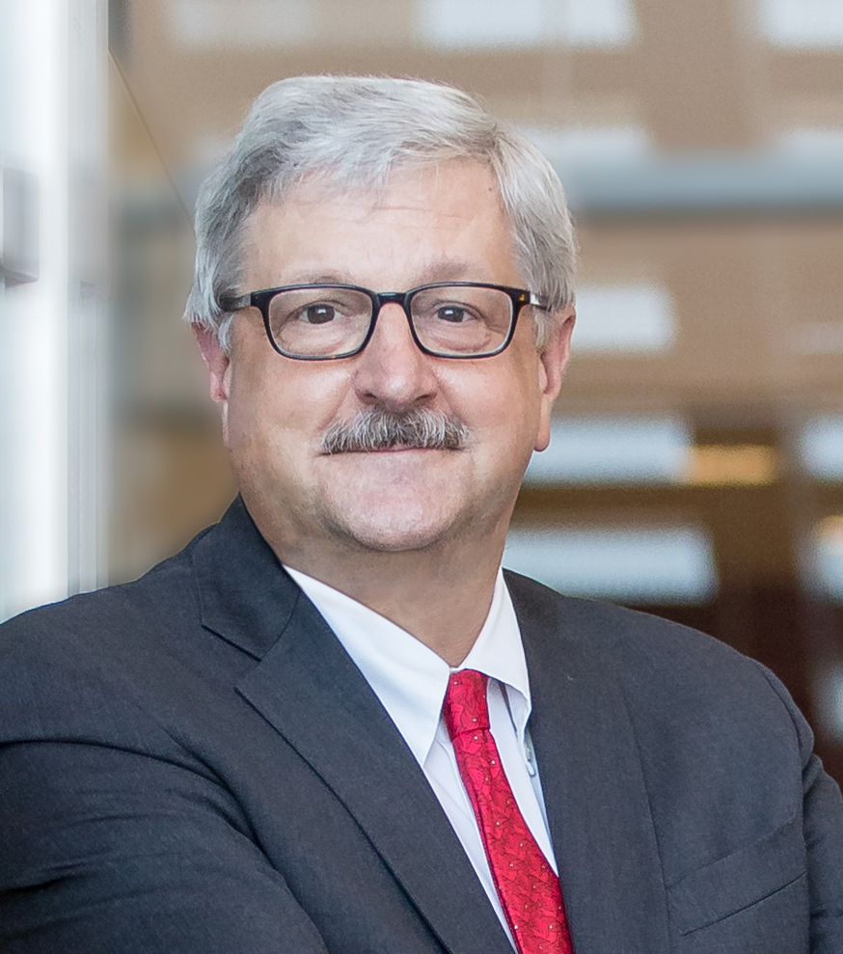
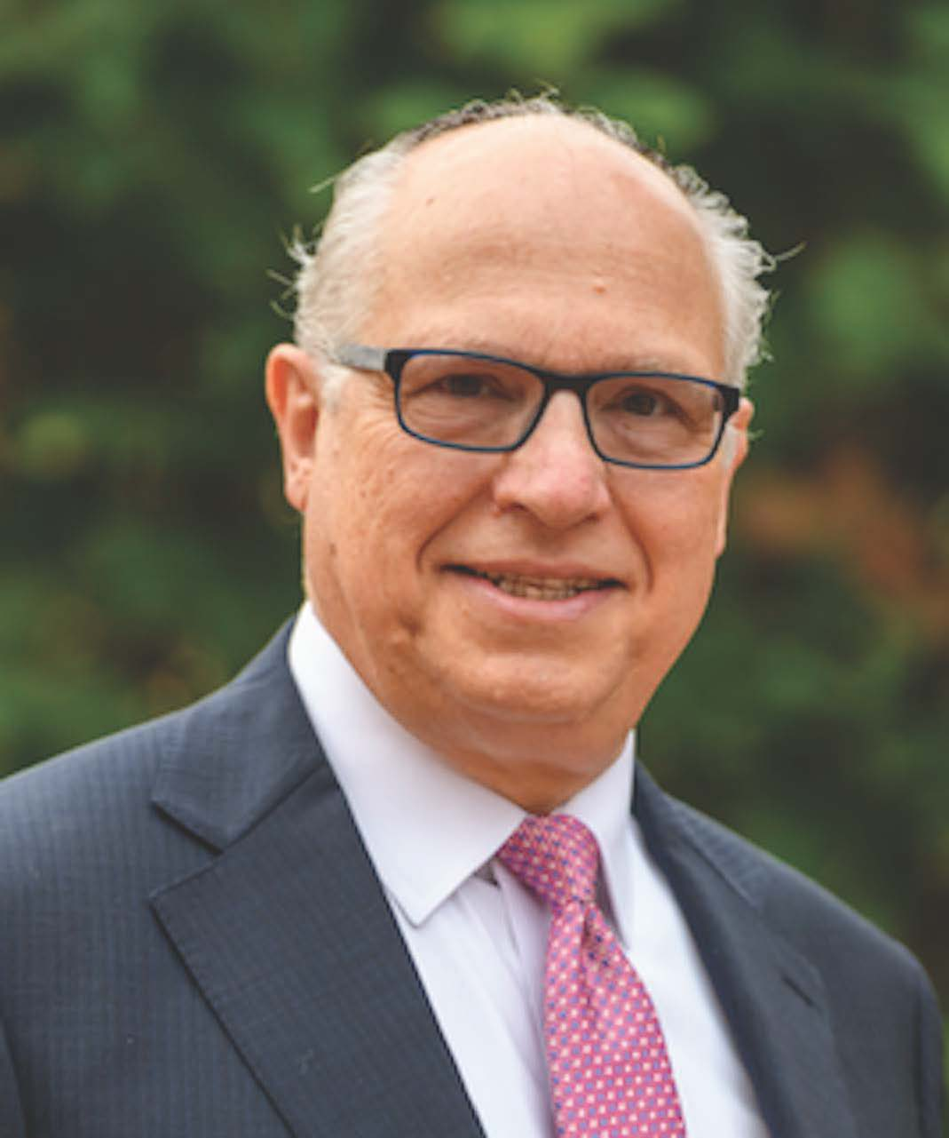
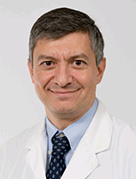
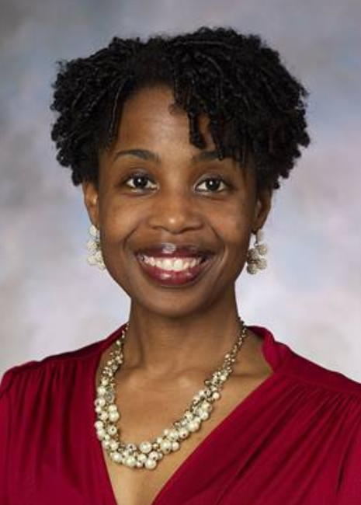
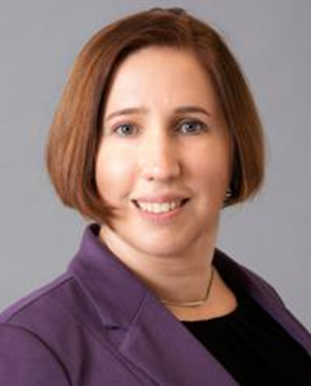
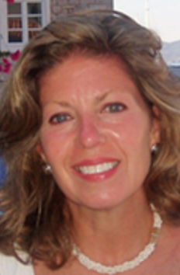
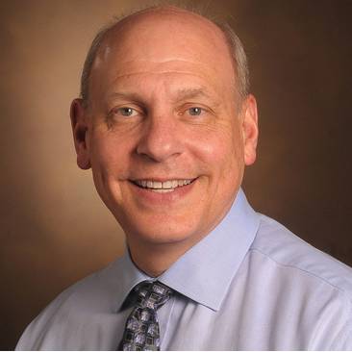
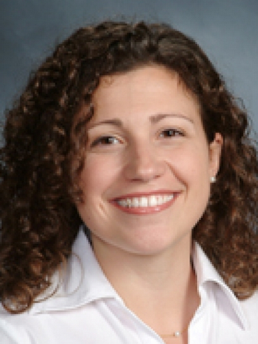
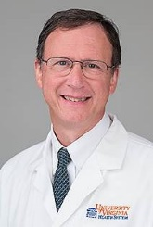
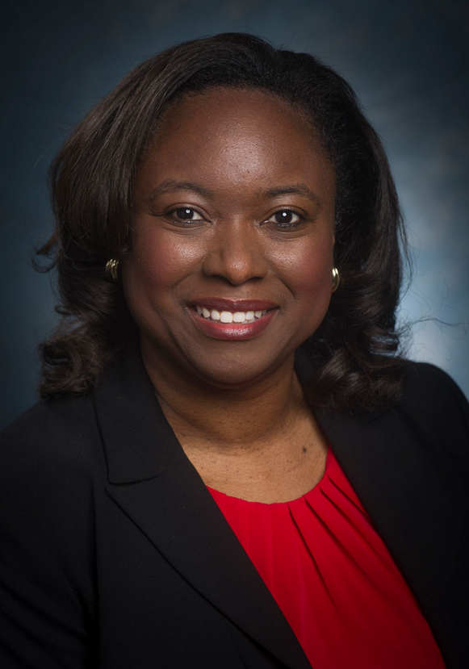
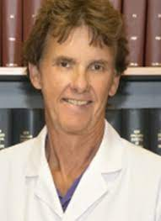
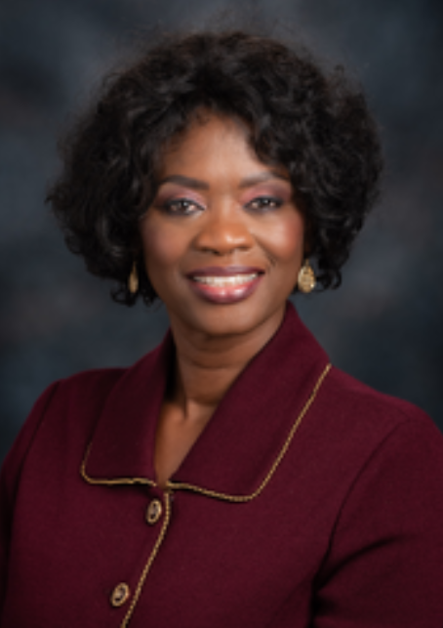
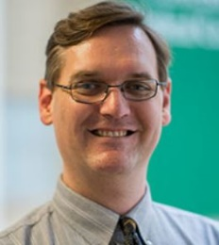
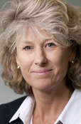
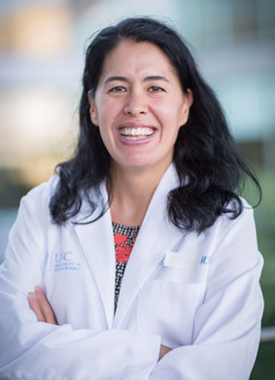
New CFAS Administrative Board, 2023-24
Nita Ahuja, MD, Chair
Arthur Derse, MD, JD Chair-elect
Aviad “Adi” Haramati, PhD, Immediate Past Chair
Steven Angus, MD
Valencia Walker, MD
Kimberly Lumpkins, MD
Shirley “Lee” Eisner, PhD
Neil Osheroff, PhD
Lily Belfi, MD
Stewart Babbott, MD
Adam Franks, MD
Monica Baskin, PhD
Catherine Pipas, MD
Deanna Sasaki-Adams, MD
Nicholas Delamere, PhD
Lisa D. Cain (Ex-Officio GFA Chair)
Notes:
And this slide shows the slate after LSL 2023 in Seattle, with Dr. Popescu rotating off the ad board.
The system allows for refreshing members and adding new faces.
All CFAS reps are encouraged to nominate themselves for roles in the next call.
We want to be sure to represent junior/early career faculty in the future

Slide 5
CFAS Committee Roster
Thematic Committees open to all CFAS reps and affiliates.
Advocacy Committee - Art Derse, Chair
Biomedical Research and Training Committee – Neil Osheroff, Chair (Newly named committee)
Diversity, Equity, and Inclusion Committee - Monica Baskin, Chair
Engagement Committee – Kimberly Lumpkins, Chair (New committee)
Mission Alignment Committee - Stewart Babbott, Chair
Faculty as Medical Educators Committee – Lily Belfi, Chair (New Committee)
Faculty and Organizational Well-being Committee - Cathy Pipas, Chair (Newly named committee)
Structural Committees open to appointed members.
Program Committee - Nita Ahuja, Chair
Nominating Committee - Gabriela Popescu, Chair
Notes:
Review the overall committee roster
As time allows, invite very brief updates from committee chairs on the floor.

Slide 6
Opening Plenary: Faculty Thriving in Academic Medicine: From Mission Impossible to Mission Accomplished
Tripartite Mission - Clinical
The strength of academic med center is to have the mix of all 3 missions (patient care, research, education) with faculty participating in all 3
In our institutions, it can often seem like the missions are in conflict from an individual standpoint
Shortages of all kinds of health care workers of are adding up (technicians, nursing assistants, etc). Those of us who survived pandemic are still being stretched. We’re also in a financial crisis because of fallout of pandemic.
Medicare fee schedule is always reimbursing less, but our hospital systems ask us to produce more.
Education mission
The educational mission in our institutions is vulnerable, costly, and relies on research and patient care revenues.
One of the biggest challenges for educators in 2023 is isolation/lack of sense of community. We’ve become too used to participating in facets of mission virtually.
When missions are aligned, there is give and take and the understanding that missions support each other.
Institutions should ensure promotion tracks reflect the educational activities faculty do, including mentoring

Slide 7
Opening Plenary: Faculty Thriving in Academic Medicine: From Mission Impossible to Mission Accomplished
Research mission
Challenges for the Tripartite Mission:
Changing priorities – creation of new med schools with minimized research emphases
Widespread recognition that research is expensive
Emphasis on clinical revenue generation
Creation of the Office of Medical Education
Recruitment of non-educator basic scientists
Competition for resources
Potential solutions:
Clinical and translational science institutes (CTSAs)
Centers for Medical Education Research
Health system science initiatives
Engage researchers in education
Team science to support clinician involvement (beyond simply being a source of samples)

Slide 8
Intention to Action: Leveraging Well-being to Support Researchers, Educators, and Clinicians
Session overview:
The session explored what can individuals do within their own institutions to advance well-being
It’s crucial for faculty members to take care of themselves
Stress and morale of academic biomedical scientists: fear of not maintaining funding; frustration with time spent doing paperwork and administrative duties

Slide 9
Unintended Bias – How to Reduce the Risk, but When it Happens, How to Respond: The ROI of Inclusion
Understanding microaggressions:
Words matter. Bias is prejudice in favor of or against one thing, person, or group compared with another, often leading to stereotyping
Unconscious/implicit biases are unintentional prejudices
Racism is a system of structuring opportunity and assigning value based on the social interpretation of how one looks (often called “race”), that unfairly disadvantages some individuals and communities
Microaggressions are “brief and commonplace daily verbal, behavioral and environmental indignities whether unintentional or intentional that impact victims.”
There’s documented literature on microaggressions, such as when a male doctor introduces a female doctor on a panel and calls her by her first name instead of her title

Slide 10
Trends and New Directions for Salary Equity in Academic Medicine
White men are paid more than men of other races and women of all races. Sometimes white women make more than women of color. Just because we have diversity, doesn’t mean we have equity
To gain traction on salary equity:
Establish mandatory unconscious bias training
Examine trends in faculty recruitment selection and hiring
Ensure equitable distribution of duties and resources across faculty
Promote flexible workplace policies
Assess trends
Promising practices and actions:
Make specialty-specific salary data widely available to members of your specialty society
Host salary equity sessions during your annual conferences
Consider programming that might build opportunities for increased equity among members at local institutions
Educate yourself about components of pay in academic medicine, research salary benchmarks for your rank, department, and geographical location using AAMC and other society-related benchmarks

Slide 11
Leadership Plenary and Community Forum
Policy Update from AAMC Chief Public Policy Officer Danielle Turnipseed, JD
Recent academic medicine wins:
NIH funding is up to $47.5 billion (+5.6%)
ARPA-H is up to $1.5 billion
HRS Title VII and VIII health workforce programs up to $879.8 million (+12%)
VALID Act (would have let FDA regulate lab-designed tests) was excluded

Slide 12
Leadership Plenary and Community Forum
Update from AAMC Chief Scientific Officer Ross McKinney:
The power keeps moving away from the dean to the CEO suite in hospitals and health systems. With this increasing focus on margin, academic medicine must keep the focus on our missions
Health system CEOs are facing challenges from DSH payments ($8 billion cut – will impact lower income people). Possibly 25% cut to NIH budget – we need faculty engaged in these policy conversations. NIH may not have a permanent director for another 2 years
The good news is that the funding rate for NIH is still 30%. But a challenge is that NIH funding is set as a criteria for promotion
The larger the average grant size, the fewer the grants. There will be increased costs from unionization of grad students and the number of grants may drop. NIH funding is almost back to where 2003 levels in inflation-adjusted dollars

Slide 13
Ignite Style Presentations
Themes for ignite sessions:
Communities of practice are sources of joy – it’s important to find or create your own
Honor yourself, stay true to your values, break down silos and have other people help you achieve your missions – leverage your community
“If you want to help yourself, practice compassion, if you want to help others, practice compassion.”
Never let a crisis (or a big change) go to waste: advance and improve the current state
Recognize core values and alignment of those values and reflect on current and future career path

Slide 14
The Big Picture of Mission Alignment: A Conversation with Michael Good
Takeaways:
Perhaps it’s best to have physician leaders for both the school and hospital side
In leadership, we have to learn to lead ourselves. Leadership is a learned skill and we need to know our strengths and weaknesses
Our jobs have infinite work. If work is infinite, we have to ask ourselves how we are going to approach work. One idea is to write yourself “vacation prescriptions.” Human performance drops off dramatically after 16 hours
We live in tense times and leaders need to learn how not to avoid difficult situations, but instead to put themselves in the center of the hardships their employees face. Becoming a “conflict-competent leader”: Conflict can be good if it’s kept in a constructive setting and focused on ideas, in contrast to destructive conflict that involves personal attacks
“Progressive incrementalism” vs. disruption. Any system can be improved. The best approach is “aggressive incrementalism” because progressive incrementalism is too slow, and disruption creates other problems

Slide 15
Mission Accepted: Sustaining Faculty for Success as Medical Educators
A PollEverywhere activity asked what the audience to identify the greatest challenge faced by a medical educator or leader of medical education. Answers included a lack of value of medical education, isolation, integration problems, faculty have no “spare time”, and struggles with lack of engagement
Educator’s perspective:
Moral injury is huge driver of burnout
Faculty should bring students to the table to help develop curriculum and policy. There are currently 3 troubling trends: 1) the devolving relationship between students and faculty, 2) students mostly communicating with administrators, and 3) how medical educators are valued. These impact us as well as the growth and professional maturity of our learners
Oftentimes, there’s no administrative consequences for students who don’t attend mandatory sessions

Slide 16
Mission Accepted: Sustaining Faculty for Success as Medical Educators
Chair’s perspective:
Early career faculty have traditionally had to “pay their dues,” but its unclear if the new generation will want to get into positions where that’s the dynamic. How do we reset expectations so everyone is on the same page from educational standpoint?
Most chairs are on the side of the faculty but it’s hard for chairs to get resources faculty need because they’ve been taken out of planning decisions. Often times, when chairs ask why the school wants them to teach things that won’t make students practice-ready, the response is, “well, the LCME says we have to.”
Dean’s perspective:
Deans are accountable to the public
Faculty need to have dedicated time and to maintain a safe learning environment. Deans are aware that faculty have competing demands for their time
There must be institutional transparency in how departments and individuals get funded

Slide 17
Closing Plenary and Final Thoughts: Recognizing and Embracing the Tension
The way forward:
Those of us working in academic medicine need to be realistic and figure out how to do more with less. But on the other hand, many physicians are older and are leaving the profession, so there are major concerns over workforce. If we try to do too much more with less, we’ll be in a very bad situation
We have to get to a culture where everyone can contribute and speak up to improve the system, similar to the Toyota assembly line
Realizing population health and value-based care is the way to move forward. Fee for service alone can’t help us anymore, but we can have synergistic models that use fee for service in some places and value-based care in others
Perhaps it’s time to change the whole structure, because it’s too focused on the costs to government, corporate America, employers, etc. and not on the costs to patient. Maybe we should question some of the basic assumptions of our system if we really believe that health care is a public good
Giving physicians a set salary that doesn’t depend on the number of patients they see could be a very helpful reform
Closing remarks:
Academic medicine needs to address salary inequities between specialties in order to incentivize more students to enter primary care

Slide 18
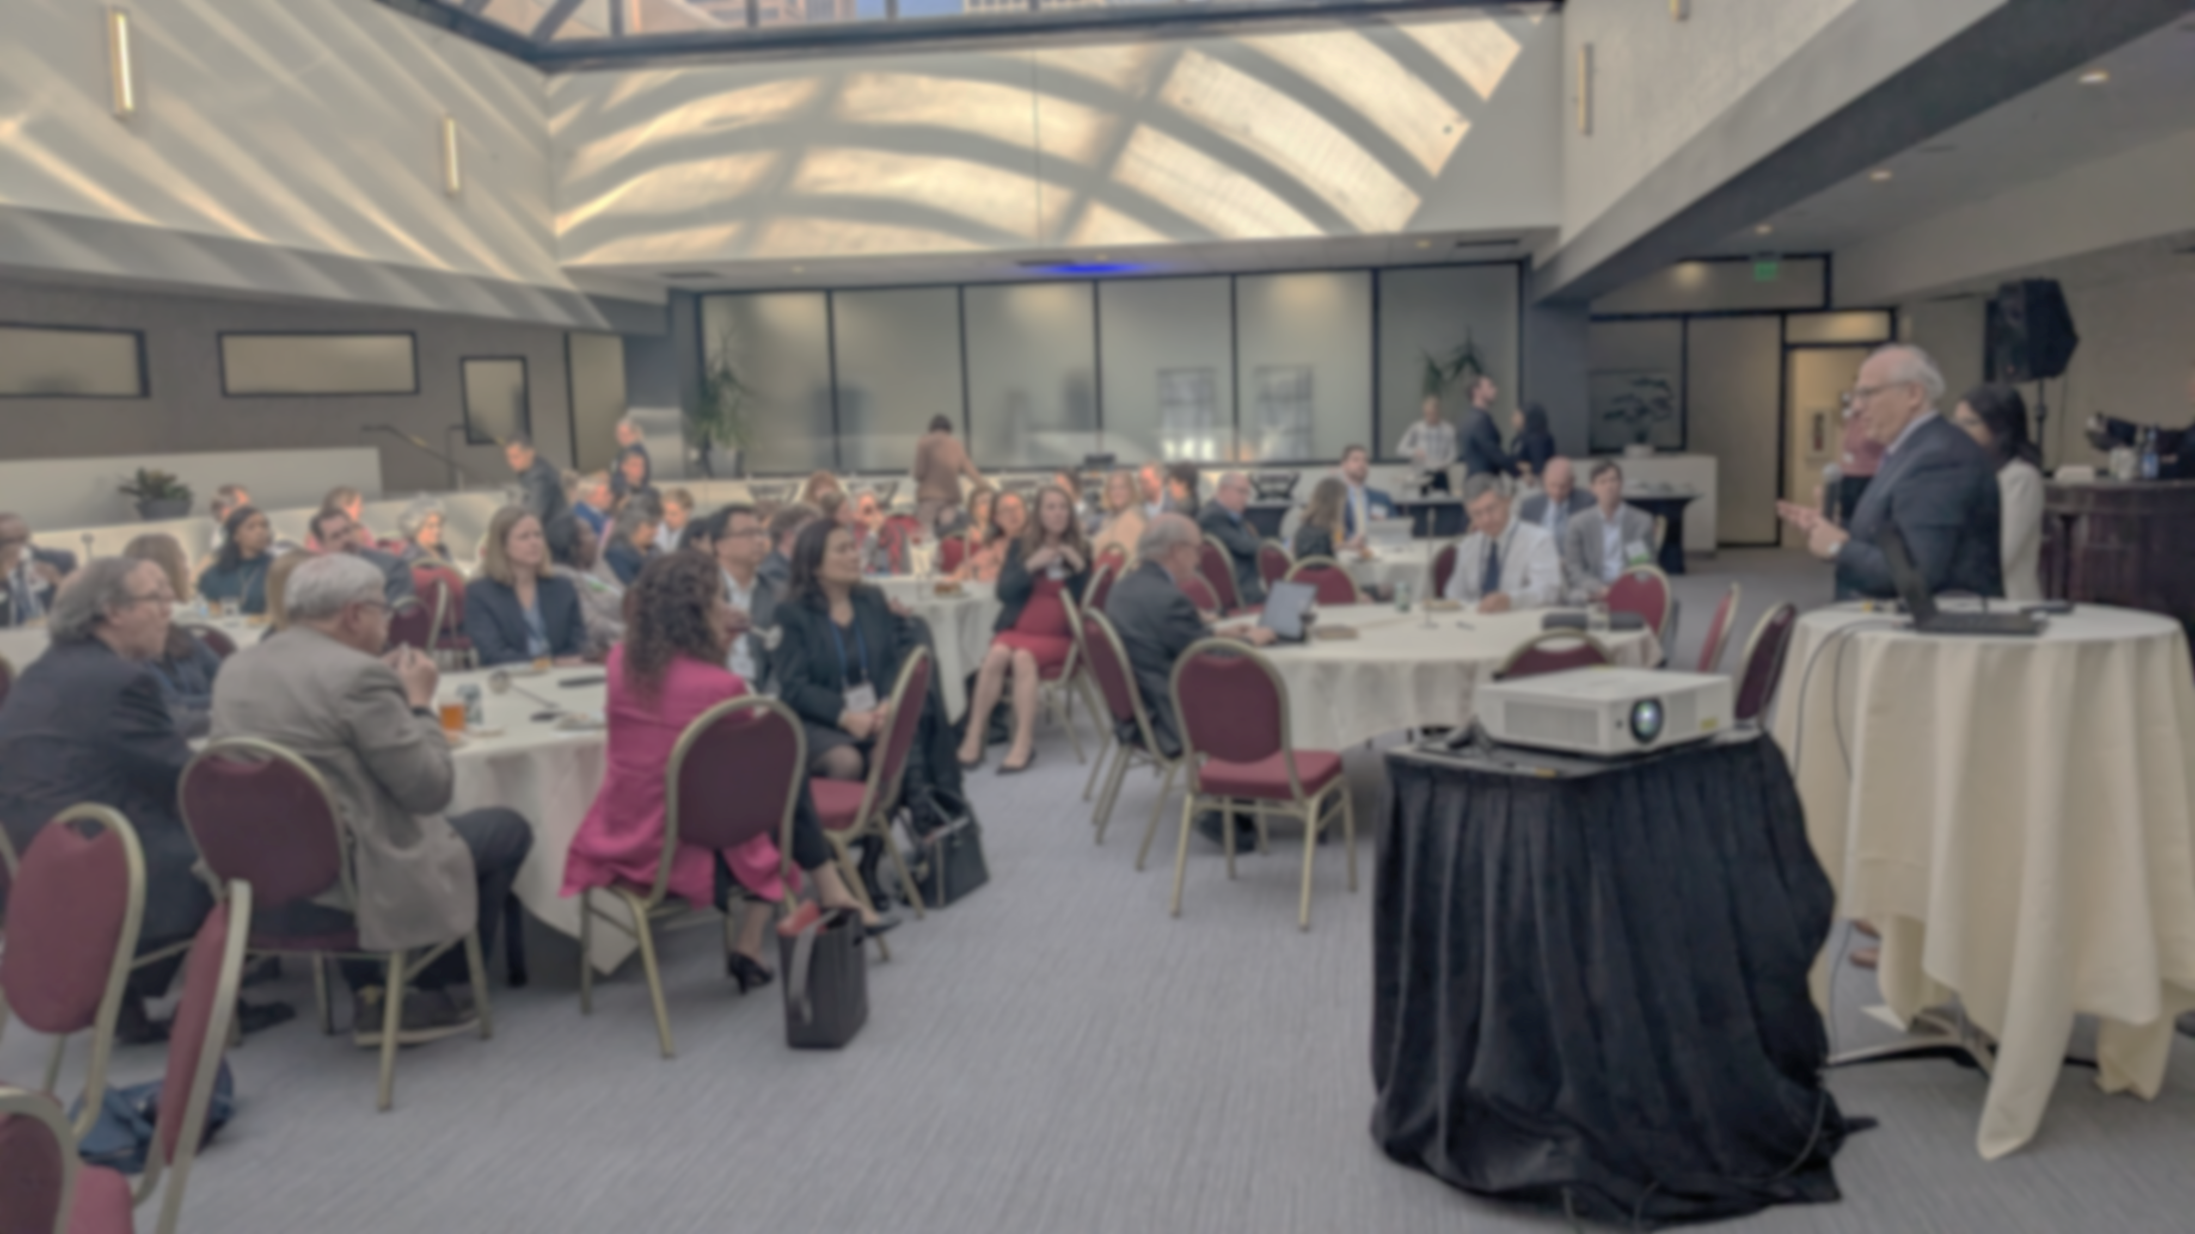
Knowledge Sharing Session
Key takeaways:
“No margin no mission; no mission no margin.” It feels like faculty are being squeezed
Younger generations have more defined sense of work-life balance and we can’t expect 55-60 hours per week from future physicians. We need to ask ourselves if our expectations are realistic
There’s a lot of tensions – between wellness and work, between margin and mission. Hopefully we’ll get the boards of CFAS and COTH and COD together because neither group can solve the problems on their own without creating unintended consequences
Talking about all the problems can be deflating but focusing on what we do in our science, care, and community service is what makes it all worth it. This meeting has been a validation of how important our environment is, despite its’ challenges
Faculty should help design new systems and models. Maybe every dollar of revenue should be taxed for research and education

