Slide 1
Learn Serve Lead 2022: The AAMC Annual Meeting
Summary for CFAS Reps

Slide 2
An Intro to LSL
Learn Serve Lead: The AAMC Annual Meeting returned to an in-person format for the first time since 2019, drawing more than 4,000 academic medicine professionals to Nashville, Tennessee, from Nov. 10 – 15

Slide 3
Plenaries and Other Meeting Highlights

Slide 4
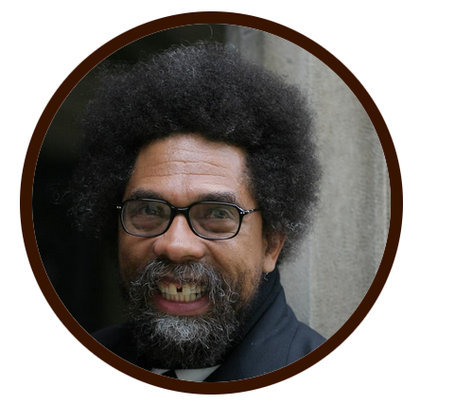
Opening Plenary: Resurrecting Civil Discourse: In Conversation With Robert George and Cornel West
Cornel West - Speaker
PhD
Dietrich Bonhoeffer Professor of Philosophy and Christian Practice, Union Theological Seminary
Professor Emeritus, Princeton University; Author and Activist
Robert George - Speaker
JD
Visiting Professor, Harvard Law School
Professor Jurisprudence, Princeton University
David J. Skorton - Facilitator
MD
President and CEO
AAMC

Slide 5
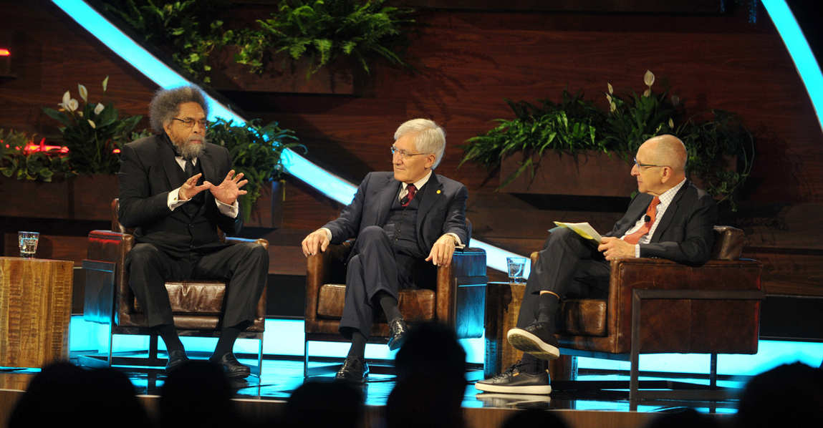
Resurrecting Civil Discourse: In Conversation With Robert George and Cornel West
The opening plenary at LSL featured a conversation between Robert George and Cornel West. The two travel the country as a somewhat odd couple talking about how to revive the seemingly lost art of civil discourse
They met as professors at Princeton and became fast friends despite significant differences in their backgrounds and worldviews.
They bonded because they were “real” with each other. George told West, “Sincerity is my main credential.”

Slide 6
Resurrecting Civil Discourse: In Conversation With Robert George and Cornel West
A painfully divided America can return to civil discourse only if people on all sides of the civic divide:
Make themselves vulnerable to being challenged on their convictions
Adopt the humility that they might be wrong
Respect the humanity of those who disagree with them
More advice on how to engage in civil discourse:
Civil discourse is not simply listening to each other politely. It consists of talking and, above all, listening to another person with a different point of view in a truth-seeking spirit with a willingness to learn. To do that, you have to cultivate the capacity to be courageous enough to be vulnerable
Only by making our convictions vulnerable to challenge and ourselves humble enough to realize we might be wrong can we have constructive, respectful conversations with those with whom we severely disagree. We have to have the courage to go into the future knowing we may change our minds

Slide 7
Resurrecting Civil Discourse: In Conversation With Robert George and Cornel West
More advice on how to engage in civil discourse:
“Our convictions help to form our identities. That’s not bad in itself. Yet when we wrap our emotions too tightly around our convictions, we become dogmatists, ideologues. That happens on the right, that happens on the left, that happens across the political spectrum,” said George.
Everyone has strong convictions but one of our convictions needs to be that we could be wrong. We know that great people, thoughtful people, intelligent people have been wrong about important issues
“I begin with what it means to be a human being and what it means to love my crooked neighbor with my crooked heart. You’re trying to stay in contact with their humanity, all their contradictions and insecurities and incongruities. You’ve got contradictions and insecurities and incongruities, too,” said West
When trying to have civil conversations with people who aren’t interested, start with finding common ground as people rather than starting the conversation with the issue that you disagree about

Slide 8
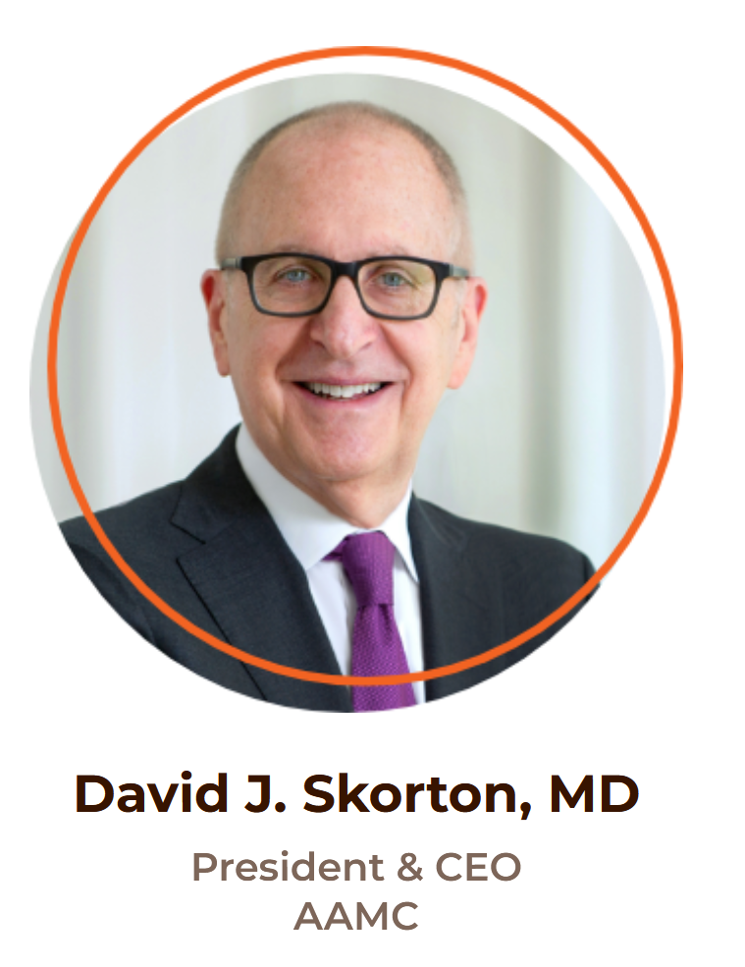
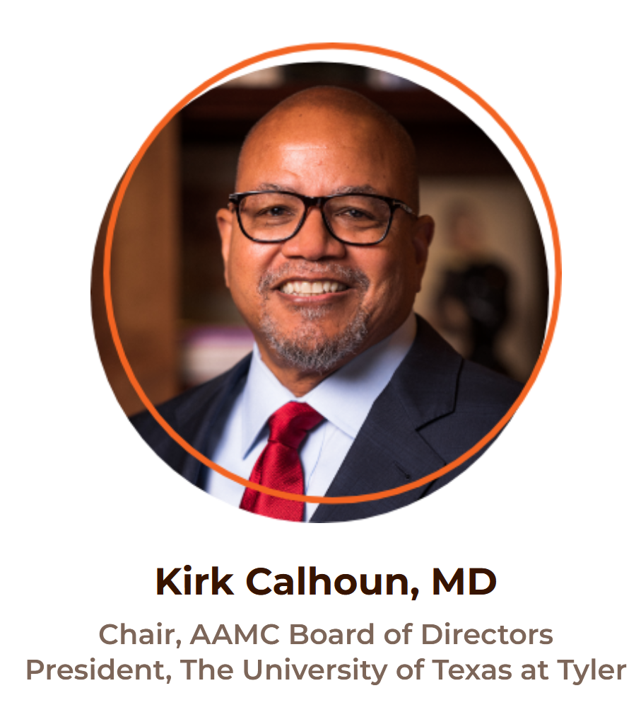
AAMC Leadership Plenary

Slide 9
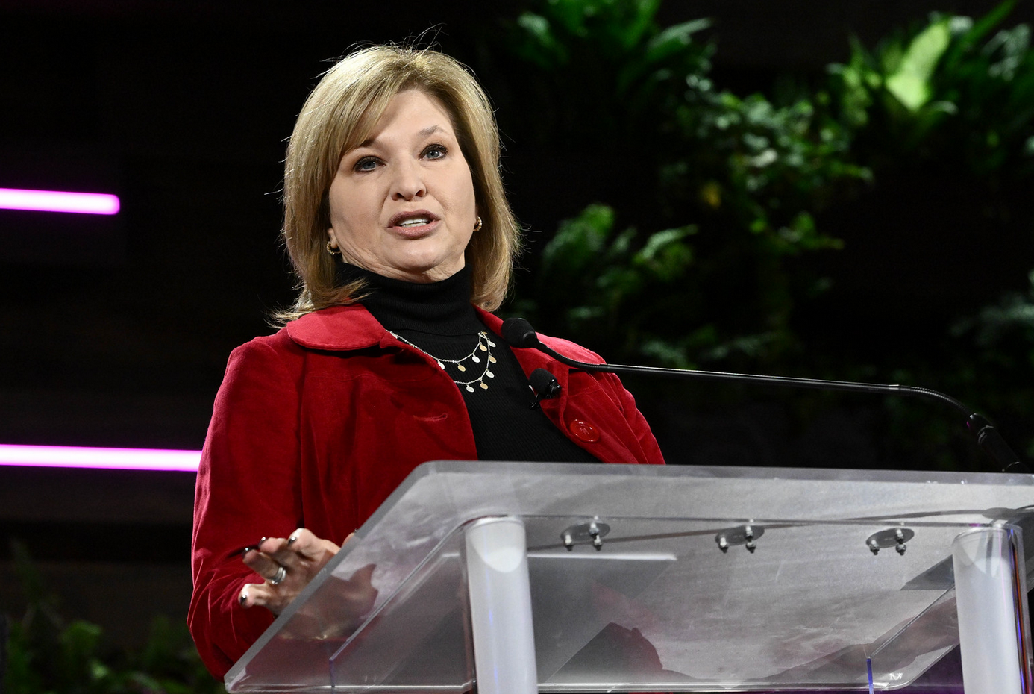
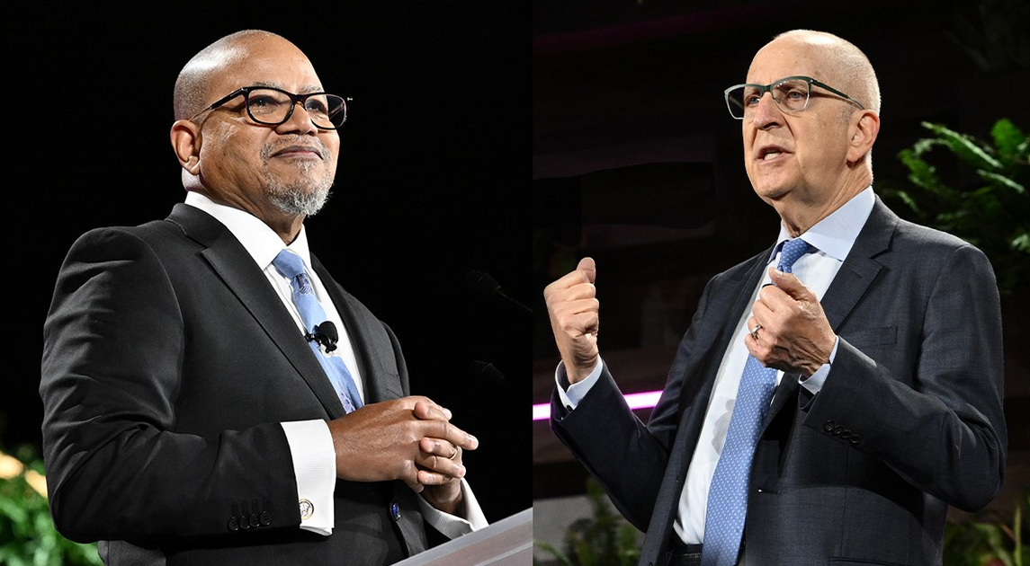
AAMC Leadership Plenary
Presentation from AAMC Board of Directors Chair Kirk A. Calhoun, MD:
How do we overcome the headwinds we encounter as educators, leaners, scientists, physicians, and health leaders?
You cannot be what you cannot see – Young people of color need to see physicians who look like them
In the 1990s, the AAMC started trying to increase representation of Black people in medicine. The AAMC realized what was needed was earlier efforts to get communities of color involved in medicine
A disastrous headwind came in the form of a series of court actions that had a chilling effect on what American medical schools felt they could do to address a lack of representation and maldistribution of physicians
The “3,000 by 2,000” initiative fell short of its goal but wasn’t a failure because it sparked many pipeline programs

Slide 10
AAMC Leadership Plenary
Presentation from AAMC Board of Directors Chair Kirk A. Calhoun, MD:
In spite of new headwinds, AAMC is still committed to creating a diverse, culturally competent workforce
We should achieve our success while staying true to our values, being faithful to facts but respecting diverse views. Fostering our obligation to professionalism will help us succeed
Academic medicine lies at the nexus of higher education and health care delivery. Both exist in very treacherous waters of rapidly changing expectations, misinformation, partisan debate, and economic pressure. We must never forget the immediate unmet needs of our patients and their families, our students, faculty, and community. This is how we remain steady against the headwinds

Slide 11
AAMC Leadership Plenary
Presentation from AAMC President and CEO David J. Skorton, MD:
In the past three years, the country has dealt with a pandemic and racial reckonings long overdue, and academic medicine has risen to these challenges to make progress
But today’s status quo is still unacceptable. So many Americans have severe difficulties hearing and listening to each other and our health is not what it should be
We need to face four issues with a sense of renewed urgency:
Diversity, equity, inclusion, and anti racism: these are the most critical issues we face. Systemic racism is our responsibility to address whenever we have the opportunity because we have to as human beings. We need to leave the world better and more just than we found it. We need to optimize the cultures of our institutions so everyone feels included. We have to start with humility and listen to the disadvantaged groups. We cannot and must not accept candidate pools that are not diverse
Wellbeing of our learners: Depression and suicide is more common for medical students compared to their age-matched peers. We must look to address problems around the curriculum and better support accessibility of behavioral health care for all who could benefit from it. Encourage students to push through any barriers to access mental health care. Come forward and share personal stories to encourage seeking help

Slide 12
AAMC Leadership Plenary
Presentation from AAMC President and CEO David J. Skorton, MD:
3. Ensuring all communities have equitable access to things needed to thrive, such as freedom from racism and discrimination, access to housing, good jobs, etc. We need to collaborate with communities to guide us toward solutions together. The relationship between physicians and patients must not be interrupted by judicial decisions or legislation. Nothing should interfere with clinicians acting on good clinical judgement in their care for pregnant women
4. Free speech. Some have concerns about the AAMC leaning too far to the left. We have to truly listen to other opinions we disagree with and not ban speakers who don’t follow the current orthodoxy
Let’s lead together in service of the public good

Slide 13
Why Climate Action Is the Future of Medicine and How Health Care Professionals Can Make a Difference
Shaneeta Johnson - Facilitator
MD, MBA
Department Director, Residency Program Director, and Professor
Morehouse School of Medicine
Renee N. Salas - Speaker
MD, MPH, MS
Harvard Global Health Institute
Harvard Medical School and Massachusetts General Hospital
Aaron Bernstein - Facilitator
MD, MPH
Interim Director, Pediatric Hospitalist
Boston Children's Hospital

Slide 14
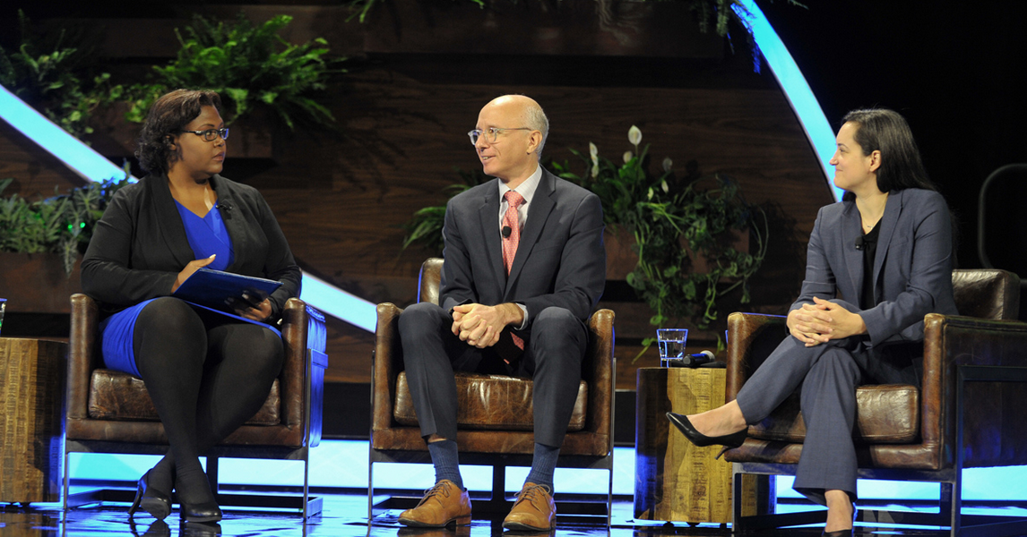
Why Climate Action Is the Future of Medicine and How Health Care Professionals Can Make a Difference
Facing the facts:
As the burning of fossil fuels and the resulting acceleration of climate change make people more ill and complicate how to care for them, the medical field must confront the crisis more directly by integrating climate change factors into patient care and medical student education, reducing the carbon footprint of the health care industry, and advocating for public policies that protect the environment
Climate change’s impact on health can be seen in the effect of air pollution, rising temperatures, and increasingly severe weather events on human health, including more heat stroke, asthma, stress-based mental illness, preterm births, and premature deaths, and the increased spread of insect-borne disease

Slide 15
Why Climate Action Is the Future of Medicine and How Health Care Professionals Can Make a Difference
Finding the solutions:
“As health care providers and physicians, we have the strongest argument about the climate change crisis we are facing. We are the game-changer in this,” said panelist Aaron Bernstein, MD, MPH, interim director of the Center for Climate, Health, and the Global Environment at Harvard T.H. Chan School of Public Health
Hospitals and other health care facilities have been taking steps to reduce their carbon footprint but must do more. The strategies have included changing to alternate fuel sources, buying supplies from companies that have pledged to produce net-zero emissions through the creation and delivery of their products, and cutting down on the use of some supplies and increasing materials that can be recycled
Climate conditions should inform such decisions as what medicines to prescribe and how to safely release a patient if they are returning to a home with extreme heat or poor air quality
Climate change factors should also be integrated into medical school curricula. That can be as simple as inserting an instructional slide into a lesson plan or adding a climate-based learning module to class instruction

Slide 16
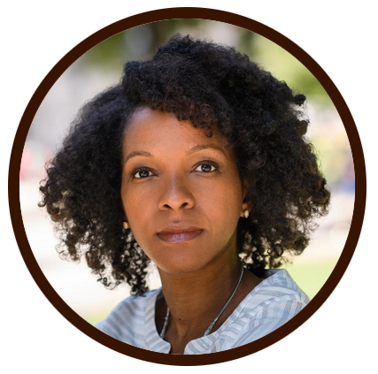
Facing the Truth that the South Defines America: A Conversation with Imani Perry
Imani Perry – Speaker
PhD, JD
Professor, African American Studies, Princeton University
Author, “South to America: A Journey Below the Mason Dixon to Understand the Soul of a Nation”
Jon Meacham – Facilitator
Presidential Historian
Author, “The Soul of America”

Slide 17
Facing the Truth that the South Defines America: A Conversation with Imani Perry
When Imani Perry, JD, PhD, set out to write her book, South to America: A Journey Below the Mason-Dixon to Understand the Soul of a Nation, she felt the need to set the story straight on the region of the United States that was her home
Throughout her life, Dr. Perry has had this feeling that there’s an extraordinary mischaracterization of the South as somehow out-of-step and behind the rest of the country
That perception is a way to make the South the scapegoat for the nation’s sins or vulnerabilities, when in fact, a much better account is that the South is really where the country began, and the place where we are forced to confront in the most dramatic ways the tensions between the promises and the ideals of the nation and the reality of a history of cruelty and exploitation

Slide 18
Facing the Truth that the South Defines America: A Conversation with Imani Perry
Key lessons:
Dr. Perry urged health care providers to resist the urge to stereotype and turn the South into the nation’s scapegoat, reminding them that the region is home to one-third of the U.S. population and to most of the country’s Black people, even after the Great Migration brought many to the North
One of the great challenges for Americans in terms of developing a kind of political maturity is to begin to step away from mythologies and romantic stories of the nation and confront honestly how we became what we are, for better and worse
The most important lesson is to listen carefully. “I know that so many physicians are under pressure to move quickly, to assess scientifically, but I think medicine is as much art as it is science. And art is dependent on attentiveness — pushing aside this shorthand set of assumptions, stereotypes, [and] judgments based upon the cadence of someone’s voice, or their appearance. I think it’s relevant for the practice of medicine to try to really be attentive to people at a human level,” said Dr. Perry

Slide 19
AAMC Leadership Presentation to COD, COTH, and CFAS
Opening remarks from AAMC Board of Directors Chair Kirk A. Calhoun, MD
After the Association of Academic Health Centers (AAHC) and its international component merged into the AAMC, Robert A. Barish, MD, MBA, vice chancellor for health affairs at the University of Illinois at Chicago and the chair of the Board of Directors of the AAHC, is now an at-large member of the AAMC’s Board of Directors. The AAMC now has an international organization built into it
2023 AAMC Awards are now accepting nominations
2022 Distinguished Service Members:
Peter Buckley, MD
Scott Gitlin, MD (former CFAS chair and representative to CFAS from ASH)
Paul Rothman, MD
Richard Eckert, PhD (outgoing CFAS Administrative Board member and representative from University of Maryland and the AMGBD)

Slide 20
AAMC Leadership Presentation to COD, COTH, and CFAS
Presentation from AAMC President and CEO David J. Skorton, MD
AAMC has welcomed two new chiefs: Danielle Turnipseed JD, MHSA, MPP, has been named AAMC Chief Public Policy Officer, and Jonathan Jaffery, MD, MS, MMM, FACP, has been named AAMC Chief Health Care Officer
As part of the AAMC’s strategic plan, the 10 Action Plans are now in the implementation phase
The AAMC’s mission statement was changed to say that the AAMC leads and serves academic medicine to put a greater emphasis on the AAMC’s leadership role
The AAMC has added community collaborations as part of the formerly tripartite mission of research, education, and patient care. True community collaborations requires that we learn from the community, not just tell them what they should know. The people who live with injustice are in a tremendous position to help solve that problem, so we take the wisdom of the community very seriously and have developed 10 Principles of Trustworthiness through our Center for Health Justice

Slide 21
AAMC Leadership Presentation to COD, COTH, and CFAS
Presentation from AAMC President and CEO David J. Skorton, MD
So far, more than 100 institutions have signed up to participate in the AAMC’s Diversity, Inclusion, Culture, and Equity (DICE) Inventory
The AAMC, ACGME, and the American Association of Colleges of Osteopathic Medicine are developing foundational competencies for undergraduate medical education
AAMC’s efforts to promote vaccine confidence received 15 million radio broadcast impressions and 155 million digital impressions
To increase diversity of applicants and matriculants, AAMC completed an in-depth needs assessment with learners from middle school through residency who identified as Black and American Indian or Alaskan Native to see what new tools and resources could improve the pipeline

Slide 22
AAMC Leadership Presentation to COD, COTH, and CFAS
Advocacy update from AAMC Senior Director of Government Relations Tannaz Rasouli:
In March, Congress provided NIH its 7th consecutive multi-billion-dollar funding increase, representing a $15 billion or 49% increase over the last 7 years
Congress also passed AAMC-endorsed legislation extending for 151 days some of the waivers that have allowed telehealth flexibilities
Inflation Reduction Act was passed and was the scaled down version of the Build Back Better legislation. It included AAMC-supported provisions such as:
3-year extension of the enhanced Affordable Care Act (ACA) premium tax credits
Some Medicare prescription drug pricing reforms
Tax incentives to support decarbonization
Unfortunately the 4,000 new Medicare-supported GME slots was not continued into the Inflation Reduction Act from the Build Back Better legislation, although there is still a lot of bipartisan momentum in that space
Favorable student loan reforms have been promoted by the Biden administration
Over the summer, Congress passed AAMC-supported legislation funding mental and behavioral health programs and community violence programs and including the first major provisions to promote gun safety in more than 20 years.

Slide 23
AAMC Leadership Presentation to COD, COTH, and CFAS
Advocacy update from AAMC Senior Director of Government Relations Tannaz Rasouli:
AAMC has filed or joined several amicus briefs on issues such as race conscious admissions and supporting the U.S. challenge to state abortion law
Issues Congress may act on now that elections are over:
Momentum around GME, hopefully will be included in year-end legislation
Legislation that would allow FDA to regulate lab-developed tests, which AAMC has expressed concern over in current form
Funding the federal government – Congress is finalizing funding bills for NIH ($2.5 billion increase was previously proposed in House, $2 billion increase proposed in Senate) and other health and science agencies

Slide 24
AAMC Leadership Presentation to COD, COTH, and CFAS
Advocacy update from AAMC Senior Director of Government Relations Tannaz Rasouli:
Issues Congress may act on now that elections are over:
Now that ARPA-H has a new director and is getting underway there may be activity coming out of Congress directing its work. House is proposing funding increase for ARPA-H separate from NIH, but Senate is proposing to level fund ARPA-H for another year and keep it within NIH
Both chambers previously proposed healthy increases for Title VII health workforce and diversity programs, although not as much as we were hoping for
Earlier versions of the spending bill proposed increased funding for the Centers for Disease Control and Prevention (CDC), the Agency for Healthcare Research and Quality (AHRQ), and the National Science Foundation (NSF), among other agencies and programs
The rate limiting step will be how much funding will actually be available overall for appropriators to work with as they make these final decisions

Slide 25
AAMC Leadership Presentation to COD, COTH, and CFAS
Advocacy update from AAMC Senior Director of Government Relations Tannaz Rasouli:
The AAMC is encouraging Congress to pass the VIPER Act, which would correct an issue with reinterpretation around conflict of interest related to salary support for Veterans Affairs (VA) researchers at private institutions
AAMC is working with the Congressional Black Caucus, including on efforts to increase diversity in the health professions
Spending bills are must-pass legislation so they may become vehicles for other policies, priorities, and provisions
AAMC is working with congress to stop provider cuts that hospitals and physicians are facing by the end of the year in the form of 4% statutory pay-go cut, as well as cuts out of the Centers for Medicare and Medicaid Services (CMS) through the Physician Fee Schedule

Slide 26
AAMC Leadership Presentation to COD, COTH, and CFAS
Advocacy update from AAMC Senior Director of Government Relations Tannaz Rasouli:
AAMC is trying to preserve the waivers that have been in place because of public health emergency and that have been helpful for institutions, including telehealth waivers
There will probably be limited legislative activity going into the next congress because of small majorities. This means there might be an increase in executive orders and “messaging” bills that are unlikely to pass but will try to create contrast between the two parties

Slide 27
AAMC Leadership Presentation to COD, COTH, and CFAS
Advocacy update from AAMC Senior Director of Government Relations Tannaz Rasouli:
In the next Congress, we anticipate more of a focus on oversight
The AAMC continues to equip institutions with the information and tools to educate lawmakers about the role of academic medicine in improving the health of communities and the nation. Institutions are incredibly powerful messengers to communicate the value of federal investment in the missions of academic medicine
AAMC is rolling out a national ad campaign titled “Academic Medicine: what starts here saves lives”

Slide 28
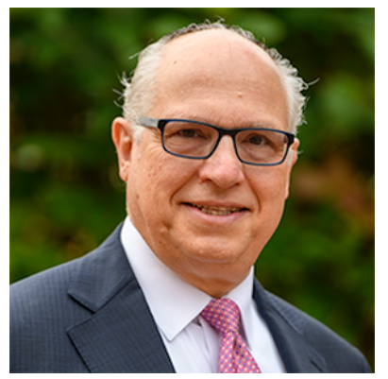
New AAMC Board of Directors
LouAnn Woodward, MD
Chair
University of Mississippi Medical Center
Lee Jones, MD
Chair-elect
Georgetown University
Kirk A. Calhoun, MD
Immediate Past Chair
The University of Texas at Tyler
Nita Ahuja, MD, MBA
Yale University – CFAS Chair-elect
Robert A. Barish, MD, MBA
University of Illinois Chicago
Catherine L. Coe, MD
University of North Carolina – Junior faculty member
Henri R. Ford, MD, MHA
University of Miami
Julie A. Freischlag, MD
Atrium Health Wake Forest Baptist
Martha E. (Meg) Gaines, JD, LLM
University of Wisconsin
Aviad “Adi” Haramati, PhD
Georgetown University – CFAS Chair
Jennifer Hayashi
Tulane University
Danny Jacobs, MD, MPH
Oregon Health & Science University
Cara V. James, PhD
Grantmakers In Health (GIH)
Charles P. Mouton, MD, MS, MBA
The University of Texas Medical Branch
Dennis Murphy, MHA
Indiana University Health
Joan Y. Reede, MD, MPH
Harvard University
Adam C. Thompson-Harvey, MD
Medical College of Wisconsin
Michael Waldrum, MD, MSc, MBA
ECU Health

Slide 29
AAMC Award Winners
2022 Robert J. Glaser Distinguished Teacher Award:
Rachel Marie E. Salas, MD, sleep specialist and professor of neurology at the Johns Hopkins University School of Medicine
Richard A. Hoppmann, MD, founder and past director of the Ultrasound Institute at the University of South Carolina School of Medicine Columbia
Rajesh S. Mangrulkar, MD, director of the Michigan Center for Interprofessional Education at the University of Michigan (U-M) Medical School
Kristina H. Petersen, PhD, assistant dean of academic support programs at New York Medical College (NYMC)
2022 Arnold P. Gold Foundation Humanism in Medicine Award:
Maura George, MD, associate professor of medicine at Emory University School of Medicine
2022 Award for Distinguished Research in the Biomedical Sciences:
Guillermina “Gigi” Lozano, PhD, professor and chair of the Department of Genetics at the University of Texas MD Anderson Cancer Center
2022 Herbert W. Nickens Award:
Thomas A. LaVeist, PhD, dean and Weatherhead Presidential Chair in Health Equity at the School of Public Health and Tropical Medicine at Tulane University
2022 Spencer Foreman Award for Outstanding Community Engagement:
The Ohio State University College of Medicine and Wexner Medical Center
2022 Excellence in Medical Education Award:
Yvonne Steinert, PhD, professor in the Department of Family Medicine and Institute of Health Sciences Education at McGill Faculty of Medicine and Health Sciences in Canada
2022 Special Recognition Award:
Lucinda L. Maine, PhD, RPh, executive vice president and CEO of the American Association of Colleges of Pharmacy
Anthony “Tony” Mazzaschi, chief advocacy officer of the Association of Schools and Programs of Public Health
Bonita “Bonnie” Stanton, MD (posthumous), founding dean of the Hackensack Meridian School of Medicine (Hackensack Meridian SOM) in New Jersey
2022 Robert Wood Johnson Foundation David E. Rogers Award:
Flaura K. Winston, MD, PhD, distinguished chair in the Department of Pediatrics at Children’s Hospital of Philadelphia (CHOP) and a tenured professor of pediatrics at the Perelman School of Medicine at the University of Pennsylvania

Slide 30
CFAS Business Meeting Highlights

Slide 31
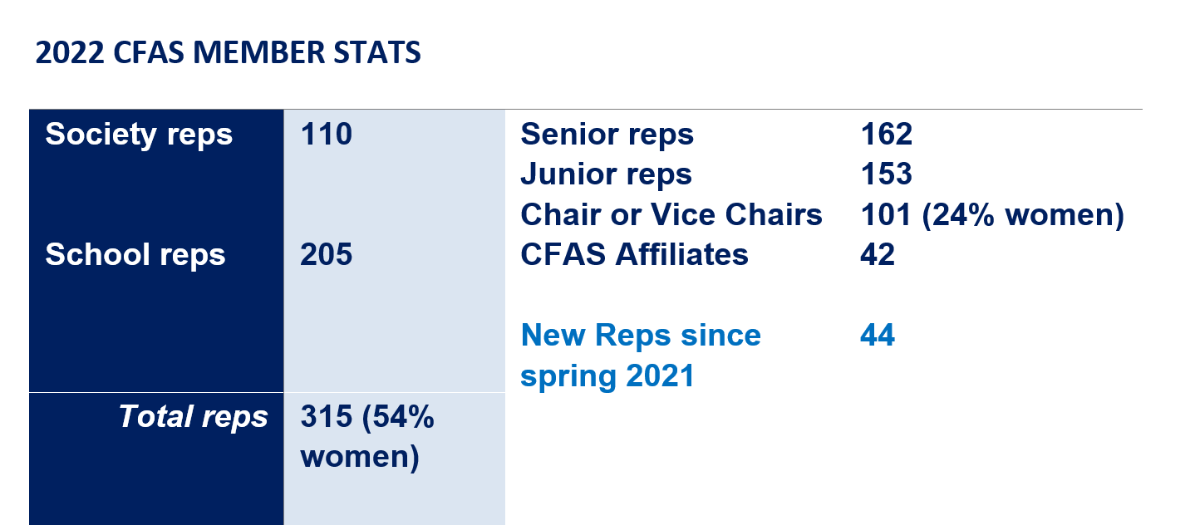
CFAS Reps by the Numbers

Slide 32
Achievements and Activities in 2021-2022
CFAS Committees have continued to meet regularly and have produced several publications and reports or have launched new projects
Focused on supporting ongoing connectivity with:
Monthly electronic CFAS Rep Bulletin
Monthly online CFAS Connects live sessions, including multiple conversations with AAMC President and CEO David J. Skorton, MD
Annual CFAS Spring Meeting
Biennial CFAS Society Summit for executives
New junior faculty member, Catherine Coe, MD, seated on the AAMC Board of Directors
Streamlining content on the CFAS website and revamping the Well-Being in Academic Medicine webpage https://www.aamc.org/news-insights/wellbeing/faculty

Slide 33
Achievements and Activities in 2021-2022
CFAS Demographic Survey has been created and will be sent to all CFAS reps after this meeting to collect updated data on the council’s diverse membership
New CFAS webpage on the benefits of membership in CFAS: https://www.aamc.org/career-development/affinity-groups/cfas/membership-benefits
CFAS Ad Board held a retreat on Sept. 21 to chart the course of CFAS in the coming years and evaluate what has worked well so far and where CFAS could improve. A summary of the retreat is available on the CFAS Resources webpage at https://www.aamc.org/career-development/affinity-groups/cfas/resources
A significant number of breakout sessions during this meeting either originated from CFAS or were inspired by a familiar topic to CFAS

Slide 34
CFAS Video Project
CFAS is producing a video series that will feature interviews with current and former reps on the benefits of membership in CFAS for faculty members and academic societies. The first video has already been published:
https://vimeo.com/764564257/8671beab42
More videos will be filmed throughout next year

Slide 35
CFAS Connects
CFAS has continued to organize monthly CFAS Connects sessions, including:
A Conversation with David Skorton, MD
Keeping Women in Medicine: A Conversation about Retaining Talented Women Physicians
Opportunities and Challenges in Building COVID-19 Vaccine Confidence: Seeking CFAS Feedback on an AAMC Strategic Planning Initiative
Gender Parity – An Example of Aligning with the Mission of CFAS
December Session – A presentation on the work of the CFAS Faculty Resilience Committee
The program, which has attracted between 50 – 75 reps per session, will continue through next year and be re-evaluated for it’s next “season.” All sessions are recorded and notes and summaries of sessions are available to reps on our website

Slide 36
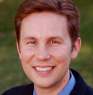
Nominating and Engagement Committee Update
CFAS Ad Board Members who rotated off in November 2022
Thank you!
Alan W. Dow, III, MD
Richard L. Eckert, PhD

Slide 37
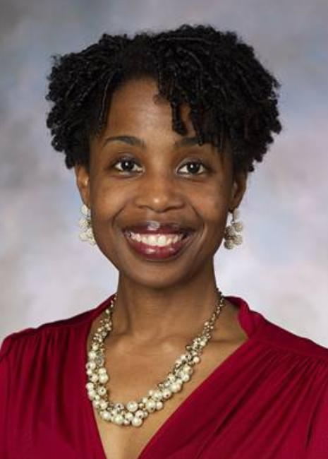
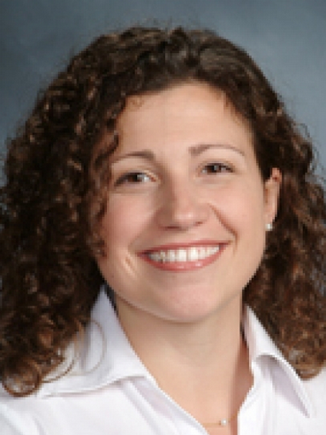
Nominating and Engagement Committee Update
New Ad Board members as of November 2022
Welcome!
Valencia Walker, MD
Lily Belfi, MD

Slide 38
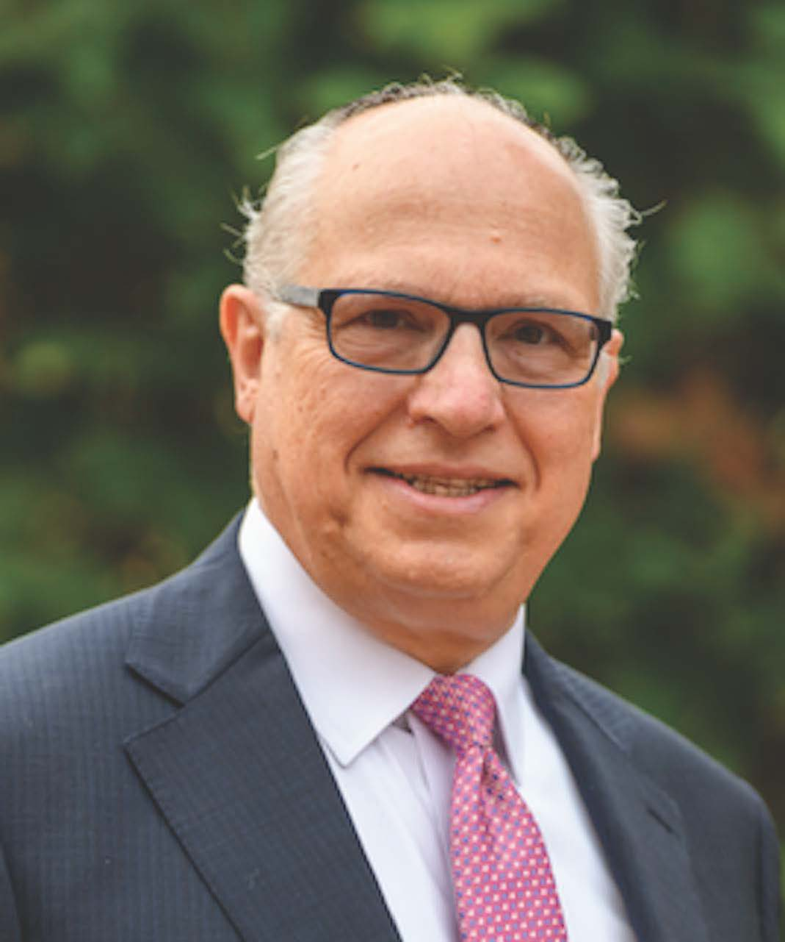
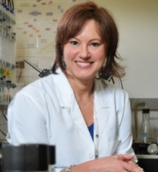
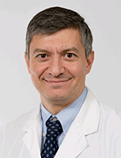
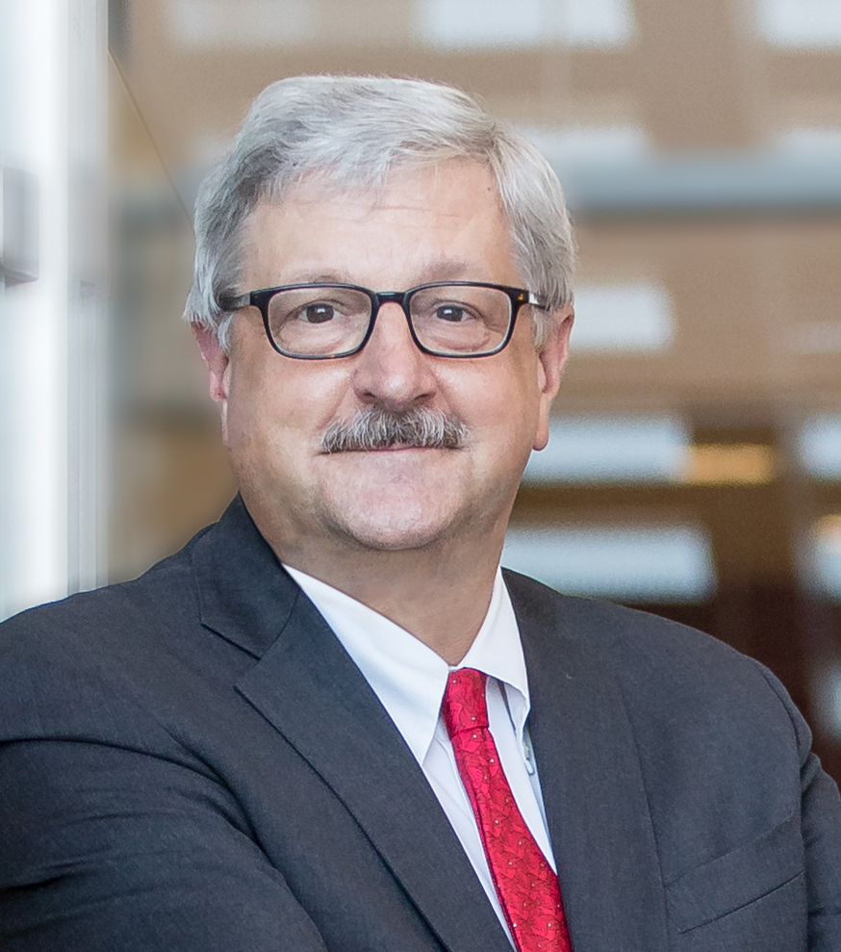
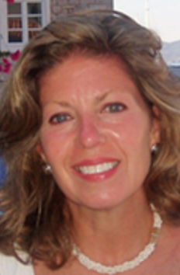
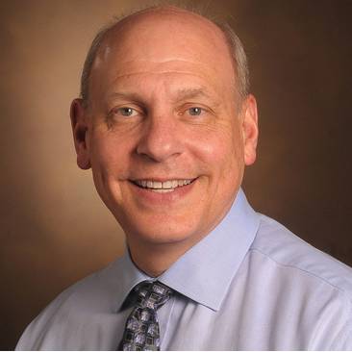
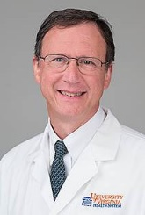
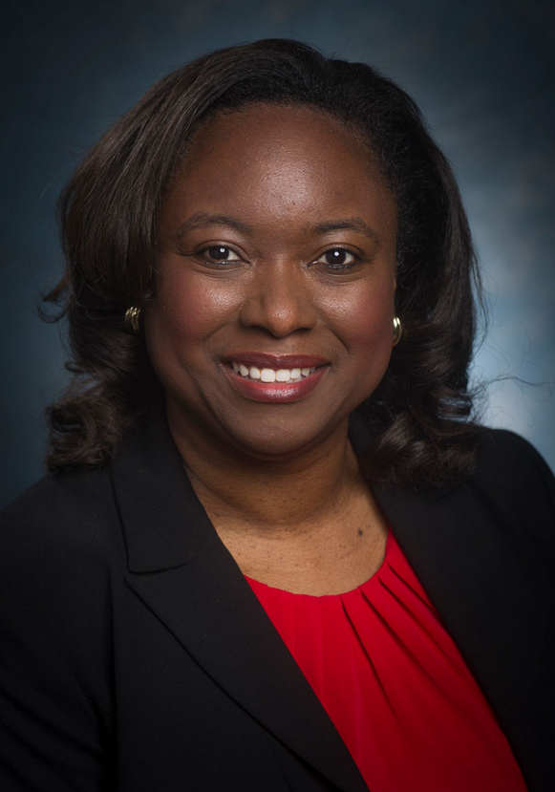
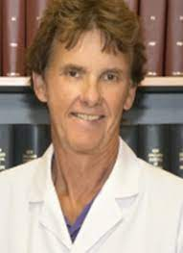
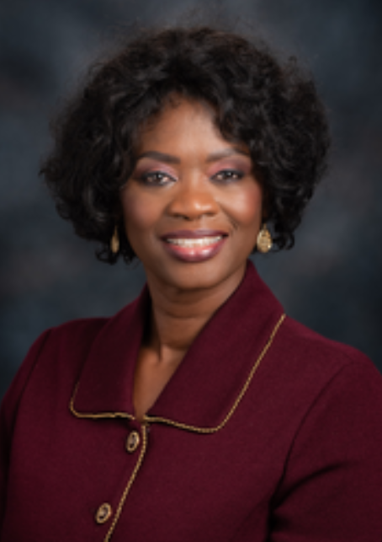
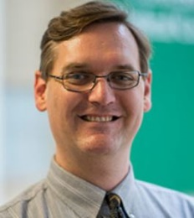
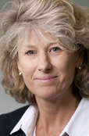
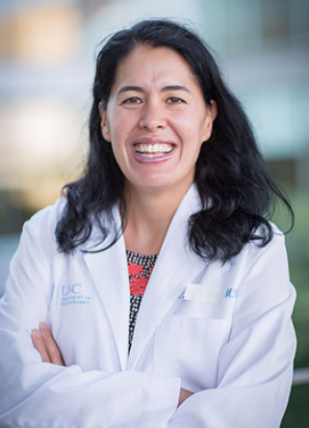
New CFAS Administrative Board
Aviad “Adi” Haramati, PhD, Chair
Nita Ahuja, MD, Chair-elect
Gabriela Popescu, PhD, Immediate Past Chair
Steven Angus, MD
Valencia Walker, MD
Arthur Derse, MD, JD
Shirley “Lee” Eisner, PhD
Neil Osheroff, PhD
Lily Belfi, MD
Stewart Babbott, MD
Adam Franks, MD
Monica Baskin, PhD
Catherine Pipas, MD
Deanna Sasaki-Adams, MD
Nicholas Delamere, PhD
Lisa D. Cain (Ex-Officio GFA Chair)

Slide 39
CFAS Committees
Thematic Committees are open to all CFAS reps and affiliates
Advocacy Committee - Arthur Derse, MD, JD, Chair
Biomedical Research and Education Committee (BREC) - Rich Eckert, PhD, Chair
Communication Committee - Alan Dow, MD, Chair
Diversity and Inclusion Committee – Monica Baskin, PhD, Chair
Mission Alignment Committee - Stewart Babbott, MD, Chair
Faculty Resilience Committee – Catherine Pipas, MD, Chair
Structural Committees open to appointed members
Programming Committee - Nita Ahuja, MD, Chair
Nominating Committee - Gabriela Popescu, PhD, Chair
Details about all CFAS Committees here: www.aamc.org/cfas

Slide 40
CFAS Engagement at LSL

Slide 41
CFAS-Inspired Table Topics
On Saturday, November 12 from 11:45 AM-1:15 PM CST, there was a Table Topics Luncheon and several Table Topics this year were sponsored by CFAS reps
The Earlier the Better: Benefits and Challenges of Incorporating Professional Competencies Into Pre-Clerkship Foundational Science Courses - Neil Osheroff, PhD
Challenges Facing Clinical Educators - Lily Belfi, MD
Understanding the Other Side: Creating Civil Dialogue Among Politically Diverse Groups to Find Common Values - Alex Bolt
Issues in the Transition to Residency: ERAS® and the Supplemental Residency Application - Sidney Weissman, MD
Harnessing the Impact of Clinician Educators for Promotion and Recognition: What Would a Clinician Educator Impact Factor Look Like? – Nandini (Dina) Calamur, MD

Slide 42
CFAS-Inspired Main Program Sessions
The Great Resignation in Health Care?
Session focused on ongoing concerns of a “great resignation.” Current data does not yet show a physician resignation, but rather exacerbation of ongoing physician shortages
Physicians’ shortages have been projected for many years and are expected to worsen significantly, especially in surgery and medical sub-specialties
Retention strategies were discussed including best practices related to compensation, work life balance, and minimizing administrative workload
As workforce issues will continue to worsen, all leaders and AAMC broadly should focus on retention of their workforce
Strategies on retention and promotion of women and other under-represented minorities discussed including on-site childcare benefits, hybrid work, and job sharing

Slide 43
CFAS-Inspired Main Program Sessions
Med Ed Strategies for Ensuring a Gender Affirming Learning Environment and Gender Inclusive Health Care
A fast-growing number of medical students identify as LGBTQ and/or gender diverse
LGBTQ content in medical school pre-clinical curriculum is expanding in some institutions, however, it’s often not reinforced in the clinical learning environment where it needs to be applied
There is a paucity of data on gender diverse student experience in the clinical learning environment
Partnering with our learners through reciprocal mentorship is a successful model to develop and facilitate gender affirming curriculum and strategies for improving the clinical learning environment
An inclusive learning environment contributes to graduating doctors with confidence and competence to care for LGBTQ+ patients and communities

Slide 44
CFAS-Inspired Main Program Sessions
Zoomed Out and Covid Fatigued: What to Keep and What to Change as We Move Forward, Post-Pandemic
The past crisis and the continued uncertainty of the future will make it unlikely that our hybrid and Zoom worlds will ever go away completely, but live events are important as well
There are pros and cons for both learners and faculty and some of them are not unique to Zoom but larger issues we had before, such as disengagement, too many meetings, content delivery, etc.
Tips for improving your Zoom presentations are important and include: Avoid camera pitfalls, improve lighting, good clear sound, set up in advance, don't be your own distraction, prepare and rehearse, and MUTE YOURSELF

Slide 45
CFAS-Inspired Main Program Sessions
Equitable Competency Assessment: Implementing Recommendations of the UME-GME Review Committee
There are many tensions between UME and GME that are heightened during the UME-GME transition for learners
The Coalition for Physician Accountability’s UGRC has outlined 34 recommendations across 9 themes to help move the UME-GME transition towards an ideal state
Development of fair and equitable assessment methodologies that include a common framework is among those recommendations
In complex ecosystems with multiple challenges or tensions, a systems-level approach, as through polarity thinking, can help us leverage the things that each side of the tension (UME and GME) do well to achieve better results for all

Slide 46
CFAS-Inspired Main Program Sessions
Leadership Education in Undergraduate Medical Education
Leadership education should begin in the UME setting and should be grounded in leadership theory
Longitudinal leadership curriculum allows introduction of concepts early in medical school with reinforcement and reflection as students progress into the clinical arena
Leadership performance has been found to be independent of academic performance (as measured by MCAT/USMLE exams) and stable over GME training

Slide 47
CFAS-Inspired Main Program Sessions
Science, Credibility, and Strategies for Addressing Health Misinformation
Vaccines could have prevented at least 318,000 Covid-19 deaths between January 2021 and April 2022
Need credible, reliable sources
Always give the basis as well as the interpretation
Be consistent
Address myths directly

Slide 48
CFAS-Inspired Main Program Sessions
Empowering Wellness by Implementing 10 "Well-being Champions” Recommendations
The bad news is the Burnout Crisis continues to grow, the good news is that so do national recommendations and promising practices for leaders to advance organizational change
The AAMC’s Report, The Rise of Wellness Initiatives in Health Care: Using National Survey Data to Support Effective Well-Being Champions and Wellness Programs and its 10 recommendations can be utilized by institutions as a resource, a guide, and an assessment tool for promoting progress along the organizational wellbeing journey
The process of transforming to a culture of wellbeing is complex and continuous. UVA, OHSU and Western University are examples of programs moving along with promising practices to share. We can all learn from each other - no matter how early or advanced we are in the process

Slide 49
CFAS-Inspired Main Program Sessions
A Transforming Landscape: What’s Working & What’s Changing in Academic Medicine Scholarly Publishing
Preprints offer a channel for rapidly disseminating research that has not been peer reviewed, and depositing a preprint provides broad, unrestricted access to non-peer reviewed research and opens important opportunities for early scientific feedback
Libraries are having a hard time funding open access publication while maintaining necessary subscriptions at a time when costs are rapidly increasing and library budgets remain flat
Institutional leadership, faculty/researchers, and librarians should work together to determine their values so that libraries know how to best direct investments in purchase of articles and defraying costs of publishing
Publishing is important for career advancement and article publication costs should not be a barrier to publication especially for junior and underrepresented faculty and trainees. Deans, chairs, and other leaders should make sure that high publication costs are not a barrier to success

Slide 50
CFAS-Inspired Main Program Sessions
Valuing Faculty in a Post-Pandemic World – Do Advancement Pathways Match the Needs?
Faculty activities in the advancing the missions of education, research, and clinical delivery experienced significant challenges during the pandemic (Since March 2020) as faculty pivoted to continue to teach, discover, and care for patients in virtual and difficult environments
Promotion in rank is one way – but not the only way – that institutions can demonstrate that faculty are valued and rewarded
Promotion must be based on significant accomplishments in teaching, scholarship, and service, but the criteria need re-evaluation in terms of what constitutes impactful scholarship and institutional service
The roles of department chairs and deans in nurturing and supporting faculty was highlighted, and leaders need to be held accountable for these aspects as part of their review

Slide 51
CFAS-Inspired Main Program Sessions
Linking Principal and Principle in Academic Health Centers: A Bridge How Far?
With expanding academic health systems, growth of the clinical enterprise has emphasized the margin (principal) over the mission (principle) by increasing scale to maximize profits, deemphasizing the academic missions of education and research in many institutions
In parallel to this organizational growth and emphasis, the governance structure in many institutions has evolved to move oversight of the clinical enterprise (including the traditional faculty practice) to the health system leadership and away from traditional academic leadership
This increasingly leaves the Dean, Department Chairs, and Faculty Senate as the primary representatives of the academic mission and underscores their common role in promoting and advocating for support of education and research activities to the health system leadership, whose primary focus is the business of the clinical enterprise
In order to preserve the value and vigor of faculty in the academic health system, Deans and Department Chairs must be involved in the initial conversations that give rise to academic health system mergers

Slide 52
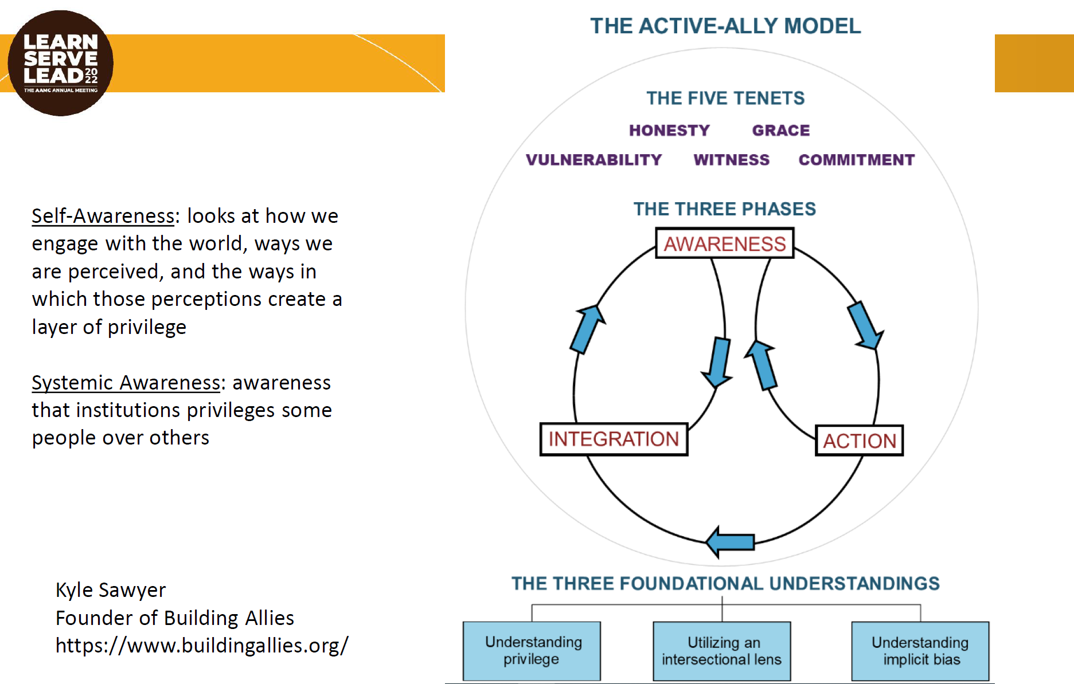
Facilitating Effective Allyship: Creating Safe Spaces for Dialogue
When in dialogue, it’s important to assume the best intentions of people, listen genuinely to experience a different point of view, and be open to criticizing ideas, not individuals
Faculty members of color, in addition to the usual workload, often have to learn how to manage all the very upsetting double standards, stereotypes, and microaggressions while also being mindful of coming across as “too angry” or “too threatening”
White men and others who are not from underrepresented background must commit to becoming allies in their institutions and should get involved with identity-based groups such as:
National Medical Association
Society of Black Academic Surgeons
Latino Surgical Society
Society of Asian Academic Surgeons
Some resources that can help people understand how to become better allies are the books White Fragility, Overcoming Bias, How to Be An Anti Racist, We Were Eight Years in Power, and the movie “13th”

Slide 53
CFAS Knowledge Sharing Session

Slide 54
CFAS Knowledge Sharing Session
Reflecting on the meeting:
There was broad recognition of CFAS’ significant achievement of getting 11 sessions into the LSL program
Being in person at a meeting again was a very meaningful experience for a lot of CFAS reps
Faculty members are still going through the fallout of the last couple years and we need to keep providing safe space for conversations about peoples’ experiences. Speaker selection for CFAS sessions was great and the speakers all seemed very authentic
A 3- to 4-page mini program of future LSL meetings with all the events listed on paper would be helpful for older faculty members to have

Slide 55
CFAS Knowledge Sharing Session
Reflecting on the meeting:
A lot of deans were panelists in CFAS sessions at this meeting. CFAS sessions were packed wall-to-wall and it was obvious there was a lot of interest
There was discussion about the need for more guided table discussions during sessions at this meeting. If we want to do more of these guided table discussions, sessions may have to be closer to two hours
There was a comment that a large-scale celebration of research seemed to be missing at LSL. This prompted discussion about how to integrate more of a focus on research into the meeting, but in the past, it’s often been a challenge to draw many people into a research-focused session because of the diversity of meeting attendees and their interests. The challenge with scientific sessions is that they often get into the weeds
There’s more opportunity to talk about how treatments moved from bench research to preclinical trials to clinical trials to patient care because those kinds of stories unite all of us working in academic medicine
To get better attendance at science focused sessions, we need to attract more scientists to LSL. Maybe there should be a basic science CFAS rep and a clinical CFAS rep from every institution

Slide 56
CFAS Knowledge Sharing Session
Looking forward to the future:
The music was moving for a lot of people at this meeting and there was a desire to keep incorporating the humanities in future meetings. If CFAS can make its committee structure align with the major interests that were highlighted during the meeting, CFAS could potentially attract more people into its committees
CFAS needs to continue to try to cultivate two-way communication with the AAMC’s Council of Teaching Hospitals and Health Systems (COTH) because faculty members are their workforce and they need to hear about the realities of faculty members’ lives and how they’re caring for patients and driving the missions of academic medicine
In communicating with COTH, be mindful of how many issues are being brought to their attention, since CFAS represents 190,000 faculty members and can’t inundate COTH with the full spectrum of issues represented in such a large population
CFAS needs to continue creating communication channels between the AAMC’s Council of Deans (COD) in addition to COTH
CFAS committee chairs were encouraged to identify the most important issues they want to focus on

Slide 57
CFAS Knowledge Sharing Session
The potential of CFAS…
Faculty members are the AAMC’s largest constituents, but to most faculty members, the AAMC isn’t relevant and CFAS is trying to change that
The diversity of ideas represented in the programming was appreciated and CFAS should keep trying to reach the 190,000 faculty members and bring different perspectives into the forum
There was discussion on what the role of faculty members in academic medicine and the AAMC should be in supporting the pipelines for allied health workers such as nurses and social workers

Slide 58
CFAS Knowledge Sharing Session
A focus on chairs:
CFAS should encourage more chairs to join to build on its representation of that group
The workforce meeting at this meeting was really good and there was appreciation of a comment during that meeting that we shouldn’t talk about “underrepresented minorities” but rather “historically/intentionally excluded” minorities. Those in leadership, such as chairs, need to take a more active role in reversing this underrepresentation and exclusion
Two chairs in the room spoke about how valuable this meeting was for them and how much they learned. They also spoke about how much they could now offer their departments back at their home institutions because of this meeting
One of the chairs was a PhD and chair of basic science department and came to LSL skeptical of how much the meeting could offer her, but she found that many sessions actually had a lot to offer. There often feels like an unnecessary division between basic science and clinical sides of academic medicine but there are a lot of common interests and concerns and there’s an opportunity for CFAS to offer more for basic scientists in meeting programming

Slide 59
CFAS Knowledge Sharing Session
Ideas and ways to improve:
Conversations that started during CFAS sessions, such as how to facilitate effective allyship, need to be developed further in future meeting programming, since there is a lot of opportunity to advance the ideas and promote them to broader audiences
It feels like CFAS is still disengaged from the larger AAMC with regard to DEI and other issues. It seems like CFAS needs to be more of a presence in some of the AAMC’s cross-cutting work
The model of research for faculty members has historically been to rely mostly on NIH grants, but that’s no longer feasible and what institutions have to do now to pay for research is transfer money over from the health system. Is this model an appropriate one? Does this system need to be changed?

Slide 60
CFAS Knowledge Sharing Session
Ideas and ways to improve:
There was a suggestion to create a demographic survey for new CFAS reps that will automatically tell them how and where they can get engaged based on the interests they enter into the form
Institutions need to make clear whether scholarly activity is expected from their faculty. This question becomes especially important for academic health systems that have relationships with a lot of hospitals, making productivity more important and funding from state governments and other places scarcer
The CFAS Spring Meeting will be held March 26 – 29 and will continue many of the conversations that bubbled up during LSL. New CFAS reps are encouraged to contribute to the programming and make their voices heard

Slide 61
For More Info About CFAS
CFAS homepage:
https://www.aamc.org/professional-development/affinity-groups/cfas
CFAS Resources webpage:
https://www.aamc.org/professional-development/affinity-groups/cfas/resources

Slide 62
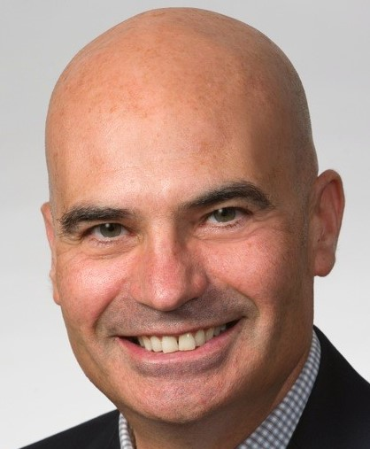
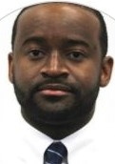
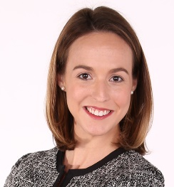
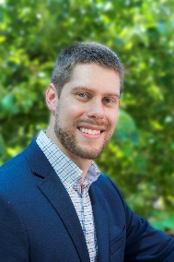
The AAMC CFAS Team
Eric Weissman, Senior Director, Society and Faculty Engagement eweissman@aamc.org
Stephen Barry, CFAS Engagement Specialist sbarry@aamc.org
Anne Berry, Lead Specialist, Implementation Research and Policy aberry@aamc.org
Alex Bolt, CFAS Communications Specialist abolt@aamc.org

