Slide 1
An Orientation to the AAMC and CFAS
Eric Weissman, Senior Director of Faculty and Academic Society Engagement, AAMC
November 13, 2022

Slide 2
Mission
The AAMC leads and serves academic medicine to improve the health of people everywhere
Vision
A healthier future through learning, discovery, health care, and community collaborations.
Notes:
INTERNAL ONLY

Slide 3
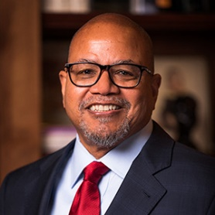
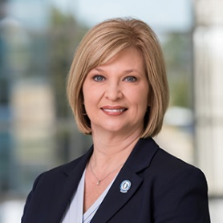
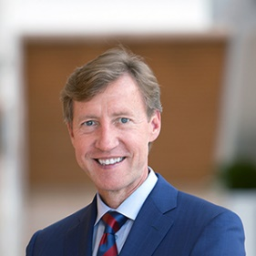
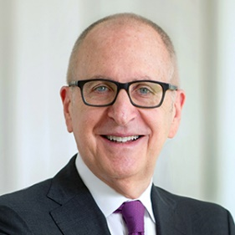
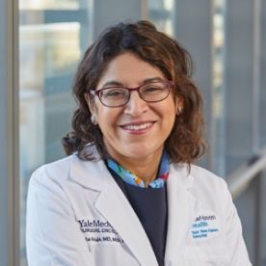
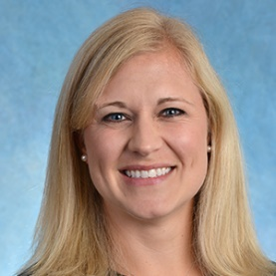
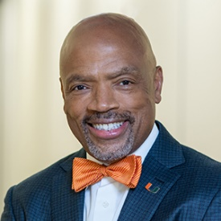
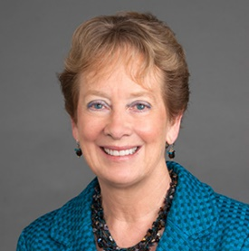
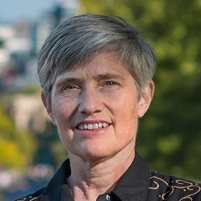
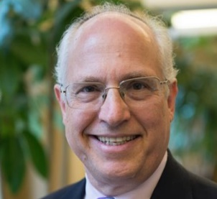
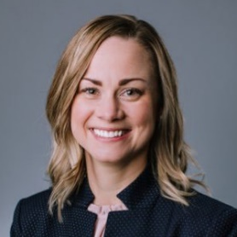
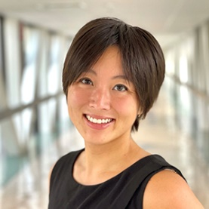
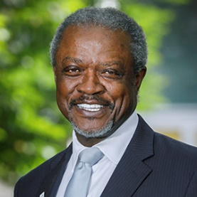
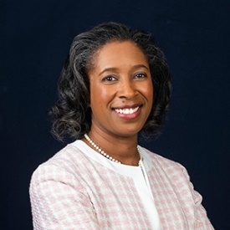
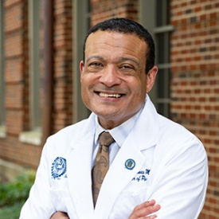
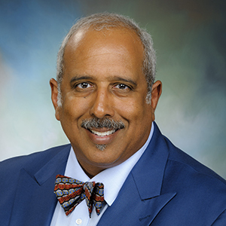
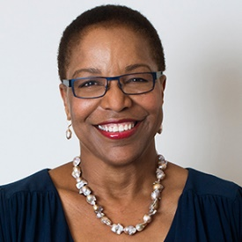
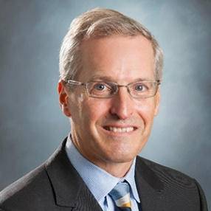
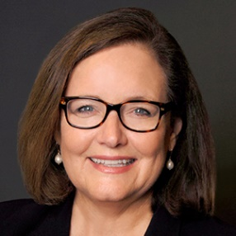
2021-2022 Board of Directors
Kirk A. Calhoun, MD
Chair
LouAnn Woodward, MD
Chair-elect
J. Larry Jameson, MD, PhD
Immediate Past Chair
David J. Skorton, MD
President and CEO
Nita F. Ahuja, MD, MBA
(CFAS Chair-elect)
Catherine L. Coe, MD (Junior Faculty Member)
Henri Ford, MD, MHA
Julie A Freischlag, MD,
Martha E. Gaines, JD, LLM
Aviad Haramati, PhD
(CFAS Chair)
Brittany N. Hasty, MD, MHPE
Jennifer Hayashi
Danny O. Jacobs, MD, MPH
Cara V. James, PhD
Lee D. Jones, MD
Charles P. Mouton, MD
Joan Y. Reede, MD, MS,
MPH, MBA
Michael Waldrum, MD,
MSC, MBA
Kate Walsh, MPH

Slide 4
How Others See Us
Member
Organization
Thought Leaders
We Are
Service
Provider
Notes:
Member organization – traditional association offerings such as meetings, publications, advocacy
Service –
Thought Leaders-

Slide 5
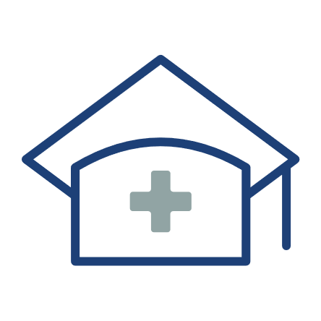
Our Members
Our member institutions represent the full spectrum of medical education:
172
accredited U.S. & Canadian medical schools
400+
major teaching hospitals & health systems, including Veterans Affairs medical centers
80
faculty & academic societies
We serve the leaders of our member institutions, as well as the following communities:
186,000+
full-time faculty members
140,000+
resident physicians
94,000+
medical students
Notes:
https://www.aamc.org/who-we-are

Slide 6
How Our Constituents Engage
Council of Deans | Council of Teaching Hospitals and Health Systems | Council of Faculty and Academic Societies
Organization of Resident Representatives | Organization of Student Representatives | Forum on Conflicts of Interest in Academe
Chief Medical Officers Group | Compliance Officers Forum | Group on Business Affairs
Government Relations Representatives | Graduate Research, Education, and Training Group | Group on Faculty Affairs
Group on Diversity & Inclusion | Group on Educational Affairs | Group on Institutional Advancement
Group on Faculty Practice | Group on Information Resources | Group on Research Advancement and Development
Group on Institutional Planning | Group on Regional Medical Campuses | Group on Women in Medicine & Science
Group on Resident Affairs | Group on Student Affairs

Slide 7
Drilling Down into CFAS
The Council of Faculty and Academic Societies (CFAS) represents U.S. medical school faculty and academic societies within the AAMC
CFAS membership consists of about 350 term-limited reps from medical schools and approximately 80 academic society members of the AAMC, of which the American Orthopaedic Association is one.
CFAS is one of only three AAMC councils, which gives it direct representation on the AAMC’s Board of Directors through our chair and chair-elect. This really matters!

Slide 8
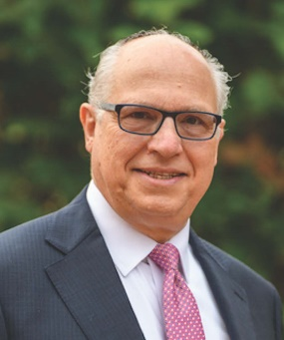
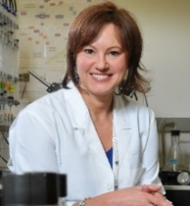
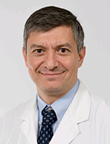
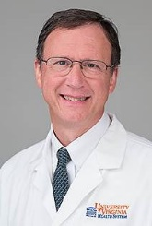
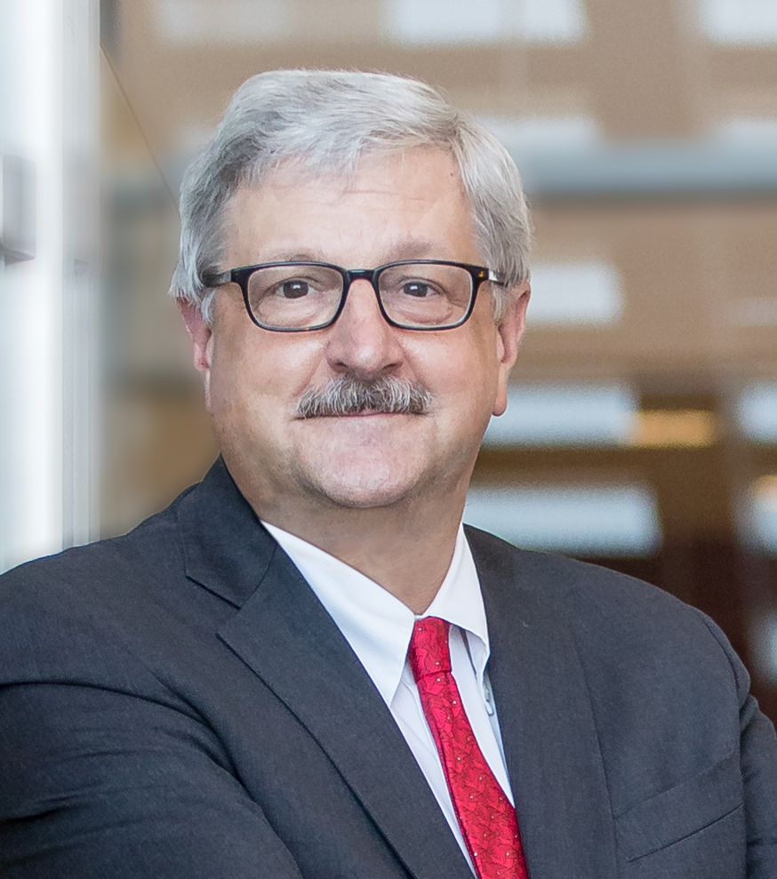
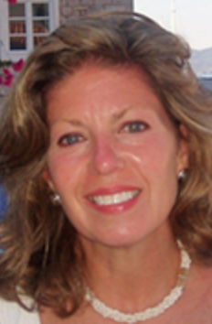
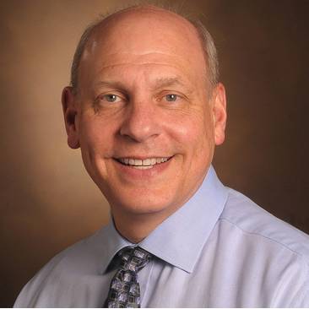
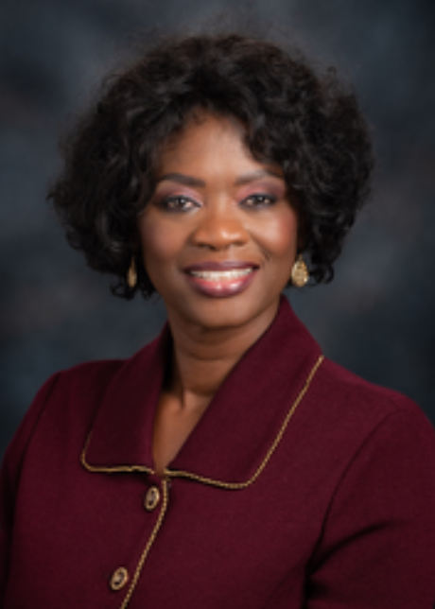
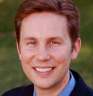
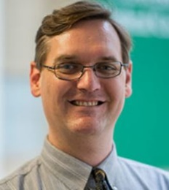
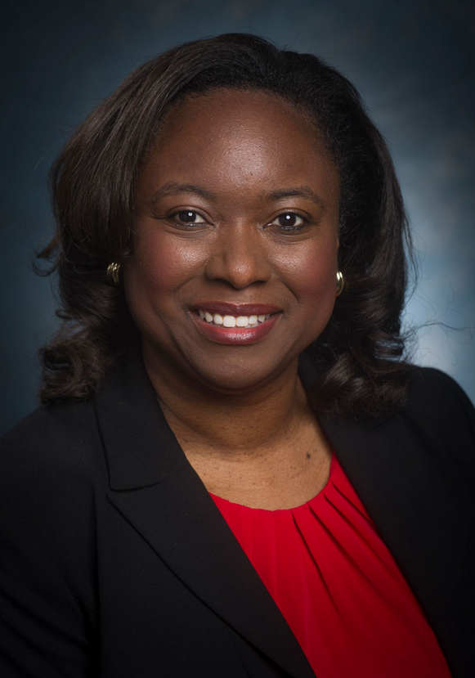
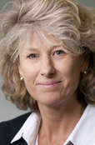
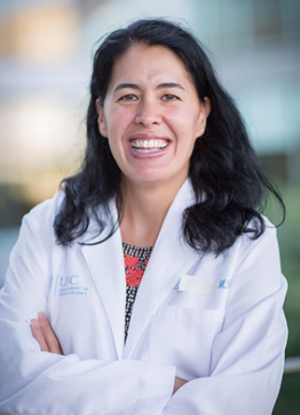
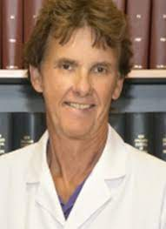
CFAS Administrative Board
Aviad “Adi” Haramati, PhD, Chair
Nita Ahuja, MD, Chair-elect
Gabriela Popescu, PhD, Immediate Past Chair
Steven Angus, MD
Stewart Babbott, MD
Arthur Derse, MD, JD
Shirley “Lee” Eisner, PhD
Neil Osheroff, PhD
Alan W. Dow, III, MD
Richard L. Eckert, PhD
Adam Franks, MD
Monica Baskin, PhD
Catherine Pipas, MD
Deanna Sasaki-Adams, MD
Nicholas Delamere, PhD
Lisa D. Cain, PhD (Ex-Officio GFA Chair)

Slide 9
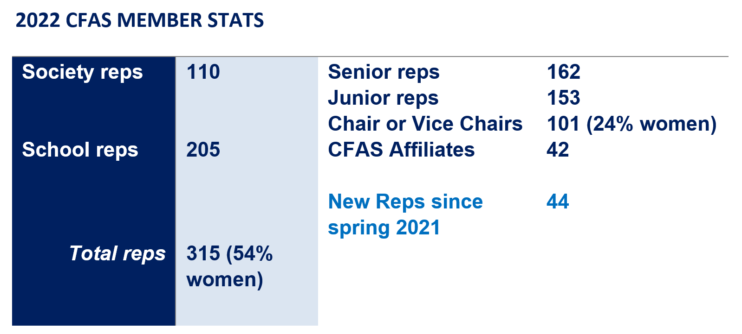
CFAS Reps by the Numbers

Slide 10
What Does CFAS Do?
The Council of Faculty and Academic Societies provides a voice for academic faculty within the AAMC’s governance and leadership structures. The council is charged with:
Identifying critical issues facing faculty members of medical schools and within academic societies;
Providing a voice for faculty about those issues to the AAMC as they relate to creation and implementation of the AAMC’s programs, services, and policies; and
Serving as a bidirectional communications conduit regarding matters related to the core missions of academic medicine.

Slide 11
But What Do We Really Do?
Engage directly with societies on major advocacy issues
Convene committees on topics that matter to faculty
Develop programming for AAMC events
Present at AAMC meetings and outside organizations
Engage in national efforts, like the NAM Action Collaborative
Connect reps with national opportunities
Create a community where reps learn from each other
Networking! Bidirectional communication! (it’s a thing)

Slide 12
What Are Our Big Issues
Major advocacy priorities – GME and NIH funding and others
Racial diversity and inclusion issues in faculty and institutions
Gender equity and harassment issues
Political influence in science
Faculty identity and faculty leadership and governance
Faculty well-being and resilience
“Mission alignment” – finding balance in the mission areas
Biomedical research advancement
The teaching and learning environment
Faculty professional development and training
…and more issues as CFAS reps raise them – We aim to be responsive and nimble in our topics.

Slide 13
Achievements and Activities in 2022
CFAS Committees have continued to meet regularly and have produced several publications and reports or have launched new projects.
Focused on supporting ongoing connectivity with:
Monthly electronic CFAS Rep Bulletin
Monthly online CFAS Connects live sessions, including multiple conversations with AAMC President and CEO David J. Skorton, MD and members of Leadership Team
Annual CFAS Spring Meeting
Biennial CFAS Society Summit for executives.
New junior faculty member, Catherine Coe, MD, seated on the AAMC Board of Directors.
Streamlining content on the CFAS website and revamping the Well-Being in Academic Medicine webpage https://www.aamc.org/news-insights/wellbeing/faculty

Slide 14
CFAS Rep Charge
Identify the issues facing faculty in academic medicine
Provide a voice for faculty members about these issues to the AAMC
Apprise faculty and societies of AAMC activities, topical issues, and resources

Slide 15
CFAS Committees
Thematic Committees are open to all CFAS reps and affiliates
Advocacy Committee - Art Derse, Chair
Biomedical Research and Education Committee (BREC) - Rich Eckert, Chair
Communication Committee - Alan Dow, Chair
Diversity, Equity, and Inclusion Committee - Monica Baskin, Chair
Mission Alignment Committee - Stewart Babbott, Chair
Faculty Resilience Committee - Cathy Pipas, Chair
Structural Committees open to appointed members
Programming Committee - Nita Ahuja, Chair
Nominating Committee - Gabriela Popescu, Chair
Details about all CFAS Committees here: www.aamc.org/cfas

Slide 16
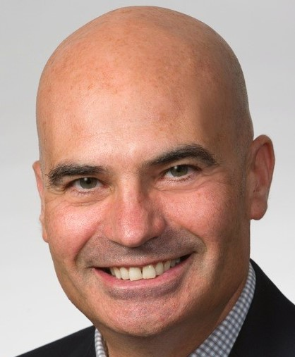
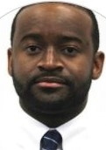
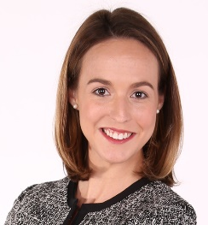
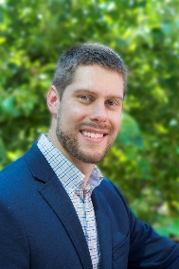
The AAMC CFAS Team
Eric Weissman, Senior Director, Society and Faculty Engagement eweissman@aamc.org
Stephen Barry, CFAS Engagement Specialist sbarry@aamc.org
Anne Berry, Lead Specialist, Implementation Research and Policy aberry@aamc.org
Alex Bolt, CFAS Communications Specialist abolt@aamc.org

Slide 17
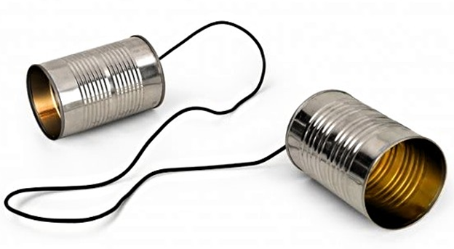
Communication
School /
Society
AAMC

Slide 18
Communication
School /
Society
AAMC
Sweet Spot

