Slide 1

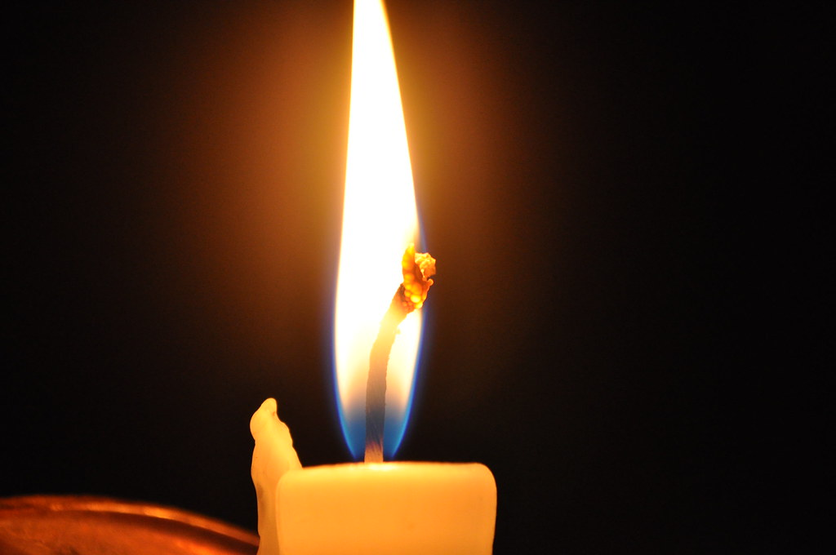
Meditation 101:
Simple Practices for Maintaining Wellbeing and Fostering Resilience
Michelle Lizotte-Waniewski, Ph.D., Charles E. Schmidt College of Medicine, Florida Atlantic University, Boca Raton, FL
Chantal Young, Ph.D., Keck School of Medicine, University of Southern California, Los Angeles, CA
WMed Team: Karen Horneffer-Ginter, Ph.D., Maria Magidenko, Allison Zheng, Melissa Pellman, Daniel Micheli, Adrienne Aardema, and Megan Sandberg, Western Michigan University (WMU) Homer Stryker School of Medicine, Kalamazoo, MI
Notes:
The purpose of this presentation is to familiarize medical students/residents with the benefits, types and practice of various forms of meditation. The notes section of the presentation for each slide will sometimes contain suggested talking points or scripts, resources and/or image credits. There are activities provided throughout, which can be included or not at the presenter’s discretion depending upon time and delivery modality. The final slide also includes an Appendix in the notes section which provides a description of break out group activities along with a suggested script. The author/source of each slide is indicated in the lower right corner of each slide.

Slide 2
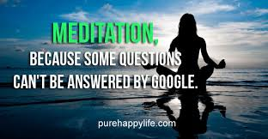
Overview
Mind Wandering, Negative Thoughts and Stress
Meditation and its Benefits
Forms of Meditation
The Importance of Physician Wellbeing
Dr. Michelle Lizotte-Waniewski
Notes:
Image Credit:
purehappylife.com
https://www.askideas.com/61-best-meditation-quotes-and-sayings-for-inspiration/meditation-because-some-questions-cant-be-answered-by-google/

Slide 3
Objectives
Recognize that modest evidence-based research exists for the utility of mindfulness and understand why it is theorized to be beneficial
Identify everyday practices that can be incorporated into other activities
Compare several example practices
Specify at least one mindfulness practice to experiment with in daily life
WMed Team
Notes:
Today’s session focuses on giving an overview of the evidence for mindfulness as well as offering you all an experience of mindfulness practices.
Image Credit:
Burning Candle Image: "burning candle" by S@veOurSm:)e is licensed with CC BY-SA 2.0. To view a copy of this license, visit https://creativecommons.org/licenses/by-sa/2.0/

Slide 4
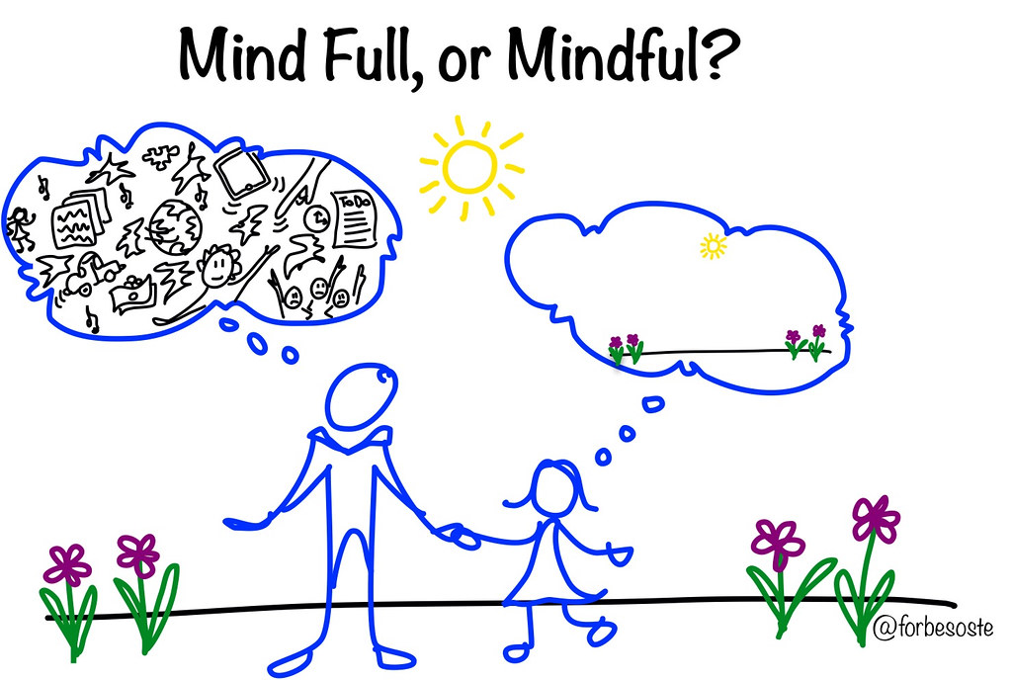

Thought Management
Recent research study estimates that the average person has 6200 thoughts per day. (Tseng and Poppenek, 2020)
Many of our thoughts are not new (repetitive thoughts)
If most of our repetitive thoughts are negative ones, what could that do to our frame of mind?
Our thoughts can create toxic stress if we let them!
The greatest weapon against stress is to choose 1 thought over another. William James
Dr. Michelle Lizotte-Waniewski
Notes:
Talking Points:
Managing our thoughts is important to keep a positive frame of mind so that we can mitigate stress.
Optional Interactive Activity – Have students provide common negative thoughts. Examples of Negative Thoughts: I’m too short, Why does this always happen to me, Ill never be good enough, How come I can never catch a break I’m so sick of my sister’s whining and complaining;I wish I could just make myself exercise
Resources for Slide Content
1) Tseng, J., Poppenk, J. Brain meta-state transitions demarcate thoughts across task contexts exposing the mental noise of trait neuroticism. Nat Commun 11, 3480 (2020). https://doi.org/10.1038/s41467-020-17255-9.
Image Credits:
Mindful Image: "Mind Full v. Mindful" by ForbesOste is licensed with CC BY 2.0. To view a copy of this license, visit https://creativecommons.org/licenses/by/2.0/
Child Brain Image: "child Head" by charlywkarl is licensed with CC BY-ND 2.0. To view a copy of this license, visit https://creativecommons.org/licenses/by-nd/2.0/

Slide 5
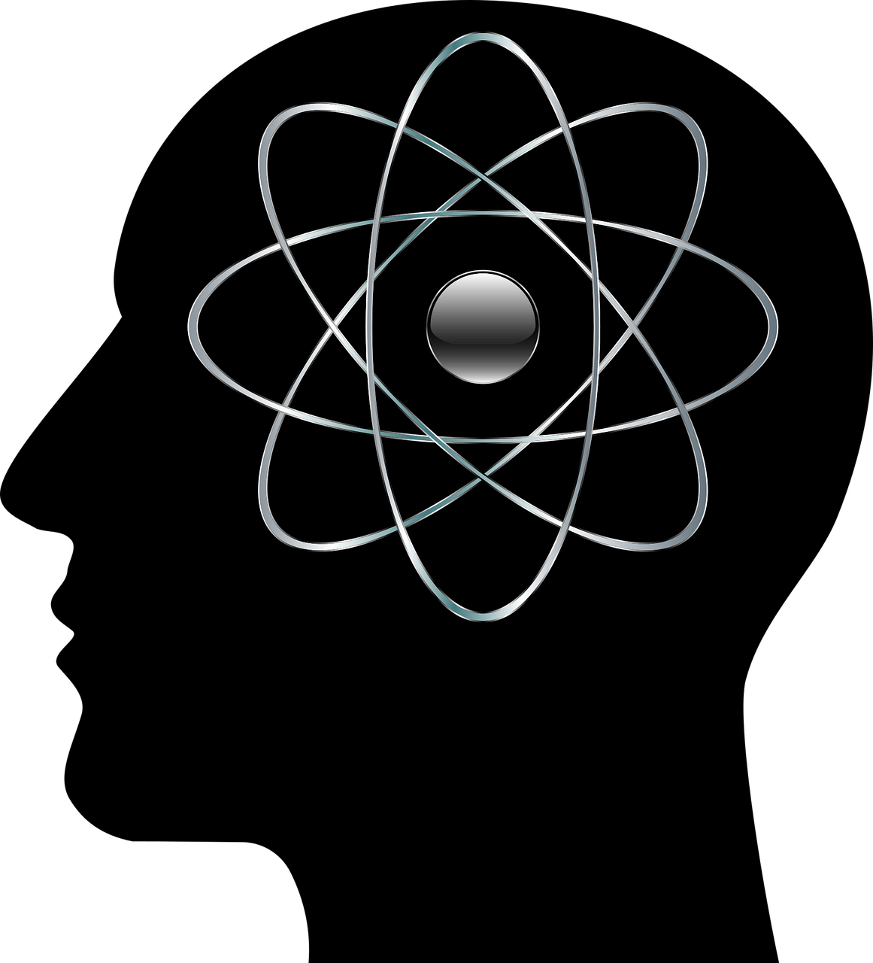
Mind Wandering
“A human mind is a wandering mind, and a wandering mind is an unhappy mind.”
“The ability to think about what is not happening is a cognitive achievement that comes at an emotional cost.”
Harvard Happiness Study – Killingsworth & Gilbert 2011
Dr. Chantal Young
Notes:
Talking Points:
1st quote: Any of you who have meditated before know that the first thing you learn is that your mind is completely out of control. This is often the point where many people stop trying to meditate, because they feel they will never get their mind under control, and it’s unpleasant to sit there and watch it go so wild. Humans have evolved an incredible capacity of mind unprecedented in species evolution on our planet. We spend probably 90% of our waking lives elsewhere in our head. Reviewing conversations that took place, planning our to-do lists, making solving problems that are not in front of us.
2nd quote: Thinking about what is not happening is survival tool, and not a problem except that survival is not concerned with your happiness. Being lost in thought makes us totally miserable at times. Because we don’t have a choice about what our minds are doing, they often go to tortuous places. Places of self-criticism, ruminating about our mistakes, worrying endlessly about future things we have little or no control over, and just generally ruining our day.
Image Credit:
Cranium: https://pixabay.com/vectors/cranium-head-abstract t-art-thought-3244101. Pixabay License Free for commercial use
No attribution required

Slide 6
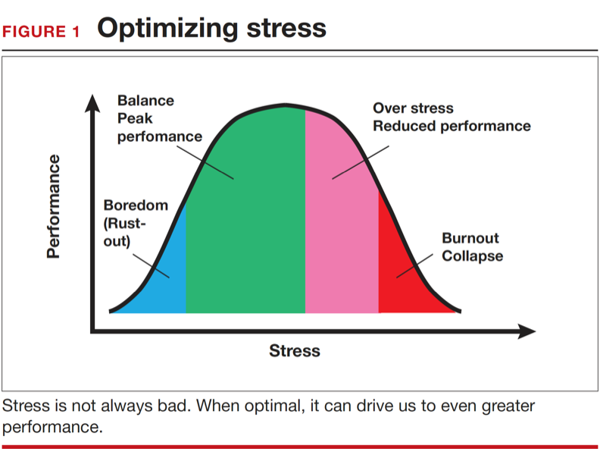
Stress: Friend or Foe?
Figure from Smith, 2016
Dr. Michelle Lizotte-Waniewski
Notes:
Talking Points:
The key is to maintain a stress level that is balanced in order to ensure optimum performance to stay in the green zone. Some level of stress improves performance but past a threshold stress becomes toxic and negatively affects performance.
Reference for Slide Content:
Smith, RP Strategies for maintaining resilience to the burnout threat. OBG Manag. 2016 October;28(10):17,18,20,22,23 – Permission granted by author.

Slide 7
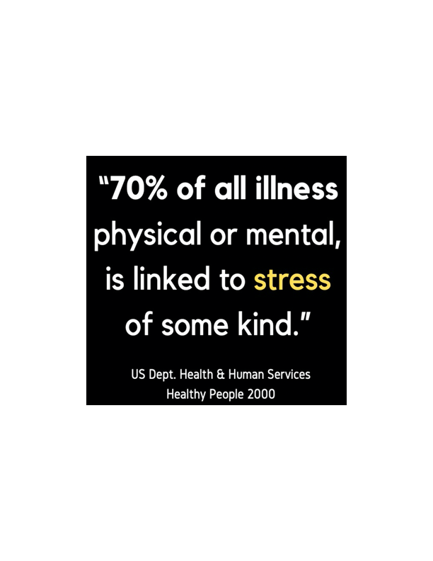
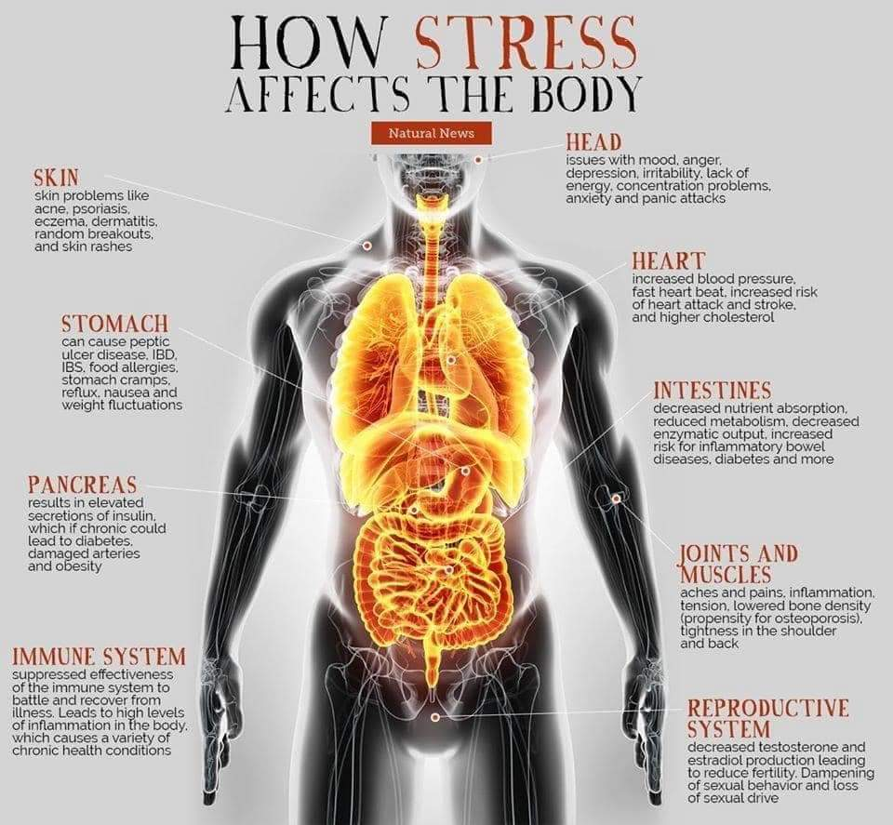
The Physiological Effect of Toxic Stress
Allosteric Overload – when the normal stress response becomes dysfunctional and leads to disease.
Dr. Michelle Lizotte-Waniewski
Notes:
Talking Points:
What is designed to be a short-term response (stimulus response followed by return to homeostasis) to an immediate threat can become a consistent state of allosteric overload.
Image Credits:
How Stress Affects the Body: https://scontent-mia3-1.xx.fbcdn.net/v/t1.6435-9/fr/cp0/e15/q65/97487549_1625917760906750_6625693632034766848_n.jpg?_nc_cat=104&ccb=1-5&_nc_sid=110474&efg=eyJpIjoidCJ9&_nc_ohc=nI1XfcbQ37sAX9MWyTL&_nc_ht=scontent-mia3-1.xx&oh=00_AT_jX7zxAtnzw_iBlUYN_JnMWoX-0Z7SfIfOGdjtvSxD6w&oe=62000895

Slide 8
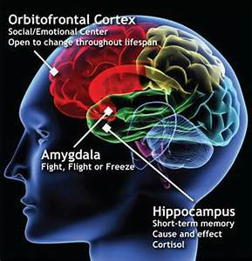
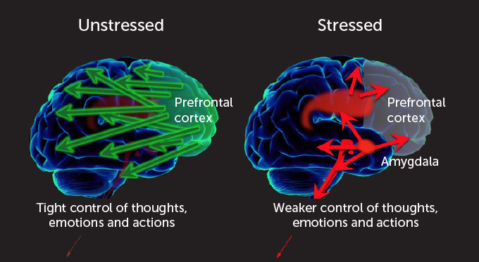
Crash Course: Your Brain on Overwhelm
Prefrontal Cortex – executive/high order functioning – planning, problem solving, concentration/focus, regulation of thoughts, emotions and behaviors. The more stress the smaller the volume of the PFC.
Amygdala controls emotional responses-
“fight or flight”. Associated with fear, anxiety, aggression, learned fear response, addiction. Important in forming and storing
memories of emotional events. The more stress the larger it gets.
Hippocampus plays a role in formation of
memories including spatial and navigation memories. The more stress the smaller it gets.
Dr. Michelle Lizotte-Waniewski
Notes:
Talking Points:
Stress changes your physiology: causes the parts of your brain responsible for executive function/behavior controls and memory (PFC and Hippocampus) to get smaller and the reactive emotional response center (amygdala) to get larger.
Potential analogy: Prefrontal cortex – the kindergarten teacher; Amygdala – classroom full of toddlers
Resources for Slide Content:
Amy F.T. Arnsten, Murray A. Raskind, Fletcher B. Taylor, Daniel F. Connor (2015). The effects of stress exposure on prefrontal cortex: Translating basic research into successful treatments for post-traumatic stress disorder, Neurobiology of Stress, Volume 1, 2015, Pages 89-99,
2) Kim, E. J., Pellman, B., & Kim, J. J. (2015). Stress effects on the hippocampus: a critical review. Learning & memory (Cold Spring Harbor, N.Y.), 22(9), 411–416. https://doi.org/10.1101/lm.037291.114
3) C. Liston, B. S. McEwen, B. J. Casey Psychosocial stress reversibly disrupts prefrontal processing and attentional control
Proceedings of the National Academy of Sciences Jan 2009, 106 (3) 912-917; DOI: 10.1073/pnas.0807041106
Image Credits:
1) Image of Brain: Image of Brain: https://commons.wikimedia.org/wiki/File:Kan_cia.jpg
This file is licensed under the Creative Commons Attribution-Share Alike 4.0 International license.
2) Stress on Brain: Normally, an alert person’s brain has moderate amounts of chemical messengers that lead the prefrontal cortex to take charge and perform high-level thinking (left). But with stress, those chemical signals can flood the brain, activating amygdala-linked brain networks involved in sensing and responding to threats (right). A. Arnsten

Slide 9






We Tend to Care for Everything but Our Minds
Work
Friends &
Community
Family
Significant Others
Our Bodies
Dr. Chantal Young

Slide 10
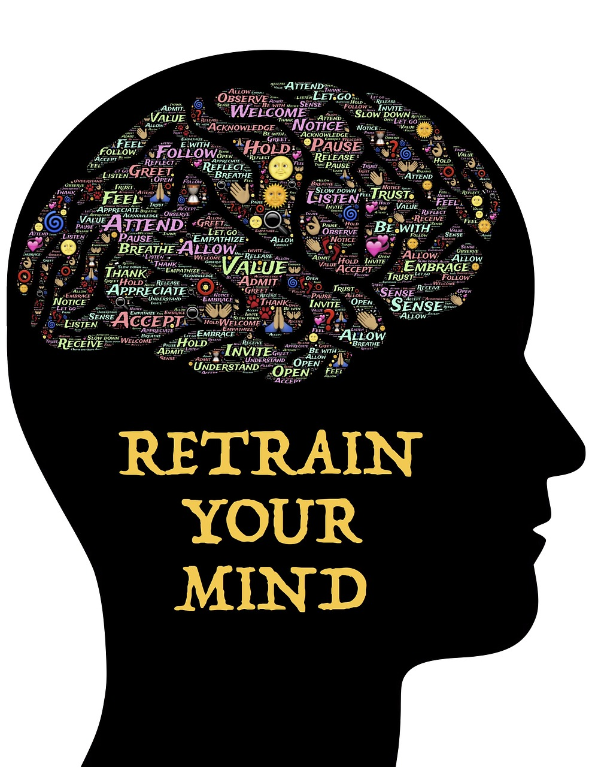
Why Meditate?
Unless we train our minds with mental exercise in the way that we train our bodies with physical exercise, there can be unhealthy outcomes that impact the quality of our lives.
The inability to manage stress can lead to negative mental and/or physical consequences that affect patient care.
More Incentive? Many CEOs from Fortune 500 Companies Meditate Daily! https://hbr.org/2015/12/how-meditation-benefits-ceos. https://www.billgeorge.org/articles/wall-street-bosses-tiger-woods-meditate-to-focus-stay-calm/
Dr. Michelle Lizotte-Waniewski
Notes:
Talking points:
Managing thoughts takes training. The literature is growing regarding the benefits of meditation for cognitive functioning and physical health.
Resources for Slide Content
1) Greeson JM and Chin, GR Mindfulness and physical disease: a concise review, Current Opinion in Psychology, Volume 28, 2019, Pages 204-210,
2) https://hbr.org/2015/12/how-meditation-benefits-ceos.
3) https://www.billgeorge.org/articles/wall-street-bosses-tiger-woods-meditate-to-focus-stay-calm/
Image Credits:
Retrain your Brain - https://www.maxpixel.net/Meditation-Mindfulness-Mindset-Self-awareness-743166 – CCO Public Domain

Slide 11
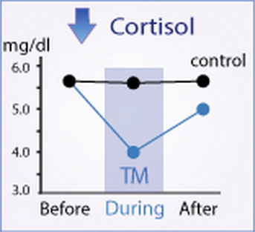
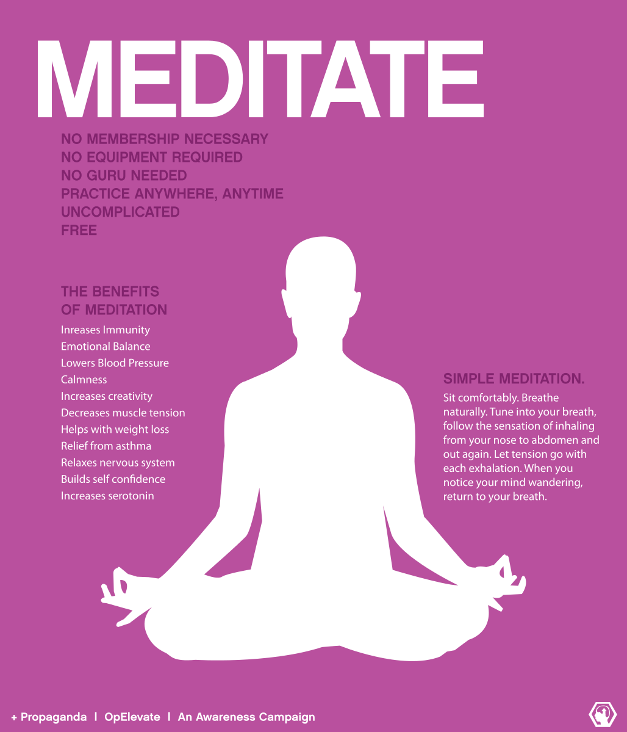
Benefits of Meditation
Physical Health Benefits
Decreases levels of cortisol
Lowers blood pressure
Reduces cardiovascular disease
Improves immune functioning
Mental Health Benefits
Improves working memory capacity
Increases empathy
Increases ability to focus attention
Induces higher levels of satisfaction
Improves sleep quality
Increases brain plasticity
Induces greater productivity/efficiency
Dr. Michelle Lizotte-Waniewski
Notes:
Image Credits:
Meditate Image: https://upload.wikimedia.org/wikipedia/commons/2/24/Meditate_opElevate.svg
This file is licensed under the Creative Commons Attribution-Share Alike 3.0 Unported license.

Slide 12
Meditation Effects on the Immune System
Mindfulness meditation and immune system biomarkers: A systematic review of 20 randomized controlled trials, comprising more than 1600 participants, revealed replicated, yet tentative, evidence that mindfulness meditation is associated with changes in select immune system processes involved in inﬂammation, immunity, and biological aging. (Black and Slavich, 2016)
Dr. Michelle Lizotte-Waniewski
Notes:
Reference for Slide Content and Image:
Black, D.S. and Slavich, G.M. (2016). Mindfulness Meditation and the Immune System: A Systematic Review of Randomized Controlled Trials”. Annals of the New York Academy of Sciences, 1373:13-24.

Slide 13
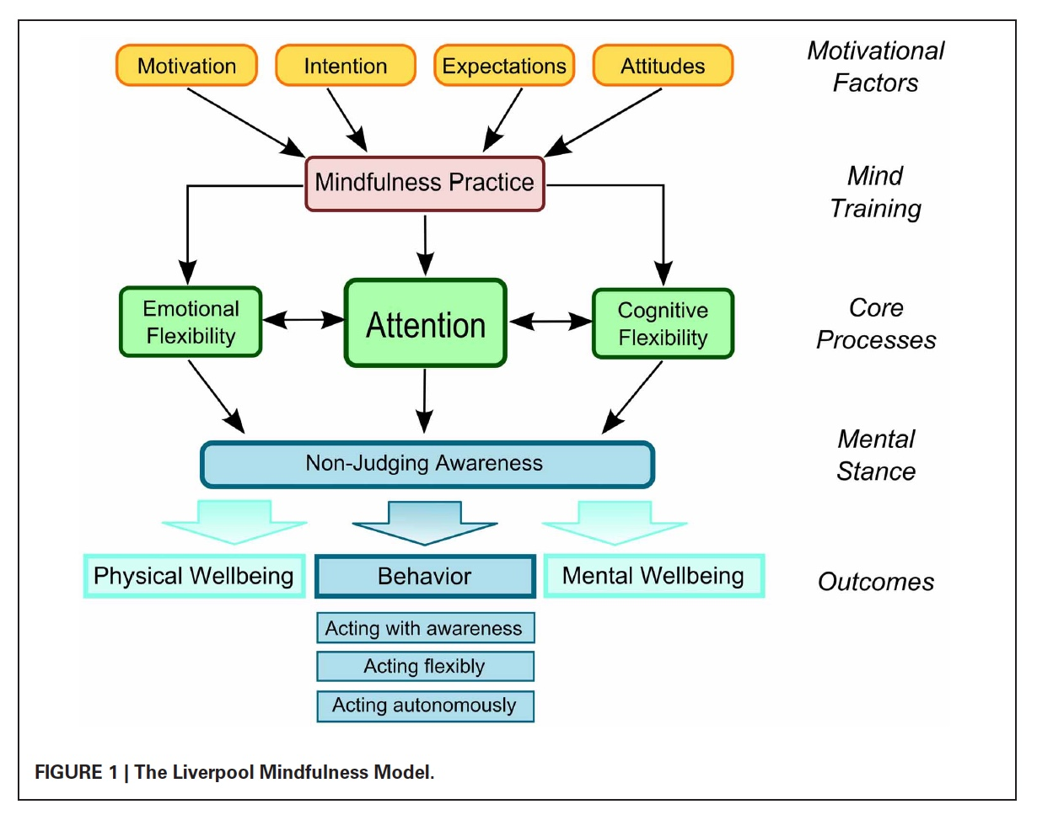
Your Brain on Meditation
Frontal Cortex – becomes larger with a greater volume of gray matter, self-regulation improves and brain plasticity increases
Amygdala - smaller and less reactive/sensitive
Meditation is used for chronic pain management, stress management, as part of a treatment regimen for addiction, anxiety and depression, and as a performance-enhancement tool.
Dr. Michelle Lizotte-Waniewski
Notes:
Talking Points:
Analogy reminder: Prefrontal cortex – the kindergarten teacher
Amygdala – classroom full of toddlers
Resources for Slide Content:
Amy F.T. Arnsten, Murray A. Raskind, Fletcher B. Taylor, Daniel F. Connor (2015). The effects of stress exposure on prefrontal cortex: Translating basic research into successful treatments for post-traumatic stress disorder, Neurobiology of Stress, Volume 1, 2015, Pages 89-99,
2) Kim, E. J., Pellman, B., & Kim, J. J. (2015). Stress effects on the hippocampus: a critical review. Learning & memory (Cold Spring Harbor, N.Y.), 22(9), 411–416. https://doi.org/10.1101/lm.037291.114
Image Credits:
Liverpool Mindfulness Model: https://www.researchgate.net/figure/The-Liverpool-Mindfulness-Model_fig3_235402631
Creative Commons Attribution 3.0 Unported
ADAPTATION: Colored boxes around “mind training” and “mental stance”

Slide 14
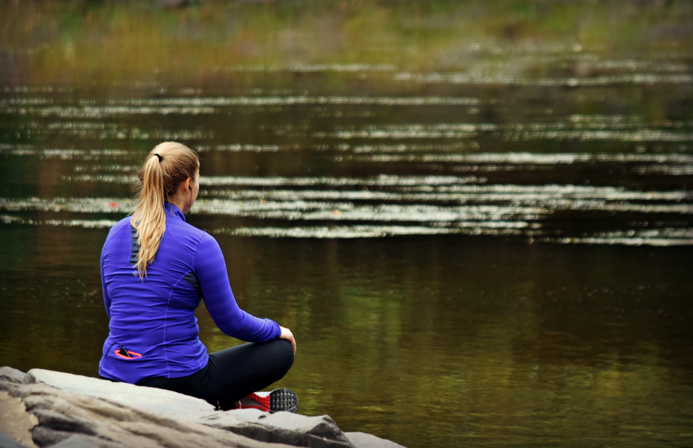
So….. What is Meditation ?
A mental discipline in which the practitioner attempts to move beyond reflexive thinking into a deeper state of awareness (or relaxation) by intentional focus.
While there are many types of meditation, they all share several of the same characteristics:
Focused attention/awareness
Paced breathing
Comfortable posture
Dr. Michelle Lizotte-Waniewski
Notes:
Resources for Slide Content:
Mayo Clinic: https://www.mayoclinic.org/tests-procedures/meditation/in-depth/meditation/art-20045858
Image Credit:
Meditation: https://www.flickr.com/photos/mtsofan/21249041964. Attribution-NonCommercial-ShareAlike 2.0 Generic (CC BY-NC-SA 2.0)

Slide 15
Misperceptions
Meditation is clearing the mind
Meditation is relaxing
Meditation is good for everyone (mindfulness is though)
Meditation is a replacement for other self-care behaviors
Dr. Chantal Young
Notes:
Possible Script:
Remember, if you try formal meditation, your mind will mutiny immediately. It will say: What’s for lunch? Do I need a haircut? What time should I set my alarm clock tomorrow? This is not a problem. The goal is not to stop thinking but to focus your mind for a few nanoseconds at a time and NOTICE when you get distracted and start again. Each time you bring your attention back it is like a bicep curl for your brain. Every time you notice you’re on a thought, and you bring it back to your object of attention, you did it. You were 100% successful because you noticed. Nobody ever clears their mind except for brief periods that come from allowing the mind to do exactly what it does. The less enchanted you are by the voice in your head, the more you can make room for entirely new kinds of thoughts and feelings to emerge.
Mindfulness is sometimes relaxing, but sometimes the goal is to look inside and see what’s going on, and if that’s chaos, you’re not going to feel relaxed, but you are still building a skill that will serve your overall relaxation.
Meditation is not good for everyone, in particular anyone with a history of trauma, or a history of panic attacks or high anxiety. Those of us with these concerns can still benefit from meditation but we may need some altered practices for it to work well with our system.
Mindfulness is not a replacement for (but may support!) other healthy and skillful life strategies such as exercise, social connection, medical care, medicine, nutrition, and therapies.

Slide 16
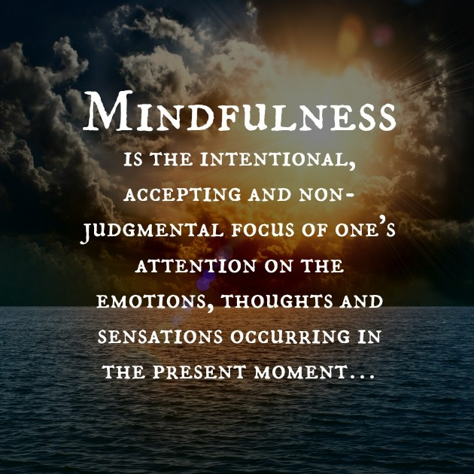
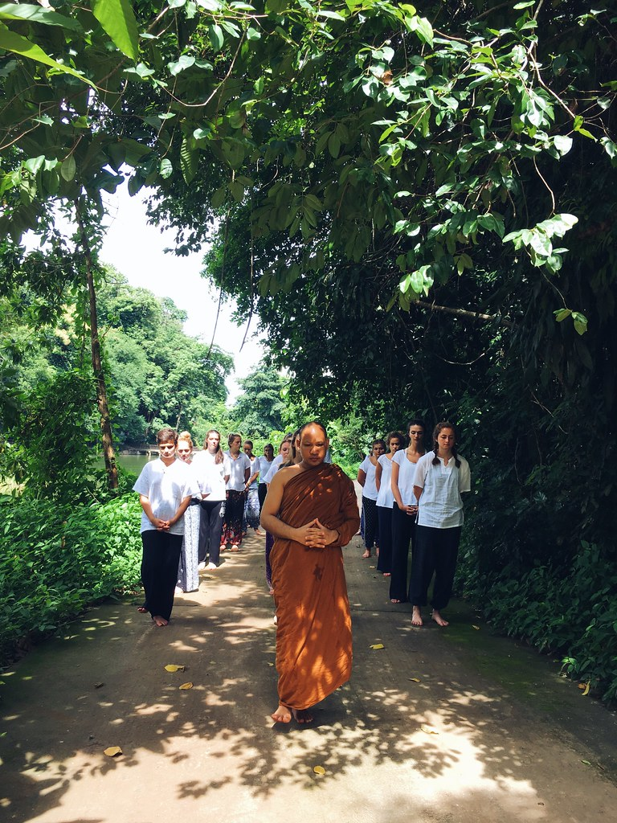

Meditation Can Take Many Forms
Mindfulness (focus attention on breath, sensations, candle)
Body Scan
Guided (Visualization/Virtual Reality)
Mantra Meditation (including Transcendental)
Walking/Movement (focus on movements of walking)
Journaling/gratitude
Prayer (Contemplative or Meditative)
Dr. Michelle Lizotte-Waniewski
Notes:
Talking Points:
Since meditation can take many forms, learners can try a few different approaches and find what works best for them and stick with those methods. These types of meditation are not mutually exclusive – for example you can have a guided breath meditation (mindfulness and guided). We will go through several of these forms of meditation and also practice a few in the upcoming slides.
Image Credits:
Mindfulness Definition: https://agelessglamouronline.com/mindfulness-the-heart-of-relationships/
Walking Meditation Image: "walking meditation" by UI International Programs is licensed with CC BY-ND 2.0. To view a copy of this license, visit https://creativecommons.org/licenses/by-nd/2.0/
Be Grateful Image: "Be Grateful." by SnoShuu is licensed with CC BY-NC-ND 2.0. To view a copy of this license, visit https://creativecommons.org/licenses/by-nc-nd/2.0/

Slide 17
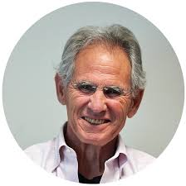
Mindfulness is..
Mindfulness is awareness that arises through paying attention, on purpose, in the present moment, non-judgmentally.
-Jon Kabat-Zinn
Dr. Chantal Young

Slide 18

Cultural Roots of Mindfulness
5,000 year history with roots in India, Buddhism
Diverse human usage across time, geography, and religion
Historical/religious vs. Western/secular
Gained popularity in US
  Arrival of Mindfulness-Based Stress Reduction in the 1980s
  Received attention in medicine with Ronald Epstein’s 1999 article Mindful Practice in JAMA
My limitations
Dr. Chantal Young
Notes:
Mindfulness meditation was discovered in India and has roots in Buddhism. But has diverse…
Secular mindfulness programs started about 30 years ago and are operating all over the world.
Teachers/instructors of mindfulness material would ideally represent the diversity of the population. I’m aware of being a white, a-religious woman teaching this beautiful and historic material, and the bent with which I’m teaching which is a scientific and practical lens. I am not able to not adequately represent the history and meaning of mindfulness.
Image Credit:
buddha monk meditation: https://pixabay.com/photos/buddha-monk-meditation-buddhist-6027762/
Public Domain Pixabay License Free for commercial use No attribution required

Slide 19

Key Concepts: Mindfulness
Here and now focus
Beginner’s mind
Attempting non-judgment
NOT: relaxation or clearing the mind
Dr. Chantal Young
Notes:
Image Credits:
Zen Relax Peace : https://www.google.com/search?q=mindfulness&tbm=isch&tbs=il:cl&client=firefox-b-1-d&hl=en&sa=X&ved=0CAAQ1vwEahcKEwjAi-D60PL0AhUAAAAAHQAAAAAQAg&biw=1326&bih=861#imgrc=LYuaA2DN_toonM

Slide 20
Continuum of Awareness (Niemiec, 2013)
Mindfulness --------------------------------------------------------------------- Mindlessness wandering/autopilot
Here, now Then, later
Skillful responding Habitual reacting
Aware, present Distracted (monkey mind)
Mode of being Mode of doing
Allowing/letting be Fighting (the experience)
Accepting/Facing reality Avoiding
Niemac, RM. Mindfulness & Character Strengths: A practical guide to flourishing.
Boston: Hogrefe, 2014.
WMed Team
Notes:
This continuum helps to highlight the distinction between bringing ‘mindfulness’ versus ‘mindlessness’ to our day-to-day activities.
Image Credits:
Zen Relax Peace : https://www.google.com/search?q=mindfulness&tbm=isch&tbs=il:cl&client=firefox-b-1-d&hl=en&sa=X&ved=0CAAQ1vwEahcKEwjAi-D60PL0AhUAAAAAHQAAAAAQAg&biw=1326&bih=861#imgrc=LYuaA2DN_toonM

Slide 21
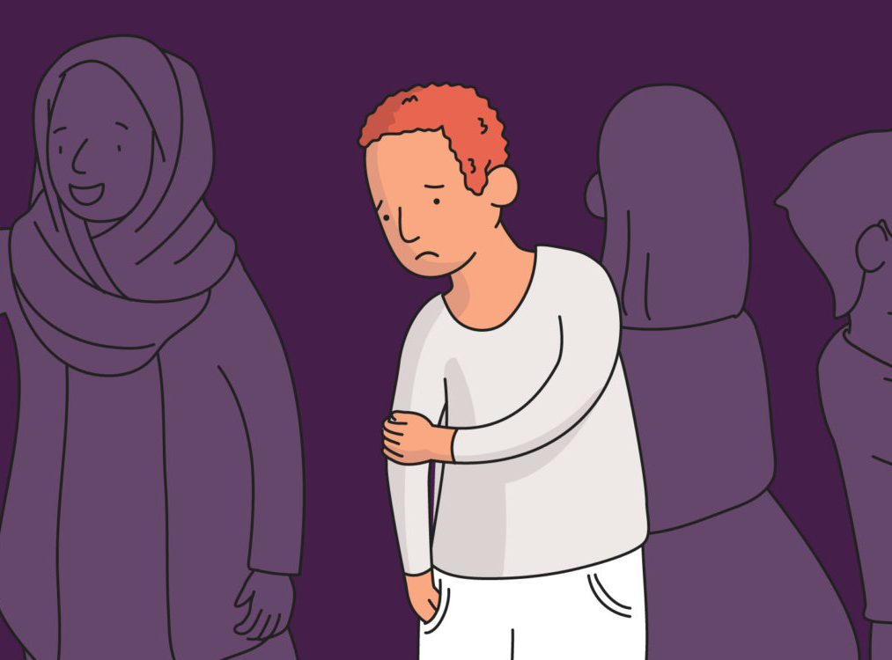

Self-consciousness vs. Self-awareness
Self-consciousness is the undue awareness of oneself, one’s appearance or one’s actions
  Judgmental and unpleasant
Self-awareness is the conscious understanding of oneself and one’s feelings, motives, desires, and actions
  Non-judgmental and neutral or pleasant
Dr. Chantal Young
Notes:
Self-consciousness – med students are usually high on this. An excessive focus on the self, a self-involved process. Consumed with mental activity and believing the thoughts about the self that are crossing the mind, which are often related to perceived flaws and how one comes across the others.
Self-awareness - a detachment from mental activity and thoughts about the self. It means being able to notice, catch, observe self-conscious thoughts while not being consumed by them or really even believing them at all. You might think you are a very self-aware person when what you really may be is a very self-conscious person. You might be hyper aware of your own faults and flaws, you might be able to observe yourself in social situations and how other people view you, and this can be a great start. The next step is developing that mindfulness muscle so that your self-consciousness transforms into an objective and scientific observing of yourself.
Scientists don’t judge the objects they observe. They don’t assign good or bad to what they observe.

Slide 22
Features of Mindfulness
“Clear”
Nonconceptual, nondiscriminatory
Flexible
Empirical
Stable
Dr. Chantal Young
Notes:
Nonconceptual – not merely concepts in the mind, but direct, immediate experience which is real, recognizable and knowable.
Nondiscriminatory – not biased or favoring some sources of information over others.
Stable – not easily disturbed or rattled, firm and steady.
Now if you didn’t know this slide were on mindfulness, this would just sound like good clinical practice and a highly competent physician.
So what we are offering you today at the very start of your medical career is that although mindfulness is often used as a spiritual, self-care, and/or therapeutic technique, it is also a fundamental skill in practicing medicine well.

Slide 23
We Can be Mindful of:
Sensory input (information coming in through sight, sound, smell, taste, and touch)
Body (breath, movements, pain, pleasure)
Mind (thoughts, attitudes, beliefs)
Emotions (actually just a combination of body + mind!)
©Mindful Practice Programs, University of Rochester, 2010
Dr. Chantal Young
Notes:
We can really only be mindful of 4 things or maybe 3.
So what’s really cool is you can use your mind to be the scientific observer of your mind.

Slide 24

Breath Meditation (Possible Activity)
Dr. Michelle Lizotte-Waniewski
Notes:
Let’s practice being mindful by doing a brief (2-3 minute) breath meditation. Using a focus on your breath to achieve a mindful state.
Possible Script for Breath Meditation:
There is no right or wrong way to meditate. Whatever you experience during this breathing meditation is right for you. Don’t try to make anything happen or judge it, just observe. As thoughts go into and out of your mind think of your mind as a blue sky watching clouds go by – watching not engaging and returning your mind to your breathing. You can’t stop your mind from thinking you can only choose not to interact with the thoughts.
Straighten your back but don’t stiffen it, rest against the chair and lower your shoulders.
Put your feet flat on the ground in a comfortable position and let your hands just rest in your lap in whatever way is comfortable.
Once you are comfortable, gently close your eyes. Relax the muscles in your face and feel your hands in your lap and your feet making contact with the floor.
Now take a deep breath in through your nose and hold it for 3 seconds and exhale from your mouth.
As you take another deep breath in and feel how your lungs are expanding as you take the air in.
Slowly exhale feeling your lungs get smaller. As you exhale, you can feel the tension and stress leave your body.
When you take another breath in notice your chest and abdomen rise. Exhale releasing any remaining tensions from your body.
As you continue to breathe in and out; notice how calm and gentle your breathing is, and how relaxed your body feels.
Inhale again and feel your heart slowing, hold the breath for 3 seconds then exhale from your mouth.
As we breath one last time, we are breathing in calm and confidence and as we and as we exhale this last time, we remove all anxiety and stress.
As we finish the exercise, when you feel comfortable you can gently open your eyes.
Image Credits:
Beach Image: "Tropical Beach" by A. Munar is licensed with CC BY-SA 2.0. To view a copy of this license, visit https://creativecommons.org/licenses/by-sa/2.0/

Slide 25

One Breath (Possible Activity)
Dr. Chantal Young
Notes:
Let’s do a short practice. Did you know that each breath only lasts about 5 seconds. And for this practice I’d like you imagine that your entire mindfulness practice is about one single breath. You breathe in, and then out, and at the end of that breath, your period of mindfulness practice is over.
Let’s try it.
Take an upright, balanced posture, close your eyes if that is comfortable to you, and in a moment, I will ask you to take a single breath, while giving it all of your attention. I want you to see how fully and completely you can experience that breath. Do it right now.
Keeping your eyes closed, that wasn’t not hard, and of course, nothing dramatic happens, you are just noticing your breath, but you are doing something that most people have never tried. You are intentionally bringing all of your attention to what is happening in the present moment. You have started your training in mindfulness.
Try the same thing again, but this time, pay attention to three breaths. I will tell you when to start. When you notice your first breath, see if you are giving it your full attention. Often we notice something without experiencing it fully. It is possible to practice mindfulness with only part of your mind. Obviously, that isn’t our goal now. If you find that part of your attention is somewhere else on your first breath, see if you can bring more of your attention to the second breath. And finally, see if you can bring all of your attention, which is completely possible, to your third breath. It might almost feel as if there is not separation between your attention and your breath; as if you are fully and completely experiencing the sensation of the flow of the breath. So now, take a moment to settle yourself, relax into your body, close your eyes, and in a moment I will ask you to bring all of your attention to three breaths in a row. See what it feels like to experience each breath a little more fully than the one before. See if you can completely merge your attention to the breath. Start your 3 breaths now.
BELL
You can open your eyes. So imagine if you kept doing that for 20 breaths, or 50, or 300, that would get you to do a sitting meditation for half an hour. And can you imagine the joy and freedom of being so present without intrusive thoughts? That’s what we slowly work up to.

Slide 26
Mindfulness in 0 Seconds (for busy people):
12 Practices that can be paired with other activities
Mindful eating (sensory experience, origin of food –can extend into cooking)
Mindful walking (especially while outside en route to school etc.)
Shifting up one’s pace with activities (slow/fast approaches)
Mindful emailing/texting (with gratitude/”loving-kindness”)
Anchoring mindfulness pauses with everyday events (red lights, brushing teeth)
Looking around when you have to wait (bank, appointments, checkout lines)
Imagine taking a picture (or take it) of something ordinary & something extraordinary
Feeling gratitude (when it naturally arises) evokes mindfulness
Bringing curiosity to an object (consider the care/intelligence that went into designing it)
Picking a color: notice it throughout the day—imagine describing it to someone
Noticing your inbreath and outbreath as you’re falling asleep
Creating a mindfulness practice no one has ever thought of—don’t tell anyone
WMed Team
Notes:
For many of us who are too busy to consider setting aside time to practice mindfulness, these mindfulness activities, which can be paired with other activities, can be very useful. This slide can be shared as a handout as well.

Slide 27
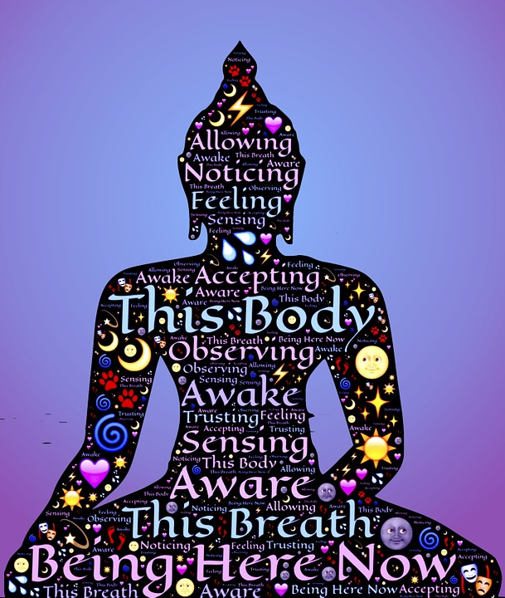
Body Scan Meditation
Can be performed while sitting or lying down
Involves the focus on the sensations of each part of the body (either top to bottom or bottom to top) followed by a relaxation of that body part.
As the practitioner progresses from 1 part of the body to the next, the goal is to maintain the relaxation of the previous sections of the body (progressive relaxation).
The practice trains you to become aware of all sensations – whether pleasant or unpleasant – that are present in the body.
Often requires 15-30 minutes to complete, although guided meditations are available for 5-10 minutes of practice (https://ggia.berkeley.edu/practice/body_scan_meditation).
Dr. Michelle Lizotte-Waniewski
Notes:
Image Credit:
Meditation: Creator: MaxPixel's contributors | Credit: https://www.maxpixel.net/photo-1054232
Copyright: Copyright by MaxPixel

Slide 28
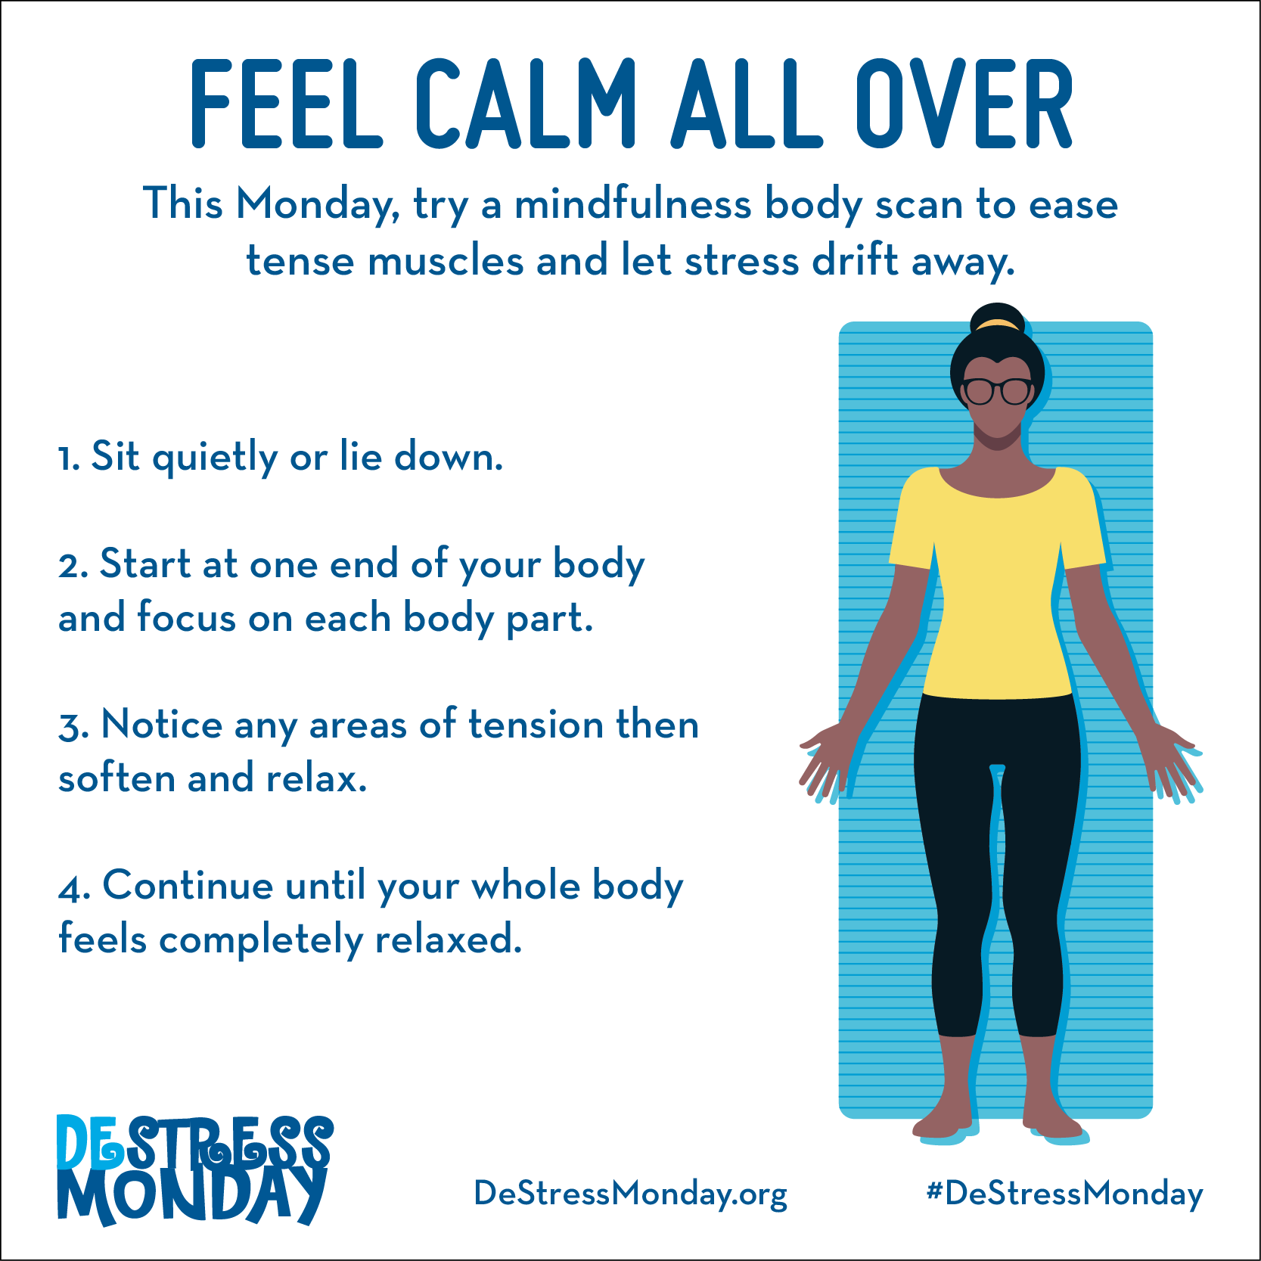
Simple Body Scan Meditation
https://www.mondaycampaigns.org/destress-monday/beat-stress-this-monday-with-a-mindful-body-scan
Dr. Michelle Lizotte-Waniewski
Notes:
Possible Activity: 4 Minute Body Scan Possible Activity
SCRIPT: FROM GREATER GOOD IN ACTION (UC BERKELEY): file:///Users/mlizotte/Desktop/practice_body_scan_meditation.pdf
The body scan can be performed while lying down, sitting, or in other postures. The steps below are a guided meditation designed to be
done while sitting. You can listen to audio of this three-minute guided meditation, produced by UCLA’sMindful Awareness Research
Center (MARC), in the player; if it doesn't play, you can find it here or download it from MARC's website.*
Especially for those new to the body scan, we recommend performing this practice with the audio. However, you can also use the script
below for guidance for yourself or for leading this practice for others.
1. Begin by bringing your attention to your environment, slowly looking around and noticing that you are safe in this moment.
2. Bring your attention into your body.
3. You can close your eyes if that’s comfortable for you or maintain a soft gaze, with your eyes partially closed but not focusing on
anything in particular.
4. You can notice your body seated wherever you’re seated, feeling the support of the chair or the floor beneath you.
5. Take a few deep, long breaths, within the range of what is comfortable for you.
6. And as you take a deep breath, bring in more oxygen, enlivening the body. And as you exhale, you might experience a sense of
relaxing more deeply.
7. You can notice your feet on the floor, notice the sensations of your feet touching the floor. The weight and pressure, vibration,
heat.
8. You can notice your legs against the chair, pressure, pulsing, heaviness, lightness.
9. Notice your back against the chair, supporting you. If you are not able to notice sensations in all areas of the body, that is OK. We
are more connected to certain areas of the body than others, at different times of the day.
10. Bring your attention into your stomach area. If your stomach is tense or tight, can you allow it to soften? Take a breath.
11. Notice your hands. Are your hands tense or tight? See if you can allow them to soften.
12. Notice your arms. Feel any sensation in your arms. Do your best to allow your shoulders to be soft.
13. Notice your neck and throat. Try to allow them be soft. See if you can invite a sense of relaxation in.
14. Try to soften your jaw. Do your best to allow your face and facial muscles to be soft.
15. Then notice your whole body present. Take one more breath.
16. Be aware of your whole body as best you can. Take a breath. Slowly open up the eyes, without focusing on anything in particular.
Allow the head and neck to gently rotate, taking in the space you are in. When you feel ready, you can return to your normal gaze.
Body Scan MeditationImage not found or type unknown

Slide 29
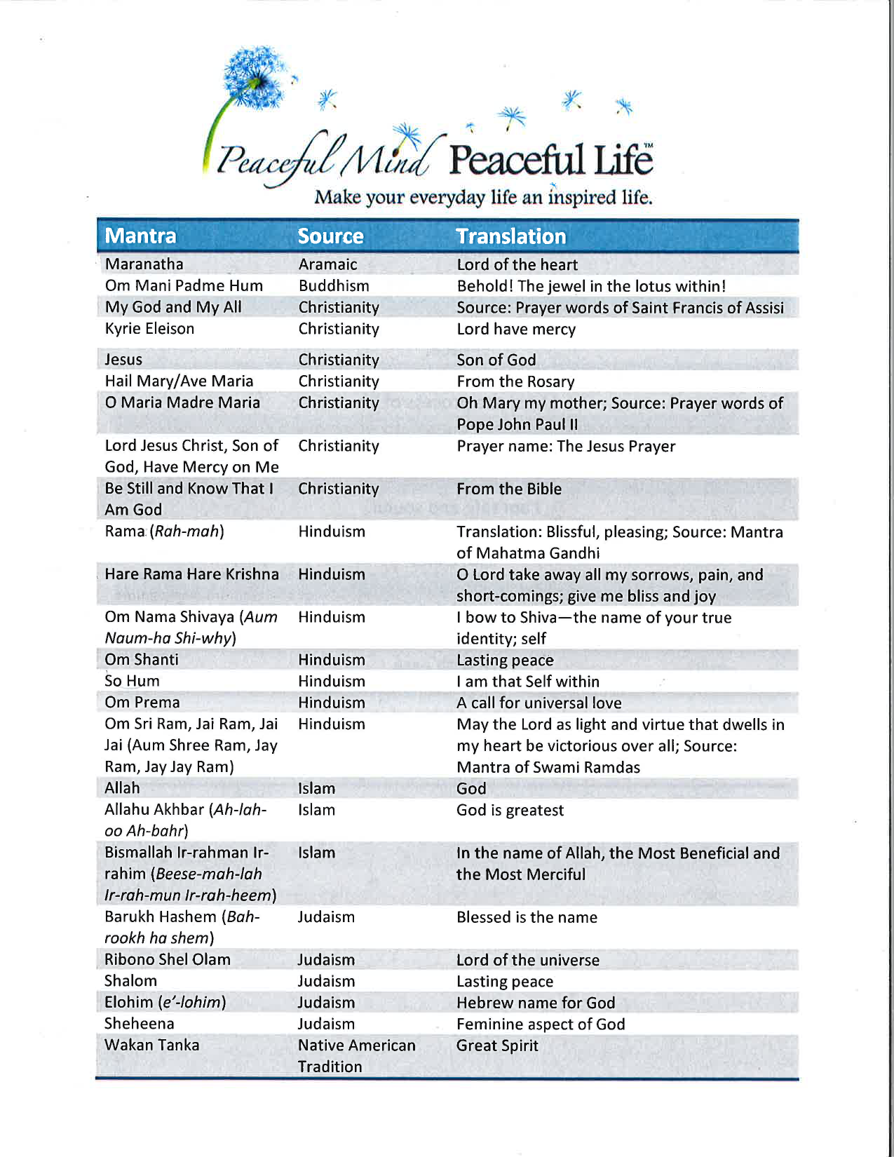
Mantra Meditation
Just a word, phrase, or prayer with a long history of use that is considered “sacred/holy” by the tradition/culture from which it originated.
The mantra can be spoken, chanted or repeated silently in the mind continuously for some period of time, and often used in conjunction with the breath.
Choose 1 mantra that resonates for you and it can be used to immediately connect to your center – be that God/Spirit/Beloved
Dr. Michelle Lizotte-Waniewski
Notes:
Image Credit:
Document from Peaceful Mind, Peaceful Life used with permission from Barbara Schdmidt.

Slide 30
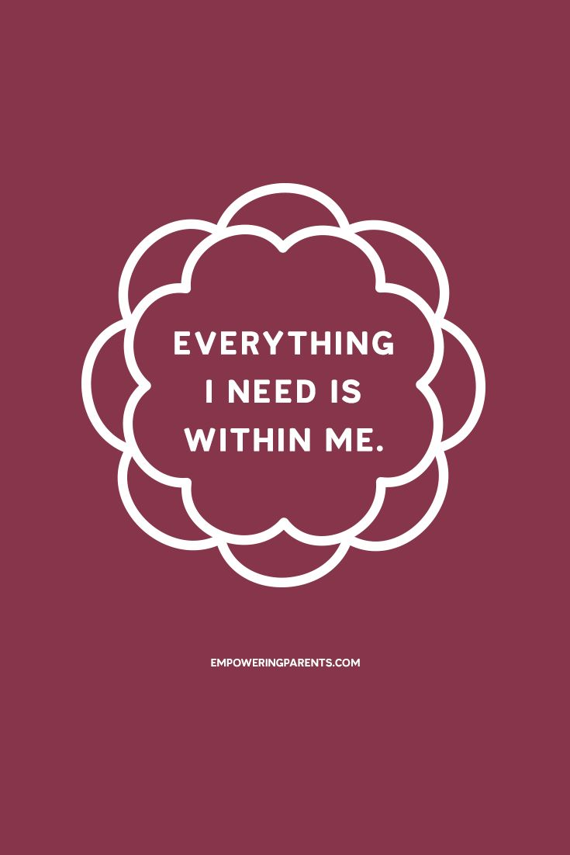
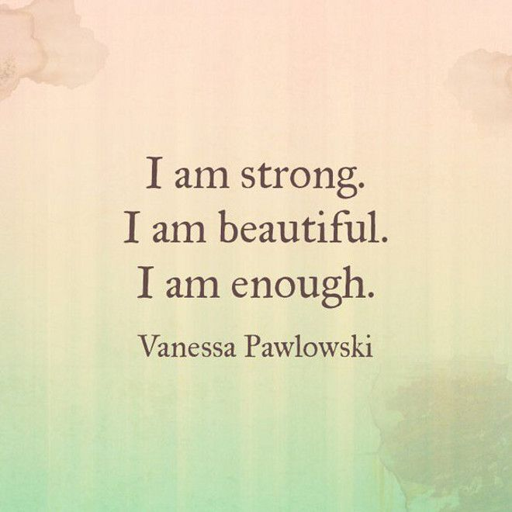
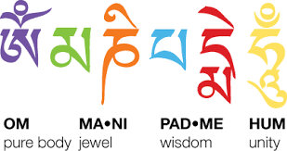
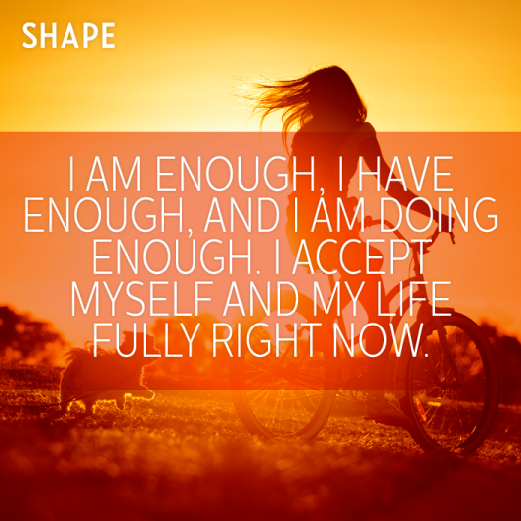

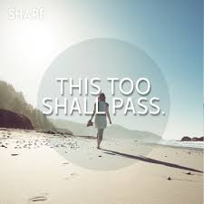



Sample Mantras
Dr. Michelle Lizotte-Waniewski

Slide 31
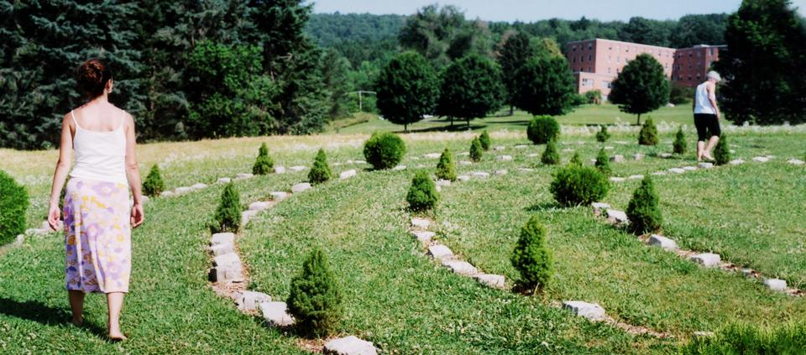
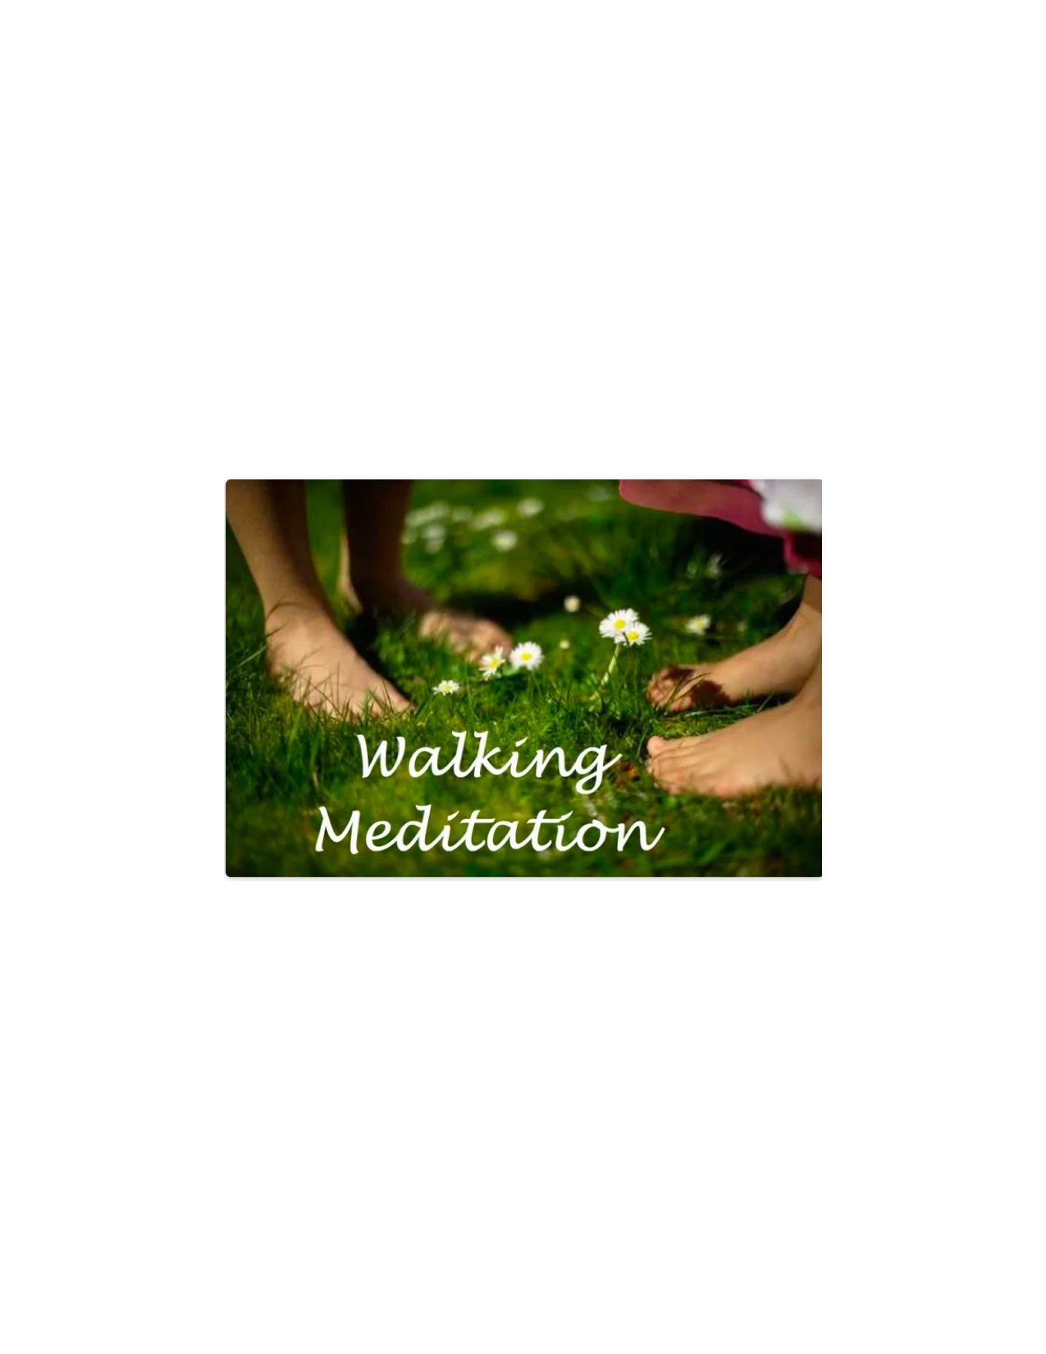
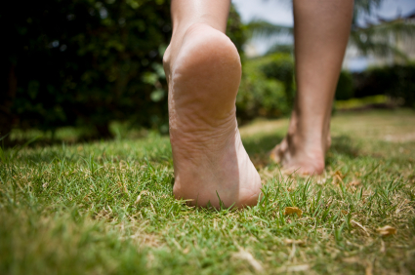
Walking Meditation
Is NOT the type of brisk walking that you do for exercise.
It is intentional walking paying attention to your feet stepping, your arms swinging and how your body feels as you move in silence.
Can be a good place to start because it presents less of a challenge than sitting still.
Dr. Michelle Lizotte-Waniewski
Notes:
Image Credits:
Walking Labryinth (Top): https://kripalu.org/resources/walking-circles-lore-labyrinth
Feet Walking (Middle): https://blog.spiritvoyage.com/yoga-for-beginners-walking-meditation/
Walking Meditation (Bottom): https://mindfulvalley.com/about/walking-meditation-basics/

Slide 32
Let’s Play a Game..
(Optional Activity)
How good is your awareness and perception….?
Dr. Michelle Lizotte-Waniewski
Notes:
Talking Points:
Now we are going to play a game. In just a minute I am going to show you a picture which I am going to leave up for 20 seconds. While the picture is showing, identify as many objects as you can that either black or brown without writing them down. After 20 seconds is done, I will remove the photo and as that you recall from memory the objects you identified. Ok I am starting my timer for 20 seconds... Now
(ADVANCE TO NEXT SLIDE FOR 20 Seconds only)

Slide 33

Notes:
Leave this slide on the screen for 20 seconds and then quickly advance to next slide.

Slide 34
Recall test...
How good is your awareness and perception….?
Dr. Michelle Lizotte-Waniewski
Notes:
Script:
Ok, now tell me what objects did you identify that are black ? (allow time for answers). And which objects did you identify that are brown? (allow time for answers).
Now tell me what objects you identified in the picture that are green? What about blue? Purple?
The audience will (hopefully) more readily objects that were brown or black than any other color.
Talking Points:
Awareness in life is might like this game. We go through so much of our day seeing only the brown or black (the negative things that happen to us) that we miss many of the blue/green/purple events because we are not focused on them. How can we change that awareness?

Slide 35

Gratitude/Journaling
Centers on remembering the positive things that happen to us daily, rather than the negative.
At the end of each day, you will need to write down at least 3 good things that happened that day.
After a short time, we begin to NOTICE the moments in our day that we are grateful for as they happen.
This leads to a mental stance of gratitude throughout the day.
Journaling can also help us to “mind dump” negative feelings or traumatic events at the end of each day so that we can release them.
Dr. Michelle Lizotte-Waniewski
Notes:
Talking Points:
At first we have to make a conscious choice to notice the positive things that happen to us throughout our day, but as we practice this we become more aware of them and the mental stance of gratitude becomes a habit.
Image Credit:
Gratitude Journal Prompts https://rhythmsofplay.com/gratitude-journal-prompts-printable/

Slide 36

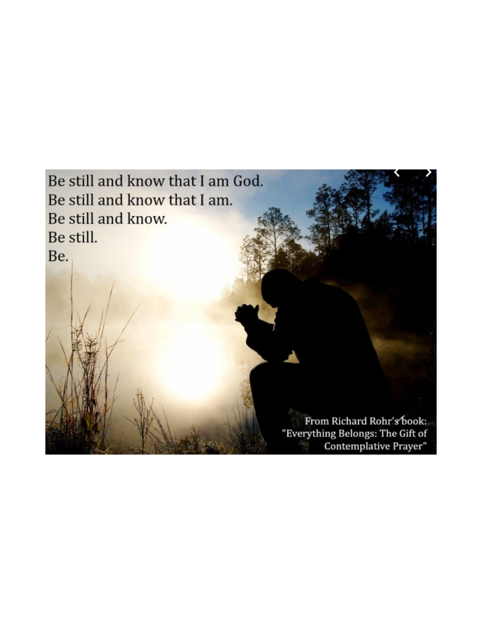
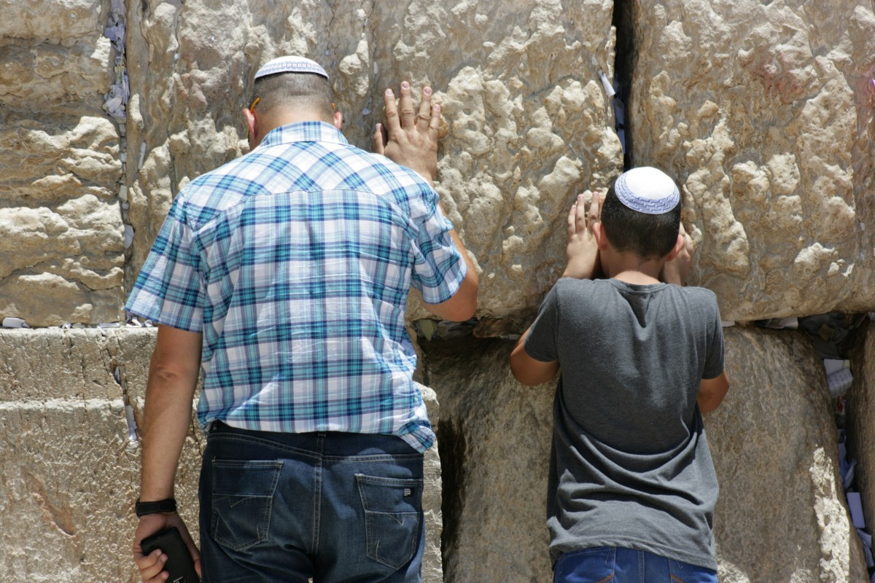
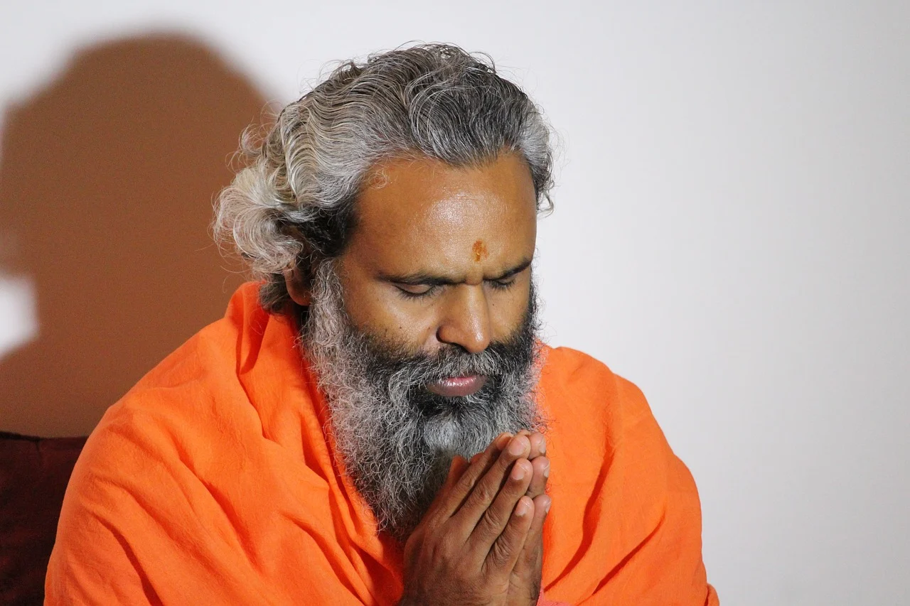
Prayer
Communing with your higher power as you know him/her/them.
Contemplative prayer is the opening of the mind and heart to God/Beloved/Universe beyond emotions, thoughts and words – just being in His/Her/Their presence.
Meditative prayer involves silently meditating on sacred texts, devotionals, sunrises/sunsets etc in order to experience their deeper meaning.
Dr. Michelle Lizotte-Waniewski
Notes:
Image Credits
Muslim Prayer: https://pixabay.com/illustrations/muslim-islamic-prayer-mosque-5075080/
Pixabay License Free for commercial use No attribution required
Hindu Prayer: https://pixabay.com/photos/prayer-hindu-swami-namaste-1855784/
Pixabay License Free for commercial use No attribution required
Jewish Prayer: https://pxhere.com/en/photo/727436
CC0 Public Domain Free for personal and commercial use No attribution required

Slide 37
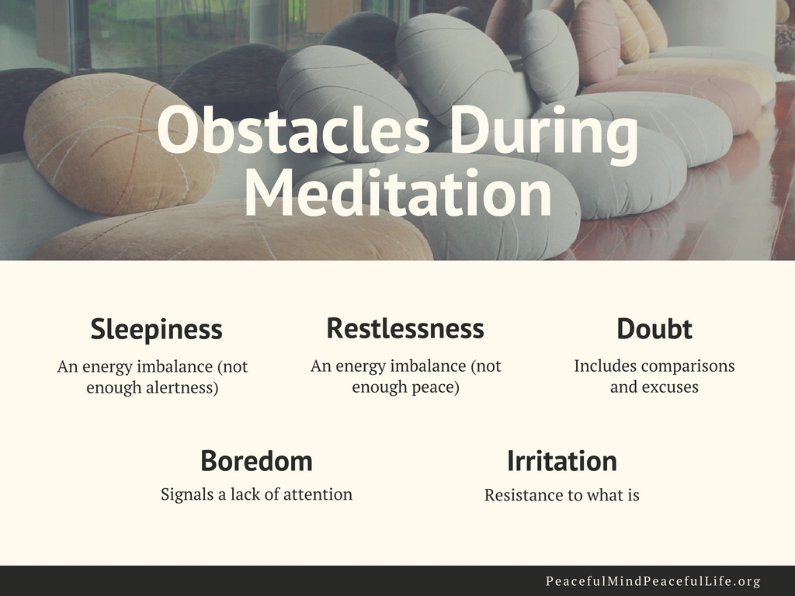
BUT- I can’t meditate because…
Dr. Michelle Lizotte-Waniewski
Notes:
Talking points:
Mind-wandering is REQUIRED for meditation. Your mind has to go somewhere else
before you can notice/be aware that it has gone somewhere else and bring it back.
Image Credit:
Slide provided by Peaceful Mind, Peaceful Life with permission from Barb Schmidt

Slide 38
Recap: Types of Meditation Discussed
Mindfulness (focus attention on breath, sensations, candle)
Body Scan
Mantra Meditation
Walking/Movement (focus on movements)
Journaling/gratitude
Prayer (Contemplative or Meditative)
Dr. Michelle Lizotte-Waniewski
Notes:
Talking Points:
Since meditation can take many forms, learners can try a few different approaches and find what works best for them and stick with those methods. These types of meditation are not mutually exclusive – for example you can have a guided breath meditation (mindfulness and guided). We will go through several of these forms of meditation and also practice a few in the upcoming slides.
Image Credits:
Walking Meditation Image: "walking meditation" by UI International Programs is licensed with CC BY-ND 2.0. To view a copy of this license, visit https://creativecommons.org/licenses/by-nd/2.0/
Be Grateful Image: "Be Grateful." by SnoShuu is licensed with CC BY-NC-ND 2.0. To view a copy of this license, visit https://creativecommons.org/licenses/by-nc-nd/2.0/

Slide 39
Specific Benefits for Medical Students, Residents, Physicians
Higher resilience in residents (Romcevich 2018)
Less burnout in physicians 3 months after (Schroeder 2016)
Less exhaustion and more self-compassion for physicians and nurses in the ICU (Gozalo 2018)
Higher distress tolerance in med students (Kraemer 2016)
More skill in delivering bad news in ENT residents (Mengin 2017)
Dr. Chantal Young
Notes:
Four 90-minute mindfulness sessions with follow-up online sessions created improvements in residents’ perceived stress and resilience. (Romcevich et al., 2018)
Brief mindfulness intervention (13-hour weekend training with 2–hour follow-up sessions) demonstrated improvements in physician stress and burnout 3-months after. (Schroeder at al., 2016)
Mindfulness workshop followed by 8 weeks of virtual guided practices with positive effects on ICU physician’s/nurses’ emotional exhaustion and self-compassion. (Gozalo et al., 2018)
Actually all kinds of things have been show to improve in med students specifically, including their mood,XX
But this study in particular I wanted to share because it looked at distress tolerance, deﬁned as the ability to withstand emotional distress, significantly improved in medical students who undertook an 11 week mindfulness class.
Delivering bad news is a stressful moment for both patient and clinician. As poor bad-news consultation quality may lead to misunderstandings, lack of treatment adherence, acute or even post-traumatic stress in patients. They had ENT residents a very short mindfulness meditation session performed just before a simulated breaking bad-news consultation to patients with laryngeal [lair-en-GEE-uhl] cancer and the patients perceived significantly higher empathy as a result.

Slide 40
Physician Well-being and Resilience
A patient care issue
Dr. Chantal Young
Notes:
Shifting gears now to physician well-being.
If only we could just keep ourselves in a vacuum where nothing we do affects anyone else, but we are social creatures so this is not the case. Your wellbeing as physician affects not only people close to you but your patients. You are an element of healing, just as much as any medication or procedure, and so the state of your mind and heart is something you can channel for your patients improvement.

Slide 41
Physician
well-being
(resilient/burned out)
Quality of care
(safety/errors)
Quality of caring
(empathy/detachment)
Shanafelt, T. D., et al. (2002). Burnout and self-reported patient care in an internal medicine residency program.
Ann Intern Med, 136, 358-367
Shanafelt, T. D., et al. (2005). Relationship between increased personal well-being and enhanced empathy among internal medicine residents. J Gen Intern Med, 20, 559-564.
Dr. Chantal Young
Notes:
Each of these bubbles has a continuum inside it.
Physician wellbeing ranges from resilient to burned out. We all move in and of these categories and along the continuum at different points in our career.
Quality of care ranges from full safety to clinical errors. There has been a body of research that suggest that that residents and physicians who are burned out provide worse technical care or quality of care, and it also leads to a lower quality of caring, which can range from empathy to total detachment and not caring at all for the people you see.
And you can imagine how these 3 things play off of each other and interconnect.

Slide 42
Physician
well-being
(resilient/burned out)
Quality of care
(safety/errors)
Mindful practice
Quality of caring
(empathy/detachment)
Shanafelt, T. D., et al. (2002). Burnout and self-reported patient care in an internal medicine residency program.
Ann Intern Med, 136, 358-367
Shanafelt, T. D., et al. (2005). Relationship between increased personal well-being and enhanced empathy among internal medicine residents. J Gen Intern Med, 20, 559-564.
Dr. Chantal Young

Slide 43
Psychological strengths
of physicians
Thoroughness
Commitment
Perfectionism
Healthy skepticism
Altruism, stoicism, hard work
Caring
Rationality
Self-criticism
Psychological vulnerabilities
of physicians
Over-compulsiveness
Over-commitment
Inability to admit mistakes
Need for certainty
Neglecting self-care and family
Compassion fatigue
Emotional distance
Self-deprecation
Dr. Chantal Young
Notes:
What personality characteristics make an exemplary physician (or med student or resident)?
How do those same characteristics become problematic?

Slide 44
Physician
well-being
(resilient/burned out)
Quality of care
(safety/errors)
Quality of caring
(empathy/detachment)
Shanafelt, T. D., et al. (2002). Burnout and self-reported patient care in an internal medicine residency program.
Ann Intern Med, 136, 358-367
Shanafelt, T. D., et al. (2005). Relationship between increased personal well-being and enhanced empathy among internal medicine residents. J Gen Intern Med, 20, 559-564.
Dr. Chantal Young
Notes:
You are an element of healing, just as much as any medication or procedure.
Each of these 3 bubbles has a continuum inside it.
And you can imagine how these 3 things play off of each other and interconnect. As you get burned out, you are more likely to make errors and to be less empathetic with patients, which then makes you feel bad, and you get more burned out.

Slide 45
Physician
well-being
(resilient/burned out)
Quality of care
(safety/errors)
Mindful practice
Quality of caring
(empathy/detachment)
Shanafelt, T. D., et al. (2002). Burnout and self-reported patient care in an internal medicine residency program.
Ann Intern Med, 136, 358-367
Shanafelt, T. D., et al. (2005). Relationship between increased personal well-being and enhanced empathy among internal medicine residents. J Gen Intern Med, 20, 559-564.
Dr. Chantal Young
Notes:
Mindfulness is an intervention for all 3 bubbles at once. It helps you personally to manage stress, it decreases errors by enhancing your concentration, and it increases the quality of your ability to be with other people in a caring way.

Slide 46



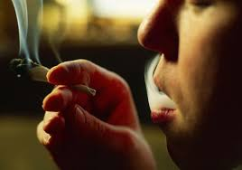
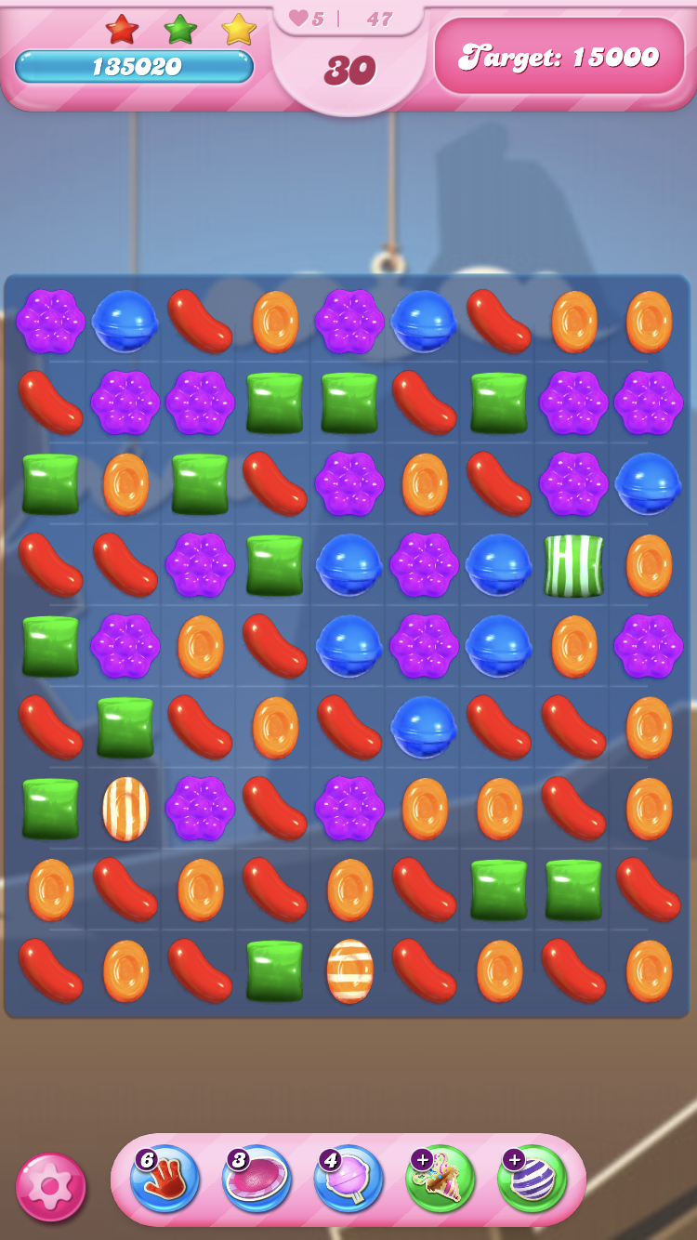




How We Typically Cope
Avoidance
Dr. Chantal Young
Notes:
Dog- We might try to do something healthier and have a spa day or a vacation!
What do all these activities have in common? They are an attempt to avoid and escape reality. To have a break from stressful situations, to be distracted and soothed and comforted, often though some dopamine hits.

Slide 47
Mindful coping: Pain vs. Suffering
Pain is inevitable, but suffering is optional
Pain x Resistance = Suffering
Reduce suffering by accepting and relaxing in response to pain
Acceptance
Dr. Chantal Young
Notes:
Pain in life is inevitable. We will all experience disappointment, frustration, failure, loss, and eventually, decline and death. We will not get everything we want no matter how we try. That is what it means to be human alive on this planet.
But suffering is defined as our response to pain. How do we treat ourselves when we are in pain? What is our reaction to the pain? Do we try to escape it and run away through avoidance behavior? Do we make it even worse by beating ourselves up?
There is a formula that says pain x resistance (how much we push away the pain or make it worse by telling stories about it) = suffering.
Mindfulness helps us eliminate suffering, by bearing pain gracefully, rather than frantically trying to avoid it or making it worse by beating ourselves up. This is what people mean when they talk about acceptance. It’s not complacency, or saying we like the pain, but just being with it because it’s here.

Slide 48
Thinking
  We believe they define who we are
  We think they have authority and are true
  We get hooked into the content of our thoughts
  “Don’t believe everything you think”
We regard our thoughts
as important!!!
Dr. Chantal Young
Notes:
the stories they tell us
the meaning they weave out of our experiences
And it’s kind of funny, because if you consider yourself a scientist and a skeptic, why don’t you apply that same skepticism to your thoughts.
One of my favorite sayings in life is: don’t believe everything you think.

Slide 49
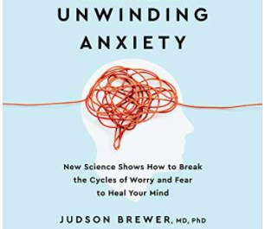
Anxiety
A kind of addiction
Worry is a “mental behavior” to cope with uncertainty
Mindfulness helps us just be with uncertainty
Dr. Chantal Young
Notes:
I want to make special mention of anxiety because it is the aspect of burnout we hear about the most from students.
Ezra Klein: think of yourself in a concert hall, listening to the sweetest music, when you suddenly remember you forgot to lock your car. You’re anxious about the car, you can’t walk out of the hall, and you cannot enjoy the music. That is often how life feels, life is objectively amazing – I am incredibly privileged, well educated, I live in an age of the internet and vaccines and incredible art and music and medicine and I have friends family who love me and I’m healthy, and I’m still just spinning my mental wheels endlessly ruminating on things I don’t want to be thinking about. And then I’m pissed off at myself, why can’t I stop? I pride myself on my discipline but my own mind is totally out of control.
This book, Unwinding Anxiety, theorizes that anxiety is kind of addiction, and like any addiction you have to understand its rewards in order to heal it.
It posits that anxiety is a mental “behavior”. As we start worrying it gets reinforced in our brain because it makes us feel like we are doing something and we are in control. You get tiny dopamine hits from worrying, even though it’s kind of unpleasant. Our neocortext says, when things are uncertain, let’s go get information. Now this is also just good problem solving when we get information that relieves the uncertainty and stops the process, but without more information we just keep spinning.
Worrying can help us survive, but also makes it harder to think, plan, see clearly, make decisions, and be with people. Remember our quote: A wandering mind is an unhappy mind.
We learn to just be with uncertainty, to be with that unpleasantness. Oh, this discomfort isn’t going to make my head explode. You can see here that grit, and resiliency are paradoxically about relaxing and allowing and accepting, leaning into reality, rather than fighting it like a battle.

Slide 50
Mindful Communication
Helps us migrate from habitual ways of interacting to more skillful ways based on mutuality and authenticity
Allows us to gather crucial information we might have otherwise missed
Key skills
  Not being in a rush
  Relax
  Open to the other
  Trust emergence
  Listen deeply
Dr. Chantal Young
Notes:
Please raise your hand if you have ever been to a doctor’s appointment where the communication was not ideal?
Relax: When we talk to people we tense our bodies. Bring awareness to those parts of the body where we tend to hold tension, and allow it to let go. Try it right now as you listen. Relax the part of your belly under your belly button.
Open to the other: Let them be as they are, even if you don’t like it. Try not to have expectations.
Trust emergence: Trust emergence is the knowing that one can fully listen, be present, and be confident in having something to say and a way to say it in the moment, without rehearsal, which may often lead to a more authentic expression of the truth of one’s own thoughts, ideas, and opinions.
Listen deeply. Make your whole body an ear. Surrender fully to the unfolding words.

Slide 51
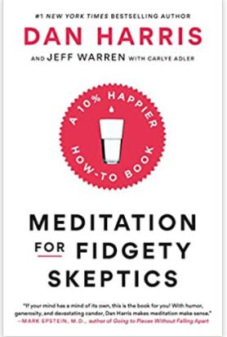
What is a practice?
A habit is an action (physical or mental) that you choose and repeat
Mindfulness is like going to the “existence gym”
We cannot fail at mindfulness, we can only fail to practice.
Don’t take it too seriously!
Dr. Chantal Young
Notes:
This slide is to remind you that mindfulness is a practice. A deliberate cultivation of habits you want.
A habit is an action. Habits don’t stay the same, they get more engrained. All of a sudden we realize that this thing we are doing is screwing us over – our studying, our relationships, whatever – Meditation and other contemplative practices are powerful, helps us re-write the way we are.
Mindfulness is like going to the existence gym. You don’t go to the gym once and expect to be stronger. Today was like me talking about riding a bike and you sat on the saddle for about 15 minutes.

Slide 52

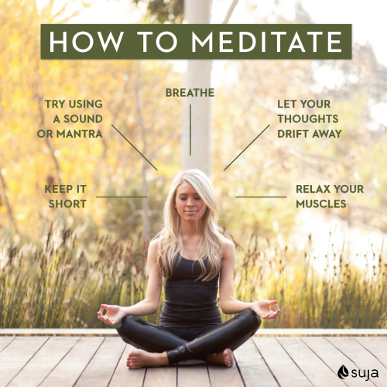
Choose Your Practice and Make a Routine
There is no right or wrong way to meditate and it doesn’t have to take any prescribed amount of time.
Like any medication that you take every day, the important thing is to be consistent. Just do it- don’t judge it – like brushing your teeth.
Start with 2-5 minutes, work up to 10 minutes. Do it 1st thing in the morning and then briefly before bed.
Pick a mantra. Use a meditation app, guided meditations are available for download.
Do something every single day for your own pleasure – schedule it like any other priority and focus on just doing that 1 thing during that time (uni-task).
Keep a gratitude journal – write 3 things at the end of the day for which you are grateful
Dr. Michelle Lizotte-Waniewski

Slide 53

Consider if you want to practice with others or alone
  Take a class
  Maybe an app? (HeadSpace, Calm)
  Create a contemplative space
Take one mindful breath whenever you…
  Stop at a red light
  Enter a room
  Hear a phone notification
Or can you do “20 Breaths”?
Pick one task or activity a week to bring your mindfulness to. Shower Brush Teeth Walk Dog Eat Wash Hands Laundry Open Doors Prepare Meals Stretch Your Body …
Dr. Chantal Young
Notes:
Don’t take it too seriously. Don’t make it something you can fail at it – there is no failure in meditation so long as you keep up. Go for joy and curiosity.

Slide 54
Taking Action!
What is 1 thing that was presented that you can commit to doing every day for the next week that will help decrease your stress/anxiety?
Write down 3 things that are gifts/talents that you think you have been given and how you will work to develop them or share them with others?
Journal of gratitude – what 3 things happened to you today for which you are grateful?
Write someone else a note letting them know how grateful you are for something that they did – can be something small. Not only will you make their day, but some studies suggest it will boost your morale also.
Dr. Michelle Lizotte-Waniewski

Slide 55
A farewell meditation
Dr. Chantal Young
Notes:
Let’s close our session, as well as making some connection between the class experience and life.
Inviting you now, if you would like, to set down anything you have in your lap or hand and placing your feet on the floor, and coming to an awareness of yourself in this moment…
Closing your eyes if you like, or simply lowering and softening your gaze….
Breathing in deeply, and then as you exhale, relax in your body. Letting go whatever tension you can easily let go.
Noticing your body as a whole, or where it makes contact with the floor, with the seat and back of the chair…
Becoming aware of sounds around you or within you….
Experiencing your breath, as it flows in…and as it flows out…
And noticing that you may be having thoughts….
Inquiring into the quality of your attention and awareness as it is now, and how it may be different from when you first entered this room….
And realizing that the quality of our attention and awareness constantly changes…
Sometimes noticing things in great depth and detail, and other times missing large pieces of our experience….
And the Mindful Practice asks us not necessarily to be perfect in our attentional skills, but to be aware of this constantly changing quality of our attention…
Opening to the possibility of seeing something new, as if for the first time….
Leaving this auditorium now, and entering into the unknown of the next moments, and entering into the freshness of each encounter with patients, illness, procedures,….paying careful attention to the waxing and waning quality of your own attention and awareness…Calling yourself to remain curious and present for the only moments you have to experience and learn anything, which is right now….

Slide 56

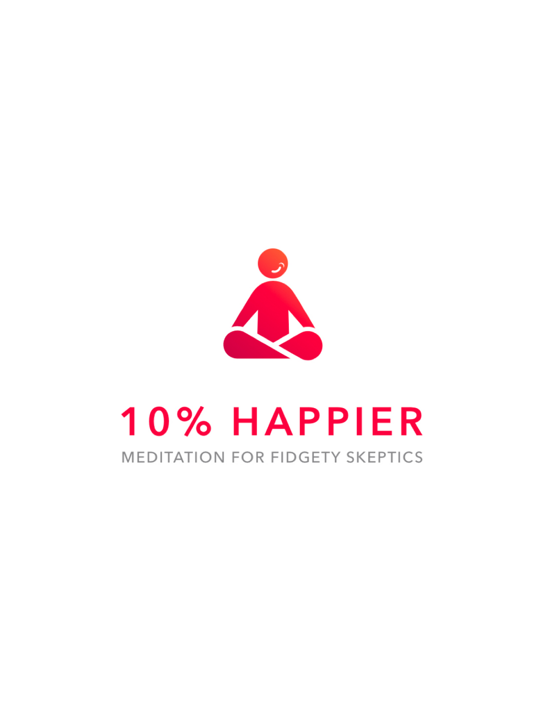
Resources for Mindfulness
Headspace app, 10 Percent Happier app, etc http://peacefulmindpeacefullife.org/ - free series
“The Practice” – by Barb Schmidt
www.calm.com
Greater Good In Action Website – all kinds of free meditations: https://ggia.berkeley.edu/
http://www.mindful.org/practice-grows-stronger/
Assorted free meditations on YouTube
“Freedom From Anxious Thoughts and Feelings: A Two-Step Mindfulness Approach for Moving Beyond Fear and Worry” by Scott Symington, PhD
Dr. Michelle Lizotte-Waniewski

Slide 57
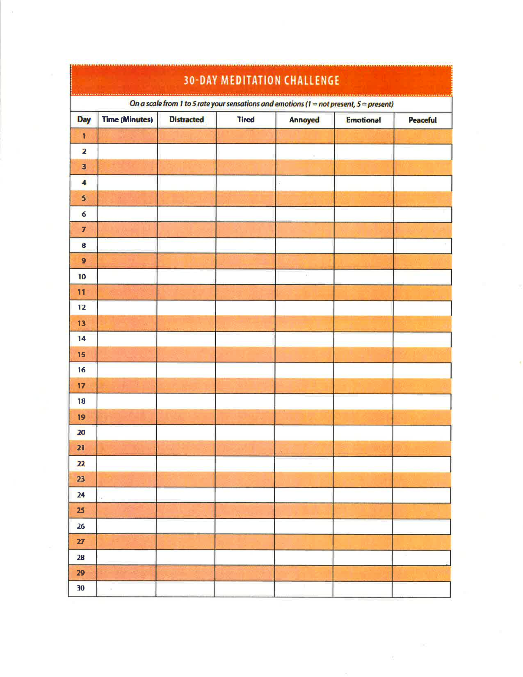
Resources - continued
What you practice grows stronger
Practice Practice Practice
2-5 minutes per day: log your progress
Do it for 30 days and notice what positive changes you see. Document them to keep you on track!
Dr. Michelle Lizotte-Waniewski
Notes:
30-Day Meditation Challenge Worksheet: Provided by Peaceful Mind, Peaceful Life with permission from Barbara Schmidt

Slide 58
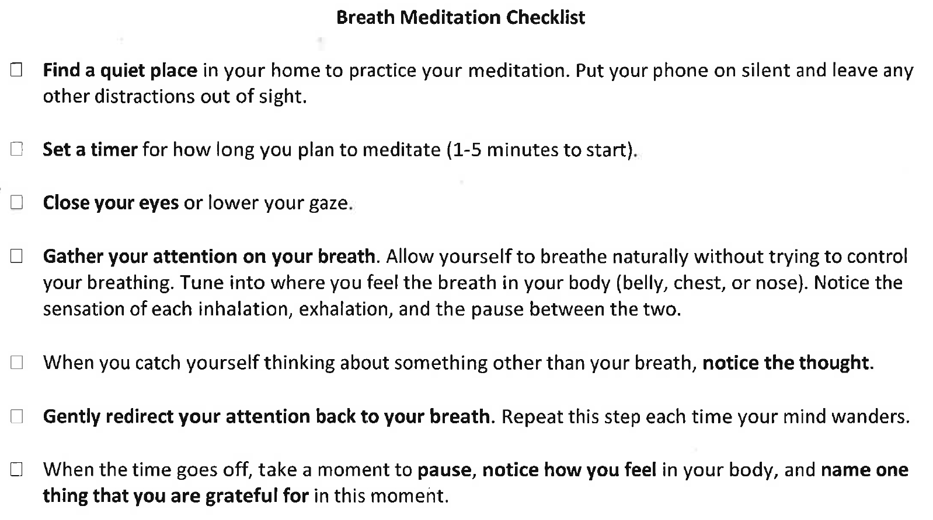
Resources-continued
Dr. Michelle Lizotte-Waniewski
Notes:
Breath Meditation Checklist: Provided by Peaceful Mind, Peaceful Life with permission from Barbara Schmidt

Slide 59
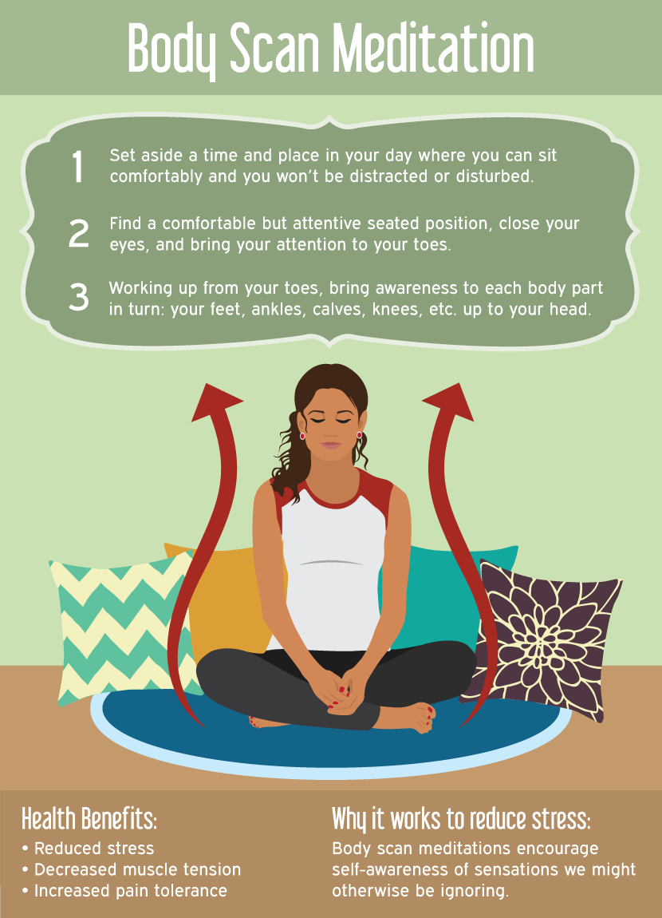
Resources- continued
Dr. Michelle Lizotte-Waniewski
Notes:
Image Credit:
https://imgur.com/gallery/cIiWY

Slide 60
EXPERIENTIAL BREAK OUT SESSIONS
At WMU Homer Stryker School of Medicine, we have found the inclusion of experiential breakout sessions to be helpful in motivating students to want to adopt or increase their mindfulness practice. Details regarding how we structured these peer-led sessions and assessed our teaching event can be found in APPENDIX A in the “Notes” Section of this Slide
Aspects of the Teaching Session that Motivated Students to Want to Adopt or Increase Their Mindfulness Practice
Session Component | Frequency— rating component as moderately or very motivational | Percentage—rating component as moderately or very motivational
Having their own choice of breakout sessions | 33 | 87%
The inclusion of experiential breakout sessions | 23 | 61%
Having the sessions be student-led | 21 | 55%
Zero-second mindfulness part of presentation | 14 | 37%
Research overview part of presentation | 7 | 19%
WMed Team
Notes:
Appendix: Instructions and Suggested Scripts for Mindfulness Activities/Breakout Groups
Sitting Meditation with Full Group (5 minutes)
Instructions: Facilitate a traditional sitting meditation practice with the full group before splitting up into the breakout groups.
Suggested Script: Find a comfortable seat, whatever that might be. Feet can be flat on the floor, shoulders stacked over hips, ears stacked above shoulders. If you would prefer not to meditate right now, you have the option of just closing your eyes, but you don’t have to follow along. Everyone can go ahead and close your eyes and just begin to notice your breath. Don’t try to control it in any way, just notice its quality. Notice if it’s shallow, deep, fast, or slow. Coming back to the breath is both a good way to start and a good way to find your way back if you notice your mind wandering, which is natural.
Begin to bring your attention to your: (go through list slowly, pausing for 15 seconds between each bullet point)
Your lungs
Your belly
Your heartbeat
Your jaw, tongue
Your eyes
Any sounds you might hear
Finally, rest your attention at the top of your head
Slowly begin to deepen your breath. Begin to wiggle your fingers, wiggle your toes. And slowly, when you’re ready, open your eyes.
Walking Meditation (20 minutes)
Instructions: Gather as a group in either an open area inside or outside in order to give instructions and begin the practice together. Build in some time for walking independently with instructions on when to come back as a group. Modify the activity as needed for anyone unable to walk or with limited mobility.
Suggested Script: Although walking is an activity most of us do every day, it can seem quite different when we bring our attention to all of the subtleties of this experience. It can be helpful to walk much more slowly than we typically do as a way to first experience walking meditation. We’re going to start as a group by forming a circle and then very slowly we’ll begin walking. I’d encourage you to notice how each foot makes contact with the ground—is it the heel that first makes contact? Notice how your weight rolls though the mid-foot onto the ball of the foot and notice all the subtleties of what is involved as you begin to shift your weight from one foot to the other. Notice where your gaze is, whether at your feet or in front of you, and try shifting it higher or lower, noticing how that changes your experience.
(After 3-5 minutes) Now, we’ll move out of the circle, and each of you can start walking in whatever direction you’d like for the next 10 minutes before we return back here. As you walk, continue to focus on the shifting of your weight, and how your feet and making contact with the ground. You can play with different speeds of walking, and notice what it’s like to expand your awareness to take in the sensations that are around you—noticing the sights, sounds, smells, and temperature of the air. I’ll set a timer for 10 minutes.
Yoga (20 minutes)
Instructions: This session is best led by an individual with training in yoga and can be done using any simple stretches, either involving standing, sitting, or laying down. For example, a series of poses can include: 1) standing mountain pose, 2) wrist circles 3) cat/cow pose, 4) vinyasa flow, 5) down dog, and 6) resting shavasana.
Suggested Script: (regardless of poses facilitated) As we move into these simple stretches, we’ll want to bring a mindful presence in noticing the physical sensations involved with each movement. It can be helpful to focus on our breath as a way of bringing our attention into the moment. In so doing, our practice of yoga can be quite similar to the practice we just did in sitting meditation.
Eating and Engaging the Senses (20 minutes)
Materials: Chocolate candies, raisins, potato chips, essential oils, cotton balls, fabric
Instructions: This session will provide participants with the opportunity to mindfully think about the senses of taste, smell, and touch.
Suggested Script: (Adapted from Whole Health for Pain and Suffering: An Integrative Approach. VHA Office of Patient Centered Care & Cultural Transformation. 1 September, 2016.)
Begin by connecting to your breath and body, feel your feet on the ground and notice your experience in this moment. With your awareness in this moment, notice any thoughts, sensations, or emotions you are experiencing.
Tune into the awareness or sensation that you have in your body of feeling hungry, thirsty, or maybe even feeling full. If you were going to eat or drink something right now, what is your body hungry for? What is it thirsty for? Just pay attention and notice with awareness the sensations that give you this information.
Now, bring your attention to the item in your hand and imagine that you are seeing it for the first time. Observe with curiosity as you pay attention and notice the color, shape, texture, and size. Is there anything else that you notice, sense, or feel?
Imagine what it took for this item to get to your hands: sunshine, water, time, processing, and shipping. You may choose to be aware of gratitude for everyone involved in the cultivation and preparation of this food item. You may choose to bring in your own gratitude or spiritual blessing.
Now place the item between your fingers and feel the texture, temperature, and ridges. Again, notice if you have any thoughts, sensations, or emotions at this time. Continue to breathe and be fully present in this moment.
Take the item and bring it toward your nose and smell with your full awareness. Notice if you have any memories, sensations, or reactions in your body. Even before you eat it, you may notice that you begin to have a digestive response in your body just by noticing and smelling.
With full awareness of your hand moving toward your mouth, place the object into your mouth without chewing or swallowing it. Just allow it to be in your mouth, roll it around to different parts of your mouth and tongue. Notice the flavor and texture. Notice the physical sensations within your body, especially your mouth and your gut. Continue to breathe as you explore the sensation of having this item in your mouth.
Next take just one bite and notice the flavor, notice the change of texture. Then very slowly begin to chew this piece of food, and notice the parts of your mouth that are involved in chewing. Notice the sound and movement of chewing, as you continue to notice the sensations and flavor.
When you are ready, swallow this item and notice the path that it follows from your mouth and throat into your stomach. Notice the sensation and taste that may linger in your mouth. Connect again to your body and your breath and notice your experience in this moment.
Repeat script paragraphs 1, 3, 4, 5, and the first two sentences of 6 for the sense of smell activity.
Repeat script paragraphs 1, 3, 4, and 5 for the sense of touch activity.
Movement to Music (20 minutes)
Materials: Music source and play list
Instructions: The intention of this session is to offer participants an experience of moving, both bouncing and dancing, mindfully. It helps to bring some humor in encouraging participants to feel okay being silly and to keep their attention on their own experience versus judging others.
Suggested Script: I have a series of songs I want to play, and mostly, I want us to have some fun, mindfully noticing what it’s like to bring movement into the body. You can begin by simply swaying back and forth, feel free to close your eyes or keep your eyes open. Either way, notice what it’s like to be moving—that might sound silly, but truly, notice all of the small and large sensations that accompany feeling some freedom and mobility in the body. Feel free to move and dance in whatever ways you want. Feel free to move around in the room, even interacting with those around you, keeping your attention on your body, your movement, and the music. As you keep moving, notice—what is it like to try to keep your attention right in the here and now as you dance?
Writing/Drawing (20 minutes)
Materials: Blank sheets of paper, pencils, colored pencils/markers/or crayons
Instructions: This session can be facilitated by either guiding students to use half of the time to write and half of the time to draw, or giving them a choice of which activity they would prefer. The intention is to offer participants an opportunity to mindfully reflect on how they are doing and to express this either in words or visual images and colors. Participants will not need to share their papers.
Suggested Script: During this time, we invite you to reflect on how you are doing today— possibly naming a high and a low of your day so far. You can also think back to a memory that taught you something meaningful. Take 10 minutes to write, just stream of consciousness. This writing is just for you, so no need to be concerned about grammar or punctuation, it is just meant to be an opportunity to connect with what you’re feeling right now. You can also take a few colored pencils/markers and create an image of what feels stressful to you right now and what you feel grateful for. There is no right or wrong way to do this exercise, just see what words, images, or colors you feel drawn to.
Student’s Choice of a Mindfulness Activity (20 minutes)
Suggested Script: During this time, we encourage you to choose a quiet activity, whether that is sitting and noticing your breath or engaging in a task on your computer, like responding to email. Experiment with what it is like to apply the principles of mindfulness:
Here & now focus
Full presence
Beginner’s mind (observant & curious)
Attempting non-judgment

