Slide 1
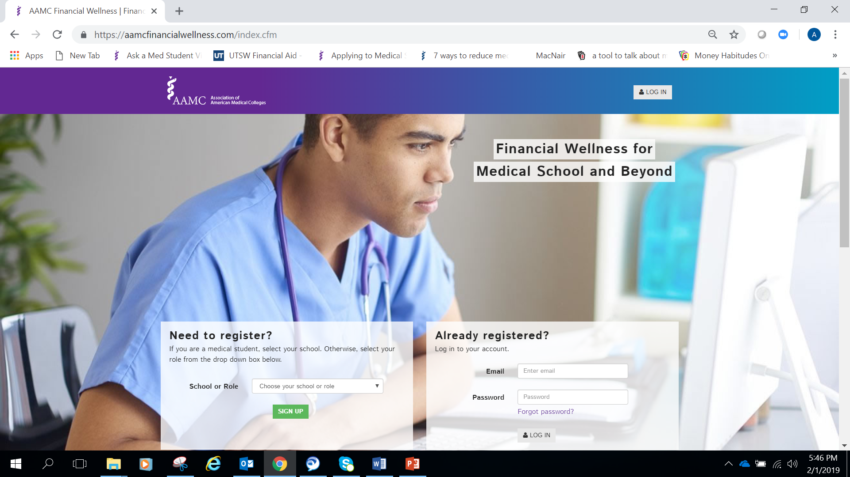
AAMC Financial Wellness
aamc.org/financialwellness

Slide 2
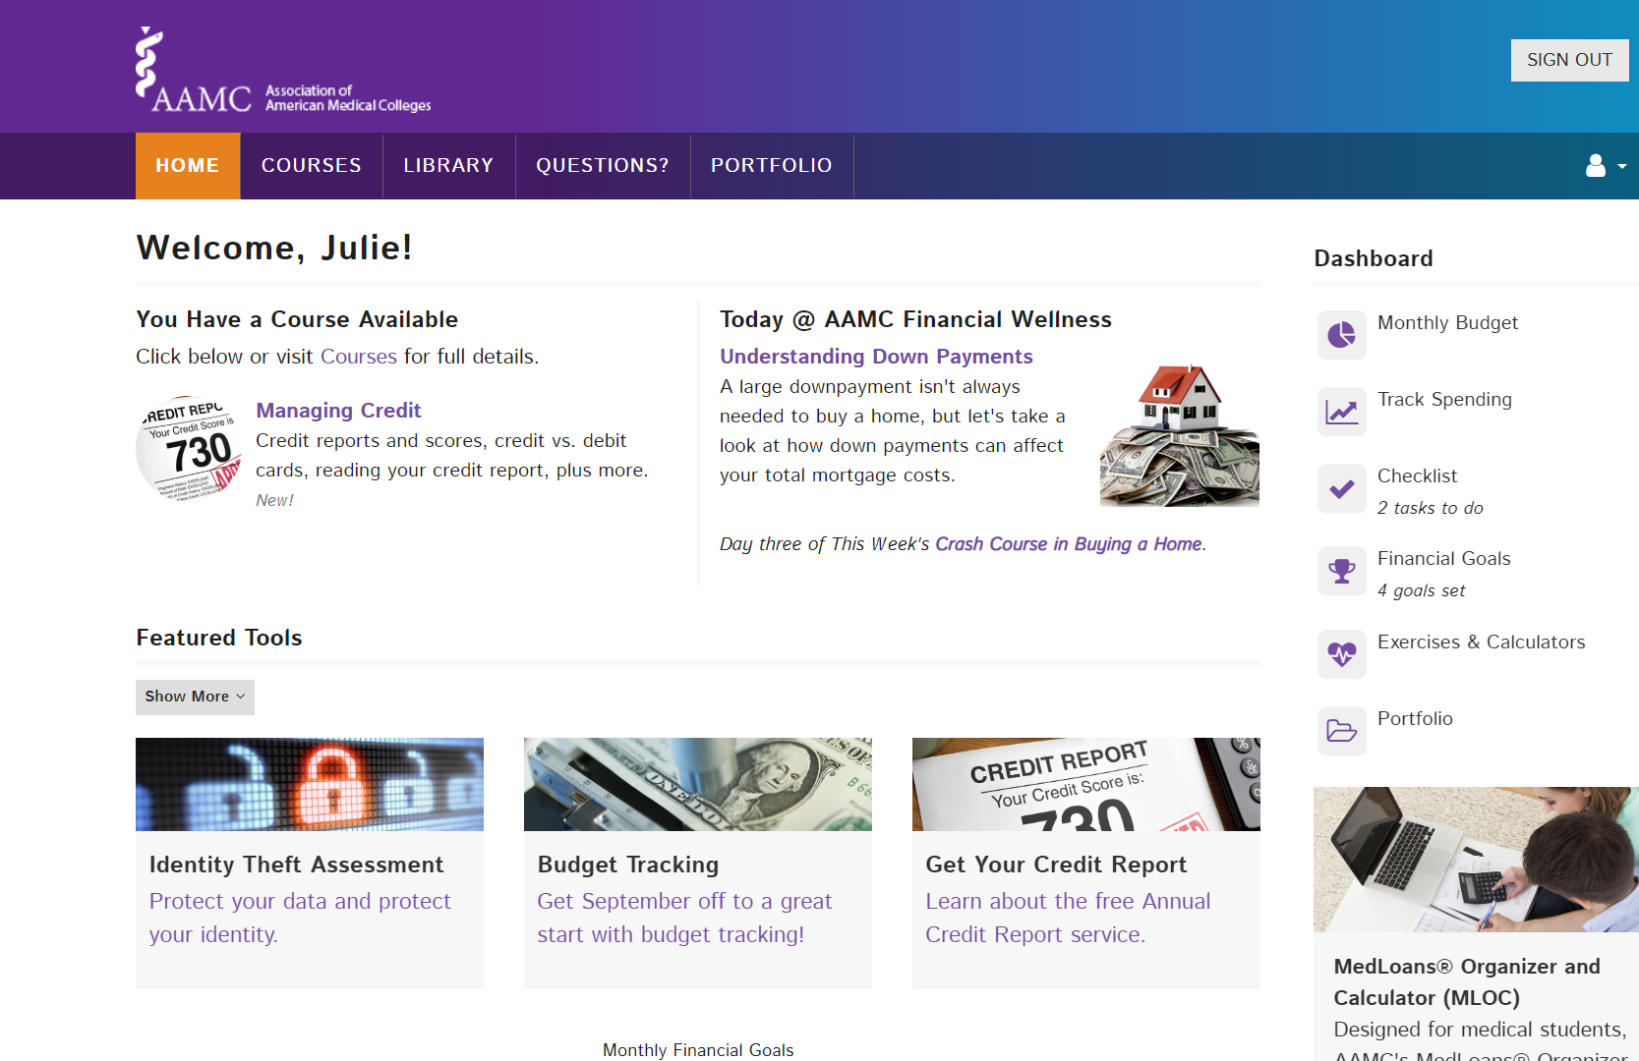
aamc.org/financialwellness

Slide 3


Slide 4
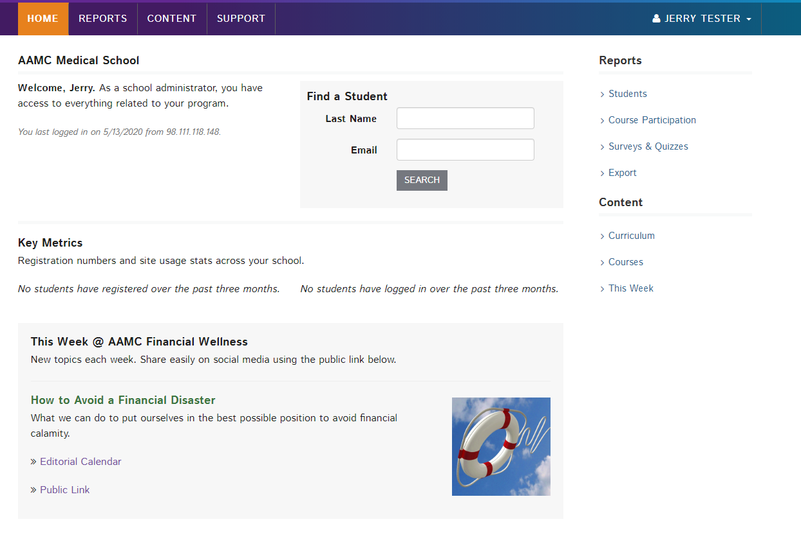
With a school administrator account, financial aid administrators can obtain key metrics about AAMC Financial Wellness usage.

Slide 5
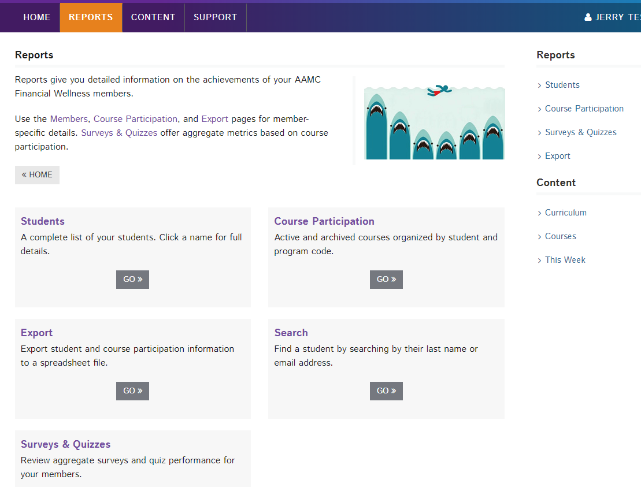
With an administrator account, financial aid administrators can run various reports.

Slide 6
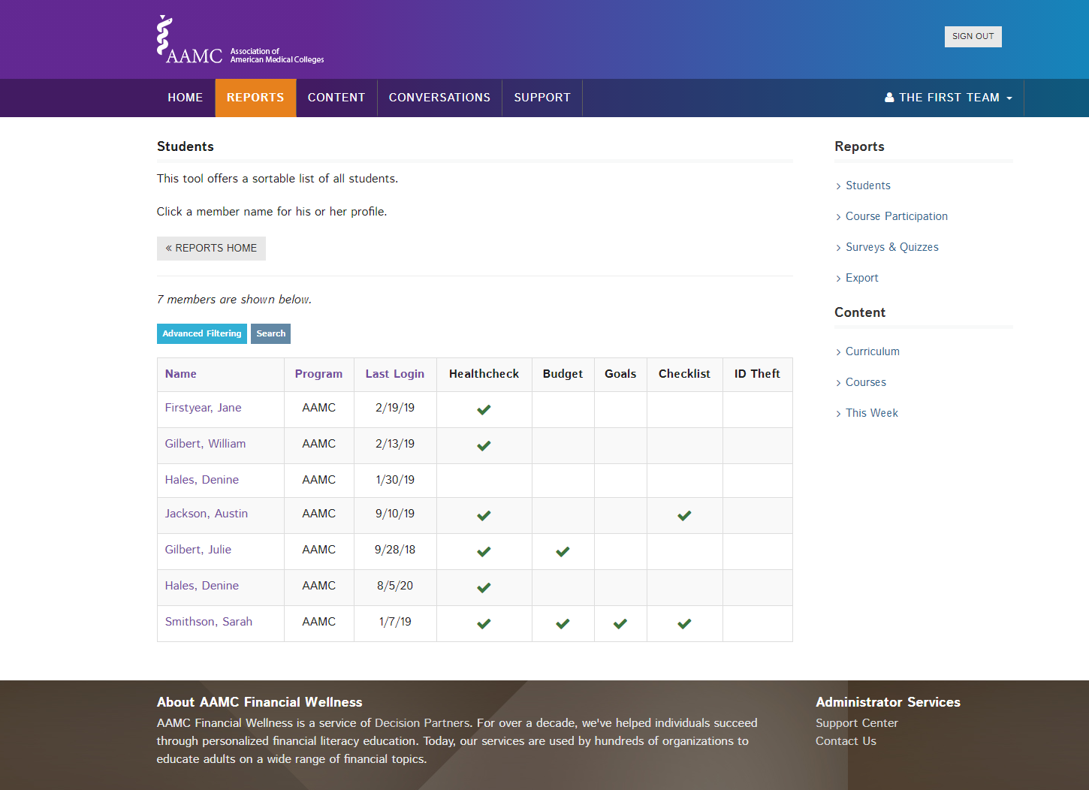

Slide 7
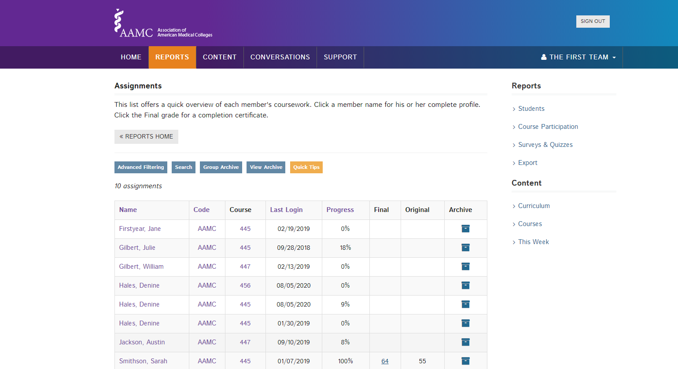

Slide 8
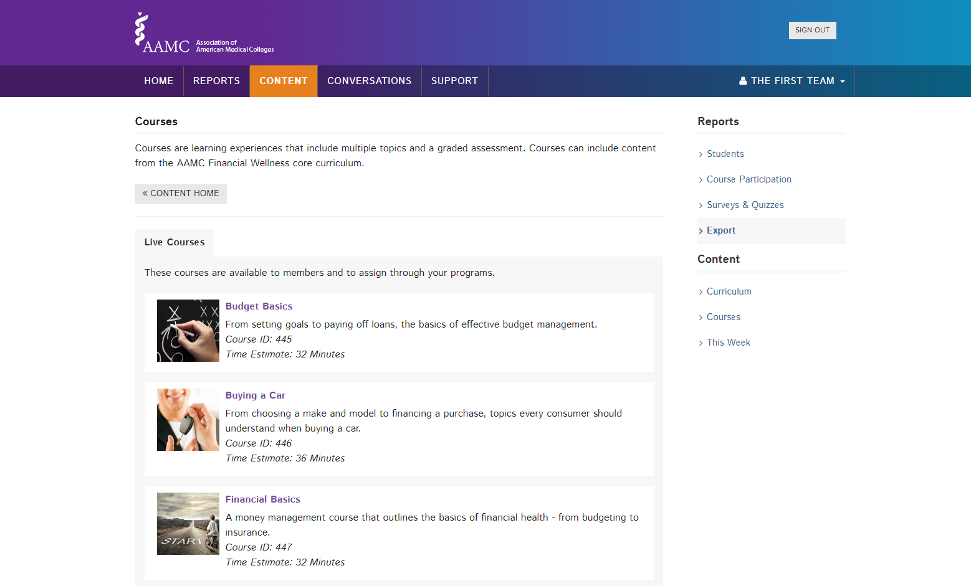

Slide 9
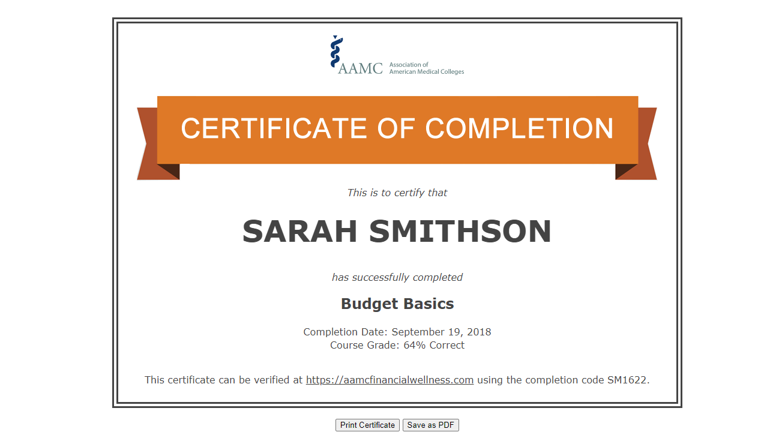

Slide 10
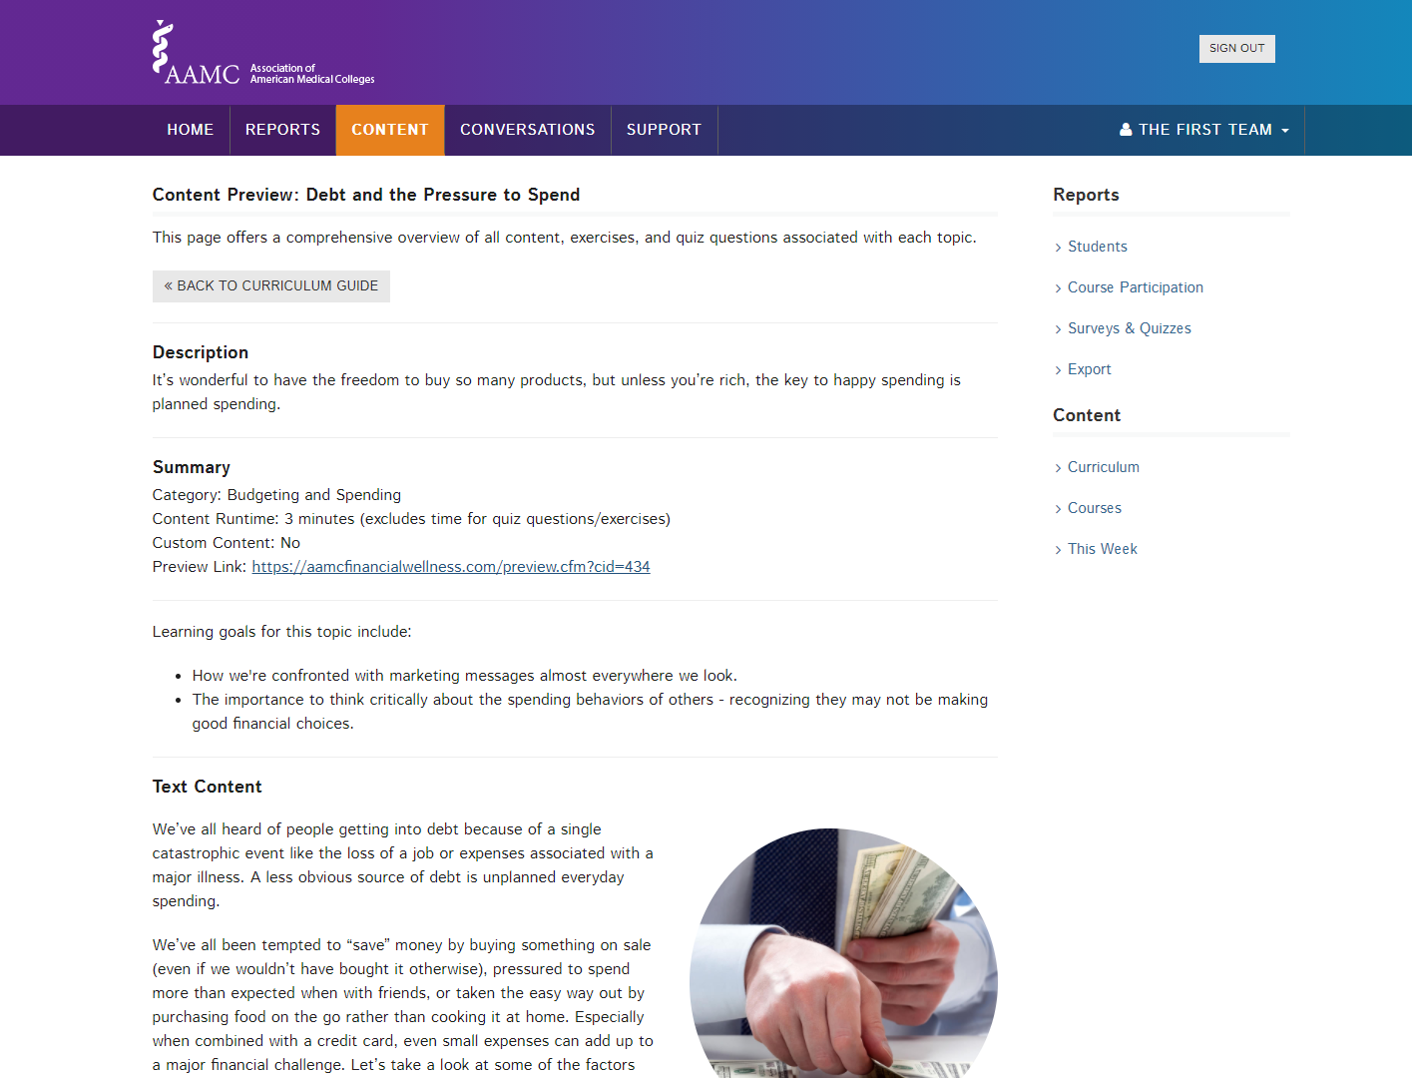

Slide 11
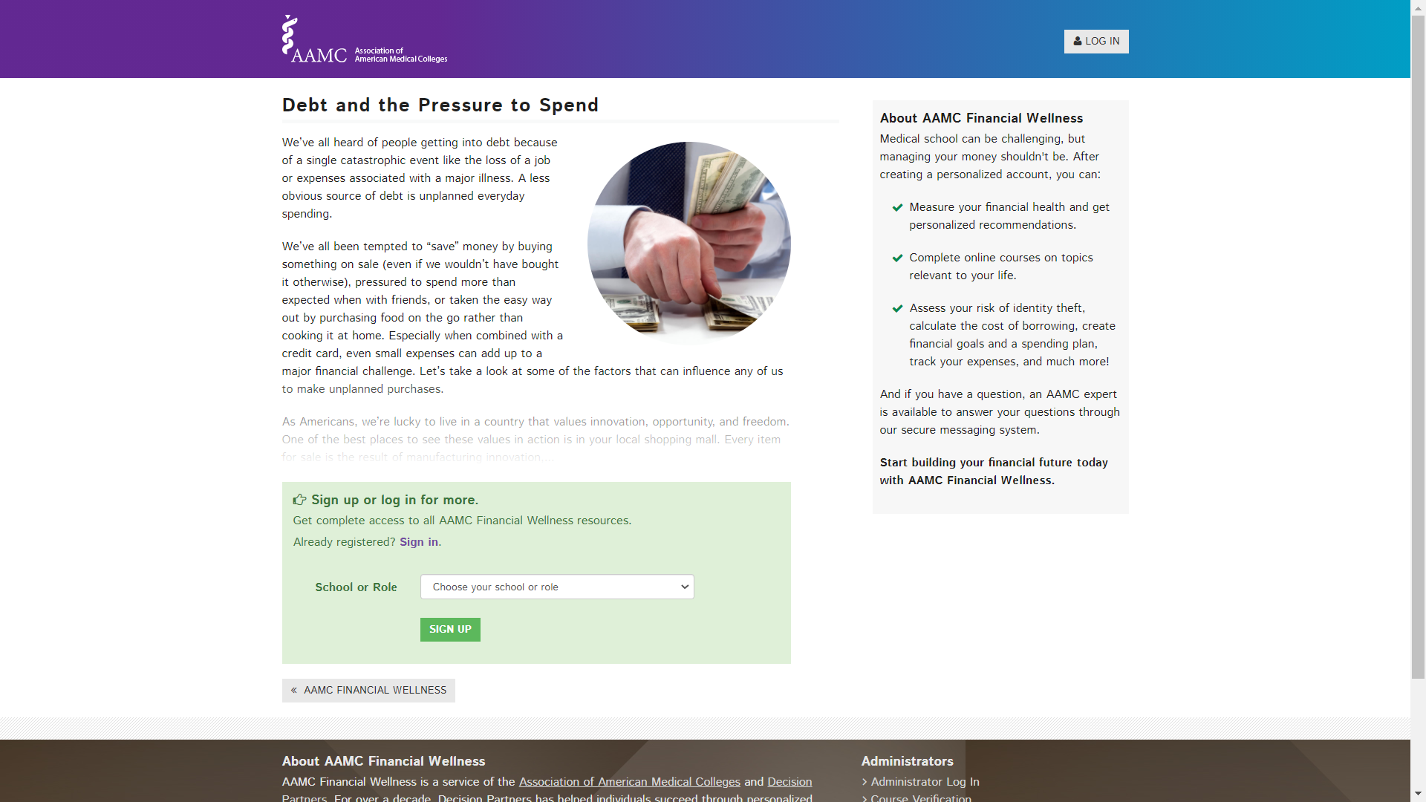

Slide 12
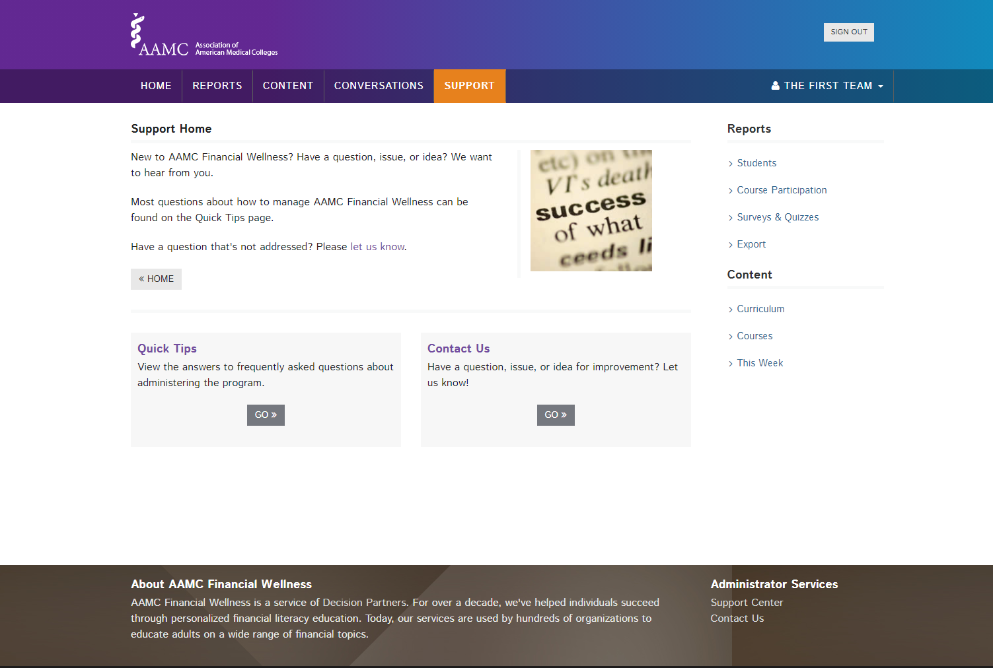

Slide 13
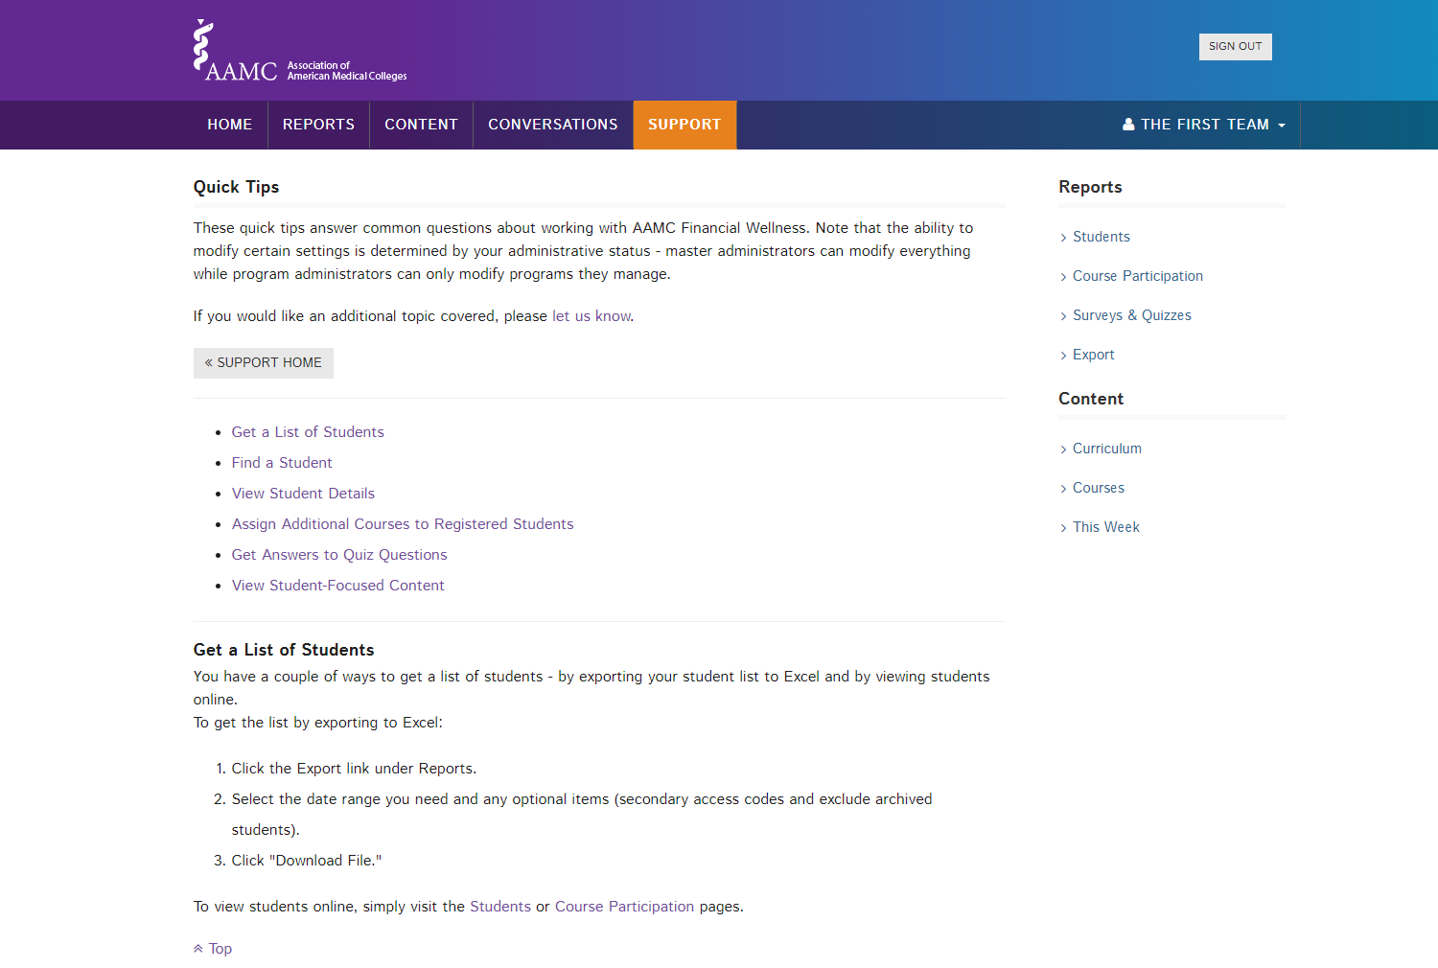

Slide 15

Questions
FIRST@aamc.org
Notes:
Much more information on these concepts are available on the FIRST website:
www.aamc.org/FIRST and aamc.org/videowebinars

