Slide 1
The Power of Social Connections Reconnecting Post-Pandemic
Katherine Daly, PhD
Director of Counseling & Wellness Services
University of Central Florida College of Medicine
Heather Rashal, LMHC
Staff Psychotherapist
Counseling & Wellness Services
University of Central Florida College of Medicine
Chantal Young, PhD
Director of the Office of Well-being
Keck School of Medicine of the University of Southern California

Slide 2
Objectives
Learn about the science and theory behind social connectedness
Develop strategies on connecting with each other
Experiential activities

Slide 3
Let’s practice: Narrative Therapy
Guidelines:
Do not include your name
Answer as honestly as you are comfortable
Responses will be randomly selected and read aloud
“If you really knew me, you would know…”
“Some of the things that have become most important to me following the pandemic are…”

Slide 4
Science and Theory of Social Connection
Yalom’s stages of group cohesion
Attachment theory

Slide 5
Yalom’s Stages of Group Cohesion
Forming/ Orientation phase
1
Storming/ Transition phase
2
Norming/ Cohesiveness phase
3
Working/ Performing phase
4
Adjourning/ Termination phase
5

Slide 6
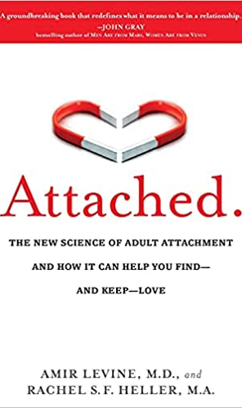
Attachment Theory
An evolutionary theory of relationships that emphasizes the interactions between a human and their primary caregivers at the beginning of life.
- We develop an attachment pattern that shapes future relationship patterns.
- Attachment is triggered when we are faced with stress, separation, illness, trauma etc.​
Strange situation studies (Ainsworth, 1970s)​
Categorizations of attachment​
- Initially identified four attachment styles
- Secure vs. Insecure​
- Avoidant and Anxious​
Relationship characteristics​ (R & J)

Slide 7
Physiological Explanations For Health Benefits of Social Ties
Social support
Reducing the impact of stress
May reduce BP, HR, stress hormones
Personal control
Enhance belief that they can control their lives.
Mental Health
In concert with everything else
Umberson D, Karas Montez J. Social relationships and health: A flashpoint for health policy. Journal of health and social behavior. 2010;51(1_suppl):S54-S66.
American College of Lifestyle Medicine 2020. All rights reserved.

Slide 8
Barriers to Building Positive Relationships
Technology
Lack of self-confidence
Lack of interpersonal skills
Reluctance to interact with others
Poor communication skills
Fear of change
Their surroundings

Slide 9
Loneliness vs Social Isolation
Loneliness
Subjective mental state
Inability to connect or communicate with others
Emotional, physical, and social factors contribute
Social Isolation
Physical state
Voluntary or involuntary absence of having contact with other individuals
Alone, but not enjoying it

Slide 10
What is the most important relationship you have?
For more reading join our book club: Next meeting August 13, 2021 at 12 PM

Slide 11
5 Strategies: Fostering respect and encouraging quality connections
1) Conveying presence
Being present, mindful, paying attention
2) Being genuine
Speaking and reacting honestly (no fronts)
3) Communicating affirmations
Searching for the positive core in another
4) Effective listening
Empathic and active, focus on speaker’s agenda
5) Supportive communication
Nonjudgmental, making requests, providing direction and guidance not criticism and threats

Slide 12
Enhancing Social Connection in your Personal Life
Accept other individuals as they are
Have an uplifting attitude
Get a roommate or pet
Volunteer
Develop quality relationships
Expect the best from themselves and others
Identify reasons why you feel lonely
Be aware that loneliness is a signal that something needs to change
Use counseling or therapy to build relational skills

Slide 13
What is Mindful Listening?
Being fully present
Not being in a rush
Avoiding inserting ourselves
Notes:
Avoiding inserting ourselves: A lot of us think it’s a nice thing, a polite thing to insert ourselves. To try to help, give advice, maybe something more subtle like ask a probing question or make a sympathetic comment, make the person feel better. In some scenarios, all of those things are good. But with mindful listening, we actually do something very counterintuitive, which is to avoid temptations to try to make the person feel better, and instead just be their silent witness.

Slide 14
Why practice Mindful Listening?
Makes the other person feel heard, valued, and safe
Enhances patience and concentration
Allows you to gather crucial information that you might have otherwise missed
Notes:
Some say the Buddha’s ears are depicted as so long because he listened so deeply.
Makes the other person more open to your views and opinions
Enhances your ability to and slow down in the rest of life
Allows you to gather crucial information that you might have otherwise missed (e.g., in a patient interview)

Slide 15
Let’s practice! Mindful Listening Exercise
Find a partner, someone you have not spoken to before
Pick who will start as the speaker and who will start as the listener

Slide 16
Speaker
Talk about someone you care about
(90 sec)
This is NOT a performance!
Notes:
Just bring to mind someone that you love, that is easy for you to love, someone you don’t have a lot of conflict with. This could be a grandparent, or a mentor, or a loved one, or even a pet. Just someone you care about easily. Think about their face, what you love about them. You’re going to share about this being to your colleague. You can tell them what they look like, what their personality is like, all about them, and why you love them. You don’t necessarily have to say who they are in your life, what their relationship is to you, but you can if you want.

Slide 17
Listener
Do not speak
Surrender the need to ask questions, give advice, fix problems, or make the person feel good
Simple eye contact is enough
RELAX your body, focus on your breathing
This is NOT a performance!
Notes:
It’s easy to become suddenly self-conscious, especially when we start practicing mindfulness and mindful listening. Self-consciousness and mindfulness are not the same thing. Self-consciousness is a level of anxiety that is more related to how we appear from the outside, such as wondering what the speaker is thinking about us or whether they have noticed the steps we have taken so far. This self-consciousness is actually a thought process and is the opposite of mindfulness. Let the thought go and bring yourself back to listening to the speaker.
When I say begin, you can start. Continue until the sound of the bell.

Slide 18
Speaker
Talk about someone you are worried about
(90 sec)
This is NOT a performance!
Notes:
Now bring to mind someone you’ve been worried about. It could be the same person or pet as before, or someone different. But someone that’s been on your mind and heart because they are going through some difficulty right now, some stress, maybe they haven’t been doing well health wise or emotionally, and you’ve been concerned. Again just bring their face to mind, what is worrying you, and how much you care about them. You’re going to share all this with your colleague.

Slide 19
Listener
Remember, no need to say anything
Take a breath, relax, and be present
This is NOT a performance!

Slide 20
What was that like?

Slide 21
Patient, Interrupted
Average interruption time in a primary care visit is 12-18 seconds
Only 23% of patients are permitted to complete their opening statement of concerns
Female physicians interrupt patients less often than male physicians
Both female and male physicians interrupt female patients more often than male patients
Beckman HB & Frankel RM. The effect of physician behavior on the collection of data. Ann Intern Med. 1984;101(5):692-6.
Rhoades DR, McFarland KF, Finch WH, & Johnson AO. Speaking and interruptions during primary care office visits. Fam Med. 2001 Jul-Aug;33(7):528-32.
Notes:
Mindful listening isn’t just a social skill, but a clinical skill.
Not only can you can make the patient feel undervalued and disrespected, but you can miss crucial information necessary for a diagnosis.

Slide 22
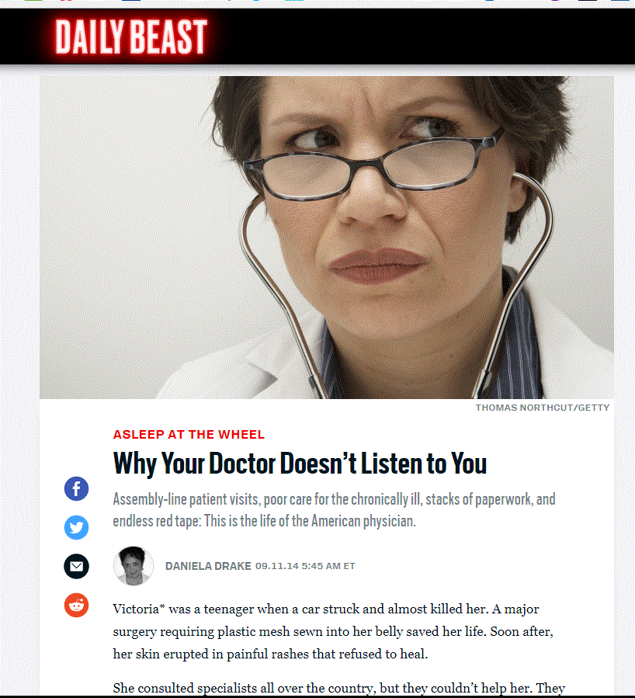
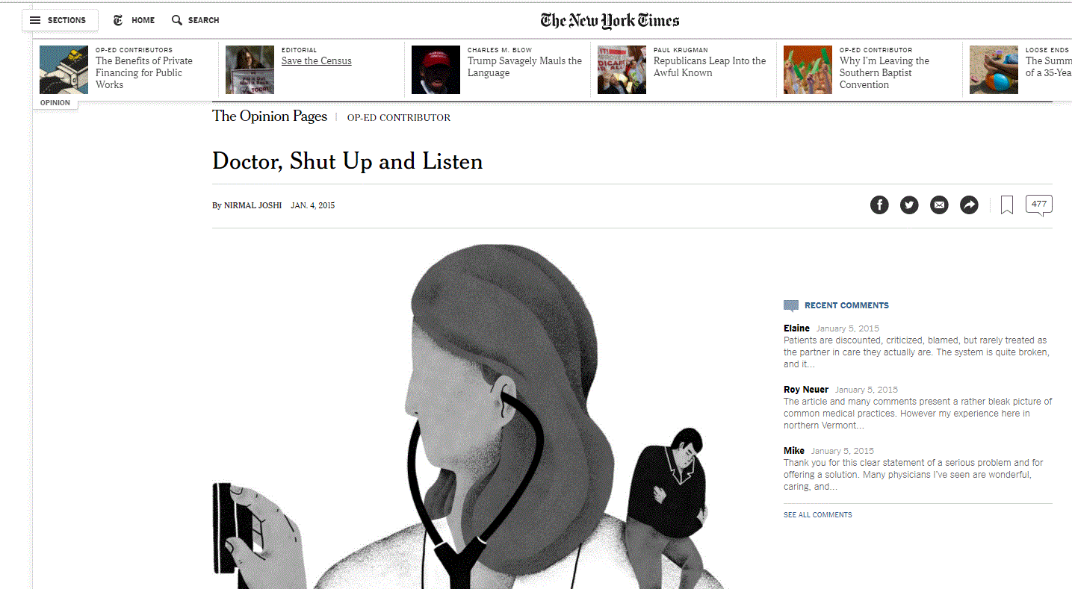
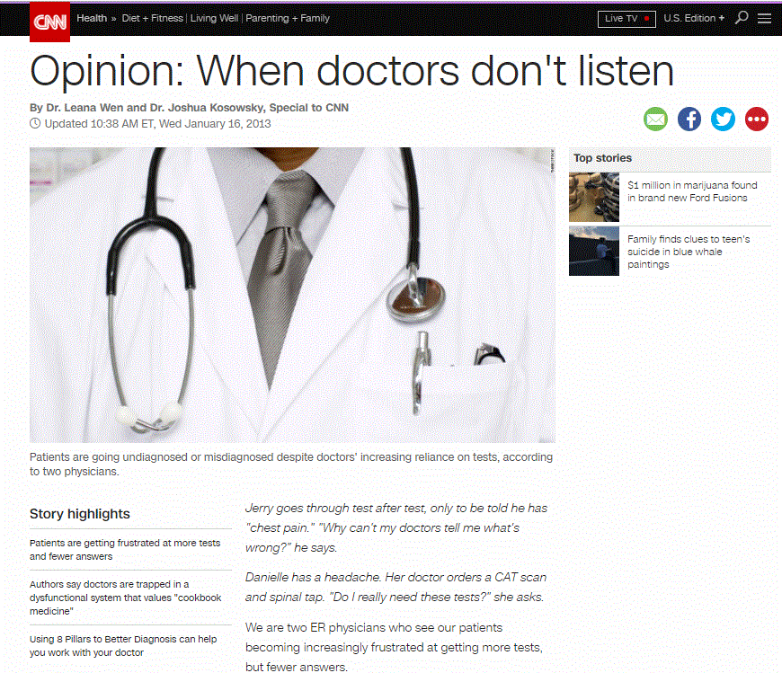
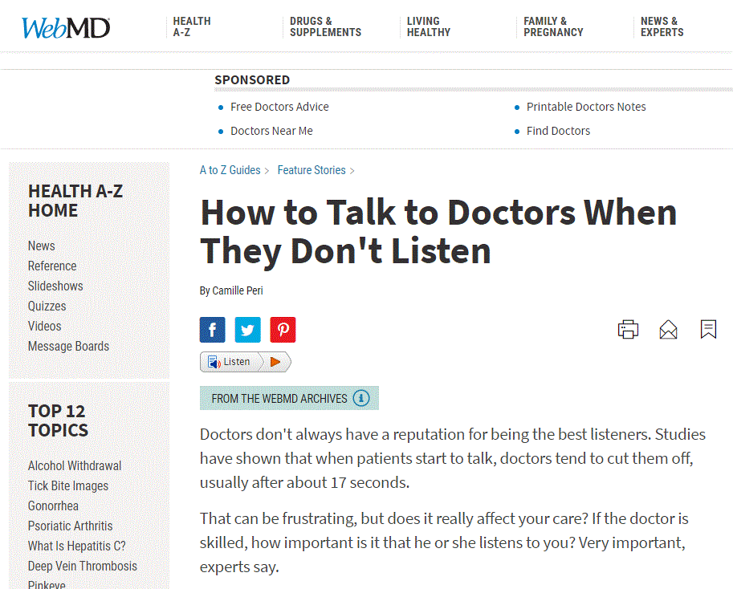

Slide 23
Questions, Reflections, and Discussion
What did you experience in terms of changes to social connection during the pandemic?
What would help you feel connected to your class?
Are there changes you want to make in terms of how you connect to others?

