Slide 1
An Overview of Medical Student Wellness
Dr. Michelle Lizotte-Waniewski, Director of HealthFirst, Florida Atlantic University, Charles E. Schmidt College of Medicine
Dr. Margaret Rea, Director of Student and Resident Wellness, University of California Davis School of Medicine
Dr. Elizabeth Lawrence, Chief Wellness Officer and Assistant Dean of Professional Wellbeing, University of New Mexico School of Medicine
Lizotte-Waniewski, et al, 2021
Notes:
INSTRUCTION and CONTEXT:
By way of introduction, this presentation is designed to discuss not only the activities that support medical student wellness but also data/evidence that encourages medical student buy-in. Because medical students have very logical minds (and because the elements of the presentation are evidenced-based) whereever possible and appropriate, data is provided to support the recommendations.
There are some optional activities presented in the powerpoint at various points which can be included in the presentation or not depending upon the time that is available for the talk. The original version of 38 slides is designed to take 1 hour with all of the activities included. The notes section of the powerpoint contains suggested talking points (when helpful), references to support statements in the slides (where appropriate) and image credits for any images used in the slide.

Slide 2

Session Objectives
To identify why wellness education is important for medical students.
To describe the key elements of a comprehensive wellness toolkit.
To create a personal wellness routine using practical suggestions from the session content.
Lizotte-Waniewski, et al, 2021
Notes:
Talking Points:
The presentation will cover the challenges that a career in medicine poses to physicians and the specific need for wellness programming. The key elements of overall wellness will be discussed along with strategies to create a personal wellness toolkit based on the techniques outlined in the presentation.
Image Credit:
Tool box: Pixabay License Free for commercial use No attribution required

Slide 3


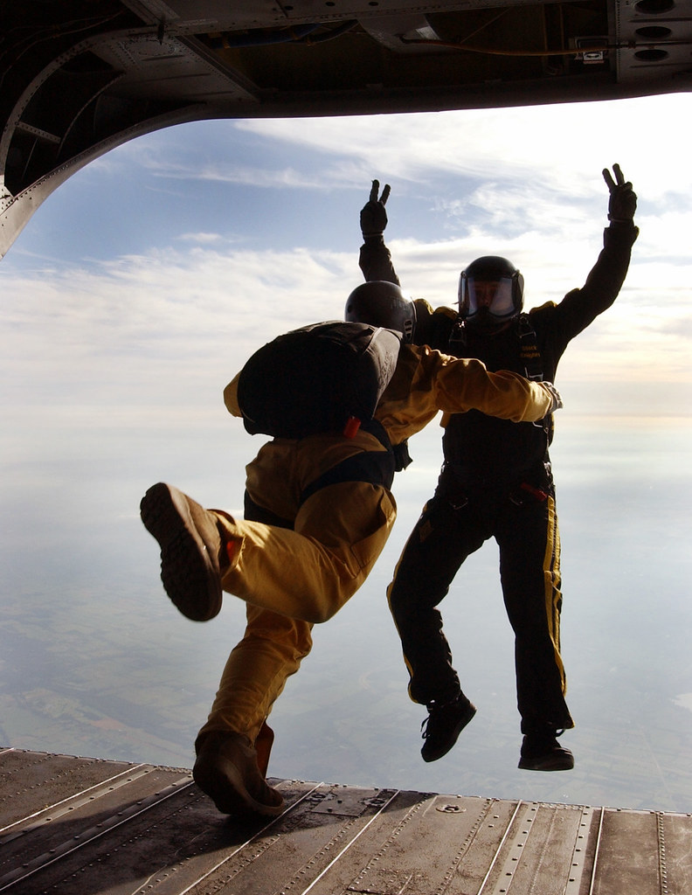
I was accepted into Medical School!!
And now, the scary part!
I know what you are thinking…
Lizotte-Waniewski, et al, 2021
Notes:
Talking Points:
Identify that immediately following the elation of finding out the students were accepted to school comes the self-doubt, anxiety, fear and other manifestations of imposter syndrome.
Image Credits:
Cat Image Credit: "...non fidarsi è meglio - my scared cat / gatto" by Paolo Margari | paolomargari.eu is licensed with CC BY-NC-ND 2.0. To view a copy of this license, visit https://creativecommons.org/licenses/by-nc-nd/2.0/
Children Jumping Image Credit: "Group of five happy children jumping outdoors." by Lighttruth is licensed with CC BY-NC 2.0. To view a copy of this license, visit https://creativecommons.org/licenses/by-nc/2.0/
Jumping from Airplane Image Credit: "Army National Guard Helicopters Provide Platform for West Point Jumpers" by DVIDSHUB is licensed with CC BY 2.0. To view a copy of this license, visit https://creativecommons.org/licenses/by/2.0/

Slide 4

“I got lucky, getting into medical school.”
“I tricked the admissions committee into thinking I am better than I really am.”
“I got by in undergrad but all my weaknesses are going to show in medical school.”
“I’m only here because the director of admissions likes me!
“I can’t compare to the other people here. They are so smart and confident.”
“Sometimes, I feel super competent. But other times I’m not.”
“I’m going to harm my future patients unless I remember every detail of the material.”
“Falling short of perfect is not an option.”
Adapted from: Chantal Young, Keck Medical School
Notes:
Talking Points/Suggested Approach:
Interactive Approach: Ask/survey the class about how they felt shortly after they found out that the were accepted to medical school, before showing any of the quotes.
Alternately you can put up 1 or 2 quotes first and then ask the students to provide other thoughts. Finally you could present all quotes and ask the students to identify whether or not they have had (or are having) any of the thoughts expressed in the slide.
Image Credits:
Poser Image: "For this With Those with Imposter Syndrome" by cogdogblog is licensed with CC BY 2.0. To view a copy of this license, visit https://creativecommons.org/licenses/by/2.0/

Slide 5
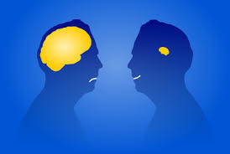
Imposter Phenomenon
The condition in which highly successful individuals have intense feelings of self doubt/inadequacy and attribute their success to external factors rather than their own abilities (Clance: “intellectual phoniness”).
Prevalence of imposter syndrome among medical students ~20-50%. ^{(1,2,3,4)}
Women, Black and other URM students, have higher a prevalence of imposter phenomenon. ^{(1,4,6,7,8)}
In addition, other studies show a correlation between IP and burnout which has implications for mental health. ^{(3,7,8)}
Lizotte-Waniewski, et al, 2021
Notes:
Talking Points:
Imposter syndrome and maladaptive perfectionism are common among medical students.
In particular, women and URMs have high incidence of IP
Because there is a correlation between feelings of IP and burnout, its prevalence in medical students may have negative effects on mental health.
Resources for Slide Content:
Holliday AM, Gheihman, G, Cooper, C, Sullivan, A, Ohyama, H. Leaf, DE and Karp-Leaf, R (2-19_ High Prevalence of Imposterism Among Female Harvard Medical and Dental Students. J Int Med2020, 35: 2499-500
Brennan-Wydra, E., Chung, H.W., Angoff, N. et al. Maladaptive Perfectionism, Impostor Phenomenon, and Suicidal Ideation Among Medical Students. Acad Psychiatry (2021). https://doi.org/10.1007/s40596-021-01503-1
Villwock JA, Sobin LB, Koester LA, Harris TM. Impostor syndrome and burnout among American medical students: a pilot study. Int J Med Educ. 2016;7:364-369. doi:10.5116/ijme.5801.
Houseknecht VE, Roman B, Stolfi A, Borges NJ. A longitudinal assessment of professional identity, wellness, imposter phenomenon, and calling to medicine among medical students. Med Sci Educ. 2019;29:493–7.
Rosenthal S, Schlussel Y, Yaden MB, et al. Persistent Impostor Phenomenon Is Associated With Distress in Medical Students. Fam Med. 2021;53(2):118-122. https://doi.org/10.22454/FamMed.2021.799997.
Swope K, Thompson BM, Haidet P. Imposter phenomenon across the span of medical training. In: Abstracts from the 2017 Society of General Internal Medicine Annual Meeting. J Gen Intern Med. 2017;32:S223.
Bravata DM,Watts SA, Keefer AL,Madhusudhan DK, Taylor KT, Clark DM, et al. Prevalence, predictors, and treatment of impostor syndrome: a systematic review. J Gen Intern Med. 2020;35:1252– 75.
Stone S, Saucer C, Bailey M, Garba R, Hurst A, Jackson SM, et al. Learning while Black: a culturally informed model of the impostor phenomenon for Black graduate students. J Black Psychol. 2018;44:491–531
Cokley K, McClain S, Enciso A, Martinez M. An examination of the impact of minority status stress and impostor feelings on the mental health of diverse ethnic minority college students. J Multicult Couns Dev. 2013;41:82–95.
10) Henning K, Ey S, Shaw D. Perfectionism, the imposter phenomenon and psychological adjustment in medical, dental, nursing and pharmacy students. Med Educ. 1998;32:456464.
11) Yanes, Arianna F. The Culture of Perfection: A Barrier to Medical Student Wellness and Development, Academic Medicine: July 2017 - Volume 92 - Issue 7 - p 900-901 doi: 10.1097/ACM.0000000000001752
Image Credits:
Brain Dunning Kruger Effectk,,,This file is licensed under the Creative Commons Attribution-Share Alike 3.0 Unported license. Attribution: © Nevit Dilmen
Imposter Syndrome Image: "Syndrome and Imposter Syndrome #incredibles #worklife #myweirdbrain" by thegreatgonzo is licensed with CC BY 2.0. To view a copy of this license, visit https://creativecommons.org/licenses/by/2.0/

Slide 6


Why Focus on Wellness in Med School?
You have chosen a challenging career! (^{1,2})
  27% rate of depression
  32.4% alcohol abuse among medical students
  Low treatment rates for depression or mental illness
  2.47x higher suicide rate than general population
Attributes of doctors predispose to burnout. Which ones?
Dyrbye LN, West CP, Satele D, Boone S, Tan L, Sloan J, et al. Burnout among US medical students,
residents, and early career physicians relative to the general US population. Acad Med. 2014;89(3):443–5.
2) Rotenstein LS, Ramos MA, Torre M, et al. Prevalence of depression, depressive symptoms, and suicidal I
Ideation among medical students-a systematic review and meta-analysis. JAMA. 2016;316(21):2214–36.
Lizotte-Waniewski, et al, 2021
Notes:
Talking Points;
The practice of medicine can have dangerous consequences to physicians who are not prepared for its unique challenges.
Suggested Interactive Activity – survey students about attributes of doctors that predispose to burnout: imposter syndrome, perfectionism, inability to say “no”, failure to delegate, intense desire to serve others (angel doctor).
Resources for Slide Content:
1) Dyrbye LN, West CP, Satele D, Boone S, Tan L, Sloan J, et al. Burnout among US medical students, residents, and early career physicians relative to the general US population. Acad Med. 2014;89(3):443–5.
2) Rotenstein LS, Ramos MA, Torre M, et al. Prevalence of depression, depressive symptoms, and suicidal ideation among medical students-a systematic review and meta-analysis. JAMA. 2016;316(21):2214–36.
3) Dyrbye, Liselotte N. MD, MHPE; Shanafelt, Tait D. MD Commentary: Medical Student Distress: A Call to Action, Academic Medicine: July 2011 - Volume 86 - Issue 7 - p 801-803 doi: 10.1097/ACM.0b013e31821da481
4) Rubin R. Recent suicides highlight need to address depression in medical students and residents. JAMA. 2014;312:17251727.
Image Credits:
Doctor on Floor Image: Young doctor in a lab coat sitting on a floor in hospital corridor touching her head — Photo by ArturVerkhovetskiy, -CCO public domain - This image is not copy righted and no attribution is required
Doctor with Wings - CCO public domain - This image is not copyrighted and no attribution is required Referer-URL:https://www.pxfuel.com/en/free-photo-epvmj

Slide 7

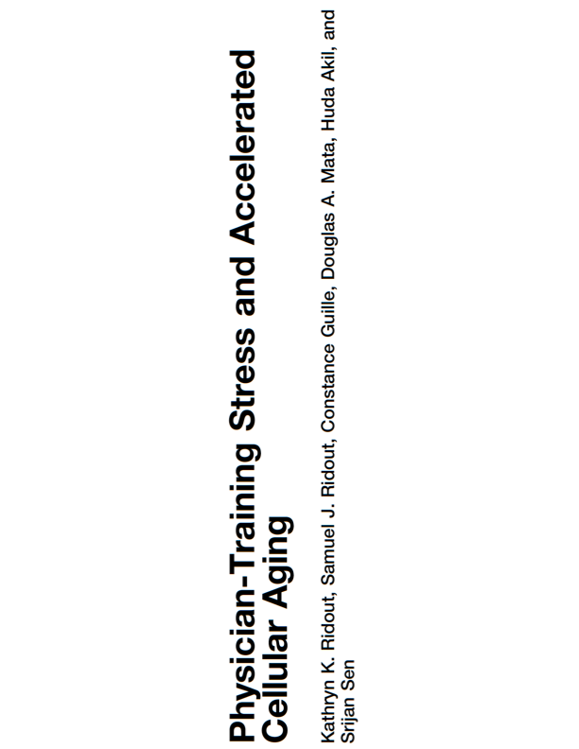
Developing the Practice of Wellness
Well-being is an essential skill in medicine:
  Personal experience can inform patient counseling
  Your health and wellness affect patient outcomes
Studies show that your training has potential implications for you at the cellular level.
Lizotte-Waniewski, et al, 2021
Notes:
Talking Points:
Wellness is important not only for the medical student but also to their patients. The healthy doctor can counsel patients from a place of experience.
Explain that the students will never be less busy than you are now so now is the time to create a wellness toolkit that helps toto avoid burnout protect their chromosomes!!
Resources for Slide Content:
1) Ridout, K. K., Ridout, S. J., Guille, C., Mata, D. A., Akil, H., & Sen, S. (2019). Physician-training stress and accelerated cellular aging. Biological psychiatry, 86(9), 725-730.
Image Credits:
Doctors at Surgery Image: "Banadir Hospital in Mogadishu" by United Nations Photo is licensed with CC BY-NC-ND 2.0. To view a copy of this license, visit https://creativecommons.org/licenses/by-nc-nd/2.0/

Slide 8
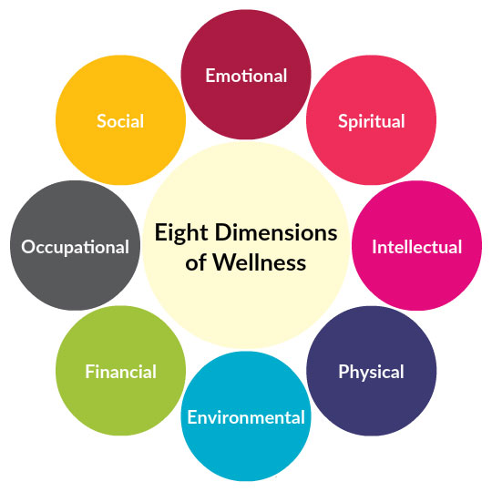
Dimensions of Wellness
Your overall holistic wellness is here
You cannot be successful if you are not well!
Lizotte-Waniewski, et al, 2021
Notes:
Talking points:
Discuss the multiple dimensions of wellness and that wellness is necessary to be successful. For summary description of each category see Montoya and Summers 2021 below.
Resources for Slide Content:
Stoewen DL. Dimensions of wellness: Change your habits, change your life. Can Vet J. 2017;58(8):861-862.
Montoya, A. L., & Summers, L. L. (2021). 8 dimensions of wellness for educators. The Learning Professional, 42(1), 49-53,62.
https://umwellness.wordpress.com/8-dimensions-of-wellness/
Image Credit:
Dimensions of Wellness Image Credit: "File:Eight Dimensions of Wellness v2.png" by DaisyFig is licensed under CC BY-SA 4.0

Slide 9
Universal Elements of Wellness
Tools which help you to manage your mental health, emotional health, physical health, social, and spiritual health.
It is important to generate a “wellness toolkit” with strategies to help you manage your wellbeing.
There are several important key elements to addressing wellness in medical school:
  Nutrition
  Exercise
  Sleep Hygiene
  Stress Management Techniques
  Social Connectedness
Lizotte-Waniewski, et al, 2021
Notes:
Talking Points:
There are some elements of wellness that are ”must have” skills including the ones mentioned in the slide.
Image Credits:
Tool box: Pixabay License Free for commercial use No attribution required

Slide 10


Nutrition
In general, a more plant-based a diet (such as the Mediterranean diet, the Mayo Clinic diet etc) will provide your brain with the nutrients it needs to function at optimum capacity.
Planning nutritious meals cannot be left to chance. Make a list, grocery shop and then prep meals for the week.
Choose some meals that can be frozen and others that are easy to grab and fresh (ie Mason Jar Salad) with a good source of protein.
Lizotte-Waniewski, et al, 2021
Notes:
Talking Points:
Since food is the fuel that ensures the physical body can function, it is important to prioritize healthy eating. Studies indicate that diets which are rich in fruits, vegetables and unprocessed foods are the most nutritious.
Resources for Slide Content:
Guasch‐Ferré, M., & Willett, W. C. (2021). The Mediterranean diet and health: a comprehensive overview. Journal of Internal Medicine. Aug 23, 2021
Caprara G. Mediterranean-Type Dietary Pattern and Physical Activity: The Winning Combination to Counteract the Rising Burden of Non-Communicable Diseases (NCDs). Nutrients. 2021 Jan 28;13(2):429. doi: 10.3390/nu13020429. PMID: 33525638; PMCID: PMC7910909.
Kahleova, H, Levin, S, and Barnard, N. (2017) Cardio-Metabolic Benefits of Plant-Based Diets. Nutrients 2017, 9(8), 84.
Song M., Fung T.T., Hu F.B.et al. (2016). "Association of animal and plant protein intake with all-cause and cause-specific mortality". JAMA Intern Med 2016; 176: 1453.
Kahleova, H., Levin, S., & Barnard, N. D. (2020). Plant-Based Diets for Healthy Aging. J. Am. Coll. Nutr, 9, 1-2.
Image Credits:
Top Image Copyright: "organic fruit and vegetables" by val'sphotos is licensed with CC BY-NC 2.0. To view a copy of this license, visit https://creativecommons.org/licenses/by-nc/2.0/
Plate Image – CCO public domain - This image is not copyrighted and no attribution is required

Slide 11
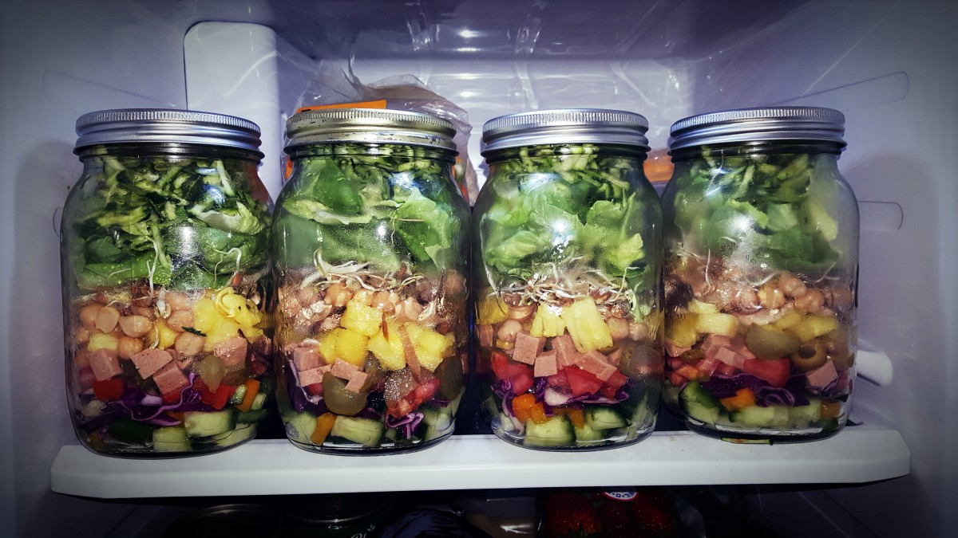
Anatomy of a Mason Jar Salad
Assembly from Bottom to Top
Salad Dressing and Wet Ingredients (Olive oil, vinegar, lemon)
Moisture Resistant Vegetables (i.e. carrots, cherry tomatoes, peppers)
Other Vegetables and/or Fruits (i.e. cucumber, sprouts, broccoli, peas)
Protein Source (i.e. chickpeas, beans, chicken)
Leafy Greens (lettuce, spinach etc), Grains (i.e. quinoa, couscous pasta), Nuts and/or Seeds
Lizotte-Waniewski, et al, 2021
Notes:
Talking Points:
Mason jar salads are easy to make in advance, bring with you and shake to serve. Any nutritious meal that can be made in advance and stored for the week are good choices for anyone who has limited time.
Image Credits:
Mason Jar Salads Image: CCO public domain - This image is not copyrighted and no attribution is required

Slide 12
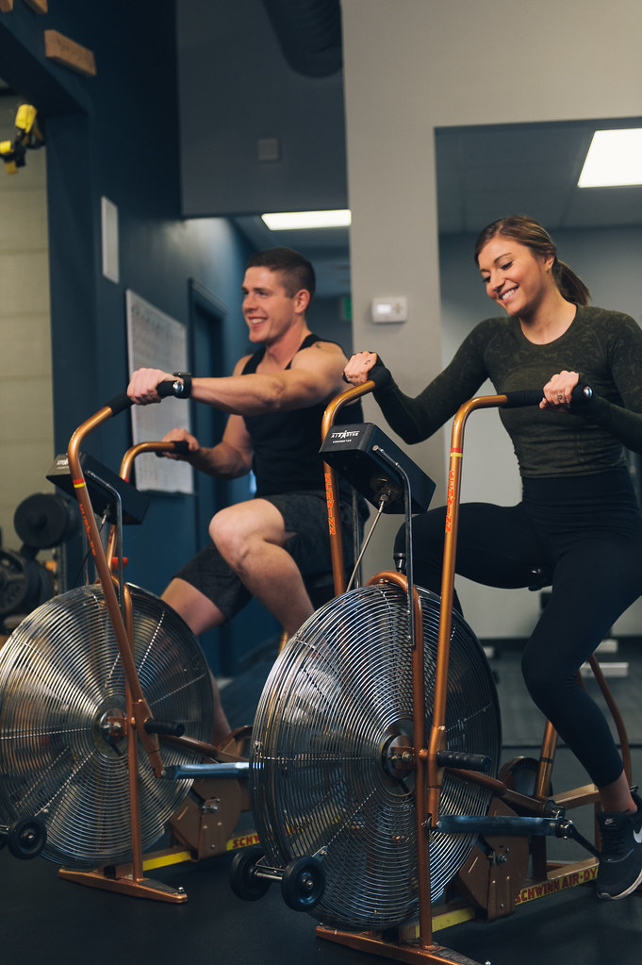

Exercise
Benefits
  boosts mood
  decreases stress and depression
  increases metabolism
  reduces cardiovascular disease and cancer risk
  improves cognitive functions
The US Department of Health recommends:
at least 150 minutes per week of moderate aerobic exercise
at least 2 days per week of muscle strengthening exercises
https://health.gov/sites/default/files/2019-09/Physical_Activity_Guidelines_2nd_edition.pdf#page=56
Lizotte-Waniewski, et al, 2021
Notes:
Talking Points:
Numerous studies have shown the extensive benefits of regular aerobic and strength training exercise.
Resources for Slide Content:
1) https://health.gov/sites/default/files/2019-09/Physical_Activity_Guidelines_2nd_edition.pdf#page=56
2) Cooney G, Dwan K, Mead G. Exercise for Depression (2014). JAMA 2014;311(23):2432-2433.
3) Ruegsegger GN, Booth FW. Health Benefits of Exercise. Cold Spring Harb Perspect Med. 2018 Jul 2;8(7):a029694. doi: 10.1101/cshperspect.a029694. PMID: 28507196; PMCID: PMC6027933.
Image Credits:
Weight Lifting Image Credit: "Young sportswoman lifting weights in gym" by shixart1985 is licensed with CC BY 2.0. To view a copy of this license, visit https://creativecommons.org/licenses/by/2.0/
Cardio Spinning Image: "Cycling Cardio Exercise - Must Link to https://thoroughlyreviewed.com" by ThoroughlyReviewed is licensed with CC BY 2.0. To view a copy of this license, visit https://creativecommons.org/licenses/by/2.0/

Slide 13
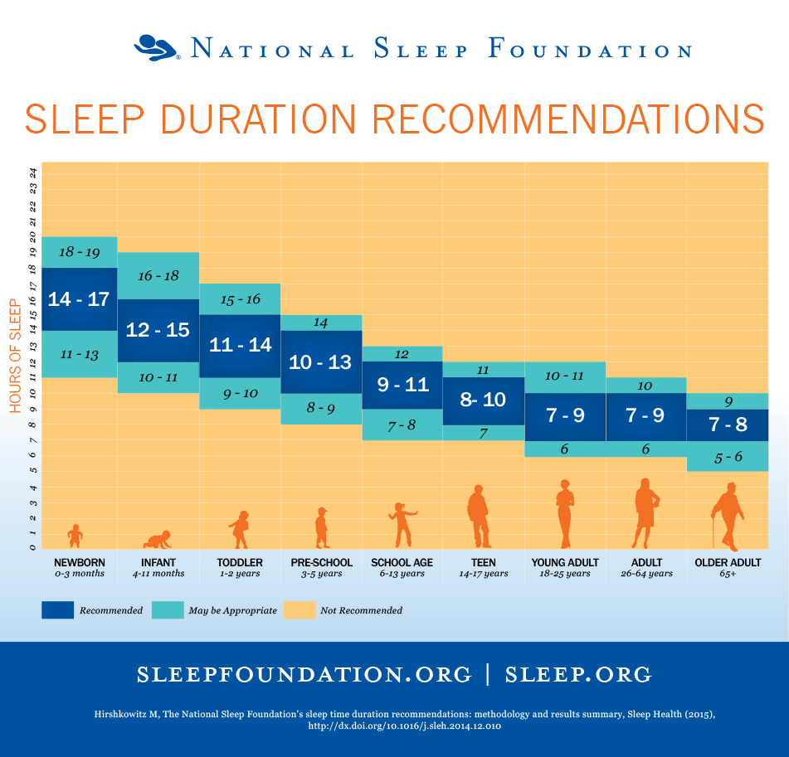
Sleep Hygiene and Routines
Go to bed and waking at the same time each day helps your circadian time clock to be consistent.
~7-8 hours of sleep each night will help you to perform at your best.
Optimal Sleep Environment is:
Dark, Cool, Comfortable, Quiet
No blue screens in bedroom!
Tips for Protecting Sleep:
Avoid caffeine, large meals and vigorous exercise before bed
Develop a bedtime ritual/routine including 30 minutes of screen-free quiet time before sleep (reading, meditation or listening to music).
If you can’t fall asleep get up and out of bed and do
something boring until you are tired then try again.
Lizotte-Waniewski, et al, 2021
Notes:
Talking Points:
Research indicates that on average medical trainees get less high-quality sleep than is recommended. Quality sleep is necessary for mental clarity, to maintain physical health and mental wellness.
Resources for Slide Content
1) Watson NF, Badr MS, Belenky G, et al. Recommended amount of sleep for a healthy adult: a joint consensus statement of the American Academy of Sleep Medicine and Sleep Research Society. Sleep. 2015;38(6):843–844.
2) Hirshkowitz M, Whiton K, Albert SM, Alessi C, Bruni O, DonCarlos L, Hazen N, Herman J, Katz ES, Kheirandish-Gozal L, Neubauer DN, O'Donnell AE, Ohayon M, Peever J, Rawding R, Sachdeva RC, Setters B, Vitiello MV, Ware JC, Adams Hillard
PJ. National Sleep Foundation's sleep time duration recommendations: methodology and results summary. Sleep Health. 2015 Mar;1(1):40-43
3) Kocevska, D., Lysen, T.S., Dotinga, A. et al. Sleep characteristics across the lifespan in 1.1 million people from the Netherlands, United Kingdom and United States: a systematic review and meta-analysis. Nat Hum Behav 5, 113–122 (2021).
4) Jahrami, H., Dewald-Kaufmann, J., Faris, M.AI. et al. Prevalence of sleep problems among medical students: a systematic review and meta-analysis. J Public Health (Berl.) 28, 605–622 (2020).
Image Credits:
Recommended number of hours of sleep by age: National Sleep Foundation.org

Slide 14
In the Tool Kit
Nutrition
Exercise
Sleep Hygiene
Notes:
Talking Points:
Review previous tools and then make transition to next slide to address managing stress
Image Credits:
Tool box: Pixabay License Free for commercial use No attribution required

Slide 15
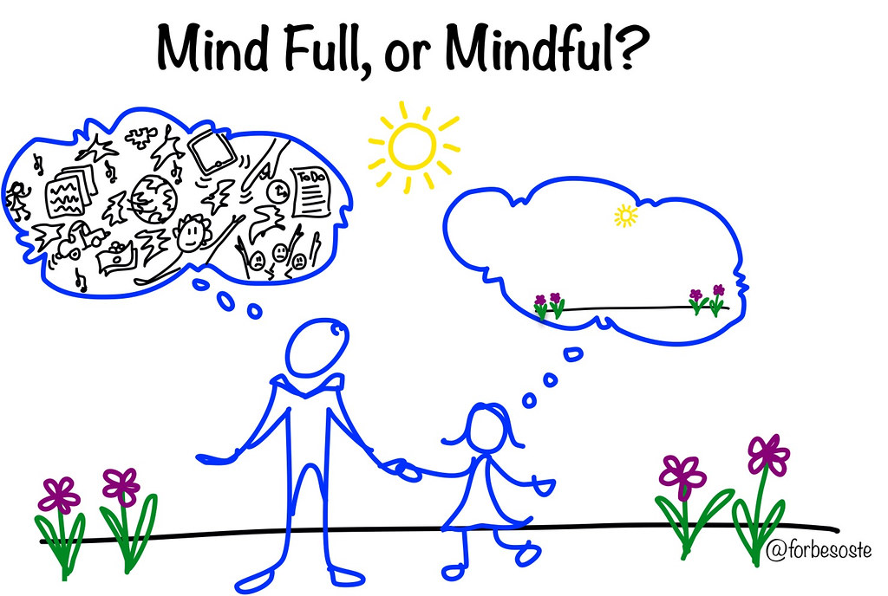

Thought Management
Recent research study estimates that the average person has ~6200 thoughts per day ⁽¹⁾.
Many of our thoughts are not new (repetitive thoughts)
If the majority of our thoughts are negative ones, what could that do to our frame of mind?
Our thoughts can create toxic stress if we let them!
The greatest weapon against stress is to choose 1 thought over another.. William James
Tseng, J., Poppenk, J. Brain meta-state transitions demarcate thoughts across task contexts exposing the
mental noise of trait neuroticism. Nat Commun 11, 3480 (2020). https://doi.org/10.1038/s41467-020-17255-9.
Lizotte-Waniewski, et al, 2021
Notes:
Talking Points:
Managing our thoughts is important to keep a positive frame of mind so that we can mitigate stress.
Optional Interactive Activity – Have students provide common negative thoughts. Examples of Negative Thoughts: I’m too short, Why does this always happen to me, Ill never be good enough, How come I can never catch a break I’m so sick of my sister’s whining and complaining;I wish I could just make myself exercise
Resources for Slide Content
1) Tseng, J., Poppenk, J. Brain meta-state transitions demarcate thoughts across task contexts exposing the mental noise of trait neuroticism. Nat Commun 11, 3480 (2020). https://doi.org/10.1038/s41467-020-17255-9.
Image Credits:
Mindful Image: "Mind Full v. Mindful" by ForbesOste is licensed with CC BY 2.0. To view a copy of this license, visit https://creativecommons.org/licenses/by/2.0/
Child Brain Image: "child Head" by charlywkarl is licensed with CC BY-ND 2.0. To view a copy of this license, visit https://creativecommons.org/licenses/by-nd/2.0/

Slide 16
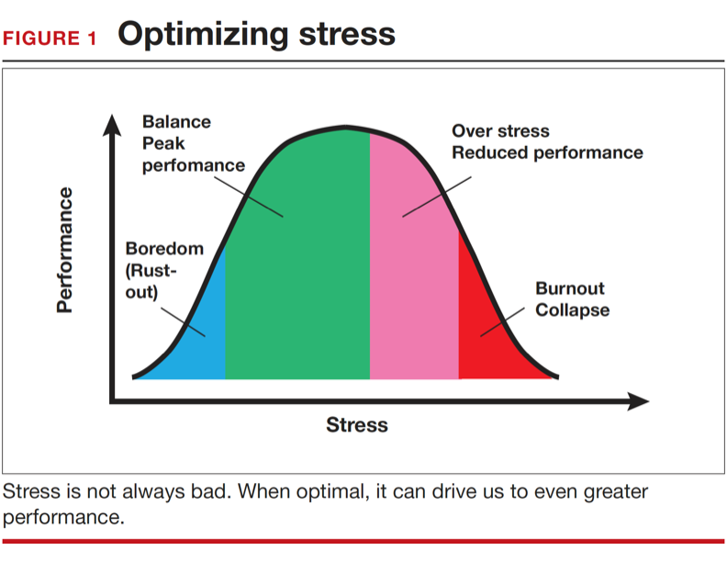
When Stressful Thoughts Get out of Control
From Smith, 2016 OBG Manag. 2016 October;28(10):17
Lizotte-Waniewski, et al, 2021
Notes:
Talking Points:
The key is to maintain a stress level that is balanced in order to ensure optimum performance to stay in the green zone. Some level of stress improves performance but past a threshold stress becomes toxic and negatively affects performance.
Reference for Slide Content:
Smith, RP Strategies for maintaining resilience to the burnout threat. OBG Manag. 2016 October;28(10):17,18,20,22,23 – Permission granted by author.

Slide 17
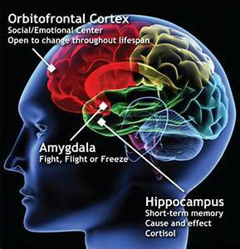
Crash Course: Your Brain on Overwhelm
Prefrontal Cortex –Executive/high order functioning. The more stress the smaller the volume of the PFC.
Amygdala- Controls emotional responses – fight or flight. The more stress the larger/more reactive it gets.
Hippocampus- Controls memory. The more stress the smaller it gets.
Amy F.T. Arnsten, Murray A. Raskind, Fletcher B. Taylor, Daniel F. Connor (2015). The effects of stress exposure on prefrontal cortex: Translating basic research into successful treatments for post-traumatic stress disorder, Neurobiology of Stress, Volume 1, 2015, Pages 89-99,
2) Kim, E. J., Pellman, B., & Kim, J. J. (2015). Stress effects on the hippocampus: a critical review. Learning &
memory (Cold Spring Harbor, N.Y.), 22(9), 411–416. https://doi.org/10.1101/lm.037291.114
Lizotte-Waniewski, et al, 2021
Notes:
Talking Points:
Stress changes your physiology: causes the parts of your brain responsible for executive function/behavior controls and memory (PFC and Hippocampus) to get smaller and the reactive emotional response center (amygdala) to get larger.
Potential analogy: Prefrontal cortex – the kindergarten teacher; Amygdala – classroom full of toddlers
Resources for Slide Content:
Amy F.T. Arnsten, Murray A. Raskind, Fletcher B. Taylor, Daniel F. Connor (2015). The effects of stress exposure on prefrontal cortex: Translating basic research into successful treatments for post-traumatic stress disorder, Neurobiology of Stress, Volume 1, 2015, Pages 89-99,
2) Kim, E. J., Pellman, B., & Kim, J. J. (2015). Stress effects on the hippocampus: a critical review. Learning & memory (Cold Spring Harbor, N.Y.), 22(9), 411–416. https://doi.org/10.1101/lm.037291.114
Image Credits:
Image of Brain: Image of Brain:
https://commons.wikimedia.org/wiki/File:Kan_cia.jpg
This file is licensed under the Creative Commons Attribution-Share Alike 4.0 International license.

Slide 18
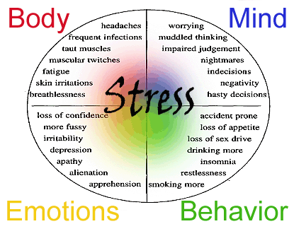
The Physiological Effect of Toxic Stress
Allostatic Overload – when the normal stress response becomes prolonged and leads to pathogenesis.
Some studies have suggested that 60-80% of illness may have a stress-related component.
Stress is a factor several of the most common causes of death (i.e. cardiovascular disease, stroke, cancer).
Nerurkar A, Bitton A, Davis RB, Phillips RS, Yeh G. When Physicians Counsel About Stress:
Results of a National Study. JAMA Intern Med. 2013;173(1):76-77.
Lizotte-Waniewski, et al, 2021
Notes:
Talking Points:
When the normal stress response, which is designed to be employed on a very short-term basis before returning to homeostasis
Is altered the result can be allosteric overload. As though we are constantly being chased by a sabertooth tiger. Prolonged and constant stress can lead to pathogenesis.
Resources for Slide Content:
Nerurkar A, Bitton A, Davis RB, Phillips RS, Yeh G. When Physicians Counsel About Stress: Results of a National Study. JAMA Intern Med. 2013;173(1):76-77.
Image Credits:
"Burnout & Stress" by Hangout Lifestyle is licensed with CC BY 2.0. To view a copy of this license, visit https://creativecommons.org/licenses/by/2.0/
Stress Symptoms Graphic: This file is licensed under the Creative Commons Attribution-Share Alike 3.0 Unported license.

Slide 19
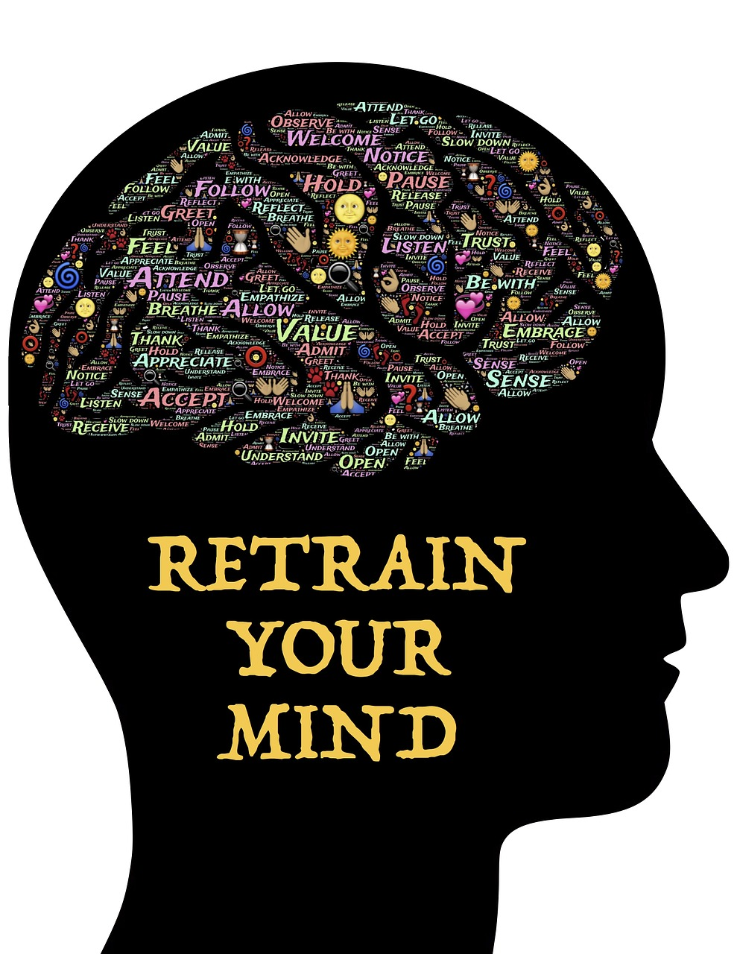
Why Meditate?
Unless we train our minds with mental exercise in the way that we train our bodies with physical exercise, there can be unhealthy outcomes that impact the quality of our lives.
The inability to manage stress can lead to negative mental and/or physical consequences such as headaches, GI distress, high blood pressure, obesity and diabetes.
An ever-growing number of CEOs of Fortune 500 Companies Meditate Daily!
https://www.businessinsider.com/ceos-who-meditate-2012-5
https://www.huffpost.com/entry/business-meditation-executives-meditate_n_3528731
Lizotte-Waniewski, et al, 2021
Notes:
Talking points:
Managing thoughts takes training. The literature is growing regarding the benefits of meditation for cognitive functioning and physical health.
Resources for Slide Content
1) Greeson JM and Chin, GR Mindfulness and physical disease: a concise review, Current Opinion in Psychology, Volume 28, 2019, Pages 204-210,
2) https://hbr.org/2015/12/how-meditation-benefits-ceos.
3) https://www.billgeorge.org/articles/wall-street-bosses-tiger-woods-meditate-to-focus-stay-calm/
Image Credits:
Retrain your Brain - https://www.maxpixel.net/Meditation-Mindfulness-Mindset-Self-awareness-743166 – CCO Public Domain

Slide 20
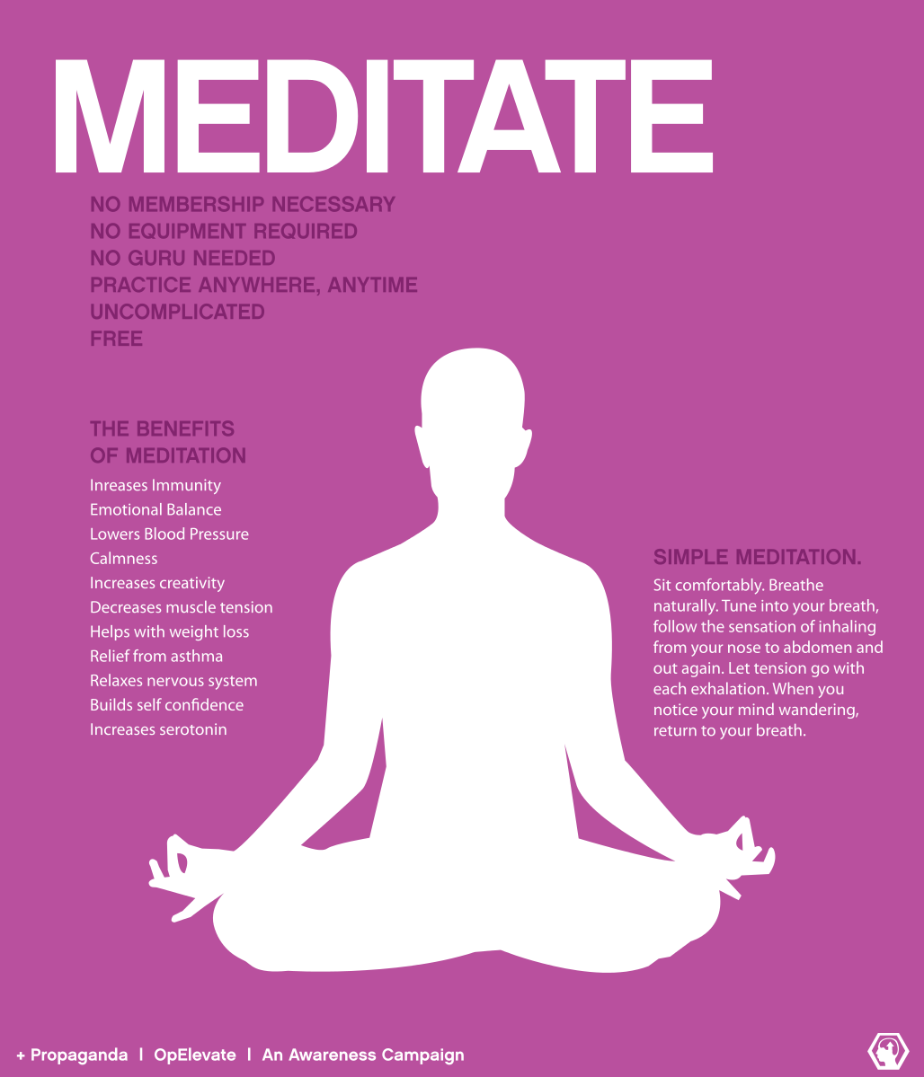
Benefits of Meditation
Physical Health Benefits
Decreases levels of cortisol
Lowers blood pressure
Reduces cardiovascular disease
Improves immune functioning
Mental Health Benefits
Improves working memory capacity
Increases empathy
Increases ability to focus attention
Induces higher levels of satisfaction
Improves sleep quality
Increases brain plasticity
Induces greater productivity/efficiency
Lizotte-Waniewski, et al, 2021
Notes:
Talking Points:
The benefits of meditation are numerous and the ever expanding research literature supports its efficacy in a number of different arenas.
Resources for Slide Content:
1) Adam Koncz, Zsolt Demetrovics & Zsofia K. Takacs (2021) Meditation interventions efficiently reduce cortisol levels of at-risk samples: a meta-analysis, Health Psychology Review, 15:1, 56-84, DOI: 10.1080/17437199.2020.1760727
2) Greeson JM and Chin, GR Mindfulness and physical disease: a concise review, Current Opinion in Psychology, Volume 28, 2019, Pages 204-210,
3) Krittanawong, C., Kumar, A., Wang, Z., Narasimhan, B., Jneid, H., Virani, S. S., & Levine, G. N. (2020). Meditation and Cardiovascular Health in the US. The American Journal of Cardiology, 131, 23-26.
4) Aherne, D., Farrant, K., Hickey, L., Hickey, E., McGrath, L., & McGrath, D. (2016). Mindfulness based stress reduction for medical students: optimising student satisfaction and engagement. BMC Med Educ, 16(1), 209-209. doi: 10.1186/s12909-
016-0728-8 https://www.ncbi.nlm.nih.gov/pubmed/27535243
Image Credits:
This file is licensed under the Creative Commons Attribution-Share Alike 3.0 Unported license.

Slide 21



Meditation Can Take Many Forms
Mindfulness (focus attention on breath, body scan, candle)
Guided (Visualization/Virtual Reality)
Mantra Meditation (including Transcendental)
Walking (focus on movements of walking)
Journaling/gratitude
Prayer (Contemplative or Meditative)
Lizotte-Waniewski, et al, 2021
Notes:
Talking Points:
Since meditation can take many forms, learners can try a few different approaches and find what works best for them and stick with those methods.
Image Credits:
Burning Candle Image: "burning candle" by S@veOurSm:)e is licensed with CC BY-SA 2.0. To view a copy of this license, visit https://creativecommons.org/licenses/by-sa/2.0/
Walking Meditation Image: "walking meditation" by UI International Programs is licensed with CC BY-ND 2.0. To view a copy of this license, visit https://creativecommons.org/licenses/by-nd/2.0/
Be Grateful Image: "Be Grateful." by SnoShuu is licensed with CC BY-NC-ND 2.0. To view a copy of this license, visit https://creativecommons.org/licenses/by-nc-nd/2.0/

Slide 22

Experience Breath Meditation (Activity)
Lizotte-Waniewski, et al, 2021
Notes:
Possible Script for Breath Meditation:
There is no right or wrong way to meditate. Whatever you experience during this breathing meditation is right for you. Don’t try to make anything happen or judge it, just observe. As thoughts go into and out of your mind think of your mind as a blue sky watching clouds go by – watching not engaging and returning your mind to your breathing. You can’t stop your mind from thinking you can only choose not to interact with the thoughts.
Straighten your back but don’t stiffen it, rest against the chair and lower your shoulders.
Put your feet flat on the ground in a comfortable position and let your hands just rest in your lap in whatever way is comfortable.
Once you are comfortable, gently close your eyes. Relax the muscles in your face and feel your hands in your lap and your feet making contact with the floor.
Now take a deep breath in through your nose and hold it for 3 seconds and exhale from your mouth.
As you take another deep breath in and feel how your lungs are expanding as you take the air in.
Slowly exhale feeling your lungs get smaller. As you exhale, you can feel the tension and stress leave your body.
When you take another breath in notice your chest and abdomen rise. Exhale releasing any remaining tensions from your body.
As you continue to breathe in and out; notice how calm and gentle your breathing is, and how relaxed your body feels.
Inhale again and feel your heart slowing, hold the breath for 3 seconds then exhale from your mouth.
As we breath one last time, we are breathing in calm and confidence and as we and as we exhale this last time, we remove all anxiety and stress.
As we finish the exercise, when you feel comfortable you can gently open your eyes.
Image Credits:
Beach Image: "Tropical Beach" by A. Munar is licensed with CC BY-SA 2.0. To view a copy of this license, visit https://creativecommons.org/licenses/by-sa/2.0/

Slide 23
Meditation Checklist
Find quiet place where you will not be disturbed for 10 minutes free of distractions and set a timer for the length of your meditation (2-10 minutes to start).
2. Sit comfortably on a chair or on the floor. You can close your eyes or lower your gaze to the floor to
minimize distractions.
3. Make sure your back is straight but not rigid and rest your hands in your lap or on a table.
4. Focus your attention on your breath. Breathe normally, but notice when the breath starts, and feeling the
expansion of your lungs as you inhale.
5. Pause briefly after the inhale and then as you slowly exhale notice the sensation of your belly and chest
falling.
6. Thoughts will come and go from your mind. Just notice that you are having a thought (label it “thinking”
and gently return your attention to your breath. You won’t be able to prevent the mind from thinking,
just be aware when thoughts arise and choose not to engage with them, returning focus to the breath.
7. Repeat steps 4-6 for the full duration of your meditation time.
8. At the last exhale name 1 thing for which you are grateful.
Lizotte-Waniewski, et al, 2021
Notes:
Talking Points:
Here is a resource so that students have a template for a simple breath meditation – no need to go over the checklist necessarily, just offer it as a resource.

Slide 24
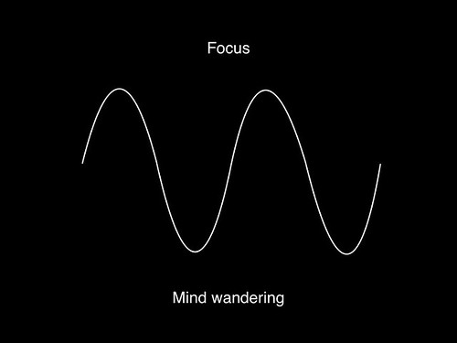
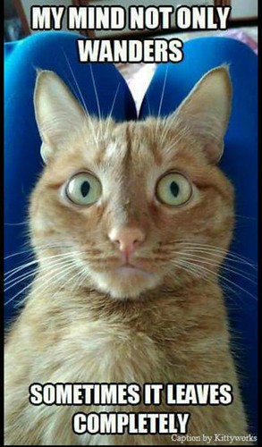
The Myth of Multitasking
A 2010 Harvard study shows that subjects were not paying attention/fully engaged with what they were doing in front of them 47% of the time!¹
When the mind wanders, where does it go? What is the result?
What about multitasking? Experts in cognition indicate frequent multitasking can cost up to 30-40% of lost productivity during brain switching (switching cost) and lead to more errors.
1) Killingsworth, M. A., & Gilbert, D. T. (2010). A wandering mind is an unhappy mind.
Science, 330 (6006), 932-932.
https://www.apa.org/research/action/multitask
Lizotte-Waniewski, et al, 2021
Notes:
Talking Points:
Even if you are note ready to start meditating 1 helpful step in the right direction is to stop multitasking
When the mind wanders where does it go? There are only 2 options if the mind is not in the present – it either goes to the past or future. In many cases, the mind will be pulled into the past where it ruminates on negative interactions/outcomes or it moves to predict the future (often times worrying about things which may never happen).
Although switch costs may be relatively small, sometimes just a few tenths of a second per switch, they can add up to large amounts when people switch repeatedly back and forth between tasks. Thus, multitasking may seem efficient on the surface but may actually take more time in the end and involve more error. Meyer has said that even brief mental blocks created by shifting between tasks can cost as much as 40 percent of someone's productive time.
Resources for Slide Content:
1) Rubinstein, J. S., Meyer, D. E. & Evans, J. E. (2001). Executive Control of Cognitive Processes in Task Switching. Journal of Experimental Psychology: Human Perception and Performance, 27, 763-797.
2) Killingsworth, M. A., & Gilbert, D. T. (2010). A wandering mind is an unhappy mind. Science, 330 (6006), 932-932.
3) Saraswathi Bellur, Kristine L. Nowak, Kyle S. Hull, (2015). Make it our time: In class multitaskers have lower academic performance,Computers in Human Behavior, Volume 53, 2015, Pages 63-70, ISSN 0747-5632.
4) Gopher, D., Armony, L. & Greenspan, Y. (2000). Switching tasks and attention policies. Journal of Experimental Psychology: General, 129, 308-229.
5) Mayr, U. & Kliegl, R. (2000). Task-set switching and long-term memory retrieval. Journal of Experimental Psychology: Learning, Memory, and Cognition, 26, 1124-1140.
6) Ophir, E, Nass, C and Wagner, AD. (2009) Cognitive control in media multitaskers PNAS September 15, 2009 106 (37) 15583-15587; https://doi.org/10.1073/pnas.0903620106
Image Credits:
Cat Mind Wandering: "My Mind Wanders" by jaygannett is licensed with CC BY-SA 2.0. To view a copy of this license, visit https://creativecommons.org/licenses/by-sa/2.0/
Mind Wandering Image: "Focus and mind-wandering" by askpang is licensed with CC BY-NC-SA 2.0. To view a copy of this license, visit https://creativecommons.org/licenses/by-nc-sa/2.0/
Matthew Killingsworth and Daniel Gilbert (2010).
In 2010, Harvard psychologists Matthew Killingsworth and Daniel Gilbert conducted a study with 2,250 subjects, checking with them at random times (via a phone app) to record what they were doing at that moment and what their mind was focused on. A quarter-million datapoints later, they determined that the test subjects (and all of us by extrapolation), had wandering minds, i.e. were not paying attention/fully engaged with what was right in front of them -- a whopping 47 percent of the time.
And here's the real kicker, the study further determined that a wandering mind is not a happy mind, as not being present in the moment was the cause of test subjects who reported unhappiness, not the consequence. As Killingsworth reported: "Mind-wandering is an excellent predictor of people's happiness. In fact, how often our minds leave the present is a better predictor of our happiness than the activities in which we're engaged."
The study also found that people's minds were more likely to wander to pleasant topics (43 percent of the time) or neutral topics (31 percent) than unhappy topics (26 percent). But people were considerably less happy when thinking about neutral or unhappy topics and were no happier when thinking about pleasant topics than when fully engaged in what they were doing.
In other words, when you're not present in the moment, all roads point to unhappiness.

Slide 25
So Far in Your Tool Kit…
Exercise
Diet
Sleep
Mindfulness
Notes:
Talking Points:
Recap of the content covered so far.
Image Credits:
Tool box: Pixabay License Free for commercial use No attribution required

Slide 26
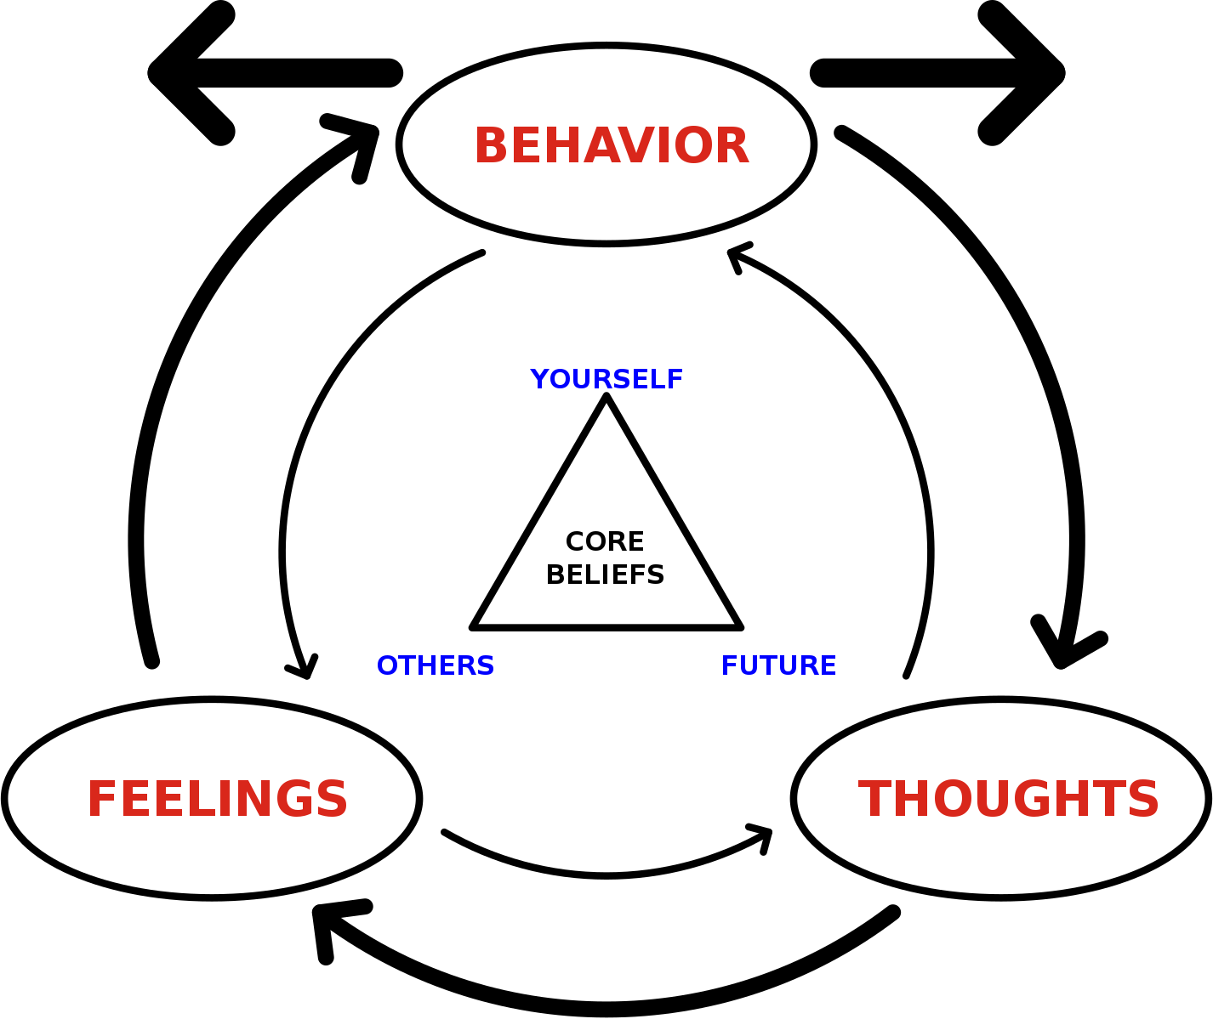
Rational Emotive Behavioral Therapy
Practical mechanism to neutralize unhelpful thoughts and patterns, by recognizing your response to a trigger, identifying the underlying irrational beliefs and disputing the beliefs to replace them with more reality-based rational beliefs.
Helps to promote a growth mindset.
Simple and practical model for replacing self-defeating thoughts with those that are empowering.
Lizotte-Waniewski, et al, 2021
Notes:
Talking Points:
Now let’s go 1 step further - so far in your toolkit we have put in exercise , diet, sleep and mindfulness toolkit now let’s move into thought management. REBT is a type of Cognitive Behavioral Therapy that focuses on changing negative emotions and behaviors that are linked to unhelpful/irrational thoughts.
Image Credits:
https://commons.wikimedia.org/wiki/File:Cognitive_behavioral_therapy_-_basic_tenets.svg. Permission is granted to copy, distribute and/or modify this document under the terms of the GNU Free Documentation License, Version 1.2 or any later version published by the Free Software Foundation; with no Invariant Sections, no Front-Cover Texts, and no Back-Cover Texts. A copy of the license is included in the section entitled GNU Free Documentation License.

Slide 27
The ABCDEs of REBT
A
An event occurs that triggers emotional or psychological stress
Activating Event/Adversity
B
The irrational belief underlying the negative response to the activating event
Beliefs (irrational/unhelpful)
C
The emotional or psychological consequences of the irrational belief
Consequences (emotional/behavioral)
D
Dispute the irrational belief(s) underlying the negative response to the activating event
Dispute Irrational Beliefs
E
Exchange the irrational belief(s) for more logical/helpful belief
Exchange for Effective/Rational Belief
Lizotte-Waniewski, et al, 2021
Notes:
Talking Points:
This is the Albert Ellis model of rational emotive behavioral therapy, using the ABCDE method.
It is helpful to go through each letter and present the overall scheme of this method.

Slide 28
Ellis: Four Types of Irrational Beliefs
Demanding Beliefs – often utilize words such as “must”, “should” (absolute), “have to”
Catastrophizing/Awfulizing – involves viewing the current situation as the worst possible thing that could happen.
Low Frustration Tolerance (LFT) –often utilizes phrases such as “I can’t stand it if..”, “it is unbearable/untenable)
Conditional Self/Other/Life/World Acceptance – negative self or other talk, defining a person based upon 1 event (i.e. “If I fail at anything then I am a failure”)
Lizotte-Waniewski, et al, 2021
Notes:
Resources for Slide Content:
1) Book - Rational and Irrational Beliefs: Research, Theory, and Clinical Practice 2010 editors Daniel David, Ssteven j Lynn and Albert Ellis

Slide 29
The ABCDEs of REBT in Action
A
You receive a lower score on an exam than your performance on other exams
Activating Event/Adversity
B
“I must do perfectly on every assessment or I will be kicked out of medical school”
Irrational Belief(s)
C
You become overly anxious about your grade and angry with yourself for not studying more
Consequences (emotional/behavioral)
D
Dispute the irrational belief(s) underlying the negative response to the activating event
Dispute Irrational Beliefs
E
“The curriculum is pass/fail and my score on this one exam will not affect my overall grade”
Exchange for Effective/Rational Belief
Lizotte-Waniewski, et al, 2021
Notes:
Talking points:
Possible activity - Ask students to come with their own examples from their experience.

Slide 30
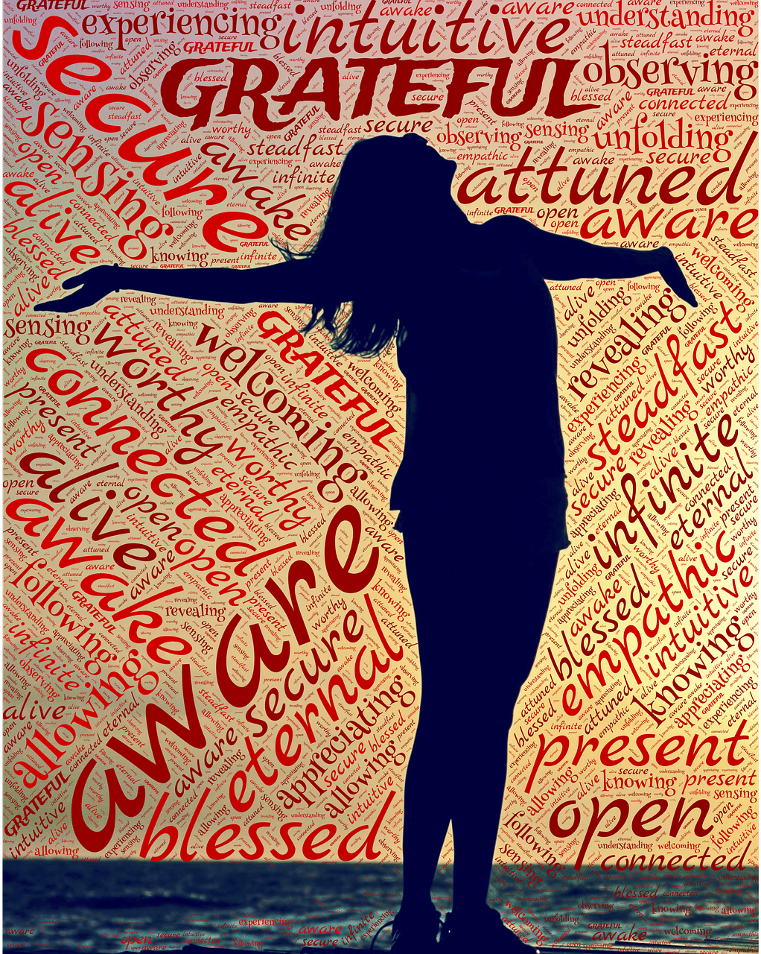

Promoting a Mental Stance of Gratitude
Centers on remembering the positive things that happen to us daily, rather than the negative.
After a short time, we begin to NOTICE the moments in our day that we are grateful for as they happen.
This leads to a mental stance of gratitude throughout the day.
Journaling can also help us to “mind dump” negative feelings or traumatic events.
Lizotte-Waniewski, et al, 2021
Notes:
Talking Points:
Taking a mental stance of gratitude is another way to reframe thoughts – just like REBT and Mindfulness
Image Credits:
Grateful Pixabay License Free for commercial use No attribution required
Gratitude Journal: This work is licensed under a Creative Commons Attribution-NonCommercial-NoDerivs 3.0 Un2021 Fireball Creative

Slide 31

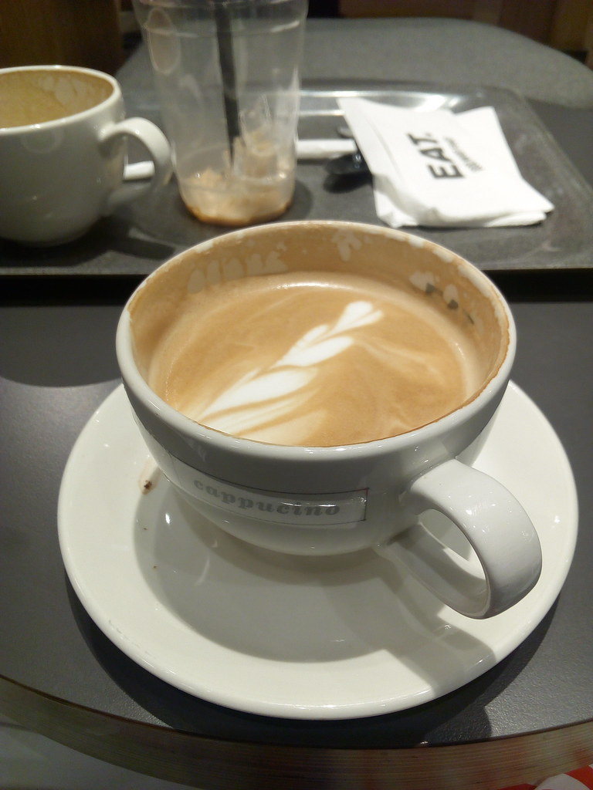
Suggestions for Gratitude Journal Prompts
What are 3 things in my life that I am most grateful for and why?
What special gift or talent am I grateful to have?
What people in my life love me the most?
What 3 things happened today for which I am grateful.
What are 3 things that I have in my life that many others in the world do not have?
What 3 songs make me happy every time I hear them?
What made me smile today?
What accomplishment am I most proud of in my life?
Lizotte-Waniewski, et al, 2021
Notes:
Talking Points and Optional Activity:
Have students choose 1 prompt and complete a brief writing reflection. Stress to the students that the things that come to mind do not need to be “big” life altering events – just simple pleasures like a cup of coffee or pets.
Image Credits:
"Cafe Latte" by ShaluSharmaBihar is licensed under CC BY 2.0
Pets: Pixabay License Free for commercial use No attribution required

Slide 32
Now in Your Tool Kit…
Exercise
Nutrition
Mindfulness
REBT
Gratitude
Notes:
Talking Points:
Recap slide of previous content.
Image Credits:
Tool box: Pixabay License Free for commercial use No attribution required

Slide 33


Social Connectedness in Medical School
A meta-analysis of 19 research studies has shown that social support provides a buffering effect which allows individuals to be more resilient to stressors (²).
Correlations have also be shown that group membership is beneficial to the wellbeing of individuals (^{1,2,3})
Because medical training is a unique experience, it can be helpful to discuss challenging experiences in learning groups or academic societies.
Social activities such as movies, game nights, etc
1) McNeill KG, Kerr A, Mavor KI. Identity and norms: The role of group membership in medical student wellbeing.
Perspect Med Educ. 2014;3:101–112.
2) Kim B, Jee S, Lee J, An S, Lee SM. Relationships between social support and student burnout: A meta-analytic
approach [published online ahead of print June 22, 2017]. Stress Health. doi: 10.1002/smi.2771.
3) Haslam SA, O’Brien A, Jetten J, Vormedal K, Penna S. Taking the strain: Social identity, social support, and the
experience of stress. dsBr J Soc Psychol. 2005;44(pt 3):355–370.
Lizotte-Waniewski, et al, 2021
Notes:
Talking Points:
Medicine has always been a team sport and that approach is beneficial both to patients and to health care providers.
Isolation has a negative impact on mental health, which has been underscored by the COVID pandemic.
Sharing experiences (positive and negative) among medical trainees leads to support in stress management
Resources for Slide Content:
1) McNeill KG, Kerr A, Mavor KI. Identity and norms: The role of group membership in medical student wellbeing. Perspect Med Educ. 2014;3:101–112.
2) Kim B, Jee S, Lee J, An S, Lee SM. Relationships between social support and student burnout: A meta-analytic approach [published online ahead of print June
22, 2017]. Stress Health. doi: 10.1002/smi.2771.
3) Haslam SA, O’Brien A, Jetten J, Vormedal K, Penna S. Taking the strain: Social identity, social support, and the experience of stress. dsBr J Soc Psychol. 2005;44(pt 3):355–370.
4) Gold JA, Bentzley JP2, Franciscus AM2, Forte C2, De Golia SG2. 8.An Intervention in Social Connection: Medical Student Reflection Groups. Acad Psychiatry. 2019 Aug;43(4):375-380. doi: 10.1007/s40596-019-01058-2. Epub 2019 Apr
Image Credits:
"Second year medical students from the UPNG School of Medicine and Health Science. Port Moresby General Hospital, PNG." by DFAT photo library is licensed with CC BY 2.0. To view a copy of this license, visit https://creativecommons.org/licenses/by/2.0/
Image; "We are #Social, #connect with our community over @ #YouTube @officialsherlocknation, on Facebook @ Sherlock Nation Official and #Twitter @ Official #SherlockNation. #entrepreneurs #tribes #sethgodin #business #empowerment #socialmedia #brands #boss #CEO #" by We Are Social is licensed with CC BY 2.0. To view a copy of this license, visit https://creativecommons.org/licenses/by/2.0/

Slide 34
Overview of Wellbeing Toolkit
Exercise both cardiovascular and strength Training
Nutrition: Plan meals and snacks in advance – meal prep on the weekends
Good Sleep Hygiene
Thought Management:
  Mindfulness
  REBT/CBT
  Gratitude
Social Connectedness - De-stressing activities (movies, virtual game night, pets etc)
Lizotte-Waniewski, et al, 2021
Notes:
Talking Points:
Summarize of all of the content presented so far, and a review of the tools that were discussed.
Image Credits:
Tool box: Pixabay License Free for commercial use No attribution required

Slide 35
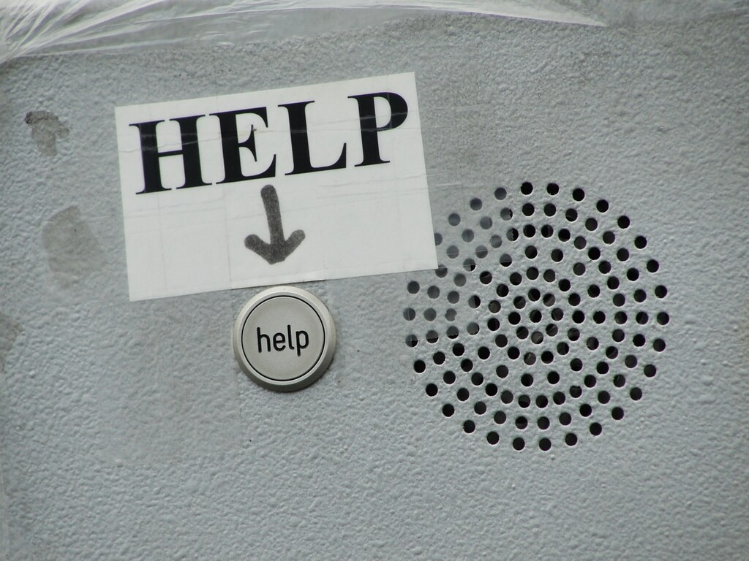
When the Tool Kit Isn’t Working
Seek help support from qualified professional practitioners
Help-seeking behavior is a STRENGTH!
Notes:
Talking Points:
It is important to stress to students that situations arise which exceed the current limits of our skill sets and at that time it makes sense to seek professional help for support. Help-seeking behavior is one of the keys to resilience and it is a strength not a weakness. Being aware of our own limitations is important for our health and that of our patients.
Image Credits:
"help" by fingle is licensed with CC BY-NC-SA 2.0. To view a copy of this license, visit https://creativecommons.org/licenses/by-nc-sa/2.0/

Slide 36
Create your Wellness Routine: Suggestions
What is 1 thing that was presented that you can commit to doing over the next week that will help decrease your stress/anxiety? – Connect with an accountability partner
Write down 3 things that are gifts/talents that you think you have been given and how you will work to develop them or share them with others?
Journal of gratitude – what 3 things happened to you today for which you are grateful? https://ggia.berkeley.edu/practice/three-good-things
Write someone else a note letting them know how grateful you are for something that they did – can be something small. Not only will you make their day, but some studies suggest it will boost your morale also.
Lizotte-Waniewski, et al, 2021
Notes:
Talking Points:
Review suggestions for crafting wellness routines. If there is time solicit other strategies from the students or do a pair-and-share exercise if there is time. This helps to create a sense of accountability.

Slide 37
Additional Resources for Wellness: Activity Log
Lizotte-Waniewski, et al, 2021
Notes:
Talking Points:
Provide to the students the PDF - Invite students to download PDF of the table and track 1 or more wellness activities over a month.

Slide 38
Other Resources
Zappetti D and Avery JD eds. Medical Student Wellbeing: An Essential Guide. Springer Press 2020
Holliday AM, Gheihman, G, Cooper, C, Sullivan, A, Ohyama, H. Leaf, DE and Karp-Leaf, R (2-19_ High Prevalence of Imposterism Among Female Harvard Medical and Dental Students. J Int Med2020, 35: 2499-500
Brennan-Wydra, E., Chung, H.W., Angoff, N. et al. Maladaptive Perfectionism, Impostor Phenomenon, and Suicidal Ideation Among Medical Students. Acad Psychiatry (2021). https://doi.org/10.1007/s40596-021-01503-1
Villwock JA, Sobin LB, Koester LA, Harris TM. Impostor syndrome and burnout among American medical students: a pilot study. Int J Med Educ. 2016;7:364-369. doi:10.5116/ijme.5801.
McConnville et al (2017). “Mindfulness Training for Health Profession Students – The Effect of Mindfulness training on Psychological Well-being, Learning, and Clinical Performance of Health Professional Students: A systematic review of randomized and non-randomized controlled trials. Academic Medicine 2017, 13(1): 26-45.
Creswell, J.D. (2017). “Mindfulness Interventions”. Annual Reviews Psychology 68:491-516.
Dyrbye L. et al (2006). ”Systematic Review of Depression, Anxiety, and Other Indicators of Psychological Distress Among US and Canadian Medical Students”. Academic Medicine, 81(4): 354-373.
Rotenstein L.S. et al (2016). “Prevalence of Depression, Depressive Symptoms, and Suicidal Ideation Among Medical Students: A Systematic Review and Meta-Analysis”. JAMA, 316(21): 2215-2236.
Black, D.S. and Slavich, G.M. (2016). Mindfulness Meditation and the Immune System: A Systematic Review of Randomized Controlled Trials”. Annals of the New York Academy of Sciences, 1373:13-24.
Montoya, A. L., & Summers, L. L. (2021). 8 dimensions of wellness for educators. The Learning Professional, 42(1), 49-53,62.
Zeidan,F. (2014). “The Neurobiology of Mindfulness Meditation”, in The handbook of Mindfulness. Ed, Brown.
Ridout, KK, Ridout, SJ, Guille, C, Mata, DA, Akil, H and Sen, s (2019). Physician-Training Stress and Accelerated Cellular Aging. Biological Psychiatry, in preprint
Mindfulness apps: 10% happier, Calm, Headspace, Insight, Dharma Seed
Lizotte-Waniewski, et al, 2021

