Slide 1
Biographical Wardrobe: How to successfully represent who you are on Paper
Emelyn Zaworski
Notes:
Thank you for participating in the student leadership elective. This is the biographical wardrobe module created and narrated by Emelyn Zaworski. The purpose of this module is to help medical students look to the future, build their CVs, and get a head start on residency applications.

Slide 2
Objectives
Recognize applicant traits and experiences valued by residency programs.
Compare and contrast values among specialties.
Identify characteristics of competitive applicants to a chosen specialty.
Curate your accomplishments into a refined CV.
Target areas for growth.
Create personalized goals.
Notes:
By the end of this module, you should be able to accomplish these objectives.

Slide 3
Quick look Ahead
Reflection
Specialty Information
CV Development
Goal Setting
Capstone
Notes:
Here’s a quick look at the sections of this module.

Slide 4
Time Allotment
Reflection: 5 minutes
Specialty Information: 15 minutes
CV Development: 45 minutes
Goal Setting: 15 minutes
Capstone: 15 minutes
Total: 95 minutes
Notes:
To help you manage your time, here is a sample of time allotments for each section of this module

Slide 5
Reflection

Slide 6
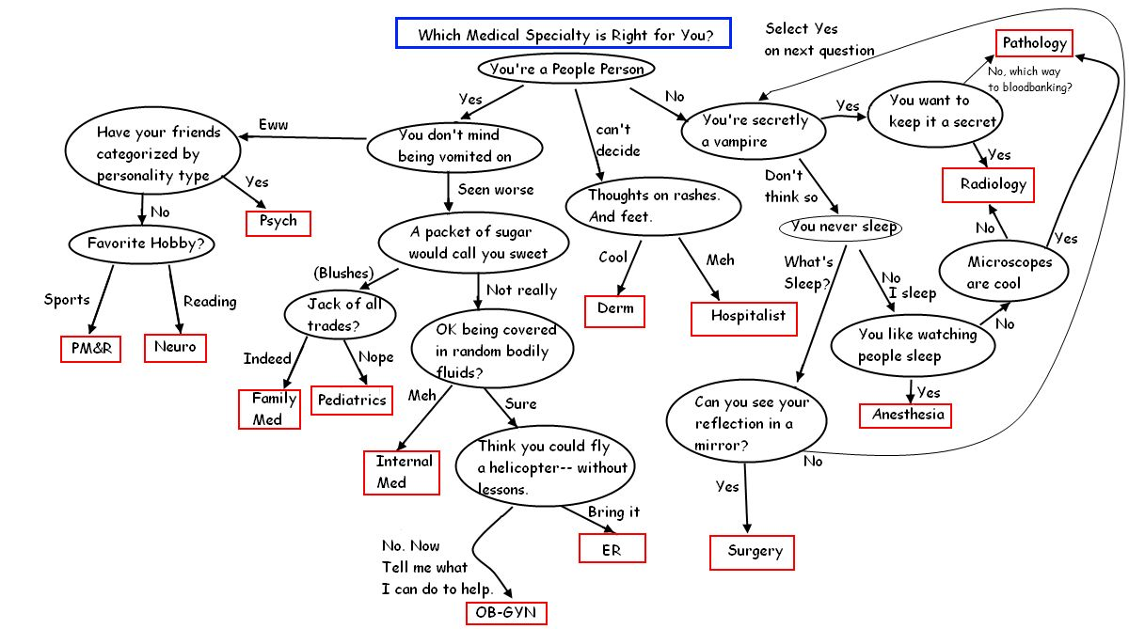
Careers in Medicine
Advising: Contact your school’s advisors
Notes:
For the next activity, consider which specialty or specialties appeal to you. If you are undecided, please use the link to explore specialty options.

Slide 7
Self-Reflection
Specialty Interest
Why this specialty?
What affects your choice?
Notes:
Now that you’ve had time to explore different specialty options, let’s take a moment to orient ourselves. The purpose of this module is to help you find your path to future success. Success looks different to everyone. So let’s review what success might look like to you and why.
Firstly, What specialty or specialties interest you?
2) Second, What is your motivation for pursuing this specialty? For example, did you work as an ER Tech and love the environment or Perhaps you have Celiac disease and found inspiration to become a gastroenterologist.
3) Next, Why Would this specialty be a good fit for you?
For example Do you prioritize working with your hands would you prefer to Have the option of working remotely. Do you thrive under pressure? Or prefer to have ample time to contemplate all your options?
3) Lastly, What situational factors might affect your choice? For example, have you had remarkable preceptor relationships affecting how you see the specialty? Or do you have a particular length of residency in mind?

Slide 8
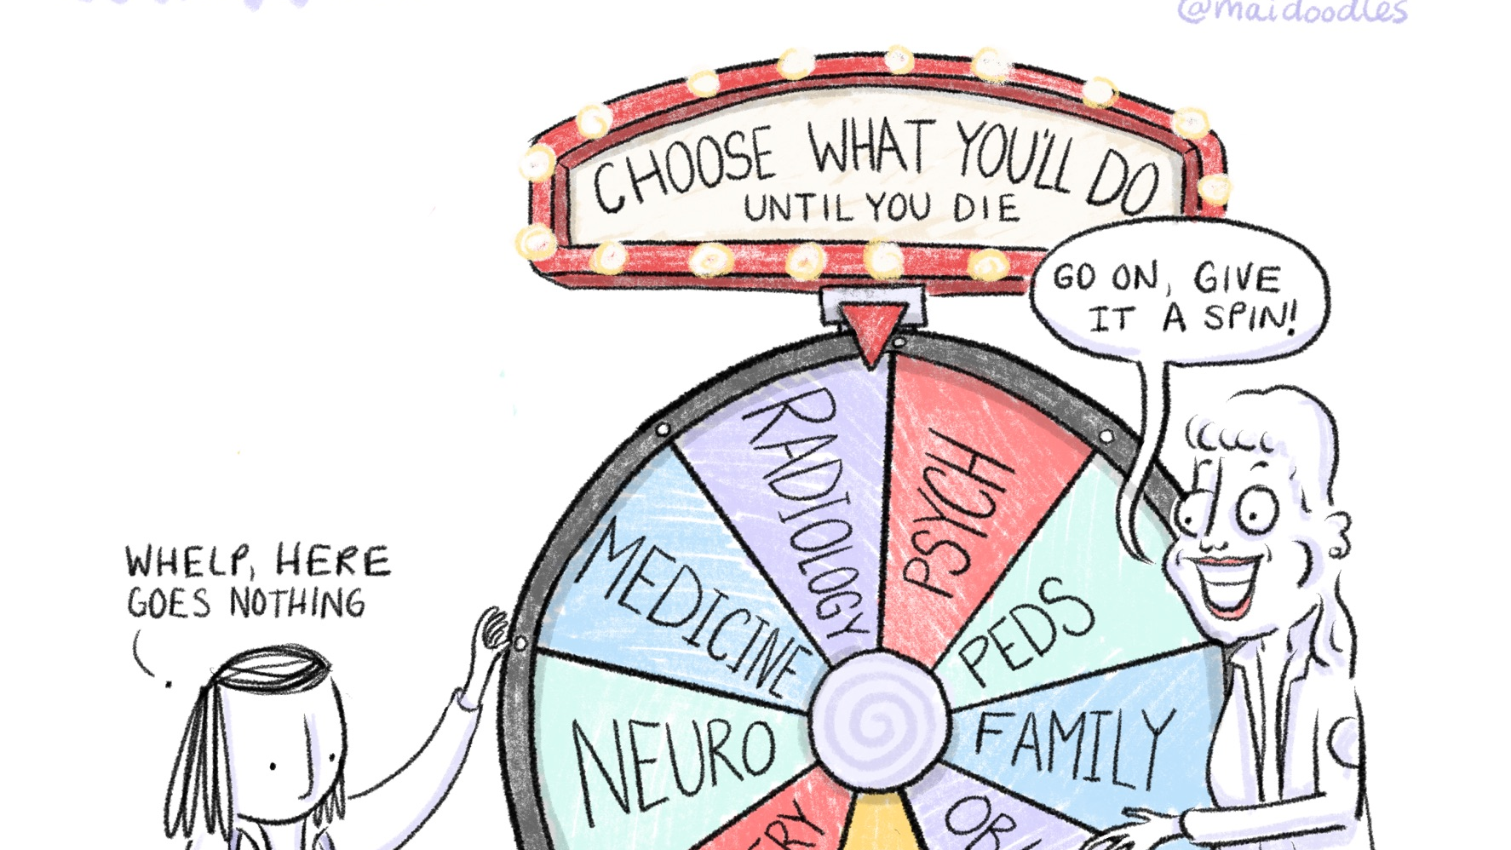
Specialty activity

Slide 9
Resources
MCW Residency Director Perspectives
2022 Match Results and Data
Notes:
As you work your way through the specialty activity, please reference these resources.

Slide 10
Items To Sort
“Honors”
Active Internship and Electives
Away Rotation
Specialty Specific Research
Any Research
Publications
3 specialty letters of recommendation
Research mentor letter of recommendation
Community Service
Leadership Roles
Notes:
For this activity, you’ll be sorting the shown items by importance to your chosen specialty or comparing how different specialties value different items. Please note some items are similar, but not identical.

Slide 11
Two Options For Sorting
Notes:
There are two options for sorting. The first option is for the “undifferentiated” medical student who is still considering multiple specialties. The second option is for the ”decided” medical student who has identified their future specialty. Please advance to the titled slide that best describes you.

Slide 12
For The Undifferentiated
Specialty 1
Specialty 3
Specialty 2
Sort items of importance by specialty
Notes:
If you have not yet decided on a specialty, compare 2 or 3 specialties that you are considering using a venn diagram. Place items of high importance into each specialty's respective circle. When done, take note of any similarities or differences.

Slide 13
For the Decided
Rank Order
ADVISOR
Notes:
If you have already decided on a specialty, sequentially rank each item in order of importance for your prospective specialty. Importantly, if you haven’t done so already, contact a specialty advisor. They will be able to provide more context and could even facilitate helpful connections for the future!

Slide 14
Side Note
Take a moment now to consider red flags and how different specialties may react to:
Course Remediation
Failed Step Exams
Poor Clinical Grades/Comments
Poor Interview Skills
Disclosure of a Mental Illness
Notes:
As an aside, this is an appropriate time to discuss what program directors might view as red flags. Consider if any of these may apply to you. If not, that’s fantastic. If so, consider how different specialties might view these bumps in the road. Don’t forget to work closely with your advisor to best represent yourself and your situation.

Slide 15
CV Activty

Slide 16
Resources
Career Services CV Development Folder
Notes:
Use the linked resources for the following activity.

Slide 17
CV Development
Templates provided
Compose personal CV
Identify important sections
Understand formatting
Notes:
With the resources provided, identify important sections of a CV and understand formatting.
Using one of the templates provided, create your own up-to-date CV.

Slide 18
Additional Tip
There are not specialty specific rules for CV formatting
However, experiences you deem more important for your specialty should be highlighted!
Notes:
Pro-tip: While there aren’t specialty specific CV templates, more valuable experiences or qualifications should be highlighted. So review your specialties values when organizing your CV!

Slide 19
Have your CV Reviewed

Slide 20
GOAL SETTING

Slide 21
Set Your Goals
Identify areas for growth
Create Goals
Share one goal
Notes:
You’ve now reviewed specialty values and have curated a CV. Let’s complete three additional steps for success.
1) Firstly, Identify any areas of growth for becoming a competitive applicant
2) Next create goals to achieve this growth. Set goals for 1 month, 1 year, and 5 years. Resources for goal setting can be found on the next slide.
3) Finally, share one goal with a mentor or classmate for accountability

Slide 22
Resources
Goal Setting (click link for directions and examples)
SMART
WOOP
Follow-through
Goal Buddy
Lifetick
Todoist

Slide 23
capstone

Slide 24
Narrative
Think about skills or qualities you possess, challenges you’ve overcome, or experiences you’ve had that will help you succeed as a physician within your intended specialty.
Notes:
As a capstone for the course, draft a short narrative story highlighting a strength or experience of yours that will help you succeed in a chosen specialty. Save this narration to serve as an inspiration for a future personal statement.

Slide 25
GOAL Check-Ins
Within Subsequent Modules
Notes:
In future modules, there will be goal check-ins. Please keep up all your great work to achieve your goals! On behalf of the student leadership elective team, thank you very much for participating in this module and good luck with all your future endeavors!

