Slide 1
CFAS Connect Housekeeping
Please mute your line as we start the Zoom, but keep your cameras on! It’s great to see faces.
If you want to ask a question or make a comment, please type your name or your question in the chat box. You will be called on in sequence during the discussion.
Unmute your line when called during discussion.
Feel free to enter comments or questions in the chat box throughout the session.
This session will be recorded and posted online along with past CFAS Connects events at www.aamc.org/professional-development/affinity-groups/cfas/resources

Slide 2
CFAS Connects: What’s Next in CFAS Programming?
Nita Ahuja, MD
May 25, 2022

Slide 3
Thank You to the Program Committee!

Slide 4
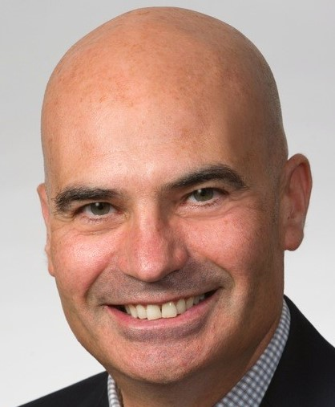
Thank You to the CFAS / AAMC Team
Eric Weissman, Senior Director, Faculty and Academic Society Engagement
Alex Bolt, Senior Specialist, Communications
Anne Berry, Lead Specialist, Implementation Research and Policy
Stephen Barry, Engagement Specialist

Slide 5
2022 CFAS Spring Meeting: Key Takeaways
Overall successful meeting and program
You miss being with each other in person, but you still liked the virtual meeting
Newer reps were especially satisfied
More than half of the post-meeting survey respondents were junior reps
CFAS reps feel like they are part of a community that collaborates on problem solving

Slide 6
2022 CFAS Spring Meeting: Key Takeaways
Nearly 80 percent of survey respondents felt the plenary topics were relevant and timely
Attendees really like the “Ignite” format and the opportunity to share stories
Attendees loved hearing about CFAS business and the activity of the council
Attendees really loved learning about the leadership journey of faculty who became deans

Slide 7
You Were Overall Satisfied…

Slide 8
And You Liked Hearing from Leaders…

Slide 9
And the Topics We Covered…

Slide 10
But You Miss Being Together…

Slide 11
…And We’ll Fix that at LSL
The Nov. 11-15 AAMC Learn Serve Lead Annual Meeting will have ample CFAS Programming –
In-Person CFAS committee meetings
CFAS receptions and breakfasts
New rep orientation
CFAS Business Meeting
Knowledge sharing session
At least 13 main-program breakouts originating with CFAS ideas featuring CFAS speakers

Slide 12
Join Us in Nashville in November!

