Slide 1
2022 CFAS Virtual Spring Meeting Summary

Slide 2
Meeting Highlights
Explored the theme of “strengthening the faculty community”
At least 9 deans or CEOs of health systems joined the meeting as attendees and speakers
137 total registrants
9 ignite sessions featuring CFAS rep speakers
45 speakers total
25 first-time CFAS attendees
Updates from all 8 CFAS committees

Slide 3
Understanding the CFAS Mission
CFAS aspires to be the voice of academic faculty within the AAMC’s governance and leadership structures. The Council is charged with:
Identifying critical issues facing faculty in medical schools and within academic societies;
Articulating a common faculty voice on these issues to the AAMC and on a national stage as they relate to creation and implementation of the AAMC programs, services, and policies;
Serving as a bidirectional communications conduit regarding matters related to the core missions of academic medicine.
Our activity over the two years during the pandemic has embodied these roles. CFAS is a stronger, more representative, and more effective voice.

Slide 4
Achievements and Activities in 2021-2022
CFAS Committees have continued to meet regularly and have produced several peer-reviewed publications and reports, or have launched new projects.
Focused on supporting ongoing connectivity with:
Monthly electronic CFAS Rep Bulletin
Monthly online CFAS Connects live sessions, including multiple conversations with AAMC President and CEO David J. Skorton, MD, and members of Leadership Team
Biennial CFAS Society Summit for executives.
New junior faculty member, Catherine Coe, MD, seated on the AAMC Board of Directors.
Streamlining content on the CFAS website and revamping the Well-Being in Academic Medicine webpage https://www.aamc.org/news-insights/wellbeing/faculty

Slide 5
CFAS Spring Meeting Session Summaries

Slide 6
Day 1: Strengthening the Faculty Community at Our Institutions
The Intersection of Faculty and Academic Medicine Leaders
Moderator:
Panelists:
Vincent Pellegrini
Professor, Orthopaedics; Vice Chair, Education & Research Affairs, Dartmouth-Hitchcock Medical Ctr, Chair, Faculty Council, Geisel School of Medicine at Dartmouth, former CFAS chair
Julie Freischlag
CEO Atrium Health Wake Forest Baptist, Dean of Wake Forest School of Medicine, and Chief Academic Officer of Atrium; Wake Forest School of Medicine of Wake Forest Baptist Medical Ctr
Lee Jones
Dean for Medical Education; Professor of Psychiatry, Georgetown University School of Medicine
Sam Hawgood
Chancellor of UCSF, University of California – San Francisco
Nancy Brown
Dean of Yale School of Medicine

Slide 7
The Intersection of Faculty and Academic Medicine Leaders
One of the most important questions we face is how to support and nurture the academic mission in our expanding health systems
Post-COVID realities, including staffing shortages, have only exacerbated the focus on the margin in academic medical centers
We must provide time for faculty to pursue education and research, which is essential to preserving their health and vigor. This in turn benefits the clinical enterprise

Slide 8
The Intersection of Faculty and Academic Medicine Leaders
It’s important to be transparent about the payment models, where the money is going, and what everyone’s mission is. Institutions must find ways to appreciate everyone’s unique contributions
Faculty often become unhappy when they realize their understanding of their roles is different than their institution’s understanding, which is why communication around expectations is so important
One institution preserves faculty expertise in the clinical enterprise by defining the role of the chair as a clinical leader across the system with both authority and responsibility over lines of service

Slide 9
The Intersection of Faculty and Academic Medicine Leaders
In communicating the unique value academic medical centers offer, key points are that AMCs are very innovative in tertiary and quaternary care and they bring a lot of value to population and public health with their powerful abilities to do things such as epidemiologic modeling
The pandemic showed us that we need to take a lot of lower-level care outside of the AMC and move it into smaller hospitals, because they can do certain things faster than we can
One way to fight burnout and fatigue by bringing joy back to medicine is to connect people with what the AMC is doing for its communities, such as student projects and community initiatives

Slide 10
Governance Models: How Can Faculty and Leaders Work Together?
Moderator:
Speaker:

Slide 11
Governance Models: How Can Faculty and Leaders Work Together?
Sometimes faculty can feel like they’re not being heard when leadership makes decisions, so it’s important for leaders to explain why a decision was made after faculty input was considered
“Wisdom circles,” which provide a way for people from a variety of ways to share their ideas and potential solutions in a non-hierarchical way, can be powerful tools to understand problems and to find solutions between faculty and institutional leaders.
In wisdom circles, the focal point is the institution, not the person who convenes the circle. This format makes people feel more comfortable about contributing

Slide 12
Governance Models: How Can Faculty and Leaders Work Together?
Basic scientists generally need time and space to pursue what they’re passionate about; leaders should be ready to provide that space as much as possible.
Having institutional leaders who advocate for the needs of their faculty members goes a long way in boosting morale of the faculty
A good leader must be willing to listen, be uncomfortable, and engage in hard conversations

Slide 13
Governance Models: How Can Faculty and Leaders Work Together?
Asking the faculty about their areas of expertise and how the dean’s office can help builds trust between the dean and the faculty
Even if there’s low trust between the dean’s office and the faculty, having transparency in decisions as much as possible can build back the foundation for trust
The best leaders 1) make sure they have the right person in place 2) make sure you and they are on the same page 3) give them the resources they need and 4) get out of the way – this last part is hard but very important!

Slide 14
How Is CFAS Improving the Governance Landscape for Faculty? Mission Alignment Committee Report
Mission Alignment and Impact of Faculty Educators Committee
Chair: Stewart Babbott, MD
Chair of the Subcommittee on Chairs: Vincent Pellegrini, MD
Chair of the Subcommittee on Governance: Mark Danielsen, PhD
Chair of the Subcommittee on Faculty: Nandini Calamur, MD

Slide 15
How Is CFAS Improving the Governance Landscape for Faculty? Mission Alignment Committee Report
Summary from Vincent Pellegrini (chairs group)
There are increasing financial restraints that:
Decrease margins and leave little for discretionary reinvestment or research support
Create challenges for recruitment AND retention of faculty
Costs in excess of NIH salary cap fall to department with no intuitional support
Faculty face obstacles to mentoring and faculty development

Slide 16
How Is CFAS Improving the Governance Landscape for Faculty? Mission Alignment Committee Report
Summary from Vincent Pellegrini (chairs group)
Marginalization of the academic mission is occurring because:
It’s difficult to keep faculty at affiliated hospitals engaged in academics
Costs in excess of NIH salary cap fall to the department!
There’s no margin to fund discretionary departmental seed research
There’s no protected time for clinicians from patient care (this also impacts basic science collaboration)

Slide 17
How Is CFAS Improving the Governance Landscape for Faculty? Mission Alignment Committee Report
Summary from Vincent Pellegrini (chairs group)
Productive strategies CFAS and the AAMC must pursue:
Advocate for the value of the academic mission to health system/affiliated hospitals
Seek to find value of the expanded system to the core academic mission
Promote the bidirectional value of education as currency in the health system and SOM
Critical role of a system CEO that values the academic mission and pedigree
Redefine the system role and purpose of departmental leadership in the system
Assess/analyze current academic health center governance structures and recommend a “best practice”

Slide 18
How Is CFAS Improving the Governance Landscape for Faculty? Mission Alignment Committee Report
Summary from Mark Danielsen (governance group)
Goals:
Evaluate the state of governance in basic sciences
Develop a set of best practices to ensure a vibrant and fair governance system in the basic sciences
Productive strategies CFAS and AAMC must pursue:
Advocate for a strong faculty voice for all faculty regardless of employer
Strengthen departmental leadership
Ensure that the governance structure serves the core missions of departments
Assess/analyze current academic health system governance structures and recommend a “best practice”

Slide 19
How Is CFAS Improving the Governance Landscape for Faculty? Mission Alignment Committee Report
Summary from Dina Calamur (faculty group)
Current tensions from the faculty perspective:
The academic mission as we know it is unsustainable
Education is no longer valued in the health system
Triple threat is triply threatening to the clinician educator – faculty members’ workload is becoming overwhelming
Can we effectively support the clinician educator in the current climate?
Do we need to rethink the various missions and how they align?

Slide 20
How Is CFAS Improving the Governance Landscape for Faculty? Mission Alignment Committee Report
Summary from Dina Calamur (faculty group)
Current ideas from the faculty perspective
Use nontraditional criteria for advancement
Demonstrate the value of the clinician educator
Develop an impact factor for the clinician educator
The Clinician Educator Milestone project, which is a joint initiative from ACGME, AAMC, and others
Rethink the missions and the promotion pathway

Slide 21
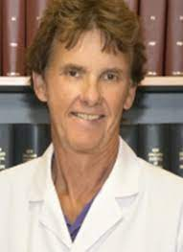
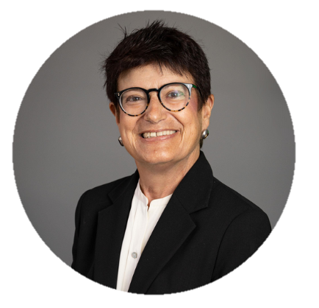
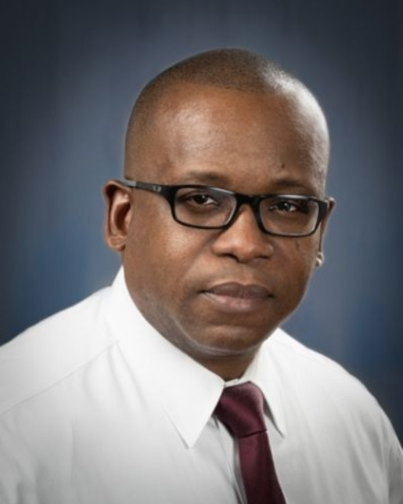
Day 2: Strengthening the Faculty Community Within Ourselves
Exploring Growth and Change: The Journey from Faculty to Institutional Leadership
Moderator:
Speakers:
Nicholas Delamere Department Head, Physiology; Professor, University of Arizona College of Medicine/Association of Chairs of Departments of Physiology
Carolyn Meltzer Dean, Keck School of Medicine of USC May S. and John H. Hooval, MD, Dean’s Chair, Keck School of Medicine of the University of Southern California, Former CFAS Administrative Board Member
J. Adrian Tyndall
Executive Vice President for Health Affairs and Dean, School of Medicine, Morehouse School of Medicine, and a former CFAS rep

Slide 22
Exploring Growth and Change: The Journey from Faculty to Institutional Leadership
Servant leadership, team-building, and a focus on the faculty are key
No path in academic medicine needs to be linear – explore the doors that open to you
Successful academic health centers today must focus on addressing health inequities and building community collaborations

Slide 23
Exploring Growth and Change: The Journey from Faculty to Institutional Leadership
It’s crucial to have a supportive network that you can lean on to combat imposter syndrome
Spend time getting to know your faculty and “walk the halls”
Having leadership courses to build “bench strength” throughout the institution helps institutional leadership get to know faculty and leads to more diverse leadership

Slide 24
Exploring Growth and Change: The Journey from Faculty to Institutional Leadership
Part of being a successful dean is learning how to triage all the issues that bombard you each day to know which issues are the critical ones that need to be addressed that day
Academic medicine needs to restructure itself because the current system is almost impossible for mid-career women faculty
Leadership is like a marshal art – you must practice your leadership principles in order to perfect them

Slide 25
Principles for Leadership Development in a Changing Paradigm
Moderator:
Speaker:

Slide 26
Principles for Leadership Development in a Changing Paradigm
There are deep challenges in health care including:
Gaping health disparities
Uneven access to health care
Systemic racism
Burnout
This calls for:
A more expansive and inclusive leadership paradigm in academic medicine and science
A more responsive and empowering approach to leadership development

Slide 27
Principles for Leadership Development in a Changing Paradigm
Part of AAMC’s new strategic plan focuses on leadership development and creating leadership development opportunities that are in tune with the changing landscape in academic medicine
This part of the AAMC strategic plan seeks to:
Provide a continuous learning journey
Serve a larger portion of the AAMC’s constituency
Help member institutions grow and diversify their leadership pipelines
Elevate content to meet more complex needs

Slide 28
Principles for Leadership Development in a Changing Paradigm
Leadership paradigms are shifting from traditional to contemporary and leadership as a position is changing to leadership as a behavior
Decision-making is shifting to a more shared and/or distributed model
Communication is shifting from one-way to vertical, horizontal, and diagonal
Traditional vs. contemporary leadership paradigms should be seen as a spectrum, where traditional leadership paradigms aren’t “bad,” they’re just insufficient for the increasingly complex landscape

Slide 29
Principles for Leadership Development in a Changing Paradigm
Leadership development:
Is a process, not an event
Requires a series of experiences
Happens over time
Is a lattice, not a ladder

Slide 30
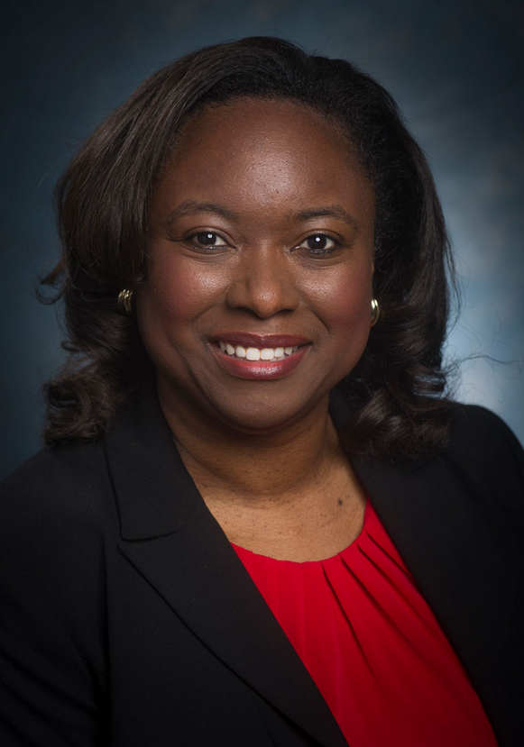
Day 3: Strengthening the Community with CFAS and the AAMC
How an Environment that Fosters Diversity and Inclusion Improves the Faculty Experience
Moderator:
Speaker:

Slide 31
How an Environment that Fosters Diversity and Inclusion Improves the Faculty Experience
Becoming an equitable and diverse institution is a continuous journey, not a destination
Getting from equality to equity to justice requires changing the system, and that means continuously examining what policies, practices, policies, systems, and infrastructure systemically introduce inequities into our systems
AAMC is developing Diversity, Equity, and Inclusion competencies
The AAMC’s strategic plan is focused on equipping institutions and leaders at every level with data, tools, training and promising practices to create more diverse, equitable, inclusive, and anti-racist organizations

Slide 32
How an Environment that Fosters Diversity and Inclusion Improves the Faculty Experience
The AAMC has multiple training programs, reports, and webinars on DEI issues at https://www.aamc.org/what-we-do/equity-diversity-inclusion
Success in DEI might look like…
DEI is strategic and integrated (not siloed)
There’s measurable impact of new or existing programs, policies, and practices
There’s an improved culture of safety
There’s a transparent process of continuous equity improvement and accountability

Slide 33
How an Environment that Fosters Diversity and Inclusion Improves the Faculty Experience
CFAS reps can be helpful to the AAMC’s DEI efforts by informing on where the pain points are in their institutions
When doing education on issues around race and anti-racism in institutions…
It’s important to emphasize that race is a social construct and not linked to biology
Think about patient descriptors in our case studies and how we may have connected certain patients to racial stereotypes
Ensure that language used is consistent across the board

Slide 34
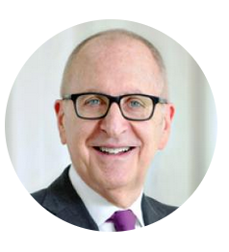
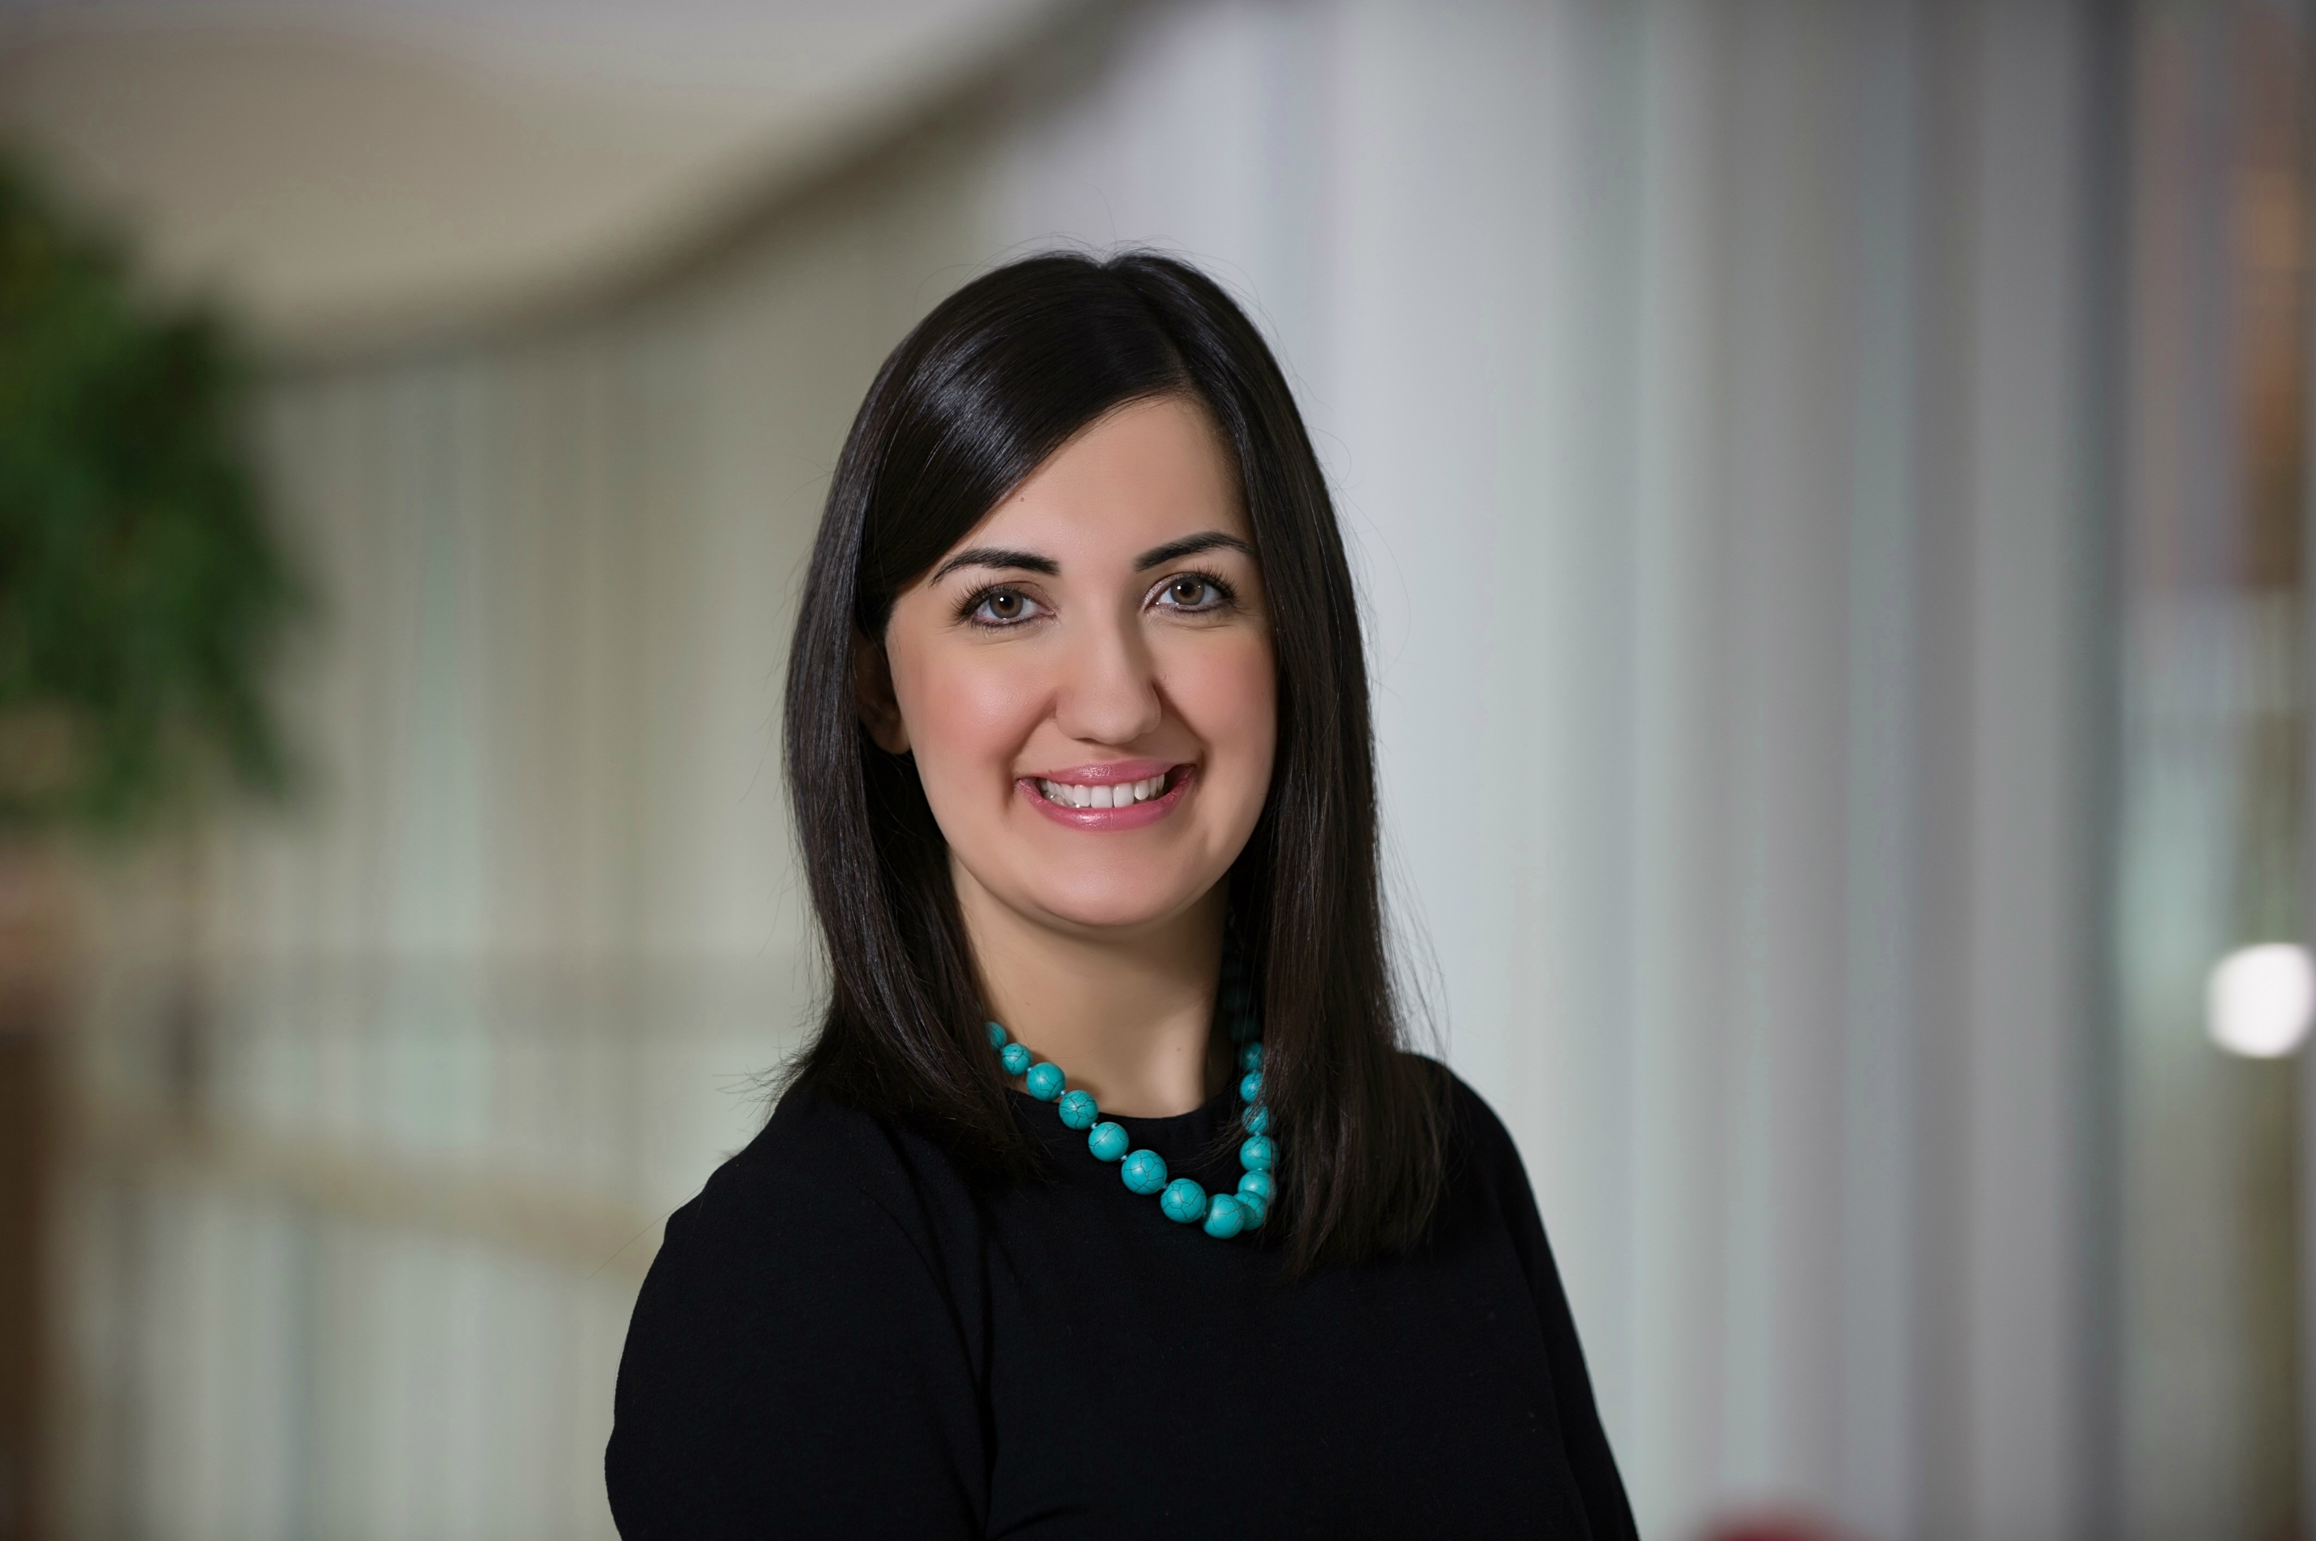
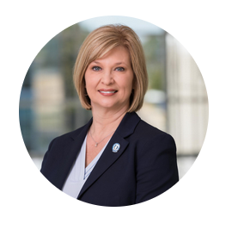
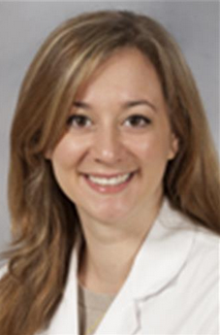
Plenary with AAMC Leadership
David Skorton
President and CEO, AAMC
Tannaz Rasouli
Senior Director, Public Policy & Strategic Outreach, AAMC
LouAnn Woodward
Vice Chancellor for Health Affairs and Dean, University of Mississippi School of Medicine
Sarah Sterling
Assistant Professor, Emergency Medicine, University of Mississippi School of Medicine

Slide 35
Plenary with AAMC Leadership
The last couple years have been academic medicine’s finest hour, despite all the hardship we’ve faced, because of the heroic work that’s been done in our institutions
A lot more people have realized the value of medical research because of the pandemic and the high-quality clinical care academic medicine can provide
Looking ahead at the vastly changed post-pandemic future, academic medicine must find ways to advance to the next level while staying true to who we are

Slide 36
Plenary with AAMC Leadership
Legislative updates
The presidential agenda will likely be shaped by the upcoming midterm elections
Congress finally passed spending bill to fund NIH and increased funding by 5% for a total of $45 billion – 7 consecutive years of meaningful growth for NIH
However, NIH is still recovering its purchasing power after 15 years of flat funding levels. In inflation-adjusted terms, the NIH is barely back to where it’s funding level was in 2003

Slide 37
Plenary with AAMC Leadership
Legislative updates
AAMC and partners are calling for $49 billion for NIH base budget
ARPA-H: for this new initiative to be successful, the foundational work that the NIH funds across the country is key, so whatever Congress wants to allocate toward ARPA-H needs to be in addition to – and not at the expense of – the sustained, reliable growth in NIH’s budget
The Build Back Better legislation would include 4k new GME slots over 2 years and create a new scholarship program to strengthen the diversity of the physician workforce

Slide 38
Plenary with AAMC Leadership
Legislative updates
There is currently a lot of bipartisan interest in addressing mental health
AAMC was among one of the earliest endorsers of the Dr. Lorna Breen Health Care Provider Protection Act, which is now law
CFAS has played an important role in educating the AAMC’s advocacy team on the issues affecting faculty and academic medical centers
Presentation from AAMC President and CEO David J. Skorton:
Pursuing DEI is not only the right thing to do, but it’s necessary to bring diverse perspectives and backgrounds together in order to solve the kinds of complex problems we now face

Slide 39
Plenary with AAMC Leadership
Presentation from AAMC President and CEO David J. Skorton:
Community collaborations, the 4th addition to the formerly Tripartite Mission, is about co-creating new opportunities and understanding with our communities and learning from them, not telling them all about what we know
Faculty need to be part of governance and should be persistent in making the case for their inclusion in their local governance models
Closing discussion:
Highlighting the community connections an institution makes is crucial when talking about the value of funding the institution’s missions to policymakers

Slide 40
Discussion:
The past 2 years have been the most productive for CFAS so far
Our institutional leaders are eager for us to offer our input and expertise in collaborative ways
The answers to some of our biggest challenges may not be apparent now, but the community of faculty can come together to find the solutions
There was much discussion on how CFAS reps from different organizations can report back on the knowledge gained during these meetings

