Slide 1
Welcome!
Thank you for joining us for today’s webinar. The program will begin shortly.
You will not hear the audio until we begin.
If you have technical questions, please email aamc@commpartners.com.
AAMC Presenters:
Mary Mullaney, mmullaney@aamc.org
Andrew Amari, aamari@aamc.org
Phoebe Ramsey, pramsey@aamc.org
June 3, 2020

Slide 2
Away Rotations 101 for Advisors: What advisors need to know to help students through the process
Chris Parr Lisa Shelburne, MBA Selma Ajanovic, MBA

Slide 3
VSLO Process Flow
2
Student prepares application
3
Home reviews and releases
5
Student responds
1
Home grants access
4
Host reviews applications
6
Host makes final decision
Student attends elective
Invite students
Search for electives
Receive notification of application
Set student eligibility
Receive notification of decision
Only applicable if there are Post-decision requirements
Set student’s phase: Pre-clinical or Clinical
Begin application
Schedule application
Complete Home Verification Statements (only done once)
Accept or decline elective offer
Review Post-decision requirements, then confirm or revoke offer
A welcome email is sent to student’s email address
Complete requirements
Complete Home requirements
Approve application (if applicable)
Notify applicant of final decision
If there are Post-Decision requirements, complete and submit to host for final review
Submit application
Release application to Host
Notify applicant of decision

Slide 4
Advisor Perspective - MU-COM
Approach to applications: quality over quantity
Different strategies – some students use VSLO yet others won’t – Urban vs. Community based
At MU-COM, there are Development Days
3-part discussion in the fall (use checklists)
By January of M4, students are ready
Students can pursue opportunities earlier
Clinical & Research Opportunities Database
Public Health Pathways for Medical Students

Slide 5
Advisor Perspective - MU-COM
MU-COM provides students with a spreadsheet to narrow things down…catalog interests & dates
Ask students to identify 3 different specialties – what interests you?
Location is a key consideration for students
DO students have high interest in primary care – 50% of class go into Family and Internal Medicine
Parallel planning is ok…know your stats
Always go to institution’s website as a starting point…always 1st source verify and network!

Slide 6
Advisor Perspective - MU-COM
What students should consider:
Financial aspect, refer to Institution Summary provided by Host institutions
Benefits of doing rotations to gain a new perspective and exposure to different practices in other settings/states/regions
Away rotations to diversify portfolios
Pace themselves…aways can be exhausting
Remain in touch and encourage to have fun!
Post-away reflection and CV updates

Slide 7
Home Perspective - LMU-DCOM
Home institution: sends their students to participating Host institutions in the VSLO program
Introduce students to away/audition rotations ongoing with consistent language
Timeline for introducing OMS III students:
Fall: students receive information on VSLO
January: students receive their invitations to VSLO

Slide 8
Home Perspective - LMU-DCOM
Ways that LMU-DCOM reaches students
Students receive clinical rotations manual containing a section on VSLO process and information
4th Friday didactics: cover different topics (LoRs, personal statements)
Alumni/Career Services Sessions monthly during all 4 years
Targeted evening sessions for students on clinical rotations

Slide 9
Home Perspective - LMU-DCOM
Components provided to programs by DCOM:
Medical School Transcript
Away Rotation Attestation
Proof of Liability/Malpractice
Up to date Drug Screen and background check
Medical School Letter of Good Standing
Clinical Rotation Evaluation form
Proof of HIPAA/OSHA/Universal Precautions/Scrub training
Assistance with AAMC or other immunization forms
Students are responsible for mask fit test, COMLEX, and USMLE score, LoRs

Slide 10
Home Perspective - LMU-DCOM
LMU-DCOM releases student applications on a rolling basis as student applications are completed
It is important to get applications to programs

Slide 11
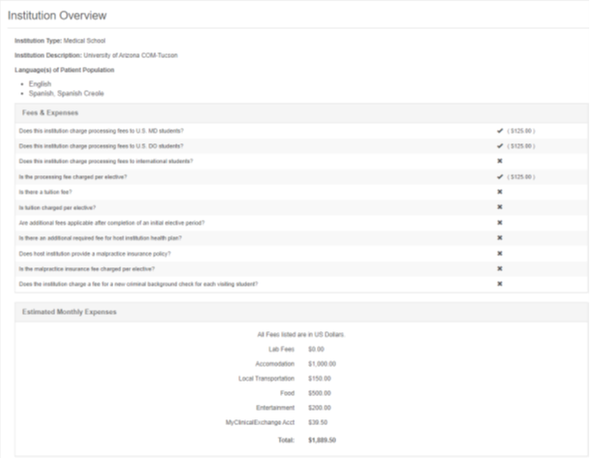
Host Perspective - COM-Tucson
Host institutions:
Receive applications from visiting students from participating Home institutions
As a Home and Host institution, COM-Tucson Curricular Affairs delegates elective options to COM-Tucson departments to determine which electives will be offered
how many slots will be offered to HOME students
how many visiting students will be accepted
Everything offered to HOME students is offered to visiting students
Before VSLO opens, important information is annually updated on the Institution Summary page for students to review:
Important Dates section
Fees & Expenses section
Estimated Monthly Expenses section
Links to the Institution Website and
Visiting Student Website

Slide 12
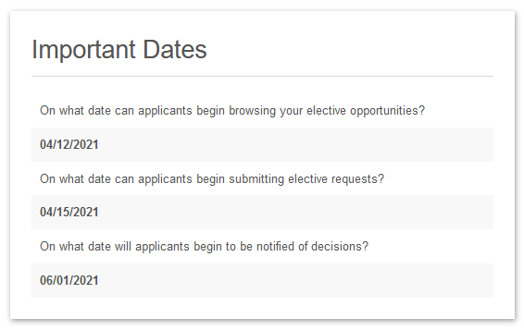
Host Perspective - COM-Tucson
COM-Tucson opens its VSLO site on
April 01
Registrar Office will review all received applications
If an applicant meets all required criteria, applications are marked as ELIGIBLE or CONDITIONALLY ELIGIBLE and released to COM-Tucson departments
Departments start reviewing applications as early as the end of June
Timeline of rendering decisions dependent on volume of applications

Slide 13
Host Perspective - COM-Tucson
Evaluating student applications and making offers:
First come first serve – Integrative Medicine
Step scores and Letter of Interest – Emergency Medicine & ORTH
DO students first (those who do not offer Sub-I rotations) – IM
Grades, Personal Statement and CV very important – PSYI
Applying for several spots through the year – greater chance of being selected – RADI
Students can stand out by putting effort into writing letter of interest
Important to know before they come to complete the rotation
Should be familiar with attendance policy before they accept rotation especially when it’s during interview season
Orientation is mandatory
Be cordial and professional when dealing with coordinators because they will attend match meetings
Importance of participation and attendance
Be ready to impress

Slide 14
Host Perspective - COM-Tucson
Evaluating student performance
If evaluation form is provided, all departments will use the evaluation form provided by student’s Home institution
If the evaluation form is not provided, we will use our Student Assessment form
EM Department will use only COM-Tucson’s evaluation form so their Home school can manipulate it to their needs
Post-decision Requirements
myClinicalExchange
Uploading Bio and Photo to share with groups
Optional pre-rotation information session
Returning their pagers and badges

Slide 15
Host Perspective - COM-Tucson
Challenges experienced by Hosts
Some Home institutions require an Affiliation Agreement – this makes it very difficult for students, as it takes time
Badges, Lodging, Transportation – caused by visiting students lack of organization or preparedness
Obtaining the Home evaluation form
Phone inquiries and questions about when applications will be reviewed and when students can expect to hear back from the department
EM department created a phone tree to answer these questions and dissuade students from calling the department just to express their interested in COM-Tucson EM program.
Proved to be an extremely effective decision

Slide 16
Contact Us
Website: aamc.org/vslo
Email: visitingstudents@aamc.org
Phone: (202) 478-9878
Client Technical Support Team: Available Monday through Friday 8:00 am - 6:00 pm ET

