Slide 1
An Orientation to the AAMC
Jennifer M. Schlener, Chief of Staff
jmschlener@aamc.org
www.aamc.org

Slide 2
Today’s Agenda
01
Who We Are – Our Mission,
History And Strategy
02
How We Serve Our Members

Slide 3
Today’s Agenda
01
Who We Are – Our Mission,
History And Strategy
02
How We Serve Our Members

Slide 4

Mission
The AAMC leads and serves academic medicine to improve the health of people everywhere
Vision
A healthier future through learning, discovery, health care, and community collaborations.
Notes:
INTERNAL ONLY

Slide 5
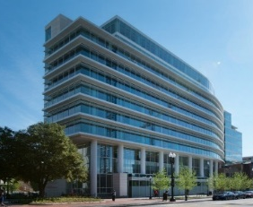
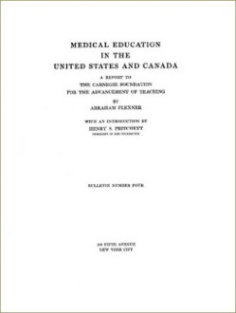


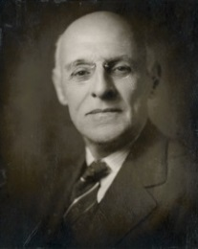
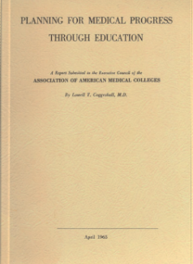

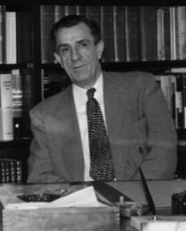
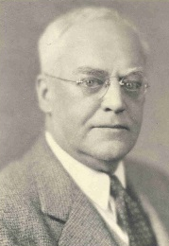
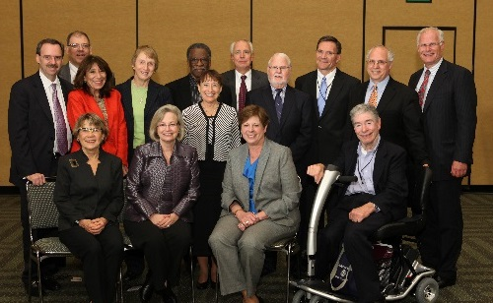
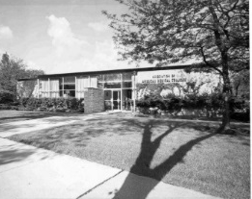
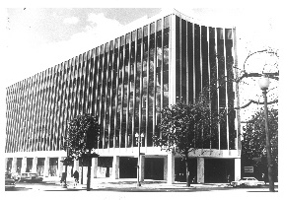
Our History
Flexner
Report released
1910
Board of Directors
established
2008
AAMC moves to 655 K St. NW 2014
Founded by
22 medical school deans
1876
Fred Zapffe becomes secretary-treasurer (serves until 1948)
1903
2013
Council of Faculty & Academic Societies
created
1965
Coggeshall Report:
AAMC moves to DC;
Reorganized to include teaching hospitals, faculty, and medical students
1890
Reformed by 66 deans
Notes:
The AAMC was founded in 1876 by 22 medical school deans who saw the need to elevate the standards of medical education. At that time, medical education was a bit like the wild west and many schools popped up to make a quick buck.
This first attempt at organization proved unsuccessful.
In 1890, the organization was reformed by 66 deans.
In 1903, the AAMC selected its first employee, Fred Zapffe. He was a volunteer in this position until 1931 when he received his first paycheck. He largely continued to run the organization until 1948.
In 1910, the Flexner Report was issued and became a watershed moment in medical education. It caused the consolidation and closure of many medical schools that were of poor quality and held up a model of basic and clinical education that is the foundation of medical schools today.
In 1965, the US health care system was undergoing dramatic changes with the implementation of Medicare and Medicaid. The AAMC also released a report that year – the Coggeshall Report – that was a blueprint for the AAMC’s continued success. It’s the reason we expanded to represent teaching hospitals, medical school faculty, and medical students and the reason we relocated from Evanston Illinois to DC.
In 2008, the AAMC reformed to create an effective Board of Directors.
In 2014, the AAMC reunited under one roof at 655 K Street.
In 2015, the AAMC reformed the Council of Academic Societies into the Council of Faculty and Academic Societies.

Slide 6









Corporate Profile
  The AAMC is a not-for-profit 501(c)(3) educational association whose purpose is to advance medical education
  Membership
Illinois corporation founded in 1876
    Medical Schools
    155 in US,
    17 in Canada
    Teaching
    Hospitals
    400+
    Academic
    Societies
    80+
  Major Services
  Employment
    MCAT
    AMCAS
    ERAS
741
    Medical College Admissions Test
    American Medical College
    Application Service
    Electronic Residency Application Service
      Full-time employees
      Competitive benefits plans including 403(b) retirement plan
  AAMC moved into
  655 K Street on
  May 20, 2014
  Fiscal year ends
  June 30

Slide 7
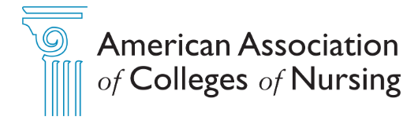
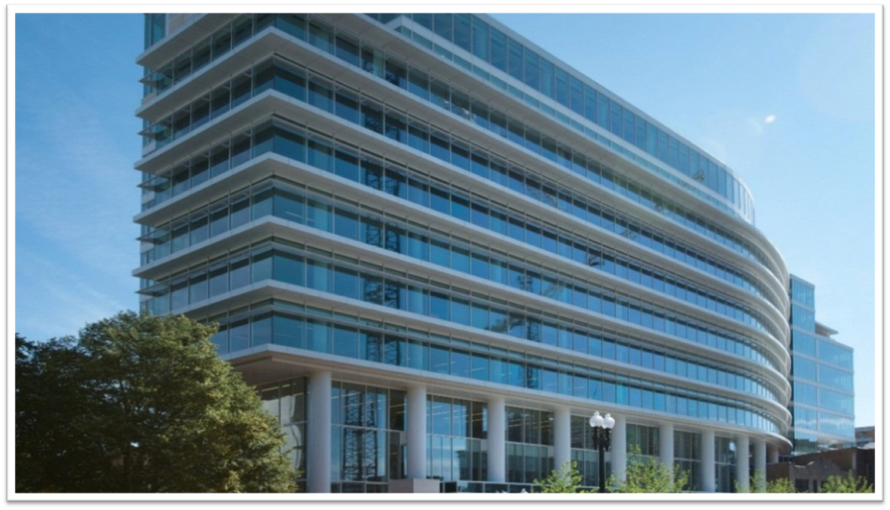



655 K Street
Notes:
https://www.aacnnursing.org/About-AACN
https://www.aavmc.org/

Slide 8
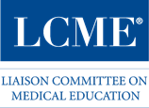


AAMC as Partner
www.lcme.org
www.ipec.org
www.physicianaccountability.org
Notes:
www.physicianaccountability.org
The Coalition's members are the national organizations responsible for the oversight, education and assessment of medical students and physicians throughout their medical careers.

Slide 9
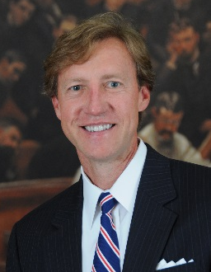
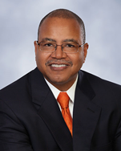
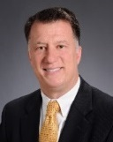
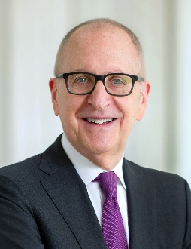
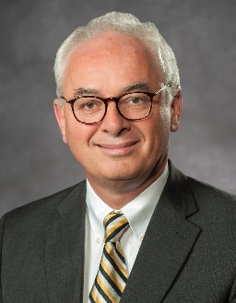
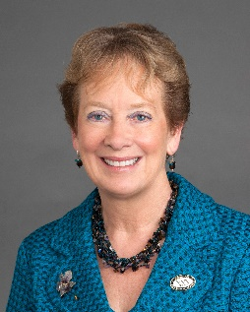
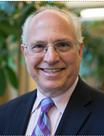
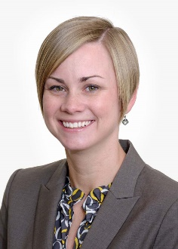
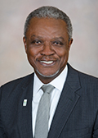
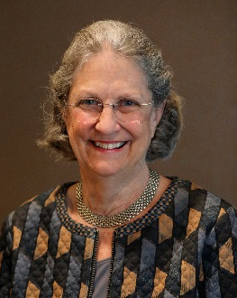
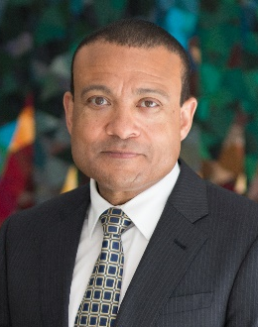
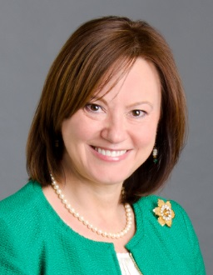
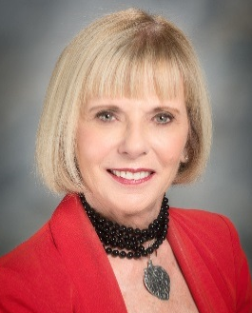
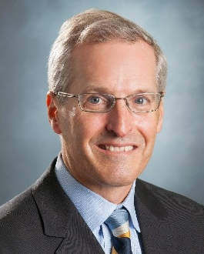
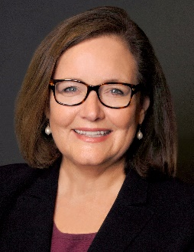
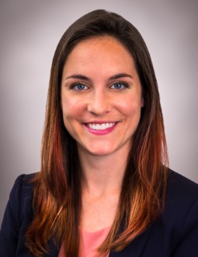
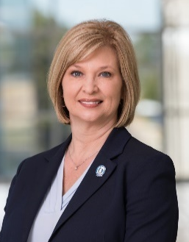
2020-2021 Board of Directors
J. Larry Jameson, MD, PhD
Chair
Kirk A. Calhoun, MD
Chair-elect
Joseph E. Kerschner, MD
Immediate Past Chair
David J. Skorton, MD
President & CEO
Peter F. Buckley,
MD
Julie A. Freischlag, MD
Aviad Haramati, PhD
Brittany N. Hasty, MD, MHPE
Danny Jacobs,
MD, MPH
Beverley H. Johnson
Lee D. Jones, MD
Gabriela K. Popescu,
PhD, MS
aamc.org/who-we-are/bod
Elizabeth L. Travis,
PhD, MEd
Michael Waldrum, MD,
MSC, MBA
Kate Walsh, MPH
Marie C. Walters, PhD, MS
LouAnn Woodward,
MD
Notes:
9
The 2020-21 Board.
For the 2020-21 term we have 3 new members joining the Board –
Dr. Julie Freischlag, who will serve as an at-large member (and also as one of the required deans/former deans)
Dr. Brittany Hasty (Hay-stee), who joins the Board as our new resident member
And Michael Waldrum, who was elected as the COTH chair-elect earlier this spring.

Slide 10
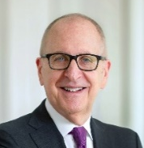
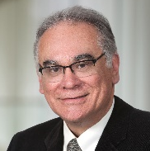
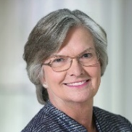
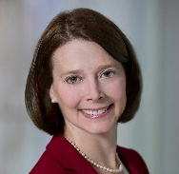
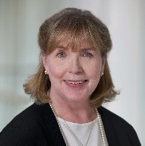
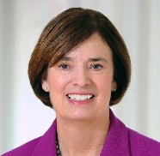
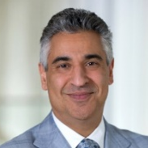
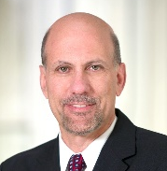
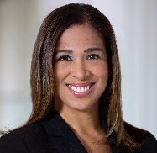
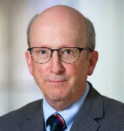
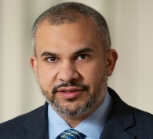
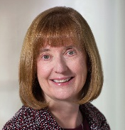
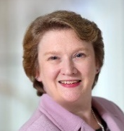
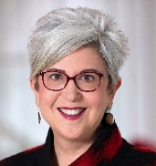
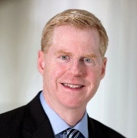
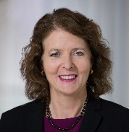
AAMC Leadership Team
David J. Skorton, MD
President & CEO
David A. Acosta, MD
Chief Diversity and
Inclusion Officer
Equity, Diversity and Inclusion
Diana Bourke
Chief Strategic Operations
and Data Officer
Gabrielle V. Campbell, MBA, LLM
Chief Services Officer
Constance M. Filling, EdD
Chief Learning Officer
Karen Fisher, JD
Chief Public
Policy Officer
Atul Grover, MD, PhD
Executive Director, AAMC Research and Action Institute
Marc Levy, MBA
Chief Information Officer
Yvonne Massenburg, MBA
Chief Human
Resources Officer
Ross McKinney Jr., MD
Chief Scientific Officer
Amir Mesarwi
Chief Financial and
Administrative Officer
Janis M. Orlowski, MD, MACP
Chief Health Care Officer
Jennifer M. Schlener
Chief of Staff
Elisa K. Siegel
Chief Communications
and Marketing Officer
Frank R. Trinity, JD
Chief Legal Officer
Alison J. Whelan, MD
Chief Academic Affairs and Medical Education Officer

Slide 11


Slide 12
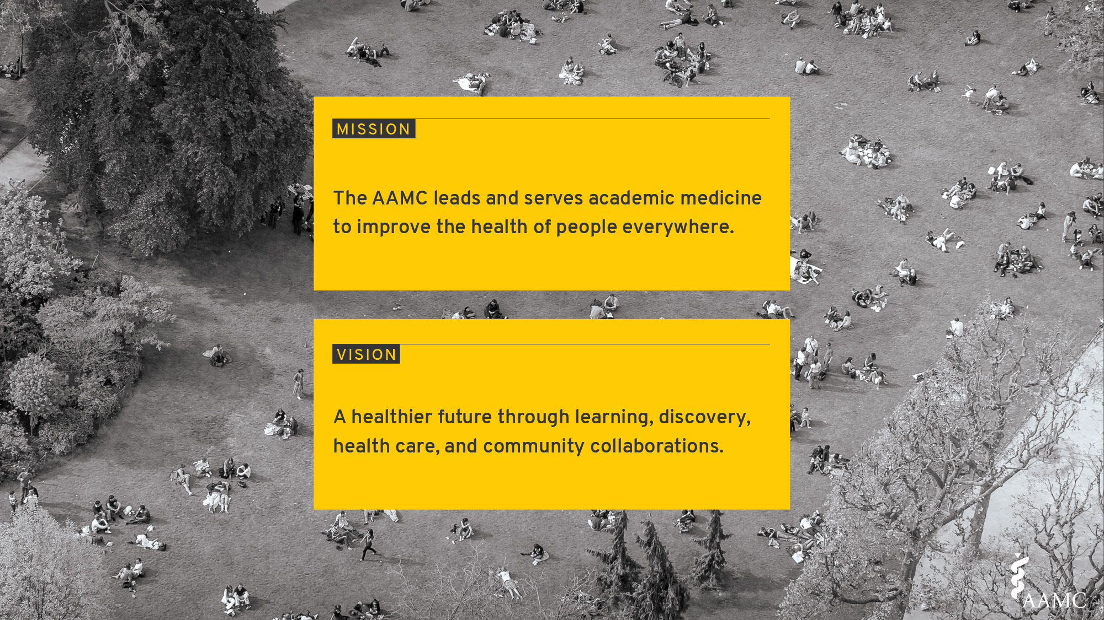

Slide 13
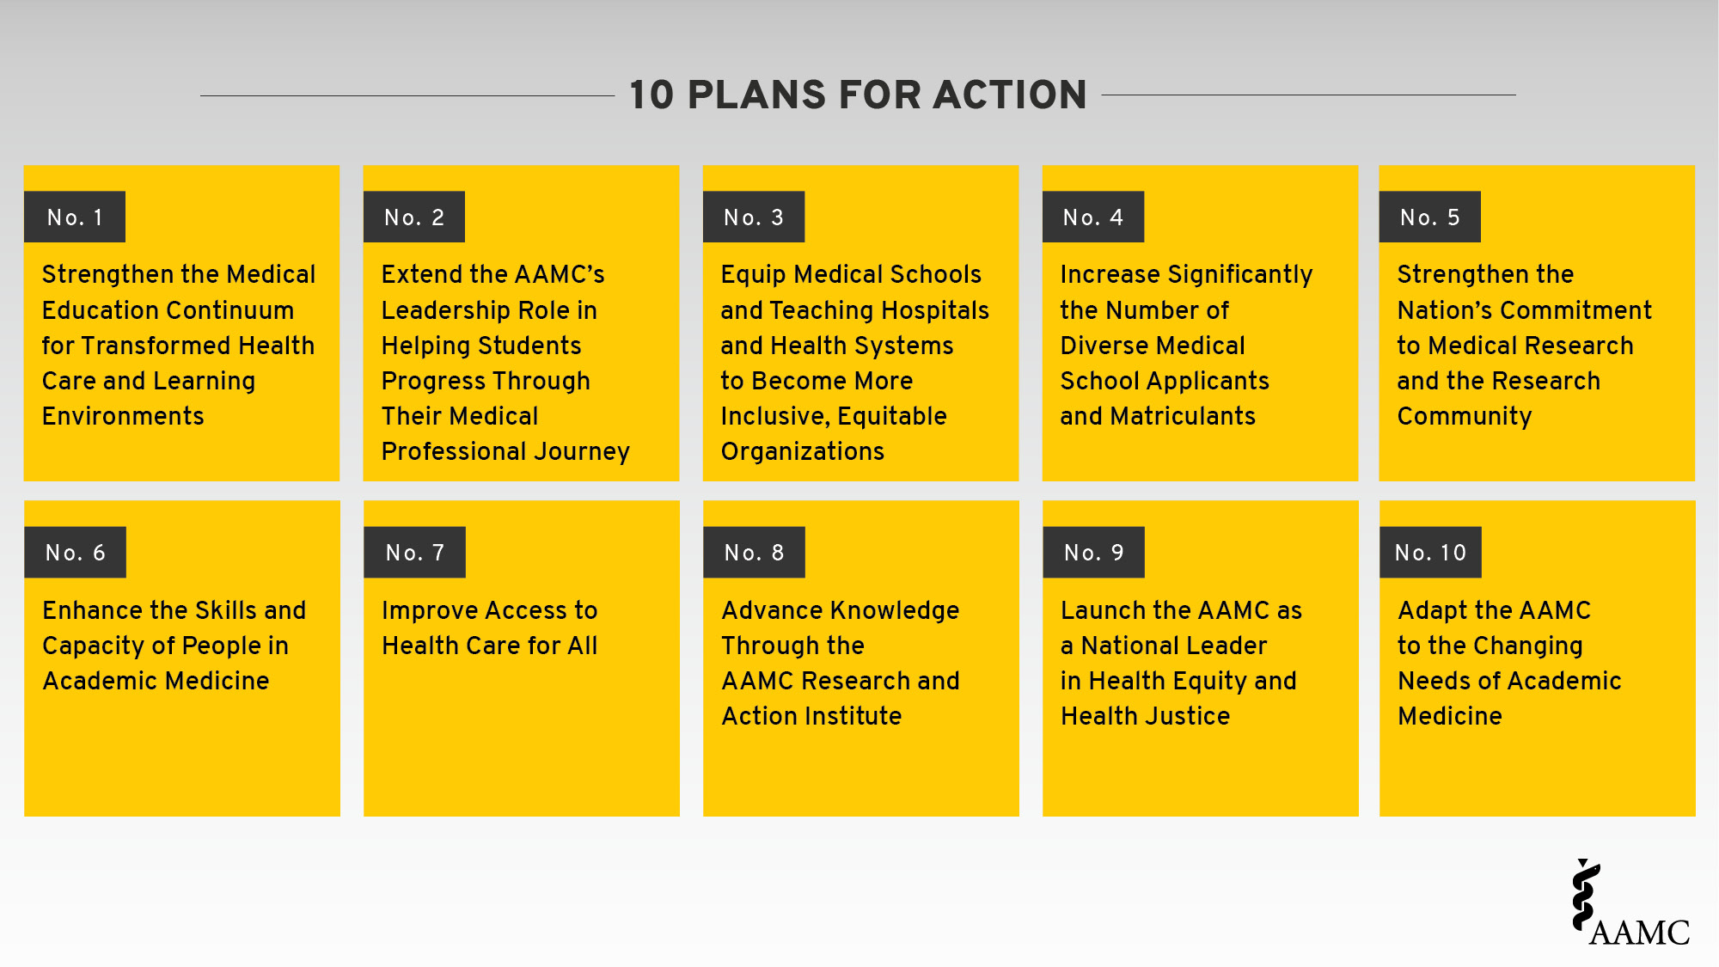

Slide 14


Slide 15
Today’s Agenda
01
Who We Are – Our Mission,
History And Strategy
02
How We Serve Our Members

Slide 16




How Others See Us
Member
Organization
Thought Leaders
We Are
Service
Provider
Notes:
Member organization – traditional association offerings such as meetings, publications, advocacy
Service –
Thought Leaders-

Slide 17
How Others See Us
Member
Organization
Thought Leaders
We Are
Service
Provider
Notes:
Member organization – traditional association offerings such as meetings, publications, advocacy
Service –
Thought Leaders-

Slide 18



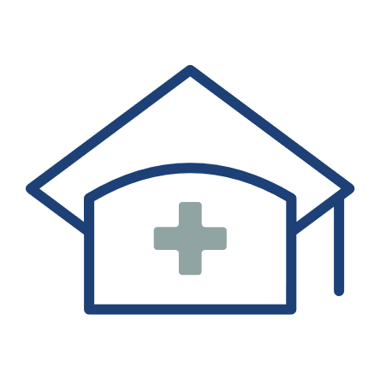


Our Members
  Our member institutions represent the full spectrum of medical education:
  172
  accredited U.S. & Canadian medical schools
  400+
  major teaching hospitals & health systems, including Veterans Affairs medical centers
  80+
  faculty & academic societies
  We serve the leaders of our member institutions, as well as the following communities:
  173,000+
  full-time faculty members
  129,000+
  resident physicians
89,000+
medical students
aamc.org/who-we-are/institutional-membership
Notes:
https://www.aamc.org/who-we-are

Slide 19
How Our Constituents Engage
Council of Deans | Council of Teaching Hospitals and Health Systems | Council of Faculty and Academic Societies
Organization of Resident Representatives | Organization of Student Representatives | Forum on Conflicts of Interest in Academe
Chief Medical Officers Group | Compliance Officers Forum | Group on Business Affairs
Government Relations Representatives | Graduate Research, Education, and Training Group | Group on Faculty Affairs
Group on Diversity & Inclusion | Group on Educational Affairs | Group on Institutional Advancement
Group on Faculty Practice | Group on Information Resources | Group on Research Advancement and Development
Group on Institutional Planning | Group on Regional Medical Campuses | Group on Women in Medicine & Science
Group on Resident Affairs | Group on Student Affairs
aamc.org/professional-development/affinity-groups

Slide 20
How Our Constituents Engage
Learner Feedback Panel
AMCAS Advisory Committee
ERAS Advisory Committee
MCAT Validity Committee
VSLO Ad Hoc Technical Working Group
MSPE Task Force
Reviewer for Academic Medicine / MedEdPORTAL
Notes:
Learner Feedback Panel: 80 learners across the continuum from premed through residency who provide feedback monthly
AMCAS Advisory Committee: Admissions officials and pre-health advisors
ERAS Advisory Committee: Medical student affairs officials, residency program directors, specialty representation, osteopathic representation, ECFMG, NBME and NBOME representation
MCAT Validity Committee: Admissions officials in U.S. and Canada, pre-health advisors, osteopathic representation
VSLO Ad Hoc Technical Working Group: MD and DO medical school student affairs, hospital clerkship directors, students

Slide 21
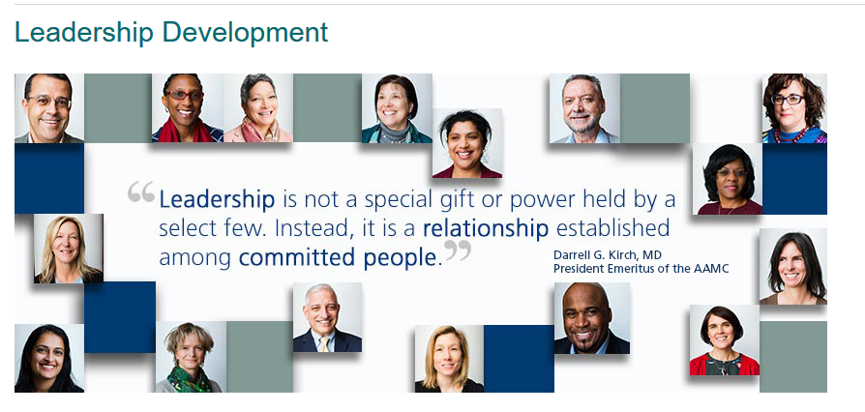
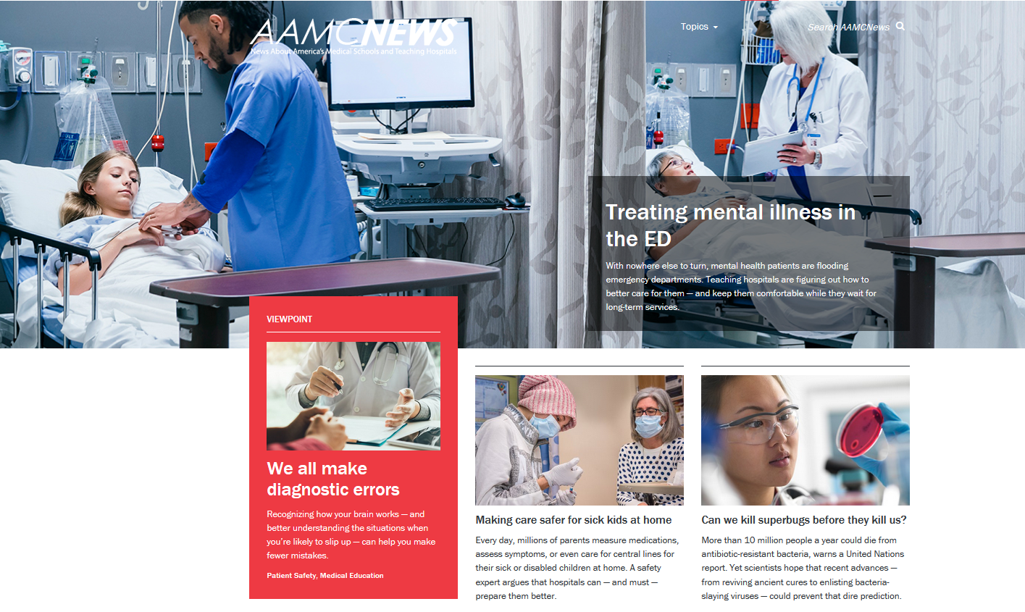



AAMC Resources
Leadership and Professional Development
AAMCNEWS
Publications and Data
aamc.org/news-insights
aamc.org/professional-development
aamc.org/data-reports

Slide 22
How Others See Us
Member
Organization
Thought Leaders
We Are
Service
Provider
Notes:
Service –

Slide 23





Continuum of Medical Education
Premedical
School
AMCAS
MCAT
MSAR
www.aamc.org
Medical
School
Careers In Medicine
ERAS
Residency Explorer
VSLO
Residency
Training
ERAS Fellowships
FindAResident
Practice
Convey
aamc.org/services

Slide 24

How Others See Us
Member
Organization
Thought Leaders
We Are
Service
Provider
Notes:
Thought Leaders-

Slide 25









Thought Leadership
aamc.org/advocacy-policy
Notes:
https://www.aamc.org/news-insights/press-releases/covid-19-updated-guidance-medical-students-roles-direct-patient-care

Slide 27
CFAS Orientation
Eric Weissman,
Senior Director, Faculty and Academic Society Engagement
April 12, 2021

Slide 28
What Is CFAS?
The Council of Faculty and Academic Societies (CFAS) represents U.S. medical school faculty and academic societies within the AAMC
CFAS membership consists of about 330 reps from medical schools and academic societies
CFAS is one of only three AAMC councils, which gives it direct representation on the AAMC’s Board of Directors through our chair and chair-elect. This really matters!

Slide 29

CFAS Reps by the Numbers

Slide 30
New CFAS Member Societies in 2020
American Council of Academic Plastic Surgeons
American Association of Clinical Anatomists
Society of Behavioral Medicine
…two other new societies are in the process of having their memberships approved.
If you are a member of a society that you believe should be a CFAS member, please contact me.

Slide 31
What Does CFAS Do?
The Council of Faculty and Academic Societies provides a voice for academic faculty within the AAMC’s governance and leadership structures. The council is charged with:
  Identifying critical issues facing faculty members of medical schools and within academic societies;
  Providing a voice for faculty about those issues to the AAMC as they relate to creation and implementation of the AAMC’s programs, services, and policies; and
  Serving as a bidirectional communications conduit regarding matters related to the core missions of academic medicine.

Slide 32
But What Do We Really Do?
Engage directly with reps on AAMC advocacy issues
Convene committees on topics that matter
Curate web content for CFAS reps and society members
Develop programming for AAMC events, including LSL
Develop our own annual spring meeting for CFAS reps
Publish and disseminate CFAS-led meeting sessions in Academic Medicine and other peer-reviewed journals
Present at AAMC meetings and outside organizations

Slide 33
But What Do We Really Do?
Host Twitter conversations on important topics in academic medicine
Engage in national efforts, like the NAM Action Collaborative
Connect you with opportunities
Create a community where we learn from each other
Networking and bidirectional communication

Slide 34
What Are Our Big Issues?
Major advocacy priorities – GME and NIH funding and others
Racial justice
Gender equity and harassment
Political influence in science and medicine
Faculty identity and leadership
Faculty well-being and resilience… AAMC pioneered on this topic
Both the clinical and basic science enterprise
Biomedical research advancement
The teaching and learning environment
Health equity and diversity
Faculty professional development and training
…and more issues as CFAS reps (you!) raise them

Slide 35
Launch of CFAS Connects
A monthly forum where we:
Engage and work collectively with CFAS reps on a range of topical issues and themes in a difficult time
Explore the work of the various CFAS committees
Bring faculty issues to the forefront of AAMC concerns
Provide professional development in key areas
Share, network, and even enjoy some levity
Between 50 and 90+ CFAS reps and society execs join each event
All events are recorded and available online with notes and summaries at www.aamc.org/cfas

Slide 36
Looking Back on CFAS Connects
March 24 – A Conversation with AAMC President and CEO David J. Skorton, MD
February 25 – Exploring Faculty Challenges and Recent High Points with the CFAS Communication Committee
January 21 – Well-Being in Academic Medicine with the CFAS Faculty Resilience Committee
December 17 – Academic Medicine in Political Transition
October 29 – The Pandemic’s Effect on Clinicians and Basic Scientists
September 30 – Faculty Perspectives and Experiences in the COVID Era
August 27 – First CFAS Connects: CFAS Business Meeting

Slide 37



AAMC Sign-on Opportunities
Through CFAS, the AAMC has distributed advocacy sign-on letters to member societies – these are meaningful given AAMC’s coalition strategy. Letters circulate on average every other month or so, and are popular with member societies.
Recent sign-on letters include,
  Immigrations issues that affect the health care workforce
  NIH funding
  Funding for Title VII health professions and Title VIII nursing workforce development programs
  GME funding
  Friends of the VA

Slide 38




AAMC and CFAS Respond to the Pandemic
AAMC released The Way Forward On COVID-19: A Road Map to Reset the Nation’s Approach to the Pandemic
AAMC Research and Action Institute released Consensus Guidance on Face Coverings
CFAS published a webpage that curated member societies’ responses to the pandemic
CFAS committees are actively planning how to move their work forward in virtual formats

Slide 39




AAMC and CFAS Address Racism and Police Brutality
The AAMC responded to racial violence with a statement and call to action against police brutality and racism
More than 30 CFAS societies and other organizations signed onto the statement, and 34 others shared their own statements – all published on the CFAS website
MedEdPORTAL, a peer-reviewed AAMC online learning resource, published a collection on anti-racism in medicine

Slide 40






CFAS Tweet Chats By the Numbers
Conversations among CFAS reps on Twitter usually create a stir, showing up in the news feeds of hundreds of thousands (and in a couple cases, more than a million) individual newsfeeds!
COVID-19 Health Disparities
Well-Being in Academic Medicine
Political Interference in Science and Medicine

Slide 41

CFAS Web Resources
Content about CFAS at www.aamc.org/cfas
Archive of monthly CFAS Rep Bulletin editions
Specific content for new reps
Content about our meetings, past, present, and future
Downloadable tools for your own use

Slide 42

New Web Content – CFAS FAQs
Answers to questions such as,
How do I become a CFAS Affiliate?
How do I request AAMC data?
How do I access the CFAS member directory?
https://www.aamc.org/professional-development/affinity-groups/cfas/faq

Slide 43

CFAS News
More than 5,200 weekly subscribers in academic medicine and media receive CFAS News
28% average open rate; widely forwarded to many more
Open mailing list available to all – just request to be added

Slide 44

CFAS Rep Bulletin
~34% average open rate
More than 400 monthly recipients
Targets the CFAS rep and society exec audience specifically

Slide 45
















CFAS Administrative Board – Today (with an Eye Toward November)
Gabriela Popescu, PhD, Chair – Becomes immediate past chair in November
Aviad “Adi” Haramati, PhD, Chair-elect – Becomes CFAS Chair in November
Scott D. Gitlin, MD, Immediate Past Chair – rotating off the ad board in November
Nita Ahuja, MD
Steven Angus, MD – First term complete; up for renewal
Stewart Babbott, MD
Arthur Derse, MD, JD
Vera Donnenberg, PhD – First term complete; up for renewal
Alan W. Dow, III, MD
Richard L. Eckert, PhD
Adam Franks, MD
Elza Mylona, PhD
(Ex-Officio
GFA Chair-elect)
Serina Neumann, PhD
VJ Periyakoil, MD – second term complete; rotating off the ad board
Catherine Pipas, MD – First term complete; up for renewal
Lumy Sawaki Adams, MD – resigned from ad board after joining the NIH

Slide 46
CFAS Committees
The following CFAS Committees are open to all reps:
Advocacy Committee (Art Derse, Chair)
Biomedical Research & Education Comm. (Rich Eckert, Chair)
Communication Committee (Alan Dow, Chair)
Diversity Committee (VJ Periyakoil, Chair)
Mission Alignment Committee (Stewart Babbott, Chair)
Resilience Committee (Cathy Pipas, Chair)
More details are available at www.aamc.org/cfas. If you wish to join a committee, send an email to Eric at eweissman@aamc.org

Slide 47
The Team
Stephen Barry, CFAS Engagement Specialist
  Logistics, membership management, society outreach, problem solving
Alex Bolt, CFAS Communications Specialist
  Presentations, writing, committee support, social media, web work
  Anne Berry, Lead Specialist, Implementation Research and Policy
  Wellbeing, research and other programming, science and research outreach
  And reaching me… Don’t be shy! I’m not…
  Eric Weissman, Senior Director, Society and Faculty Engagement
  eweissman@aamc.org
  301-437-2572

Slide 48
Questions? Thoughts?

