Slide 1
CFAS Business Meeting 2021 CFAS & GFA Joint Meeting
Gabriela Popescu, PhD
CFAS Chair
April 14, 2021

Slide 2
2021 Joint Planning Committee

Slide 3
CFAS Business Meeting Agenda
The State of Membership
Update from the AAMC Chief Scientific Officer
CFAS Activity and Engagement Over the Past Year
Committee work
Update and Timeline on CFAS Nominating Process
Discussion and Q&A

Slide 4
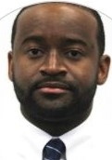
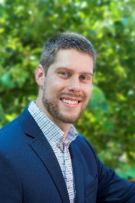
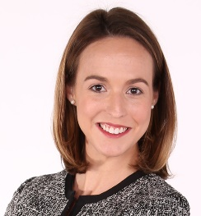
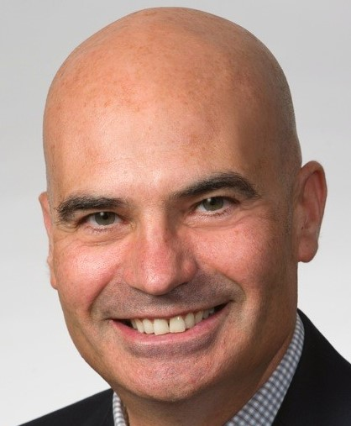
The AAMC CFAS Team
Stephen Barry, CFAS Engagement Specialist sbarry@aamc.org
Alex Bolt, CFAS Communications Specialist abolt@aamc.org
Anne Berry, Lead Specialist, Implementation Research and Policy aberry@aamc.org
Eric Weissman, Senior Director, Society and Faculty Engagement eweissman@aamc.org

Slide 5
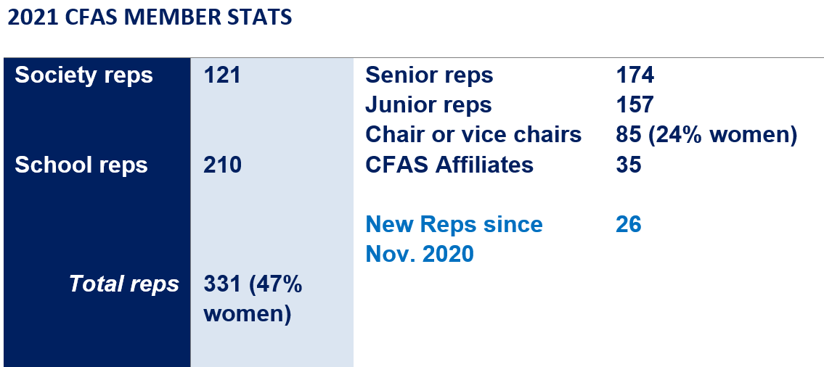
CFAS Reps by the Numbers

Slide 6
New CFAS Member Societies in 2020
American Council of Academic Plastic Surgeons
American Association of Clinical Anatomists
Society of Behavioral Medicine
…two other new societies are in the process of having their memberships approved.
If you are a member of a society that you believe should be a CFAS member, please contact Eric Weissman

Slide 7
News Regarding Member Dues
AAMC waived society dues in the past year due to concerns about financial impacts on societies during the COVID-19 pandemic
Dues will resume in the upcoming fiscal year with the understanding that some societies may request waivers due to ongoing financial challenges
No society memberships will be canceled in FY 2022 for inability to pay dues as societies regain financial footing
Society engagement is paramount to the AAMC

Slide 8
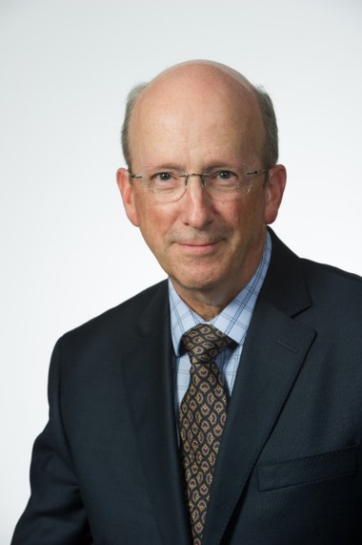
Update from AAMC Chief Scientific Officer Ross McKinney, MD

Slide 9
The Past Year: Putting Our Activity into Context
CFAS provides a voice for academic faculty within the AAMC’s governance and leadership structures. The council is charged with:
Identifying critical issues facing faculty members of medical schools and within academic societies;
Providing a faculty voice on those issues to the AAMC as they relate to creation and implementation of the AAMC programs, services, and policies
Serving as a bidirectional communications conduit regarding matters related to the core missions of academic medicine.
Our activity over the past year has exemplified these premises.

Slide 10
Launch of CFAS Connects
A monthly forum where we:
Engage and work collectively with CFAS reps on a range of topical issues and themes in a difficult time
Explore the work of the various CFAS committees
Bring faculty issues to the forefront of AAMC concerns
Provide professional development in key areas
Share, network, and even enjoy some levity
Between 50 and 90+ CFAS reps and society execs join each event
All events are recorded and available online with notes and summaries at www.aamc.org/cfas

Slide 11
Looking Back on CFAS Connects
March 24 – A Conversation with AAMC President and CEO David J. Skorton, MD
February 25 – Exploring Faculty Challenges and Recent High Points
January 21 – Well-Being in Academic Medicine
December 17 – Academic Medicine in Political Transition
October 29 – The Pandemic’s Effect on Clinicians and Basic Scientists
September 30 – Faculty Perspectives and Experiences in the COVID Era
August 27 – First CFAS Connects: CFAS Business Meeting

Slide 12
Looking Ahead to CFAS Connects
Next CFAS Connects: This Meeting!
The First CFAS Connects Social Hour… All of you have the appointment including a suggested cocktail or mocktail. No agenda. Just socialize.
Thursday, April 15, 6-7 p.m. Eastern
And Beyond…
When we resume an in-person meeting schedule, we will keep this forum given its success.

Slide 13
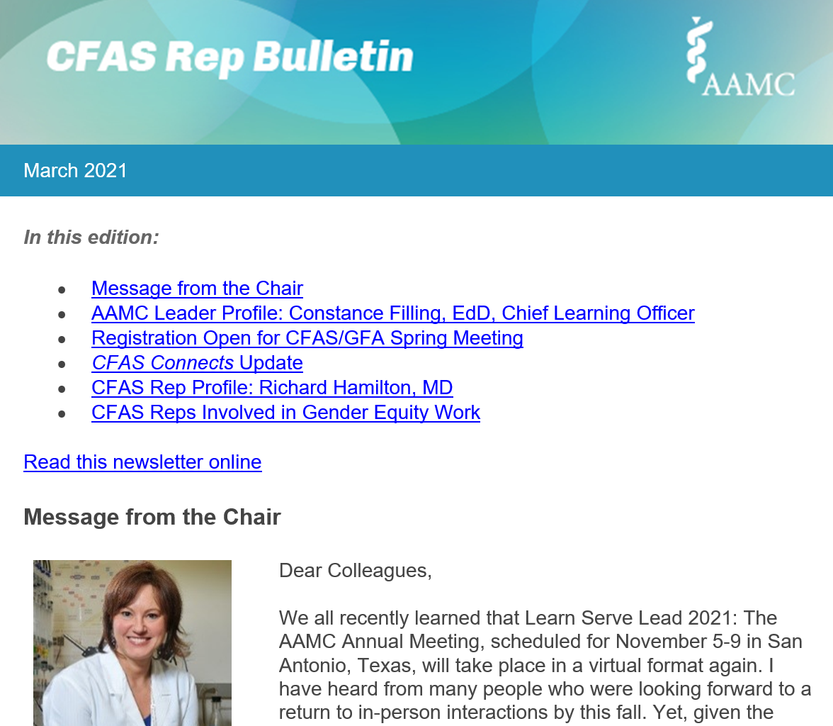
CFAS Rep Bulletin
~34% average open rate on this monthly electronic publication targeting the CFAS community with the goal of informing and encouraging dialogue More than 400 monthly recipients
Each edition covers news and events, and profiles a society or a CFAS rep.
CFAS reps and society executives can (and have) suggested topics we’ve covered.

Slide 14
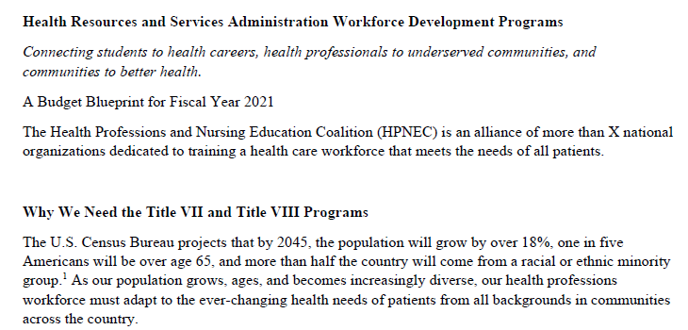
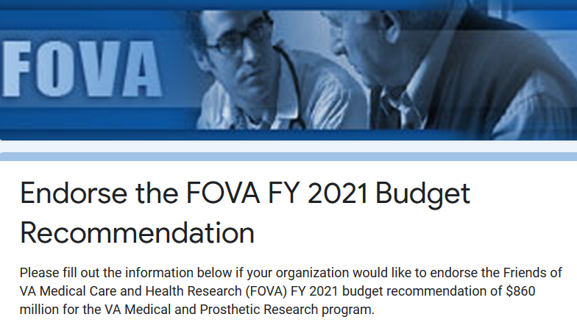
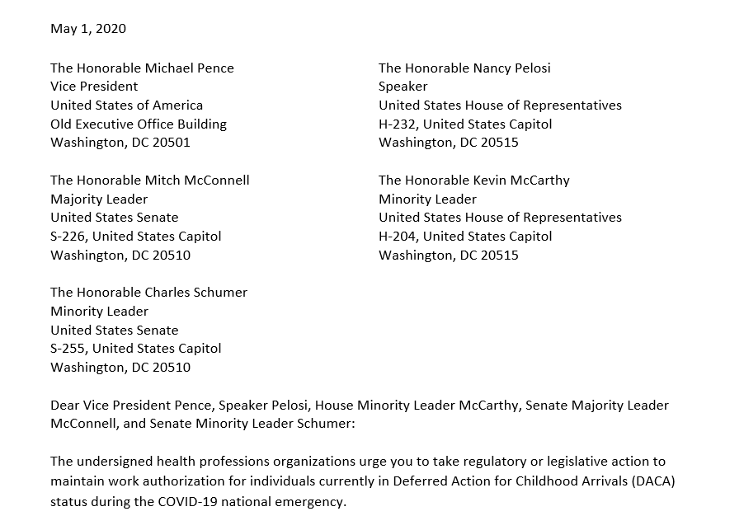
AAMC Sign-on Opportunities
Through CFAS, the AAMC has distributed advocacy sign-on letters to member societies – these are meaningful given AAMC’s coalition strategy. Letters circulate on average every other month or so, and are popular with member societies.
Recent sign-on letters include,
Immigrations issues that affect the health care workforce
NIH funding
Funding for Title VII health professions and Title VIII nursing workforce development programs
GME funding
Friends of the VA

Slide 15
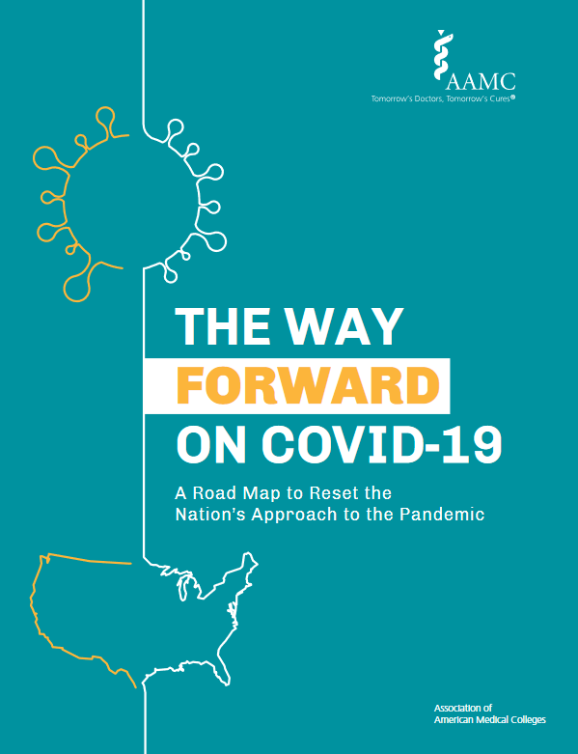
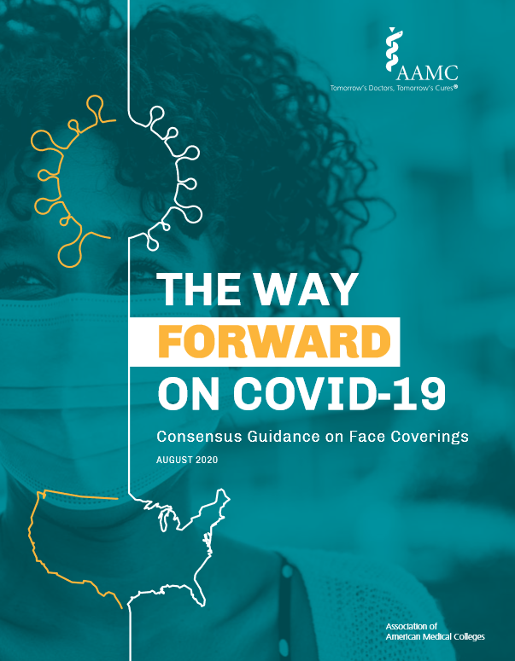
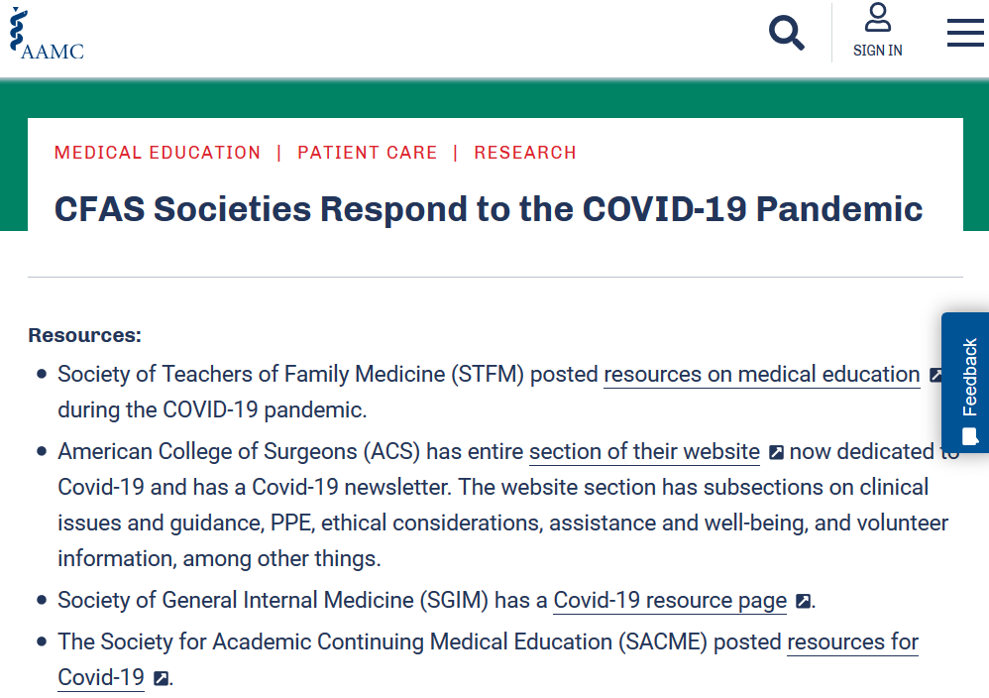
AAMC and CFAS Respond to the Pandemic
AAMC released The Way Forward On COVID-19: A Road Map to Reset the Nation’s Approach to the Pandemic
AAMC Research and Action Institute released Consensus Guidance on Face Coverings
CFAS published a resource that curated member societies’ responses to the pandemic
CFAS committees have moved their work forward in virtual formats, usually open to all interested CFAS reps

Slide 16
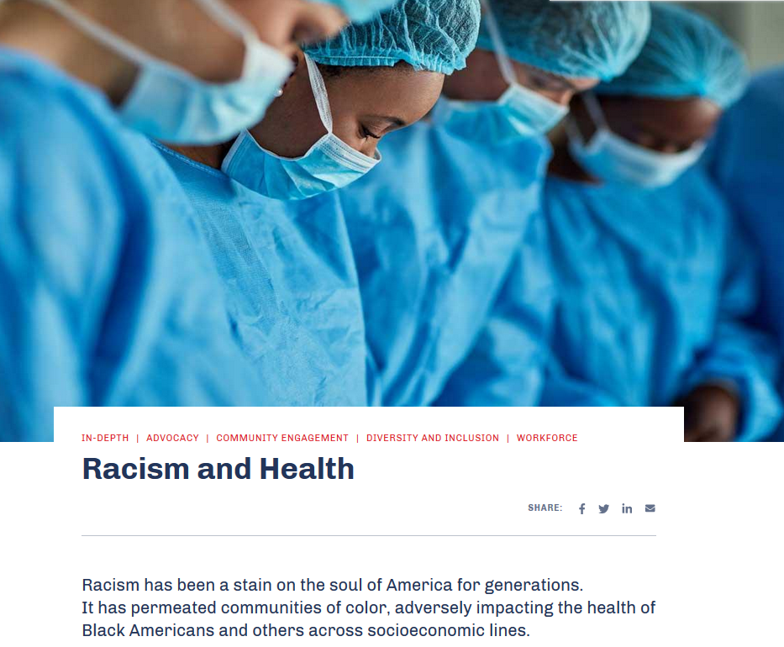
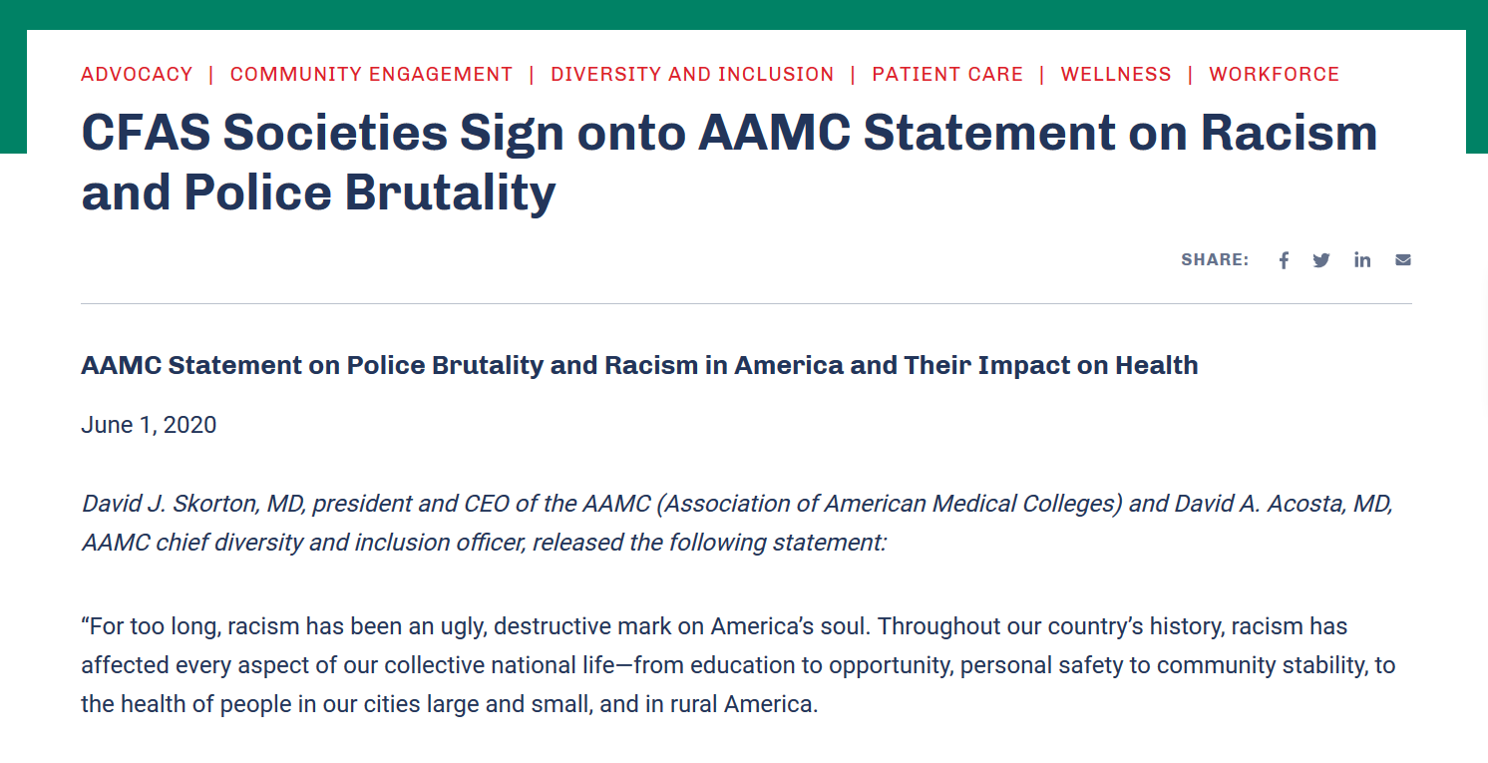
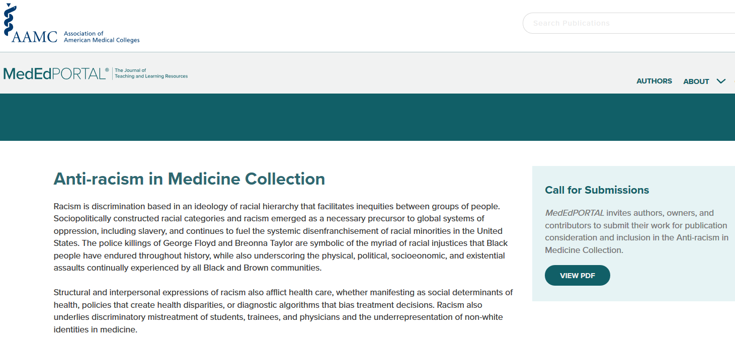
AAMC and CFAS Address Racism and Police Brutality
The AAMC responded to racial violence with a statement and call to action against police brutality and racism
More than 30 CFAS societies and other organizations signed onto the statement, and 34 others shared their own statements – all published on the CFAS website
MedEdPORTAL, a peer-reviewed AAMC online learning resource, published a collection on anti-racism in medicine

Slide 17
CFAS Tweet Chats
CFAS Tweet Chats are a popular activity among reps and usually draw participants in the dozens to discuss the important topics in academic medicine.
Included among the participants are often medical schools, academic societies, health policy experts, and thought leaders.
CFAS has hosted tweet chats on topics such as
Diversity, equity, and inclusion
How to manage wellness during the pandemic
Medical education
Political interference in science and medicine
Health disparities during the pandemic
The importance of the humanities in medicine

Slide 18
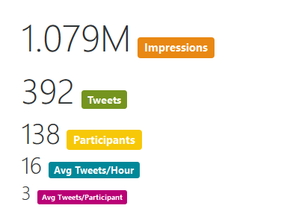
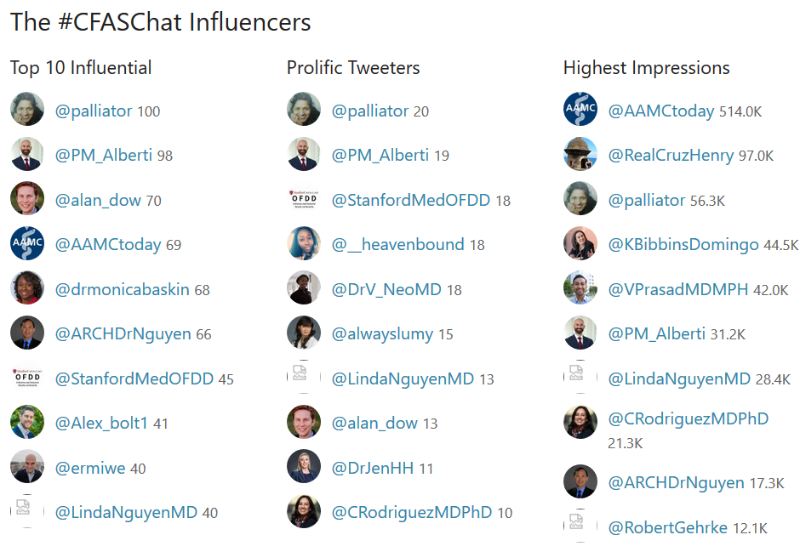
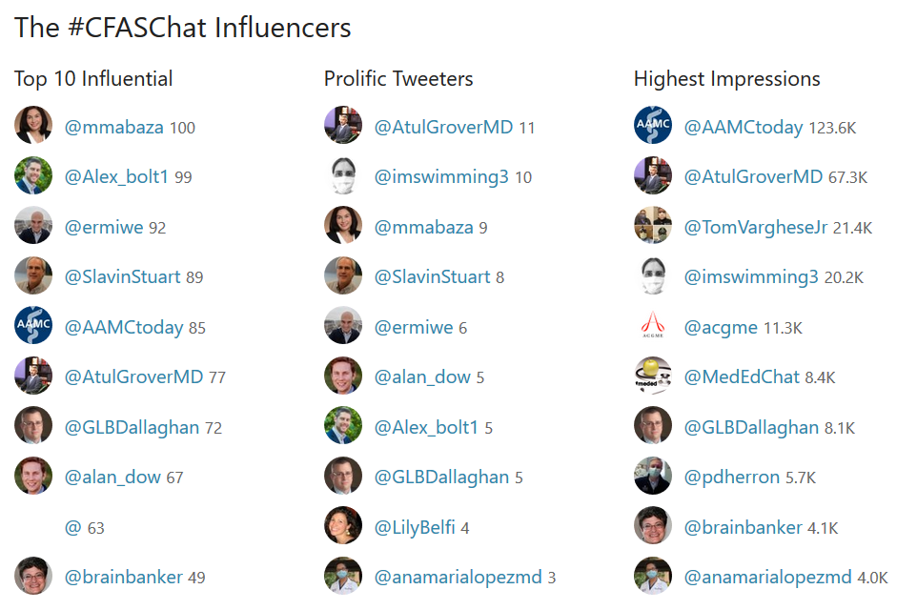
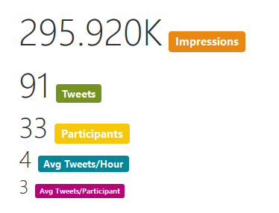
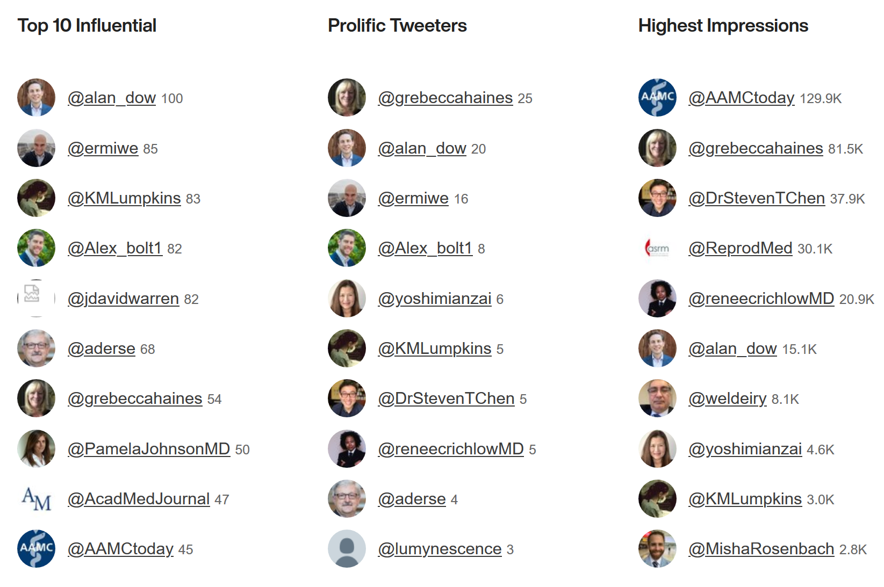
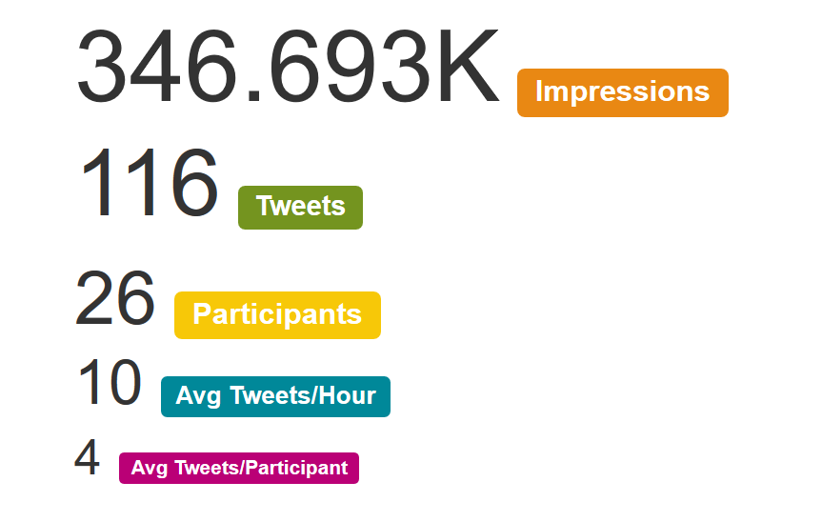
CFAS Tweet Chats By the Numbers
Conversations among CFAS reps on Twitter usually create a stir, showing up in the news feeds of hundreds of thousands (and in a couple cases, more than a million) individual newsfeeds. CFAS Tweet Chats Since the Pandemic:
COVID-19 Health Disparities
Well-Being in Academic Medicine
Political Interference in Science and Medicine

Slide 19
CFAS Structural Committees
The following CFAS Committees have term-limited memberships that are filled by nominated/appointed CFAS reps. All CFAS reps are able to apply for positions when they are announced.
Program Committee (Aviad “Adi” Haramati, Chair – note: this role is always filled by the CFAS Chair-elect)
Nominating and Engagement Committee (Scott Gitlin, Chair – note: this role is always filled by the CFAS Immediate Past Chair)

Slide 20
CFAS Topical Committees
The following CFAS Committees are open to all reps:
Advocacy Committee (Art Derse, Chair)
Basic Research and Education Committee (BREC) (Rich Eckert, Chair)
Communication Committee (Alan Dow, Chair)
Diversity Committee (VJ Periyakoil, Chair)
Mission Alignment Committee (Stewart Babbott, Chair)
Faculty Resilience Committee (Cathy Pipas, Chair)
Topical committees have held monthly or bi-monthly virtual meetings during the past year.
Each of these committees have sponsored a CFAS Connects event – and CFAS Connects itself was conceived by the Program Committee
More details are available at www.aamc.org/cfas.

Slide 21
CFAS Committee Staffing
Please reach out to these staff members for committee info.
Alex Bolt abolt@aamc.org:
Diversity & Inclusion Committee
Advocacy Committee
Communication Committee
Anne Berry aberry@aamc.org :
Biomedical Research and Education Committee
Faculty Resilience Committee
Stephen Barry sbarry@aamc.org :
Mission Alignment Committee
Nominating and Engagement Committee (with Eric)
Program Committee (with Eric)

Slide 22
CFAS Nominating and Engagement Committee Update
Scott D. Gitlin, MD, CFAS Immediate Past Chair and Chair of the Nominating and Engagement Committee
Role of the Nominating Committee
Maintain leadership continuity for CFAS
Ensure CFAS leadership reflects values of the organization
Manage open nomination/self-nomination process each year
Identify new CFAS Administrative Board Members each year
Identify a new CFAS Chair-elect every other year

Slide 23
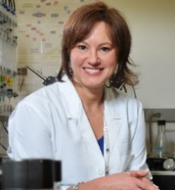
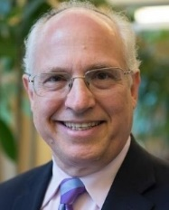
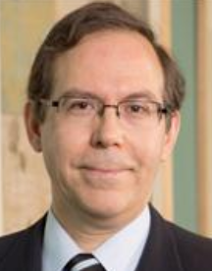
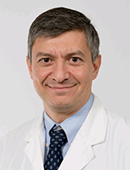
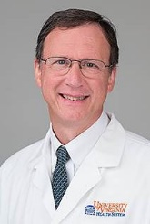
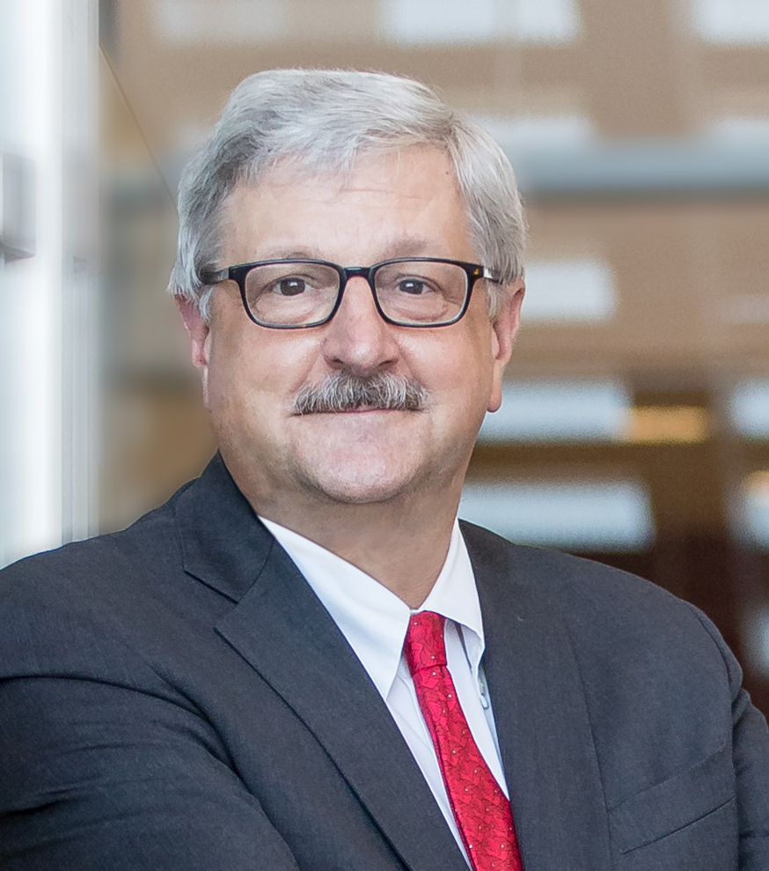
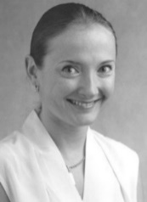
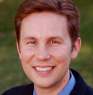
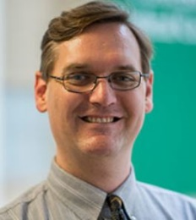
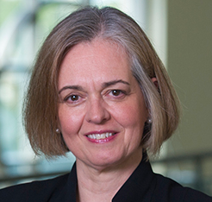
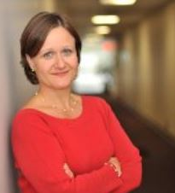
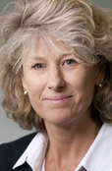
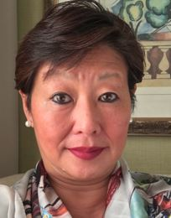
CFAS Administrative Board – Today (with an Eye Toward November)
Gabriela Popescu, PhD, Chair – Becomes immediate past chair in November
Aviad “Adi” Haramati, PhD, Chair-elect – Becomes CFAS Chair in November
Scott D. Gitlin, MD, Immediate Past Chair – Rotates off the ad board in November
Nita Ahuja, MD
Steven Angus, MD – First term complete; up for renewal
Stewart Babbott, MD
Arthur Derse, MD, JD
Vera Donnenberg, PhD – First term complete; up for renewal
Alan W. Dow, III, MD
Richard L. Eckert, PhD
Adam Franks, MD
Elza Mylona, PhD (Ex-Officio GFA Chair-elect)
Serina Neumann, PhD
VJ Periyakoil, MD – second term complete; rotating off the ad board
Catherine Pipas, MD – First term complete; up for renewal
Lumy Sawaki Adams, MD – resigned from ad board after joining the NIH

Slide 24
Nominating Committee 2021 Process
Nomination call for CFAS Administrative Board seats and Chair-elect opened in February.
Call will remain open through April 23 to accommodate this meeting.
Committee will review nominees and make its recommendation on a slate for the Ad Board to review in early May.
CFAS reps will receive an electronic ballot to vote on the slate in mid-May.
New Ad Board members and the new Chair-elect will be announced before June 1.

Slide 25
Nominations for Ad Board Still Being Accepted!
Submit nomination here: https://www.aamc.org/professional-development/affinity-groups/cfas/administrative-board-nominations
Deadline: April 23, 2021 at 11:59 p.m. Eastern.
If you have questions about the process or nominee qualifications, please reach out to Scott Gitlin at sgitlin@umich.edu, or Eric Weissman at eweissman@aamc.org.
Who Can Nominate?
Any active CFAS representative, including CFAS Affiliate reps, can nominate a current, active CFAS rep to serve on the CFAS Administrative Board or to serve as Chair-elect. A rep can be at any point in their term when serving on the CFAS Administrative Board.

Slide 26
Questions, Comments, and Discussion

Slide 27
© 2018 AAMC. May not be reproduced without permission.

