Slide 1
Program Evaluation and Scholarship in Faculty Affairs and Development: Mapping your design and analysis
GFA Research and Scholarship Committee KoKo Aung, MD, MPH Clara Lapiner, MPH Troy Buer, PhD Janine Shapiro, MD Guadalupe Federico-Martinez, PhD Kimberly Skarupski, PhD, MPH (Chair) Jessica Kahn, MD, MPH
AAMC GFA
Professional Development Conference
Webinar October 21, 2020
v6

Slide 2
Session Learning Objectives
1. Recognize the importance of aligning program and institutional goals with outcome measures for optimal program evaluation in FAD.
2. Apply the concepts learned in the session to current or future program evaluation planning and implementation.
3. Identify best practices in transforming program evaluation into scholarship for publication and grant application searches.

Slide 3
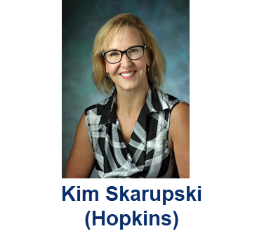
Foundation of Program Evaluation Presented by:

Slide 4



Foundations of Program Evaluation
What is program evaluation (PE) in the context of faculty affairs and development?
Program evaluation is the systematic collection of information
Patton’s “Experience, Explore, Observe, and Evaluate Exercise” (1978)
Instructions: Explore “this space.” Move around the room, touch things, move things, experience different parts of this setting. While you’re doing this, watch what others do. I’ll then ask you to give an “evaluation report.” (One rule = no talking)
Notes:
Your segment is 10 min

Slide 5
Program Evaluation (PE)
Why is it important?
Because what we do requires/assumes/includes:
$$$ (unexpected impact of COVID-19 on budgets)
Resources (staff [pre-COVID = space, supplies, hospitality])
Time:
Faculty schedules (competing demands, pre-COVID ‘transportation’)
Instructor(s): development, preparation, presentation, post-session consultations and follow-up, assessment/debrief, improvement/revision
Staff: room reservations, announcements/RSVPs, hospitality, materials and pre-session communications, set-up/tear-down, evaluations/follow-up
Continuous improvement & evolution (“anything worth doing is worth measuring”)
Competition
Shifting priorities
Public relations, marketing, communication

Slide 6
Program Evaluation (PE)
WHO wants to evaluate? (will help you discern the REASON/INTENTION for evaluation)
You, Your team? Because you want to improve & share with the AAMC GFA Family?
Your Chair, Vice Dean, Dean, President? (Hint: Ask, “What will you do with the results?”)
WHEN?
In the beginning, when you’re developing a new program; in the middle, when you have the data/want to course-correct; at the end, when you want to measure impact….so….ALL THE TIME!
WHAT?
It depends…

Slide 7
2 Types of Evaluation (per evaluators’ intentions)
Formative – done to identify strengths and weaknesses (during development); goal is improvement; most believable if done in-house; audience is program directors
cook tasting the soup
Summative – done to make judgment of worth (after finished); goal is decision-making; most believable if done externally; audience is ‘funder’
guest tasting the soup

Slide 8
2 Types of Evaluation (per program phase)
Process – used when you want to know what’s going on; if the program is doing what it’s supposed to do; how it’s being implemented
Outcomes – examines end results/ impacts/effects of the program

Slide 9
PE Models are based on…
Theory
Theory = a statement/set of statements that attempt to explain how something works or how something occurs.
You already have one (whether you know it or not – implicit/articulated)
Structure
“If-then” statements that break the program down into specific, systematic, related functions
Advantages: allows you to detect where the program ISN’T working and helps to understand and explain how it IS working.

Slide 10
# and % of a target population who report, demonstrate, or
exhibit an outcome in a specified quantity in a specified
timeframe/circumstance
Outcome
Indicators
Long Term
Outcomes
changes in condition/status (BEING)
Intermediate
Outcomes
changes in behaviors (DOING)
Initial
Outcomes
changes in knowledge, attitudes, or skills (KNOWING)
Outputs
volume of work - # of faculty/sessions
what the office does – orientation, sessions, longitudinal programs, bootcamps, WAGs, retreats, mentoring/coaching, etc.
Activities
Inputs
resources – money, staff, time, facilities, etc.
United Way of America’s Logic Model Format
“Measuring Program Outcomes: A Practical Approach”

Slide 11
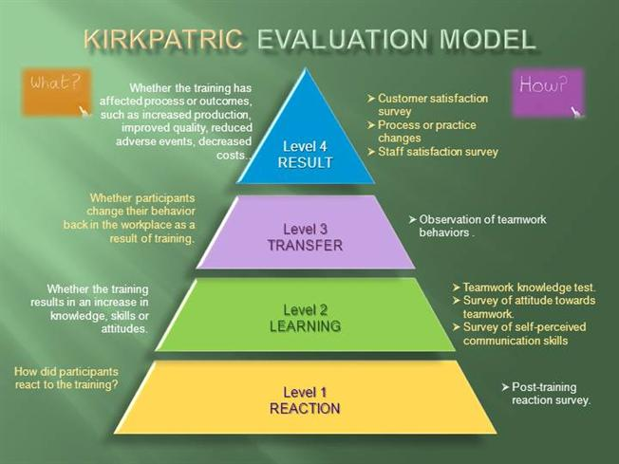

Kirkpatrick DI. Evaluating Training Programs: The Four Levels, 3rd ed. San Francisco: Berrett-Koehler;2006.
Notes:
Kim: I like the WHAT and HOW components of this image I found on Bing…but of course I don’t like the TYPO in “Kirkpatrick” – I can make a joke about that…

Slide 12
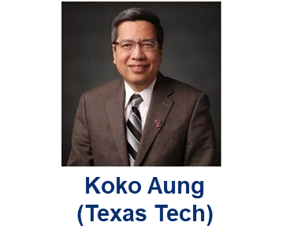
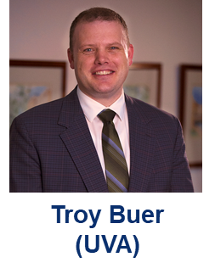
Core Elements of Program Evaluation Presented by:
KoKo Aung
(Texas Tech)

Slide 13
Purpose
Evaluation is a process that critically examines a program. It involves collecting and analyzing information about a program’s activities, characteristics, and outcomes. Its purpose is to make judgments about a program, to improve its effectiveness, and/or to inform programming decisions.
Patton, M.Q. (1987). Qualitative Research Evaluation Methods. Thousand Oaks, CA: Sage Publishers.

Slide 14
Scholarly approach to evaluation
Clear goals
Adequate preparation
Appropriate methods
Significant results
Effective communication
Reflective critique
Evaluation goals: clarity, specificity, importance, measurability
Why and for whom is it being done?
Common purposes: program improvement, accountability, and knowledge generation
What model is driving the development of your program (i.e. conceptual framework)?
What evaluation model best fits your goals?
Key: integrate scholarly evaluation plan at the beginning of program design
Glassick CE. Boyer's expanded definitions of scholarship, the standards for assessing scholarship, and the elusiveness of the scholarship of teaching. Acad Med. 2000 Sep;75(9):877-80.
Li ST, Gusic ME, Vinci RJ, Szilagyi PG, Klein MD. A Structured Framework and Resources to Use to Get Your Medical Education Work Published. MedEdPORTAL. 2018;14:10669.
Li, ST, Klein, MD, Balmer, DF, Gusic ME. Scholarly evaluation of curricula and educational programs: Using a systematic approach to produce publishable scholarship [published ahead of print July 9, 2020]. Acad Pediatr. https://doi.org/10.1016/j.acap.2020.07.005.
Zackoff MW, Real FJ, Abramson EL, Li ST, Klein M, Gusic ME. Enhancing Educational Scholarship through Conceptual Frameworks: A Challenge and Roadmap for Medical Educators. Academic Pediatrics 2019; 19(2): 135-141.

Slide 15
Scholarly approach to evaluation
Clear goals
Adequate preparation
Appropriate methods
Significant results
Effective communication
Reflective critique
Be systematic
Review literature and understand best practices
What is your program contributing?
What data do you need given program and evaluation goals (measures, outcomes)? What information do you need to learn what you want to learn?
Who are your stakeholders and what do they need or want?
Glassick CE. Boyer's expanded definitions of scholarship, the standards for assessing scholarship, and the elusiveness of the scholarship of teaching. Acad Med. 2000 Sep;75(9):877-80.
Li ST, Gusic ME, Vinci RJ, Szilagyi PG, Klein MD. A Structured Framework and Resources to Use to Get Your Medical Education Work Published. MedEdPORTAL. 2018;14:10669.
Li, ST, Klein, MD, Balmer, DF, Gusic ME. Scholarly evaluation of curricula and educational programs: Using a systematic approach to produce publishable scholarship [published ahead of print July 9, 2020]. Acad Pediatr. https://doi.org/10.1016/j.acap.2020.07.005.
Notes:
Stakeholders: decision makers, program sponsors, participants, program leaders, peers, evaluation and research community, etc.

Slide 16
Scholarly approach to evaluation
Clear goals
Adequate preparation
Appropriate methods
Effective communication
Reflective critique
Significant results
Align evaluation with program design.
Program and evaluation goals drive data needed (measures, outcomes).
Triangulation
Use multiple sources: source(s) with most accurate information
Utilize multiple data collection instruments: observations, interviews, focus groups, document review, surveys, etc.
How will you make sense of the data?
Glassick CE. Boyer's expanded definitions of scholarship, the standards for assessing scholarship, and the elusiveness of the scholarship of teaching. Acad Med. 2000 Sep;75(9):877-80.
Li ST, Gusic ME, Vinci RJ, Szilagyi PG, Klein MD. A Structured Framework and Resources to Use to Get Your Medical Education Work Published. MedEdPORTAL. 2018;14:10669.
Li, ST, Klein, MD, Balmer, DF, Gusic ME. Scholarly evaluation of curricula and educational programs: Using a systematic approach to produce publishable scholarship [published ahead of print July 9, 2020]. Acad Pediatr. https://doi.org/10.1016/j.acap.2020.07.005.

Slide 17
CIPP (Context/Input/Process/Product) Model
Focus on development and continuous improvement (evaluators work closely w/ stakeholders)
Context Evaluations
Identify needs, assets, obstacles, and opportunities; connect with key stakeholders; understand situation/environment
Input Evaluations
Collect info about available resources (e.g., infrastructure, human, time, budget, etc.) to help make resource allocation decisions to achieve program’s goals/plans;
Process Evaluations
Track and document how inputs used to implement program and achieve stated goals
Product Evaluations
Assess intended and unintended outcomes and short/long-term outcomes
Stufflebeam D.L. The CIPP model for evaluation. In: Kellaghan T., Stufflebeam D.L. (eds) International Handbook of Educational Evaluation. Kluwer International Handbooks of Education, vol 9. Dordrecht: Springer; 2003: 31-62.

Slide 18
Evaluation questions in CIPP
Context | Input | Process | Product
Educational needs? Impediments to meeting needs? Available expertise, services, or other assets? Existing opportunities? (funding, administrative support, etc) | Potential approaches to meet educational need? Feasibility of the identified approaches for specific needs? Cost-effectiveness of each approach? | Actual program implementation vs. plan? Documentation of program implementation? Activities on schedule? Actual cost vs. budget? Efficiency of the program? Participants' ability to perform their roles? Problems and solutions? Participants’ and observers’ feedback on quality of the process? | Positive and negative outcomes? Achievement of intended outcomes? Unintended outcomes? Implications of outcomes (short/long-term) Impacts and effectiveness of the program? Sustainability of the program? Sustainability outcomes? Adoptability of program elements by others?
Frye AW, Hemmer PA. Program evaluation models and related theories: AMEE guide no. 67. Med Teach. 2012;34:e288–e299

Slide 19
Logic Model
Inputs
Activities
Outputs
Outcomes
Focus on program context and program elements: depicts “if-then” relationship between activities and intended outcomes
Outcomes:
short-term, medium-term, and longer range changes intended
individual, group, or organization level
Outputs:
indicators of tangible program activities/deliverables
Activities:
interventions, innovations, etc.
Inputs:
resources to implement program (e.g., funding sources, facilities, human resources, tech, etc.)
Moderators:
Contextual factors that may hinder/help achieving outcomes; out of program’s control
W.K. Kellogg Foundation. Logic Model Development Guide. Battlecreek Michigan: W.K. Kellogg Foundation; 2004. Available https://www.wkkf.org/resource-directory/resources/2004/01/logic-model-development-guide. Accessed October 14, 2020.

Slide 20
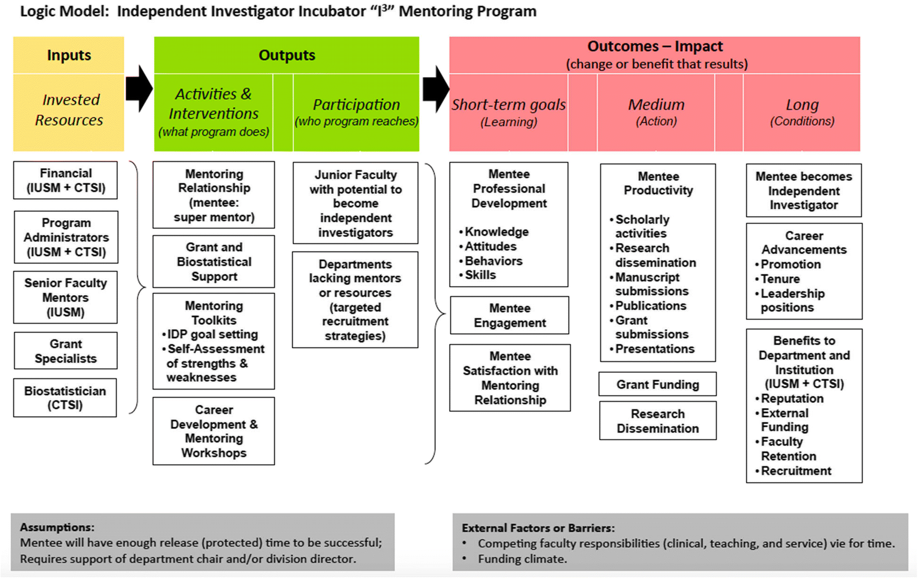
Figure from Spence, J.P., Buddenbaum, J.L., Bice, P.J. et al. Independent investigator incubator (I³): a comprehensive mentorship program to jumpstart productive research careers for junior faculty. BMC Med Educ 18, 186 (2018). Creative Commons Attribution 4.0 International License.

Slide 21
Typical Logic Model evaluation questions
Implementation of each program activity vs. plan; changes made (if any)
Personnel: availability; actual participation vs. plan; possession of required skills and experience
Degree of activities meeting the needs of all learners
Barriers to program implementation; modification of planned program to accommodate barriers
Faculty participation in faculty development plan; acquired skills or knowledge; implementation of newly acquired skills in program activities
Participants’ evaluation of program activities (effectiveness, accessibility, etc.)
Learners’ achievement outcomes
Learners’ application of newly acquired knowledge and skills in clinical practice
Changes in patient outcomes after program implementation
Frye AW, Hemmer PA. Program evaluation models and related theories: AMEE guide no. 67. Med Teach. 2012;34:e288–e299

Slide 22
Kirkpatrick & New World Kirkpatrick Models
Popular program evaluation model within health sciences
Gathers data to assess four hierarchical “levels” of program outcomes:
Level 1: Reaction: participant reactions to the program and how engaging and relevant content is to their jobs
Level 2: Learning: degree to which participants acquire intended knowledge, skills, attitudes; their confidence and commitment to use/apply learning
Level 3: Behavior: degree to which participants apply what they learned to their work; processes that monitor/facilitate application of learning/ behavior change (required drivers)
Level 4: Results: degree to which targeted outcomes occur as a result of the program; short-term observations/outcomes that suggest progress toward desired results (leading indicators)
Kirkpatrick JD, Kirkpatrick WK. 2016. Kirkpatrick's four levels of training evaluation. Alexandria (VA): ATD Press.
Li, ST, Klein, MD, Balmer, DF, Gusic ME. Scholarly evaluation of curricula and educational programs: Using a systematic approach to produce publishable scholarship [published ahead of print July 9, 2020]. Acad Pediatr. https://doi.org/10.1016/j.acap.2020.07.005.

Slide 23
Scholarly approach to evaluation
Clear goals
Adequate preparation
Appropriate methods
Significant results
Effective communication
Reflective critique
Demonstrate effectiveness by connecting: Intervention > Outcomes > Sources > Methods
Remember your specific aims(s)
Outcomes to consider measuring:
Kirkpatrick and NWK: participant satisfaction, perceived engagement, perceived relevance of content; change in KSAs, confidence/ commitment to apply; transfer of learning, change of behavior, etc.
Consider short/long-term and intended/unintended
Glassick CE. Boyer's expanded definitions of scholarship, the standards for assessing scholarship, and the elusiveness of the scholarship of teaching. Acad Med. 2000 Sep;75(9):877-80.
Li ST, Gusic ME, Vinci RJ, Szilagyi PG, Klein MD. A Structured Framework and Resources to Use to Get Your Medical Education Work Published. MedEdPORTAL. 2018;14:10669.
Li, ST, Klein, MD, Balmer, DF, Gusic ME. Scholarly evaluation of curricula and educational programs: Using a systematic approach to produce publishable scholarship [published ahead of print July 9, 2020]. Acad Pediatr. https://doi.org/10.1016/j.acap.2020.07.005.

Slide 24
Scholarly approach to evaluation
Clear goals
Adequate preparation
Appropriate methods
Significant results
Effective communication
Reflective critique
Dissemination of findings and forums
What?
Manuscript, quality improvement, education program, education tool, etc.
Who?
Internal/external audiences and stakeholders
How?
Abstracts, posters, workshops, publications, web-based, etc.
Glassick CE. Boyer's expanded definitions of scholarship, the standards for assessing scholarship, and the elusiveness of the scholarship of teaching. Acad Med. 2000 Sep;75(9):877-80.
Li ST, Gusic ME, Vinci RJ, Szilagyi PG, Klein MD. A Structured Framework and Resources to Use to Get Your Medical Education Work Published. MedEdPORTAL. 2018;14:10669.
Li, ST, Klein, MD, Balmer, DF, Gusic ME. Scholarly evaluation of curricula and educational programs: Using a systematic approach to produce publishable scholarship [published ahead of print July 9, 2020]. Acad Pediatr. https://doi.org/10.1016/j.acap.2020.07.005.

Slide 25
Scholarly approach to evaluation
Clear goals
Adequate preparation
Appropriate methods
Significant results
Effective communication
Reflective critique
Critical reflection and analysis, evidence-based recommendations, and improve future work
Glassick CE. Boyer's expanded definitions of scholarship, the standards for assessing scholarship, and the elusiveness of the scholarship of teaching. Acad Med. 2000 Sep;75(9):877-80.
Li ST, Gusic ME, Vinci RJ, Szilagyi PG, Klein MD. A Structured Framework and Resources to Use to Get Your Medical Education Work Published. MedEdPORTAL. 2018;14:10669.

Slide 26
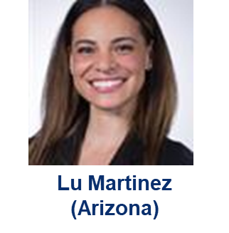
Best Practices in Program Evaluation Systematic Planning Presented by:
Lu Federico-Martinez
(UArizona – Phoenix)

Slide 27

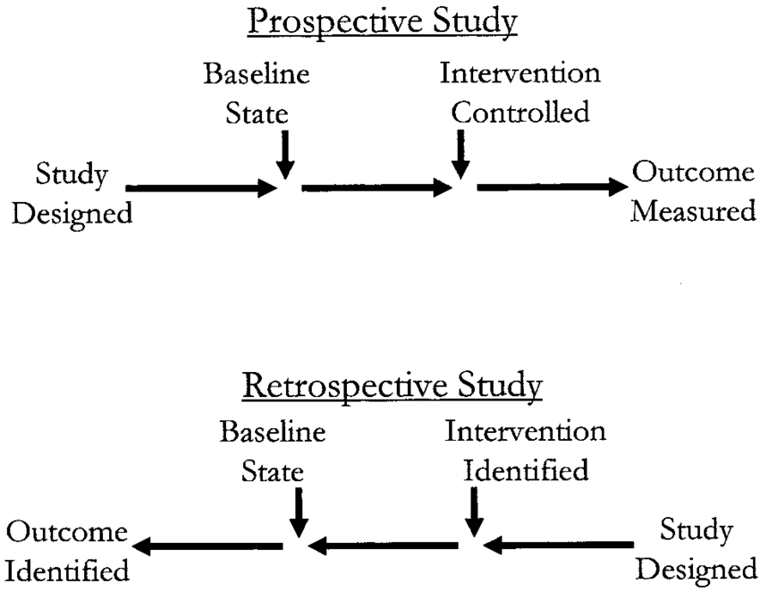
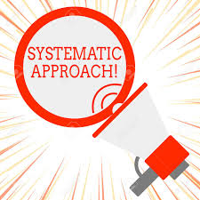

Guiding Philosophy in Program Design: Planning- execution-reporting phases
Rossi et al., Evaluation: A systematic approach, SAGE, 1979
Notes:
Across journals and national conference peer review practices is a serious elevation in expectation of quality.
Move beyond a) descriptive and b) (dis)satisfied.
Looking for rich descriptions that fully grasp institutional context/setting.
Meaningful quant/qual trends with deeper connections and exploration/relations to +/-implications for practice.
Hallmarks of high quality are: prospective design, system evaluation methods, incorporation of theory

Slide 28

Incorporation of theory
Theory is a set of ideas about what is at play and how it all works together
Part of the strategy for generating a deeper understanding of events, outcomes and conditions.
Sophisticated framework by which to conclude discussion sections
Making sense of and explaining complexities
Nimmon et al., Integration of theory in qualitative research, Journal of Graduate Medical Education, 2016
Sullivan, Deconstructing quality in educational research, Journal of Graduate Medical Education, 2011
Notes:
Nimmon, 2016
Sullivan, 2011, Deconstructing Quality in Educational Research, JGME
Lay out framework used in methods and WHY it is appropriate.
After each finding-relate and explain the finding using the theory OR
Use the discussion section to summarize the explanation.
EXAMPLE:

Slide 29
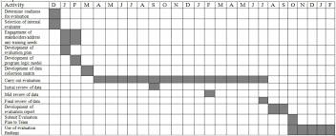
Necessary timing and resources needed
Scouting collaborators with particular strength (i.e. design/theory, time, dedication)
Anticipate challenges with multi-site engagements – Be flexible!
Funding mechanisms
Informs bandwidth and timeline
Martin, Plan for program evaluation, National Institute of Justice Journal, 2015
Pangaro, Leadership Careers in Academic Medicine, American College of Physicians Book Series, 2010
Notes:
Hunt down education specialists like EdD and PhD and Masters in your college or public health or education social/behavioral. Therein lie the experts on prog eval.
Particularly with design choice-data collection tool fie tuning-theory consultation. Authorship for them. Interdisciplinary.
NIH-R25 especially for ODI
HRSA
DOD
DOE
Internal school-or college—FOR deans/provosts on the call---work with FA/DI/COMMISION WOMEN to develop such competitive opportunities for funding and showcasing.

Slide 30

Dissemination - your local/national/global reach
Communication platform and strategy
Executive report
Transform into academic paper
(Innovation; original article; perspective; Podium Presentation)
Add to promotion dossier
Service outreach
Teaching portfolio
Leadership portfolio
Diversity, inclusion and equity dimension

Slide 31
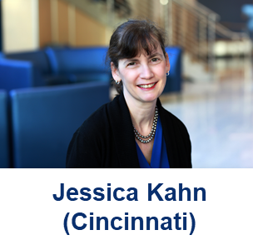
List of Relevant Topics in Faculty Affairs and Development Presented by:

Slide 32
List of relevant topics for FAD offices
Reappointment, promotion and tenure
RPT criteria development, promotion and tenure support
New faculty onboarding/orientation, faculty evaluations
Faculty recognition and appreciation events
Career development seminars and workshops
Leadership development programs
Mentorship programs
Networking opportunities
Diversity, equity and inclusion initiatives
Faculty vitality and wellness initiatives
COVID-19 related supports

Slide 33
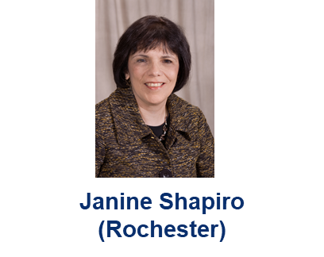
Application - Case Study Review Presented by:

Slide 34
Case Example
You are implementing a longitudinal leadership development program designed to address a professional development need in leadership development for senior leaders in academic medicine.
It is a multi-faceted two-year program that includes monthly seminars, independent learning and reflective practice, engagement in a professional learning community of senior leaders, and real-life application through an individual experiential leadership project that addresses a departmental or institutional need and focuses on improving leadership competence and skills.
The program is open to faculty in senior leadership positions at your institution and is made possible through faculty development funds from the Dean’s office.

Slide 35
Specific Program Goals
Describe effective academic leadership practice and capabilities;
Apply relevant leadership theories and frameworks to guide ongoing leadership development and leadership effectiveness;
Use reflective practice and self-management strategies to develop and enhance personal leadership style;
Demonstrate effective leadership behaviors in various settings;
Apply leadership knowledge and skills to the strategic and tactical departmental/institutional issues through an experiential leadership project.

Slide 36
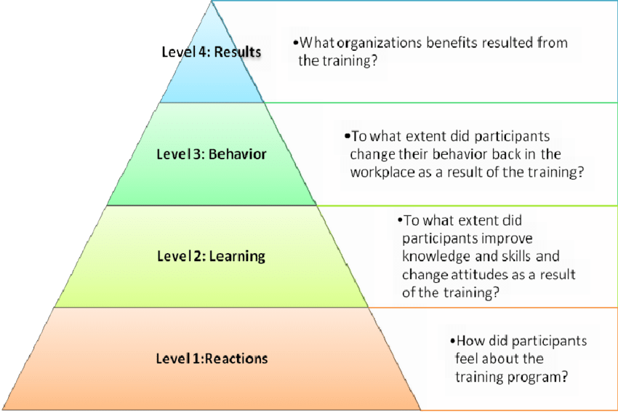

Slide 37
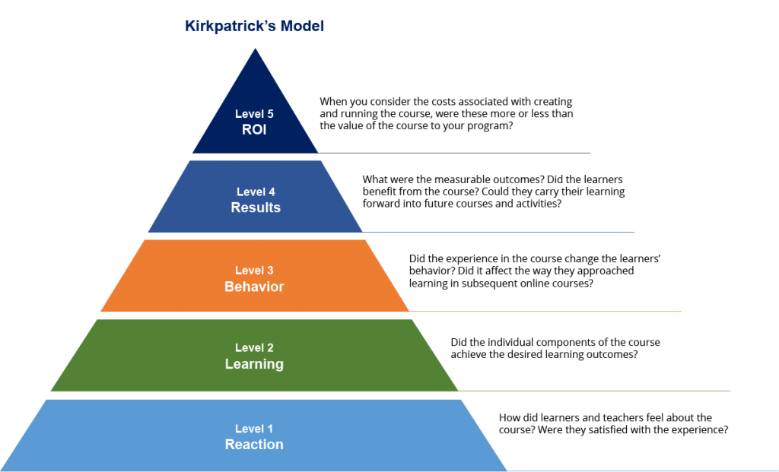

Slide 38
Program Evaluation – Key Questions and Considerations
Who are the stakeholders of your faculty development program?
How will evaluation results be used?
What resources are available for evaluation?
Identify critical evaluation questions. Are they aligned with the goals of your program?
What is the most appropriate evaluation design and method for each evaluation question?
Consider data collection process, analysis, reporting, and time frame
Consider ethical issues
Thomas PA, Kern DE, Hughes MT, Chen BY. Curriculum Development in Medical Education: A Six-Step Approach, 3rd ed. John Hopkins University Press; 2016.

Slide 39
Users
Program Director(s)
Course Faculty
Uses
Formative information to guide program improvement
Dissemination and scholarship
Resources
External and internal resources for evaluation development, administration, and collation
CME Office
Dean
Program participants and prospective participants
Summative evaluation for CME Office, Dean (ROI)

Slide 40
Evaluation Questions
Demographic questions, # participants
Program components and facilitators rated by participants
Evaluation Methods and Instruments
Survey of participants
Program’s strengths and weaknesses rated by participants
Demonstration of effective leadership behaviors in the workplace
Self-assessment of gain in leadership knowledge and skills
Completion and impact of experiential leadership project
Long term program impact e.g. senior leadership positions
360⁰ evaluation of leadership behaviors
Topics, impact, ROI of leadership projects
Long-term survey of participants of perceived impact of program, leadership career path/ achievements

Slide 41
Data Collection
Brief electronic survey at end of each session
Detailed survey at end of program
Data Analysis
Descriptive data analysis
Reporting of Results
Monthly evaluation results distributed to course faculty
Peer-reviewed dissemnation and publication
360⁰ pre- and post program
Long term follow-up survey 12 months post program
Completion of evaluation reminders
Qualitative and quantitative data analysis
Statistical consultant if needed
Summary evaluations to major stakeholders

Slide 42
Ethical Concerns
Demographic data
Voluntary participation in 360⁰
Respondents confidentiality, aggregate data
IRB approval

Slide 43
Case Examples
Your Office of Faculty Affairs is implementing a faculty orientation program for new faculty joining your institution. The program includes a welcoming packet of information, a half-day faculty orientation meeting, and assignment of an onboarding mentor for the first year.
How would design an evaluation of this new program?

Slide 44
Case Examples
You are charged by your dean to develop policies to support part-time faculty at your institution.
How would you design an evaluation that demonstrates the impact of these policies e.g. impact on satisfaction, retention, and academic advancement of part-time faculty members ?

Slide 45
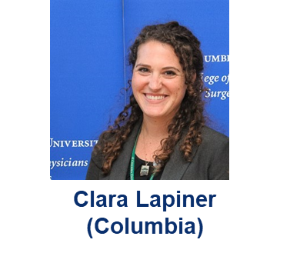
Activity Segment Facilitated by:

Slide 46
ACTIVITY I (PRE-WORK) Program Evaluation Design and Dissemination Planning Project
What is the overall objective of your evaluation? How can the objective be reframed into a research question?
What are your measures and are they aligned with:
programmatic (and investigatory) goals
institutional goals/values
What is your methodology? (Will you be using quantitative, qualitative or a mixed method evaluation design?)
Are there potential barriers? If so, what are they?
What is your methodology for data collection and analysis? (i.e. How will your results be interpreted?)
Next Steps (how will your results be used? how will they be implemented? Do you have plans to continue the research? What are the future implications of this work?)

Slide 47
ACTIVITY II: Share and critique
You will be placed into breakout groups
Discuss your plan
5 minutes per person
Questions to consider:
Does the research question make sense?
Do the measures align with the research question?
Does the study design match the research questions?

Slide 48
ACTIVITY III: Commitment to Action Exercise
What steps will you take to move your evaluation project forward?
How will you ensure a scholarly approach to your program evaluation?
What are your priorities/established benchmarks for carrying out your evaluation?
With whom will you connect to plan/implement your program evaluation?
What resources will you need to be successful?

Slide 49
CONCLUSION
Hopefully, we have achieved our objectives and you:
1. Know that program evaluation is important
2. Have learned how to apply the concepts
3. Appreciate the necessity of scholarship
And most importantly, we hope you know that you are NOT alone (“We are all in this together!”)
Are you waving or drowning?
“I was much further out than you thought/and not waving but drowning” Stevie Smith poem

Slide 50
Resources (will be emailed to participants)
Google Scholar (search: “Faculty development program evaluation reports”)
AAMC-GFA
GFA Listserve
Listserve Archive
MedEdPORTAL
Academic Medicine
Journal of Faculty Development
Faculty Factory
Deciding where to publish:
https://journalfinder.elsevier.com/
https://www.journalguide.com/
https://journalsuggester.springer.com/
http://jane.biosemantics.org/

Slide 51
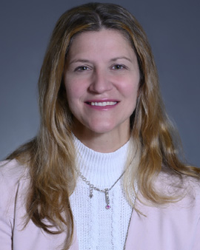
Group on Faculty Affairs Research and Scholarship Committee Poll Question #1: How can we further promote research and scholarship in faculty affairs and faculty development?
Topic Area 1: Research Learning Groups Please select one area that most interests you:
Learning communities focused by FA/D topic
Collaborative teams for FA/D possible project
Emerging FA/D topics exploratory working groups
Michele Kutzler, PhD
(Drexel)
*key: FA/D = Faculty Affairs/Development

Slide 52
Group on Faculty Affairs Research and Scholarship Committee Poll Question #2: How can we further promote research and scholarship in faculty affairs and faculty development?
Topic Area 2: Knowledge Sharing Sessions:
Research Methods (Quantitative and Qualitative)
Program design, evaluation, & implementation for FA/D
Data management & analysis
FA/D scholarly writing
Overview of AAMC data, reports, and tools
Please select one area that most interests you:
*key: FA/D = Faculty Affairs/Development

Slide 53



