Slide 1
CFAS Tweet Chat on Well-Being in Academic Medicine
July 30, 2020
Hosts:
Mona Abaza, MD, and Stuart Slavin, MD

Slide 2
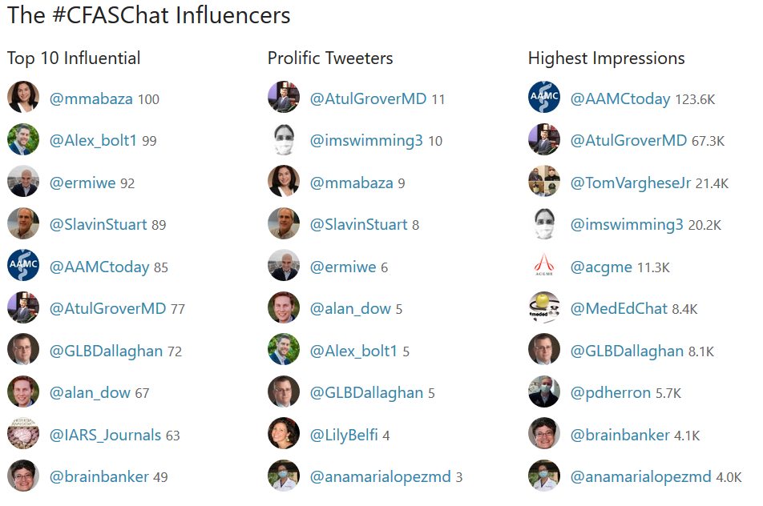
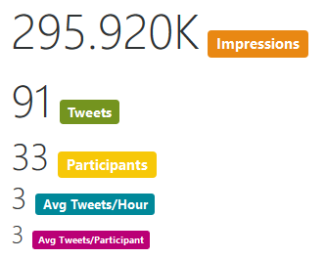
By the Numbers

Slide 11
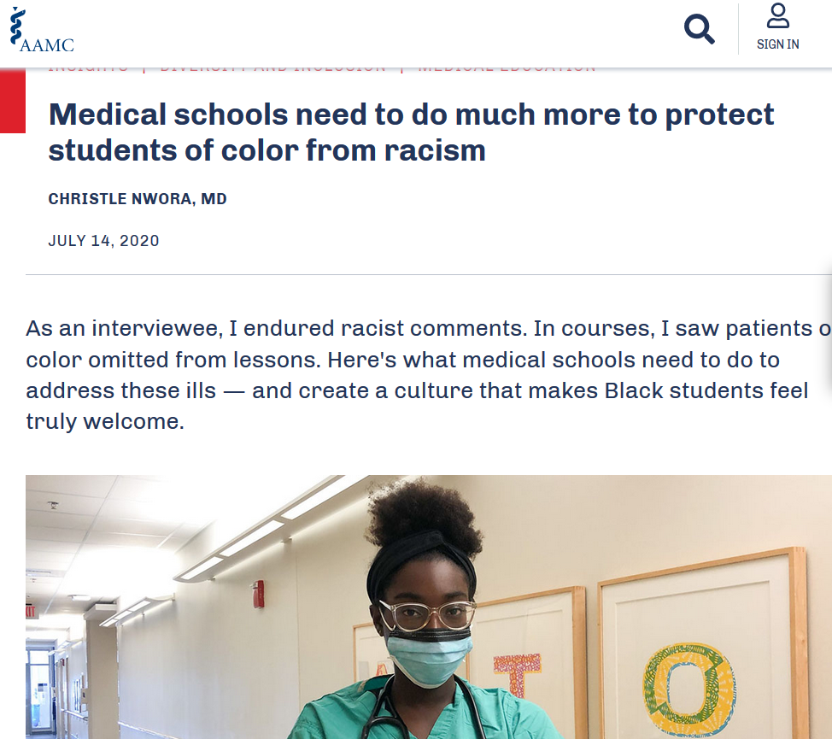

Slide 12
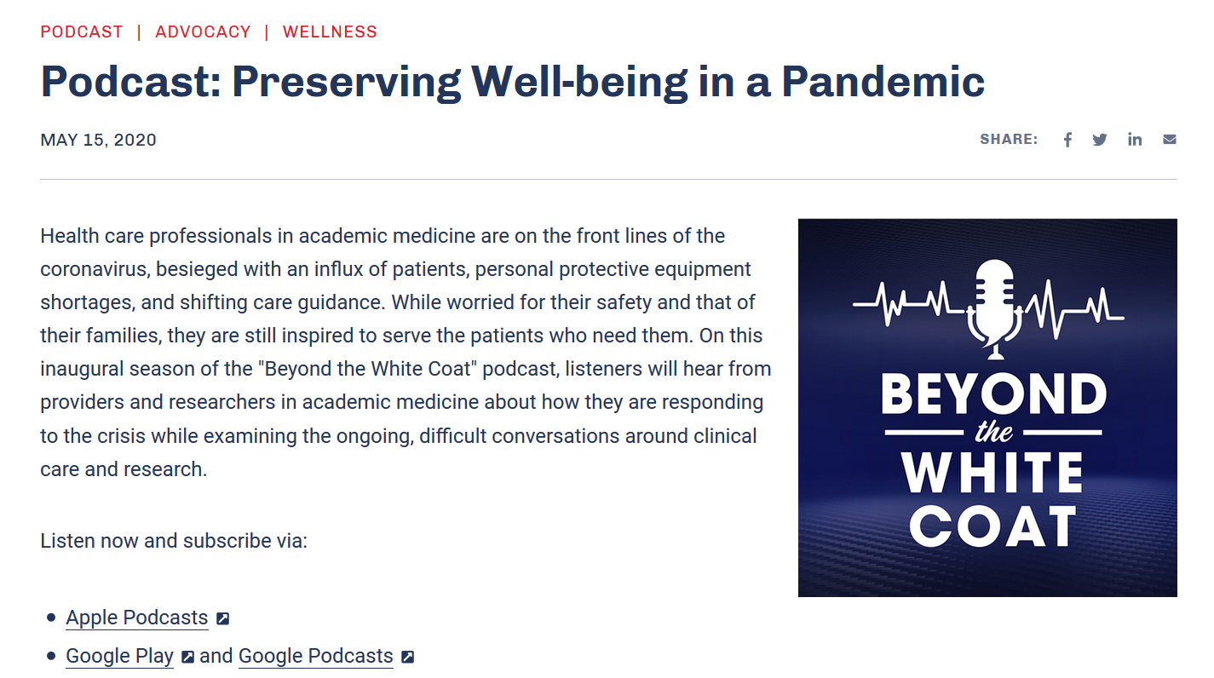
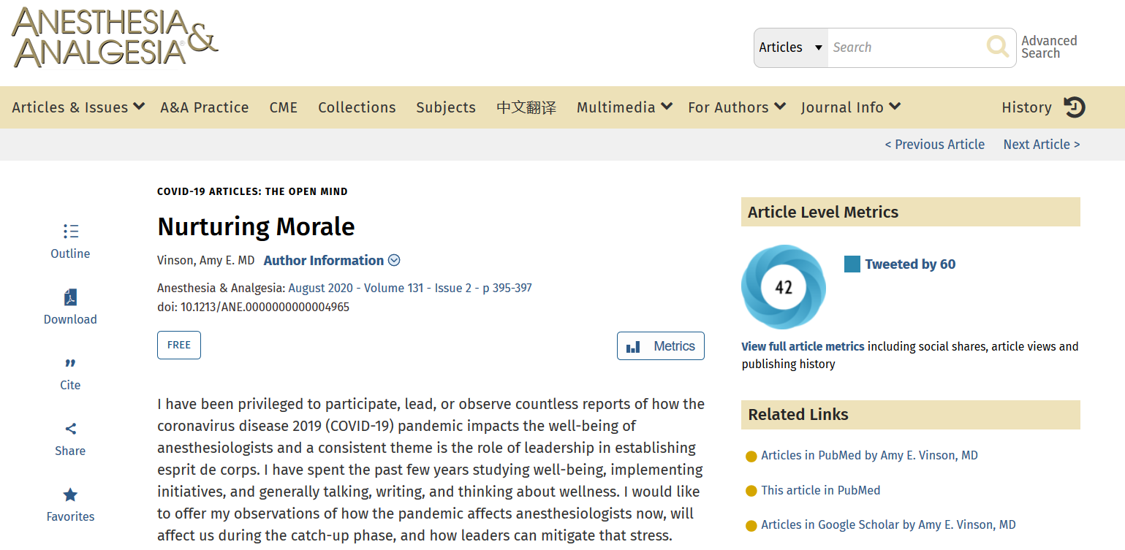
Resources Shared
https://www.aamc.org/news-insights/podcast-preserving-well-being-pandemic?utm_source=twitter&utm_medium=aamctoday&utm_content=075a705a-7790-4382-aa53-650bad4e52d2
https://www.aamc.org/news-insights/medical-schools-need-do-much-more-protect-students-color-racism
https://journals.lww.com/anesthesia-analgesia/pages/articleviewer.aspx?year=2020&issue=08000&article=00012&type=Fulltext

Slide 13
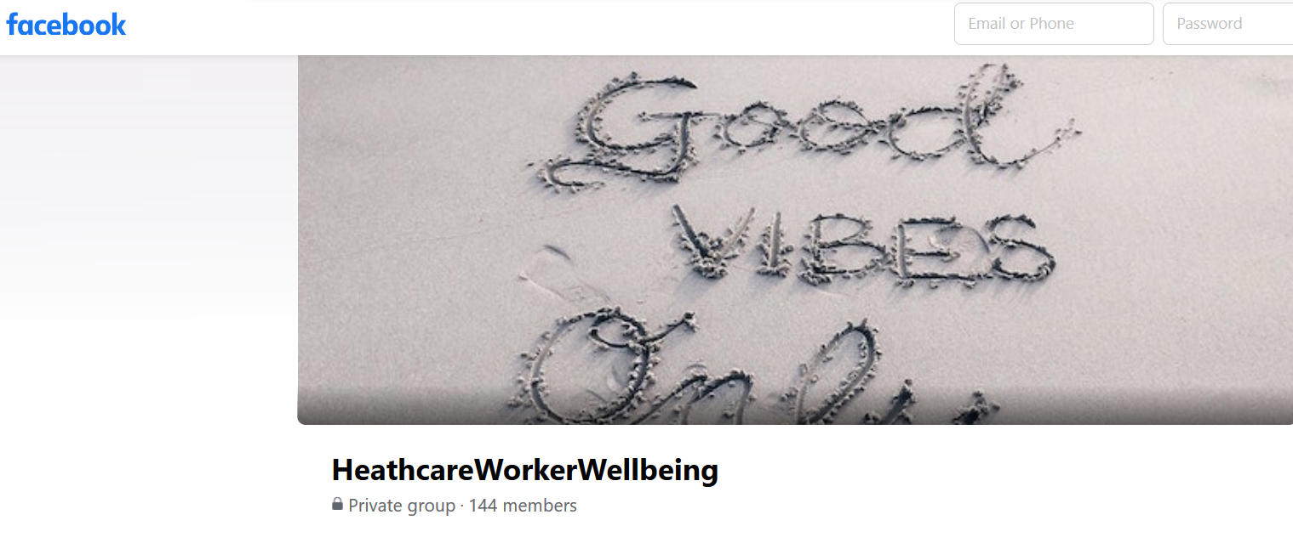
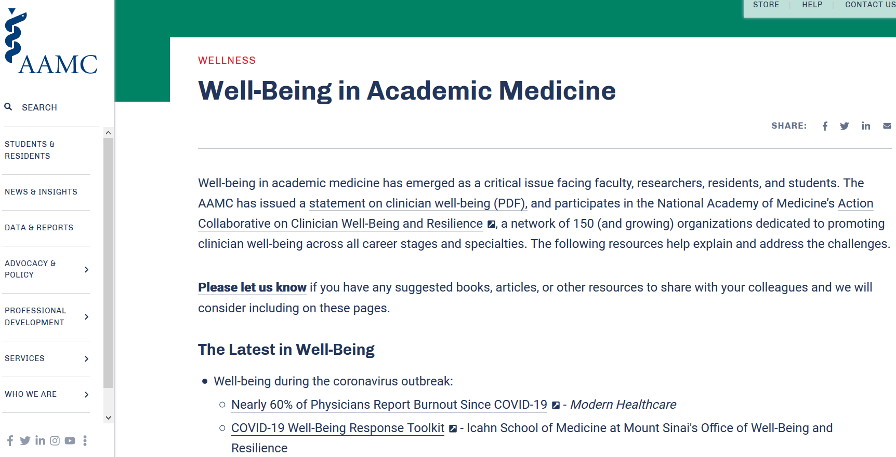
Resources Shared
https://www.aamc.org/covidroadmap/roadmap
https://www.facebook.com/groups/heathcareworkerwellbeing/
https://www.aamc.org/news-insights/wellbeing/faculty

