Slide 1
CFAS August, 27, 2020 Virtual Business Meeting
Please mute your line and shut off your video to avoid latency during the WebEx.
If you want to ask a question, please type your name in the chat box and you will be called on to ask your question in the order your name appears. You can also email questions to Alex Bolt at abolt@aamc.org.
During the Q&A and comments periods, unmute your line when called to ask your question.
If you are experiencing technical problems with WebEx, please email Victor Lainez at vlainez@aamc.org.
Notes:
This slide will be shown on the screen as people enter the webex

Slide 2
CFAS Business Meeting
Gabriela Popescu, PhD
CFAS Chair
August 27, 2020

Slide 3
Welcome!
How will this WebEx meeting proceed?
Who will be presenting?
How can CFAS reps interact today?
Notes:
Gabriela’s intro: Welcome to the CFAS Business meeting. We only have an hour and there’s lots to go over, so before we get started, I just wanted to go over a few quick ground rules. To keep the line open and clear, please mute your audio and your video feed. I will be presenting with CFAS colleagues including Adi Haramati, CFAS Chair-elect, Scott Gitlin, CFAS Immediate Past Chair, and Eric Weissman of the AAMC. At the end of each section, we’ll have a Q&A period where you can enter your name in the chat box and we’ll then unmute you so you can ask your question or make your comment. Also feel free to use the chat function to enter comments and ideas during the meeting. We’ll save all the comments you make here.

Slide 4
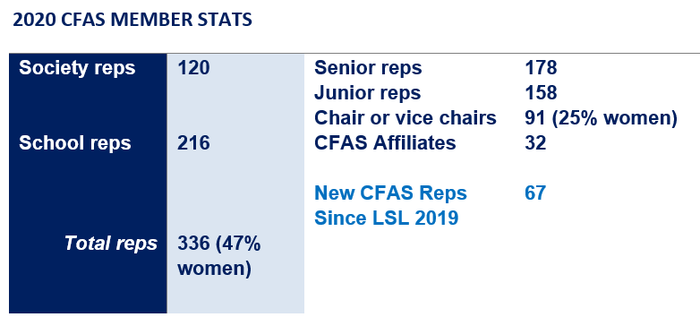
CFAS Demographics
Notes:
First, this is our traditional update about our representatives… [this slide will be filled out by Friday]

Slide 5
Board of Directors Update
How has the AAMC Board of Directors been engaged over the past several months?
How has the AAMC responded to the COVID-19 pandemic and the related crises in academic medicine?
How can CFAS play a role in shaping our direction and next steps?
Notes:
GP’s BOD update

Slide 6
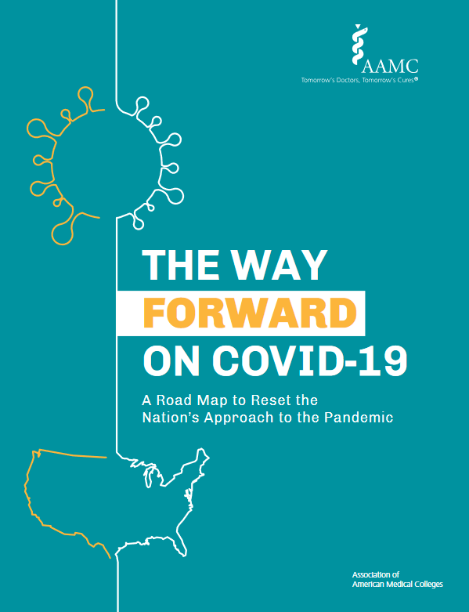
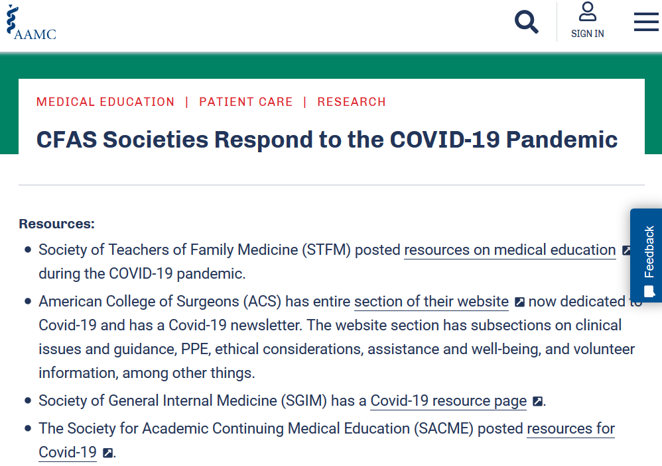
AAMC and CFAS Respond to the Pandemic
AAMC released The Way Forward On COVID-19: A Road Map to Reset the Nation’s Approach to the Pandemic
AAMC Research and Action Institute released Consensus Guidance on Face Coverings
CFAS published a webpage that curated member societies’ responses to the pandemic
CFAS committees are actively planning how to move their work forward in virtual formats

Slide 7
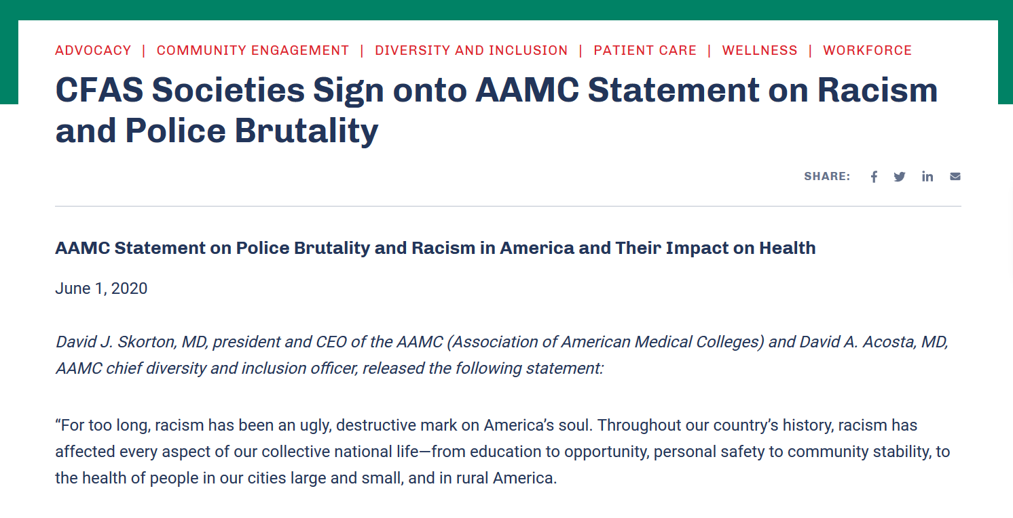
AAMC and CFAS Address Racism and Police Brutality
The AAMC responded to racial violence with a statement and call to action against police brutality and racism in America
More than 30 CFAS societies and other organizations signed onto the statement, and 34 others shared their own statements – all were published on the CFAS website
MedEdPORTAL, a peer-reviewed AAMC online learning resource, published a collection on anti-racism in medicine

Slide 8
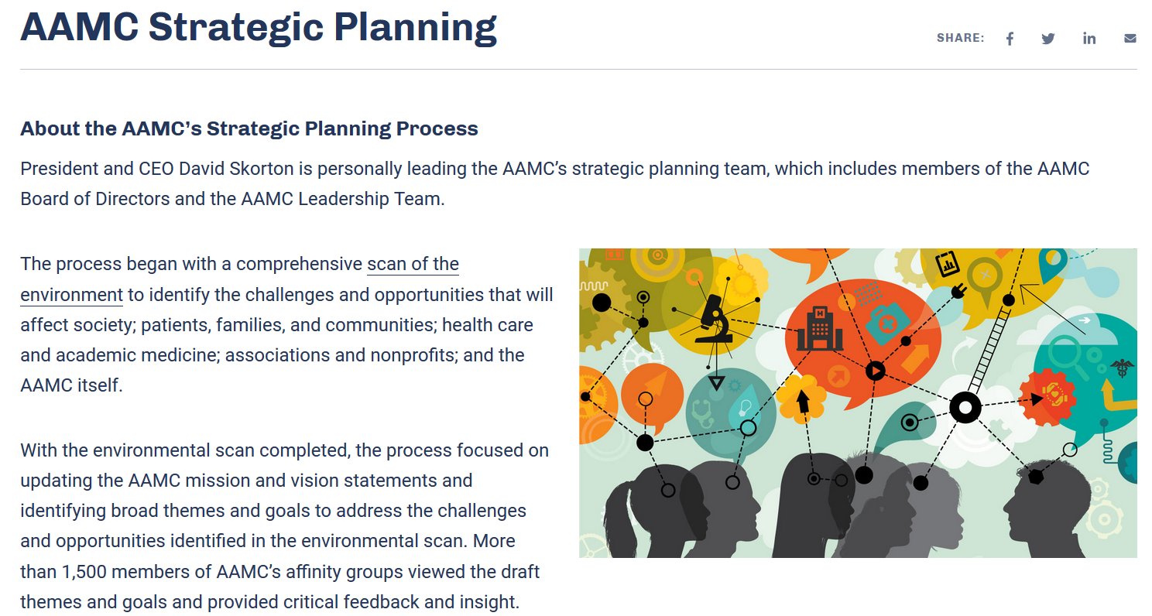
AAMC Strategic Planning Update
Well underway before the pandemic and the protests over racism captured the attention of the academic medicine community, the AAMC strategic plan has now been adapted to comprehensively address both topics and their intersections of long-standing health inequities in America
10 action plans are being modeled and drafted by teams of AAMC staff. As those plans crystalize, CFAS will restart its work on a strategic planning process to align the council with the AAMC’s goals.

Slide 9
CFAS Society Sign-on Letters
So far this year, CFAS distributed 6 AAMC advocacy sign-on letters to member societies and the most recent letter received 16 signatories. Topics include:
NIH funding
DACA health profession
VA research funding
Funding for HRSA Titles VII and VIII Programs
ASAE's Request to Include 501(c) Organizations in COVID-19 Stimulus
GME funding advocacy

Slide 10
CFAS Business Meeting – AAMC Update
Eric Weissman
Senior Director, CFAS Engagement
August 27, 2020

Slide 11
AAMC Update
AAMC cancelation of in-person meetings and professional development
Learn Serve Lead 2020 plans
Decision to waive member society dues for FY2021
AAMC response to MCAT safety concerns
CFAS communication channels
Questions/concerns? Email Eric at eweissman@aamc.org

Slide 12
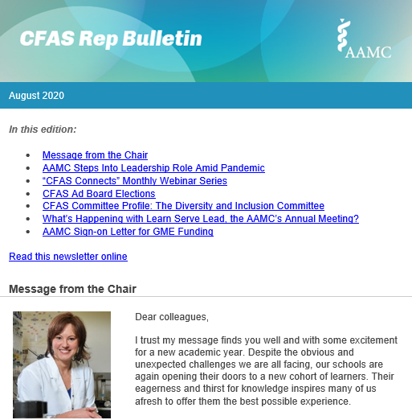
CFAS Rep Bulletin
This year, we relaunched the quarterly CFAS Rep Update as a monthly publication, the CFAS Rep Bulletin.
Open rates ~36%

Slide 13
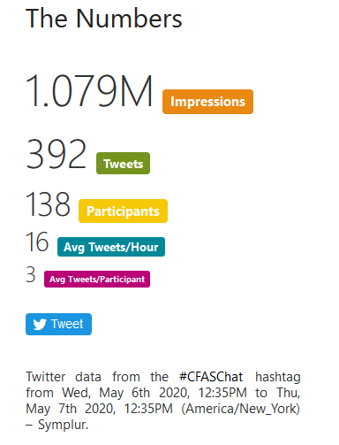
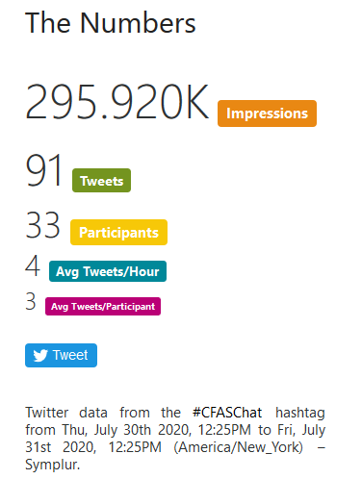
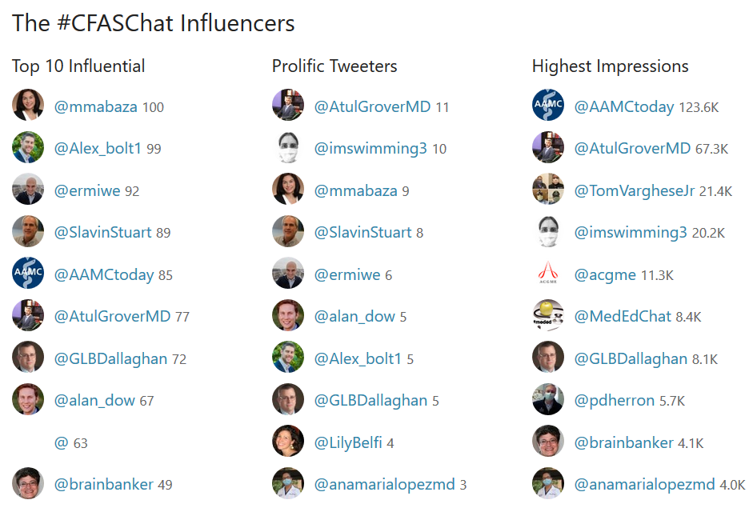
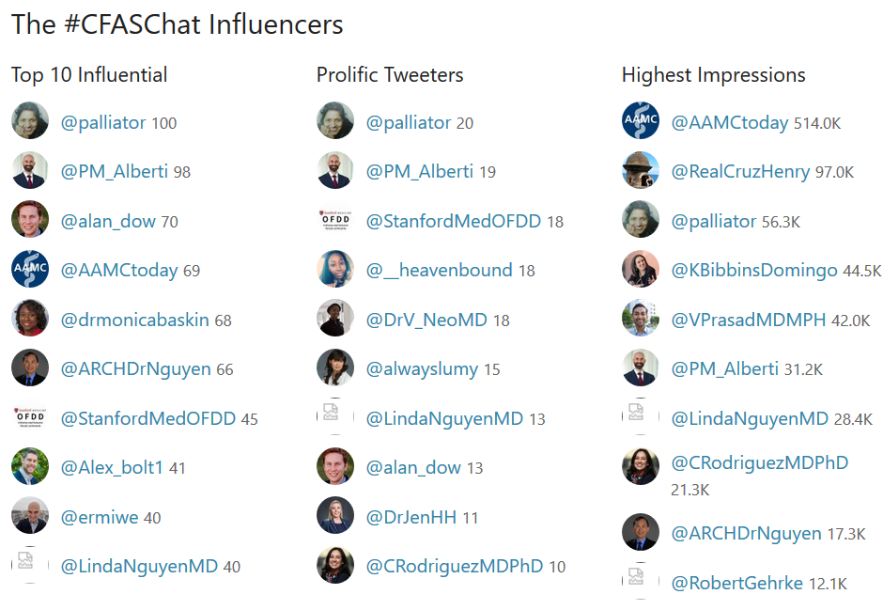
CFAS Tweet Chats
So far this year, CFAS has hosted two Tweet Chats.
Topics included:
COVID-19 Health Disparities
Well-Being in Academic Medicine

Slide 14
CFAS Business Meeting – Program Committee Update
Aviad “Adi” Haramati, PhD
CFAS Chair-elect, Program Committee Chair
August 27, 2020

Slide 15
What Is CFAS Connects?
A monthly forum where we are seeking to:
Engage and connect with CFAS reps
Bring your issues to the forefront of AAMC concerns
Provide professional development on key topical areas
Provide a forum for discussion and knowledge sharing
Work together through a collectively difficult time

Slide 16
CFAS Connects Monthly Forum Series
The CFAS Program Committee developed programming open to everyone in the CFAS community. This CFAS Business Meeting is the first in the series.
WebEx conferences will be alternated monthly by day (Wednesdays and Thursdays) but all will be in a 60-minute slot from 3–4 p.m. ET.
Some sessions will be Webinars others will be a Community Forum moderated by one of the CFAS Committees. The sessions will be recorded.
All future dates and times will be emailed to CFAS reps at a later time.

Slide 17
What Topics Should We Cover?
The CFAS Program Committee has several topics of interest including:
How faculty are facing challenges during the pandemic
The path forward on racism and gender equity at AHCs
Social Justice and the mission of medical school
USMLE Step 1: perspectives from UME, GME and NBME
Please use the chat box in your WebEx screen view to enter topics you’d like us to explore in CFAS Connects.
Email your ideas to haramati@georgetown.edu.

Slide 18
CFAS Business Meeting – Nominating Committee Update
Scott D. Gitlin, MD
CFAS Immediate Past Chair
August 27, 2020

Slide 19
Role of the Nominating Committee
Maintain leadership continuity for CFAS
Ensure CFAS leadership reflects values of the organization
Manage open nomination/self-nomination process each year
Identify new CFAS Administrative Board Members each year
Identify a new CFAS Chair-elect every other year

Slide 20
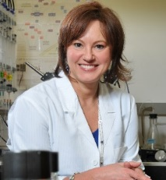
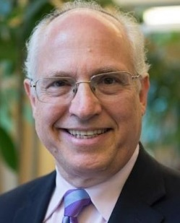
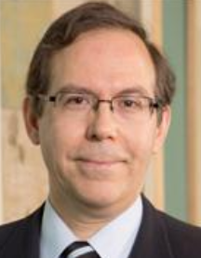
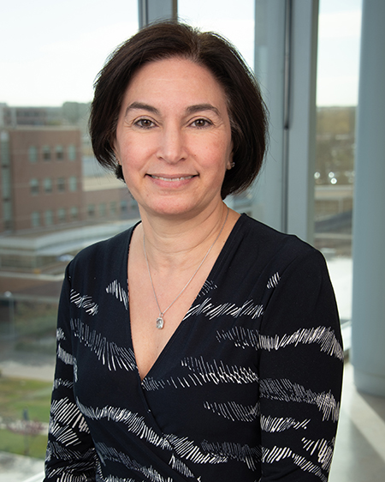
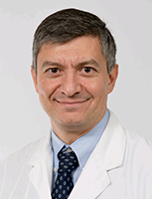
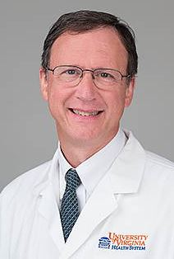
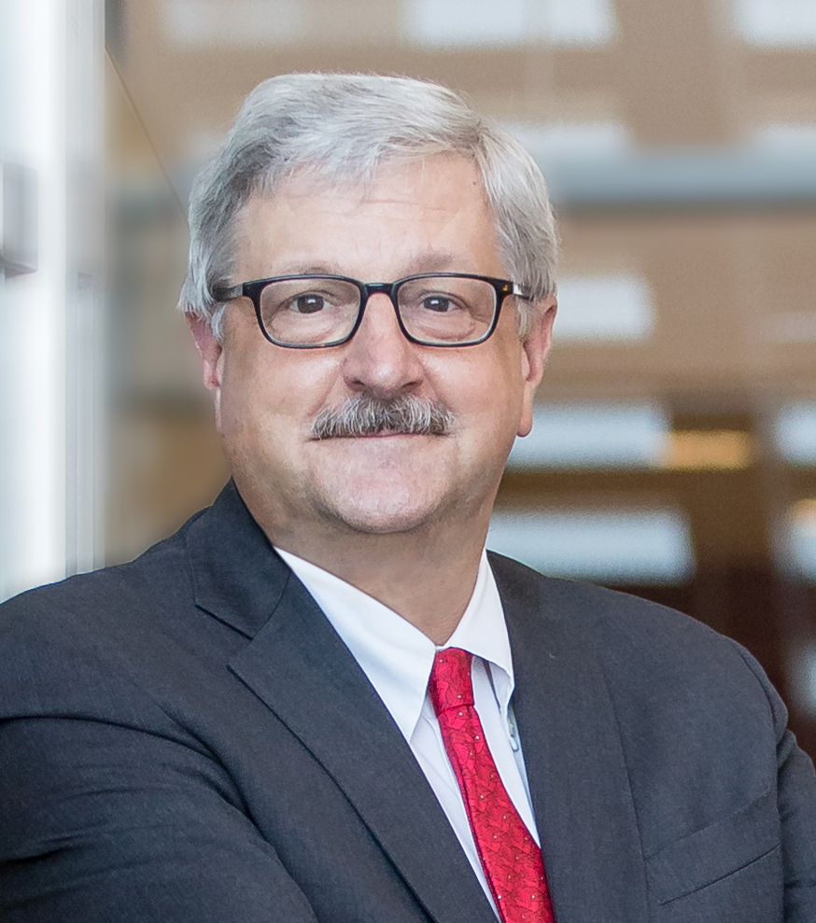
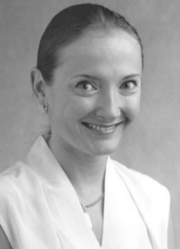
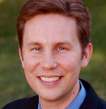
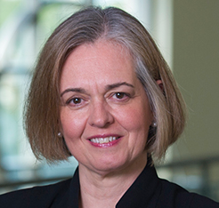
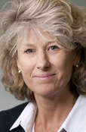
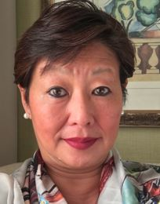
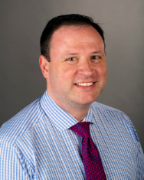
CFAS Administrative Board Elections
Current CFAS Administrative Board
(members in potential transition highlighted)
Gabriela Popescu, PhD, Chair
Aviad “Adi” Haramati, PhD, Chair-elect
Scott D. Gitlin, MD, Immediate Past Chair
Mona Abaza, MD
Nita Ahuja, MD
Steven Angus, MD
Stewart Babbott, MD
Arthur Derse, MD, JD
Vera Donnenberg, PhD
Alan W. Dow, III, MD
Richard L. Eckert, PhD
Elza Mylona, PhD (Ex-Officio GFA Chair-elect)
VJ Periyakoil, MD
Catherine Pipas, MD
Lumy Sawaki Adams, MD
J. David Warren, PhD

Slide 21
Members Rotating Off
Thank You!
Mona Abaza, MD, MS
Senior CFAS Rep for the Society of University Otolaryngologists
J. David Warren, PhD
Junior CFAS Rep for Weill Cornell Medicine

Slide 22
Proposed Members for Reappointment
Nita Ahuja, MD
Senior CFAS Rep for the Yale University School of Medicine
Arthur Derse, MD, JD
Senior CFAS Rep for the Association of Bioethics Program Directors

Slide 23
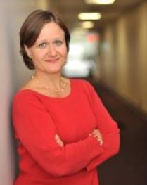
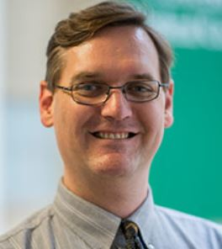
Proposed New Members
Serina Neumann, PhD
Senior CFAS Rep for Eastern Virginia Medical School
Adam Franks, MD
Senior CFAS Rep for the Marshall University Joan C. Edwards School of Medicine

Slide 24
Proposed New Administrative Board
Gabriela Popescu, PhD, Chair
Aviad “Adi” Haramati, PhD, Chair-elect
Scott D. Gitlin, MD, Immediate Past Chair
Steven Angus, MD
Stewart Babbott, MD
Arthur Derse, MD, JD
Vera Donnenberg, PhD
Nita Ahuja, MD
Alan W. Dow, III, MD
Richard L. Eckert, PhD
Adam Franks, MD
Elza Mylona, PhD (Ex-Officio GFA Chair-elect)
Serina Neumann, PhD
VJ Periyakoil, MD
Catherine Pipas, MD
Lumy Sawaki Adams, MD

Slide 25
Online Election Deadline: August 19, 2020
Votes to approve the slate: 120
Votes against the slate: 2
Reps that chose to abstain: 5
New Administrative Board will be seated in November 2020, at the conclusion of Learn Serve Lead, the AAMC Annual Meeting

Slide 26
What’s Next for the Nominating Committee?
Fall 2020:
Call for new CFAS Administrative Board members
Call for new CFAS Chair-Elect
Call for new CFAS Nominating and Engagement Committee members (term limited, appointed positions)
Spring 2021:
Election of CFAS reps to fill new positions
Fall 2021:
New CFAS Administrative Board members and new CFAS Chair-elect seated

Slide 27
What’s Next for CFAS?
CFAS Connects Programming
Re-engaged CFAS Committee Activity
Initiatives we adopt from your input
Planning for CFAS Spring Meeting
Notes:
Gabriela takes the helm from Scott

Slide 28
Your Questions and Thoughts
Q&A
Please type your name in the chat box and we will call on you, ask you to unmute, and ask your question.
You also may email questions to Alex Bolt at abolt@aamc.org
Technical problems with WebEx? Email Victor Lainez at vlainez@aamc.org.

Slide 29
Contacting CFAS
Eric Weissman Senior Director, Faculty and Academic Society Engagement AAMC (202) 828-0044 eweissman@aamc.org
Stephen Barry CFAS Engagement Specialist AAMC 202-828-1127 sbarry@aamc.org
Alexander Bolt CFAS Communications Specialist AAMC 202-739-2976 abolt@aamc.org

