Slide 1
Using MCAT Data in 2024 Medical Student Selection
Online Resource for Medical School Admissions Officers
1

Slide 2
Agenda
The MCAT exam: What does it measure and how is it scored?
Best practices in interpreting MCAT scores
How medical schools use MCAT scores and other application data in holistic admissions
Value of MCAT scores and undergraduate GPAs in predicting medical student performance
Q&A
©2023. May not be reproduced without permission.
Notes:
In this presentation, we will be discussing the MCAT exam, how to interpret MCAT section and total scores, how medical schools use MCAT scores along with other application data in holistic admissions, and validity evidence on MCAT scores, along with undergraduate GPAs, in predicting medical student performance.

Slide 3


Check out the MCAT Resource Hub for Admissions Officers at aamc.org/mcatadmissions for more resources and data for using MCAT scores in admissions.
A sample of the resources available on the Resource Hub is shown on the next slide.
©2023. May not be reproduced without permission.
3
Notes:
The MCAT Resource Hub for Admissions Officers provides admissions officers with resources and data for using MCAT scores in admissions.

Slide 4


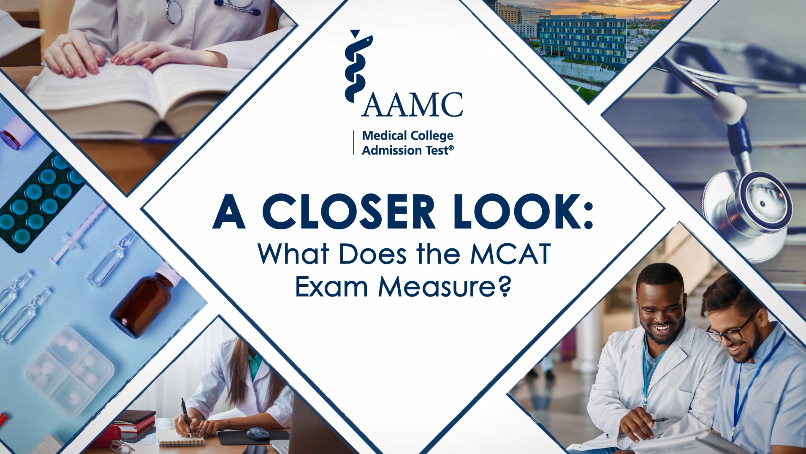
MCAT Resource Hub for Admissions Officers
Admitting Diverse Classes: Strategies, Barriers, and Possibilities for Using MCAT Scores in Context (2021 Learn Serve Lead)—Promising practices from three medical schools
MCAT Admissions Insights series—Highlights from the 2021 MCAT Admissions Officer Survey about diversity and use of MCAT scores
A Closer Look: MCAT Microlearning Video Series—Resources to help admissions officers and their admissions committees understand the MCAT exam and score use
©2023. May not be reproduced without permission.
4
Notes:
A variety of digital resources can be found on the MCAT Resource Hub for Admissions Officers.

Slide 5
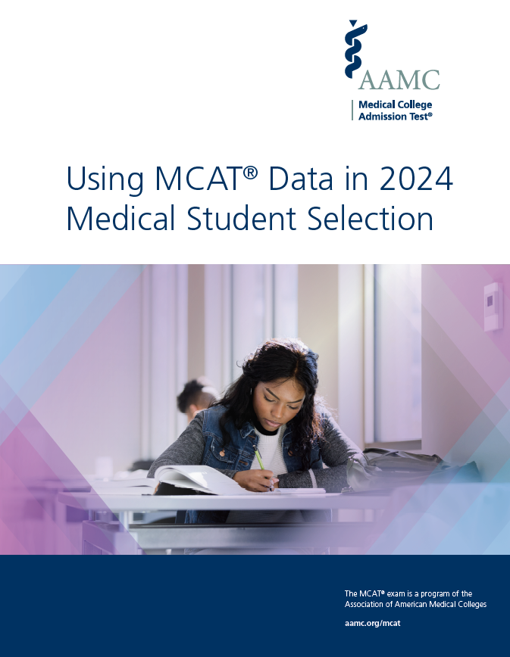
See the new guide to Using MCAT® Data in 2024 Medical Student Selection for more details about the MCAT exam and the MCAT validity research.
aamc.org/newmcatguide
©2023. May not be reproduced without permission.
Notes:
In June 2023, the AAMC released the new guide to Using MCAT Data in 2024 Medical Student Selection.
The guide provides current information and data about the MCAT exam to help admissions officers and their committees make informed decisions about applicants’ academic readiness for medical school.
Throughout the presentation, the button with the guide icon in the upper right corner of the slide provides a hyperlink to the guide with page numbers of the relevant section and additional information when available.

Slide 6
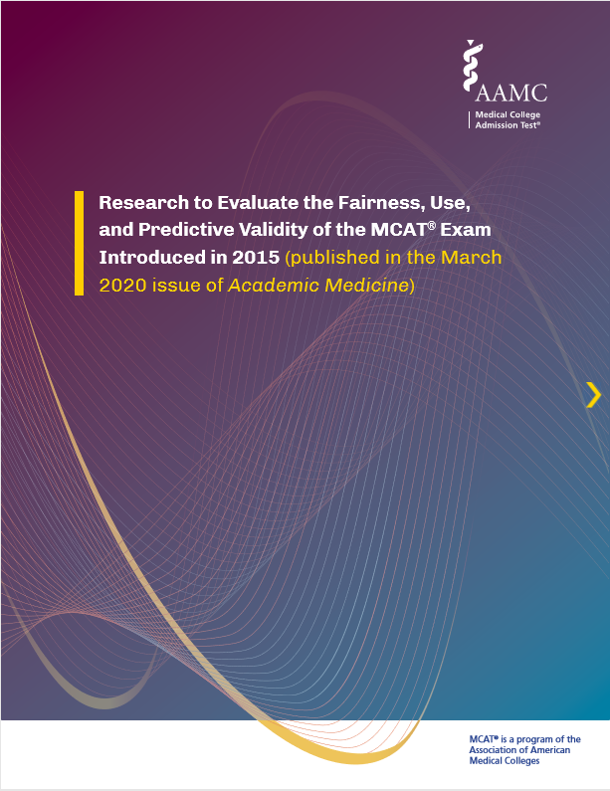
Collection of Academic Medicine publications
Busche K, Elks ML, Hanson JT, et al. The validity of scores from the new MCAT exam in predicting student performance: results from a multisite study. Acad Med. 2020;95:387-395.
Girotti JA, Chanatry JA, Clinchot DM, McClure SC, Swan Sein A, Walker IW, Searcy CA. Investigating group differences in examinees’ preparation for and performance on the new MCAT exam. Acad Med. 2020;95:365-374.
Swan Sein A, Cuffney F, Clinchot DM. How to help students strategically prepare for the MCAT exam and learn foundational knowledge needed for medical school. Acad Med. 2020;95:484.
Terregino CA, Saguil A, Price-Johnson T, Anachebe NF, Goodell K. The diversity and success of medical school applicants with scores in the middle third of the MCAT score scale. Acad Med. 2020;95:344-350.
Lucey CR, Saguil A. The consequences of structural racism on MCAT scores and medical school admissions: the past is prologue. Acad Med. 2020;95:351-356.
Schwartzstein RM. Leveraging the medical school admissions process to foster a smart, humanistic, and diverse physician workforce. Acad Med. 2020;95:333-335.
www.aamc.org/mvc2020articles
©2023. May not be reproduced without permission.
©2021. May not be reproduced without permission.
Notes:
To further support admissions officers and their committees, the AAMC published a compilation of Academic Medicine articles based on research conducted by the MCAT Validity Committee (MVC).
The MVC's research is focused on evaluating the fairness, use, and predictive validity of the new MCAT exam. For more information about the MVC, visit the “MCAT Validity Research” section on the MCAT Resource Hub for Admissions Officers.
This collection of Academic Medicine articles is available in a booklet at www.aamc.org/mvc2020articles.

Slide 7
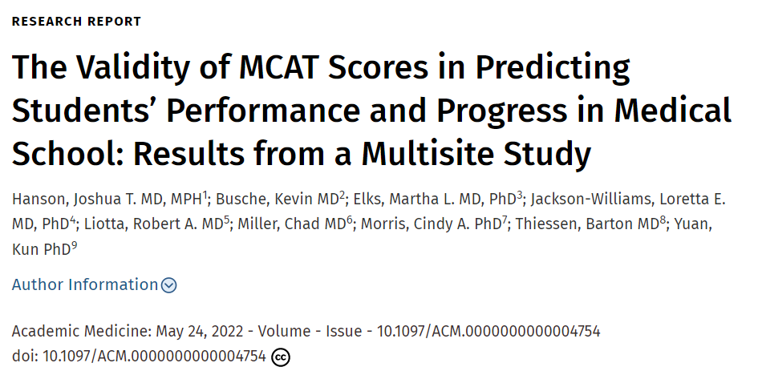
Additional MVC research article in Academic Medicine
Read the 2022 article published by the AAMC MCAT Validity Committee examining the predictive validity of MCAT scores and undergraduate GPAs for performance in preclerkship and clerkship courses, on USMLE Step 1 and Step 2 CK exams, and students’ progress in medical school.
©2023. May not be reproduced without permission.
©2021. May not be reproduced without permission.
Notes:
A May 2022 MVC research article published in Academic Medicine by Hanson, et al., reports the results of a multisite investigation of the predictive validity of MCAT scores and undergraduate GPAs for performance in preclerkship and clerkship courses and on the Step 1 and Step 2 CK examinations. The article also studies students’ progress in medical school. The results demonstrate that MCAT scores add value to the prediction of medical student performance and progress and that applicants from different backgrounds who enter medical school with similar ranges of MCAT scores and undergraduate GPAs perform similarly in the curriculum.
The Validity of MCAT Scores in Predicting Students’ Performance and Progress in Medical School: Results from a Multisite Study
Hanson, Joshua T. MD, MPH¹; Busche, Kevin MD²; Elks, Martha L. MD, PhD³; Jackson-Williams, Loretta E. MD, PhD⁴; Liotta, Robert A. MD⁵; Miller, Chad MD⁶; Morris, Cindy A. PhD⁷; Thiessen, Barton MD⁸; Yuan, Kun PhD⁹
Academic Medicine
Published online ahead of print May 24, 2022
doi: 10.1097/ACM.0000000000004754
https://doi.org/10.1097/ACM.0000000000004754

Slide 8
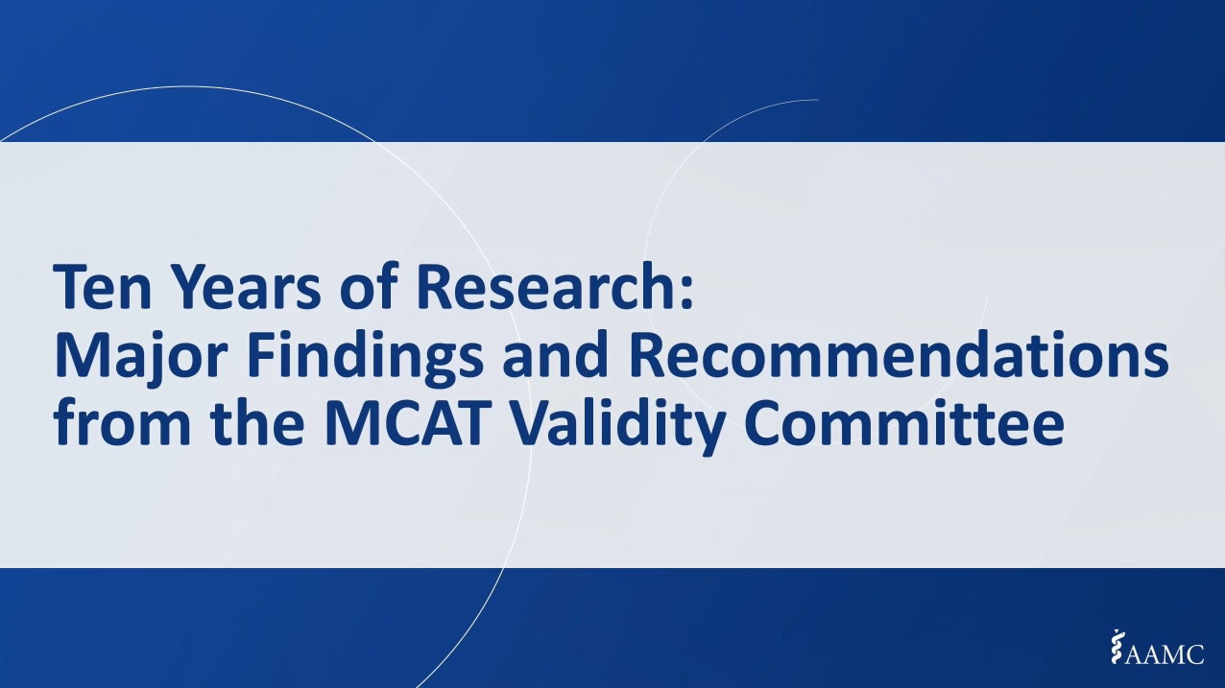
Ten Years of Research: Major Findings and Recommendations from the MCAT Validity Committee
Learn more about the MCAT Validity Committee’s research on diversity, fairness, and academic preparation, admissions decision-making, and predicting academic performance. View this four-part video series at aamc.org/services/mcat-admissions-officers/mvcvideos.
©2023. May not be reproduced without permission.
©2021. May not be reproduced without permission.
Notes:
A four-part video series summarizing the MCAT Validity Committee’s research on diversity, fairness, and academic preparation, admissions decision-making, and predicting academic performance is available on the MCAT Resource Hub for Admisisons Officers.
aamc.org/services/mcat-admissions-officers/mvcvideos

Slide 9
The MCAT Exam: A Measure of Academic Readiness for Medical School
©2023. May not be reproduced without permission.

Slide 10
Successful medical school applicants demonstrate multiple core competencies
Pre-professional competencies
Service orientation
Social skills
Thinking & reasoning competencies
Critical thinking
Scientific inquiry
Science competencies
Cultural competence
Teamwork
Oral communication
Ethical responsibility
Reliability & dependability
Resilience & adaptability
Capacity for improvement
Quantitative reasoning
Written communication
Living systems
Human behavior
©2023. May not be reproduced without permission.
Notes:
Successful applicants to medical school demonstrate multiple competencies. Many needed competencies are about how applicants relate to, work with, and respect others as well as their reliability, resilience, ethical responsibility, and capacity for improvement. Applicants must also demonstrate thinking and reasoning and science competencies – many of which are measured by the MCAT exam.
The MCAT exam measures the concepts and reasoning skills that are building blocks for learning in medical school about the science and practice of medicine.
*****Background notes***********
References include:
Association of American Medical Colleges. https://www.aamc.org/services/admissions-lifecycle/competencies-entering-medical-students.
Schwartzstein RM, Rosenfeld GC, Hilborn R, Oyewole SH, Mitchell K. Redesigning the MCAT exam: balancing multiple perspectives. Acad Med. 2013;88(5);560-567.

Slide 11

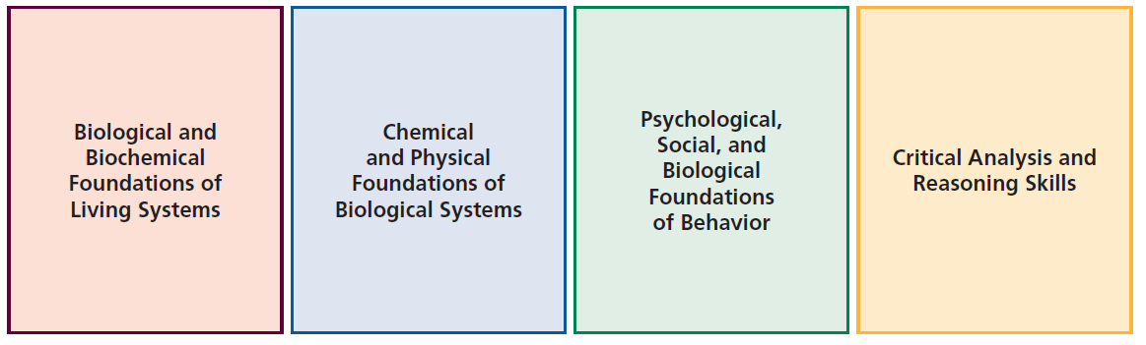
The MCAT exam includes four sections that test thinking and reasoning and science competencies
See pg. 2
Living Systems
Human Behavior
Quantitative Reasoning, Scientific Inquiry
Critical Thinking
©2023. May not be reproduced without permission.
Notes:
Through four MCAT sections, applicants demonstrate critical thinking, quantitative reasoning, and scientific inquiry skills, as well as their mastery and ability to work with information in the natural, behavioral, and social sciences – that is, about living systems and human behavior. These concepts and reasoning skills were identified by medical school faculty and others as essential for entering students to be ready for the rigors of medical school (described in the Schwartzstein article).
The MCAT exam has four sections:
Biological and Biochemical Foundations of Living Systems
Chemical and Physical Foundations of Biological Systems
Psychological, Social, and Biological Foundations of Behavior
Critical Analysis and Reasoning Skills
The two natural sciences sections and the behavioral and social sciences section test 10 foundational concepts and four scientific inquiry and reasoning skills that are the building blocks for learning in medical school. These sections ask test takers to combine their knowledge of concepts from courses in first-semester biochemistry, psychology, and sociology and year-long courses in biology, chemistry, and physics with their scientific inquiry and reasoning skills to solve problems presented in passages and test questions. The resulting scores provide information about applicants’ readiness to learn in medical school.
The Critical Analysis and Reasoning Skills section tests how well test takers comprehend, analyze, and evaluate what they read, draw inferences from text, and apply arguments to new ideas and situations. The passages are drawn from the humanities and social sciences.

Slide 12
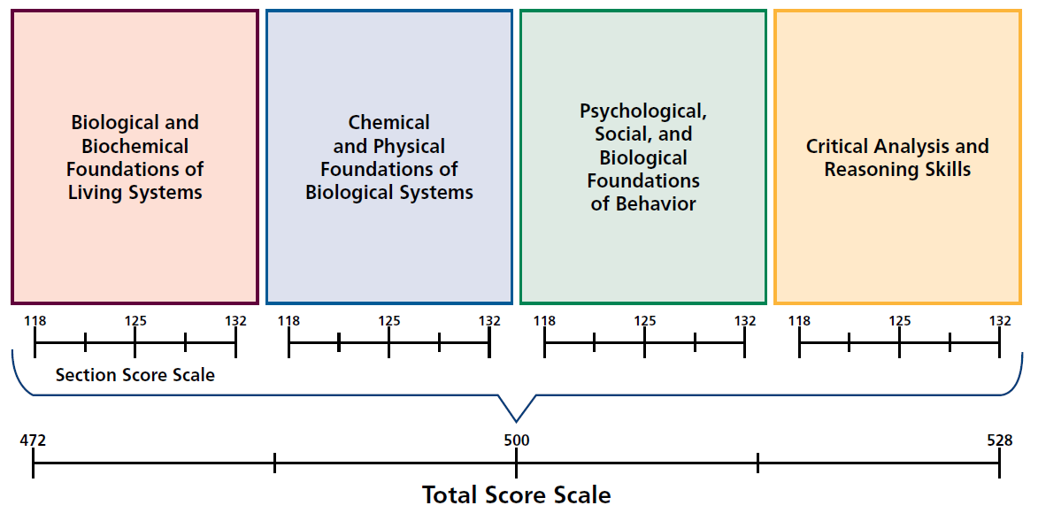
The MCAT total score is the sum of the four section scores
See pg.4
©2023. May not be reproduced without permission.
12
Notes:
Scores on the four sections of the exam are reported on numeric scales centered at 125 and ranging from 118 to 132.
Scores from the four sections are summed to produce a total score centered at 500 and ranging from 472 to 528.
The MCAT score scales draw attention to the center of the scales to encourage admissions committees to consider applicants with a wide range of scores.

Slide 13
Best Practices in Interpreting MCAT Scores
©2023. May not be reproduced without permission.

Slide 14
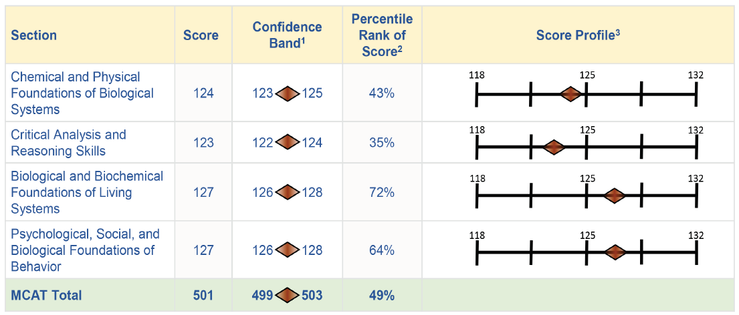
Confidence bands, percentile ranks, and score profiles help understand an applicant’s scores
See pg. 9
©2023. May not be reproduced without permission.
Notes:
Four types of information are essential for interpreting MCAT scores:
Total and section scores
Confidence bands
Percentile ranks associated with the scores
Score profile
This figure shows a replica of an examinee’s score report that includes these four components. We will walk through each component in more detail next.

Slide 15
Confidence bands provide information about the precision of each score
1.9"
See pg. 9
©2023. May not be reproduced without permission.
Notes:
As with any other test scores, MCAT scores are not perfectly precise. The confidence bands around test scores mark the ranges in which the test taker’s true scores probably lie. The diamond shape shows the confidence band graphically and indicates that the reported score is the best estimate of an applicant’s true score. The reported score is in the center of the diamond, where the diamond is the tallest and the shading is the darkest.
For the four sections, non-overlapping confidence bands show a test taker’s likely strengths and weaknesses. Overlapping confidence bands suggest that there are not meaningful differences in performance between sections.

Slide 16
Confidence bands remind admissions committees not to overemphasize small differences in scores
The confidence band shows how much confidence we have in the precision of each MCAT score
  MCAT total scores are reported with a confidence band of plus or minus two points
  MCAT section scores are reported with confidence bands of plus or minus one point
  Considering applicants’ scores AND their confidence bands will show why small differences in MCAT scores should not be overinterpreted
See pg. 10
©2023. May not be reproduced without permission.
Notes:
Every score has some uncertainty; random fluctuations might boost it a little higher on one day, and lower it a little on a different day. The confidence band provides important information about score accuracy and helps you judge the zone of confidence in the score.
Confidence bands help admissions officers and their committees avoid overweighing small differences in scores.
The confidence band, plus or minus two, applies to every total score. Examinees who test on different days all have scores with comparable accuracy and the same confidence bands.
It’s really important to review every score with its confidence band so that you don’t overweigh small differences in scores.

Slide 17
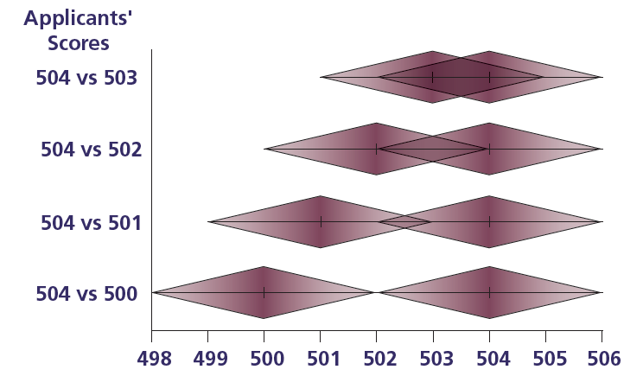
The closer two applicants’ scores are, the more their confidence bands overlap
4 plausible values in common
3 plausible values in common
2 plausible values in common
1 plausible value in common
©2023. May not be reproduced without permission.
Notes:
The closer two applicants’ scores are, the more their confidence bands overlap.
As shown in this figure, scores that are only one point apart have four overlapping scores between their confidence bands, whereas scores that are four points apart only have one overlapping score between their confidence bands.

Slide 18
Percentile ranks show how an applicant’s scores compare to other test takers' scores
See pg. 11
See pg. 10
©2023. May not be reproduced without permission.
Notes:
The percentile ranks for the total and section scores show how the scores of individual applicants compare with the scores of others who took the exam.
The percentile ranks show the percentages of test takers who received the same or lower scores on the exam.
Every year on May 1, the percentile ranks for MCAT scores are updated using data from the previous three administration years. This is a common practice in the standardized test industry to ensure that percentile ranks reflect current information about examinees’ scores. Because examinees change from one year to the next, the percentile ranks associated with scale scores may change over time. Basing the percentiles on data from three administration years instead of one year makes the results more stable, but it doesn’t prevent year-to-year changes.
The current percentile ranks are based on data from 2020, 2021, and 2022.

Slide 19
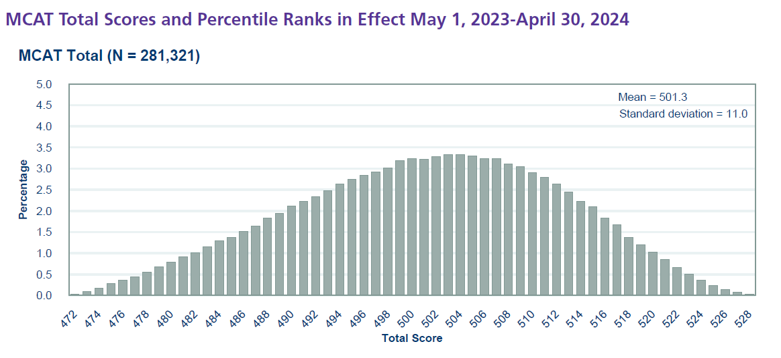
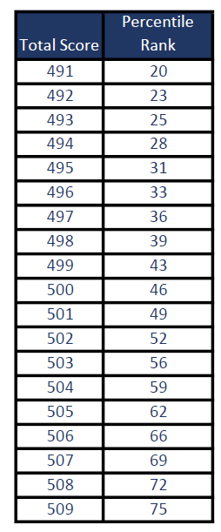
Percentile ranks show how an applicant's scores compare to other test takers' scores
See pg. 44
©2023. May not be reproduced without permission.
Notes:
The column labeled “Percentile Rank” provides the percentage of scores equal to or less than each score point. These percentile ranks are based on all MCAT results from the 2020-2022 testing years combined. For example, 49% of MCAT total scores were equal to or less than 501 across all exams administered in 2020, 2021, and 2022.
Updates to the percentile ranks are made on May 1 each year based on exams administered in the three most recent test administration years.

Slide 20
Score profiles highlight applicants' strengths and weaknesses across the four sections of the exam
See pg. 11
©2023. May not be reproduced without permission.
Notes:
The MCAT score profile highlights applicants’ strengths and weaknesses across the four sections of the exam through reported scores for each section.
This figure from the score report illustrates the score profile associated with an applicant’s MCAT section scores. Applicants’ strengths and weaknesses on the exam can be considered along with other information about their academic preparation (e.g., coursework and grades) and in relation to institutional missions and goals.

Slide 21
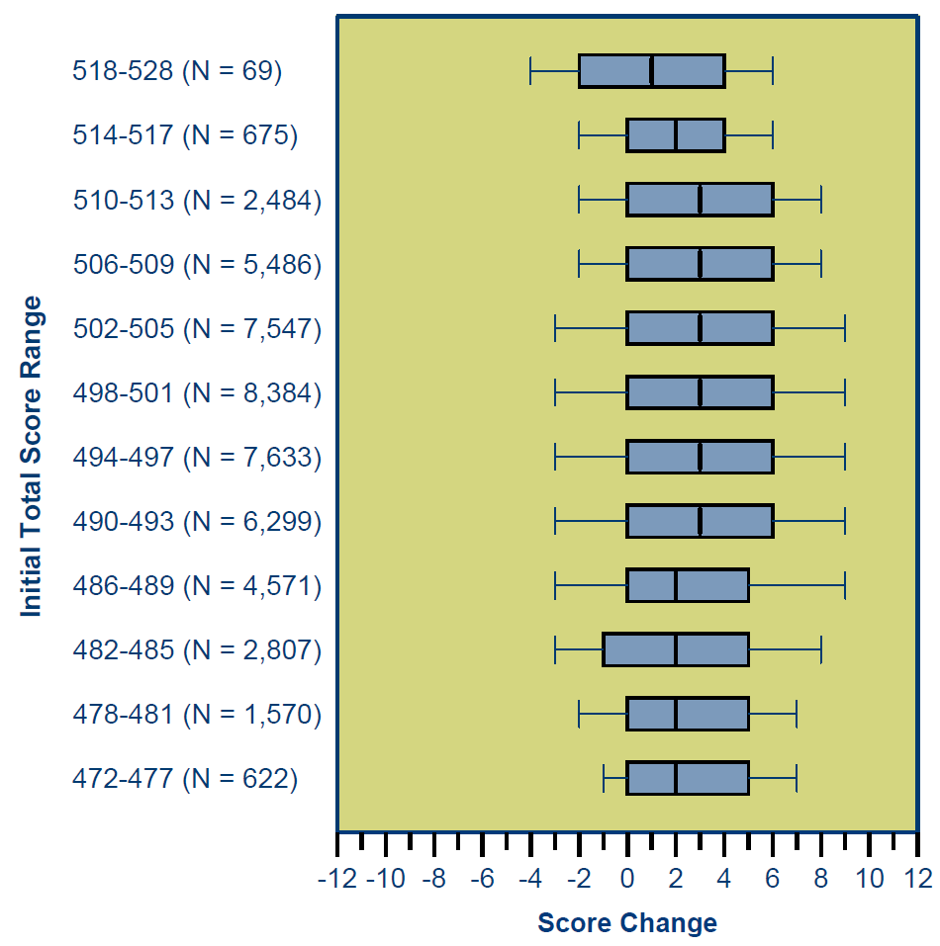

Schools use different approaches to work with the MCAT scores from examinees who test more than once
Most examinees take the exam one or two times
The typical gain is 2 to 4 points
Schools use it in these ways:
  The most recent scores
  The highest total scores
  Average total scores across administrations
  Triangulate with other academic preparation records
See pg. 12
©2023. May not be reproduced without permission.
Notes:
The figure on this slide uses box-and-whisker plots to show the distributions of score gains (and losses) on examinees’ second attempts at the exam, by their first-attempt scores.
The data show that retesters across a wide range of scores tend to obtain higher scores on their second exams.
This figure shows that the median gain was generally two to three score points for examinees who tested a second time and whose first-attempt scores were between 472 and 517. For examinees whose initial scores were between 518 and 528, the median gain was one point.
AAMC conducted a survey of admissions officers in 2017 to learn how they use MCAT scores and other information in medical student selection. The survey results show that schools used multiple MCAT scores from applicants in different ways:
41% used the most recent scores
39% used the highest total scores
7% averaged total scores across administrations
9% triangulate with other academic preparation records
More than 67% of examinees test only once in their lifetime. About 25% test twice. A small percentage of examinees test more than 2 times (8%-6% test 3 times, and 2% test more than 3 times).
Examinees can take the exam up to 7 times in their lifetimes (and yes, there’s an appeal process). They can take the exam up to 3 times in one calendar year and 4 times across two calendar years. Not showing up for an exam counts as an attempt toward the lifetime limit.

Slide 22
How Medical Schools Use MCAT Scores and Other Application Data in
Holistic Admissions
©2023. May not be reproduced without permission.

Slide 23
MCAT scores should not outweigh other application data
Can
do
Will
do
Should
do
Accept
✓
The MCAT exam measures some, but not all, important premedical academic competencies
MCAT scores are not perfectly precise
MCAT scores reflect the “can do” aspect of admissions decisions
©2023. May not be reproduced without permission.
Notes:
MCAT scores provide a common metric for evaluating the academic preparation of applicants who have different course-taking histories and come from institutions with different curricula and grading standards. But they should not be overvalued in admissions decision making.
Here are some of the reasons why:
Scores from the MCAT exam will measure only a subset of what is needed for medical school. The MCAT exam cannot feasibly measure every premedical academic competency that medical students need, and it may not cover everything needed to succeed at your institution. Missing from the exam, for example, are measures of important skills like synthesis skills and writing skills, which are also critical to students’ success in medical school.
Scores from the MCAT exam are not perfectly precise. The exam does not measure test takers’ achievement with perfect accuracy—test takers’ scores can be reduced by factors like fatigue, test anxiety, and less than optimal test room conditions; or they can be boosted by recent exposure to some of the tested topics. Because MCAT scores are not perfectly precise, it is important not to over-interpret small differences in test scores.
MCAT scores reflect only one source of information about an applicant – their academic readiness. The MCAT doesn’t assess their motivation or resilience, and it doesn’t assess their personal characteristics.

Slide 24
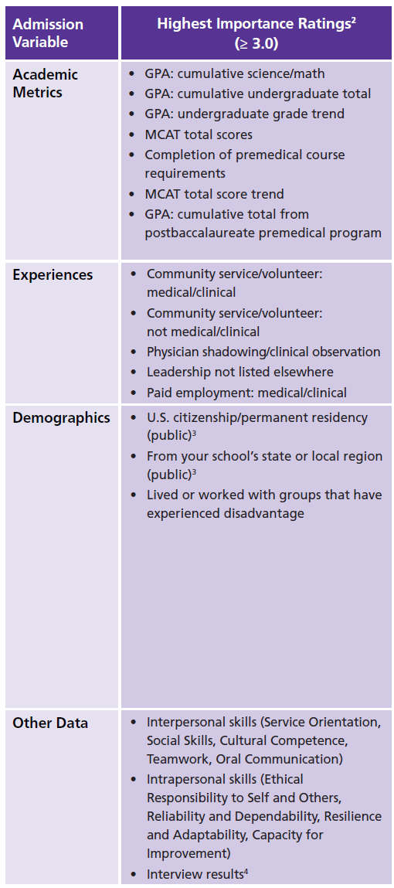
Medical schools use academic metrics, experiences, and attributes holistically
See pg. 15
©2023. May not be reproduced without permission.
Notes:
This table shows a subset of the findings from a 2022 AAMC survey of admissions officers on the importance of different academic metrics, experiences, demographics and other data used in medical student selection. This slide shows the academic metrics, experiences, demographics, and other data that received the highest mean importance ratings – either important or very important. Page 15 of the guide also shows data on the types of information that received medium and low mean importance ratings.
Admissions officers find a number of academic metrics important – undergraduate GPA (total and science/math), MCAT total scores, upward or downward undergraduate grade trends, and performance in a post-bac program. These data suggest that MCAT scores are triangulated with other academic data to evaluate an applicant’s readiness for medical school.
Healthcare experience, community service/volunteer experience, and leadership experience were among the most important types of experiences.
Finally, for demographic information, public schools rated U.S. citizenship/permanent residence and state/local regional residency as important, and both public and private schools rated experience living or working with disadvantaged groups as important.
In total, these survey findings suggest that MCAT scores are important, as are so many other academic, experiential, and demographic data.

Slide 25
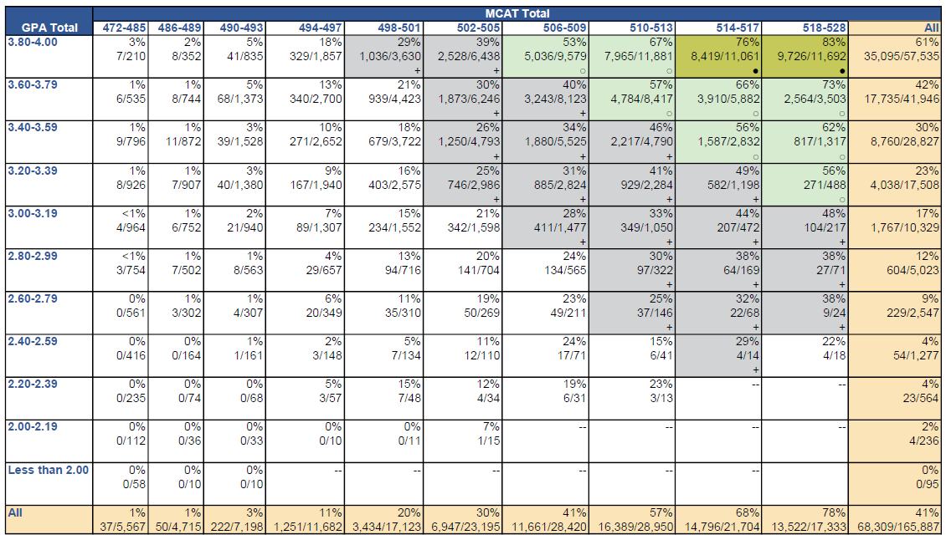
Admissions committees used holistic review practices to put MCAT scores in context
See pg. 16
See pg. 17
Percentage and Number of 2020, 2021 and 2022 Applicants Accepted Into at Least One Medical School, by MCAT Total Score and Undergraduate GPA Ranges
25
©2023. May not be reproduced without permission.
Notes:
We know that holistic review practices are alive and well. Medical schools are doing a good job at contextualizing MCAT scores.
Data on this slide show how admissions committees used holistic review practices in 2020, 2021, and 2022 medical student selection to put academic metrics in context.
This table shows the relationships between undergraduate GPAs, MCAT scores, and the likelihood of acceptance into one or more medical schools. It shows the percentages of applicants with different undergraduate GPAs and MCAT scores who were accepted into one or more medical schools in the 2020, 2021, and 2022 admissions cycles.
The columns show MCAT total score ranges from low to high as you read from left to right. And the rows show undergraduate GPA ranges, from high to low as you move down the table.
The top right corner shows acceptance rates in dark green shading: these are MCAT score and GPA ranges with acceptance rates greater than or equal to 75%. The light green shading shows acceptance rates of 50-74%. The gray shading shows acceptance rates of 25-49%.
Technical Notes
Dark green shading (●) = acceptance rates ≥ 75%.
Light green shading (○) = acceptance rates of 50–74%.
Grey shading (+) = acceptance rates of 25–49%.
Dashes = cells with fewer than 10 observations; blank cells = cells with zero observations.
For students who took the new MCAT exam multiple times, the most recent new MCAT total score was used in this analysis.
This table summarizes data for 2020, 2021, and 2022 applicants who reported MCAT scores from the current exam and undergraduate GPAs (N = 165,887).

Slide 26
Some applicants with high UGPAs and MCATs are not accepted
17% of applicants with GPAs at or above 3.8 and MCAT scores at or above 518 were not admitted into any medical schools
See pg. 16
Percentage and Number of 2020, 2021 and 2022 Applicants Accepted Into at Least One Medical School, by MCAT Total Score and Undergraduate GPA Ranges
26
©2023. May not be reproduced without permission.
Notes:
These data show that admissions committees used MCAT scores and undergraduate GPAs in balanced ways in 2020, 2021, and 2022 selection. They show that, while undergraduate GPAs and MCAT total scores are important factors in admissions, they are not the sole determinants of admissions decisions. ​
​
Some 2020, 2021, and 2022 applicants with strong academic metrics didn’t get any acceptances. For example, 17% of applicants with undergraduate GPAs of 3.8 or higher and MCAT total scores of 518 or above were rejected by all the medical schools to which they applied. ​
​
​

Slide 27
Other applicants with modest credentials are accepted
See pg. 16
Percentage and Number of 2020, 2021 and 2022 Applicants Accepted Into at Least One Medical School, by MCAT Total Score and Undergraduate GPA Ranges
15% of applicants with GPAs 3.00-3.19 and MCAT scores
498-501 were admitted into at least one medical school
27
©2023. May not be reproduced without permission.
Notes:
In comparison, about 15% of applicants with undergraduate GPAs of 3.0 to 3.19 and MCAT total scores ranging from 498 to 501 were accepted into medical school.​
​
When taken together, these survey data and acceptance data show that putting MCAT scores and undergraduate GPAs in the context of applicants’ lived experiences helps schools identify the applicants who will contribute to their mission and goals.​
​
Every year, applicant and acceptance data show that schools put MCAT scores and undergraduate GPAs in context. Some applicants with the highest MCAT scores and undergraduate GPAs receive no acceptance offers, and others with more modest MCAT scores and undergraduate GPAs receive at least one acceptance.​
​
However, as a community we know there is room to improve these practices and further grow the diversity of our medical school classes.​
​

Slide 28
The Value of MCAT Scores and Undergraduate GPAs in Predicting
Medical Student Performance
©2023. May not be reproduced without permission.

Slide 29
Examining the associations of MCAT scores and undergraduate GPAs with medical students’ performance on varied outcomes provides a more complete picture of applicants’ likely success in medical school
There is a strong relationship between MCAT scores and students’ preclerkship, clerkship, and USMLE licensure exam performance.
Some students perform better than their MCAT scores predict, and others perform less well.
Using MCAT total scores and undergraduate GPAs provides better prediction of medical student performance than using either one alone.
Students with a wide range of MCAT scores and undergraduate GPAs pass the Step 1 and Step 2 CK exams on the first attempt, progress to year three on time, and graduate within four or five years.
©2023. May not be reproduced without permission.
Notes:
In the following slides, we present findings related to a range of medical student performance outcomes from entry to medical school through clerkship courses.
Together, the validity findings tell the following story:
• A strong relationship exists between MCAT scores and students’ preclerkship, clerkship, and USMLE licensure exam performance.
• Some students perform better than their MCAT scores predict, and others perform less well than their scores predict.
• Using MCAT total scores and undergraduate GPAs together provides better prediction of medical student performance than using either one alone.
• Students with a wide range of MCAT scores and undergraduate GPAs pass the Step 1 and 2 CK exams on the first attempt, progress to year three on time, and graduate within four or five years.
Technical Notes
The validity research findings presented in the guide come from a research collaborative evaluating the fairness, use, and predictive validity of scores from the MCAT exam introduced in 2015.
Some of the results are summarized at the aggregate school level, and others show what the data look like for individual students. More information about the samples used in each analysis can be found in Table 3 on pg. 18 of the guide.
This research follows two cohorts of students to evaluate how well MCAT scores predict a range of academic outcomes throughout medical school.
Some of the outcomes, such as performance in preclerkship and clerkship courses, come from two cohorts of students admitted with scores from the current MCAT exam who are enrolled in medical schools participating in the research collaborative (i.e., validity schools).
The USMLE Step 1 and Step 2 CK data are for these same cohorts, but they are national from all US MD-granting programs.
Data on graduation within four or five years are also national.

Slide 30
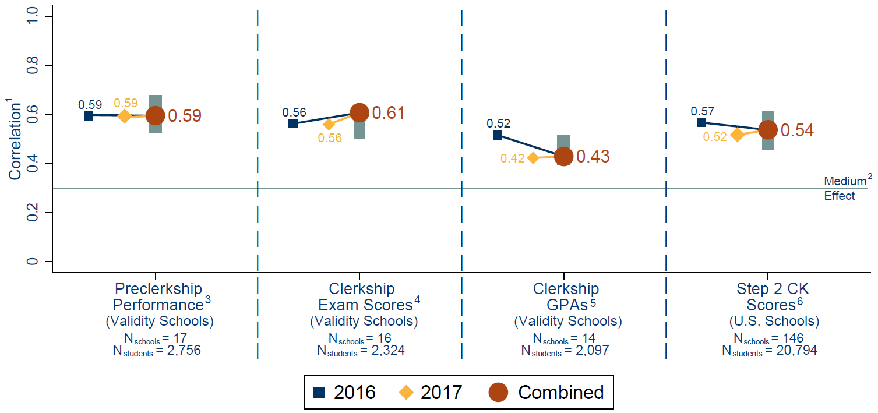
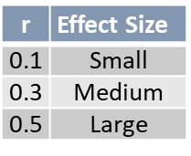

There is a strong relationship between MCAT scores and preclerkship, clerkship, and Step 2 CK performance
Median and interquartile range of correlations of MCAT total scores with students’ preclerkship, clerkship, and Step 2 CK performance
See pg. 20
30
©2023. May not be reproduced without permission.
Notes:
This figure summarizes how well MCAT total scores predict students’ preclerkship performance, clerkship exam scores, clerkship GPAs, and Step 2 CK scores from the first attempt. Corrected correlations between MCAT scores and each medical student performance outcome are computed for each school and then summarized. For each outcome, the median corrected correlation for the 2016 cohort is shown with a square, the median corrected correlation for the 2017 cohort is shown with a diamond, and the median corrected correlation for the two cohorts combined is shown with a circle. The two ends of the gray bar show the correlations for the two cohorts combined at the 25th and 75th percentiles.
This figure illustrates the following findings:
MCAT total scores do a good job of predicting medical students’ preclerkship, clerkship, and Step 2 CK performance — that is, outcomes that measure students’ acquisition and application of medical knowledge during medical school.
The median correlations of MCAT scores with preclerkship, clerkship, and Step 2 CK performance shown in this figure are medium to large.
Prior research has also shown large correlations between MCAT scores and Step 1 performance across cohorts (see Hanson et al., Academic Medicine, 2022).
The difference observed between cohorts for some performance outcomes are small and consistent with prior research.
The variability across schools in the relationship between MCAT scores and students’ performance highlights the importance of studying local validity data so schools can draw conclusions about the ways MCAT scores predict their students’ performance in their local environment.
Although MCAT scores are good predictors of students’ preclerkship, clerkship, and Step 2 CK performance, the strength of prediction varies from one medical school to another.
Technical Notes
Medical students’ most recent MCAT total scores at the time of matriculation were correlated with each performance outcome. Analyses were conducted separately for each school with 30 or more students who have data available for each performance outcome. Sample correlations were corrected for range restriction on MCAT total scores and total undergraduate GPAs due to the selective nature of the admissions process but not for unreliability in MCAT total scores or medical student outcomes. Corrections for range restriction were made at the institution level. At each medical school, the applicants from an admissions cycle served as the reference population. Using established statistical methods, the observed correlations were adjusted to reflect what the correlations would be if there had been no selection — that is, if all applicants had been selected for admission.
According to Cohen (1992), a correlation coefficient of 0.10 is considered a small association in the social sciences; a correlation coefficient of 0.30 is considered a medium correlation; and a correlation of 0.50 or greater is considered a large correlation.
The “Preclerkship Performance” panel shows the median and interquartile range of correlations of MCAT total scores with preclerkship performance at the 17 validity schools. The median correlation of MCAT total scores with students’ preclerkship performance for 2016 is 0.59, for 2017 is 0.59, and for both cohorts combined is 0.59.
The “Clerkship Exam Scores” panel shows the correlations of MCAT total scores with the average clerkship exam scores at 16 validity schools. The median correlation of MCAT total scores with clerkship exam scores for 2016 is 0.56, for 2017 is 0.56, and for both cohorts combined is 0.61.
The “Clerkship GPAs” panel shows the correlations of MCAT total scores with clerkship GPAs at 14 validity schools. The median correlation of MCAT total scores with clerkship GPAs for 2016 is 0.52, for 2017 is 0.42, and for both cohorts combined is 0.43.
The “Step 2 CK Scores” panel shows the correlations of MCAT total scores with Step 2 CK scores at the 146 U.S. MD-granting medical schools with at least 30 students who took the Step 2 CK exam for the first time by summer 2020. The median correlation of MCAT total scores with Step 2 CK scores for 2016 is 0.57, for 2017 is 0.52, and for both cohorts combined is 0.54.

Slide 31
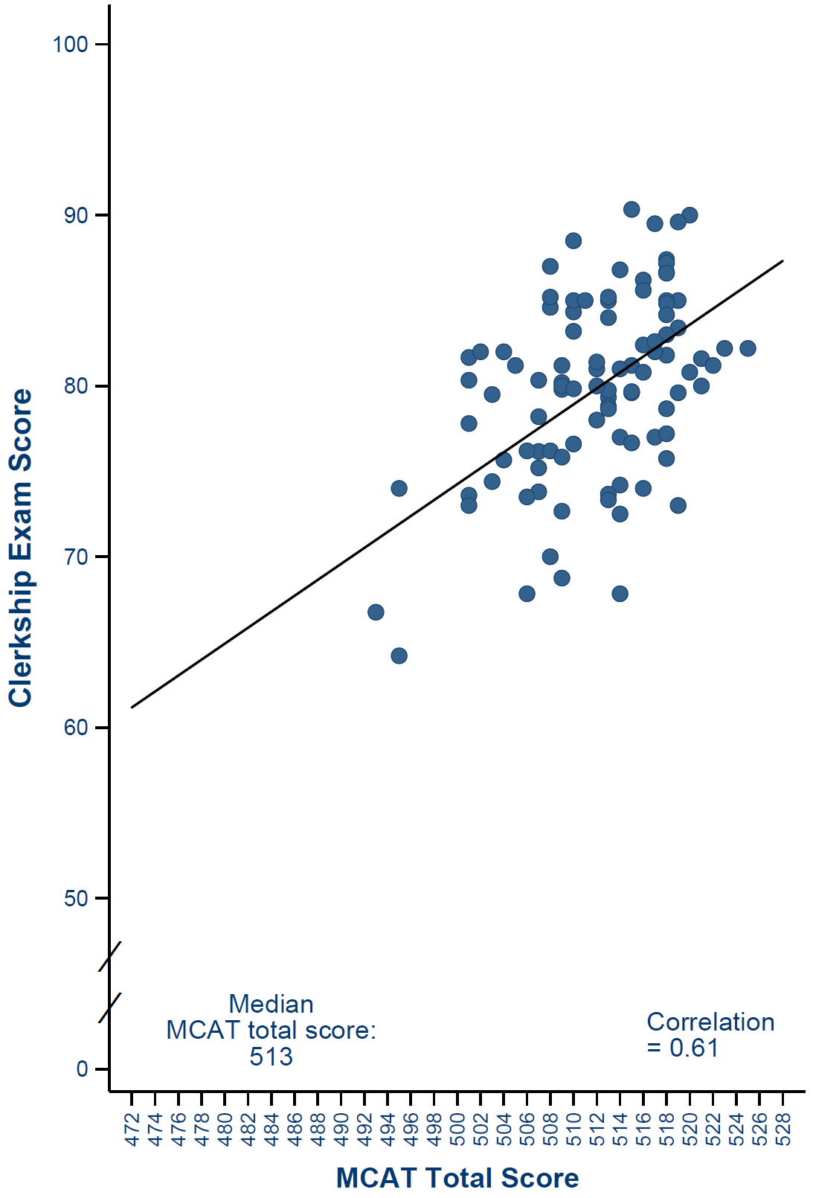
At this validity school, students with higher MCAT scores had higher clerkship exam scores.
Scatter plot of clerkship exam scores by MCAT total score for 2016- and 2017-entering students at one validity school
See pg. 22
At every MCAT total score, some students performed better than expected, and others performed less well.
31
©2023. May not be reproduced without permission.
Notes:
This figure shows how well MCAT total scores predict the clerkship performance of students at a single medical school. It presents a scatter plot that shows the 2016- and 2017-entering students’ MCAT scores against their clerkship exam scores at one of the validity schools. Data from the students at this school can be used to study the association of MCAT scores with clerkship exam scores to illustrate the patterns that may occur at other schools that use similar performance outcomes.
The patterns of dots show three important findings:
First, this validity school accepts students with a wide range of MCAT total scores.
Second, on average, participants admitted with higher MCAT total scores show higher clerkship performance.
Third, there is substantial variability in individual medical student performance. Some students show higher performance in clerkships than others admitted with the same MCAT score, while others show lower performance. Some students admitted with lower MCAT scores outperformed students with higher scores.
Technical Notes
The x-axis shows MCAT total scores from low to high (left to right). The y-axis shows students’ clerkship exam scores on a scale from 0 to 100 (bottom to top). Each dot represents an individual student’s data — the MCAT score he or she was admitted with and his or her average clerkship exam score. The diagonal line shows the estimated relationship of MCAT scores with clerkship exam scores.
The results are for the 98 medical students who entered with scores from this version of the MCAT exam at this validity school in 2016 or 2017 whose clerkship exam scores are available. The median MCAT total score for the students in this analysis is 513 and is based on the most recent score at the time of matriculation. At this validity school, the corrected correlation between MCAT scores and clerkship exam scores is 0.61.

Slide 32
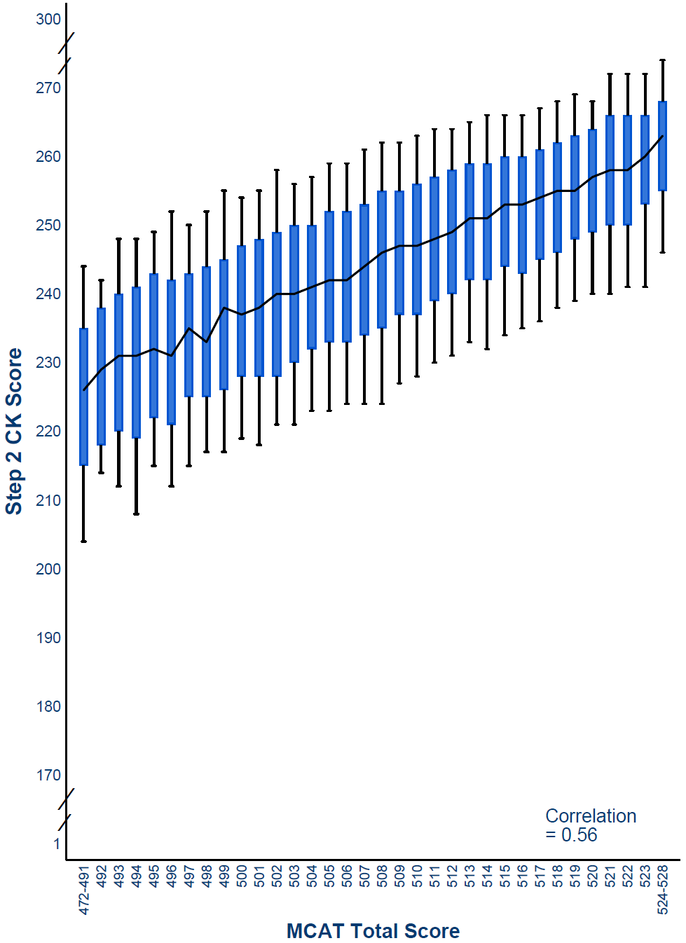
Nationally and on average, students with higher MCAT scores had higher Step 2 CK scores.
Distribution of Step 2 CK scores, by MCAT total score for 2016- and 2017-entering medical students
See pg. 23
32
©2023. May not be reproduced without permission.
Notes:
Let’s look at national data about the association of MCAT scores with Step 2 CK scores. This figure shows the Step 2 CK scores for 23,939 medical students who entered in 2016 and 2017 with current MCAT scores.
The x-axis shows the MCAT total scores, the y-axis shows Step 2 CK scores, and the jagged line shows the median Step 2 CK score for students who entered with each MCAT total score. The number of students with specific score points at each tail is too small to be comparable to those at other points. Therefore, results for students with a MCAT total score in the range of 472-491 are reported together, as are the results for those who scored between 524 and 528.
This slide illustrates the following findings:
Nationally and on average, 2016 and 2017 entrants with higher MCAT scores obtained higher Step 2 CK scores.
This slide suggests that, at a population level, MCAT scores, which reflect students’ foundational preparation in scientific concepts and reasoning skills taught in college, do a good job of predicting their performance on a test that measures students’ ability to apply medical knowledge, skills, and understanding of clinical science acquired during medical school. The slope of the jagged line shows that MCAT total scores are closely correlated with Step 2 CK scores, with a correlation corrected to the national applicant population of 0.56.
But the population trend line does not hold for any individual medical student. This figure also shows the range of Step 2 CK scores (at the 10th and 90th percentiles) for students at each MCAT total score point. The blue vertical boxes show the Step 2 CK scores at the 25th to 75th percentiles, and the black vertical lines show the Step 2 CK scores at the 10th to 25th and 75th to 90th percentiles for students who entered at each MCAT total score.
Taken together, this figure shows that, while MCAT scores show medium to large associations with performance on the Step 2 CK exam, other factors also contribute to performance on the Step exam. Remember, many students take the MCAT exam when they are juniors, and then complete their senior year, followed by more than three years of medical school before taking the Step 2 CK exam. Significant learning happens during these years, students learn at different rates, and their rank order changes over time.
The overall Step 2 CK pass rate for this sample is 99% (23,676/23,939).

Slide 33
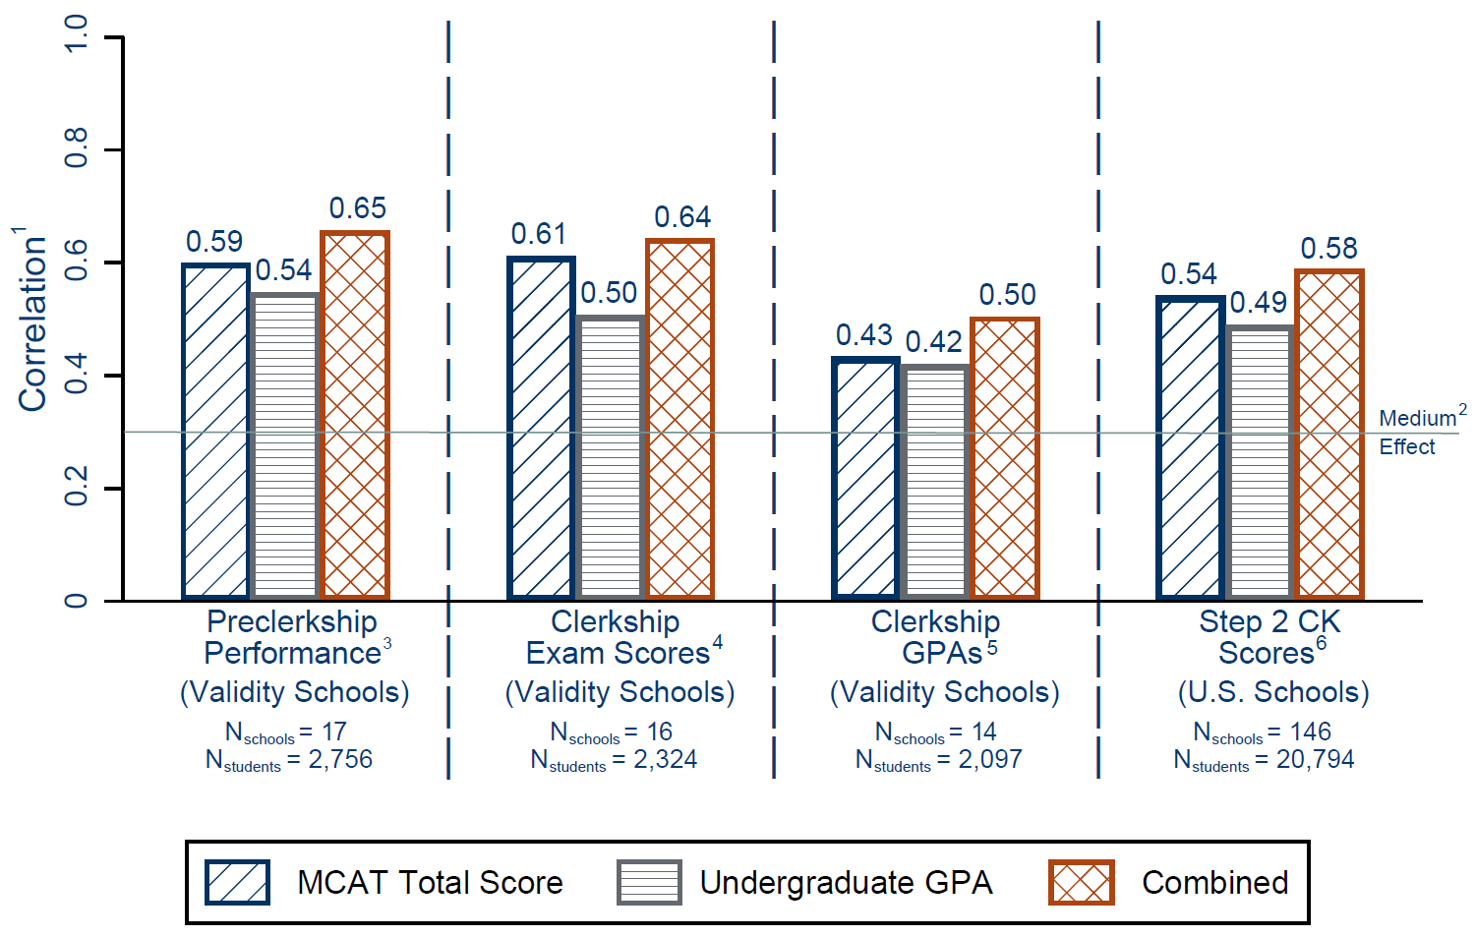
Using MCAT total scores AND undergraduate GPAs better predicts medical student performance than using either one alone
Correlations of MCAT scores and undergraduate GPAs alone and together with preclerkship, clerkship, and Step 2 CK performance: medians across schools.
See pg. 25
33
©2023. May not be reproduced without permission.
Notes:
This slide shows results for four medical student performance outcomes: preclerkship performance, clerkship exam scores, clerkship GPAs, and Step 2 CK scores. The bars on the left (blue) show the median correlation (the correlation at the 50th percentile) of MCAT scores alone with each outcome, the middle bars (gray) show the correlation of undergraduate GPAs alone, and the bars on the right (orange) show the correlations of MCAT scores and undergraduate GPAs combined. The horizontal line at a correlation of 0.3 shows the threshold for a medium effect size in the social sciences.
Overall, this slide reveals three important findings:
Both MCAT scores and undergraduate GPAs are good predictors of students’ performance during medical school. The correlations of MCAT scores and undergraduate GPAs, alone and together, with each medical student performance outcome are medium to large.
For every medical student performance outcome, the median correlations are larger for MCAT scores than for undergraduate GPAs.
Importantly, using MCAT scores and undergraduate GPAs to assess premedical academic readiness predicts future performance in medical school and on the licensing exams better than using either academic metric alone.

Slide 34
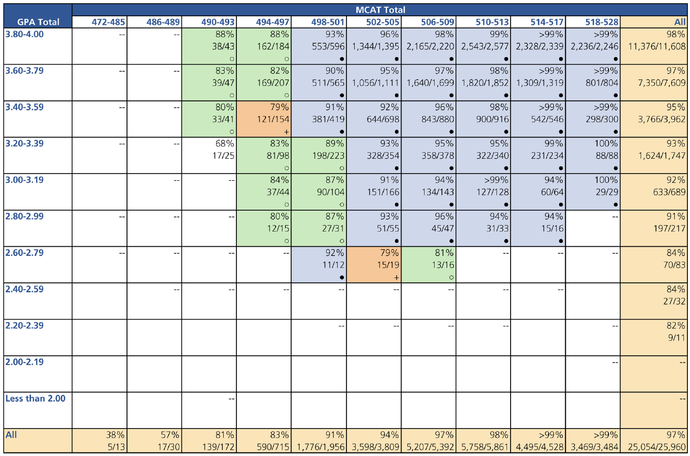
MCAT scores and undergraduate GPAs tell more about students’ Step 1 pass rates on the first attempt
See pg. 27
Percentage and Number of 2016- and 2017-Entering Students Admitted With Scores from the Current MCAT Exam Who Passed the Step 1 Exam on the First Attempt, by MCAT Total Score and Undergraduate GPA Ranges
Blue shading (●) = Pass rates of 90-100%; green shading (○) = Pass rates of 80-89%; orange shading (+) = Pass rates of 70-79%.
©2023. May not be reproduced without permission.
Notes:
This slide shows that together, MCAT scores and undergraduate GPAs provide more information about the success of students with different combinations of academic metrics.
This grid format has been used previously to illustrate a variety of medical school metrics by MCAT total scores and undergraduate GPAs. The columns show MCAT total score ranges, low to high, as you read from left to right. The rows show undergraduate GPA ranges, highest at the top, to the lowest range at the bottom. Students’ most recent MCAT score was used in the analysis.
The Step 1 pass rate is highest in the top right of the figure, where MCAT scores and GPAs are highest. But similar pass rates also appear at ranges for more modest MCAT and GPA ranges. This shows that students admitted with a wide range of academic credentials succeed.
In the cell at the lowest right, we see that overall, 97% of 2016 and 2017 entrants who took the Step 1 exam passed it on the first attempt.
Technical Notes
Each cell shows the percentage of students who passed Step 1 on the first attempt. The cell shading indicates the pass rates at each MCAT/GPA combination.
The blue shading (●) shows pass rates greater or equal to 90%.
The green shading (○) shows pass rates of 80-89%.
The orange shading (+) shows pass rates of 70-79%.
Cells with dashes had fewer than 10 students; blank cells had zero students.

Slide 35
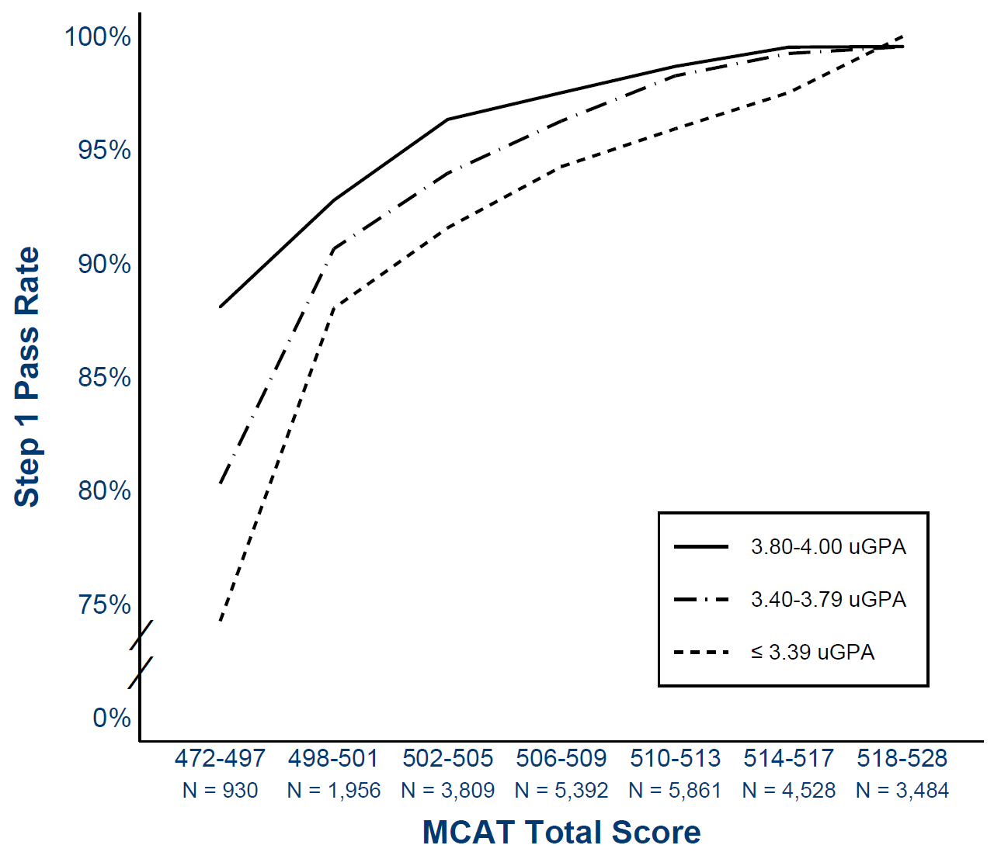
Step 1 pass rates, by MCAT total score and undergraduate GPA ranges
See pg. 26
©2023. May not be reproduced without permission.
Notes:
This slide shows the same data as the previous slide in a different format. Like the previous slide, this slide shows the value of using applicants’ MCAT scores and undergraduate GPAs in admissions decisions.
These data are from the U.S. medical students entering in 2016 and 2017 and took the Step 1 exam (N = 25,960). The lines show the Step 1 pass rate for these students by their most recent MCAT total score at the time of matriculation, grouped by undergraduate GPAs less than 3.40, from 3.40 to 3.79, and greater than or equal to 3.80. Results for students admitted with MCAT total scores from 498 to 517 are grouped in three-point score ranges. Results for students admitted with MCAT total scores from 472 to 497 are reported together, as are the results for those who scored from 518 to 528, because fewer students are admitted with MCAT scores at the bottom and top of the MCAT score scale.

Slide 36
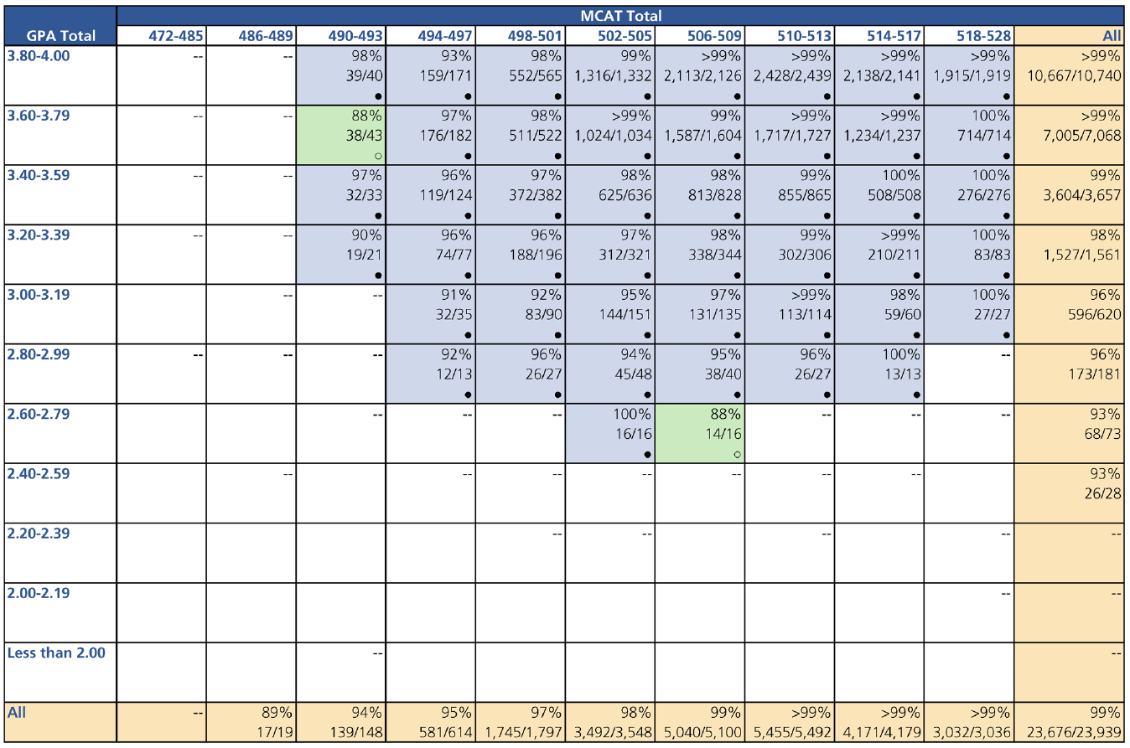
MCAT scores and undergraduate GPAs tell more about students’ Step 2 CK pass rates on the first attempt
See pg. 29
Percentage and Number of 2016- and 2017-Entering Students Admitted With Scores from the Current MCAT Exam Who Passed the Step 2 CK Exam on the First Attempt, by MCAT Total Score and Undergraduate GPA Ranges
Blue shading (●) = Pass rates of 90-100%; green shading (○) = Pass rates of 80-89%
©2023. May not be reproduced without permission.
Notes:
This slide shows that together, MCAT scores and undergraduate GPAs provide more information about the success of students with different combinations of academic metrics.
This grid format has been used previously, to illustrate a variety of medical school metrics by MCAT total scores and undergraduate GPAs. The columns show MCAT total score ranges, low to high, as you read from left to right. The rows show undergraduate GPA ranges, highest at the top, to the lowest range at the bottom. Students’ most recent MCAT score was used in the analysis.
The Step 2 CK pass rate is highest in the top right of the figure, where MCAT scores and GPAs are highest. But similar pass rates also appear at ranges for more modest MCAT and GPA ranges. This shows that students admitted with a wide range of academic credentials succeed.
In the cell at the lowest right, we see that overall, 99% of 2016 and 2017 entrants who took the Step 2 CK exam passed it on the first attempt.
Technical Notes
Each cell shows the percentage of students who passed Step 2 CK on the first attempt. The cell shading indicates the pass rates at each MCAT/GPA combination.
The blue shading (●) shows pass rates greater or equal to 90%.
The green shading (○) shows pass rates of 80-89%.
Cells with dashes had fewer than 10 students; blank cells had zero students.

Slide 37
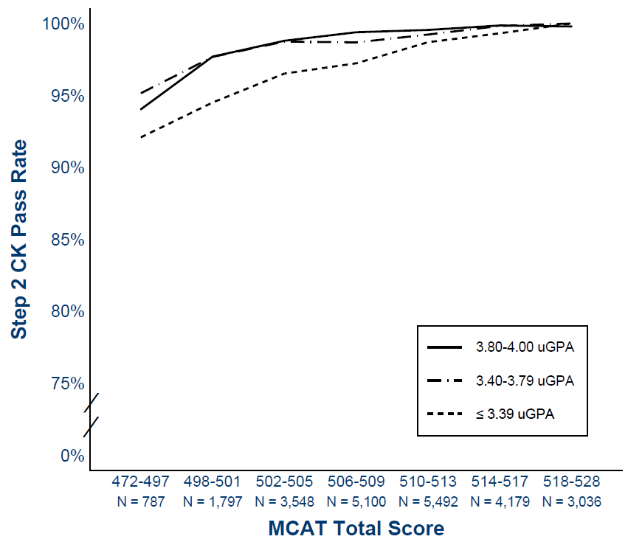
Step 2 CK pass rates, by MCAT total score and undergraduate GPA ranges.
See pg. 28
©2023. May not be reproduced without permission.
Notes:
This slide shows the same data as the previous slide in a different format. Like the previous slide, this slide shows the value of using applicants’ MCAT scores and undergraduate GPAs in admissions decisions. As shown on the previous slide, the overall pass rate on Step 2 CK is very high (99%), so incremental increases in pass rate by MCAT score and GPA are much smaller compared to what was shown for Step 1.
These data are from the U.S. medical students entering in 2016 and 2017 who took the Step 2 CK exam (N = 23,939). The lines show the Step 2 CK pass rate for these students by their most recent MCAT total score at the time of matriculation, grouped by undergraduate GPAs less than 3.40, from 3.40 to 3.79, and greater than or equal to 3.80. Results for students admitted with MCAT total scores from 498 to 517 are grouped in three-point score ranges. Results for students admitted with MCAT total scores from 472 to 497 are reported together, as are the results for those who scored from 518 to 528, because fewer students are admitted with MCAT scores at the bottom and top of the MCAT score scale.

Slide 38
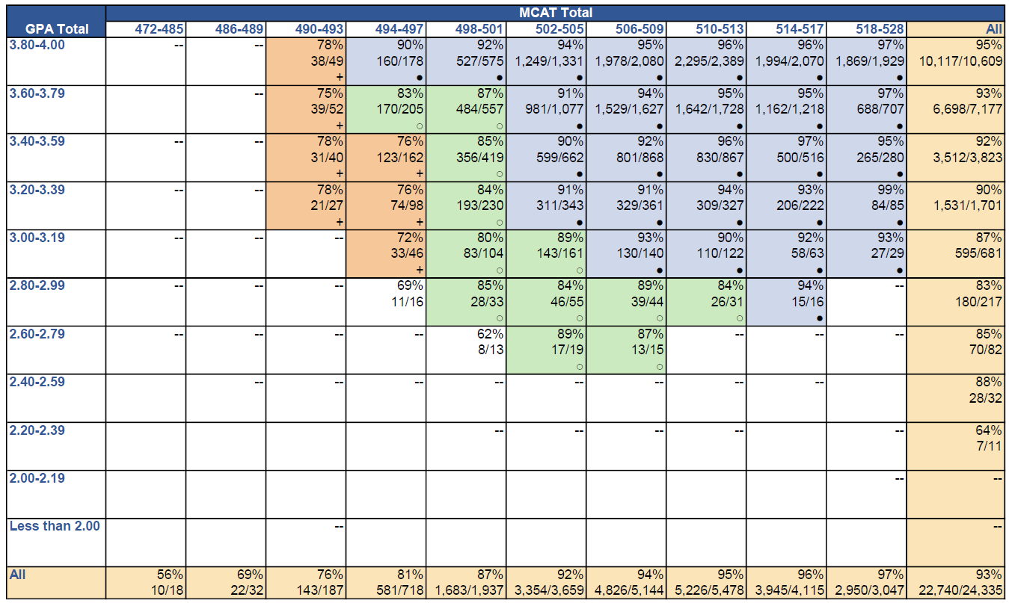
MCAT scores and undergraduate GPAs tell more about students’ progression to year three on time
See pg. 31
Percentage and Number of 2016-and 2017-Entering Students Admitted With Scores From the Current MCAT Exam Who Progressed to Year Three on Time, by MCAT Total Score and Undergraduate GPA Ranges
Blue shading (●) = Progression rates of 90-100%; green shading (○) = Progression rates of 80-89%; orange shading (+) = Progression rates of 70-79%.
©2023. May not be reproduced without permission.
Notes:
This slide shows that together, MCAT scores and undergraduate GPAs provide more information about the success of students with different combinations of academic metrics.
This grid format has been used previously, to illustrate a variety of medical school metrics by MCAT total scores and undergraduate GPAs. The columns show MCAT total score ranges, low to high, as you read from left to right. The rows show undergraduate GPA ranges, highest at the top, to the lowest range at the bottom. Students’ most recent MCAT score was used in the analysis.
Overall, most (93%) of the 2016 and 2017 entrants with scores from this exam progressed to year three on time, including those who entered with modest MCAT scores. The last row of this table shows the positive relationship between MCAT scores and on-time progression to year three. As the columns go from left to right, the rates of on-time progression increase. The last column shows the same relationship for undergraduate GPAs and on-time progression to year three.
Technical Notes
Each cell shows the percentage of students who progressed to year three on time. The cell shading indicates the progression rates at each MCAT/GPA combination.
The blue shading (●) shows progression rates greater or equal to 90%.
The green shading (○) shows progression rates of 80-89%.
The orange shading (+) shows progression rates of 70-79%.
Cells with dashes had fewer than 10 students; blank cells had zero students.

Slide 39
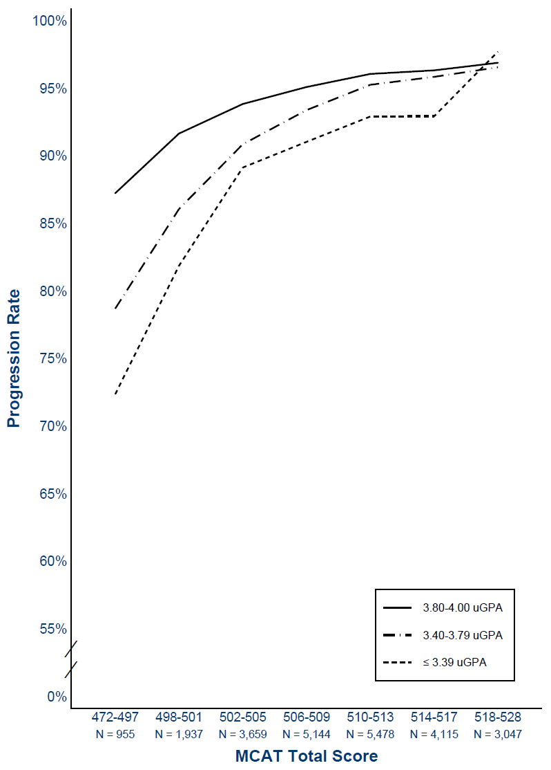
Median rates of on-time progression to year three, by MCAT total score and undergraduate GPA ranges.
See pg. 30
©2023. May not be reproduced without permission.
Notes:
This slide shows the same data as the previous slide in a different format. Like the previous slide, this slide shows the value of using applicants’ MCAT scores and undergraduate GPAs in admissions decisions.
These data are from the U.S. medical students entering in 2016 or 2017 who progressed to year three on time (N = 24,335). The lines show the median rates of on-time progression to year three for these students by their most recent MCAT total score at the time of matriculation, grouped by undergraduate GPAs less than 3.40, from 3.40 to 3.79, and greater than or equal to 3.80. Results for students admitted with MCAT total scores from 498 to 517 are grouped in three-point score ranges. Results for students admitted with MCAT total scores from 472 to 497 are reported together, as are the results for those who scored from 518 to 528, because fewer students are admitted with MCAT scores at the bottom and top of the MCAT score scale.

Slide 40
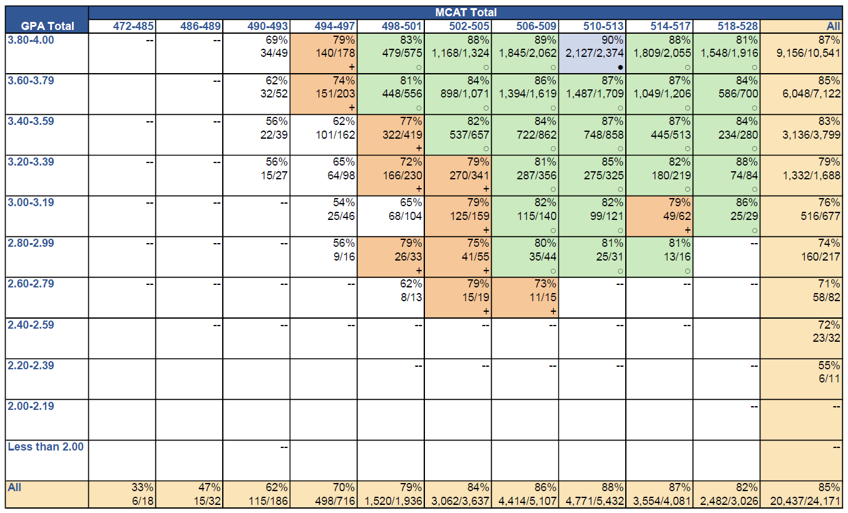
MCAT scores and undergraduate GPAs tell more about students’ graduation within 4 years
See pg. 33
Percentage and Number of 2016- and 2017-Entering Students Admitted With Scores From the Current MCAT Exam Who Graduated within Four Years, by MCAT Total Score and Undergraduate GPA Ranges
Blue shading (●) = Progression rates of 90-100%; green shading (○) = Progression rates of 80-89%; orange shading (+) = Progression rates of 70-79%.
©2023. May not be reproduced without permission.
Notes:
This slide shows that together, MCAT scores and undergraduate GPAs provide more information about the success of students with different combinations of academic metrics.
This grid format has been used previously, to illustrate a variety of medical school metrics by MCAT total scores and undergraduate GPAs. The columns show MCAT total score ranges, low to high, as you read from left to right. The rows show undergraduate GPA ranges, highest at the top, to the lowest range at the bottom. Students’ most recent MCAT score was used in the analysis.
Overall, most (85%) of the 2016 and 2017 entrants with scores from this exam graduated within four years, an impressive result given the 62% average graduation rate from U.S. graduate and professional schools generally. The last row of this table shows the positive relationship between MCAT scores and on-time graduation in four years. As the columns go from left to right, the rates of on-time progression increase. The last column shows the same relationship for undergraduate GPAs and graduation within four years.
Technical Notes
Each cell shows the percentage of students who graduated within four years. The cell shading indicates the graduation rates at each MCAT/GPA combination.
The blue shading (●) shows graduation rates greater or equal to 90%.
The green shading (○) shows graduation rates of 80-89%.
The orange shading (+) shows graduation rates of 70-79%.
Cells with dashes had fewer than 10 students; blank cells had zero students.

Slide 41
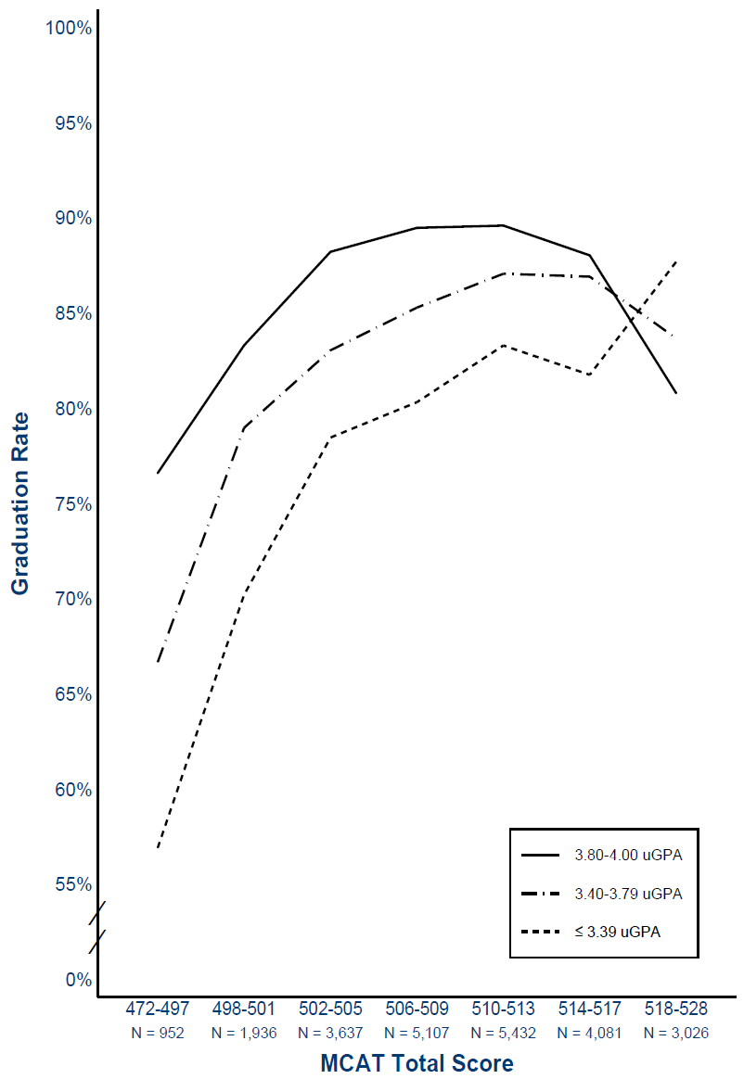
Four-year graduation rates, by MCAT total score and undergraduate GPA ranges.
See pg. 32
©2023. May not be reproduced without permission.
Notes:
This slide shows the same data as the previous slide in a different format. Like the previous slide, this slide shows the value of using applicants’ MCAT scores and undergraduate GPAs in admissions decisions.
These data are from the U.S. medical students entering in 2016 or 2017 who graduated within four years (N = 24,171). The lines show the median graduation rates for these students by their most recent MCAT total score at the time of matriculation, grouped by undergraduate GPAs less than 3.40, from 3.40 to 3.79, and greater than or equal to 3.80. Results for students admitted with MCAT total scores from 498 to 517 are grouped in three-point score ranges. Results for students admitted with MCAT total scores from 472 to 497 are reported together, as are the results for those who scored from 518 to 528, because fewer students are admitted with MCAT scores at the bottom and top of the MCAT score scale.

Slide 42
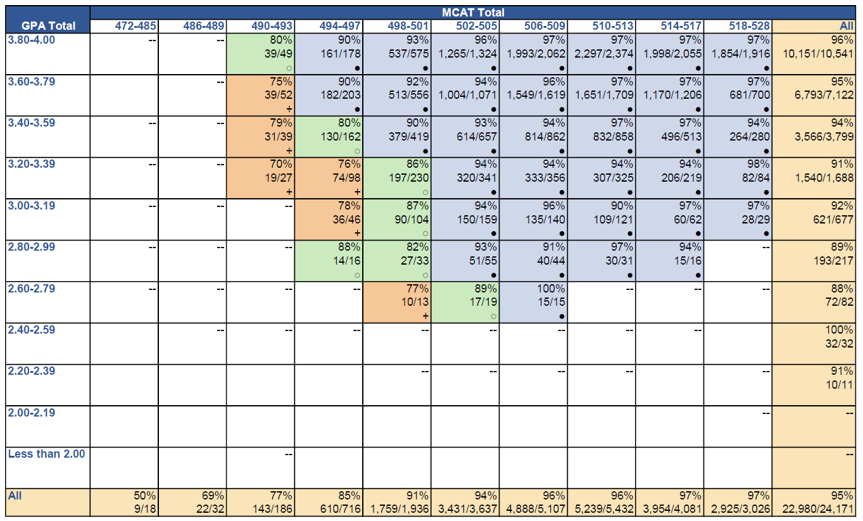
MCAT scores and undergraduate GPAs tell more about students’ graduation within 5 years
See pg. 35
Percentage and Number of 2016- and 2017-Entering Students Admitted With Scores From the Current MCAT Exam Who Graduated within Five Years, by MCAT Total Score and Undergraduate GPA Ranges
Blue shading (●) = Progression rates of 90-100%; green shading (○) = Progression rates of 80-89%; orange shading (+) = Progression rates of 70-79%.
©2023. May not be reproduced without permission.
Notes:
This slide shows that together, MCAT scores and undergraduate GPAs provide more information about the success of students with different combinations of academic metrics.
This grid format has been used previously, to illustrate a variety of medical school metrics by MCAT total scores and undergraduate GPAs. The columns show MCAT total score ranges, low to high, as you read from left to right. The rows show undergraduate GPA ranges, highest at the top, to the lowest range at the bottom. Students’ most recent MCAT score was used in the analysis.
Overall, most (95%) of the 2016 and 2017 entrants with scores from this exam graduated within five years, including those who entered with modest MCAT scores. These overall graduation rates are consistent with data reported in a recent AAMC Data Snapshot, which show that five-year graduation rates have consistently remained at 95% for more than two decades. The last row of this table shows the positive relationship between MCAT scores and on-time graduation in five years. As the columns go from left to right, the rates of on-time progression increase. The last column shows the same relationship for undergraduate GPAs and graduation within five years.
Technical Notes
Each cell shows the percentage of students who graduated within five years. The cell shading indicates the graduation rates at each MCAT/GPA combination.
The blue shading (●) shows graduation rates greater or equal to 90%.
The green shading (○) shows graduation rates of 80-89%.
The orange shading (+) shows graduation rates of 70-79%.
Cells with dashes had fewer than 10 students; blank cells had zero students.

Slide 43
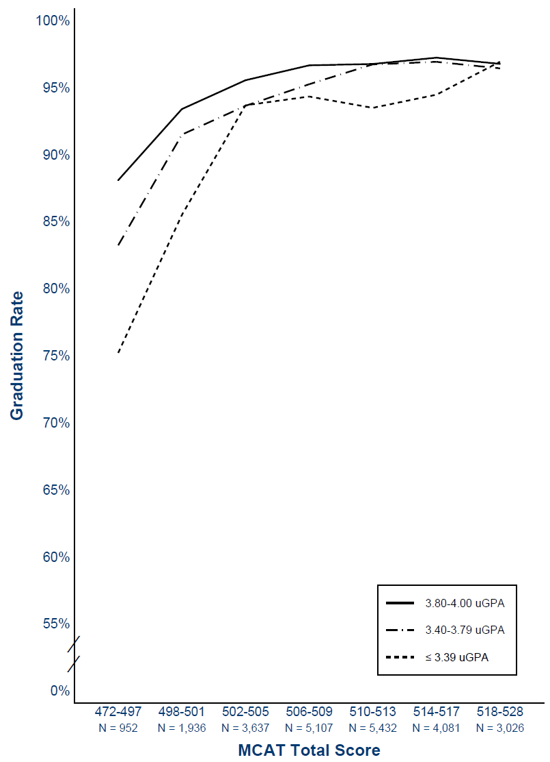
Five-year graduation rates, by MCAT total score and undergraduate GPA ranges.
See pg. 34
©2023. May not be reproduced without permission.
Notes:
This slide shows the same data as the previous slide in a different format. Like the previous slide, this slide shows the value of using applicants’ MCAT scores and undergraduate GPAs in admissions decisions.
These data are from the U.S. medical students entering in 2016 or 2017 who graduated within five years (N = 24,171). The lines show the median graduation rates for these students by their most recent MCAT total score at the time of matriculation, grouped by undergraduate GPAs less than 3.40, from 3.40 to 3.79, and greater than or equal to 3.80. Results for students admitted with MCAT total scores from 498 to 517 are grouped in three-point score ranges. Results for students admitted with MCAT total scores from 472 to 497 are reported together, as are the results for those who scored from 518 to 528, because fewer students are admitted with MCAT scores at the bottom and top of the MCAT score scale.

Slide 44
MCAT scores provide comparable prediction for students from different sociodemographic backgrounds
Research was conducted to examine the predictive validity of MCAT scores for students grouped by race/ethnicity, SES, and gender
Results show MCAT scores neither overpredict nor underpredict the performance of students from these groups on:
  Validity school outcomes: Performance across preclerkship courses and clerkships
  National outcomes: Step 1 and Step 2 CK scores, on-time progression to year three, and graduation within four or five years
©2023. May not be reproduced without permission.
Notes:
When talking about fairness and standardized exams, it’s helpful to understand how test bias is defined: Test bias is present if the test does not show comparable prediction of performance across populations or groups. This is one important measure of fairness in the use of academic metrics like test scores in student selection – that scores from the current exam, just like those from the previous version, predict performance comparably for students from different backgrounds. While multiple studies show that the current and past versions of the MCAT predict medical school performance across groups, we know that the exam exists in a broader context of societal inequity.
Research results suggest that the scores from the current MCAT exam show comparable prediction for students from different sociodemographic backgrounds. Medical students from different groups admitted with the same MCAT scores show similar outcomes in medical school in their preclerkship and clerkship courses, on Step 1 and Step 2 CK, on progression to year three, and on graduation.
For a 2020 Academic Medicine article, authors from the MCAT Validity Committee (Busche et al), examined 2016 entrants’ summative performance in M1 for validity schools, and on-time progression to M2 for the national sample. They tested whether MCAT total scores predict the outcome comparably for students by race/ethnicity (that is, students identifying as URIM or not-URIM), by students’ socioeconomic status measured by their parents’ highest education, and by the student’s gender. They conducted a series of regression analyses that are commonly used to answer such questions in educational measurement and testing. The Academic Medicine article discusses details about the analysis.
The 2020 Busche et al. analyses were replicated in the more recent Academic Medicine article (Hanson et al., 2022) on the outcomes presented in this guide: for preclerkship and clerkship courses, Step 1 and Step 2 CK scores and pass rates, and rate of progression to Year 3 on time.
All of the analyses conducted to date showed that scores from the current MCAT exam provide comparable prediction for students from different sociodemographic backgrounds on all of the outcomes examined. Any differences (i.e., effect sizes) were minor and neither of practical nor statistical significance.
Group Differences and Educational Opportunity (Not shown on this slide—refer to Figure 7 on pg. 8 of the MCAT Data Guide)
Societal and economic factors shape a student’s trajectory through high school and college, and they can also contribute to gaps in achievement in school and on standardized tests.
Compared with non-URM examinees, those underrepresented in medical school are more likely to experience adverse socioeconomic, environmental, and educational factors that limit their ability to reach their potential, and they are less likely to experience or have access to enhancers that more advantaged students receive that maximizes their achievement.
MCAT scores show population group differences, which was also true for scores from the previous version of the exam and for scores from other standardized tests such as the LSAT, GMAT, or GRE.
However, these differences do NOT equate to test bias.
The broad impact of these inequalities can be seen not only in performance on standardized tests like the MCAT exam, but also performance in high school and college. For example, group differences in medical school applicants’ undergraduate GPAs are identical to group differences in MCAT scores.
Together, the group differences in undergraduate GPAs and MCAT scores, combined with evidence of comparable prediction in medical school, point to the pernicious effects of inequality in limiting educational opportunity and academic achievement.
Structural racism and privilege likely contribute to the differences seen across exams and other measures of academic achievement.
So our question is what we in medical education can do to mitigate the effects of inequality in a principled way to increase the diversity of our future physician workforce, including by using holistic review to consider applicants in the context of their lived experiences.

Slide 45

Questions
©2023. May not be reproduced without permission.

