Slide 1
CFAS COVID-19 Disparities Tweet Chat Wednesday, May 6 2020
Host: VJ Periyakoil, MD
Co-hosts: Alan Dow, MD, and Philip Alberti, PhD

Slide 2
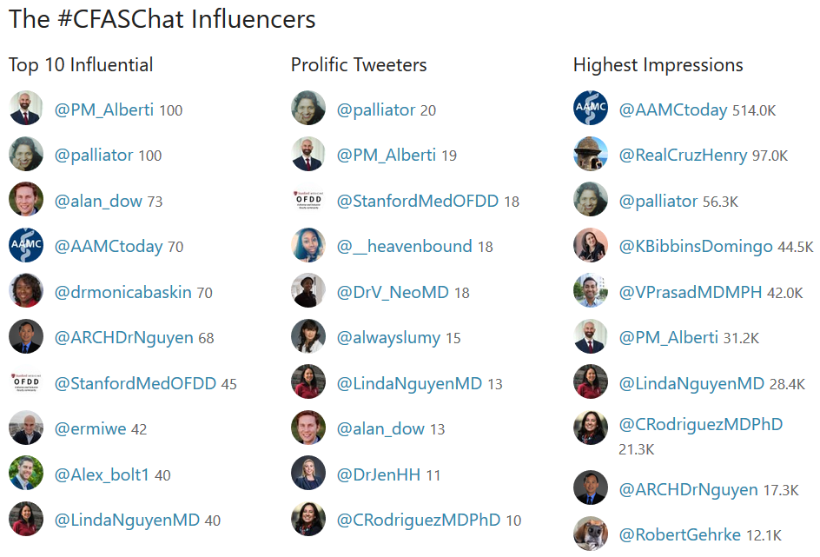
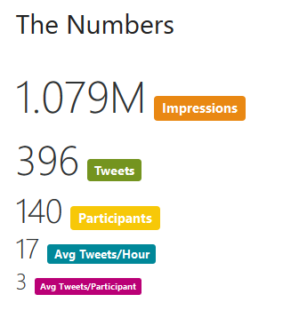
Impact
Resources shared during chat listed on slides 15–17

Slide 15
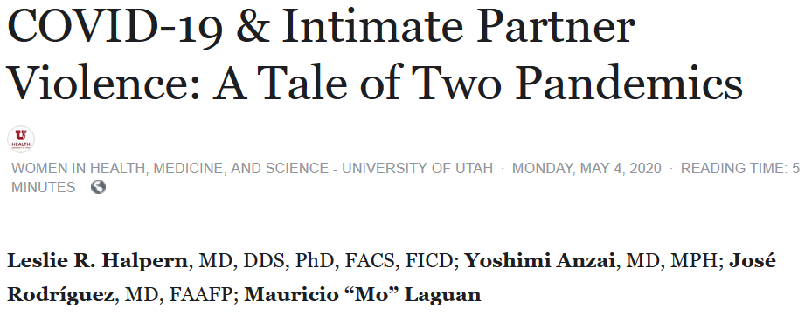
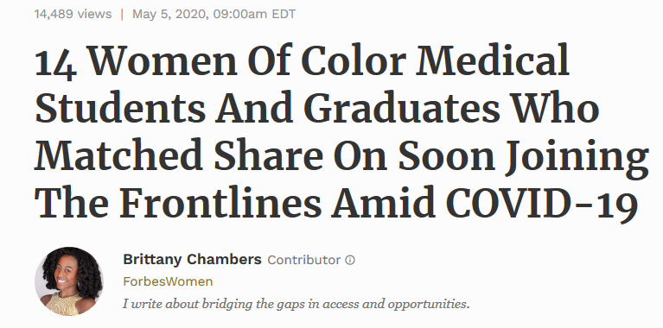
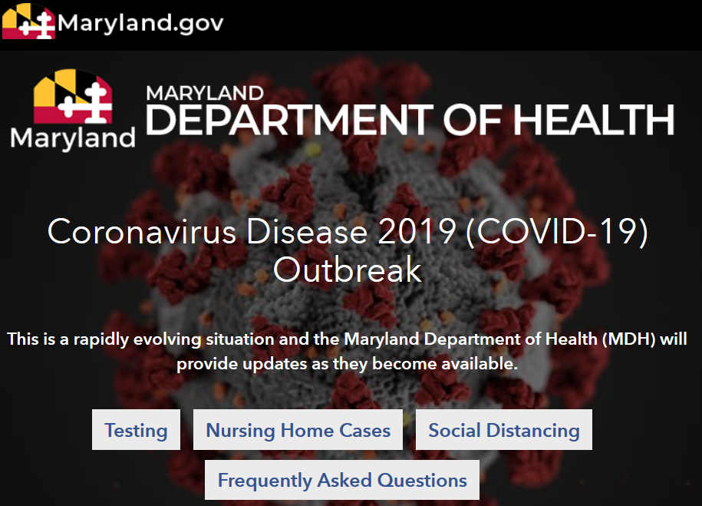
Resources Shared
https://www.forbes.com/sites/brittanychambers/2020/05/05/14-women-of-color-medical-students-and-graduates-who-matched-share-on-soon-joining-the-frontlines-amid-covid-19/#6a47b916902a
https://www.facebook.com/notes/women-in-health-medicine-and-science-university-of-utah/covid-19-intimate-partner-violence-a-tale-of-two-pandemics/2654552394801788
https://www.aamc.org/news-insights/medical-students-need-learn-about-health-disparities-combat-future-pandemics
https://www.sfgate.com/news/editorspicks/article/90-of-people-who-tested-positive-for-COVID-19-in-15247476.php#photo-19344363
https://www.npr.org/sections/health-shots/2020/04/02/825730141/the-coronavirus-doesnt-discriminate-but-u-s-health-care-showing-familiar-biases
https://coronavirus.maryland.gov/

Slide 16
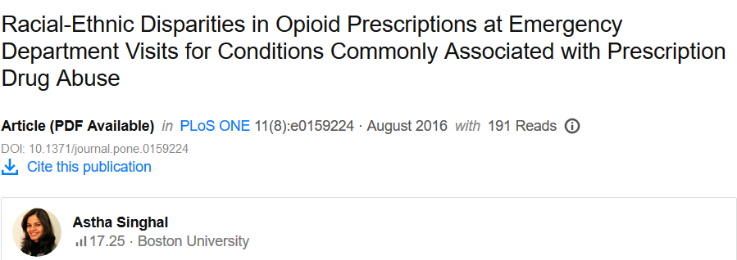
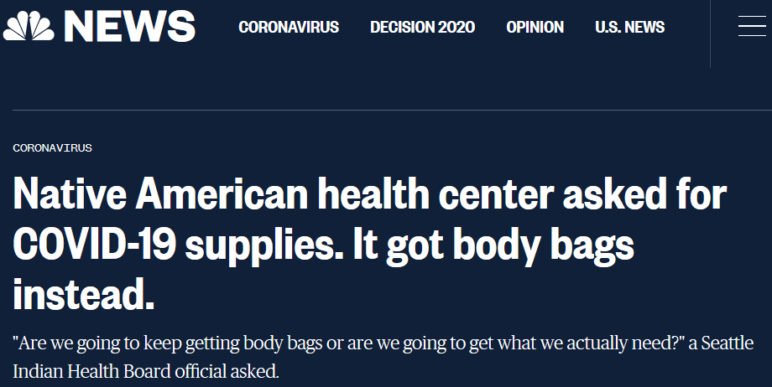
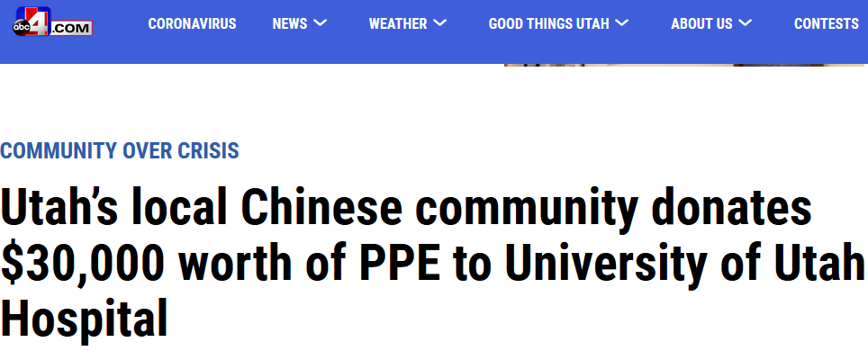
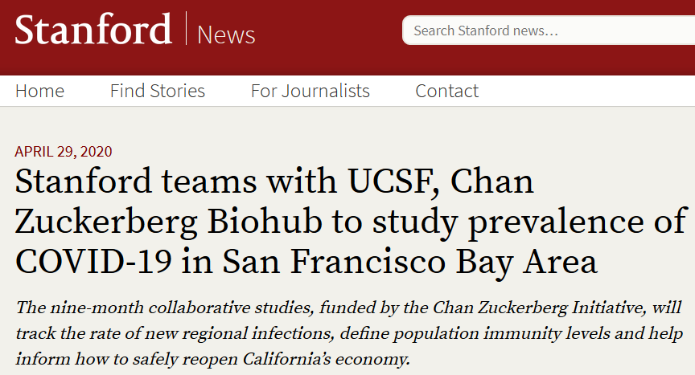
Resources Shared
https://www.researchgate.net/publication/306006034_Racial-Ethnic_Disparities_in_Opioid_Prescriptions_at_Emergency_Department_Visits_for_Conditions_Commonly_Associated_with_Prescription_Drug_Abuse
https://www.nbcnews.com/news/us-news/native-american-health-center-asked-covid-19-supplies-they-got-n1200246
https://structuralcompetency.org/
https://www.abc4.com/news/community-over-crisis/utahs-local-chinese-community-donates-30000-worth-of-ppe-to-university-of-utah-hospital/
https://news.stanford.edu/2020/04/29/stanford-teams-ucsf-chan-zuckerberg-biohub-study-prevalence-covid-19-san-francisco-bay-area/
http://med.stanford.edu/facultydiversity/faculty-development/cme-course--unconscious-bias-in-medicine.html

Slide 17
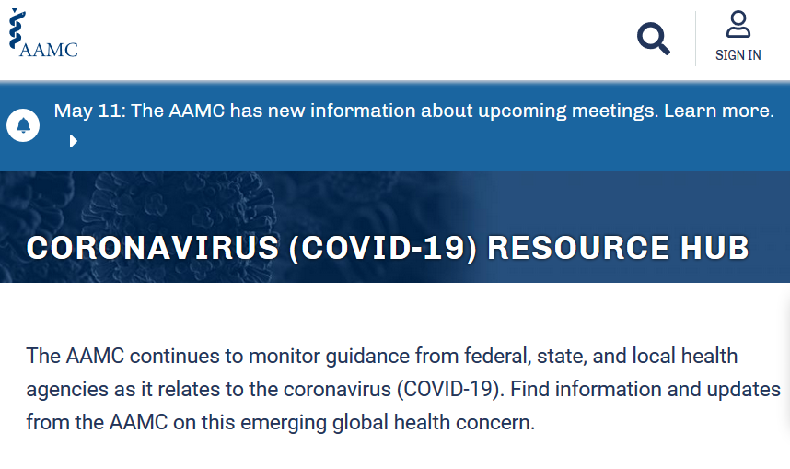
Resources Shared
https://academic.oup.com/jid/article/189/Supplement_1/S146/821322
https://www.aamc.org/what-we-do/mission-areas/medical-research/health-equity/aamc-charge
https://www.aamc.org/coronavirus-covid-19-resource-hub?utm_source=twitter&utm_medium=pm_alberti&utm_content=d02f907b-4bb1-4e14-8ca1-dd3e428421a1

