Slide 2
Joint CFAS/Medical Humanities Tweet Chat
November 11, 2019

Slide 3
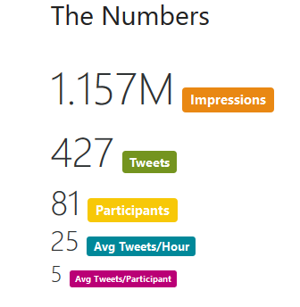
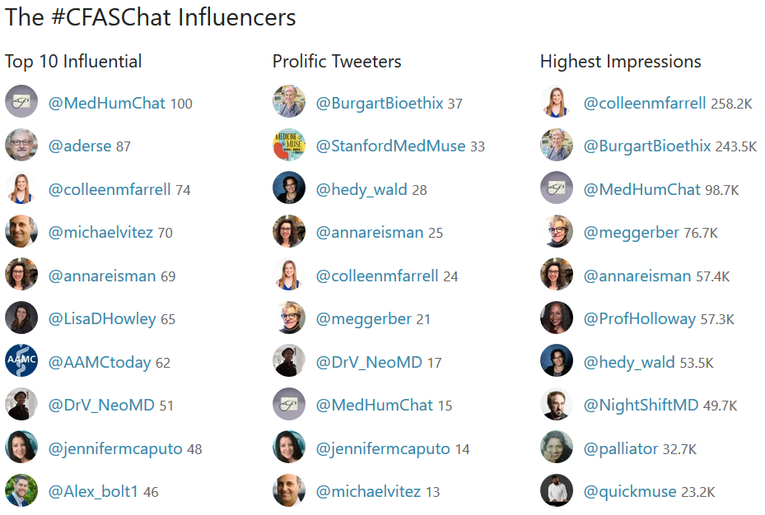
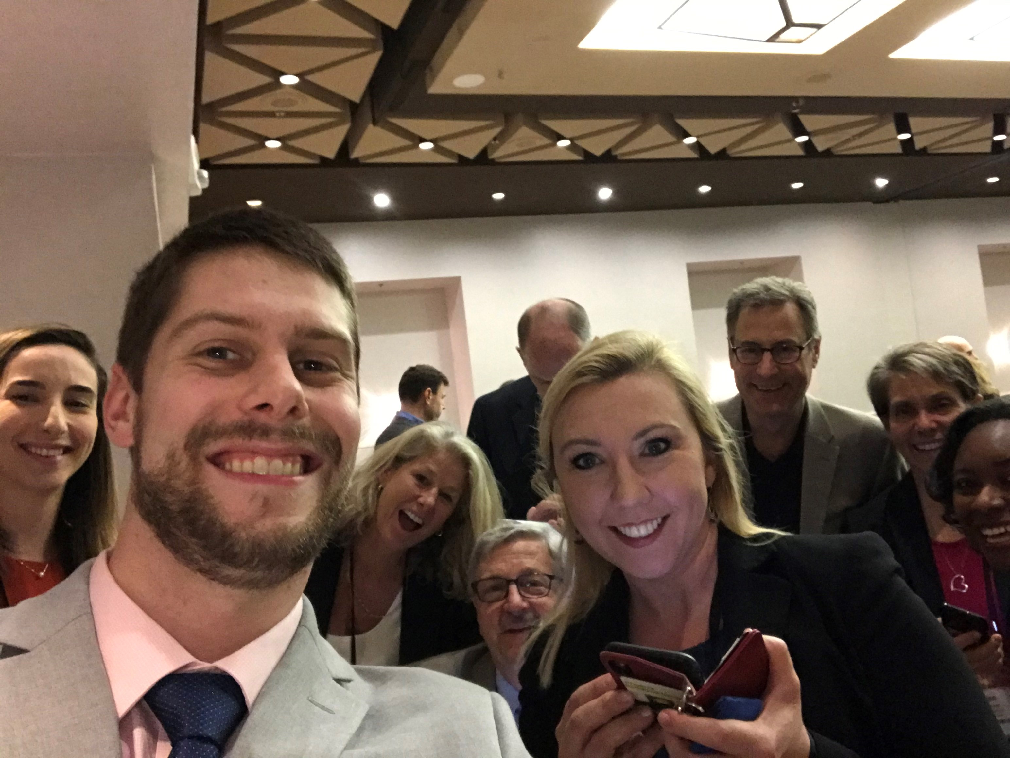

Slide 4





Slide 5






Slide 6



Slide 7





Slide 8





Slide 9





Slide 10





Slide 11





Slide 12


Slide 13






Slide 14






Slide 15






Slide 16





Slide 17






Slide 18






Slide 19





Slide 20





Slide 21





Slide 22


Slide 23



Slide 24


Slide 25





Slide 26





Slide 27





Slide 28




