Slide 1
Aamc/adea dental loan organizer and calculator
Tips for using the AAMC/ADEA DLOC
to manage your student loans
Paul S. Garrard, Consultant
American Dental Education Association
January 2020

Slide 2
AAMC/ADEA DLOC benefits
Keep all borrowing in one electronic file.
See impact of additional borrowing on repayment each time you borrow.
Help choose a repayment strategy based on your own debt, repayment objectives and career plans.
Use free for seven years.

Slide 3
Getting started
Visit adea.org/DLOC and follow instructions for new users:
Create an account with AAMC
Two main sections to AAMC/ADEA DLOC:
Dental Loan Organizer
Dental Loan Calculator

Slide 4
AAMC/ADEA DLOC Sections
Dental Loan Organizer
Store your borrowing history:
Upload federal borrowing from NSLDS*
Manually input prospective borrowing
Input loan servicer information
Dental Loan Calculator
Customize repayment based on career plans:
Choose directly into practice or advanced dental education (hospital or academic based)
* National Student Loan Data System at NSLDS.ed.gov

Slide 5
Using the Organizer
Once NSLDS record uploaded, add projected borrowing to loan information in Organizer
Enter individual loans by academic year
Select loan type (direct unsubsidized and direct PLUS)*
Use same nickname for the same loan**
Enter loan amount
Use 10 years for repayment term for federal loans
Consider relatively high rate to show worst-case scenario
* These two loans usually comprise the bulk of dental school students’ borrowing ** This will help ensure the same loans are always grouped together in summary

Slide 6
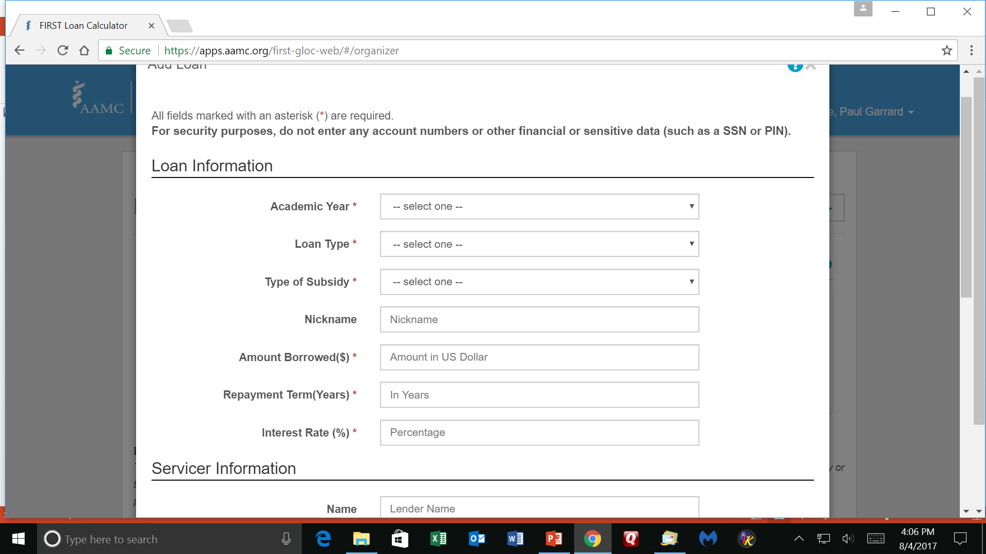
Example: Where to add loans in the Organizer
Choose easy nickname for all loa

Slide 7
Example: Direct Unsubsidized entered in Calculator

Slide 8
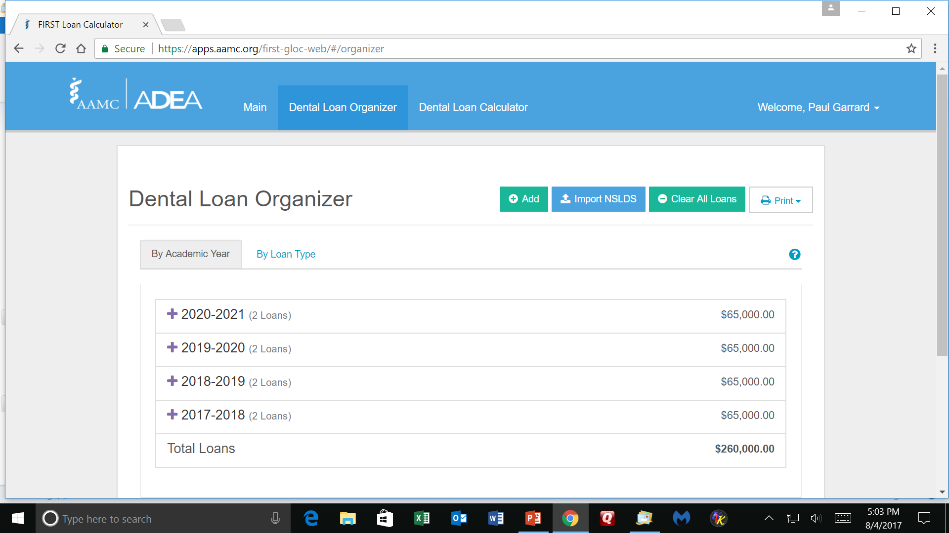
Sample display of loans by academic year
Choose easy nickname for all loa

Slide 9
Sample display of loans by loan type

