Slide 1
CFAS Diversity and Inclusion Tweet Chat
September 19, 2019

Slide 2
Background
A tweet chat, or Twitter chat, is a dynamic group conversation on Twitter focused on a single topic. Starting in the spring of 2019, CFAS has held four tweet chats on topics including medical education, well-being in academic medicine, and diversity and inclusion.
CFAS launched its first two Tweet chats at the 2019 CFAS Spring Meeting. This approach has steadily grown in popularity and reach, both among CFAS reps and external audiences, extending the reach of CFAS beyond just our engaged reps.
The hashtag that designates our chats, “#CFASChat,” has trended on Twitter twice, meaning that the conversations reached a very large number of people on Twitter.
During CFAS tweet chats, Twitter accounts belonging to academic health centers and academic societies have joined in the conversations, demonstrating a great reach.
The tweet chat approach has gotten the attention of other groups at the AAMC, who are now beginning to experiment with this approach on their own.
The following slides present highlights of the discussion on Sept. 19, which focused on diversity and inclusion in academic medicine, and featured CFAS Administrative Board Member and CFAS Diversity Committee Chair VJ Periyakoil, MD, as the moderator.

Slide 3
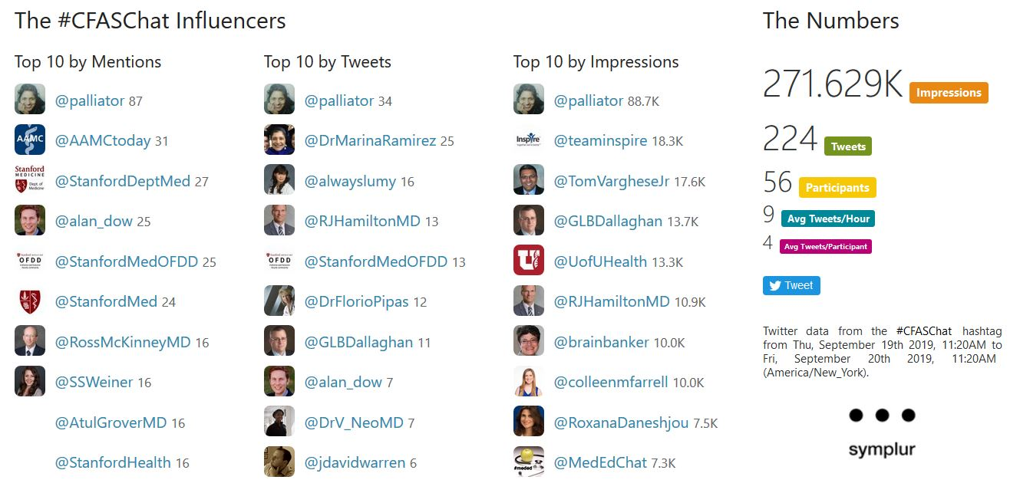
By the Numbers

