Slide 1
AAMC Building Better Curriculum Webinar Series We will begin our presentation shortly. Topic: How to use Internal CI at Tulane to support Accreditation Jennifer Gibson, Director, Office of Medical Education, Tulane University Rhonda Coignet, Accreditation Project Manager, Tulane University How can the AAMC CI help with Accreditation Angela Blood Director, Curricular Resources, AAMC PLEASE NOTE: All users will be muted during the webinar but should use the chat feature to send questions to Angela Blood during the presentation. We will try to answer as many questions as possible at the end of the presentation.

Slide 2
Using your curriculum map to support accreditation
Jenny Gibson, PhD
Director, Office of Medical education
Rhonda Coignet, MBA
Accreditation Project manager

Slide 3
Objectives
Review LCME standards and elements relating to curriculum management and mapping
Discuss strategies for tagging/categorizing data in your curriculum map
Explore reports that can meaningfully contribute to efficient completion of the DCI
Share challenges and opportunities related to curriculum mapping

Slide 4
Standard 6 competencies, curricular objectives, and curricular design
Instructional formats and number of formal instructional hours/course (6.0)
Competencies, program objectives and outcome measures (6.1)
Self-directed and life-long learning (6.3)

Slide 5
Standard 6 competencies, curricular objectives, and curricular design
Instructional formats and number of formal instructional hours/course (6.0)
Course | Academic Level | Lecture | Lab | Small groups | Patient Contact | Other | Total
Gross Anatomy | Year 1 | 48 | 81 | 21 | 11 | 28 | 190
TOTAL

Slide 6
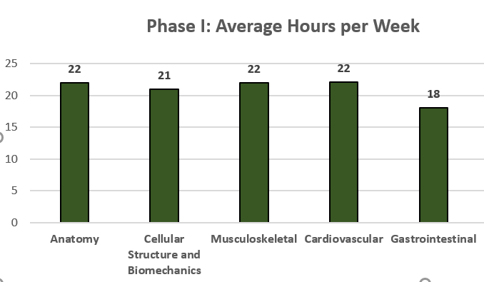
Pre-clinical contact hours

Slide 7
Standard 6 competencies, curricular objectives, and curricular design
Program and Learning Objectives (6.1) Interpersonal & Communication Skills: Maintain comprehensive, timely, and legible medical records

Slide 8
Standard 6 competencies, curricular objectives, and curricular design
Self-directed and life-long learning (6.3)

Slide 9
Standard 7 curricular content
Courses and clerkships: Where are specific topics taught and assessed? (7.1)
Biomedical informatics, global health issues, nutrition, pain management, etc.
Scientific method and translational research (hands-on or simulated experiences) (7.3)
Critical judgment and problem solving skills (7.4)
Societal problems (7.5)
Cultural competence and healthcare disparities (7.6)
Medical ethics (7.7)
Communication skills (7.8)
Interprofessional collaborative skills (7.9)

Slide 10
Standard 7 curricular content
Courses and clerkships: Where are specific topics taught and assessed? (7.1)
Table 7.1-1 | Curricular Content
For each topic area, place an “X” in the appropriate column to indicate whether the topic is taught separately as an independent required course and/or as part of a required integrated course. Place an “X” under each column to indicate the year(s) in which the learning objectives related to each topic are taught and assessed.
Topic Areas | Course Type |  | Years Topic Areas Are Taught and Assessed
 | Independent course | Integrated course(s) | Year 1 | Year 2 | Year 3 and/or 4
Biochemistry
Biostatistics and epidemiology
Genetics

Slide 11
Standard 7 curricular content
Where are specific topics taught and assessed?
e.g., Nutrition, Critical Judgment
Course | Session | Topics
Cardiovascular I | Mrs. Hermione Waters Case (PBL) | Critical Judgment
Endocrine/Reproductive I | Self-Directed Learning | Critical Judgment
Renal I | Mr. IP Sweet (PBL) | Critical Judgment
Cardiovascular I | Cholesterol Transport | Nutrition
Endocrine/Reproductive I | Teaching Kitchen | Nutrition
Neoplasia/Hematology | Hemolytic Anemias | Nutrition
Interdisciplinary Seminars | Lipids in Disease: The Impact of Dietary Fats on Health | Nutrition

Slide 12
STANDARD 8 CURRICULAR MANAGEMENT, EVALUATION, AND ENHANCEMENT
Use Of Medical Educational Program Objectives (8.2)
Curricular Design, Review, Revision/Content Monitoring (8.3)

Slide 13
STANDARD 8 CURRICULAR MANAGEMENT, EVALUATION, AND ENHANCEMENT
Use Of Medical Educational Program Objectives (8.2)

Slide 14
Curricular Design, Review, Revision/Content Monitoring (8.3)
STANDARD 8 CURRICULAR MANAGEMENT, EVALUATION, AND ENHANCEMENT
Describe how the curriculum as a whole is evaluated, including the methods used and the data collected to determine the following:
1. The horizontal and vertical integration of curriculum content, and whether sufficient content is included and appropriately placed related to each of the medical education program objectives.
2. The outcomes of the medical education program and whether each of the medical education program objectives is being met.

Slide 15
STANDARD 8 CURRICULAR MANAGEMENT, EVALUATION, AND ENHANCEMENT

Slide 16
STANDARD 9 TEACHING, SUPERVISION, and ASSESSMENT
Narrative Assessment (9.5): courses and clerkships that include narrative descriptions as part of the final assessment
Formative Assessment and Feedback (9.7): courses and clerkships that include formative assessment and feedback

Slide 17
STANDARD 9 TEACHING, SUPERVISION, and ASSESSMENT
Narrative Assessment (9.5): courses and clerkships that include narrative descriptions as part of the final assessment
Course | Session | Assessment Type
Gross Anatomy | Narrative Assessment | AM010 Narrative Assessment
Clerkships: End-of-Year Assessments | Full History and Physical (H&P) 3rd Year Exam | AM010 Narrative Assessment
Clerkships: End-of-Year Assessments | TOSCE | AM010 Narrative Assessment
Family Medicine | Preceptor Evaluation of Student | AM010 Narrative Assessment
Medicine | Faculty Evaluation of Student | AM010 Narrative Assessment

Slide 18
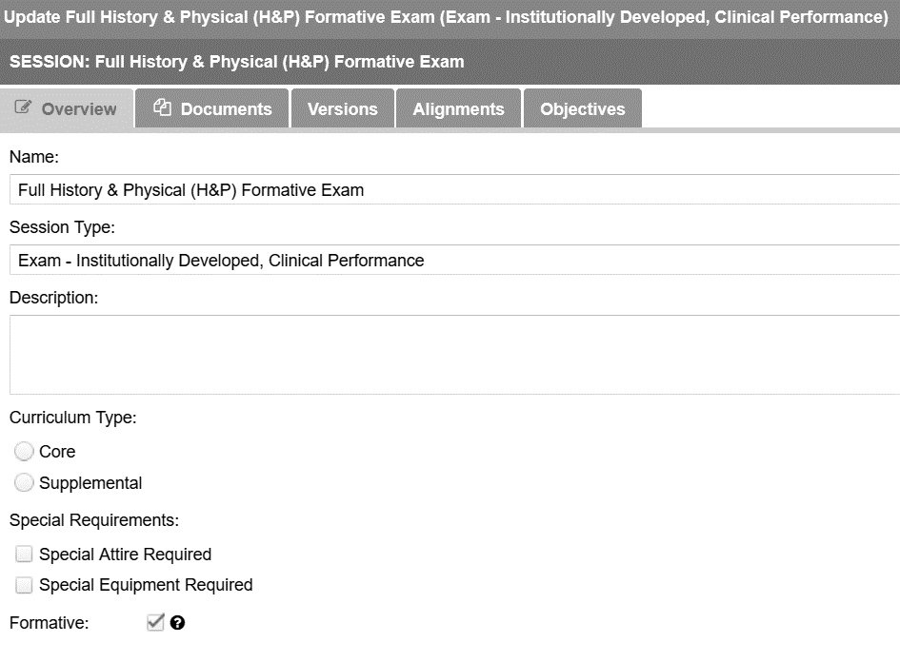
STANDARD 9 TEACHING, SUPERVISION, and ASSESSMENT
Courses and clerkships that include formative assessment and feedback (9.7)

Slide 19
Challenges and Opportunities
OPPORTUNITIES
Provide global perspective of curriculum
Engage faculty in curriculum mapping
Audit the database
Contribute to effective CQI process and review
CHALLENGES
Horizontal and vertical integration of curriculum content
Ensuring content is tagged correctly
Ensuring syllabi include required mapping information
Keeping database current

Slide 20
Contact information
Jwgibson@Tulane.edu
rhondac@Tulane.edu

Slide 21
How the AAMC CI Verification Report Supports Accreditation
Angela Blood
Director, Curricular Resources

Slide 22
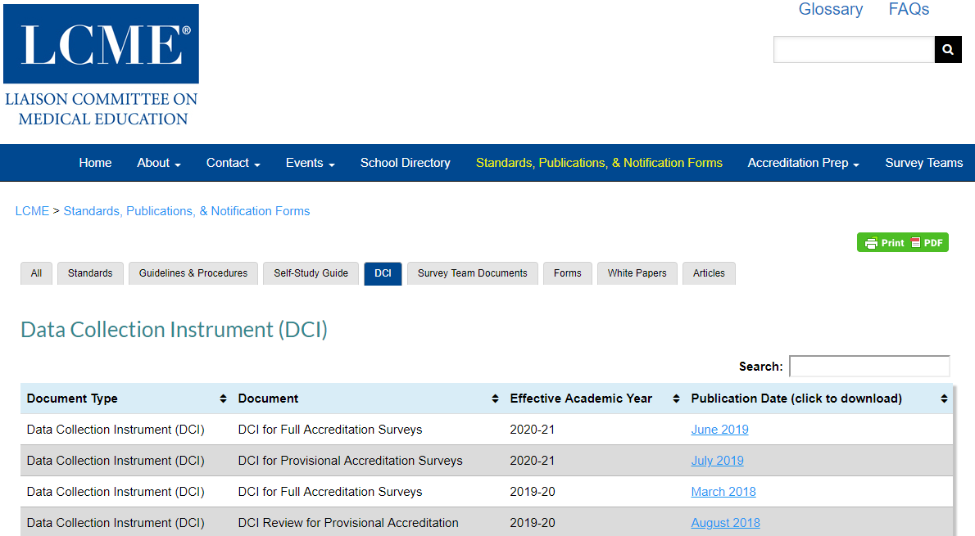
LCME Data Collection Instrument (DCI)
http://lcme.org/publications/#DCI
Notes:
There are multiple versions available because these documents are updated every year. In the Verification Report, we list which version we consulted.

Slide 23
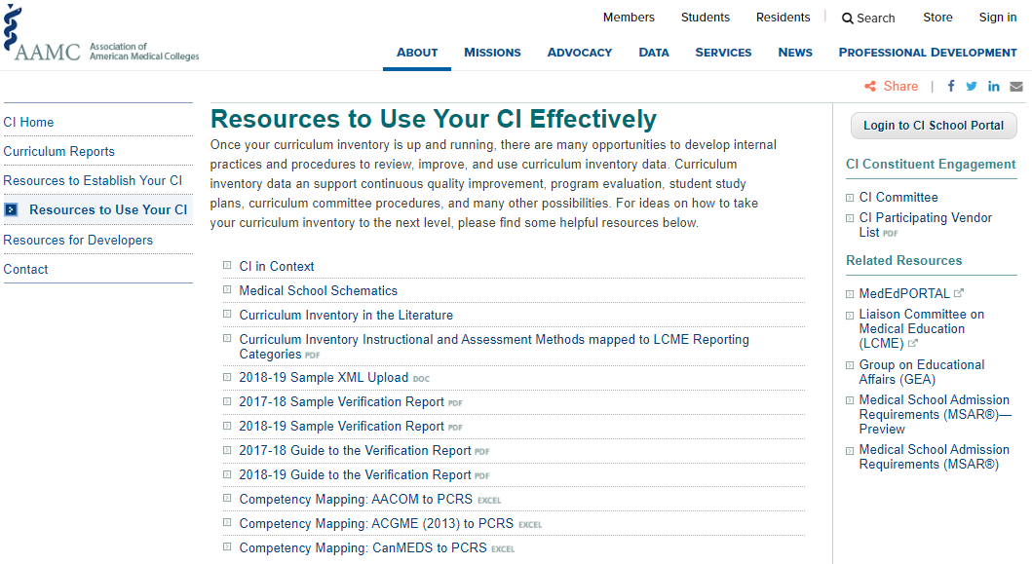
The AAMC CI Verification Report
https://www.aamc.org/initiatives/cir/useci/
Notes:
Now that we’ve seen how to use your local curriculum inventory to support accreditation, let’s look at how the national AAMC CI program can be helpful.
We’ll look at the Verification Report, the report that each school receives upon successful upload of their CI data. We have a number of resources related to the Verification Report, including a sample, located on the CI website here. The Verification Report has a number of updates and improvements for this year.

Slide 24
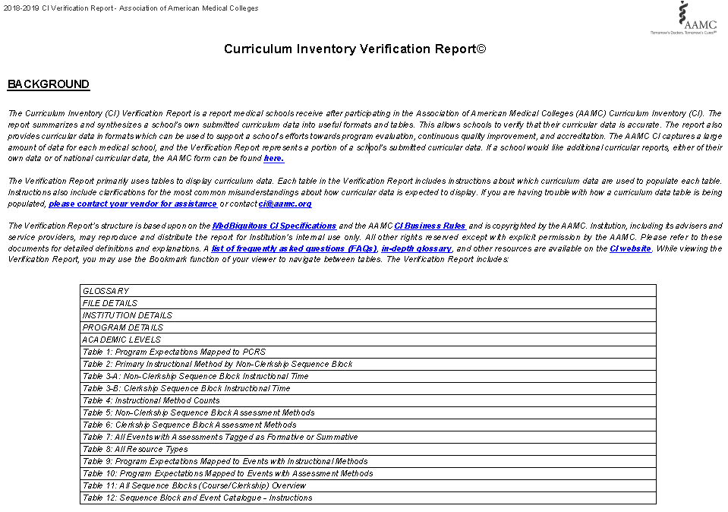
Verification Report – the first page

Slide 25
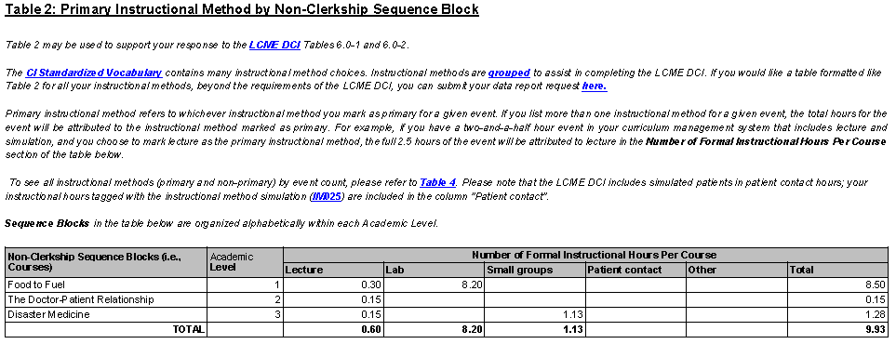
LCME DCI Tables 6.0-1 and 6.0-2

Slide 26
LCME DCI Table 6.0-3

Slide 27
LCME DCI Tables 9.0-1 and 9.0-2

Slide 28
LCME DCI Table 9.0-3

Slide 29
LCME Data Collection Instrument (DCI)
http://lcme.org/publications/#DCI
Notes:
There are multiple versions available because these documents are updated every year. In the Verification Report, we list which version we consulted.

Slide 30
The AAMC CI Verification Report
https://www.aamc.org/initiatives/cir/useci/
Notes:
Now that we’ve seen how to use your local curriculum inventory to support accreditation, let’s look at how the national AAMC CI program can be helpful.
We’ll look at the Verification Report, the report that each school receives upon successful upload of their CI data. We have a number of resources related to the Verification Report, including a sample, located on the CI website here. The Verification Report has a number of updates and improvements for this year.

Slide 31
Verification Report – the first page

Slide 32
LCME DCI Tables 6.0-1 and 6.0-2

Slide 33
LCME DCI Table 6.0-3

Slide 34
LCME DCI Tables 9.0-1 and 9.0-2

Slide 35
LCME DCI Table 9.0-3

Slide 36
Thank you and we will see you next month!
Register for September Building Better Curriculum Webinar Series:
Wednesday, September 11, 2019 at 1:00 pm EST
Corrin Sullivan, PhD : University of Nevada
“Community Service, Palliative Care Rotations, and Intersession Programming”
&
Rebecca S. Keller, PhD : Albany Medical College
“Service learning linked with preclinical and clinical experiences”
We will post August’s series on AAMC’s website here:
www.aamc.org/cir/webinars

