Slide 1
AAMC Building Better Curriculum Webinar Series
We will begin our presentation shortly.
Topics:
Integrating Community Service, Palliative Care, Wellness and Integrative Medicine into the Medical Education Curriculum
Corrin Sullivan
Assistant Dean of Curriculum, University of Nevada
Annie Weisman
Director of Wellness & Integrative Medicine, University of Nevada
Service Learning in Curriculum
Rebecca S. Keller
Assistant Dean of Medical Education, Albany Medical College
PLEASE NOTE: All users will be muted during the webinar but should use the chat feature to send questions to Angela Blood during the presentation. We will try to answer as many questions as possible at the end of the presentation.

Slide 2
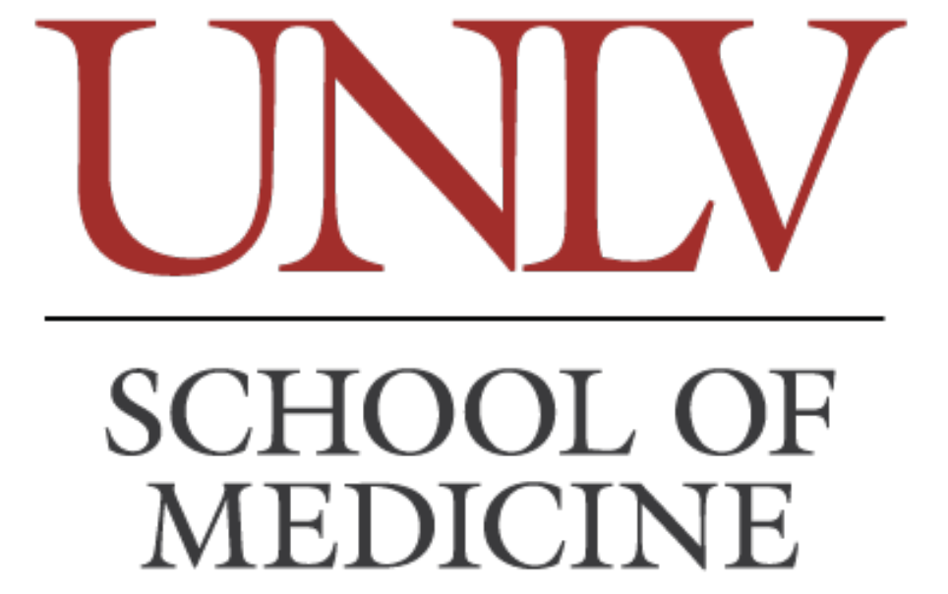

AAMC Building Better Curriculum
September 11, 2019 Webinar
Integrating Community Service, Palliative Care,
Wellness and Integrative Medicine into the Medical Education Curriculum
Corrin C. Sullivan, Ph.D – Assistant Dean of Curriculum
Annie Weisman, Ph.D – Director of Wellness & Integrative Medicine

Slide 3
Disclosures
We are not receiving financial compensation for this presentation.
We have no relationships with for-profit or not-for-profit organizations/corporations.

Slide 4
Outline
Overview of the UNLV School of Medicine’s, UNLVSOM, mission and context.
Curriculum’s emphasis on community service, palliative care, wellness and integrative medicine.
  Where these major themes reside in the curriculum and purpose.
How is it all mapped?
Quick Q & A

Slide 6
Curriculum Overview
The UNLVSOM curriculum integrates foundational science, primary care and palliative care clinical experiences with community-based service learning that addresses population health and social disparities, incorporates independent research projects (contributing to the growth of scientific knowledge and community health resources), and develops strong commitments to quality patient care, public service, and lifelong learning.

Slide 7
Curriculum Overview
The UNLVSOM curriculum integrates foundational science, primary care and palliative care clinical experiences with community-based service learning that addresses population health and social disparities, incorporates independent research projects (contributing to the growth of scientific knowledge and community health resources), and develops strong commitments to quality patience care, public service and lifelong learning.

Slide 8
Medical Knowledge & Applied Clinical Skills

Slide 9
Medical Knowledge & Applied Clinical Skills
Relationships | Humanism

Slide 10
Medical Knowledge & Applied Clinical Skills
Relationships | Humanism
Personal Care & Wellness

Slide 11
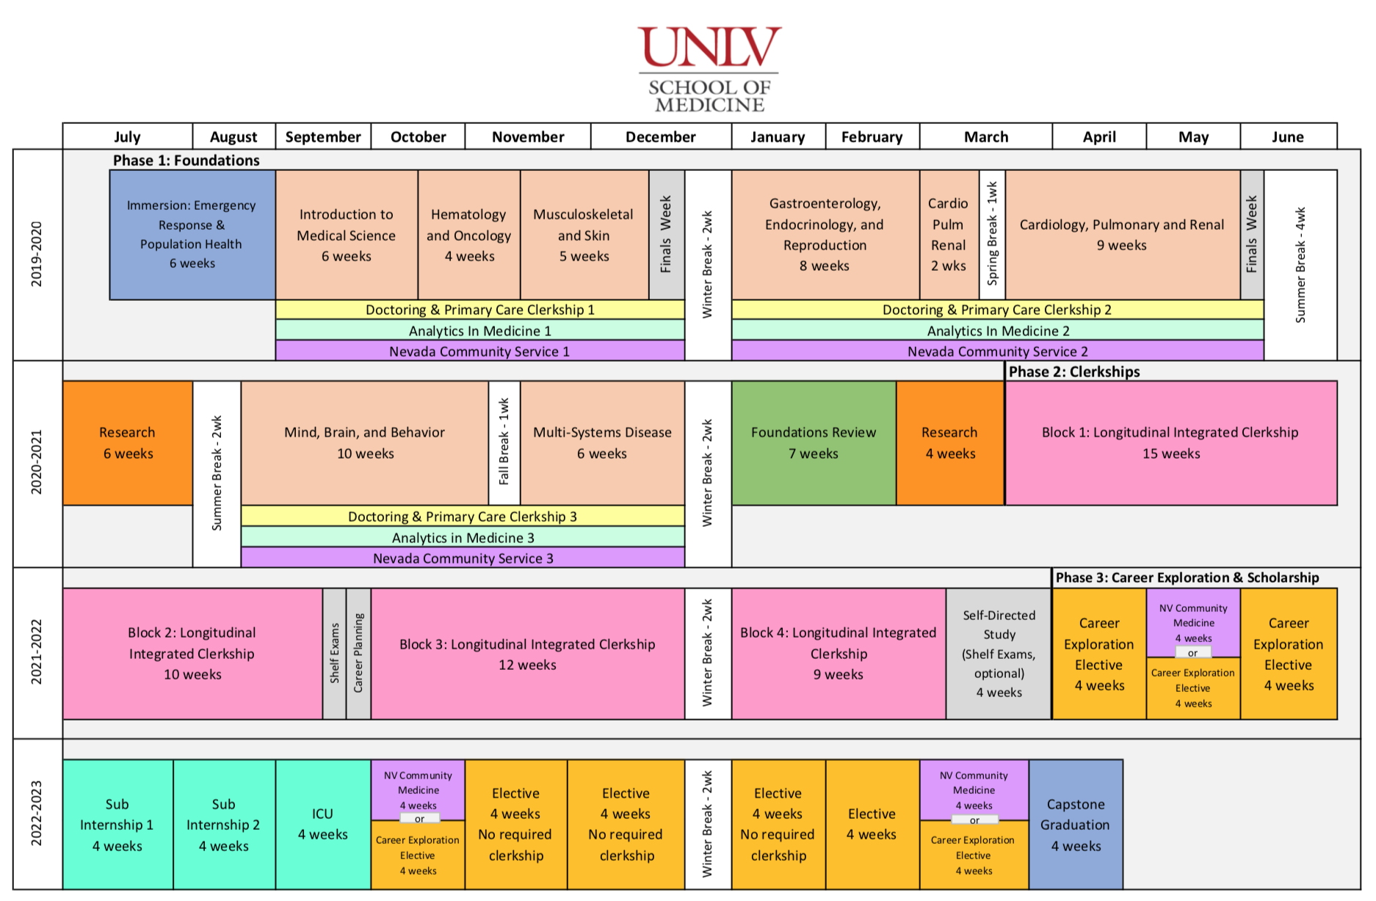

Slide 14
PHASE 1 – Foundations

Slide 15
PHASE 2 – Clerkships

Slide 16
PHASE 3 – Career Preparation

Slide 17
Palliative Care & Hospice
In the first year (Phase 1: Foundations)
Demonstrates collaborative approach to patient care.
The Life Cycle
Care of Chronic Disease

Slide 18
Wellness & Integrative Medicine
On-campus wellness activities offered throughout all Phases of the curriculum and for residents – yoga, tai chi, meditation, impromptu parties, therapy dogs, chair massage, etc.
Annual ‘Relationships in Medicine’ workshop for students and significant others.
Integrative Medicine taught as a major thread throughout all four years of the medical education curriculum.
Care of Chronic Disease

Slide 20
Knowledge & Applied Skills
Clinical Reasoning
& Applied Care
Organ-System
Courses
Doctoring
AIM
LICs
Resource
PBL
EMT
PCC
Research
Integrative Medicine
NV Community Service
Relationships Humanism

Slide 21
Contact Info
Corrin C. Sullivan, Ph.D – Assistant Dean of Curriculum
Corrin.Sullivan@unlv.edu | (702) 895-1409
Annie Weisman, Ph.D – Director of Wellness & Integrative Medicine
Anne.Weisman@unlv.edu | (702) 895-1409

Slide 22
Building Better Curriculum
Service Learning in the Curriculum

Slide 23
No Disclosures to report

Slide 24
Objectives
Describe the process used at AMC for mapping the curriculum
Describe the use of Service Learning Objectives in mapping
Describe how this is used in assessment of the curriculum

Slide 25
AMC Curriculum
2 years pre-clinical
  Organ system based, integrative
  Year 1 normal with clinical vignettes
  Year 2 abnormal
2 years clinical
  Year 3 core clerkships
  Year 4 electives
Longitudinal themes throughout the 4 years
  Evidence Based Health Care
  Ethics/legal
  Informatics
  Nutrition

Slide 26
Service Learning at AMC
During Orientation
  Lecture about Service Learning and Community Engagement
  Full Day ‘Immersion Event’
Requirements for all students
  40 hours of Service Learning with reflection
  Over 20 different programs
  2-3 Days of Service throughout the year

Slide 27
Service Learning Integrated into the Curriculum
Service Learning is a curricular component
Service Learning faculty
  Dr. Ingrid Allard, Associate Dean
  Marva Richards, MPH
  Kara Burke, MPH
Invited to present material at pre-clinical and clinical faculty meetings

Slide 28
Curriculum Database
Originally used CurrMIT at AAMC
Current database developed by Michael Acadia at George Washington University in 2006-2007
  Used for both Medical and Graduate Curriculum
  Accessible by faculty, students and staff
Data is copied every year and then updates are made throughout the year
  All course directors review database entries

Slide 29
Service Learning and Curriculum Database
Service Learning Programs are objective driven
Mapped in the Curriculum Database
  Program Objectives
  Theme Objectives

Slide 30
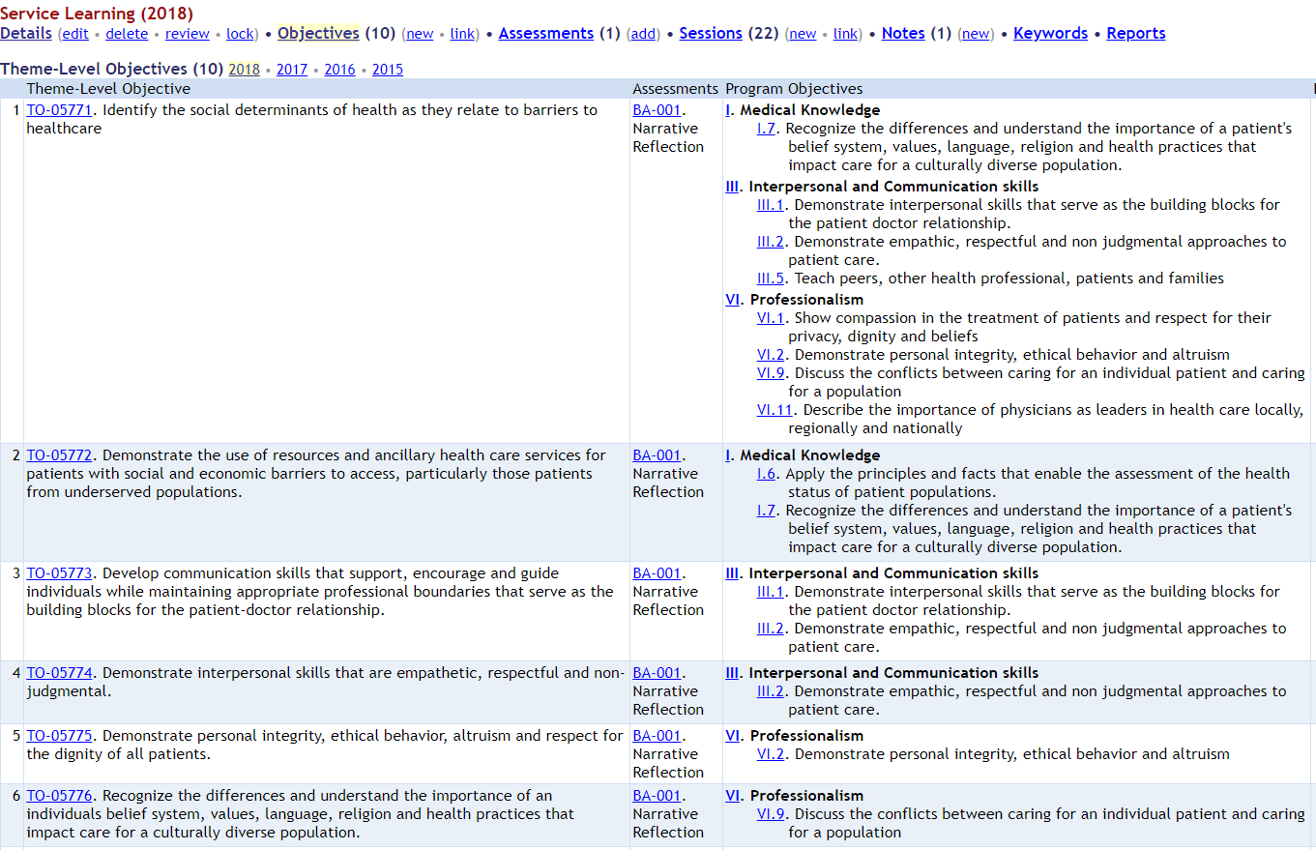

Slide 31
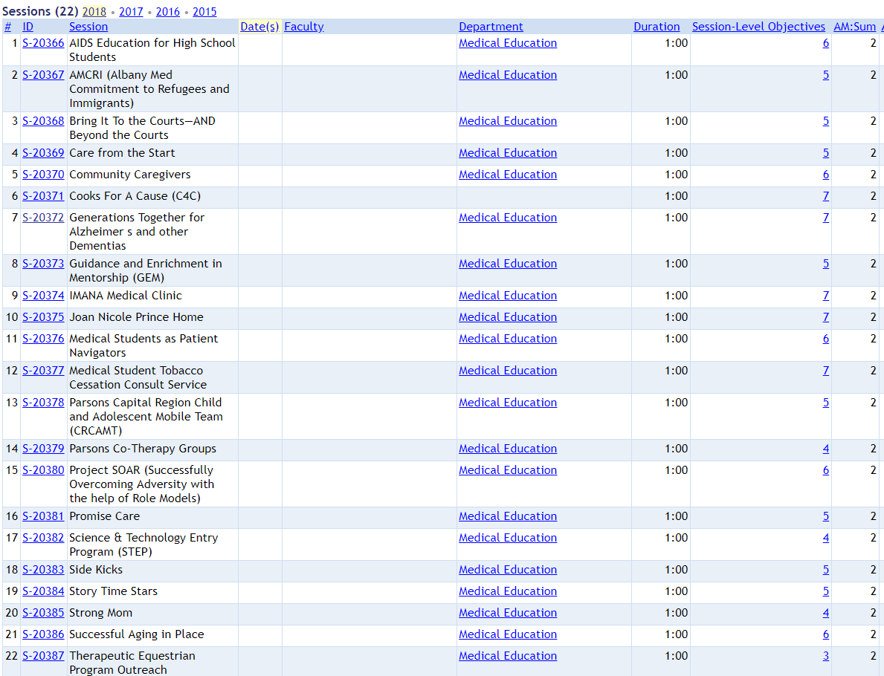

Slide 32
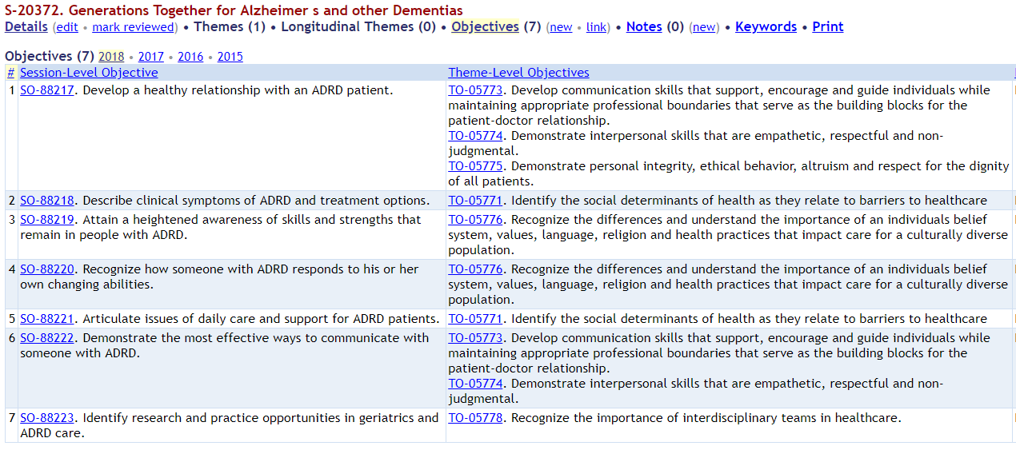

Slide 33
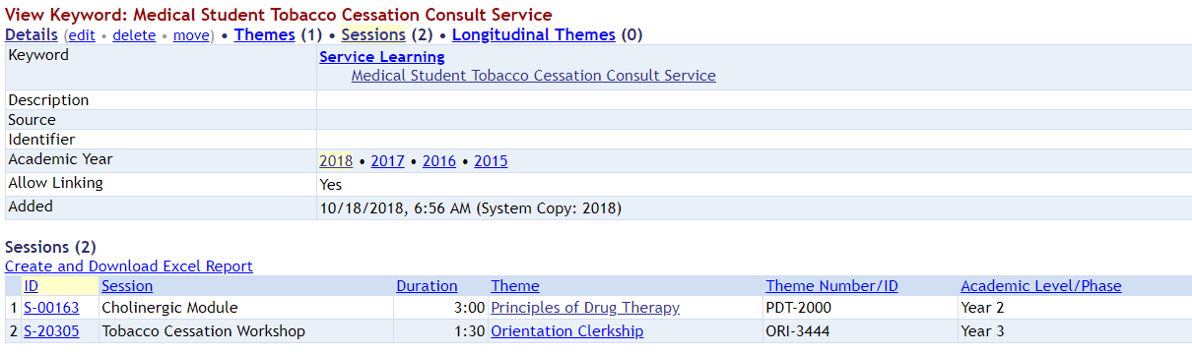

Slide 34
Curriculum Assessment
Service Learning is evaluated every 3 years
  Every year in the overall 4 year report
Reports generated from the curriculum database allows the assessment team to have current data to track different topics.
Service Learning leaders submit an end of year report with student and program evaluation

Slide 35
Use of the Data
Faculty
  Continue to integrate service learning with the curriculum
  Look for opportunities to increase integrations
Students
  Learn where service learning fits into the pre-clinical curriculum

Slide 36
Challenges
As new programs are developed, finding intentional integration in the curriculum
Integrating into the Clinical Curriculum
Continuing to identify needs of the community

Slide 37
Questions
Feel free to contact me:
  Rebecca Keller, PhD
  Albany Medical College
  Asst Dean, Medical Education
  Professor, Molecular and Cellular Physiology
  kellerre@amc.edu
  (518) 262-8105

Slide 38
Thank you and we will see you next month!
Please register for next month’s
Building Better Curriculum Webinar Series on
Wednesday, October 9, 2019 at 1:00 pm EST.
Using Interactive Learning Modules to Teach Value-Based Health Care to Health Profession’s Trainees Across the United States
Victoria Valencia, Assistant Director for Health Care Value, Dell Medical School – The University of Texas at Austin
We will post September’s series on AAMC’s website here:
www.aamc.org/cir/webinars

