Slide 1
Solano County Behavioral Health MHSA Innovation Plan
A Joint Project Between Solano County and the UC Davis Center for Reducing Health Disparities
Notes:
Mary Slide

Slide 2
Mental Health Services Act (MHSA)
November 2004 passage of Proposition 63 – Response to the limitations of local mental health system
1% tax on income over $1 million
Community-driven program and service delivery design to reach traditionally underserved populations
Outcome driven
Notes:
Provide brief history of MHSA for the public:
Why proposition 63 came to be: underfunded local mental health system + high demand of community mental health services = tax ballot to raise additional funds.
1% tax on the wealthiest Californians to provide additional funding into the local mental health system
Required in California statue that MHSA programs and services are designed with the community; planning process must be community driven, wellness and recovery emphasis, and programs should target traditionally underserved populations and communities.
Best and promising practices are used for program design

Slide 3
MHSA
Five areas that can be funded by MHSA dollars:
Community Services and Supports (CSS)
Prevention and Early Intervention (PEI)
Capital Facilities and Technology Needs (CFTN)
Workforce Education & Training
Innovation
Required community planning process – 3yr integrated plan and annual updates: all submitted to the California MHSA Oversight and Accountability Commission(MHSAOC)
Notes:
Briefly touch on the areas funded through MHSA, emphasizing innovation. Briefly touch on the required planning process, the three-yr. integrated plan that Solano adopted, and annual updates.

Slide 4
MHSA Innovation – Nuts & Bolts
Innovation programs and services must be:
Unique and creative: new, not just “new to me”
Promote recovery and resiliency
Developed with communities, including underserved populations within communities
Lead to system reformation and new approaches
Notes:
New to me: meaning, services or programs that exist in the state cannot be just duplicated using MHSA-innovation funds. Duplication can only occur if there is a difference in the program design and/or population that will be served by the program (e.g. using a evidence-based practice tailored for urban settings, for rural communities).

Slide 5
Solano County MHSA – Innovation Proposal
Five guiding principles for the proposal:
Cultural transformation
Reduction in health disparities
Inclusion
Transparency and public access
Lean management
Notes:
Mary Slide
1. Cultural Transformation: Stakeholders express their values about the characteristics of a culturally and linguistically responsive behavioral health system in Solano County, and take action toward those values and outcomes that matter to the communities.
2. Reduction of Health Disparities: The CLAS standards, created by the DHHS Office of Minority Health, serve to reduce health disparities by setting standards for mental health and health care organizations to ensure appropriate language access, workforce diversity and cultural competence, and organizational supports for culturally and linguistically appropriate care.
3. Inclusion: We aim to develop action plans that incorporate the perspectives, needs, and assets of key community-based partners, mental health consumers, their families, and their communities, in addition to Solano County’s Mental Health Care System.
4. Transparency and Public Access: We will build transparency into the process and ensure public access to agendas and minutes and a way for unsolicited input to be received and considered.
5. Lean Management: We will optimize efficient utilization of culturally and linguistically appropriate services by building upon community and organizational assets with high potential to contribute to CLAS, and work across organizational silos while minimizing wasted efforts.

Slide 6
Solano County: Cultural Transformation Model
OVERARCHING GOALS
Develop collaborative network of community, county, and community-based organization leaders trained on CLAS Standards
Design and implement CLAS policies, procedures, and programs and evaluate outcomes
Address the mental health needs of three of Solano County’s most underserved communities (i.e., Latinos, Filipino-Americans, and LGBTQ)
First County to design a multi-phase Innovation training and transformation project that combines CLAS with community engagement
Notes:
Gustavo Slide

Slide 7
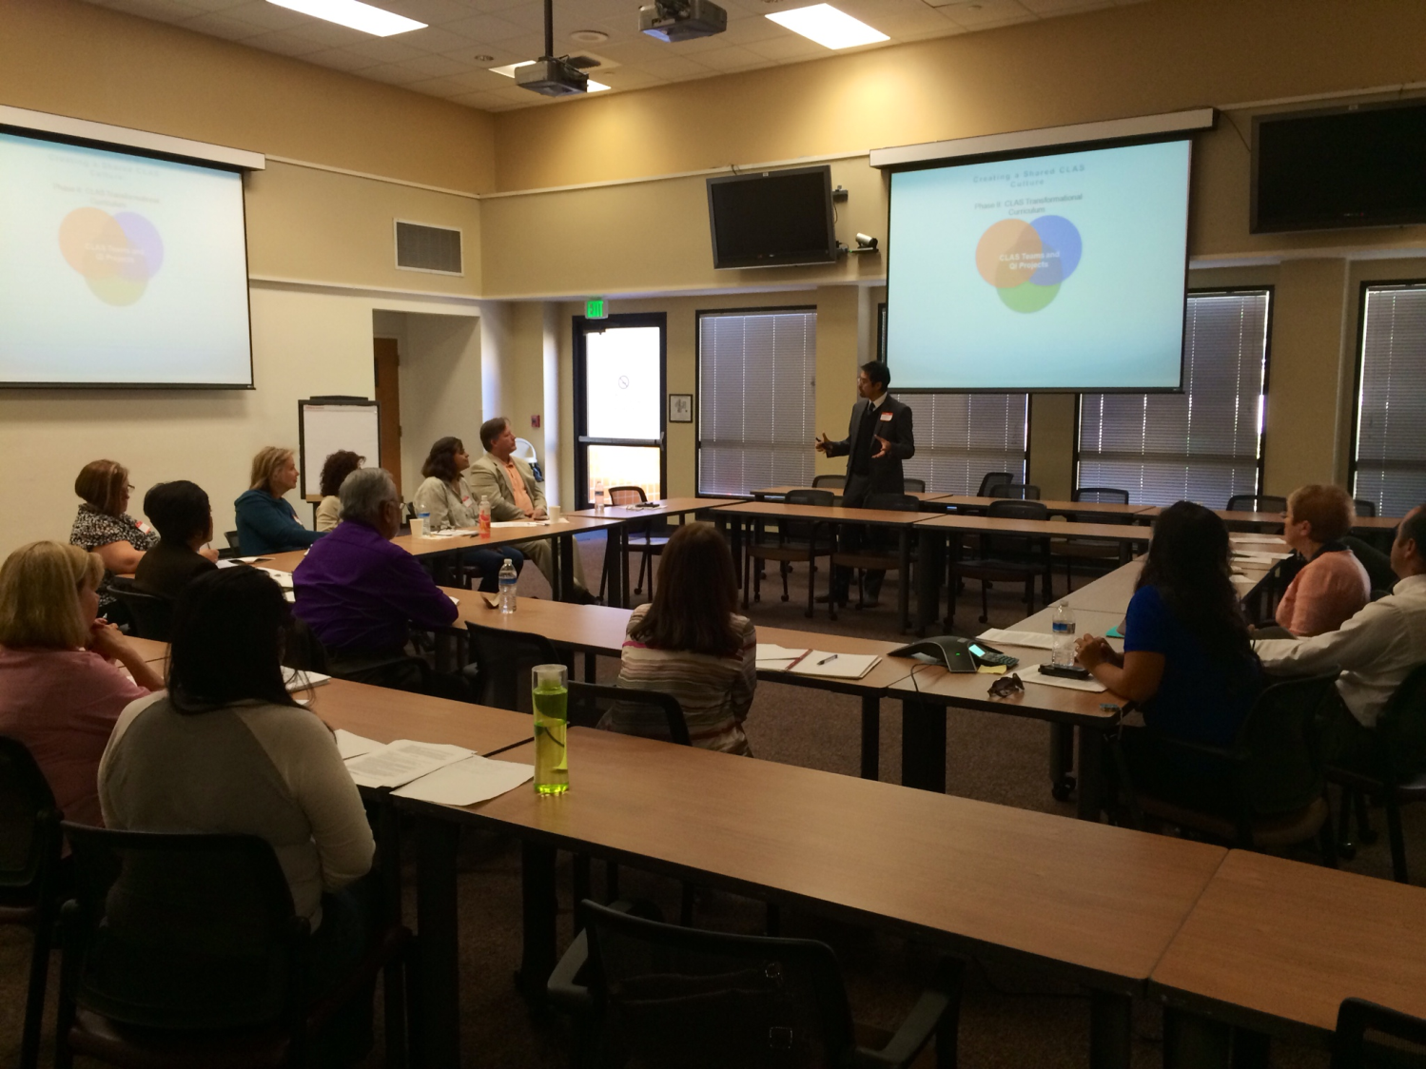
Transforming Solano County through the MHSA Innovations Program
Develop collaborative network and train community, county, and CBO leaders on CLAS
Design and implement policies and systems to promote CLAS
To address the mental health needs of Solano County’s two most underserved communities
Notes:
Gustavo Slide

Slide 8
Phase I:
Engagement & Organizations’ Cultural Assessment
County
CBOs
Community
Determine what matters to community, county, CBOs, and researchers and strike a balance
Notes:
Gustavo Slide

Slide 9
Creating a Shared CLAS Culture
Phase II:
CLAS Transformational
Curriculum
County
CBOs
CLAS Teams and
QI Projects
Community
Notes:
Gustavo Slide

Slide 10
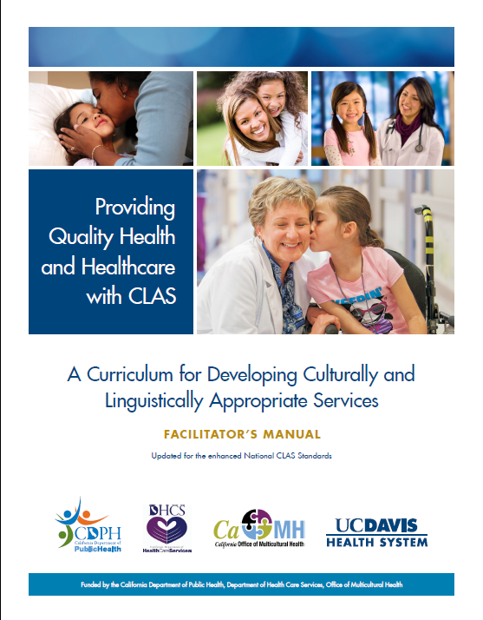
Health System Transformation through Culturally and Linguistically Appropriate Services (CLAS)
The enhanced CLAS standards:
Include an emphasis on the critical role of health care leaders in advancing quality care and health equity for diverse populations
Promote health equity as integral to the operational environment and strategic planning process of a health care organization
Notes:
Gustavo Slide

Slide 11
Notes:
Gustavo Slide

Slide 12
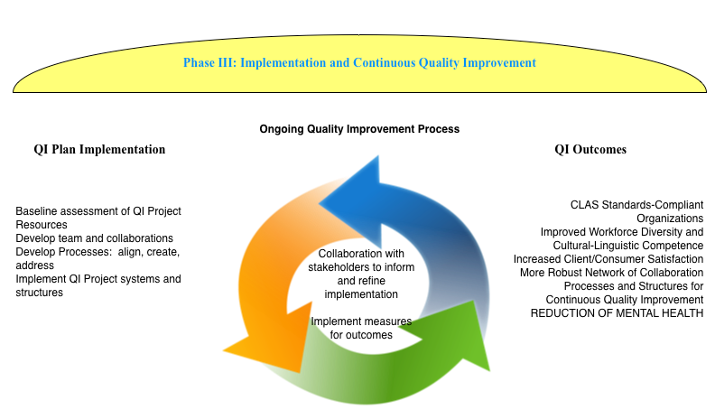
Notes:
Gustavo Slide

Slide 13
Cultural Transformation Model
Solano County
Alonzo Plough, Robert Wood Johnson Foundation, 2015
Notes:
Gustavo Slide

Slide 14
Timeline and Activities
Year | Quarter 1 | Quarter 2 |  | Quarter 3 |  | Quarter 4
One | Recruit staff for project CRHD attend community forums/agency meetings to foster CRHD-Solano relationship Identify cultural brokers and key informants Identify county data sources to establish baseline | Initiate key informant Interviews Analyze county data sources Continue to build CRHD-Solano County relationships Plan and starting to conduct focus groups Plan community forums Plan interviews with CBOs Plan focus groups with cultural competency advisory workgroups (Latino, Filipino-American, LGBTQ) |  | Analyze Key Informant Interviews Conduct focus groups and community forums Conduct focus groups with cultural competency advisory workgroups |  | Analyze community forum/focus group data Start customizing CLAS transformational curriculum based on key informant interviews, focus groups, and community forums Recruit for participants CLAS transformational curriculum CLAS transformational curriculum for trainers
Two | CLAS transformational curriculum Recruit cohorts | Train cohort 1 Cohort 1 implementation process |  | Train cohort 2 Cohorts 1 implementation process |  | Train cohort 3 Cohorts 1 and 2 implementation process
Three | CLAS transformational curriculum conference Design/disseminate CLAS strategies sourcebook Implementation process | Implementation and ongoing quality improvement (QI) process
Four | Implementation and ongoing QI process Design/disseminate CLAS implementation tips sourcebook Recruit and train CLAS sustainability coordinator |  |  | Design evaluation methods to assess countywide impact of CLAS on patient satisfaction and effectiveness of Solano County efforts (governance, leadership and workforce, etc.)
Five | Continue work with the CLAS sustainability coordinator | Convene CLAS sustainability symposium Implement countywide CLAS evaluation process | Design and implement CLAS sustainability plan |  | Design and disseminate resources on the Solano County CLAS transformation process
Notes:
Gustavo Slide

Slide 15
Outcomes
Short-term (i.e., increased bidirectional trust, communication, and collaboration). Use metrics re: what matters to communities, county, CBOs, and researchers and reach a balance
Intermediate-term (i.e., increased community capacity to engage in joint decisions re: service delivery AND county and CBOs capacity to engage with communities): Enhance the experience of care, improve health outcomes, and lower the costs (Triple Aim)
Long-term outcomes: Achieve health equity in access and utilization of mental health services by Filipinos, Latinos, and LGBTQ communities
Notes:
Gusatvo Slide

