Slide 1
Mother’s Wisdom Breast Health Program (2010-2013)
Final Enrollment
Five participating health clinics
579 AI/AN women enrolled
98 Talking Circles Completed
474 Participants Completed Talking Circles

Slide 2
Study Goal: 1) To increase awareness and knowledge of breast cancer among AI/AN women, 40 years and older; 2) To increase mammography screening by at least 18%; higher than 49% among eligible AI/AN women.

Slide 3
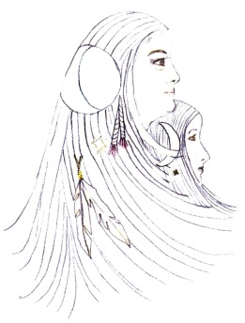
Mother’s Wisdom Breast Health Program Three-Year Study (2010-2013)
Clinic | % of eligible Women Screened in 2009 | %of eligible Women Screened in 2013 | GPRA Target for 2013**
SNAC | 0% | 53% | 49%
K’imaw | 51% | 59% | 49%
UIHS | 48% | 29%* | 49%
Pitriver | 46% | 70% | 49%
MACT | 19% | 59% | 49%
* UIHS experienced significant staff turnover during this three-year period that prevented recruiting enough women to participate in the study and completing as many mammograms as possible.
** The GPRA targets are established by the Indian Health Service.

