Slide 1
Disability Law 101: What Faculty Need to Know About Student Accommodations
Elisa Laird-Metke, J.D.
University of California, San Francisco
Jon McGough, M.Ed.(c)
University of Washington
Lisa Meeks, Ph.D.
University of California, San Francisco

Slide 2
The Coalition wishes to thank the AAMC and for their generous support in developing this webinar series.

Slide 3
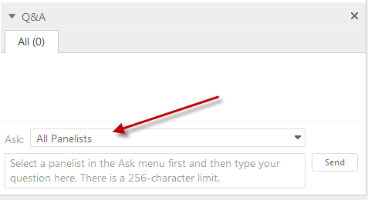
  Please use the Q&A panel located on the right hand side of your screen to submit your questions. Send to All Panelists.
Notes:
Imagine description: As you can see there is a red arrow pointing to the dropdown menu on your screen showing where to go to ask your questions.

Slide 4
Today’s Topics:
Why are more students receiving disability accommodations?
What are the disability laws applicable to higher education?
How is “disability” determined, and what are a school’s obligations?
Faculty’s role regarding the determination and implementation of disability accommodations.
How disability accommodations intersect with patient safety and technical standards.

Slide 5
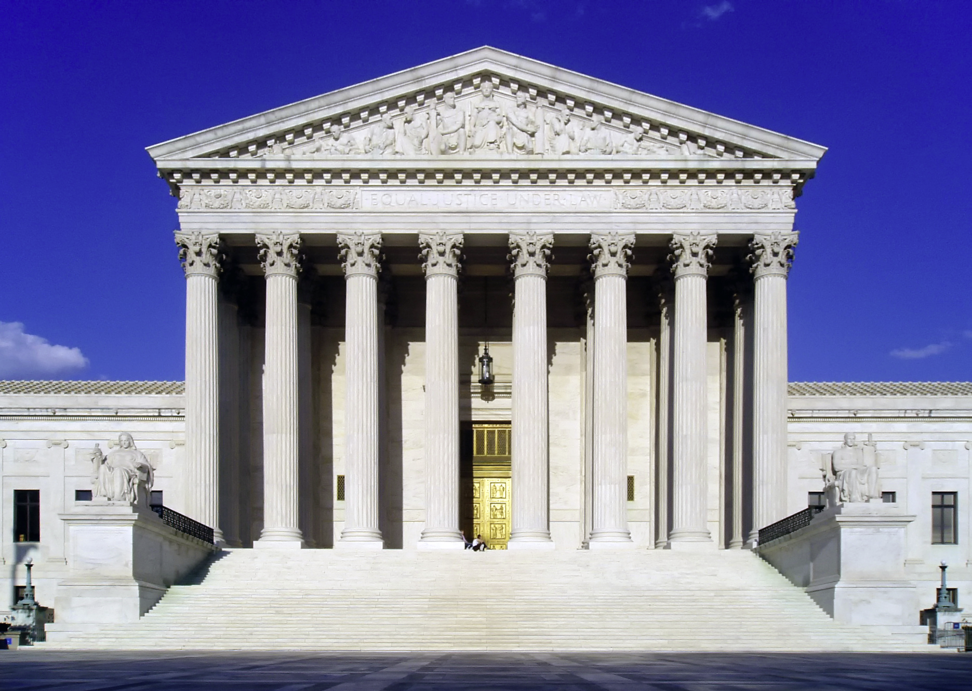
Evolution of the Law
Notes:
Image Description: A picture of the supreme court with a gold door. The photo also shows a blue sky.

Slide 6
Evolution of Disability Law
1973 Section 504
1990
ADA
2008 ADAAA
State Law
Notes:
Image description: A grey arrow with three blue boxes indicating the progression of the laws that guide the ADA.

Slide 7
Why More Students Now?
More students with disabilities attending college.
Increased awareness and reduced stigma.
Changes in the law in 2008 mean more students are eligible for disability services.

Slide 8
Benefits of Accommodations
Improved student retention and graduation.
Reduced disability-related complaints and litigation.
Increased diversity in medical programs.
Schools can meet new NIH requirements in grant applications for describing university efforts to recruit, retain, and graduate students with disabilities.

Slide 9
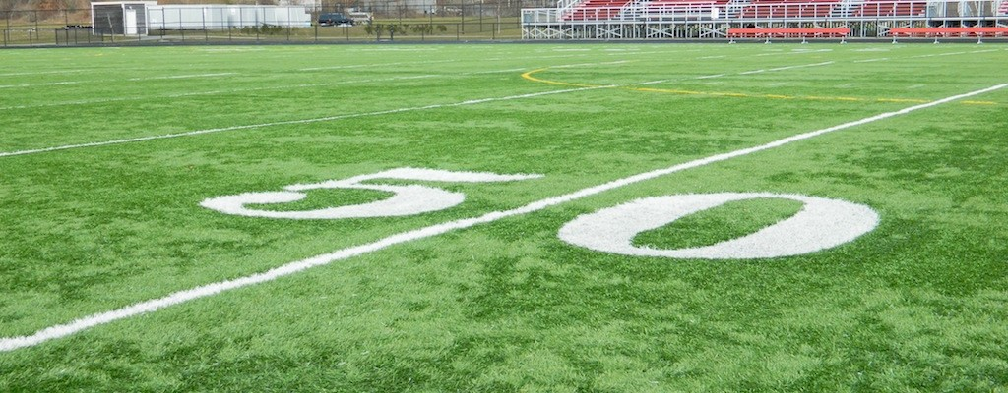
Notes:
Image description: This image is of the 50 yard line on a football field, the field is green and the letters five and zero are written in white with a line down the middle.

Slide 10
What does the DS office do?
Understand disability laws and school’s obligations.
Work on behalf of the school.
Work on behalf of students.
Knowledge of common accommodations.
Problem solve for uncommon accommodations.

Slide 11
ADA definition of “disability”
A physical impairment that substantially limits one or more major life activities.
Major life activities include: performing manual tasks, seeing, hearing, eating, sleeping, walking, standing, lifting, bending, speaking, breathing, learning, reading, concentrating, thinking, communicating, and working.
Major Bodily Functions include: functions of the immune system, normal cell growth, digestive, bowel, bladder, neurological, brain, respiratory, circulatory, endocrine, and reproductive functions.

Slide 12
Accommodations
Student interview
Documentation
Observation
Notes:
Image description: The image has three blue square boxes with the words student interview, documentation and observation written in them. They also have grey arrows pointing to a blue oblong with accommodations written in the oblong.

Slide 13
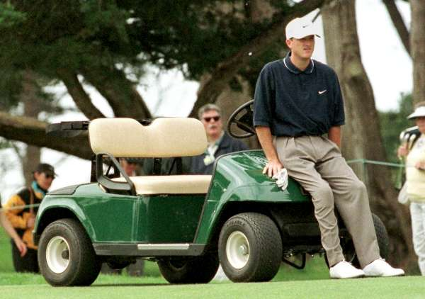
Photo: www.compleatgolfer.co.za
Notes:
Image description: This photo is of Casey Martin, world famous golfer, leaning against a green golf cart on the fairway. He is wearing khaki pants and a blue Nike t-shirt with white nike hat and white golf shoes.

Slide 14
Faculty’s role in accommodations:
Work with DS staff to determine accommodations.
The interactive process is critical!
-Zuckle (1999), Kaltenberger (1998), McGuinness (1998), Wynne (1991), Wong (1999).
Key players must be involved: disability experts AND faculty.
-OCR letter to U.C. Santa Cruz (1999)(Faculty alone cannot determine accommodations).

Slide 15
Faculty’s role in accommodations:
2. Implement the accommodations approved by DS staff.
OCR case decision: Faculty can’t refuse to implement approved accommodations.
-OCR letter to Kennesaw State University (2013)
If you have concerns about accommodations, contact DS.

Slide 16
Faculty’s role in accommodations:
3. Ensure students know about DS office.
Students must follow established procedures for requesting accommodations.
-OCR cases: A.T. Still (2009), Western Mich.(2000), Texas Women’s U. (2000), Coll. of St. Rose (2001).
If students don’t know about the process for requesting accommodations, they cannot be held responsible for failing to fulfill them.
-OCR Letter to Concord Career Institute (2005).

Slide 17
Faculty’s role in accommodations:
4. Refer students to DS office.
Student disclosing disability to faculty = student disclosing to the institution.
-North v. Widener University (2012).
The word “disability” is not necessary to constitute disclosure—disclosure could be as simple as mentioning undergoing treatment or having an ailment.

Slide 18
Faculty’s role in accommodations:
What faculty DON’T have to do:
Tolerate inappropriate behavior from students—professionalism standards are not waived, even for disability.
-Halpern v. Wake Forest University Health Sciences (2012).

Slide 19
Technical Standards
  Schools “shall not impose or apply eligibility criteria that screen out or tend to screen out an individual with a disability or any class of individuals with disabilities…unless such criteria can be shown to be necessary for the provision of the service, program, or activity being offered.”
28 C.F.R. 35.130(b)(8); 28 C.F.R. 36.301(a).

Slide 20
Technical Standards
Examples:
  Ability to hear a heartbeat
    would likely be impermissible because individuals who cannot hear may just as effectively rely on digital stethoscopes to “see” a heartbeat on a screen.
  Ability to detect a heartbeat
    more clearly describes the desired skill, without screening out the entire class of individuals with reduced hearing.

Slide 21
Technical Standards
Schools must create the technical standards themselves—this task can’t be punted to another entity, such as a clerkship site.
-OCR Letter to Milligan College (2011).

Slide 22
Patient Safety
“In determining whether an individual poses a direct threat to the health or safety of others, a [school]
must make an individualized assessment,
based on reasonable judgment that relies on current medical knowledge or on the best available objective evidence,
to ascertain: the nature, duration, and severity of the risk; the probability that the potential injury will actually occur;
and whether reasonable modifications of policies, practices, or procedures or the provision of auxiliary aids or services will mitigate the risk.”
28 C.F.R. 36.208.

Slide 23
Patient Safety
Featherstone v. Pacific Northwest University of Health Sciences (2014).
Compare to case we started with:
Southeastern Community College v. Davis (1979).

Slide 24
QUESTIONS ?

Slide 25
Be sure to register for the next webinar on June 10, 2015:
Separating Fact From Fiction: Debunking Disability Myths and Addressing Legitimate Concerns
Details and Registration can be found
at www.aamc.org/gsa.

Slide 26
Notes:
Image description: The UCSF logo of all white letters

