Slide 1
AAMC Building Better Curriculum Webinar Series We will begin our presentation shortly. Topic: The CI upload process and Verification Report Update from the AAMC’s Curriculum Inventory Presenter from AAMC: Angela Blood Director, Curricular Resources PLEASE NOTE: All users will be muted during the webinar but should use the chat feature to send questions to Walter Fitz-William during the presentation. We will try to answer as many questions as possible at the end of the presentation.

Slide 2
AAMC Building Better Curriculum webinar series
The CI upload process and Verification Report
July 2019

Slide 3
Agenda
- Access to CI School Portal and CI Staging Environment
- CI Vendor Portal
- New CI participating vendor contracts
- AAMC Business Rules for August 1, 2019
- Verification Report 2019

Slide 4
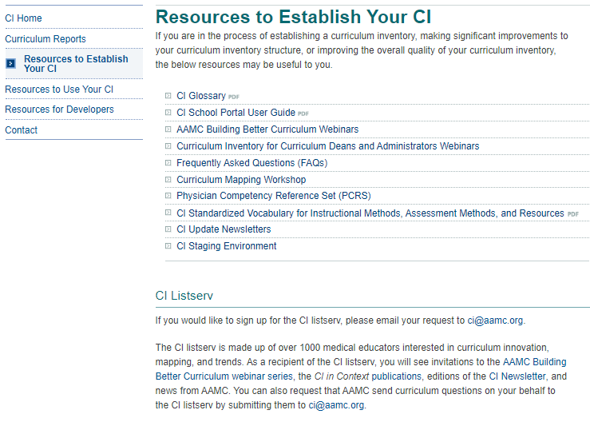
CI Website
Notes:
We’re going to be talking about resources that will be helpful to you during the CI data upload process, beginning August 1 and closing September 30, 2019. The resources we’ll be referencing are located on the CI website, so you can choose to open up a browser and follow along while we go through these resources.
The CI Website is organized according to resources to establish a curriculum inventory, resources to use your curriculum inventory effectively, and resources for developers and vendors. Some of the communications that are especially helpful and can be found here include:
The CI School Portal user guide
The AAMC Building Better Curriculum webinar series
The CI Standardized Vocabulary on instructional methods, assessment methods, and resources
The CI Newsletter
The CI Staging environment
And the CI listesrv

Slide 5
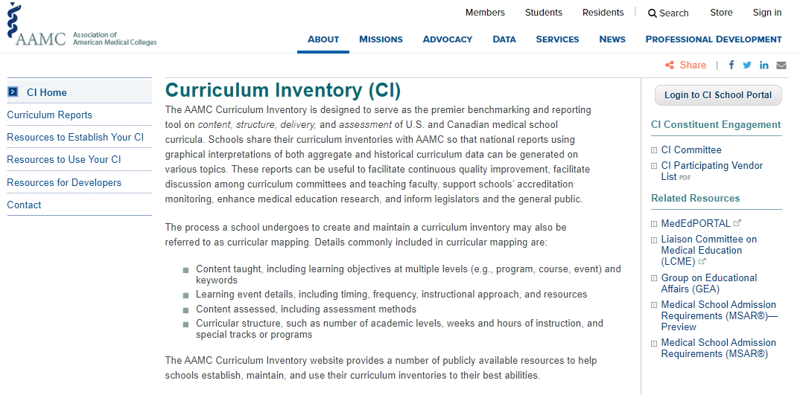
CI School Portal
Notes:
This is the production site, used once per year to submit school CI data. This will now hold “Your Curriculum Reports” including past Verification Reports, requested custom reports, and special AAMC reports.

Slide 6
CI Account Management
Email changes to CI Primary Admin or Curricular Dean roles to ci@aamc.org.
All other roles, you can edit under “Manage Users” in your CI School Portal.

Slide 7
CI Staging Environment
Email names and email addresses of those you would like to have access to the CI Staging Environment to ci@aamc.org. These faculty must already have access to your CI School Portal).
Notes:
CI Staging Environment: open all year but cannot be used to officially submit CI data, only to test CI data submissions. In the past, not all the functionality of the staging site matched the CI School Portal (production) site.
Emails went out about a month ago to the Curriculum Dean and CI Primary Admins for each school asking for updates to your institutions’ names and email addresses of people you want to have access to your CI School Portal and CI Staging Environment. If you still need to make updates,

Slide 8
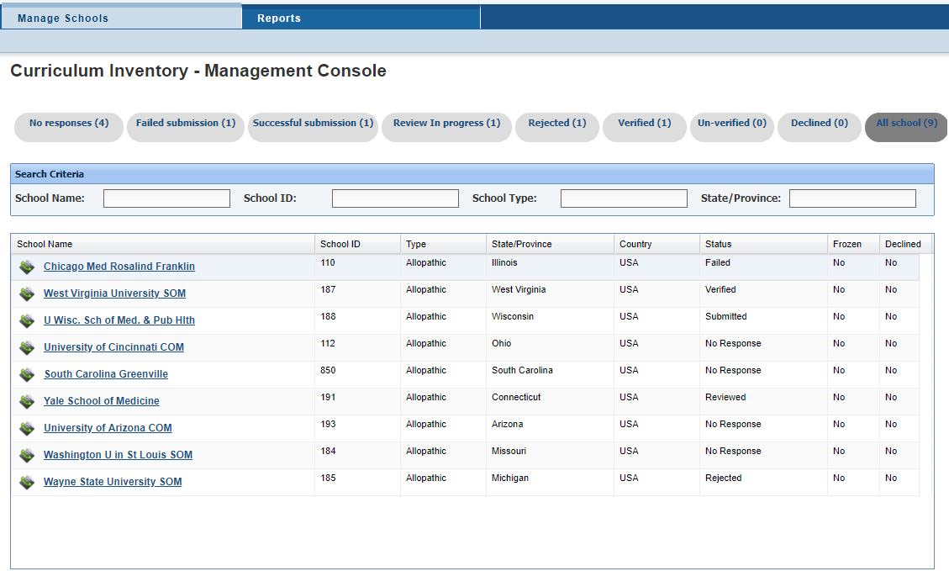
New CI Vendor Portal
Notes:
One of the major improvements this year to support vendors in helping their clients is a new Vendor Portal. This was one of the major asks we heard from vendors during our needs assessment last year. Schools also need this to open the “black box” of issues when a school encounters trouble in submitting their CI data.
Vendors want a better idea of which of their clients was where in the CI process, and this portal will give them a password-protected view of which of their clients might need the most support. The schools above are just sample data. Vendors can only see the schools who assign them as a vendor, so there is no way a vendor can access a school’s verification report who hasn’t designated them as having permission. You need to choose your vendor through the CI School Portal; only then does AAMC give that vendor view-only access to your XML file and Verification report through the CI Vendor Portal.
Through the different tabs across the top of this image, vendors can see which of their clients have completed the process, how many times schools have attempted to submit (and perhaps target their customer service better to you). It also shows the vendor the Verification Report so they can in real time see the same potential error messages if there’s an issue, and the same results that you see. Instead of you having to send your vendor your verification report or take screen shots of errors, they can view these things for themselves.

Slide 9
New AAMC CI participating vendor agreements
- Consistent across all CI participating vendors
- Up to date with AAMC’s data management approach
- Technical requirements more explicit
- Agreement covers several years, but we also now have a yearly survey for vendors to update information like their staff members and contact information
Notes:
We’ve been working on this for about a year. It’s been a lot of internal work with AAMC’s legal department to make sure our agreements are up to date and in-keeping with AAMC’s approach to data management. We’ve told vendors these are coming, through our every-other-month web meetings and our in-person retreat for vendors last January.

Slide 10
AAMC Business Rules
-Rules that overlay the MedBiquitous Technical Standards
- We made only cosmetic or clarifying improvements this year, knowing that we are undergoing a review of the MedBiquitous Technical Standards
- Previously it was decided that AM015 Practical Lab would no longer a valid assessment method and its use will trigger a violation of CS12.
- AM019 Exam - Institutionally Developed, Laboratory, Practical remains a valid assessment method.
- Sequence Blocks nested in other sequence blocks must still be defined. If you do not define the sequence block, CS24 will be triggered.
Notes:
These are rules that overlay the MedBiquitous Technical Standards. An updated version is posted on our website. We made only cosmetic or clarifying improvements this year, knowing that we are undergoing a review of the MedBiquitous Technical Standards so significant work to the AAMC Business Rules will be undertaken following the MedBiquitous review is complete. We’ll highlight the AAMC Business Rule clarifications for you now. We briefed participating CI vendors on these during our January 2019 retreat.

Slide 11
Verification Report 2019
Continue trends from last year: readability, explanations, wording
New Goal: Make the report easier to share with your faculty
This will be the last year for the “big” Verification Report.
Notes:
We recognize that for some schools, the Verification Report can be very lengthy.
If the goal of reviewing the Verification Report is to make sure its accurate, asking one curricular dean to know the details or each event or course is probably not realistic. The faculty directly involved in the leadership of specific sections of the curriculum (like a neurology clerkship director, or dean of basic science) are likely to know their sections of the curriculum more intimately. It would also help not only help check for accuracy in the Verification Report, but use the report for program evaluation if the report were easier to share.
Currently, all sequence blocks/courses were listed in one large table (and the same was true for events, across courses) so parsing out pieces of the Verification Report for specific faculty or specific purposes was not really possible.
If we could at least insert page breaks among sequence blocks/courses, the report would be easier to share with other key faculty and curriculum leaders.
Important resources on the CI website: VR sample and VR Guide.
Still has 12 tables and we didn’t delete info but we shuffled items around so we could fit more content into the report. Your report may be longer this year than it was last year, we’re hoping the potential increase in length will be justified because of the added value.

Slide 12
CI Verification Report Resources
https://www.aamc.org/initiatives/cir/useci/
Notes:
Before we jump into improvements, I wanted to share this website with you. All of the resources we’re talking about today are available to you on the CI website, specifically under “Resources to Use Your CI.” You can find samples of Verification Reports, and a Guide explaining how the previous version of the Verification Report differs from the new version.

Slide 13
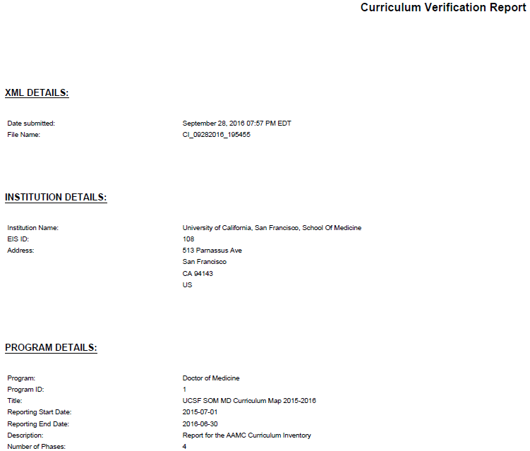
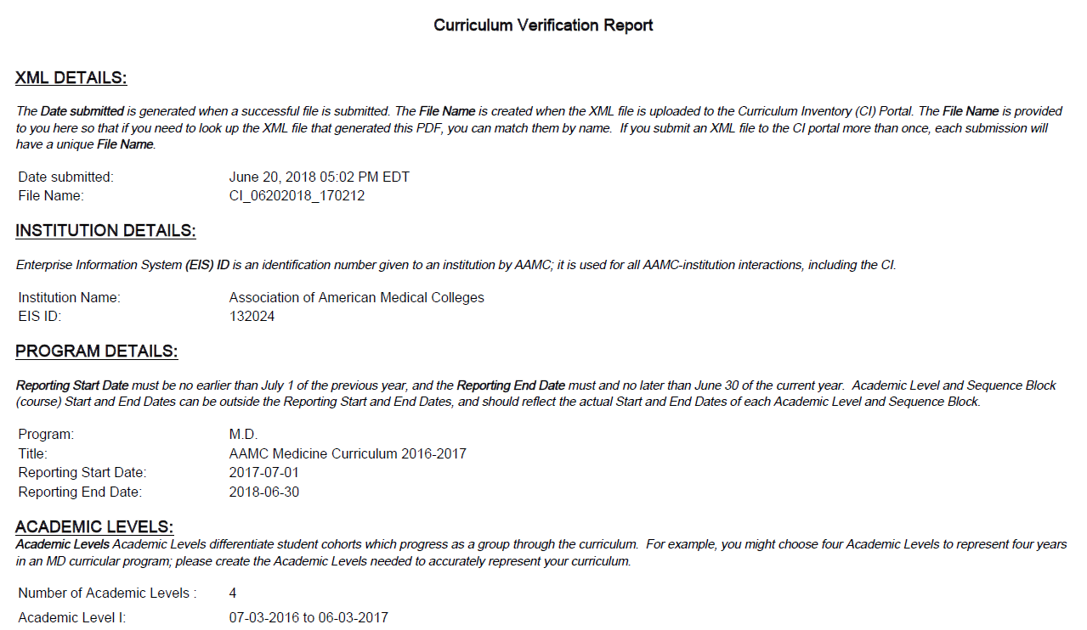
Verification Report Improvements from 2018
Readability: we changed the font, increased the size slightly, and tried to make better use of white space
Explanations: we added guide information for every section of the report, explaining what data is and is not included in given tables, how amounts are calculated, etc.
Wording: we added clarity in the glossary, retitled tables, retitled columns, and added columns within tables to more accurately represent which data is provided
OLD
NEW
Notes:
Here on the left is a reminder of what the Verification Report used to look like, and what the major aims for the Verification Report improvements in 2018 were. We focused on the readability, using the white space on the pages thoughtfully, adjusting the font and size of text. We added explanations for each table, and adjusted wording where needed for clarity.
These changes were made in a matter of months, with a very aggressive delivery timeline. Now we’ve had additional time to improve the Verification Report for 2019 so I’m excited to show you the further improvements we’ve built upon here.

Slide 14
OLD
NEW
Notes:
The table above is the previous version. The table below is the updated 2018 version.
We received a very positive reception to the changes we made for 2018. The improvements included:
Numbering of all tables
Underlines within tables as clickable links so you can jump to other parts of the PDF.
Links to resources on the CI website from within the report
Explicit wording to show which tables are designed to align with the LCME DCI.
Relabeling tables. It might have said “all” but it really was primary.
Adding explanations so its clear how formulas are calculated, what data makes it into the data.

Slide 15
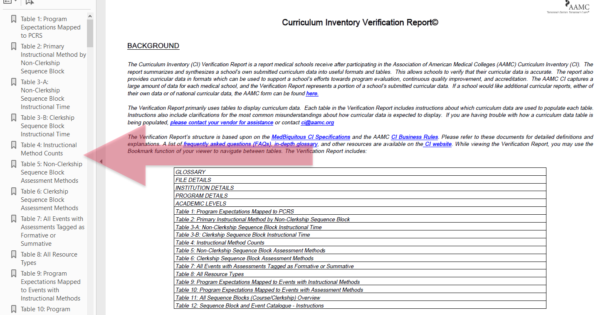
Navigating the Verification Report
Notes:
Another key improvement for 2018 was adding the bookmarks feature, so that the reader of the Verification Report could jump around from one section of the report to another. I’m showing you this especially here because we’re planning additional uses for the bookmarks feature for 2019.

Slide 16
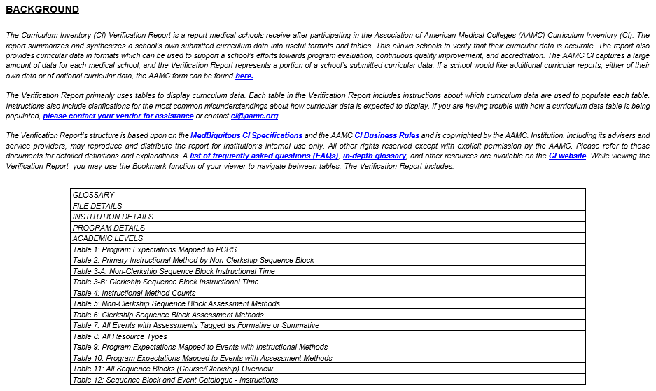
New background details and TOC

Slide 17
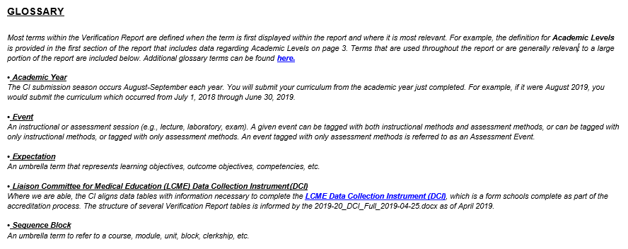
Glossary in Verification Report
Notes:
In the Glossary section, we’ve relocated some terms and definitions within the Verification Report so that you can read the definition of an item in the relevant report location. Terms that are used throughout the report or are generally relevant to a large portion of the report will be included in this Glossary. There’s a lengthier CI glossary on the CI website under “Resources to Establish your CI,” if you need more terms defined. We removed any terms from this glossary that aren’t directly related to the VR.

Slide 18
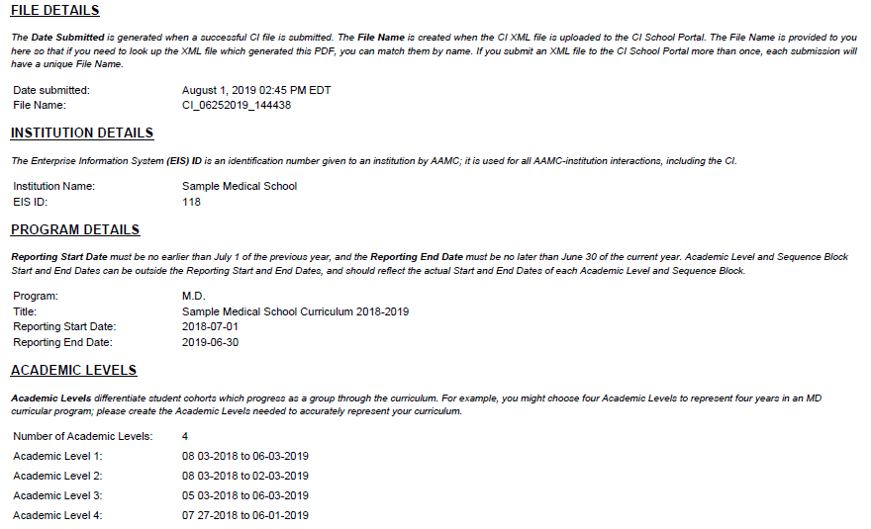
File details
Notes:
We’ve kept fields here that we think some of our members may need, and removed fields that were not necessary. Regarding File Details, many users may submit their CI data only once and will not need separate File Names for each CI data submission. However, there are some users who submit CI data, review their Verification Report, then make improvements and submit again. It may be important for them to compare files, so we’ve kept File Name in the Verification Report.

Slide 19
Table 1: Program Expectations Mapped to PCRS
Notes:
All tables are now numbered and have a written explanation below their titles. References to other tables within a specific table description are hyperlinked to enable easy navigation within the report. Another way to navigate the report, if you’re using Adobe PDF, is to open Bookmarks. The bookmarked links allow you to easily jump between tables in the Verification Report.
Page breaks are added between each table to better enable you to share different portions of the report with different groups. For example, you may want to share pre-clerkship course information with pre-clerkship faculty, and clerkship information with clerkship directors. This may make the Verification Report more useful and help you avoid asking your faculty to search through the entire report for the sections most relevant to them.
Table 1: Program Expectations Mapped to PCRS
A single Program Expectation can be related to more than one PCRS competency statement, and a single PCRS competency statement can be related to more than one Program Expectation. Therefore, you might see multiple PCRS within a row for a single Program Expectation.

Slide 20
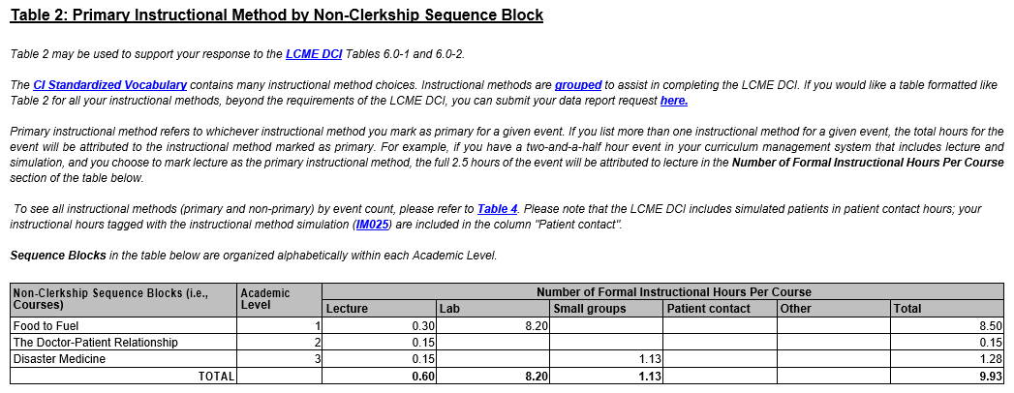
Table 2: Primary Instructional Method by Non-Clerkship Sequence Block
Notes:
Table 2 has been retitled compared to its 2018 version (Primary Instructional Method: Courses). When applicable, we refer to which portions of the LCME Data Collection Instrument (DCI) the data is relevant. Table 2 explanation also shows how mathematical formulas are calculated. When needed, we’ve improved the formulas.

Slide 21
Table 3: Instructional Time
Notes:
Table 3: Instructional Time
Table 3 is made up of “Table 3-A: Non-Clerkship Sequence Block Instructional” and “Table 3-B: Clerkship Sequence Block Instructional Time”. An “Academic Level” column has been added to this table. Notice that this content was previously listed after assessment methods. We’ve moved this up earlier in the report so that instructional information is grouped together, and assessment information is grouped together.

Slide 22
Table 4: Instructional Method Counts
Notes:
Table 4 has been retitled compared to its 2018 version (Primary Instructional Method Count). We have added a column for Number of Non-primary Occurrences of This Method so that Table 4 documents the Number of Events where a certain Instructional Method is tagged as Primary Method, and as Non-Primary Method.

Slide 23
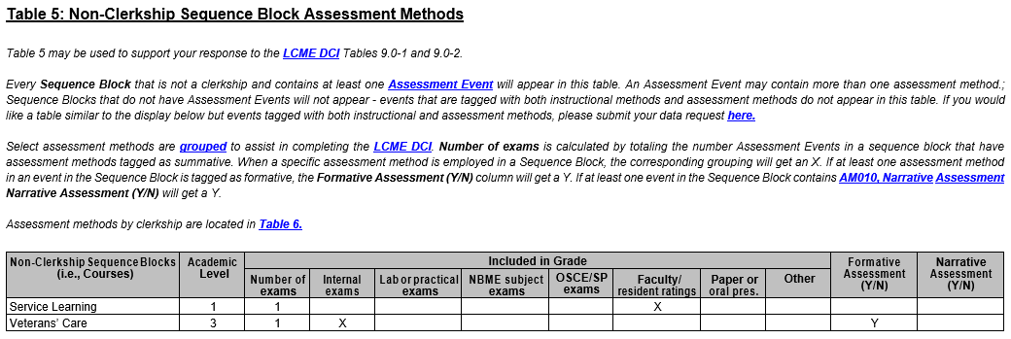
Table 5: Non-Clerkship Sequence Block Assessment Methods
Notes:
Table 5 has been retitled compared to its 2018 version (Assessment Methods: Courses) and new explanations have been added for clarity. You’ll again find the linkage to the LCME DCI in the description of Table 5. There are definitions for various terms within the table as well as links to external resources and other tables within the Verification Report. One of the external links directs you to the LCME DCI Crosswalk, which makes explicit which assessment methods are included in the “other” column. As you know, the CI’s standardized vocabulary on instructional methods, assessments, and resources has more options than the LCME DCI explicitly identifies, so the LCME Crosswalk collapses these instructional and assessment methods into LCME categories. The LCME has removed formative feedback from this table in newer iterations of the DCI, but we are continuing to include formative feedback here for those schools that use this data internally for their continuous quality improvement or program evaluation processes.

Slide 24
Table 6: Clerkship Sequence Block Assessment Methods
Notes:
Table 6: Clerkship Sequence Block Assessment Methods
Table 6 has been retitled compared to its 2018 version (Assessment Methods: Clerkships). Similar to Table 5, LCME DCI references, term definitions, and explanation of formulas, as well as the addition of Narrative Assessment as a column are highlighted in the table description. The columns in Table 6 slightly differ from those in Table 5 (Non-Clerkship Sequence Block Assessment Methods). Those differences are reflected in the composition of the LCME DCI Crosswalk. As an example, Table 5 (see above) has a column for “Lab or practical exams” and Table 6 does not. This is because the LCME DCI calls for different terms for these two areas, and we’ve formatted these tables to support your accreditation efforts.

Slide 25
Table 7: All Events with Assessments Tagged as Formative or Summative
Notes:
Table 7 contains all events with assessments tagged as formative or summative combines with a TOTAL value listed on the last row of the table. Notice that this table calculates not the number of events, but the number of times an assessment method is used; this means more than one method of assessment may be used in a single event.

Slide 26
Table 8: All Resource Types

Slide 27
Table 9: Program Expectations Mapped to Events with Instructional Methods
Notes:
This is a NEW table to the 2019 AAMC CI Verification report. This table contains Program Expectations Mapped to Events with Instructional Methods. The explanation illustrates how Program Expectations populate the table.

Slide 28
Table 10: Program Expectations Mapped to Events with Assessment Methods
Notes:
Table 10: Program Expectations Mapped to Events with Assessment Methods
Table 10 contains Program Expectations Mapped to Events with Assessment Methods. In the 2018 Verification Report, this information was included in Table 9. Two new columns have been added to show Program Expectation ID and Academic Level.

Slide 29
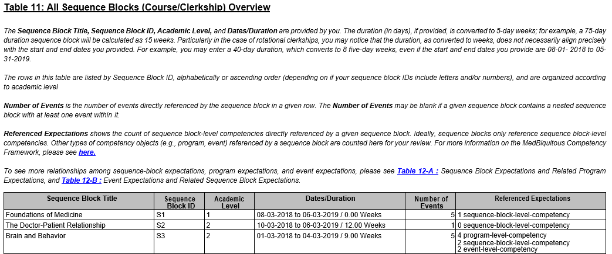
Table 11: All Sequence Blocks (Course/Clerkship) Overview
Notes:
This is a NEW table to the 2019 AAMC CI Verification Report. Having this high-level data should allow a Curricular Dean to quickly review the number of events and learning objectives for each course.

Slide 30
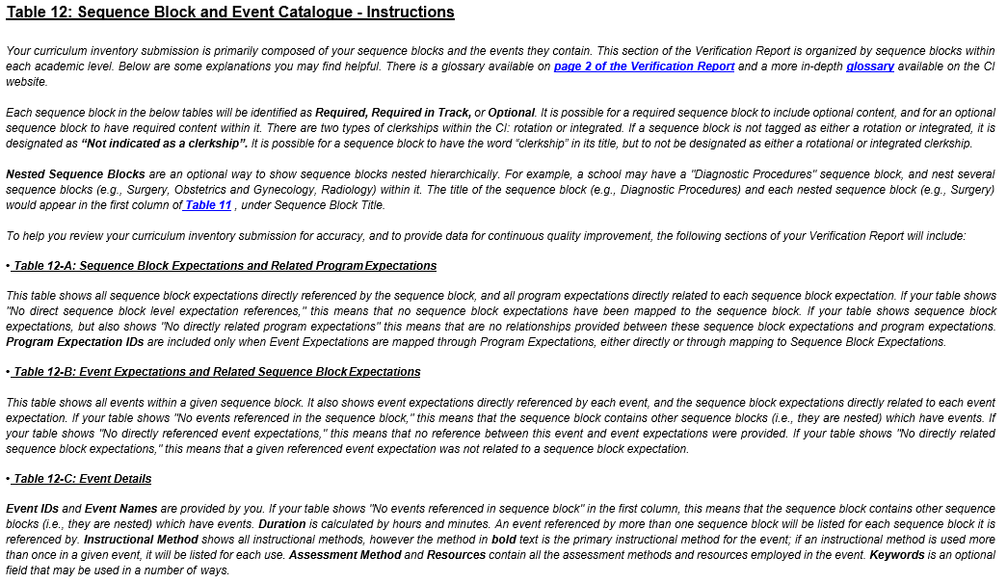
Table 12: Sequence Block and Event Catalogue – Instructions
Notes:
Table 12: Sequence Block and Event Catalogue – Instructions
Details about specific sequence blocks/course are packaged in Table 12 with bookmarks to readily support sharing of relevant content with appropriate faculty leaders. Table 12 are made up of Table 12-A: Sequence Block Expectations and Related Program Expectations, Table 12-B: Event Expectations and Related Sequence Block Expectations, and Table 12-C: Event Details. With these tables, faculty leaders can review the portions of the curriculum that they are most familiar with, rather than needing to comb through the entire report. These new tables may increase the length of your Verification Report. We hope these additions enhance your CI data verification process, but also are useful for your internal program evaluation.

Slide 31
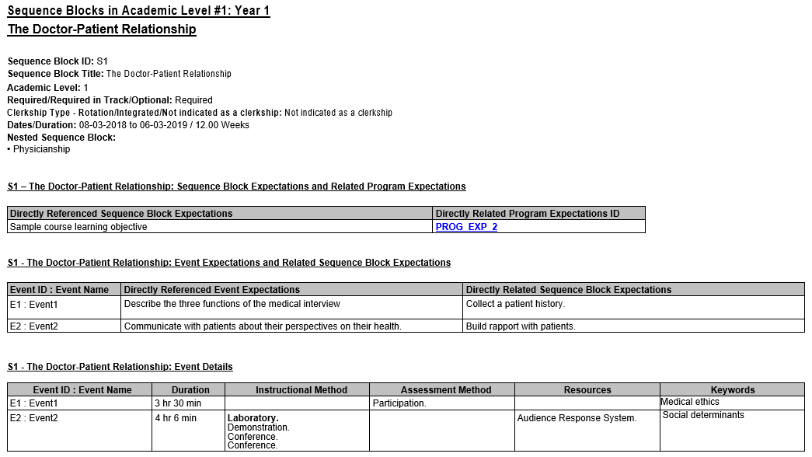
Table 12: Sequence Block and Event Catalogue – Sample
Notes:
Remember, these examples and a guide for the VR are on our website. You can always email ci@aamc.org if you have questions.

Slide 32
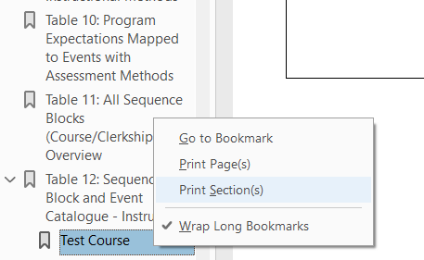
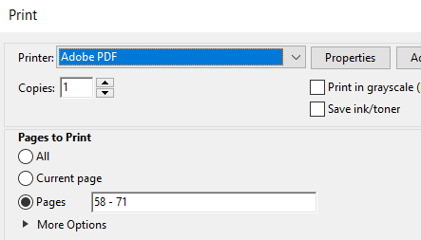
Print Sections in the Bookmarks
1. Right click the desired bookmark
2. Print or Save as needed, automatically sized
3. Pick the new section to view
4. Share as much or as little as needed

Slide 33
Thank you and we will see you next month!
Please register for next month’s
Building Better Curriculum Webinar Series on
August 14, 2019 at 1:00 pm EST.
We will post this latest webinar recording on AAMC’s website here:
www.aamc.org/cir/webinars
Curriculum Inventory: ci@aamc.org

