Slide 2
CFAS Business Meeting
November 2, 2018
Convention Center Ballroom BC
Scott Gitlin, MD
CFAS Chair

Slide 3
Welcome to All CFAS Reps!
About 124 CFAS reps registered to attend Learn Serve Lead: the 2018 AAMC Annual Meeting
About 12 newly appointed CFAS reps have registered
Total of 350 CFAS reps, down slightly from 358 last spring
Notes:
- If you are a new rep or a rep who is attending for the first time, please stand up and wave to your CFAS colleagues
I urge you to make a connection with a member of the ad board at this session or at any number of other sessions
Get to know your CFAS colleagues at the networking sessions, like tomorrow’s breakfast or our reception tomorrow night

Slide 4
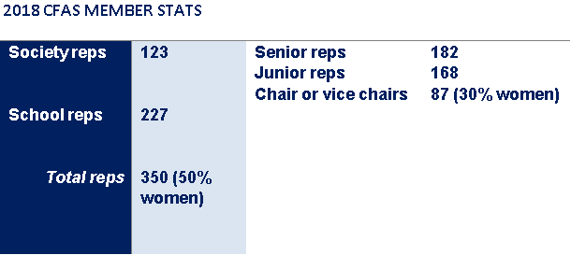
CFAS Progress Report
Up from 25%!
Up from 47%!

Slide 5
Preview of Learn Serve Lead and CFAS Programming
“Welcome to Austin Reception” starts right after this meeting – Convention Center Hall I
CFAS Networking Breakfast – tomorrow, 7:30-8:30 a.m., JW Lone Star Salon D
Plenaries and Breakouts start tomorrow morning – more on CFAS-related breakouts coming up
Joint CFAS/COD/GFA/GWIMS reception – tomorrow, 6:30-8:30 p.m., JW Lone Star Salon E
CFAS New Rep Orientation – Sunday, 4:30-5:45, Hilton: Austin Grand H
Notes:
The reception tonight is open to ALL CFAS REPS. Please attend.
The NETWORKING BREAKFAST is a CFAS tradition. While there are some themed discussion groups, it is primarily an opportunity to meet your colleagues, make connections, and share ideas. Please attend to get to know the other medical school faculty and society representatives who make up the CFAS representative community.
ALL CFAS REPS should attend the Saturday night joint reception – interesting opportunity to meet your peers from other groups, including deans who will be attending with the COD.
The New Rep Orientation is geared to the newest members of the CFAS community, but it is open to all CFAS reps. Please come to meet the new reps or to get a refresher on the operation of the AAMC and CFAS.

Slide 6
Preview of Learn Serve Lead and CFAS Programming
AAMC Awards Reception and Dinner – Sunday, 6:30-10 p.m. JW Grand Ballroom Foyer and Ballroom 5-6
CFAS Knowledge Sharing Session + Mini-reception (with snacks and drinks!) – Monday, 4:30-5:45 pm JW: Lone Star Salon D
Notes:
The BLACK TIE AWARDS RECEPTION AND DINNER is open to all CFAS reps, who are able to attend free of charge. but you need to have registered ahead of time. I hope you have taken care of that.
The CFAS KNOWLEDGE SHARING SESSION is an open mic conversation where you can share ideas, impressions, thoughts about what CFAS should be doing, observations about the meeting, and more.

Slide 7
Breakouts with CFAS Involvement
Nine breakout sessions from Saturday–Tuesday either originated within CFAS or feature at least one CFAS speaker or panelist:
The Continuum of Sexual Harassment in Science and Medicine: From Postdoctoral Trainees to Faculty
Addressing Clinician Well-Being at the Institutional Level
Professionalism in Medicine and Medical Education in the Age of Social Media and the #MeToo Movement
Tools of Torture: Enhancing the Value of EHRs for Clinicians and Learners
Notes:
Please consult the program to find the specific session descriptions, speaker lists, times, and locations of these sessions
Your tables have a list of the programs on them
Will everyone who is engaged as a speaker or moderator in one of the breakout sessions on the general program please stand up
It’s always impressive how many CFAS reps we have engaged in these meetings – it’s one of the biggest ways that CFAS makes a difference at the AAMC

Slide 8
Breakouts with CFAS Involvement
Proactive Student Interventions
Learner Transitions
Data Reproducibility: Yes, We Can!
Learning from and with Other Professions: IPE as a Driver of Culture Change
Practical Strategies to Achieve Cognitive Integration of Clniical Skills and Basic Science

Slide 9
Networking Opportunities at LSL
Friday, Nov. 2
4:30–5 p.m.: Cookies and coffee networking reception
6:15–7:45 p.m.: “Welcome to Austin” Reception, open to all Learn Serve Lead/Annual Meeting attendees (Convention Center: Hall 1)
Saturday, Nov. 3
7:30–8:30 a.m.: CFAS Networking Breakfast (JW: Lone Star Salon D)
6:30–8:30 p.m.: GWIMS, GFA, COD, and CFAS joint reception (with awards and poster program) (JW: Lone Star Salon E)
Monday, Nov. 5
[time] CFAS Knowledge Sharing session
6–7:30 p.m.: Posters-Up and Wine-Down Reception (Hilton: Austin Ballroom)
Ad hoc meetings for surgical subspecialists, family medicine physicians
Want to start a discussion group for tomorrow morning? Let Eric know!
Notes:
Please take advantage of the networking opportunities at LSL. I hope you got to spend some time right before this meeting reconnecting with colleagues or getting to know new people – but there are many more opportunities, including right after this session where all of you are invited to attend the “Welcome to Austin” reception in the Convention Center.
Breakfast tomorrow morning is also a great time to connect with fellow CFAS reps. We traditionally don’t put programming over this breakfast specifically so people can sit together and make connections. I urge you to talk to new people or invite someone you haven’t met before to join you and a group of friends.
That said, the Family Medicine specialists in CFAS for years have gotten together in the breakfast room to discuss a number of issues related to their specialty, and also surgical subspecialists have recently begun meeting to also collaborate through CFAS. I encourage other groups with shared interest to consider using this time meet your colleagues who do work that aligns with your own.
If you’d like to set up an on-the-fly, topical table for breakfast please find Eric right after this meeting.

Slide 10
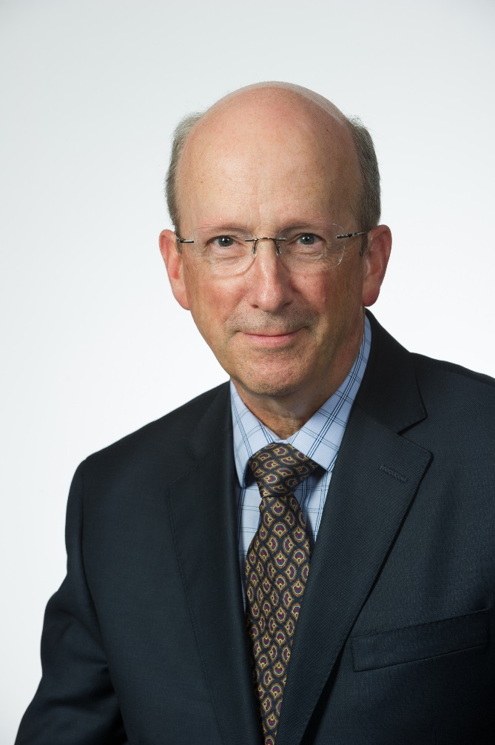
Update from the Chief Scientific Officer
Ross McKinney, MD

Slide 11
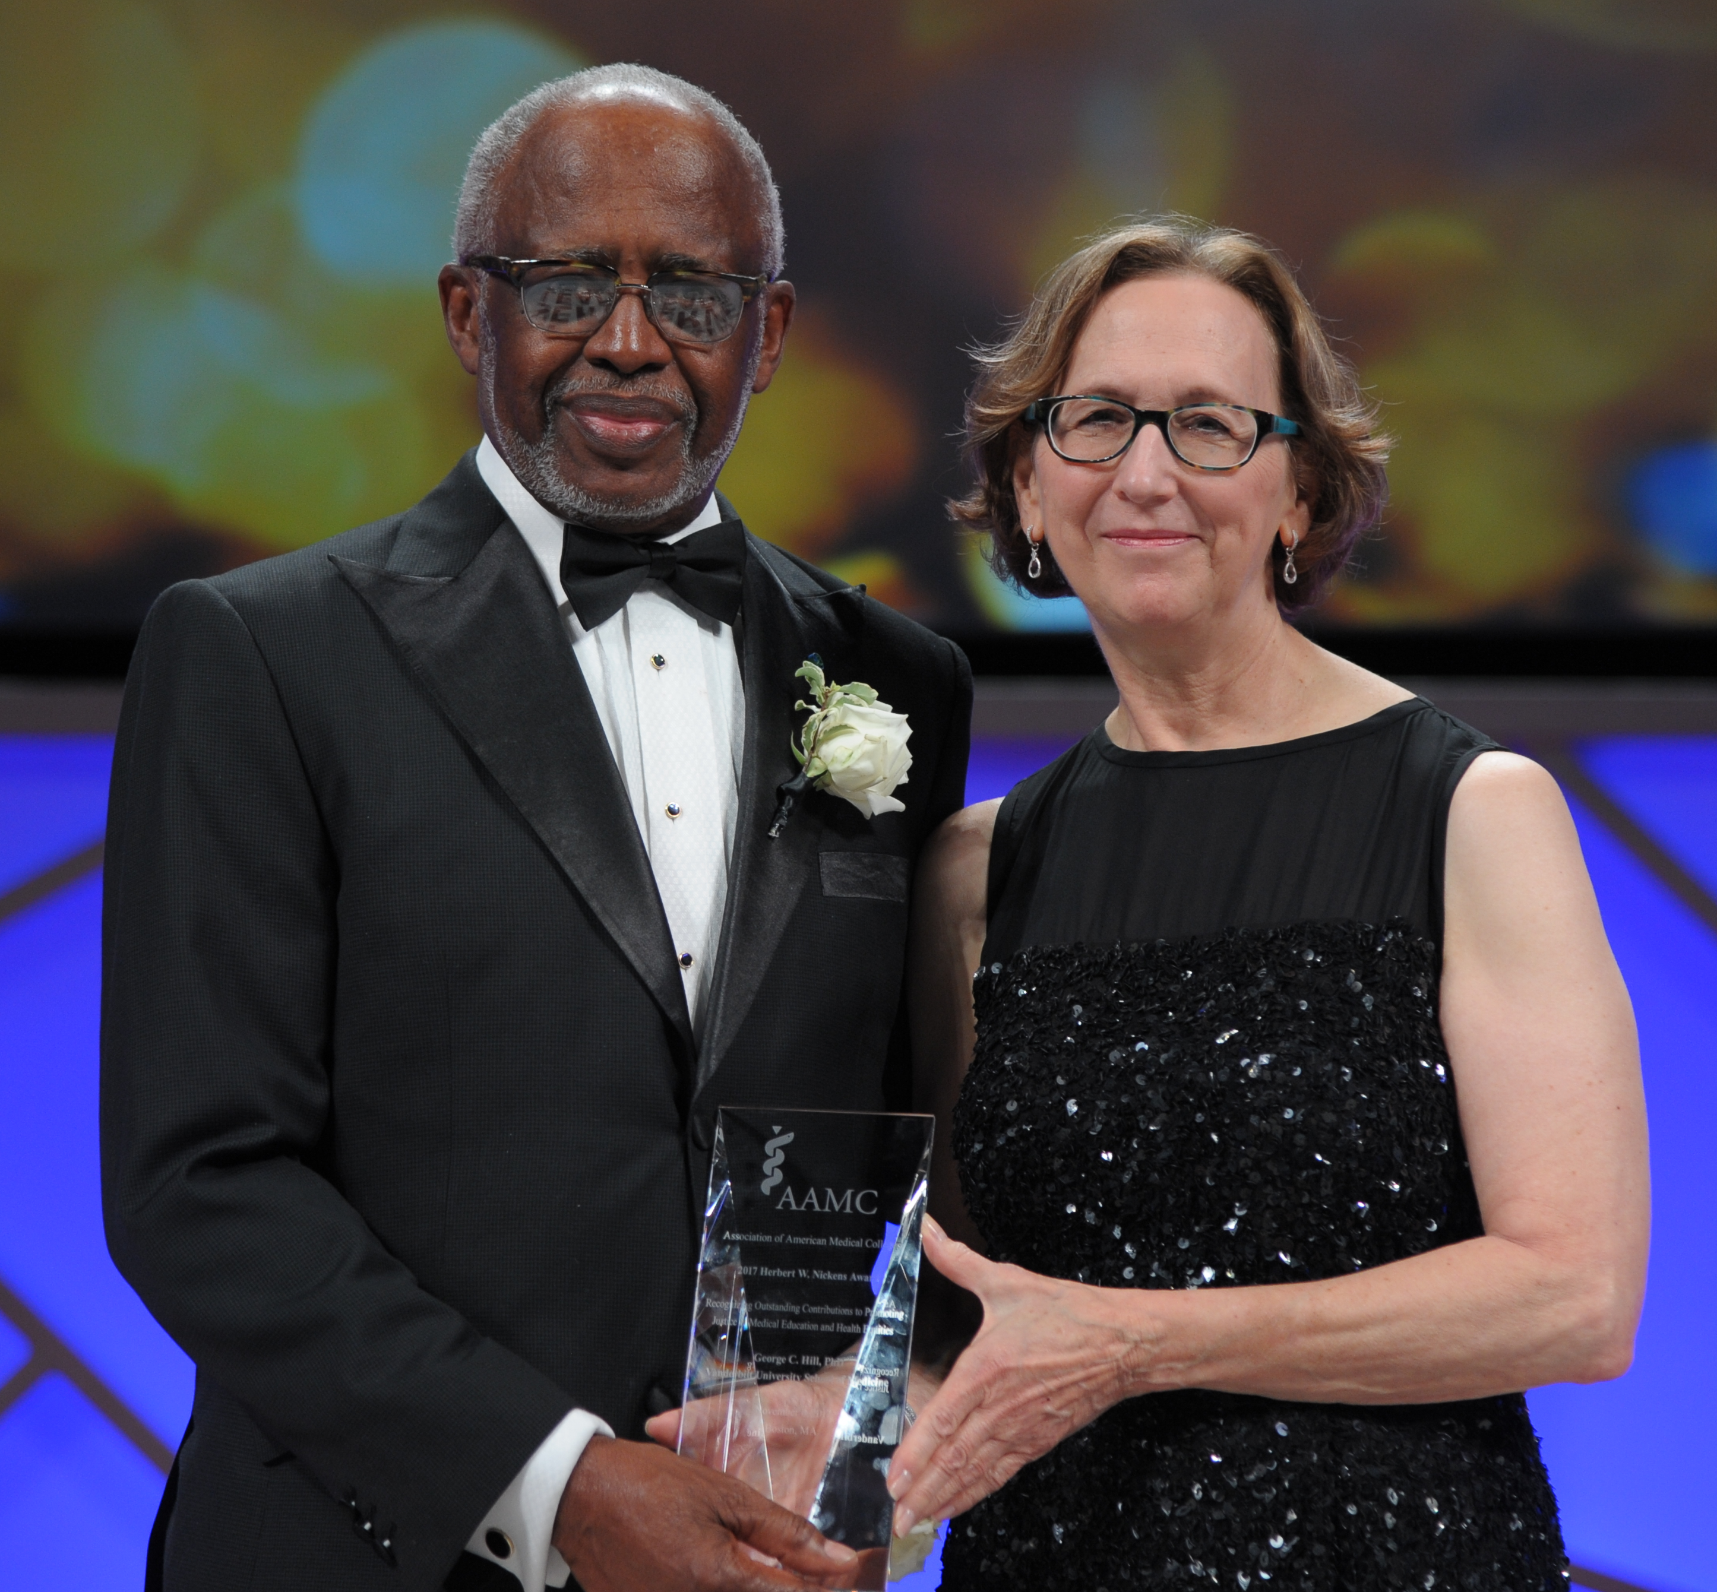
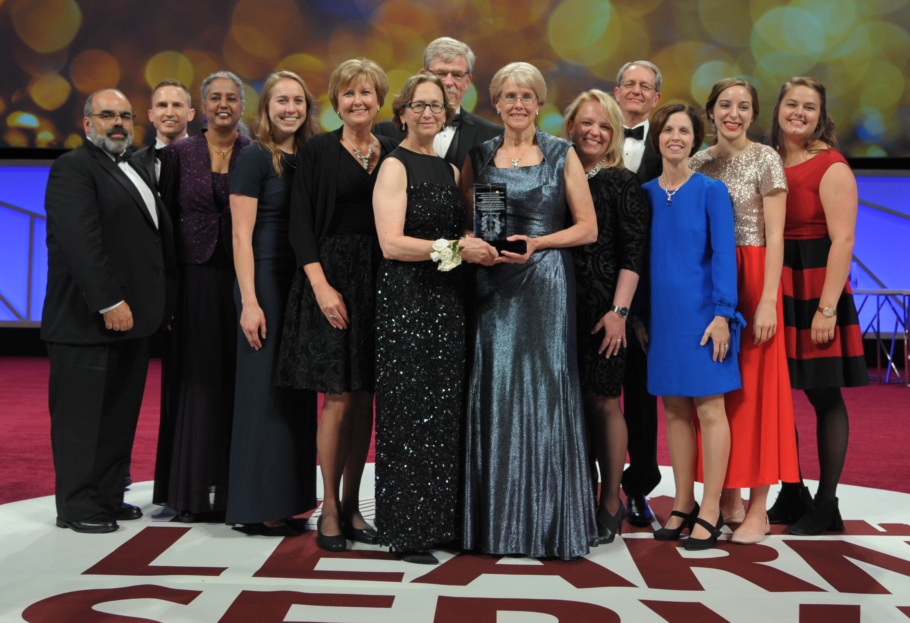
Nominate for the 2019 AAMC Awards
www.aamc.org/awards
Notes:
At this morning’s AAMC leadership presentation to COD/COTH/CFAS, Roy Wilson emphasized the importance of your institutions in ensuring that these awards are presented to a group of outstanding individuals and institutions that truly represent the deep diversity of our community
I’d like to echo Roy’s sentiments and also note that several of the awards can be nominated by faculty members – this is a real opportunity for individuals in this room to recognize colleagues who are doing exceptional work and to contribute to the diversity of next year’s awardees
As Roy mentioned, the call for nominations is already open to give you more time to nominate outstanding colleagues for 2019

Slide 12
Upcoming CFAS Meeting
Call for Ignite-Style Proposals Open!
2019 CFAS Spring Meeting
April 4-6, 2019
JW Marriott Atlanta Buckhead
Atlanta, Georgia
Notes:
Our 2019 Spring Meeting in Atlanta is well under way with planning. The Program Committee met in person in Washington over the summer, and also met this morning during the CFAS committee meetings – and there will also be an in-person meeting this winter.
Registration will open for the meeting in January, with plenty of time for the early bird discount.
We’re especially excited about this year’s planning, which will be a little different than past meetings, in large part because there will be fewer breakouts and many more opportunities for CFAS reps to work together rather than split up into smaller sessions.
Program Committee Chair and CFAS Chair-Elect Gabriela Popescu will be giving an update on the meeting and providing more information a bit later in this session.

Slide 13
2020 COD/COTH/CFAS Co-located Spring Meeting
Notes:
While we’re on the subject of CFAS Spring meetings, planning is starting unusually early for the 2020 CFAS Spring Meeting because it’s a little more complicated given a different proposed format.
Spring 2020 will be the first formal spring meeting season for the new AAMC president and CEO, so it’s a tremendous opportunity for the AAMC’s councils to help the new executive understand who we are and what kind of work we do.
Normally, 2020 would be a joint COD/COTH meeting (those two councils traditionally meet together every other year), but due to these special circumstances, AAMC staff will be co-locating all three of the AAMC’s councils: COD, COTH, and CFAS
This will present an opportunity for one day of joint programming among all three councils, and the COD, COTH, and CFAS will also have separate and protected time for their own programming
Potential topics for discussion include issues of interest to all three stakeholder groups; town hall-style conversations with the new president and CEO; and discussions about what it means to be part of an AAMC council operating within the association’s governance structure; how faculty, deans, and hospital executives can all work together.
We do not anticipate that this will become the model for future years but are capitalizing on the opportunity that 2020 presents – and we remain open to new possibilities that may be revealed when we actually hold this meeting.
We are in the process of a request for proposals from suitable venues and will announce the location once a contract has been finalized. At this point, the meeting will likely be in the second week of March of 2020, but please stay tuned for details are they come together.

Slide 14
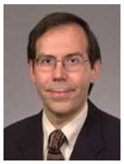
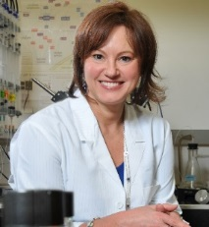
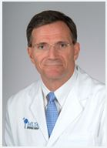
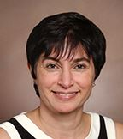
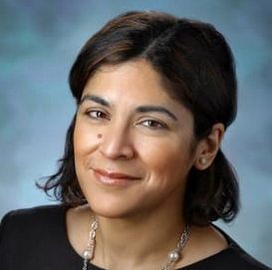
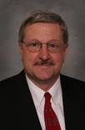
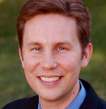
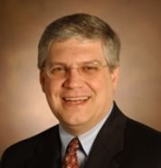
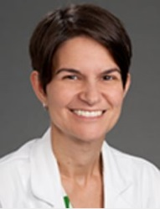
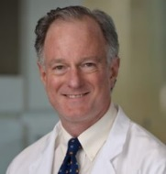
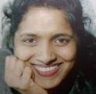
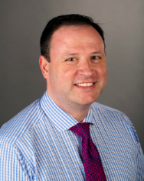
Current CFAS Administrative Board
Scott D. Gitlin, MD, Chair
Gabriela Popescu, PhD, Chair-Elect
Vincent D. Pellegrini, MD, Immediate Past Chair
Mona Abaza, MD
Nita Ahuja, MD
Maureen T. Connelly, MD, MPH (GFA Chair Elect)
Arthur Derse, MD, JD
Alan W. Dow, III, MD
Richard L. Eckert, PhD
Michael E. Engel, MD, PhD
Amy Hildreth, MD
Joseph Hill, MD, PhD
Carolyn Meltzer, MD
Robin McGoey, MD
VJ Periyakoil, MD
J. David Warren, PhD

Slide 15
Outgoing CFAS Administrative Board Members – Thank You!
Michael E. Engel, MD, PhD
Amy Hildreth, MD
Joseph Hill, MD, PhD
Notes:
Thank departing Administrative Board members for their service (parting gifts are on stage – ask them to come up and accept the gift):
Amy Hildreth, MD, of Wake Forest
Mike Engel, MD, PhD, of University of Utah
Joe Hill, MD, PhD, of UT Southwestern Medical School
Any personal words about each of them? Amy has served with distinction as the chair of communication committee, introducing such innovations as the CFAS Member Rep Newsletter, the thank-you letters to sponsoring institutions when CFAS reps attend meetings, improvements to our Website, such as a collection of materials for new reps, social medial expertise, and an ongoing, as-yet-unrealized attempt to have Podcasts added to the CFAS resources. Joe Hill is the current chair of the Advocacy Committee and has cochaired the committee with Rich Eckert for many years before that. Michael Engel is a past member of the CFAS program committee. All three were very active members of the CFAS Ad Board – and while they will be missed in that role, they leave true legacies that will help new members serve even better.

Slide 16
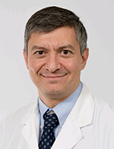
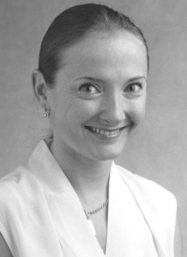
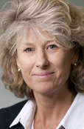
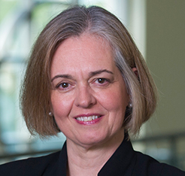
Incoming CFAS Administrative Board Members
Steven Angus, MD (University of Connecticut School of Medicine)
Vera Donnenberg, PhD (American College of Clinical Pharmacology)
VJ Periyakoil, MD
(American Academy of Hospice and Palliative Medicine)
Reappointment
Catherine Pipas, MD (Society of Teachers of Family Medicine Foundation)
Elza Mylona, PhD (Eastern Virginia Medical School) Ex-Officio Member – GFA Chair-elect
Notes:
Note leadership changes that will take effect following the AAMC Annual Meeting:
As covered at the 2018 CFAS Spring Meeting in Chicago, the CFAS Nominating and Engagement Committee had large number of nominees to select from in order to fill opening seats for this year. Those positions begin their new three-year terms at the conclusion of the AAMC Annual Meeting.
I’d like to ask each of the THREE new CFAS Ad Board representatives starting their first new term to stand when I announce your name:
Steven Angus, MD, representing the University of Connecticut School of Medicine
Catherine Pipas, MD, representing the Society of Teachers of Family Medicine Foundation, and also a faculty member at Geisel School of Medicine at Dartmouth
Vera Donnenberg, PhD, representing the American College of Clinical Pharmacology, and a faculty member at University of Pittsburgh School of Medicine
VJ Periyakoil, MD, was nominated to serve a second term on the ad aboard as the rep from the American Academy of Hospice and Palliative Medicine. She is a faculty member at Stanford School of Medicine.
CFAS additionally has a seat on its ad board that traditionally goes to the chair or chair-elect on the AAMC’s Group on Faculty Affairs, which is the AAMC affinity group that represents the interests and work of academic health center faculty affairs deans. Maureen Connelly, who is not here today, has served in this role for the past three years. We’re delighted to add GFA Chair-Elect Elza Mylona, PhD, Vice Provost for Faculty Affairs and Institutional Effectiveness Professor of Medicine of Eastern Virginia Medical School as the new ad board member from the GFA.

Slide 17
CFAS Administrative Board Members
Scott D. Gitlin, MD, Chair
Gabriela Popescu, PhD, Chair-Elect
Vincent D. Pellegrini, MD, Immediate Past Chair
Mona Abaza, MD
Nita Ahuja, MD
Elza Mylona, PhD (Ex-Officio GFA Chair-elect)
Arthur Derse, MD, JD
Alan W. Dow, III, MD
Richard L. Eckert, PhD
Steven Angus, MD
Vera Donnenberg, PhD
VJ Periyakoil, MD
Reappointment
Carolyn Meltzer, MD
Robin McGoey, MD
Catherine Pipas, MD
J. David Warren, PhD
Notes:
Another Leadership Note: Gabriela Popescu, Vin Pellegrini, and I will all begin our second years in their two-year terms as chair, chair elect, and immediate past chair. At next year’s LSL meeting, the CFAS leadership transition will take place at this level. We’ll be talking about the process for nominating and electing a new CFAS Chair Elect a bit later – but it will be a big part of our business at the 2019 CFAS Spring Meeting in Atlanta.
A personal note/reflection upon completing your first year as chair? Hopes for next year?

Slide 18
Thank You, CFAS Nominating and Engagement Committee Members
Barbara Jobst, MD
VJ Periyakoil, MD
Lumy Sawaki-Adams, MD, PhD
…and new member as of Nov. 2018
Vincent Pellegrini, MD, chair Nita Ahuja, MD
James Burris, MD
Leslie Ellis, MD
Evelyn Granieri, MD, MPH
Notes:
Before I turn the microphone over to Vin Pellegrini, I’d like to take a moment to acknowledge the hard work of the CFAS Nominating and Engagement Committee and in particular, Vin’s work to clarify the activities of the committee – but first, will the committee members who are here please stand and wave to everyone. It is a tremendous amount of work to name the new members of the ad board given about 20 qualified nominees – and I know how thorough and considered the process was.
Additionally, the committee has done other work through the year to help define the people who can serve as leaders of CFAS.
In his report to you, Vin Pellegrini will discuss some of the structural changes in the committee to ensure its important work moves forward smoothly, and that the committee itself at once represents CFAS and refreshes regularly to bring in new perspectives over time.

Slide 19
Nominating Committee Update
What does the Nominating & Engagement Committee Do?
Addresses issues related to CFAS rep qualifications and service
Reviews and approves prospective new CFAS member societies
Manages annual call for nominees & selection of Nom Com members
Manages the call for nominees and rolling selection of new CFAS Administrative Board members annually
Selects a new CFAS Chair-Elect every other year
Responsible for the vitality and annual renewal of CFAS!!

Slide 20
Who Can Serve on the Nominating Committee?
Any CFAS rep in good standing can serve
Selection criteria strongly consider engagement with CFAS; e.g., service on another committee, regular meeting attendance, or someone who has participated in CFAS programming
Diversity of all types is important, including professional diversity; i.e., clinicians, basic scientists, medical educators, chairs, junior faculty, etc.
Must be ready to work – the selection process is rigorous. Last year, more than 20 nominees were up for 4 potential ad board seats, and more than 10 for one Nom Com seat

Slide 21
Nominating Committee Structure
2018 Focus on Committee Structure and Standards
Membership fixed at 9, including the chair, who by definition is the CFAS Immediate Past Chair
8 regular members each serve a 3-year term, renewable once after one year off the committee
Chair serves a 2-year term, non-renewable
Emphasis on transparency and integrity of processes
The goal: Stay fresh and renew regularly. Our structure ensures new faces and perspectives on the committee.

Slide 22
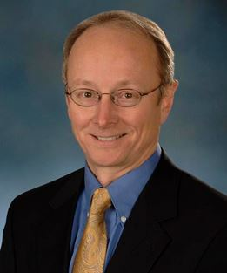
New Nom Com Member
…and this time next year there will be 3 new faces on the committee, including a new chair. Please consider serving.
Richard L. Eckert, PhD Professor and Chair, Dept. of Biochemistry & Molecular Biology
University of Maryland School of Medicine

Slide 23
Next Order of Business for the Committee
Selection of a New CFAS Chair-Elect and Ad Board Slate
A call for nominations will go out soon after LSL (right now!)
The committee will evaluate candidates in the winter and recommend a slate to the CFAS Administrative Board for approval
The assembled CFAS representative body will vote on the slate at the 2019 CFAS Spring Meeting in Atlanta
The new CFAS Chair-Elect and Ad Board members (4) will begin terms at the 2019 LSL Meeting, commencing as both CFAS leaders and a member of AAMC BoD (CFAS chair-elect)

Slide 24
CFAS PROGRAM COMMITTEE
Gabriela K. Popescu, PhD, chair
Nita Ahuja, MD
Steven V. Angus, MD
Lisa Bellini, MD
Richard Eckert, PhD
Lee Eisner, PhD
Scott D. Gitlin, MD
Evelyn C. Granieri, MD
Mark L. Jordan, MD
Robin McGoey, MD
Carolyn Meltzer, MD
Laura Shaffer, PhD
Dixon Santana, MD
Lumy Sawaki Adams, MD, PhD

Slide 25
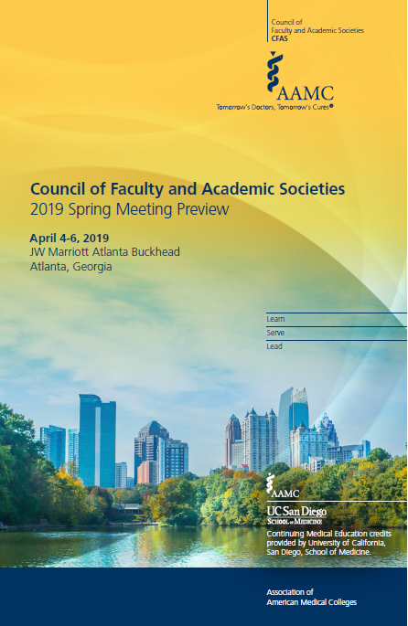
CFAS Program Committee Update
2019 CFAS Spring Meeting Preview
April 4-6, 2019
JW Marriott Atlanta Buckhead
Atlanta, Georgia
Notes:
Our 2019 Spring Meeting in Atlanta is well under way with planning. The Program Committee met in person in Washington over the summer, and also met this morning during the CFAS committee meetings – and there will also be an in-person meeting this winter.
Registration will open for the meeting in January, with plenty of time for the early bird discount.
We’re especially excited about this year’s planning, which will be a little different than past meetings, in large part because there will be fewer breakouts and many more opportunities for CFAS reps to work together rather than split up into smaller sessions.
Program Committee Chair and CFAS Chair-Elect Gabriela Popescu will be giving an update on the meeting and providing more information a bit later in this session.

Slide 26
Major Meeting Themes
The 2019 CFAS Spring Meeting will have 3 plenary themes:
Addressing sexual harassment in academic medicine
(opening plenary)
Hot topics in bioethics, health policy, and research
(Friday morning plenary)
Prepping faculty for changes in medical education
(Closing plenary)
…Plus a business meeting and AAMC Leadership Update

Slide 27
A New Breakout Approach
In an effort to keep CFAS reps working together, there will be fewer concurrent breakouts – and more workshops and shorter presentations to reflect variety of perspectives
WORKSHOP SESSIONS (in two concurrent groups):
Community engagement
Global health
Diversity and inclusion
Research training

Slide 28
A New Breakout Approach
Ignite style sessions
Open call for proposals for 2 sets of brief, fast-moving “Ignite-style” presentations on a theme, with each slot consisting of 4 back-to-back presenters
Sexual harassment (following opening plenary)
Medical education (reflecting UME, GME, and research)

Slide 29
Networking!
Networking is always cited among the best aspects of CFAS programming
Opening-night networking reception
Table topic breakfasts (Friday)
Dine-around dinners (Friday night)
Themed breakfast discussions (Saturday)

Slide 30
Well-being at CFAS
In response to written feedback and conversation at our last meeting, we will be mindful of wellbeing in the program…
Longer breaks between sessions to relax and reflect
Morning walking and running groups to keep fit
Friday evening stroll to unwind before dine-arounds

Slide 31
Submit a Session Proposal
Visit the CFAS website for instructions on submitting a session proposal:
www.aamc.org/cfas

Slide 32
Committee Updates
Advocacy Committee, Joe Hill, MD, PhD, chair
Bidirectional communication around AAMC advocacy efforts and what’s happening at the grassroots at our institutions.
Ongoing regular dialogue with the AAMC advocacy staff to align efforts
Issues of particular interest include health care access, GME appropriations, NIH funding
Design of programs to advance advocacy messages

Slide 33
Committee Updates
Basic Science Committee, Rich Eckert, PhD, chair
Focus on basic science and the research environment
Specific topics for programming: Animal research regulatory burden and PhD education session (presented at LSL this year)
Burnout issues as it affects basic scientists
Basic science department structure
This meeting: focus on education issues around basic science

Slide 34
Committee Updates
Communication Committee, Amy Hildreth, MD, chair
Improving communication related to CFAS/AAMC meetings and activity, before, during, and after
Strategize on effective social media engagement among CFAS reps at AAMC meetings
Developed onboarding resources for new reps

Slide 35
Committee Updates
Diversity Committee, VJ Periyakoil, MD, chair
Developed a new online diversity resource highlighting notable diversity tools at various academic health centers
Call for other schools/CFAS reps to submit content to the page
Recruitment issues as they relate to diversity
Mentoring issues around diversity
Discussing collaboration with AAMC’s MedEdPORTAL to add to its diversity collection
Notes:
Screenshot on the next slide

Slide 36
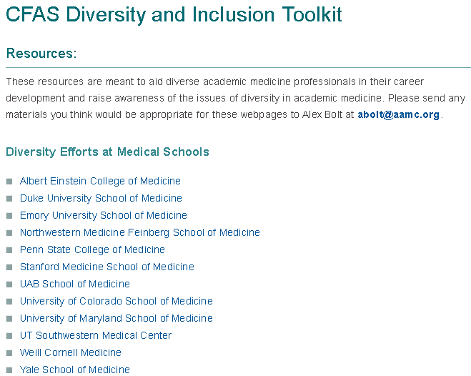
CFAS Diversity Resource on AAMC.org
Notes:
This is currently live on the CFAS Website – www.aamc.org/cfas

Slide 37
Committee Updates
Evaluation Committee, Carolyn Meltzer, MD, chair
Looking for liaisons for the other committees
Focusing on ensuring updated knowledge sharing for how reps can educate their institutions or societies
Inactive reps – why? Continuity for CFAS reps
Continuity for the committee itself

Slide 38
Committee Updates
Mission Alignment of Faculty as Educators, Stewart Babbott, MD, chair
Expectations of students and how they change over time
Alignment between other AAMC groups: GEA and GFA
What keeps us up at night?
And who is my boss?
How do we live as faculty in the world of clinical productivity demands other institutional demands?
Are we preparing 3rd, 4th year learners?

Slide 39
Committee Updates
Resilience Committee, Mona Abaza, chair
Committee work focused on developing metrics related to faculty resilience and wellbeing
Collaborating with AAMC’s Standpoint Surveys to develop survey questions to assess resilience issues among faculty
Early conversation with AAMC’s MedEdPORTAL to develop content in a resilience/wellbeing collection
Ongoing updates to www.aamc.org/wellbeing - the AAMC’s online wellbeing resource

Slide 40
CFAS-Oriented Publications
Various CFAS projects and meeting sessions are being adapted into peer-review publications now in process.
Paper on Academic Health Center Governance (ePub)
Paper on the 4th Year of Med School (under review)
“Creating a Value Proposition for Teaching”
Paper from the Definition of Faculty Working Group
Notes:
First two: Pellegrini
Third: Bellini through committee work
Fourth: Ongoing work from the definition of faculty working group, beginning with Rosemarie Fisher – several sessions at past LSL meetings
Will provide full citations as they become available

Slide 41
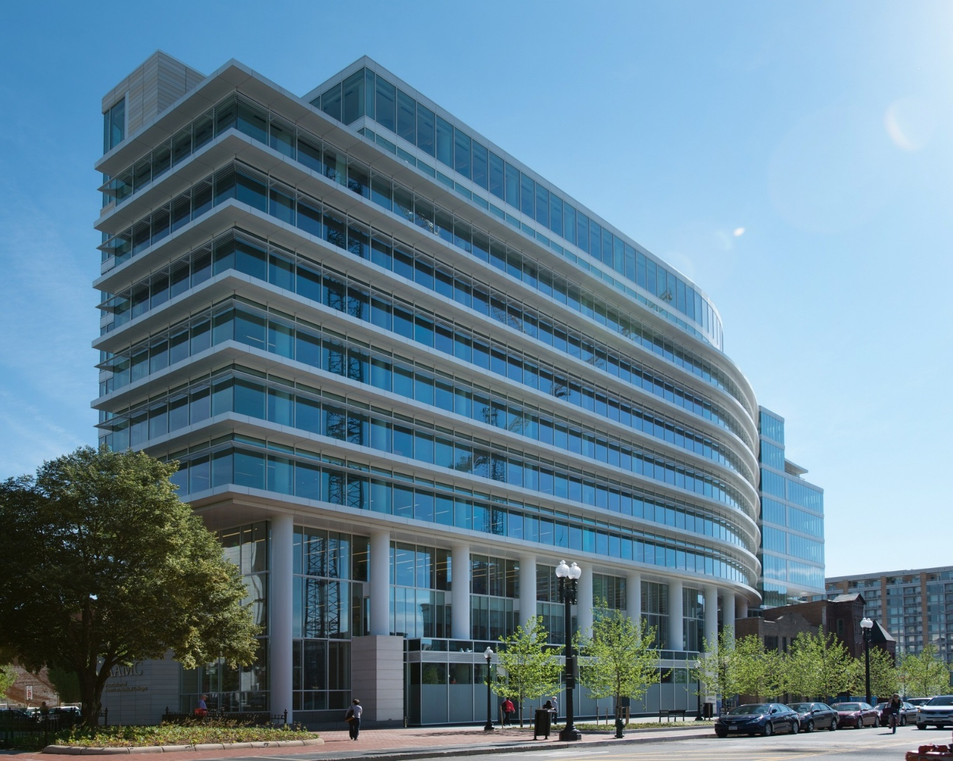
CFAS Society Summit
AAMC Washington Headquarters
Notes:
Describe the purpose and goals of the CFAS Society Summit
Benefits of building strong relationships with the business and strategic leadership of member societies
Identifying a date for the winter/early spring

Slide 42
Salary Equity Project
This project aims to encourage medical schools to undertake their own salary equity projects by providing them with new AAMC data, tools, and community promising practices to facilitate their success. A cross section of CFAS reps at the department chair level have been informally consulted to help create a clearer picture of what’s happening at academic health centers to address salary equity.
Notes:
*Per AAMC's data collection policies we report "sex" as opposed to gender and will use this terminology throughout the project
This project seeks to create three core work products:
National Salary Trends Tool (Dynamic excel-based tool looking at salaries based on specialty, gender, rank, and degree over the past 5 years)
Promising Practices Publication (School profiles of institutions who have conducted salary studies, identified financial strategies to address inequities, and communicated this effort to faculty as a joint, and on-going, effort across the dean’s office (e.g. diversity leaders, finance leaders etc.))
Will also include a national analysis of the faculty salary survey data by gender across the past 5 years
Toolkits and resources for schools to launch the process of a salary study on campus regarding the establishment of the initiative and templates for communication to the faculty
This project is not:
A group specific project – it’s an AAMC project informed by group stakeholders
Just an analysis – it’s an effort to provide comprehensive knowledge for undertaking salary equity reviews locally
All-encompassing – it’s a first effort making use of current data
The success of this AAMC project is reliant on strong communication and engagement from members across groups and councils. CFAS already has contributed. Eric Weissman, working with other AAMC staff, has reached out to a select group of CFAS reps – all of them chairs – as fact finding about work they, their departments, or their institutions have done in this area. Stakeholder feedback will also be sought from other AAMC faculty-focused groups as the project develops. (e.g. GWIMS, GDI, GBA, GFA, etc.)
Work on this project began in the summer of 2018, with plans to publicly release work products later in 2019.

Slide 43
Questions and Comments
Contact Eric Weissman at eweissman@aamc.org or call Eric at 202-828-0044
Visit https://www.aamc.org/members/cfas/

