Slide 2
Learn Serve Lead 2018: The AAMC Annual Meeting
Summary for CFAS Reps

Slide 3
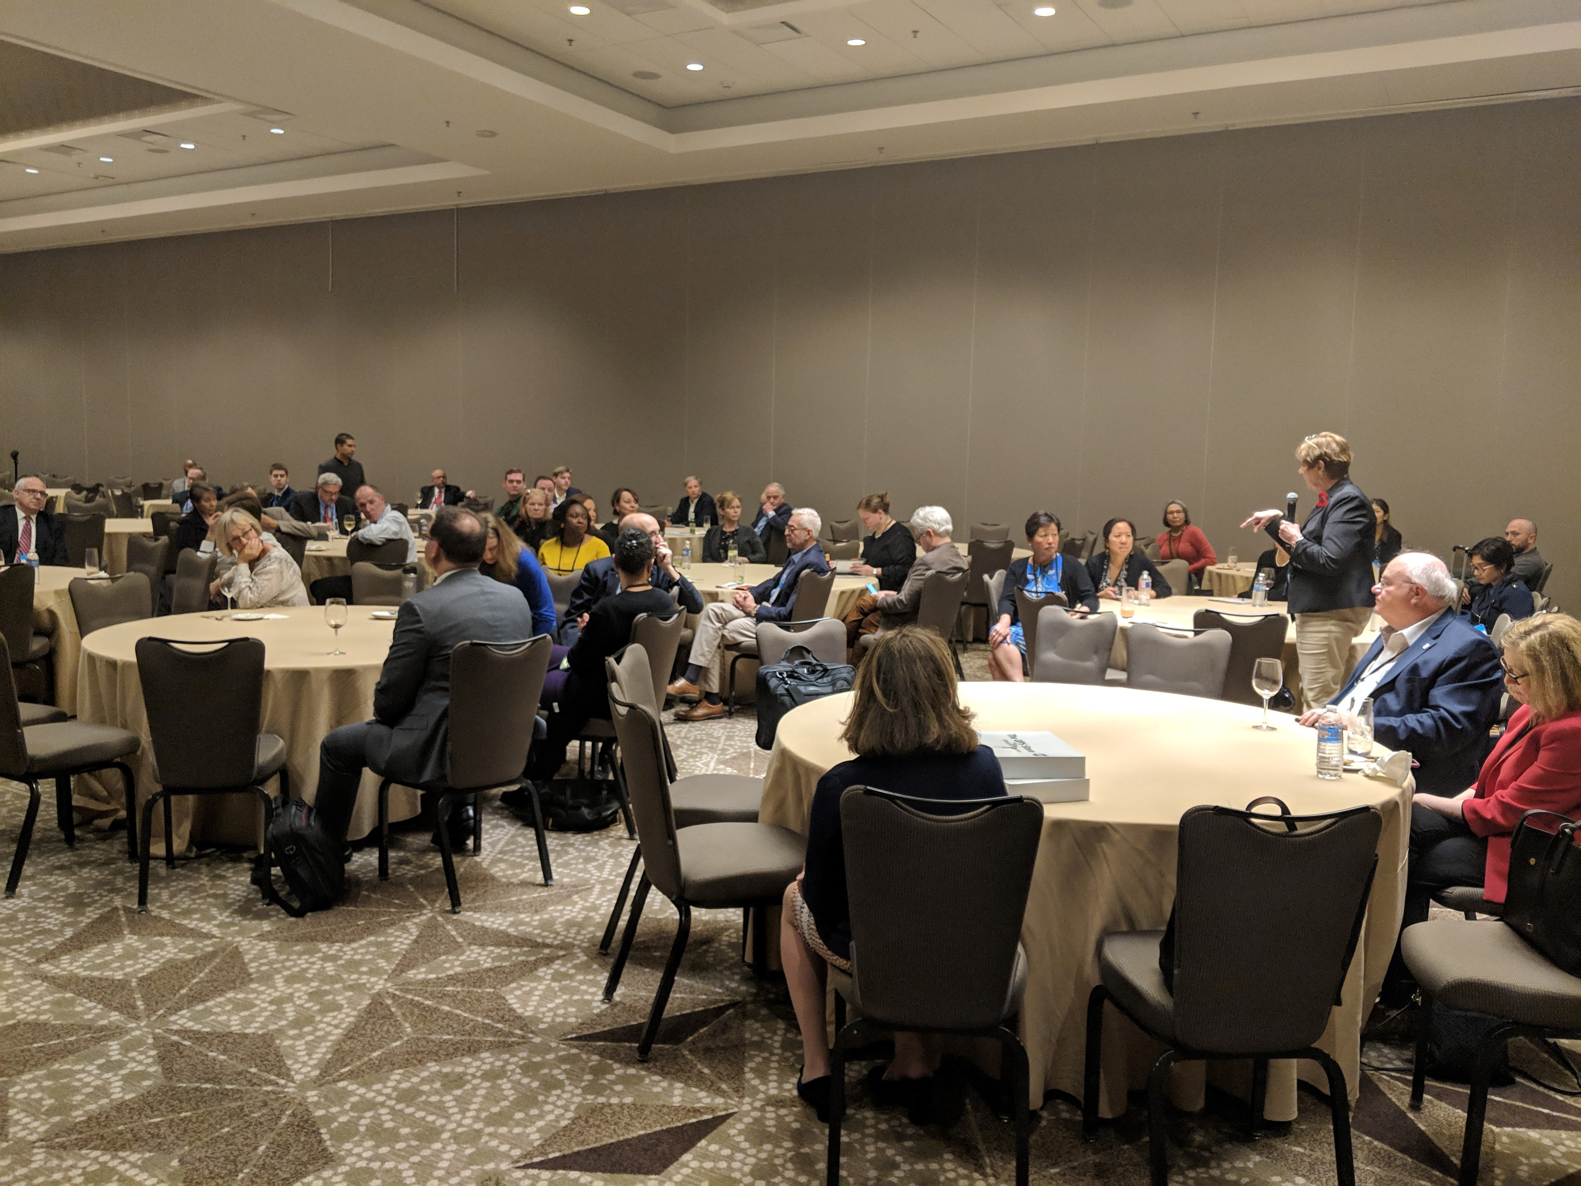
CFAS Reps at LSL
118 CFAS reps attended Learn Serve Lead: the 2018 AAMC Annual Meeting
12 newly appointed CFAS reps attended

Slide 4
LSL Breakout Sessions with CFAS Involvement
Nine breakout sessions from Saturday–Tuesday either originated within CFAS or feature at least one CFAS speaker or panelist:
The Continuum of Sexual Harassment in Science and Medicine: From Postdoctoral Trainees to Faculty
Addressing Clinician Well-Being at the Institutional Level
Professionalism in Medicine and Medical Education in the Age of Social Media and the #MeToo Movement
Tools of Torture: Enhancing the Value of EHRs for Clinicians and Learners

Slide 5
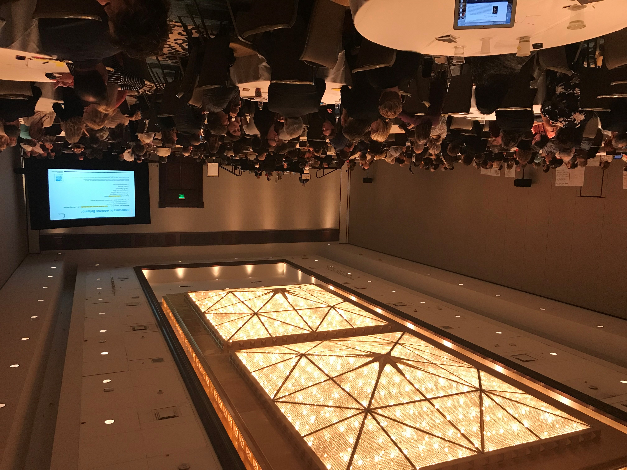
LSL Breakout Sessions with CFAS Involvement
Proactive Student Interventions
Learner Transitions
Data Reproducibility: Yes, We Can!
Learning from and with Other Professions: IPE as a Driver of Culture Change
Practical Strategies to Achieve Cognitive Integration of Clinical Skills and Basic Science

Slide 6
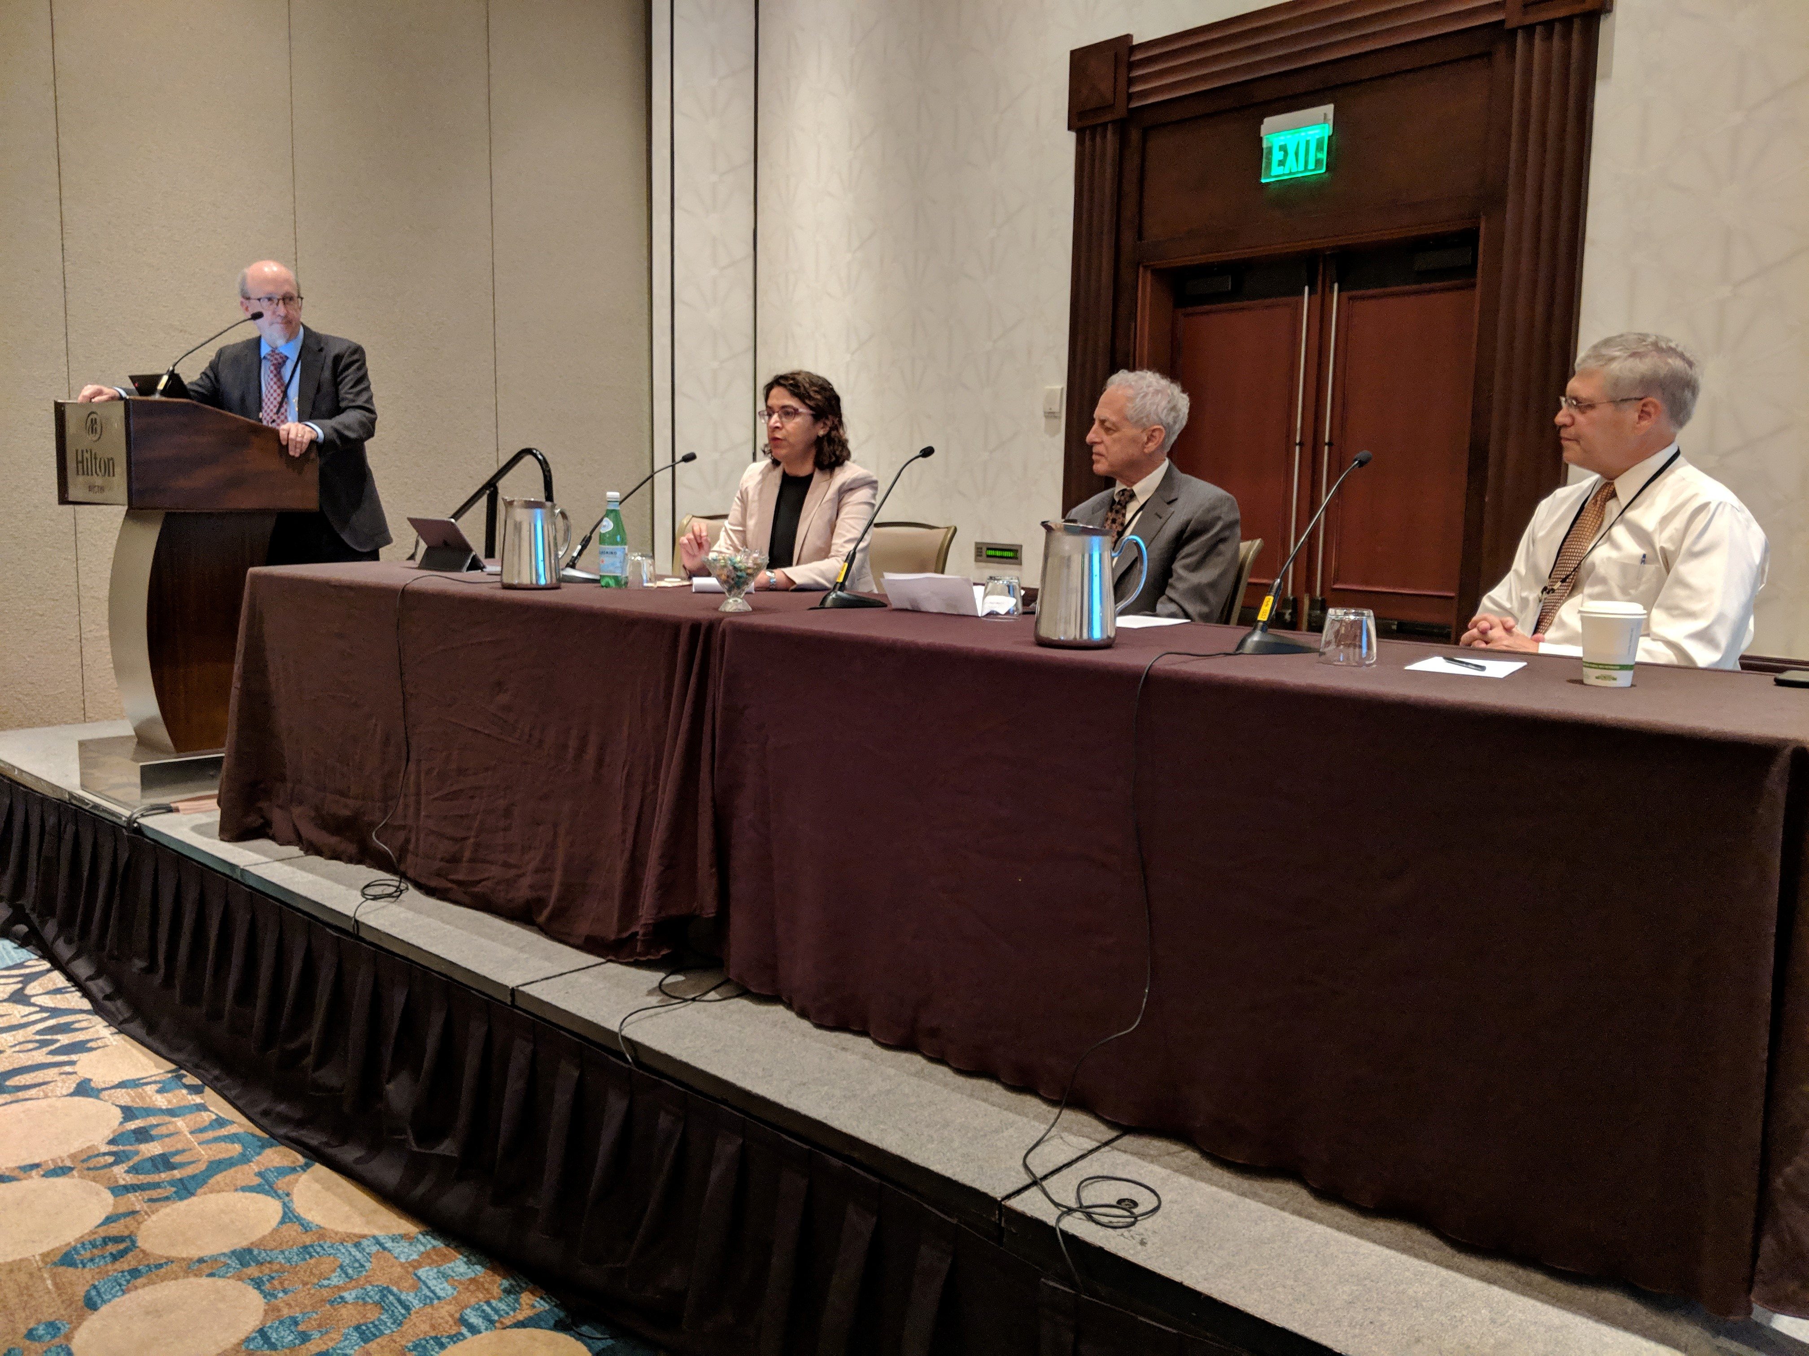
Breakout Session: “Data Reproducibility: Yes, We Can!”
Speakers:
Ross McKinney, MD, Chief Scientific Officer, AAMC
Nita Ahuja, MD, CFAS Rep, Chair, Department of Surgery, Yale School of Medicine
David Sklar, MD, CFAS Rep, Editor-in-Chief of Academic Medicine, Senior Advisor and Professor, Arizona State University
Michael Engel, MD, PhD, CFAS Rep, Professor of Pediatrics, Division Chief of Pediatric Hematology/Oncology, University of Virginia School of Medicine

Slide 7
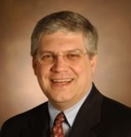
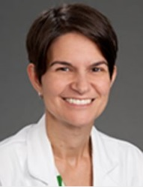
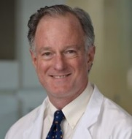
Outgoing CFAS Administrative Board Members – Thank You!
Michael E. Engel, MD, PhD, (Currently representing University of Virginia School of Medicine but originally appointed for University of Utah School of Medicine)
Amy Hildreth, MD, Wake Forest School of Medicine
Joseph Hill, MD, PhD, UT Southwestern Medical School

Slide 8
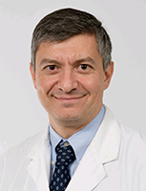
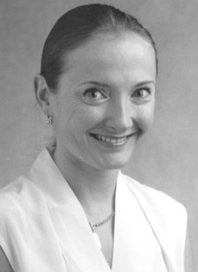
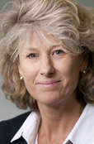
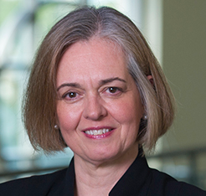
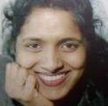
Incoming CFAS Administrative Board Members
Steven Angus, MD (University of Connecticut School of Medicine)
Vera Donnenberg, PhD (American College of Clinical Pharmacology)
Catherine Pipas, MD (Society of Teachers of Family Medicine Foundation)
Elza Mylona, PhD (Eastern Virginia Medical School) Ex-Officio Member – Group on Faculty Affairs (GFA) Chair-elect
Reappointment: VJ Periyakoil, MD
(American Academy of Hospice and Palliative Medicine)
Reappointment

Slide 9
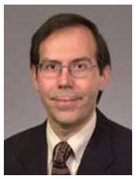
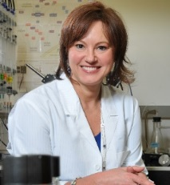
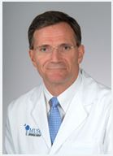
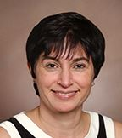
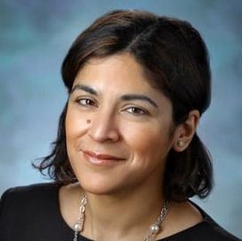
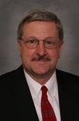
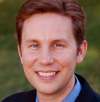
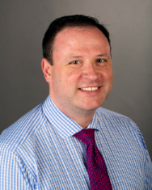
CFAS Administrative Board Members (2018-2019)
Scott D. Gitlin, MD, Chair
Gabriela Popescu, PhD, Chair-Elect
Vincent D. Pellegrini, MD, Immediate Past Chair
Mona Abaza, MD
Nita Ahuja, MD
Elza Mylona, PhD (Ex-Officio GFA Chair-elect)
Arthur Derse, MD, JD
Alan W. Dow, III, MD
Richard L. Eckert, PhD
Steven Angus, MD
Vera Donnenberg, PhD
VJ Periyakoil, MD
Reappointment
Carolyn Meltzer, MD
Robin McGoey, MD
Catherine Pipas, MD
J. David Warren, PhD

Slide 10
AAMC Leadership Presentation to Council of Teaching Hospitals (COTH), Council of Deans (COD), CFAS
Lilly Marks became the chair of the AAMC Board of Directors for 2018-2019
Nominations for AAMC Board of Directors can be submitted to boardnominations@aamc.org
AAMC’s new CEO will be named Dec/Jan. 2019, will assume position on July 1
Michael Levitzky, PhD, a former CFAS administrative board member, and Peter Slavin, MD, president of Massachusetts General Hospital, were awarded the Distinguished Service Award

Slide 11
AAMC Leadership Presentation to Council of Teaching Hospitals (COTH), Council of Deans (COD), CFAS
AAMC President and CEO Darrell G. Kirch, MD, presented an update on the AAMC’s top priorities and most recent efforts, as well as the national state of academic medicine:
AAMC Board of Directors taking up issue of sexual harassment in its upcoming Leadership Forum
AAMC continuing 340B litigation
AAMC published its National MD-PhD Program Outcomes Study

Slide 12
AAMC Leadership Presentation to Council of Teaching Hospitals (COTH), Council of Deans (COD), CFAS
AAMC is an amicus signatory on constitutionality of ACA, and Harvard case
Research continues to emerge showing better quality of care in academic health centers
AAMC searching for new editor in chief of Academic Medicine as CFAS rep David Sklar, MD, steps down from the position

Slide 13
AAMC Leadership Presentation to Council of Teaching Hospitals (COTH), Council of Deans (COD), CFAS
Public Policy Update from Karen Fisher, JD, AAMC’s Chief Public Policy Officer:
Despite partisan rancor, important bipartisan work is getting done:
Labor-HHS bill pass by beginning of year (1st time in 22 years)
Passage of a wide-ranging bill addressing opioid epidemic
NIH received $39.1 billion for FY19, F&A preserved, $9 billion cumulative increase since FY15, and $2 billion over FY18
Most Title VII, VIII grant programs spared but not increased

Slide 14
AAMC Leadership Presentation to Council of Teaching Hospitals (COTH), Council of Deans (COD), CFAS
HHS accelerating the deadline for 340B cuts thanks to AAMC’s legal maneuvers
AAMC supports AHA’s voluntary stewardship standards showing how important 340B is to institutions
CHIP reauthorized for total of 10 years
Cuts to Medicaid DSH delayed for 2 years

Slide 15
AAMC Leadership Presentation to Council of Teaching Hospitals (COTH), Council of Deans (COD), CFAS
After elections, it’s important to meet new congressional members to forge ties and educate them on academic medicine
The work our members do every day to advance care, research, education, and community is the most important advocacy asset in academic medicine

Slide 16
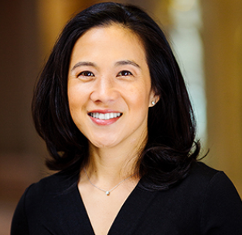
Opening Plenary: True Grit: The Surprising, and Inspiring, Science of Success
Grit involves perseverance (finishing what one starts, being a hard worker, being resilient, etc.), but it also involves consistency and long duration of passion
Talent combined with effort over a period of time produces skill; skill combined with effort produces achievement
Angela Duckworth, PhD, author of #1 New York Times bestseller, Grit

Slide 17
Opening Plenary: True Grit: The Surprising, and Inspiring, Science of Success
A purposeful, service-oriented approach, as opposed to a passion fueled by pleasure (money, recognition, etc.), produces gritty people
“There’s nothing about grit that involves martyrdom” - gritty experts focus on getting sleep and don’t overwork themselves
Expert, deliberate practice is focusing on a small sub-skill to practice, then practicing that sub-skill with 100% focus, then getting feedback on how it went, and reflecting on that feedback

Slide 18
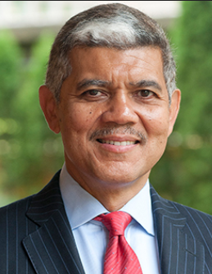
Leadership Plenary
AAMC President and CEO Darrell G. Kirch, MD, and chair of the AAMC Board of Directors M. Roy Wilson, MD, presented their insights into the current state and future direction of academic medicine
“Be good to medicine and medicine will be good to you.” Respect medicine and medicine will provide many rewards, including deep career satisfaction
Financial reward and profit are compatible with good medicine, but profit for the sake of profit is anathema to medicine and undermines public trust
M. Roy Wilson, MD, Chair of AAMC Board, President, Wayne State University

Slide 19
Leadership Plenary
Our sophisticated health care technology and systems can’t meet the needs of vulnerable, needy populations without humanism in medicine
The tent of medicine must be large and inclusive of the many segments of America’s diverse population
Medical educators have responsibility to teach learners a sense of optimism and hope and the joy of practicing medicine

Slide 20
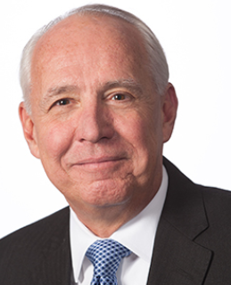
Leadership Plenary
AAMC President and CEO Darrell G. Kirch, MD
Academic health centers are engaging their communities through helping homeless leave streets, bringing grocery stores to food deserts, supporting 6.3 million jobs in US, helping communities with gun violence, and revitalizing neighborhoods
We must make technology work for us in restoring humanism in medicine

Slide 21
Leadership Plenary
Black women have especially made progress, but we’re still falling short with lack of black males, American Indians, and Alaskan natives in medicine
Our values were on display when academic medicine physicians took care of Robert Bowers, the Tree of Life Synagogue shooter
Putting those values on display are important not just to the health care system but to our democracy now

Slide 22
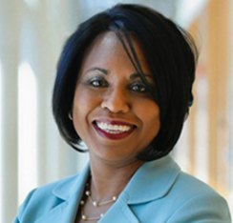
Plenary: Making the Equality Dream a Reality: Confronting Bias and Harassment
Anita Hill, JD, who testified against Supreme Court nominee Clarence Thomas in 1991, discussed the prevalence of sexual harassment, and strategies institutions can adopt to mitigate the issue
Gender equity and sexual harassment are linked because of the power imbalance in our workplaces. The way to alleviate the problem is to correct the imbalance
Resistance to the experiences of victims of sexual harassment fuels a sense of despair and betrayal
Anita Hill, JD, Professor of Social Policy, Law, and Women’s Studies, Brandeis University

Slide 23
Plenary: Making the Equality Dream a Reality: Confronting Bias and Harassment
The systems in place create and perpetuate bias and keep women from getting to the positions to change sexual harassment rules and structural barriers
Sexual harassment perpetrators must be punished – even if a Nobel prize winner doesn’t employ women in their labs, they need to be asked to leave our institutions
Those found guilty of misconduct shouldn’t be passed onto other institutions

Slide 24
Plenary: Making the Equality Dream a Reality: Confronting Bias and Harassment
When investigating someone accused of harassment, the appropriate standard is not innocent until proven guilty, all that’s required is viable evidence that the person violated institutional standards
Workplace leaders need to know when to intervene on gender harassment so it doesn’t escalate into sexual harassment

Slide 25
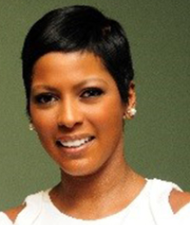
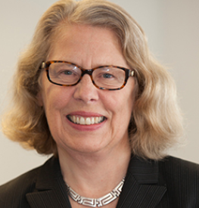
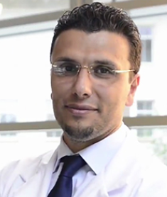
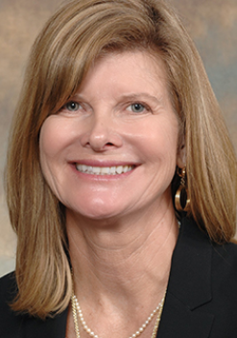
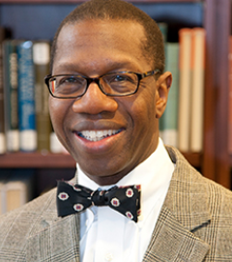
Plenary: The Extra Mile
Award-winning journalist Tamron Hall led a roundtable discussion with four doctors on how they cultivated empathy and resilience from adverse life experiences.
Tamron Hall – Award-winning journalist
Claire Pomeroy, MD, MBA – President, Albert and Mary Lasker Foundation
Heval Mohammad Kelli, MD – Cardiology Fellow, Emory University School of Medicine
Suzanne Watson, MDiv, MD, Resident in Family Medicine and Psychiatry, University of Cincinnati Medical Center
Will Ross, MD, MPH - Associate Dean for Diversity and Professor of Nephrology, Washington University in St. Louis

Slide 26
Plenary: The Extra Mile
There’s an importance in sharing experiences of adverse life events because it inspires others to persevere
Post-traumatic growth: Adversities provide empathy, and a passion and commitment to address hard issues
To care for people who hate you, you have to believe there’s value and something special in all of us by virtue of us being human

Slide 27
CFAS Knowledge Sharing Session
The CFAS Knowledge Sharing Session is a staple of CFAS programming at both LSL and CFAS spring meetings. It is an open-mic forum to freely and honestly share thoughts, ideas, and experiences to help advance the effectiveness of CFAS

Slide 28
CFAS Knowledge Sharing Session
Impact of CFAS:
CFAS, particularly the CFAS Faculty Resilience Committee, is directly responsible for NAM’s Action Collaborative on Clinician Well-Being
CFAS has also brought societies together to comment to CMS on a final rule on E/M documentation and many of those recommendations were implemented in the final rule
The number of AAMC meeting sessions that originate from CFAS is higher than any other AAMC group

Slide 29
CFAS Knowledge Sharing Session
Themes from the 2018 session:
Planning for the first Society Summit
How CFAS can advance women and minorities in academic medicine through awards
How to make future knowledge sharing sessions even more engaging by having table topics, report outs from the tables, etc.
Content for the 2019 CFAS Spring Meeting
Future projects CFAS can take on

Slide 30
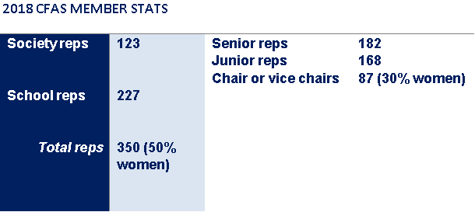
CFAS Membership Update
Up from 25%!
Up from 47%!

Slide 31
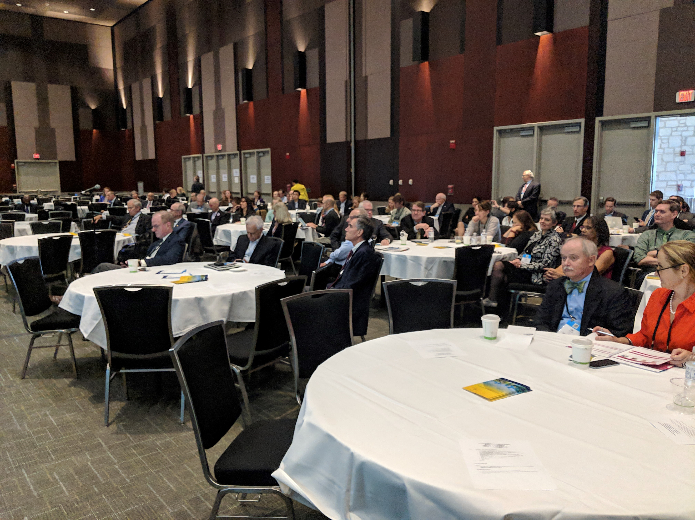
CFAS Highlights in 2018
In 2018, CFAS has
Completed and published the results of a demographic survey of its membership
Engaged in an AAMC initiative to study salary equity issues among clinical chairs at member institutions
Published the online “CFAS Diversity and Inclusion Toolkit”
Maintained the AAMC’s “Well-Being in Academic Medicine” website
The CFAS Communications Committee developed online resources to help new reps navigate and understand their responsibilities
CFAS continues to send AAMC advocacy sign-on letters to societies

Slide 32
Networking Opportunities at LSL
“Welcome to Austin” Reception, open to all Learn Serve Lead/Annual Meeting attendees
CFAS Networking Breakfast - including special interest conversations with surgical subspecialists and family medicine specialists
Group on Women in Medicine and Science (GWIMS), Group on Faculty Affairs (GFA), Council of Deans (COD), and CFAS Joint Reception (with awards and poster program)
CFAS Knowledge Sharing Session

Slide 33
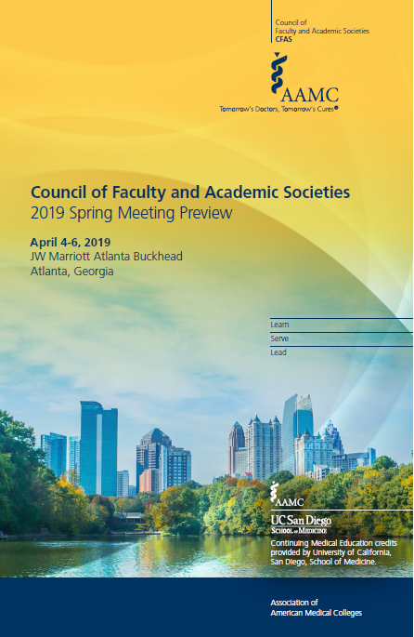
2019 CFAS Spring Meeting Preview
The 2019 CFAS Spring Meeting will have 3 plenary themes:
Addressing sexual harassment in academic medicine
(opening plenary)
Hot topics in bioethics, health policy, and research
(Friday morning plenary)
Prepping faculty for changes in medical education
(Closing plenary)
…Plus a business meeting and AAMC Leadership Update
April 4-6, 2019
JW Marriott Atlanta Buckhead
Atlanta, Georgia

Slide 34
2020 COD/COTH/CFAS Co-located Spring Meeting
To introduce the new AAMC president and CEO to the AAMC’s three councils (COD, COTH, and CFAS), AAMC staff will be co-locating the councils’ spring meetings in 2020
This will present an opportunity for one day of joint programming among all three councils
Potential topics for discussion include issues of interest to all three stakeholder groups; town hall-style conversations with the new president and CEO; and discussions about what it means to be part of an AAMC council operating within the association’s governance structure

Slide 35
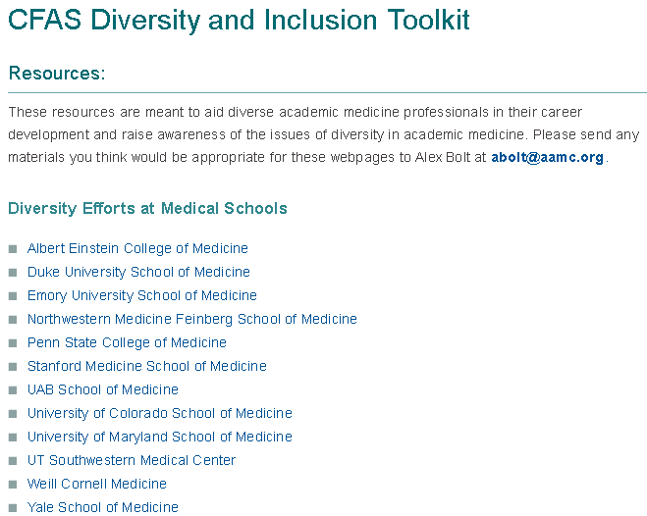
New CFAS Diversity Resource
https://www.aamc.org/members/cfas/diversity-and-inclusion-toolkit/

Slide 36
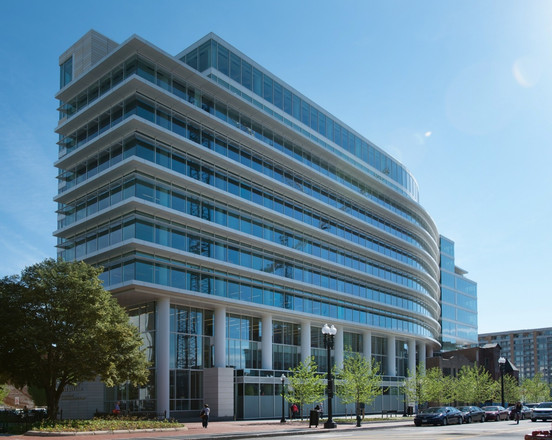
CFAS Society Summit
CFAS is planning a summit at the AAMC’s Washington, D.C. headquarters to bring together society representatives and executives to strategize on how CFAS can create more value for society members
Currently working out a date for 2019
AAMC Headquarters in Washington, D.C.

Slide 37
Questions and Comments
Contact Eric Weissman at eweissman@aamc.org or call Eric at 202-828-0044
Visit https://www.aamc.org/members/cfas/

