Slide 1
Project Medical Education
Name of institution(s)
Month XX, 201X
May add subtitle that highlights a theme for your program

Slide 2
Welcome to
(Insert Name of Institution)

Slide 3
Educating and Training Tomorrow’s Doctors and Future Health Care Leaders
149 Allopathic Schools of Medicine
More than 1,000 Teaching Hospitals
Approximately 400 Major* Teaching Hospitals
* Defined as short-term, general non-federal hospital with membership in AAMC Council of Teaching Hospitals & Health Systems (COTH)
Notes:
For use with Block 1

Slide 4
Three Intertwined Missions
Education
Research
Patient care
Notes:
For use with Block 1

Slide 5
A Cross-section of Skilled Individuals at
(Institution)
Medical students ###
Residents ###
Doctoral candidates ###
Faculty ###
Support staff ###
Employees ###
Notes:
For use with Block 1
You may insert your own institution’s data on this slide

Slide 6
First-Year M.D Enrollment
 | 20XX | 20XX | Number | % Increase
Male
Female
Combined
Notes:
For use with Block 1
You may insert your own institution’s data on this slide and add further breakdowns of your entering class.

Slide 7

Educating Tomorrow’s Doctors… the Role of Academic Physicians
Classroom teachers of students
Bedside teachers of residents
Health care providers
Consultants to other physicians
Clinical investigators
Administrators
Notes:
For use with Block 1

Slide 8
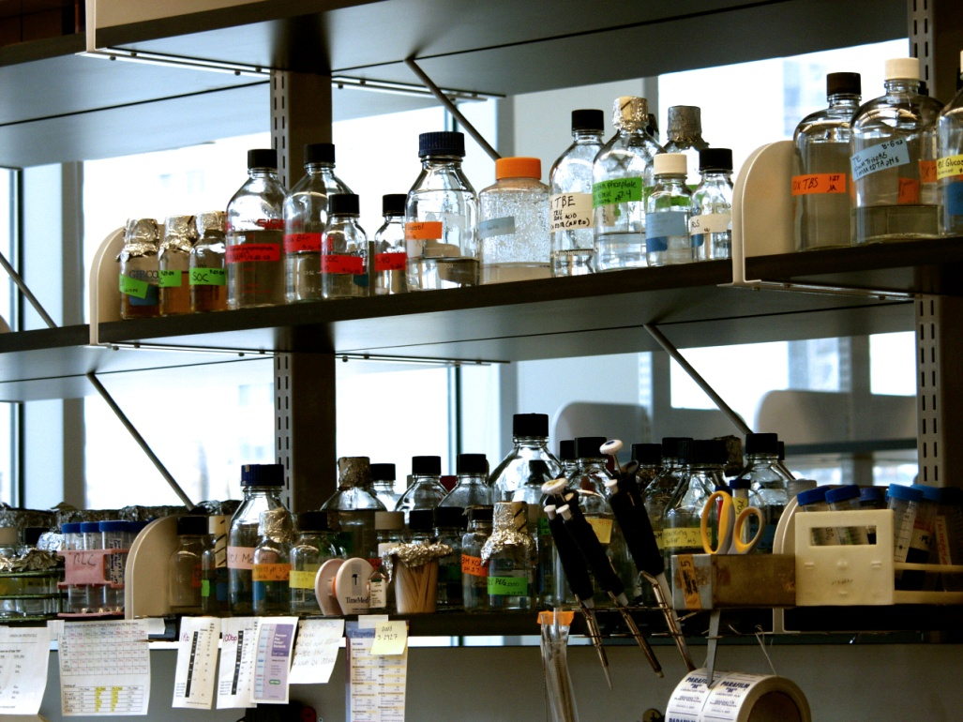
Research Mission
Finding Tomorrow’s Cures
More than half of the NIH extramural funding goes to support research at medical schools and teaching hospitals
Notes:
For use with Block 1 or Block 5

Slide 9

Patient Care and the
Teaching Hospital
  Sophisticated services and technology
  Regional health facilities
  Specialized services for special populations—elderly, women, children
  Sites of public health preparedness
  Medical schools and teaching hospitals are the safety net
  for health care
Notes:
For use with Block 1 or Block 3

Slide 10
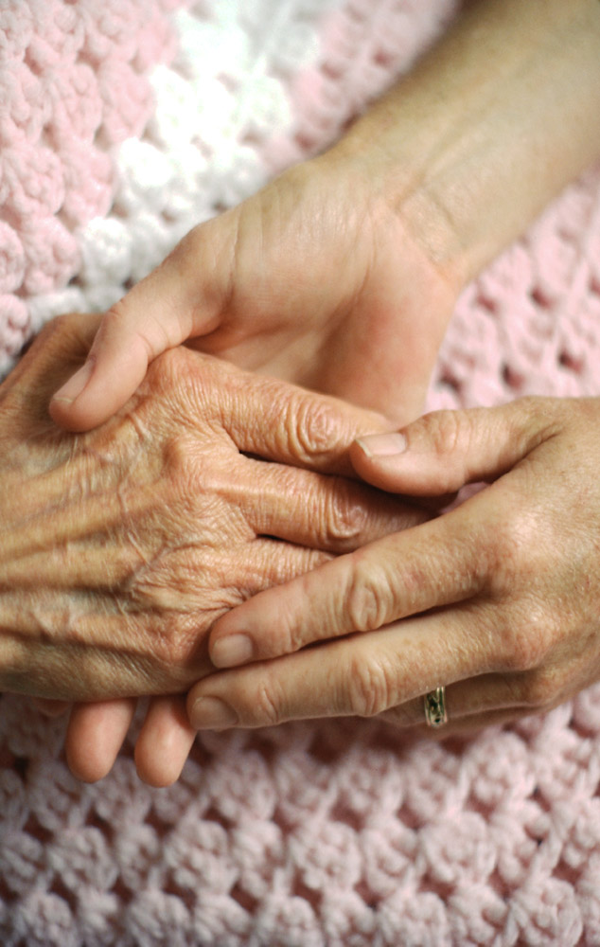
Community Service Programs
(Example)
(Example)
(Example)
(Example)
Notes:
For use with Block 1 or Block 3
You may insert your own institution’s data on this slide

Slide 11
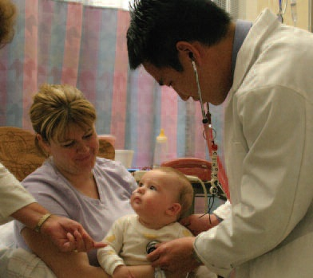
Outreach Clinics
(Example)
(Example)
(Example)
(Example)
Notes:
For use with Block 1 or Block 3
You may insert your own institution’s data on this slide

Slide 12
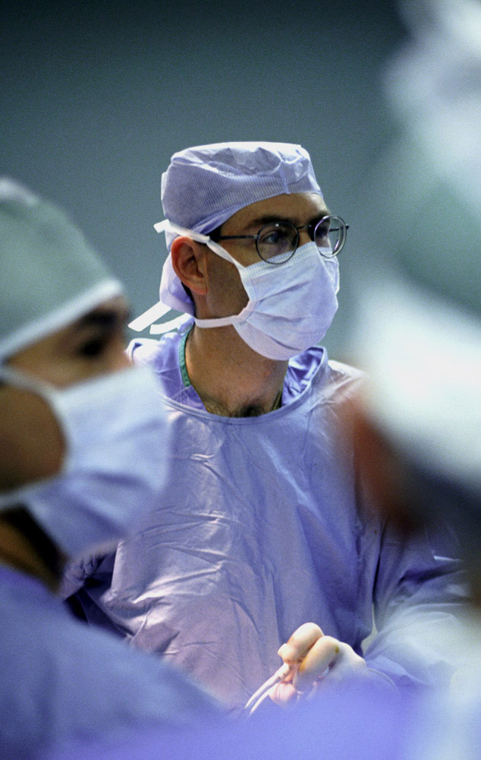
Medical Schools and Teaching Hospitals
The backbone of American medicine and health care
Notes:
For use with Block 1

Slide 13

Funding for Medical Education is a Critical Issue
Erosion of federal and state support endangers the ability of medical schools and teaching hospitals to pursue their essential missions
Notes:
For use with Block 1

Slide 14
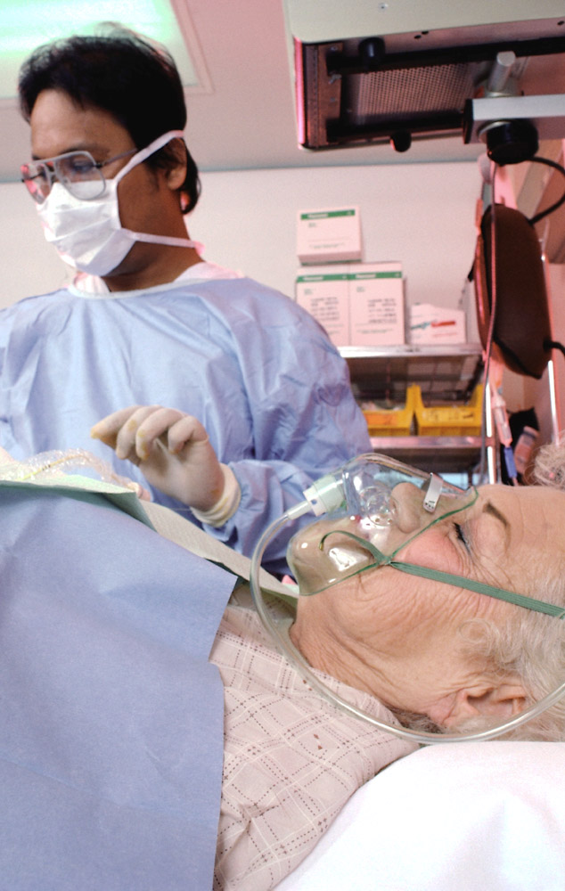
Reliable, consistent government support for the missions of medical schools and teaching hospitals is critical to maintaining the world-class doctors and health care system we have today
Notes:
For use with Block 1

Slide 15
Funding Challenges and
Declining Revenues
Chronic government underfunding
Cost-cutting by insurance companies and inadequate reimbursement
Increasing number of uninsured (over 46 million people in the U.S.)
Notes:
For use with Block 1

Slide 16
Reduced Funding Affects:
Research
Patient care
Faculty recruitment
Medical education
Notes:
For use with Block 1

Slide 17
Medical school funding
State & Local Gov’t Appropriations and Parent University Support
6.3%
Federal Grants & Contracts
19.2%
Federal Appropriations
0.3%
Tuition & Fees 3.4%
Other 4.0%
Endowment & Gifts 5.0%
Non-federal Grants & Contracts 9.6%
Faculty Practice Plan
37.6%
Hospital Revenues
14.7%
Source: LCME Part I-A Annual Financial Questionnaire, FY2008 Data, Updated 6/09
Notes:
For use with Block 2

Slide 18
Becoming a Physician
Undergraduate degree
Medical school
Residency training
Fellowship
Lifelong learning
Notes:
For use with Block 2

Slide 19

Medical Education Team
Medical student
Intern
Resident physician
Fellow
Attending physician
Allied health professionals
Notes:
For use with Block 2

Slide 20
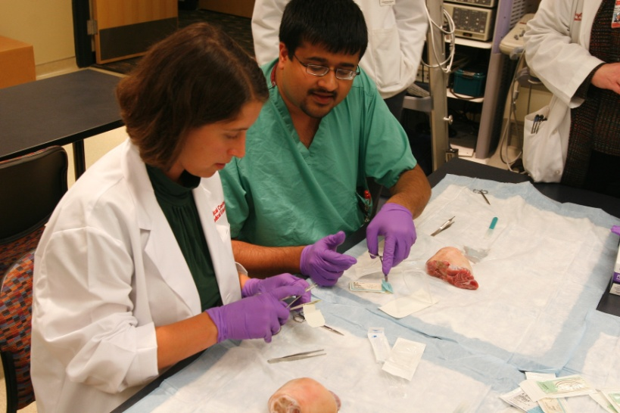
Medical Education Curriculum
Year 1
Year 2
Year 3
Year 4
Notes:
For use with Block 2

Slide 21

Medical School Curriculum Changes
  More small group instruction
  Less teaching in hospital
  More balance between teaching in hospital and ambulatory setting
  Responsive to society’s changing health care needs
Notes:
For use with Block 2

Slide 22

Medical School Curriculum Changes
  Emphasis on preventive medicine
  Use of information technology
  Focus on communication
  with diverse cultures and cultural competencies
Notes:
For use with Block 2

Slide 23

Median Annual Costs of Attending Medical School
$82,278 at private schools
$60,945 at public schools
Soure: AAMC Tuition and Student Fees Survey 2015-16 data; Based on the 88 public schools and 54 private schools for which data are available
Notes:
For use with Block 2

Slide 24

Important to Remember:
Tuition does not cover all the costs to fund a medical degree.
On average, tuition and fees account for only 3.4 percent of a medical school’s annual revenues.
This inherently means that medical schools must derive funds from other sources.
Notes:
For use with Block 2

Slide 25

Average Debt of Medical Students
$190,694*
*AAMC Graduate Questionnaire, 2007; average of those incurring debt
* Source: FIRST analysis of AAMC 2017 GQ data. Education debt figures include premedical education debt plus medical education debt. Non-education debt includes car, credit card, residency relocation loans, etc.
Notes:
For use with Block 2

Slide 26
The Cost of Medical Education
Tuition: $X
Books & fees: $X
Living expenses: $X
Average annual cost: $X
Notes:
For use with Block 2
You may insert your own institution’s data on this slide

Slide 27
Welcome to
(Name of Teaching Hospital)
Notes:
For use with Block 3

Slide 28
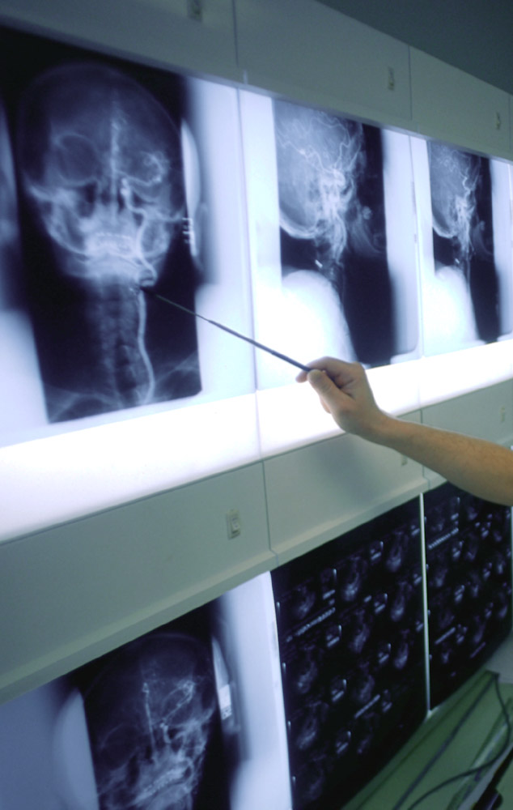
Teaching Hospitals
  Provide care for more severely ill patients
  Provide complex procedures
  Treat patients with rare conditions
  Provide vitally needed stand-by outreach services
Notes:
For use with Block 3

Slide 29
The Role of COTH Hospitals in Graduate Medical Education
COTH Hospitals as a Percent of All
Teaching Hospitals
Residents Educated at COTH and Other Teaching Hospitals
26%
Other
Teaching
Hospitals
78%
COTH Hospitals
22 %
74%
Note: Data reflect short-term, general, non-federal hospitals. Data for COTH hospitals reflect integrated and independent COTH members.
Source: 2016 AAMC Data Book
Notes:
For use with Block 3

Slide 30
COTH Characteristics
Short-Term, General, Non-Federal
 | COTH as % of All Hospitals
Hospitals | 5%
Cardiac Intensive Care | 17%
Births | 18%
Outpatient Visits | 22%
Surgical Operations | 21%
Emergency Visits | 14%
Neonatal ICU | 34%
Pediatric ICU | 60%
Burn Units | 69%
Level 1 Regional Trauma Centers | 71%
Note: COTH Teaching Hospitals include 273 members of the Council of Teaching Hospitals and Health Systems. All Hospitals include 4,548 short-term, general, non-federal hospitals.
Source: 2017 AAMC Data Book
Notes:
For use with Block 3

Slide 31
Total Average Resident Costs
Stipend $00,000
Direct fringe $00,000
Accreditation costs $00,000
Faculty supervisory costs $00,000
Malpractice $00,000
Other $00,000
Total $000,000
Notes:
For use with Block 3
You may insert your own institution’s data on this slide

Slide 32
Economic Impact
Patient care and graduate medical education
Employees (FTEs) ####
Compensation and benefits $$$$
Supplies, services and capital $$$$
Subtotal $$$$
Research
Employees (FTEs) ####
Total expenditures $$$$
Total economic impact $$$$
Notes:
For use with Block 3
You may insert your own institution’s data on this slide

Slide 33

Medicare is the Largest Explicit Financing Source for the Special Missions of Teaching Hospitals
Direct graduate medical education payment (DGME)
Indirect medical education (IME) adjustment
Notes:
For use with Block 3

Slide 34
Medicare Provides Special Payments for Social Missions
Payment Mechanism
Adjustment to each Medicare hospital case, recognizing that teaching hospitals have inherently higher costs because they treat sicker patients, act as referral centers for other hospitals, and support education and research.
Indirect Medical Education (IME) Adjustment
Payments to teaching hospitals for the direct costs of educating resident physicians, including resident and faculty salaries, classroom space, administrative support, and overhead costs.
Direct Graduate Medical Education (DGME) Payment
Disproportionate Share (DSH) Adjustment
Payments to teaching hospitals for the direct costs of educating resident physicians, including resident and faculty salaries, classroom space, administrative support, and overhead costs.
Notes:
For use with Block 3

Slide 35
Medicare Payments as a Share of Total Resident Training Costs
Medicare payments as a percent of total resident training costs
Insert a chart with your data here
Notes:
For use with Block 3
You may insert your own institution’s data on this slide

Slide 36
Funding for Graduate
Medical Education
??%
Medicaid, State, Clinical Revenues, Private Payers
??%
Medicare Funding
Notes:
For use with Block 3
You may insert your own institution’s data on this slide

Slide 37
Changes in Funding
(Example)
(Example)
(Example)
(Example)
Notes:
For use with Block 3
You may insert your own institution’s data on this slide

Slide 38
Ways to Reduce Costs
Reduce personnel
Eliminate programs
Close patient units
Admit fewer students
Drop or severely curtail support of one of the core missions
Notes:
For use with Block 3

Slide 39
Welcome to Residency Training at
(Local Institution)
Notes:
For use with Block 4

Slide 40

Residency Training
(Graduate Medical Education)
  Integral component of the formal education of doctors
  Three to seven (or more) years
  Inpatient experience
  Ambulatory care training
  In-depth, supervised training
Notes:
For use with Block 4

Slide 41
Graduate Medical Education (GME) Training Requirements for Specialty Board Certification
Years of
Specialty GME Required
Anesthesiology 4
Emergency Medicine 3
Family Practice 3
Internal Medicine 3
Obstetrics/Gynecology 4
Pathology 4
Pediatrics 3
Psychiatry 4
Radiology 4
Surgery 5
Source: ACGME
Notes:
For use with Block 4

Slide 42
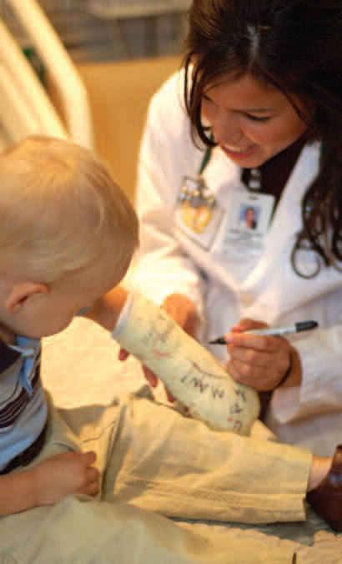
Graduate Medical Education
Residents training ###
Primary care ###
Specialists ###
Total residents trained ###
Notes:
For use with Block 4
You may insert your own institution’s data on this slide

Slide 43
Residency Curriculum
  Scholarship and
  lifelong learning
  Communication skills
Ethics
Personal and professional development
  Medical practice issues
Notes:
For use with Block 4

Slide 44

Residency Training Curriculum
Residents assume progressively more responsibility for patient care as they advance through their training
(Describe components)
(Describe components)
(Describe components)
(Describe components)
Notes:
For use with Block 4
You may insert your own institution’s data on this slide

Slide 45
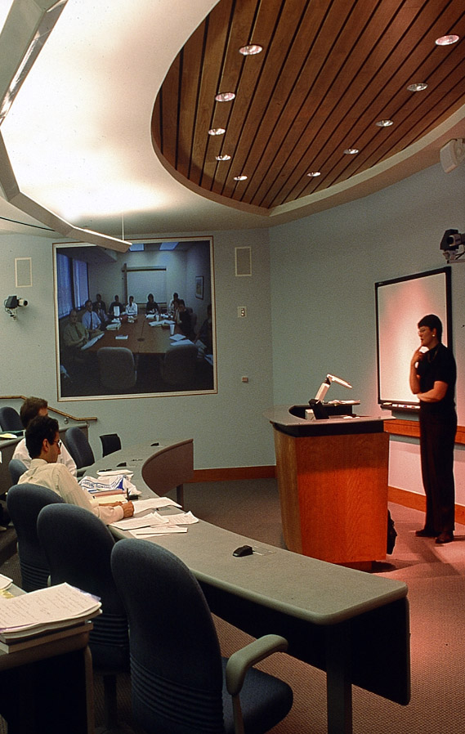
GME Curriculum Changes
  More inpatients with severe illness
  More ambulatory experience
  More emphasis on evidence-based medicine
  More emphasis on decision-making skills
  Impact of information technology
  National limits on residents’ hours
Notes:
For use with Block 4

Slide 46
Distribution of Residents
Completing All Training
Surgical
Subspecialties
??
Medical and
Pediatric
Subspecialties
??
Psychiatry/
Neurology
??
Other
??
Hospital-
Based
Specialties
??
Primary Care
??
General Surgery
??
Notes:
For use with Block 4
You may insert your own institution’s data on this slide

Slide 47
Accreditation Council on
Graduate Medical Education
Reviews facilities and faculty
Reviews facilities and faculty
Approves size of programs
Monitors resident duty-hours
Notes:
For use with Block 4

Slide 48
ACGME Required Competencies
Patient Care that is compassionate, appropriate, and effective for the treatment of health problems and the promotion of health
Medical Knowledge about established and evolving biomedical, clinical, and cognate (e.g., epidemiological and social-behavioral) sciences and the application of this knowledge to patient care
Practice-Based Learning and Improvement that involves investigation and evaluation of their own patient care, appraisal and assimilation of scientific evidence, and improvements in patient care
Interpersonal and Communication Skills that result in effective information exchange and teaming with patients, their families, and other health professionals
Professionalism, as manifested through a commitment to carrying out professional responsibilities, adherence to ethical principles, and sensitivity to a diverse patient population
Systems-Based Practice, as manifested by actions that demonstrate an awareness of and responsiveness to the larger context and system of health care and the ability to effectively call on system resources to provide care that is of optimal value.
Notes:
For use with Block 4

Slide 49
Organizations Involved in Accreditation of Medical Educational Programs and Licensure and Certification of Physicians
International Medical Graduates
Medical Education
Four-year program offered at 134 U.S. medical schools. Medical education programs accredited by the Liaison Committee on Medical Education, cosponsored by the AAMC and AMA.
Graduate Medical Education
certified for entrance into a U.S. residency program by the Educational Commission for Foreign Medical Graduates (ECFMG)
Licensure
(Mandatory)
Certification
(Voluntary)
American Board of Medical Specialties, umbrella organization of 24 specialty boards. Physicians certified by an ABMS member board have successfully completed an approved residency training program and an evaluation process assessing their competence in the specialty.
The USMLE, a three-part external examination required for licensing, is sponsored by the National Board of Medical Examiners and the Federation of State Medical Boards, which represents the 54 state and jurisdictional licensing authorities.
Practice
Notes:
For use with Block 4

Slide 50
Complexities of Physician Supply
  Supply = (Current + New – Exiting) X Efficiency
Age Distribution
Economy
Satisfaction
Teams
PAs, NPs,
Service delivery
HIT/EMR
# of Physicians
x
Work hours
GME Slots
Payment
Regulation
Gender
Age
Systems Factors
GME Reimbursement & Policy
MD Enrollment
DO Enrollment
IMGs
Regulations
Payment -Policies
Notes:
© 2006 Association of American Medical Colleges.
50
Suggested use with Block 4

Slide 51
Complexities of Physician Demand
Demand = Population x Health x Utilization Rates
Prevalence & incidence of conditions & diseases
Insurance
Access
Organization of services
Available supply
Medical advances
Number
Age
Gender
Race/ethnicity
Location
Medical advances
Environment
Poverty/income
Prevention
Public health measures
Behavior/lifestyle
Notes:
For use with Block 4

Slide 52
Postgraduate Training Programs
(Listing of specialties and fellowships)
(Listing of specialties and fellowships)
(Listing of specialties and fellowships)
(Listing of specialties and fellowships)
Notes:
For use with Block 4
You may insert your own institution’s data on this slide

Slide 53
Medicare and Medicaid Support for Graduate Medical Education
Medicare support
Direct medical education costs ####
Indirect medical education costs ####
Total ####
Medicaid support for GME ####
Notes:
For use with Block 4
You may insert your own institution’s data on this slide

Slide 54
Medical Research at
(Local Institution)
Notes:
For use with Block 5

Slide 55

Research Leads to . . .
  Improved patient care
  Earlier, cost-effective diagnosis
  Less invasive procedures
  More effective rehabilitation
  Up-to-date medical education
Notes:
For use with Block 5

Slide 56
Promoting the Full
Continuum of Research
Basic Science Discoveries
Clinical Science Discoveries
Developing Expertise in the Full Spectrum of Science
Redesigning the Training of the New Scientific Workforce
Sustainability Initiative
Advocacy
Evidence-based
Health Care and Prevention of Disease
Knowledge
Translation
Comparative Effectiveness
Delivery System Transformation
Patient and Community Engagement through Research
Notes:
For use with Block 5

Slide 57
Medical Education is the Foundation and Future of Our Health Care System
  Medical education is a complex, collaborative process that requires substantial resources—both intellectual and financial.
  Medical schools and teaching hospitals are national resources that provide essential benefits to the public through four intertwined missions.
  Reliable, consistent government support for the missions of medical schools and teaching hospitals is critical.
  Erosion of federal and state support endangers the ability to pursue these essential missions.
Notes:
For use with Block 6

Slide 58


