Slide 1
AAMC Building Better Curriculum Webinar Series We will begin our presentation shortly. Topics: CIR Mapping at Wake Forest USMLE and Hot Topic Links Update from the AAMC’s Curriculum Inventory Presenters: E Shen, Assistant Professor, Director of Healthcare Teaching and Learning Rebecca Keller, PhD, Asst Dean, Medical Education, Professor, Molecular and Cellular Physiology Walter Fitz-William, Senior Program Operations Specialist, Curricular Resources PLEASE NOTE: All users will be muted during the webinar but should use the chat feature to send questions to Angela Blood during the presentation. We will try to answer as many questions as possible at the end of the presentation.

Slide 2
CIR Mapping @ Wake
E Shen, Assistant Professor, Director or Healthcare Teaching and Learning
Notes:
Hello everyone, I am
I am here to share the journey of how Wake Implemented CIR upload and how are we doing to keep the curriculum mapping updated. And discuss the lesson learned and future directions.

Slide 3
Disclosure Statement of Financial Interest
I DO NOT have a financial interest/arrangement or affiliation with one or more organizations that could be perceived as a real or apparent conflict of interest in the context of the subject of this presentation.

Slide 4
Objectives
Describe how Wake Forest established the mapping in 2015
Describe the process to keep the curriculum map up to date
Share the lessons learned
Discuss the future directions

Slide 5
Background
2014
Homegrown curriculum delivery system with limited tagging capabilities
Hire vendor at the end of academic year to perform CIR upload
Notes:
The system can tag instructional, assessment method, resource type
At the end of the year, we pay vendor on yearly basis for CIR upload. Vendor provides a spreadsheet templet, we fill in the spreadsheet.

Slide 6
Example spreadsheet

Slide 7
Establish mapping
2015
New CMS has CIR upload capability
Standardized course syllabus for all courses
Notes:
It offers the capability to link session objectives to course objectives, course objectives to PCRS and Institutional objectives. It offers flexibility on tagging system that we can use for mapping EPA, clinical conditions, and LCME hotptoics
The course syllabus require course learning objectives, as well assessment method of each learning objectives, and its links to institutional objectives, EPA and LCME hot pics. The course syllabus become a buleprint for course mapping and was very helpful when we try to establish curriculum mapping.

Slide 8
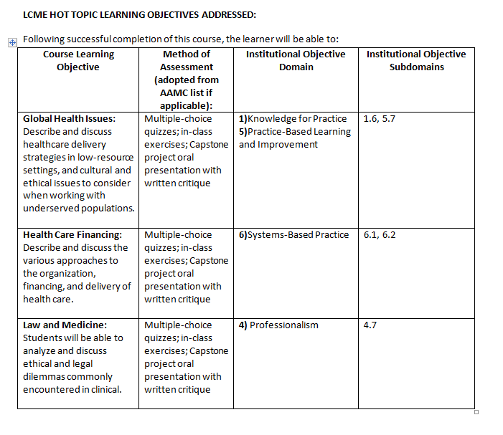
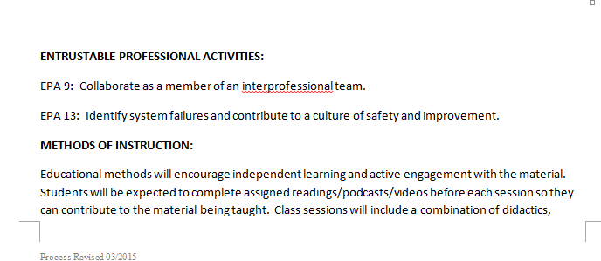
Course syllabus example

Slide 9
Student effort
For preclinical years, during summer 2015, about 20 students mapped:
Event objectives to course objectives
Instructional methods
Assessment methods
LCME hot topics and EPAs
Notes:
Those Year one and Year two student just attended these events. And content are fresh in their mind. Most of the event mapping were completed during the summer while students were away from the campus. They were trained on how to map with virtual classrooms. We gave them gift cards as rewards.

Slide 10
Faculty and staff effort
3rd year clerkship instructional events were mapped by clerkship directors
4th year required courses were mapped by 4th year clerkship committee
Notes:
For 3 rd year, we send out spreadsheets to clerkship directors and these spreadsheet were filled by course directors. For 4th year, we have a committee led by a very capable staff member.

Slide 11
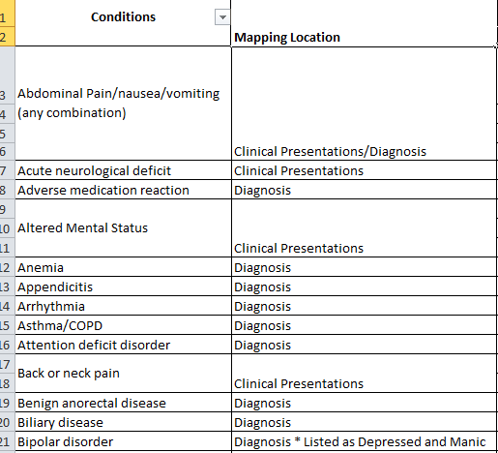
Enhancements and updates
Add conditions/diagnosis for pre-clinical year events to align with clinical years
Add/update mapping
New courses
New events
Event objective change; IM/AM change
LCME hot topics change
Notes:
Clinical yeas have a conditions and procedures tracking system on what conditions and procures they need to participate or see for each clerkship. In order to better linking clerkship materials with pre-clinical curriculum, we tried to map pre-clinical events with conditions. This is a suggestion come from underrate medical education committee (UMECC)
We start the update in May/June every year before the course rollover. It takes about one month.

Slide 12
Sample institutional curriculum mapping report requests
What was taught where?
e.g. pharmacology thread; how can we better integrate clinical skills course with other blocks
Were all of our institutional objectives taught before students graduate? If yes, where and how many instructional hours?
Where was condition x taught in pre-clinical years?
Identification of curriculum on pain management, addiction/practice of prescribing or dispensing opioids
Notes:
1. The most common request is what was taught where, can be a specific topic like patient safety, it can be a curriculum thread like pharmacology, or can be a an entire course integration like the timing of the clinical skill sessions for pre-clinical years
Item is most recent alumni to verify the education of Verification Form for “Alumni that Graduated in 2018 program includes at least 2 hours of education on pain management and 2 hours of education on prescribing opiates”

Slide 13
Lessons learned
Syllabus
Senor leadership support
Write into every year component review report
Well trained, dedicated staff
Course objective changes
Notes:
Course syllabus is the foundation of the curriculum mapping and it is tool to communicate between course director and mapping staff members
We all know the support of leadership is important, clinicians have very busy schedule. We are lucky to have very supportive senior associated dean. As well as associate deans who are in charge of clinical years, pre-clinical years, and longitudinal courses.
If the mapping goal can be Witten into any document, it helps. For us, in the past few years, the mapping enhancements and updates were written into our annul review reports as goals.
We had course objective system a couple years ago, a large number of course objectives are changes, it caused a lot of re-map work (event to course objectives). If you are planning on course objective change, I recommend better coordination between course director and mapping staff member.

Slide 14
Future directions
How to encourage students use the map?
Measure not what was taught, but what was learned.
Notes:
Aside from administration and accreditation. One of the most important stakeholders for mapping is students. If students can find the mapping useful for their learning, that will make the mapping a living and breathing document, instead of for documentation purpose only. That will in turn motivate course director on their effort of mapping. I think the condition/diagnosis mapping is a one step toward right direction. But, there many more things we can do to make the mapping useful to students.
The next one is a bit out of the scope of mapping. But I want to everyone don lose the sight that the most important thing is not what they’ve taught, but they’ve learned and evaluated/verified. Mapping laid out the foundation, but many more needs to be done. Such as EPA based dashboard, portfolio system.
With all that said, I am open to any questions. And any suggestions and recommendations on how we can better implement curriculum mapping.

Slide 15
Questions
E Shen
eshen@wakehealth.edu

Slide 16
Building Better Curriculum
USMLE and Hot Topic Links

Slide 17
No Disclosures to report

Slide 18
Objectives
Describe the process used at AMC for mapping the curriculum
Describe the use of USMLE STEP 1 and STEP 2 CK Content in mapping
Describe the use of hot topics in mapping
Describe how this is used in assessment of the curriculum

Slide 19
AMC Curriculum
2 years pre-clinical
Organ system based, integrative
Year 1 normal with clinical vignettes
Year 2 abnormal
2 years clinical
Year 3 core clerkships
Year 4 electives
Longitudinal themes throughout the 4 years
Evidence Based Health Care
Ethics/legal
Informatics
Nutrition

Slide 20
Curriculum Database
Originally used CurrMIT at AAMC
Current database developed by Michael Acadia at George Washington University in 2006-2007
Used for both Medical and Graduate Curriculum
Accessible by faculty, students and staff
Data is copied every year and then updates are made throughout the year
All course directors review and advise database entries

Slide 21
USMLE Content
Content for both STEP I and STEP 2CK are in the database
Faculty are provided with spreadsheets to indicate session objectives that cover material
Reports can be generated
Work in progress – probably 80% complete

Slide 22
Example – STEP I

Slide 24
Example – STEP 2CK

Slide 25
Hot Topics
The list comes from the Graduation Questionnaire and LCME site visits
New topics are added from our Curriculum Assessment process and student evaluation data
Generates reports to track topics and to use in assessment reports

Slide 26
Hot Topics (cont)
Currently, track 27 topics
From Health care systems to ethic topics to IPE to pharmacology, etc
Mapped to Themes (courses) and sessions, sometimes objectives
Working on Societal Problems
Abuse and Violence, Addiction, HIV, Obesity, Poverty

Slide 27
Hot Topic Examples

Slide 28
Curriculum Assessment
Each theme/clerkship is evaluated every 3 years
The 4 year curriculum is evaluated every year
Reports generated from the curriculum database allows the assessment team to have current data to track different topics.
Each theme leader/clerkship director submit an end of year report – also used in the assessment process

Slide 29
Use of the Data
Faculty
Education leaders use the database to look for integration of topics that they teach
Presentations are in the database, who teaches the session, what part of the curriculum
Students
While studying, students can search and go directly to presentation material for review
Discover all areas of the curriculum that cover a topic – increases knowledge of intentional integration

Slide 30
Challenges
This is still a work in progress.
Educational faculty leaders use the database, hot topics, USMLE content to inform how to improve content or show integration
Students – some use the database a lot (we have data that shows that) but we need to do a better job with educating the students of the resource

Slide 31
Questions
Feel free to contact me:
Rebecca Keller, PhD
Albany Medical College
Asst Dean, Medical Education
Professor, Molecular and Cellular Physiology
kellerre@amc.edu
(518) 262-8105

Slide 32
AAMC Building Better Curriculum webinar series
Preparing for the CI upload process
June 2019

Slide 33
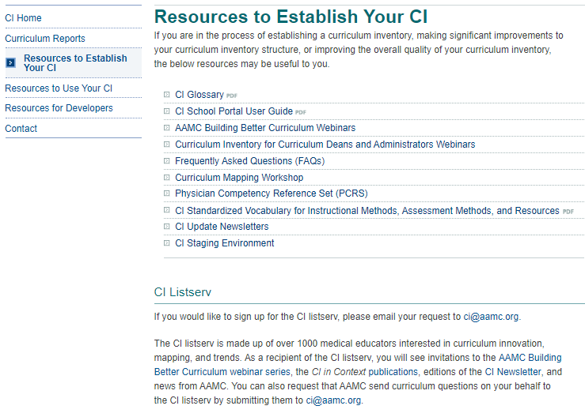
CI Website
Notes:
The CI Website is organized according to resources to establish a curriculum inventory, resources to use your curriculum inventory effectively, and resources for developers and vendors. Some of the communications that are especially helpful and can be found here include:
The CI School Portal user guide
The AAMC Building Better Curriculum webinar series
The CI Standardized Vocabulary on instructional methods, assessment methods, and resources
The CI Newsletter
The CI Staging environment
And the CI listesrv

Slide 34
Agenda – Preparing for the CI upload process
CI School Portal and CI Staging Environment access
CI Vendor Portal
New CI participating vendor agreements
AAMC Business Rules for August 1, 2019
Verification Report 2019

Slide 35
Explaining AAMC Resources
CI School Portal: the production site, used once per year to submit school CI data. This will now hold “Your Curriculum Reports” including past Verification Reports, requested custom reports, and special AAMC reports.
CI Staging Environment: open all year but cannot be used to officially submit CI data, only to test CI data submissions. In the past, not all the functionality of the staging site matched the CI School Portal (production) site.

Slide 36
CI Account Management
Email changes to CI Primary Admin or Curricular Dean roles to ci@aamc.org
Email names and email addresses of those you would like to also have access to the CI Staging Environment (must be from your faculty already having access to the CI School Portal).

Slide 37
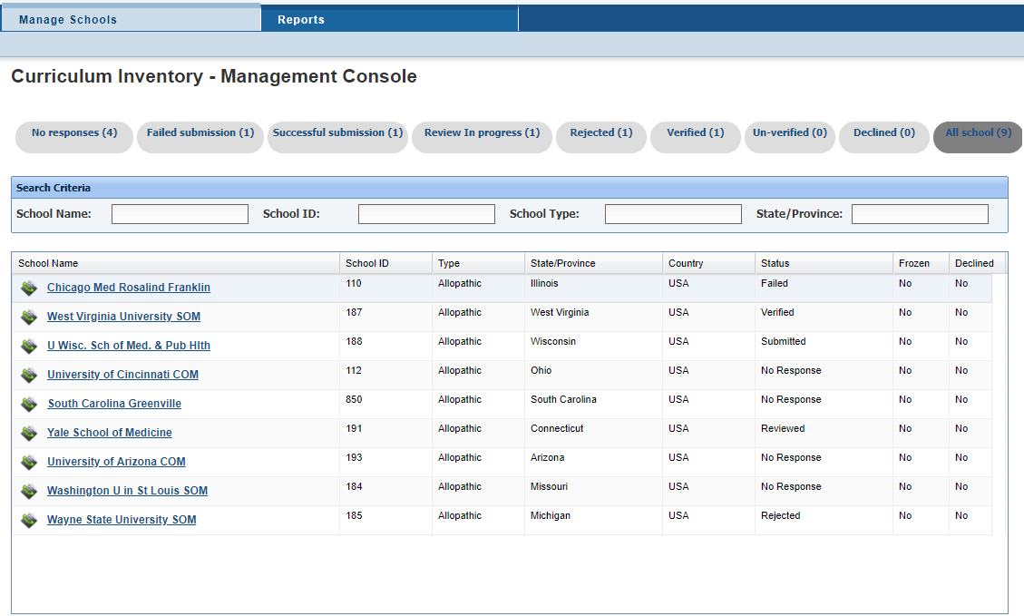
New CI Vendor Portal
Notes:
One of the major improvements this year to support vendors in helping their clients is a new Vendor Portal. This was one of the major asks we heard from vendors during our needs assessment last year. Schools also need this to open the “black box” of issues when a school encounters trouble in submitting their CI data.
Vendors want a better idea of which of their clients was where in the CI process, and this portal will give them a password-protected view of which of their clients might need the most support. The schools above are just sample data. Vendors can only see the schools who assign them as a vendor, so there is no way a vendor can access a school’s verification report who hasn’t designated them as having permission. You need to choose your vendor through the CI School Portal; only then does AAMC give that vendor view-only access to your XML file and Verification report through the CI Vendor Portal.
Through the different tabs across the top of this image, vendors can see which of their clients have completed the process, how many times schools have attempted to submit (and perhaps target their customer service better to you). It also shows the vendor the Verification Report so they can in real time see the same potential error messages if there’s an issue, and the same results that you see. Instead of you having to send your vendor your verification report or take screen shots of errors, they can view these things for themselves.

Slide 38
New AAMC CI and Vendor agreements
Launched June 3, 2019
Consistent across all CI participating vendors
Up to date with AAMC’s data management approach
Technical requirements more explicit
Agreement covers several years, but we also now have a yearly survey for vendors to update information like their staff members and contact information
Notes:
We’ve been working on this for about a year. It’s been a lot of internal work with AAMC’s legal department to make sure our agreements are up to date and in-keeping with AAMC’s approach to data management. We’ve told vendors these are coming, through our every-other-month web meetings and our in-person retreat for vendors last January.

Slide 39
AAMC Business Rules
AM015 Practical Lab is no longer a valid assessment method and its use will trigger a violation of CS12.
AM019 Exam - Institutionally Developed, Laboratory, Practical remains a valid assessment method.
Sequence Blocks nested in other sequence blocks must still be defined. If you do not define the sequence block, CS24 will be triggered.
Notes:
These are rules that overlay the MedBiquitous Technical Standards. An updated version is posted on our website. We made only cosmetic or clarifying improvements this year, knowing that we are undergoing a review of the MedBiquitous Technical Standards so significant work to the AAMC Business Rules will be undertaken following the MedBiquitous review is complete. We’ll highlight the AAMC Business Rule clarifications for you now. We briefed participating CI vendors on these during our January 2019 retreat.

Slide 40
Verification Report 2019
Continue trends from last year: readability, explanations, wording
New Goal: Make the report easier to share with your faculty
This will be the last year for the “big” Verification Report.
Notes:
We recognize that for some schools, the Verification Report can be very lengthy.
If the goal of reviewing the Verification Report is to make sure its accurate, asking one curricular dean to know the details or each event or course is probably not realistic. The faculty directly involved in the leadership of specific sections of the curriculum (like a neurology clerkship director, or dean of basic science) are likely to know their sections of the curriculum more intimately. It would also help not only help check for accuracy in the Verification Report, but use the report for program evaluation if the report were easier to share.
Currently, all sequence blocks/courses were listed in one large table (and the same was true for events, across courses) so parsing out pieces of the Verification Report for specific faculty or specific purposes was not really possible.
If we could at least insert page breaks among sequence blocks/courses, the report would be easier to share with other key faculty and curriculum leaders.

Slide 41
CI Verification Report Resources
https://www.aamc.org/initiatives/cir/useci/
Notes:
Before we jump into improvements, I wanted to share this website with you. All of the resources we’re talking about today are available to you on the CI website, specifically under “Resources to Use Your CI.” You can find samples of Verification Reports, and a Guide explaining how the previous version of the Verification Report differs from the new version.

Slide 42
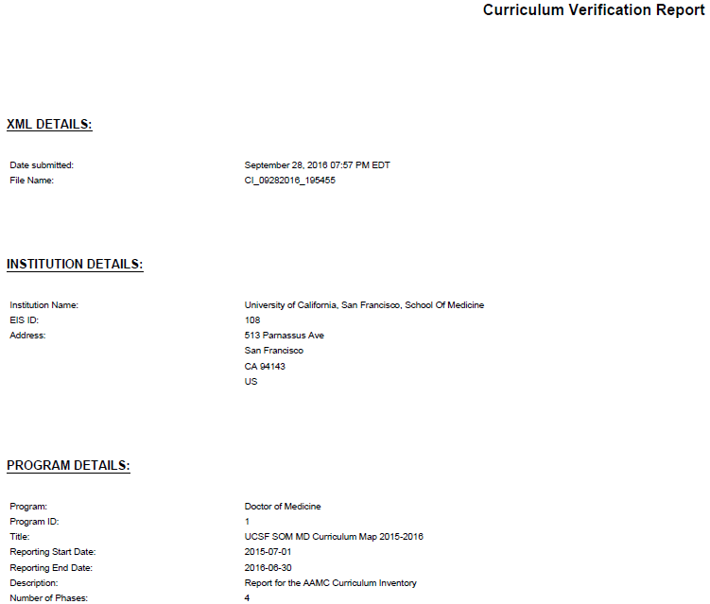
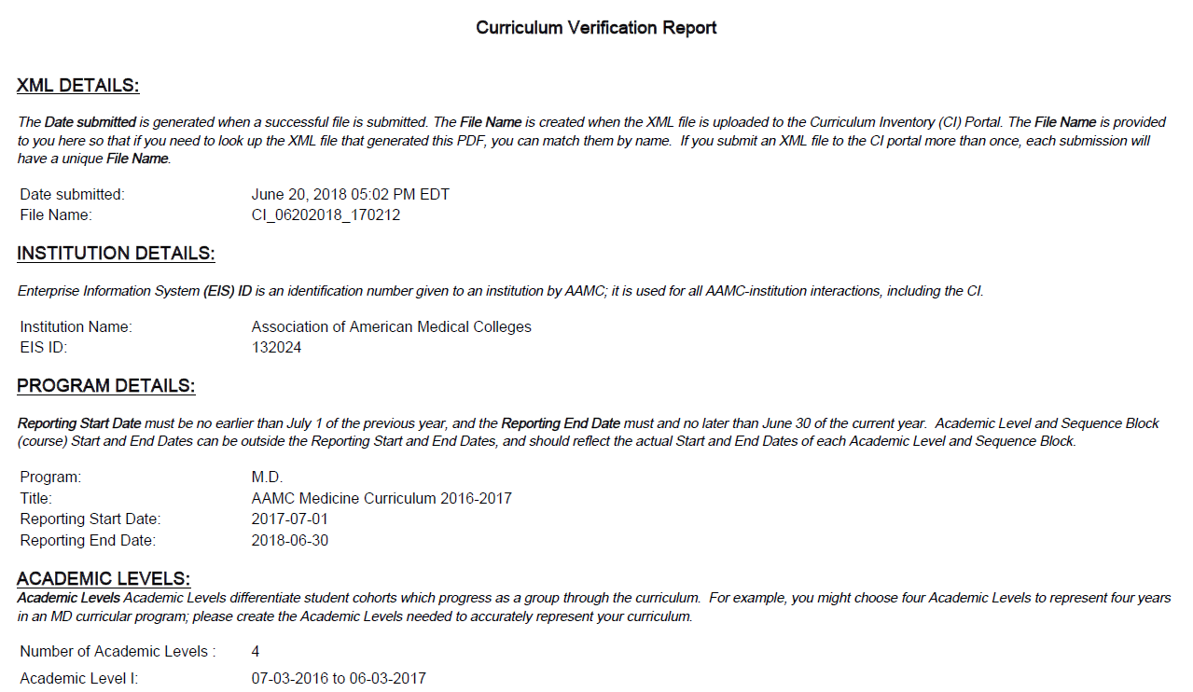
Verification Report Improvements
Readability: we changed the font, increased the size slightly, and tried to make better use of white space
Explanations: we added guide information for every section of the report, explaining what data is and is not included in given tables, how amounts are calculated, etc.
Wording: we added clarity in the glossary, retitled tables, retitled columns, and added columns within tables to more accurately represent which data is provided
OLD
NEW
Notes:
Here on the left is a reminder of what the Verification Report used to look like, and what the major aims for the Verification Report improvements in 2018 were. We focused on the readability, using the white space on the pages thoughtfully, adjusting the font and size of text. We added explanations for each table, and adjusted wording where needed for clarity.
These changes were made in a matter of months, with a very aggressive delivery timeline. Now we’ve had additional time to improve the Verification Report for 2019 so I’m excited to show you the further improvements we’ve built upon here.

Slide 43
OLD
NEW
Notes:
The table above is the previous version. The table below is the updated 2018 version.
We received a very positive reception to the changes we made for 2018. The improvements included:
Numbering of all tables
Underlines within tables as clickable links so you can jump to other parts of the PDF.
Links to resources on the CI website from within the report
Explicit wording to show which tables are designed to align with the LCME DCI.
Relabeling tables. It might have said “all” but it really was primary.
Adding explanations so its clear how formulas are calculated, what data makes it into the data.

Slide 44
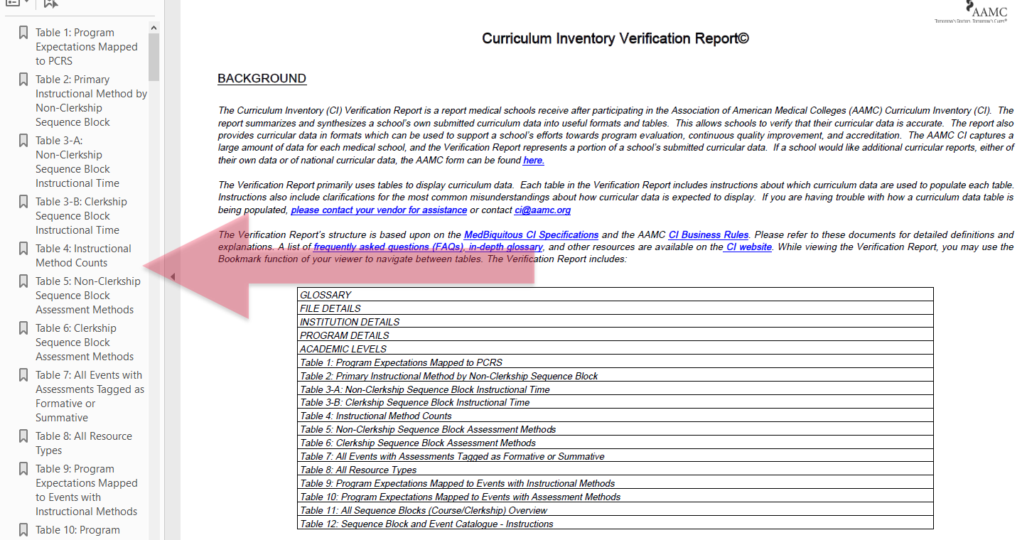
Navigating the Verification Report
Notes:
Another key improvement for 2018 was adding the bookmarks feature, so that the reader of the Verification Report could jump around from one section of the report to another. I’m showing you this especially here because we’re planning additional uses for the bookmarks feature for 2019.

Slide 45
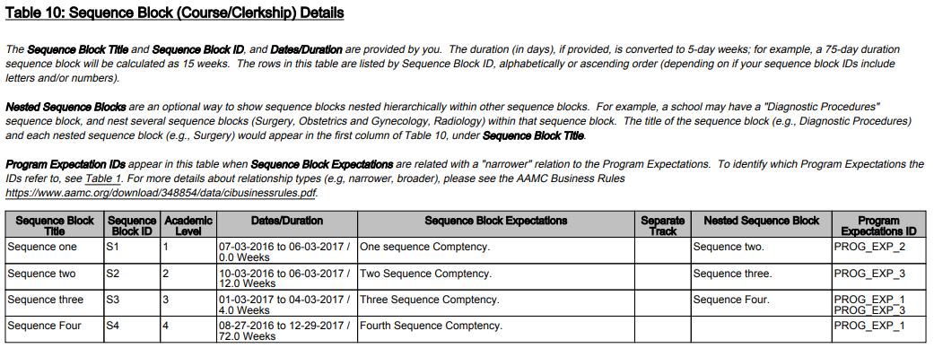
Previous Sequence Block (10) Details Table
Notes:
As a reminder, this is the table, table 10, which had the most details about sequence blocks (typically thought of as courses). It had information like the dates and duration of the course, the learning objectives (sequence block expectations), links to program objectives (program expectation ID).

Slide 46
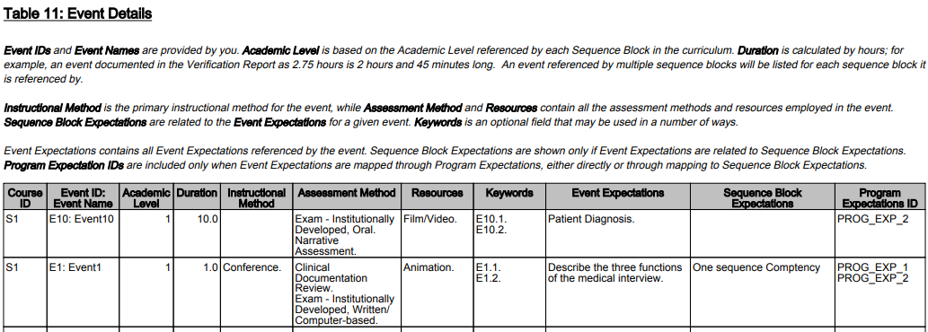
Previous Event (11) Details Table
Notes:
As a reminder, this is the table, table 11, which had the most details about events (or sessions). It had information like the instructional methods, assessment methods, and resources for a given event, as well as sequence block and program expectation (learning objective) links.

Slide 47
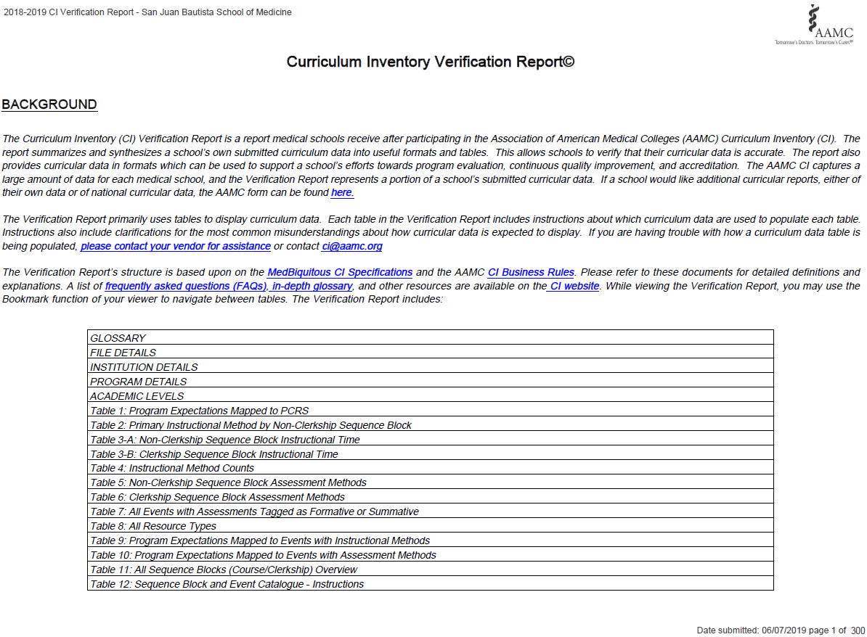
Notes:
SCREENSHOT OF NEW FIRST PAGE OF THE VR - ADDED

Slide 48
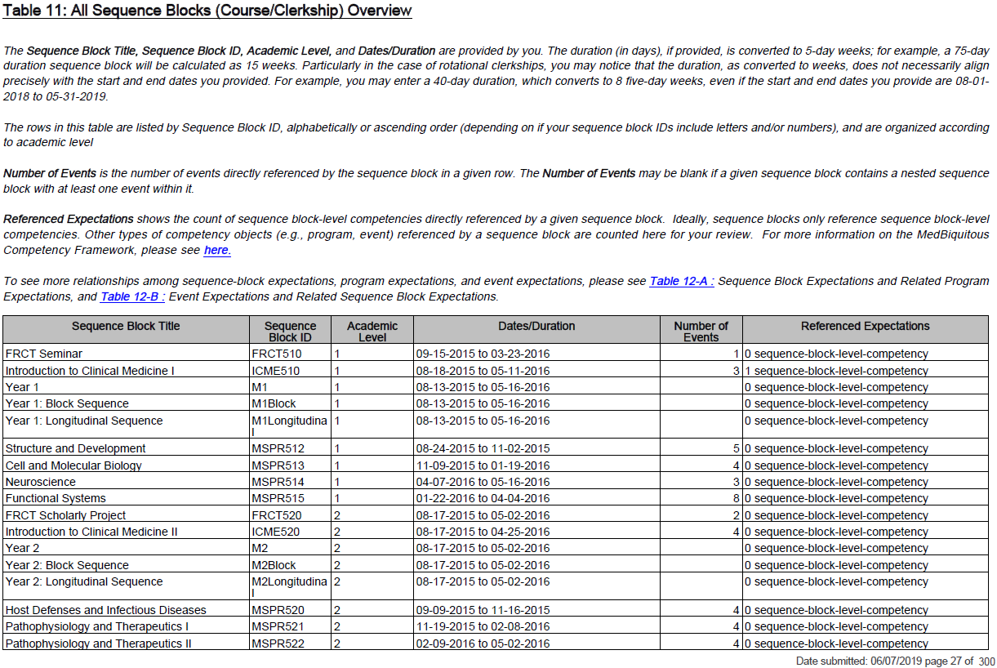
New Sequence Block/Course Summary Table
Notes:
This is all sample data, so we’re sharing this with you not so much to read the specific content, but to see the new formatting.
We will have a new summary table for your courses, so as the curricular dean you can see some big picture information about your sequence blocks/courses. Having this high level data would allow the dean to see if the number of events seem equitable (or not) across courses, if the links to course objectives look right, etc.
NEED NEW SCREEN SHOT – new screenshot added

Slide 49
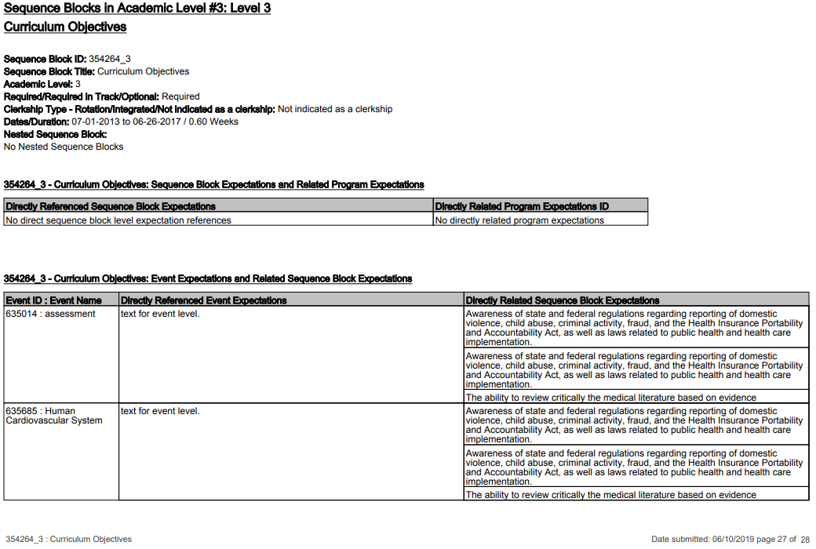
New Table on Learning Objectives and Links
Notes:
For the details about sequence blocks/courses, we will separate those from the big picture items related to courses. With a piece of the report packaged around a specific course, and bookmarked, it will be easier for you to potentially share this data with your faculty leaders (directing them, to say, pages 23-26, as an example) so that they can review their curricular data which they’re most familiar with, and use the information to inform curricular adjustments.
As an example, you might ask your faculty to make sure all course objectives have a link to at least one program objective (table above), or you might ask your faculty to do the same with event and course objectives (table below). You might ask your faculty to not only check that there are objective links, but to check that they make sense (as an example, you have an event objective about a specific pharmacokinetic pathway that is linked to a course objective about professionalism. That doesn’t seem quite right, there’s probably a better link that can be made).
NEED NEW SCREEN SHOT – new screen shot added

Slide 50
New Event Details Table
Notes:
Again this is using sample made up data, and the point of this slide is more to show the look and format. This table has very similar content to the “old” event details table, but we were able to take out links to objectives as we’re putting that into a new table on the previous slide. This gives you more room to see the items on this table. You could use a table like this to not only verify that the data is accurate, but also judge if the match among event expectations (learning objectives), instructional methods, assessment methods, and resources are as they should be.
Lots of other improvements but we’re highlighting them for you here. New table for showing you your instructional methods mapped up to your program learning objectives, new bookmarks by Sequence Block (or course), etc.
Larger file size so may take more time to process.
NEED NEW SCREEN SHOT – new screen shot added

Slide 51
Thank you and we will see you next month!
Please register for next month’s
Building Better Curriculum Webinar Series on
Wednesday, July 10, 2019 at 1:00 pm EST.
We will post June’s series on AAMC’s website here:
www.aamc.org/cir/webinars
E Shen: eshen@wakehealth.edu
Rebecca Keller: kellerre@amc.edu
Curriculum Inventory: ci@aamc.org

