Slide 1
Welcome to the
AAMC Building Better Curriculum Webinar Series
We will begin our presentation shortly.
The moderator for this call is Walter Fitz-William, Sr. Program Operations Specialist, Curricular Resources.
PLEASE NOTE: All users will be muted during the webinar but should use the chat feature to send questions to the moderator. We will try to answer as many questions as possible at the end of the presentation.
Presentation title goes here Subtitle of Presentation

Slide 2
The UW Flexible Option UW-Milwaukee RN-to-BSN Program
Kim Litwack
Dean and Professor
College of Nursing
UW Milwaukee
litwack@uwm.edu
Aaron Brower
Executive Director
UW Extended Campus
Senior Associate Vice President
UW System
aaron.brower@uwex.edu
Notes:
LISA – So this leads us to the need for innovative programs and the rationale behind why we created our own CBE program focused on post-licensure RN-BSN students.

Slide 3
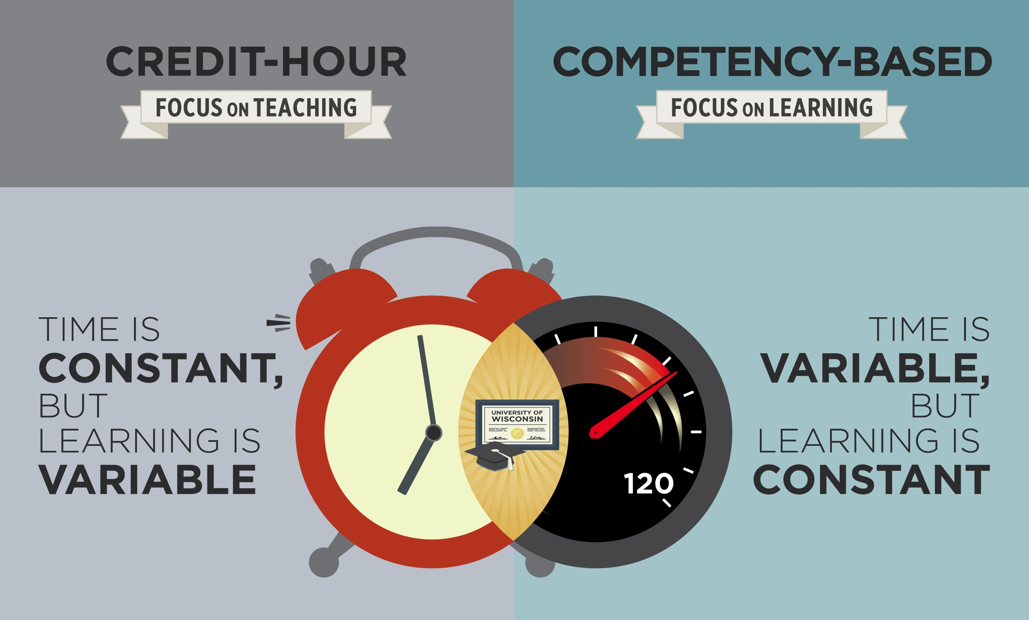
The Higher Education Mindshift

Slide 4
Direct Assessment CBE
Learning Outcomes
Course-Based
Instruction
Assessment
Prior Learning
MOOC’s
Faculty Developed Assessments
Faculty Developed Competencies
Military
Self-Taught
Curated Content

Slide 5
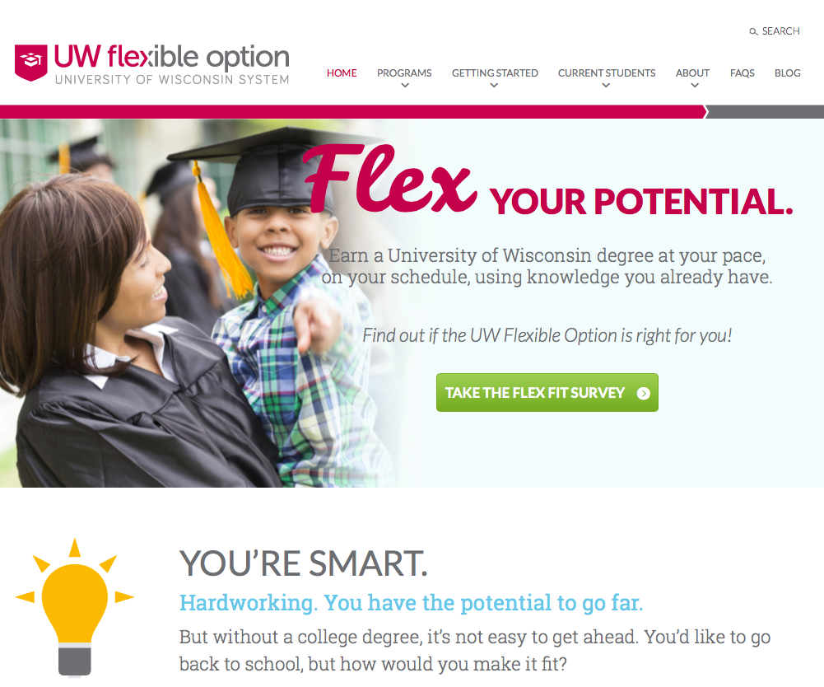
Key Features of UW Flex
Partnerships: UW Extended Campus and UW campuses
Backward design; integrated curriculum
Progress when material mastered, not seat time
“Regular” UW faculty
Unbundled roles
New role: Academic Success Coach
Wrap-around, proactive support
3-month subscription periods
Start at beginning of any month
New operational models – admissions, bursar, registration, transcripts, financial aid – not based on credits
Cost-recovery business model
All-You-Can-Learn & One-at-a-Time pricing
“No asterisk on diploma”
flex.wisconsin.edu

Slide 6
The UW Extended Campus Extending the physical boundaries of the UWs to the borders of the state and beyond
22 online collaborative programs – noncredit thru masters
Adult & Professional Students
Soup-to-nuts support and resources
8 DA/CBE (UW Flex Option), including RN-to-BSN
Began 2014
Designed as Non-term Direct Assessment CBE
First in nation public system to receive HLC and US Dept of ED approvals for DA/CBE
Notes:
KIM – Your slide – add more as you wish! ? # of faculty/staff? Size of undergrad or graduate programs? Your call.

Slide 7
The University of Wisconsin Milwaukee (UWM)
Urban R1 institution
27,500 students
Largest College of Nursing in Wisconsin
Baccalaureate, Master’s and Doctoral Programs (DNP, PhD)
Notes:
KIM – Your slide – add more as you wish! ? # of faculty/staff? Size of undergrad or graduate programs? Your call.

Slide 8
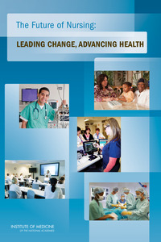
IOM Future of Nursing Report
Goal of 1 million BSN’s and 90% of ADN’s to the BSN by 2025, such that
There is an 80% baccalaureate prepared workforce
Currently 54.4% of RNs have a BSN or higher degree
Joint statement on academic progression for nursing students and graduates to promote “seamless transition from the associates to the baccalaureate, masters and doctoral degrees”
Barriers to the BSN degree
Cost, time, work and family issues, lack of perceived benefit (Reese et al, 2018; Duffy et al, 2014; Perfetto, 2015)
Motivators to the BSN degree
Decreased cost and decreased time, increased support from employers, family and faculty (Reese et al, 2018; Perfetto, 2015; Sarver et al, 2015)

Slide 9
UWM CON RN-to-BSN Program
Our RN-to-BSN Option program is open to licensed registered nurses with an Associate Degree in nursing; all students have passed NCLEX
124 credit curriculum – Identical curriculum for all programs in our RN-to-BSN degree options:
30 credits – Past nursing coursework
30 credits – Advanced nursing courses
64 credits – Non-nursing pre-requisite and GER courses
Students can meet all degree requirements by bringing in past credits, taking courses FTF or online or via FLEX - UW-Colleges offers pre-requisite GER sets; CON offers advanced nursing coursework as “competency sets”
Notes:
LISA - Our RN-to-BSN Nursing FLEX Option program is open ONLY to licensed RNs with a past ADN degree in nursing. We offer one curriculum offered in three modes of learning at the UW-Milwaukee College of Nursing – the curriculum and requirements are the same for all modes of learning. The delivery mode is what changes in each specific learning mode.

Slide 10
UWM College of Nursing RN-to-BSN Program One Curriculum – Three Modes of Learning
Face-to-Face Course | Traditional Online Course | UW FLEX Option
Faculty present; significant consistent interaction with faculty | Led by faculty; instructor present consistently online | No instructor present; faculty role is to define competencies and evaluate mastery of assessments
Syllabus and weekly content & assignments | Syllabus and weekly content & assignments | Syllabus, learning paths, no set deadlines; self-paced
Open discussions & group work | Online discussions & group work | No discussions or group work
Specific texts, content and media required | Specific texts, content and media required | Resources posted; learners choose which options to use (plus coaching & tutoring)
Faculty – 1st contact | Faculty – 1st contact | ASC – 1st contact
Traditional semester | Traditional semester | 3 month subscription periods
Notes:
LISA - We offer one curriculum offered in three modes of learning at the UW-Milwaukee College of Nursing. The chart above is a comparison of the three modes of learning that we offer. The curriculum, outcomes and competencies are identical is all modes – only the delivery method changes. The first point of contact for issues and concerns in FLEX related to each competency set is the Academic Success Coach (ASC). A very important part of our curriculum is that it is the same curriculum in three modes. The FLEX model (CBE approach) is not right for all students – so students who try the FLEX model and feel it does not work for them can move back into a more traditional mode.

Slide 11
Lessons Learned
Notes:
KIM – So on to the lessons learned!

Slide 12
First in the Nation Challenges & Opportunities
Federal & State Policy |  | HLC & Disciplinary Accreditors, US Dept of ED Financial Aid Direct Assessment Experimental Sites Institutional Policies & Practices
Infrastructure & Backend Operations |  | Little that’s off-the-shelf Creating own Student Engagement System
Program Array & Institutional Culture |  | Market-driven decisions …to build new programs …to modify/close existing programs New roles & workload expectations
© University of Wisconsin – Extension 2017
Notes:
Federal financial aid
We are ahead of the regulators
Direct assessment
Senate hearings in 2016 (we testified) as run up to Higher Ed Authorization Act revision. Maybe 2018?
Infrastructure
Nothing can be utilized off the shelf
We’ve been handling this manually
Failed SIS RFP which would have cost millions –Other CBE having to create their own, too
Southern New Hampshire, Western Governors, Northern Arizona
Looking at innovative, less costly solutions – We part of a national consortium and collaborating with vendors and other institutions.
Program array & Institutional culture
In the past year, faculty has been instrumental in adapting programs to CBE
We will continue to call on them with new programs.
We’re also seeking ability to grant degrees when we can’t find partners (Flex bus. & management bachelors)
Market Driven decisions on next array to meet the needs of employers in the state and nation
Student interested new programs: 38% Business / 5 % Accounting / 57% Others

Slide 13
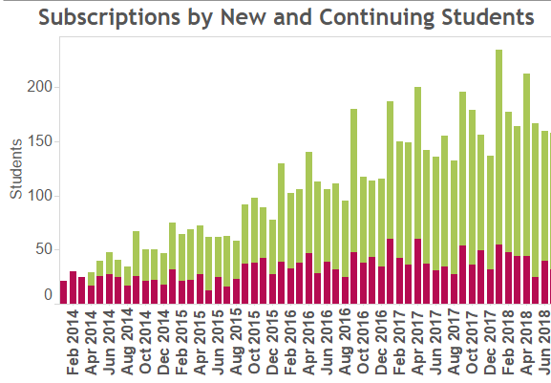
How’s it Working? (Jan 2014 – June 2018)
Enrollments/Subscriptions: 5,829 (BSN: 941)
Unique Headcount: 1,795 (BSN: 389)
Retention: 72% (BSN: 77%)
Graduates: 324 (BSN: 62)
(174 from credit-bearing degree or cert programs)
Age: 52% between 31-45
Gender: 63% female
Employment: Most work part or full time
In-State: 77% (of subscribed students)
Read about Flex students:
IT Student Completes 51 credits in 9 months
Nursing Student Earns Bachelors at Own Pace
Nursing Student Earns Bachelors Degree/Fulfills Mission to Improve Elder Care
Diagnostic Imaging Degree Opens Doors for College Instructor

Slide 14
Lessons Learned: New Partnerships
Can you do this alone?
Can you partner within your system?
Cost-benefit of for-profit partnerships
Private foundations
Need for soup-to-nuts support when moving away from credit hour
Notes:
KIM – The UW system has a centralized “CEOEL” department that wanted to partner with us to offer this program. This university department is a partner with us and does share in the costs and the revenue that results from the program. This situation creates both opportunities and challenges as we work together to offer these collaborative programs.

Slide 15
Lessons Learned: Admissions and Enrollment
Look Before You Leap…
Careful market analysis of student demand before investing time & resources
Careful analysis of competition/market saturation
Is there an easier way to achieve institution’s goals?
Thorough understanding of learning style required by model
Solid admissions advising and onboarding so students know what they’re getting
Notes:
LISA - When we began this program in 2014, we did not know if there would be a demand for a CBE RN-BSN Program. We knew RN-BSN programs were needed, but we already had two of those already (online and F2F). We started with 8 students in January of 2014, and today we have more than 250 students and 80 graduates! Marketing continues to be challenging as there are more than 600 RN-BSN in the USA and trying to focus on students in our own area who want this CBE type of an approach is a challenge.

Slide 16
Lessons Learned: Administration
Need for institutional champions
Need for risk tolerance
Willingness to close program if necessary
Faculty and other resources to scale
Ability to be in it for the long term
Notes:
KIM - When the request for proposals came out from our system (UW system) came in , our very innovative dean (at that time) was willing to jump in to this new endeavor! You need an innovative team that is ready to take risks and think in new and different ways. You also need to think about whether you have enough faculty to ask some of them to take the time do something like this.

Slide 17
Lessons Learned: New Roles for Faculty
Creation of competency sets
Creation of assessments, detailed evaluation rubrics
Determination of competency
Evaluation of student work
Providing best practice feedback
Strong connections & communication with ASCs
Notes:
LISA - This is Dr. Laura Joosse – she is one of our FLEX faculty. Faculty and IAS who work in our FLEX Option program also teach in our other programs – RN-BSN, undergraduate or Masters degree programs. We make the decision not to “hire out” this part of our program by hiring adjuncts – this is the model that many programs do use.

Slide 18
Lessons learned: Role of the ASC in Flex
Masters-level Professionals Provide Wrap-Around & Proactive Tutoring, Mentoring, Advising
85:1 ratio; proactive contact once/week
Assigned at registration; continues through graduation
Create a customized learning plan & timeline w/student
Provides “foundation level” tutoring, overseen by faculty
Connects student to specialized resources
Helps keep student on track, provides guidance based on feedback received from faculty and assessments
Strong connections & communication with faculty
Notes:
Mike Exum, Kristin Hoffmann, and Nadia Kaminski UW Flexible Option Academic Success Coaches

Slide 19
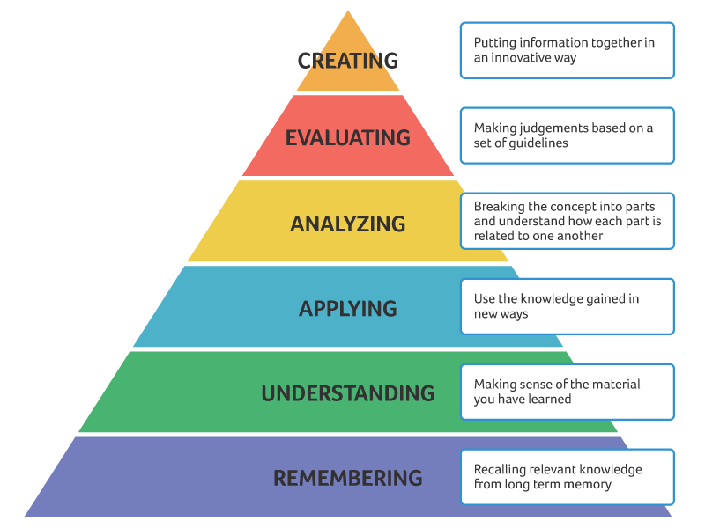
FLEX Nursing Competency Set
Each advanced nursing 3-credit course is a “competency set”
The same approved and required course outcomes are used to create competencies and assessments
Each nursing competency set has three to four assessments; no multiple choice exams are used
Each assessment has a:
Learning Path (guides student through preparing for the assessment)
Learning Resources (articles, videos, books, resources)
The authentic assessment
Detailed evaluation scoring rubric https://www.aacu.org/value/rubrics
Notes:
KIM - A “competency set” has been created for each 3-credit advanced nursing course in our curriculum. Every competency set has a uniform syllabus, four larger high-stakes assessments, learning paths to guide the student, learning resources and detailed scoring rubrics.

Slide 20
Lessons Learned: Feedback
Importance of feedback on learning
Feedback must be:
Given using evidence based best practice
Timely, clear, tangible, actionable and content-specific
Tied to the competencies in your rubric
Positive, constructive and encouraging
(Ambrose et al, 2010; Fleming at al, 2016)
RSI – “Regular and substantive interaction” is required by the Department of Education if federal financial aid is used
Notes:
LISA - Once students are enrolled in a competency set, the faculty role is to provide “RSI” – regular and substantive interaction” which in our program is feedback on completed assessments. Students also submit a monthly “FCI” to interface with faculty about their goals and plans for the work in the competency set. The concept of “RSI” is a very big issue in CBE programs nationally – accreditors and financial aid funders want students to have “substantive” interaction with faculty. We have had to work hard on how specific feedback improves learning. Feedback is more effective when it identifies specific criteria that need to improve (rather than generic praise or discouragement). Balancing strengths and weaknesses helps students hear feedback and enhances self efficacy; Providing too many comments in paper margins can be too overwhelming for students; Timing (how soon) and frequency (how often) are important. We also use the U-PACE model – positive/needs improvement/encouragement.
(Ambrose et al, 2010)

Slide 21
Lessons Learned: Staffing & Workload
How will you staff this program?
How will you manage your workload model?
Our FLEX team includes both faculty, instructional academic staff and our academic success coaches
Not everyone embraces the model – assigning the right staff is very important
Notes:
KIM - We have created a workload model that uses a student load of 40 active students over three active subscription periods as a 3-credit course workload. Faculty and IAS who work in our FLEX Option program also teach in our other programs – RN-BSN, undergraduate or Masters degree programs. We made the decision not to “hire out” this part of our program by hiring adjuncts – this is the model that many programs do use. We wanted to keep our FLEX Option program under our own control and have faculty who teach in our other programs work in this program as well.

Slide 22
Lessons Learned: Continuous Quality Improvement
Do you have a quality framework? https://www.cbenetwork.org/wp content/uploads/2018/09/1st_button_CBE17016__Quality_Framework_Update.pdf
Will you follow a traditional semester timeline?
When will you make corrections, adjustments or improvements?
How will you manage unanticipated changes?
Notes:
LISA - In our program, we have a new start on the first day of every month – this means we can modify, correct, improve continuously. Students enroll in 12 week “subscription periods” to complete a 3-credit competency set (equivalent to a 3-credit course). Often the improvements we need to make are not anticipated – the students show us the way with their questions. We also use a quality framework promoted by CBEN.

Slide 23
Lessons Learned: Student Financial Aid
US Dept. of Education regulations for funding higher education programs
This has been challenging!
Notes:
KIM – Although the DOE is actually supportive of innovative educational models, they have significant concerns about financing students educational loans and grants if they cannot determine that there is “RSI” – regular and substantive interaction between teachers and learners. When our program launched in 2014, our students could not get financial aid for taking a FLEX set. Our financial aid office has worked very hard to create a financial aid model that will work in FLEX and students now can get federal financial aid in FLEX. One roadblock we have right now is that students cannot be “co-funded” in two different educational options –ie – a student cannot receive financial aid for doing FLEX along with doing an online or F2F course. We hope that in the future this will be able to happen, but the federal DOE moves slowly…..David Musser who is the current director of the federal DOE does attend the CBEN conference every year and has been very supportive of both innovative education and CBE models in general.

Slide 24
Lessons Learned: Different than what was envisioned…
Early vision of program wrongly assumed proactive & wrap-around student support, but with a ”light touch”
Extremely high need for communication and coordination between ASCs and Faculty
ASC role absolutely critical to student success. Not all advisors can do this.
Faculty interactions absolutely critical, but different. Still “teaching” but neither classroom nor independent study. Requires dedicated risk-taking faculty. Not all faculty can do this.
Notes:
LISA – When this program was first imagined by our partners at CEOEL – their vision was that students in FLEX programs would have very little contact with faculty – and that they would do all communication through their ASC. In reality, students need guidance from faculty and do have content related questions that need faculty answers. So we do try to send students to their ASC as their first point of contact, we are also very willing to connect with our FLEX students by email or even by phone if needed.

Slide 25
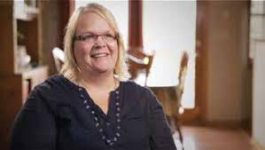
Does CBE work?
“The thing I liked best was my Academic Success Coach. I also appreciate the control I have over my own schedule and my learning. I can also leverage my nursing experience to earn my degree. Before this program, I had not found a program that would work for me and my life.”
Carla Lundeen RN, BSN
“The lack of classroom time was the thing that appealed to me most. I was raising three kids alone and lived far from campus. I was able to move through some sets very quickly because of my nursing knowledge. I would highly recommend this for nurses who work full time and need to obtain their degree”
Denise Herriges RN, BSN
Notes:
KIM - Here are some of our students – for them this CBE approach was what they needed to get their BSN degree.

Slide 26
Questions?
Kim Litwack Aaron Brower
litwack@uwm.edu aaron.brower@uwex.edu

